Slide 1
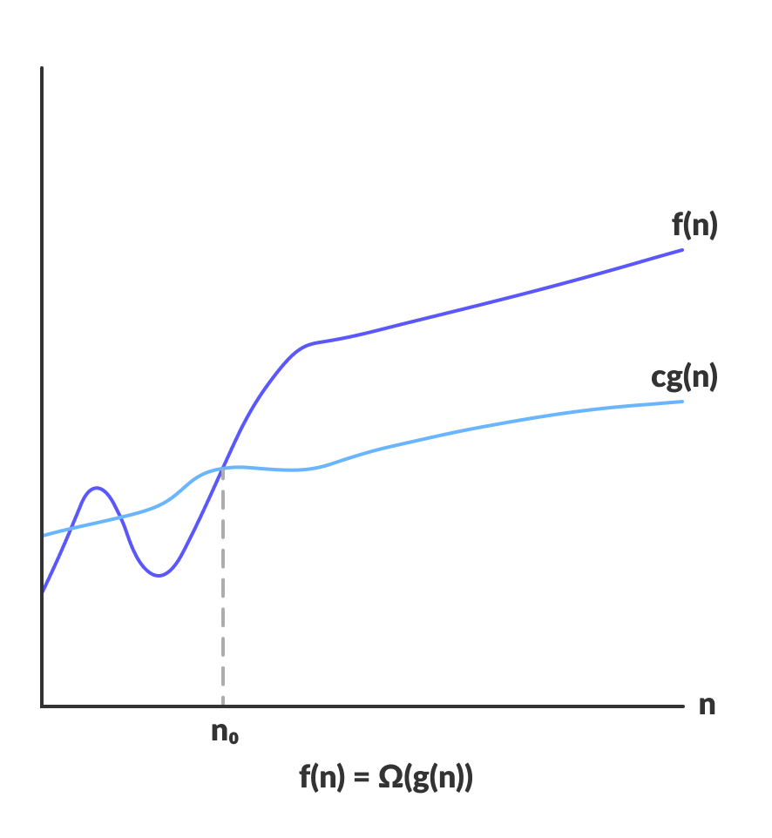
Time Complexity
f(n)
cg(n)
O (n^2)
n₀

Slide 2
Calculate Time Complexity
How To
O(n^2)
Operations
O (n log n)
O (n^2)
O(n)
Elements

Slide 3
What is Time Complexity?
Topic/Course
You can get the time complexity by “counting” the number of operations performed by your code.
This time complexity is defined as a function of the input size n using Big-O notation. n indicates the input size, while O is the worst-case scenario growth rate function.
We use the Big-O notation to classify algorithms based on their running time or space (memory used) as the input grows.
The O function is the growth rate in function of the input size n.

Slide 4
Big O Cheatsheet
Big O Notation | Name | Examples
O(1) | Constant | Odd or Even number
O(log n) | Logarithmic | Finding element on sorted array with binary search
O(n) | Linear | Find max element in unsorted array
O(n log n) | Linearithmic | Sorting elements in array with merge sort
O(n²) | Quadratic | Sorting array with bubble sort
O(n³) | Cubic | 3 variables equation solver
O(2^{n}) | Exponential | Find all subsets
O(n!) | Factorial | Find all permutations of a given set/string
Topic/Course

Slide 5
Predict the time complexity for the given below code snippet
int fun()
{
for(i = 1; i < n; i++)
{
System.out.println(“Hello”);
}
return 0;
}
A) O(n)
B) O(log n)
C) O (sqrt n)
D) O(n * n)
Notes:
A

Slide 6
Predict the time complexity for the given below code snippet
int fun()
{
for(i = 1; i <= sqrt(n); i++)
{
System.out.println(“Hello”);
}
return 0;
}
A) O(n)
B) O(log n)
C) O (sqrt n)
D) O(n * n)
Notes:
B

Slide 7
Predict the time complexity for the given below code snippet
int fun()
{
for(i = 1; i*i <= n; i++)
{
System.out.println(“Hello”);
}
return 0;
}
A) O(n)
B) O(log n)
C) O (sqrt n)
D) O(n * n)
Notes:
C

Slide 8
Predict the time complexity for the given below code snippet
int fun()
{
for(i = 1; i <= n; i=i*2)
{
System.out.println(“Hello”);
}
return 0;
}
A) O(n)
B) O(log n)
C) O (sqrt n)
D) O(n * n)
Notes:
B

Slide 9
Predict the time complexity for the given below code snippet
int fun()
{
int n, i = 1, s = 1;
while(s <= n)
{
i++;
s = s + i;
System.out.println(“Hello”);
}
return 0;
}
A) O(n)
B) O(log n)
C) O (sqrt n)
D) O(n * n)
Notes:
C

Slide 10
Predict the time complexity for the given below code snippet
int fun()
{
int n;
while(n > 1)
{
n = n / 2;
}
return 0;
}
A) O(n)
B) O(log n)
C) O (sqrt n)
D) O(n * n)
Notes:
B

Slide 11
Predict the time complexity for the given below code snippet
int fun()
{
for(i = 1; i < n; i++)
{
for(j = 1; j < n; j++)
{
System.out.println(“Hello”);
}
}
return 0;
}
A) O(n)
B) O(log n)
C) O (sqrt n)
D) O(n * n)
Notes:
D

Slide 12
Predict the time complexity for the given below code snippet
int fun()
{
for(i = 1; i < n; i++)
{
for(j = 1; j < n; j++)
{
System.out.println(“Hello”);
break;
}
}
return 0;
}
A) O(n)
B) O(log n)
C) O (sqrt n)
D) O(n * n)
Notes:
A

Slide 13
Predict the time complexity for the given below code snippet
int fun()
{
for(i = 1; i < n; i++)
{
for(j = 1; j < n; j=j+i)
{
System.out.println(“Hello”);
}
}
return 0;
}
A) O(n)
B) O(log n)
C) O (n * log n)
D) O(n * n)
Notes:
C

Slide 14
Predict the time complexity for the given below code snippet
int fun()
{
int i, j;
for(i = 1; i < n; i++)
{
for(j = 1; j < n; j=j*2)
{
System.out.println(“Hello”);
}
}
return 0;
}
A) O(n)
B) O(log n)
C) O (n * log n)
D) O(n * n)
Notes:
C

Slide 15
Predict the time complexity for the given below code snippet
int fun()
{
int i, j;
for(i = 1; i < n; i++)
{
for(j = n; j > 1; j--)
{
System.out.println(“Hello”);
}
}
}
A) O(n)
B) O(log n)
C) O (n * log n)
D) O(n * n)
Notes:
D

Slide 16
Predict the time complexity for the given below code snippet
int fun()
{
int i, j, a = 0, b = 0;
for(i = 1; i < n; i++)
a = a + i;
for(j = 1; j < m; j++)
b = b + j;
return 0;
}
A) O(n)
B) O(m)
C) O (n + m)
D) O(n * m)
Notes:
C

Slide 17
Predict the time complexity for the given below code snippet
for(i = 1; i <= n; i++)
{
for(j = 1; j <= i; j++)
{
for(k = 1; k <= 20; k++)
{
System.out.println(“Hello”);
}
}
}
A) O(n)
B) O(log n)
C) O (sqrt n)
D) O(n * n)
Notes:
D

Slide 18
Predict the time complexity for the given below code snippet
for(i = 1; i <= n; i++)
{
for(j = 1; j <= i*i; j++)
{
for(k = 1; k <= (n/2); k++)
{
System.out.println(“Hello”);
}
}
}
A) O(n)
B) O(n ^ 2)
C) O (n ^ 3)
D) O(n ^ 4)
Notes:
D

Slide 19
Predict the time complexity for the given below code snippet
for(i = n/2; i >=1; i--)
{
for(j = 1; j <= n; j=j*2)
{
for(k = 1; k <= n; k=k*2)
{
System.out.println(“Hello”);
}
}
}
A) O(n)
B) O(n * n)
C) O (sqrt n)
D) O(n*(log n)^2)
Notes:
D

Slide 20
Predict the time complexity for the given below code snippet
for(i = n/2; i <= n; i++)
{
for(j = 1; j +n/2<= n; j++)
{
for(k = 1; k <= n; k=k*2)
{
System.out.println(“Hello”);
}
}
}
A) O(n)
B) O(log n)
C) O (n * n)
D) O(n^2 (log n))
Notes:
D

Slide 21
Predict the time complexity for the given below code snippet
int fun()
{
int n, ans = 0;
n = 1234
while(n > 0)
{
ans += n % 10;
n /= 10;
}
return 0;
}
A) O(log₂ n)
B) O(log₃ n)
C) O(log₁₀ n)
D) O(n)
Notes:
C

Slide 22
Predict the time complexity for the given below code snippet
for(i = n/2; i >=1; i--)
{
for(j = 1; j <= n/2; j++)
{
for(k = 1; k <= n; k=k*2)
{
System.out.println(“Hello”);
}
}
}
A) O(n)
B) O(log n)
C) O (n * n)
D) O(n^2 (log n))
Notes:
D

Slide 23
Predict the time complexity for the given below code snippet
int fun(int n)
{
if(n > 1)
return fun(n – 1);
}
A) O(n)
B) O(log n)
C) O (n * log n)
D) O(n * n)
Notes:
A

Slide 24
Predict the time complexity for the given below code snippet
int fun()
{
for(i = 1; i < n; i++)
{
for(j = 1; j < sqrt(n); j++)
{
System.out.println(“Hello”);
}
}
return 0;
}
A) O(n)
B) O(n * sqrt n)
C) O (n * log n)
D) O(n * n)
Notes:
B

Slide 25
THANK YOU

