Slide 1
Deep Learning Workshop
Session 4
Hoai Nam Dang

Slide 2
Outline Session 3
Recurrent Neural Network (RNN)
Gated Recurrent Unit (GRU)
Long Short Term Memory (LSTM)
Natural Language Processing (NLP)
Language Models
Sentiment Analysis

Slide 3
Sequence Models
Speech recognition (sequence to sequence):
X: wave sequence
Y: text sequence
Sentiment classification (sequence to one):
X: text sequence
Y: integer rating from one to five
DNA sequence analysis (sequence to sequence):
X: DNA sequence
Y: DNA Labels
Machine translation (sequence to sequence):
X: text sequence (in one language)
Y: text sequence (in other language)

Slide 4
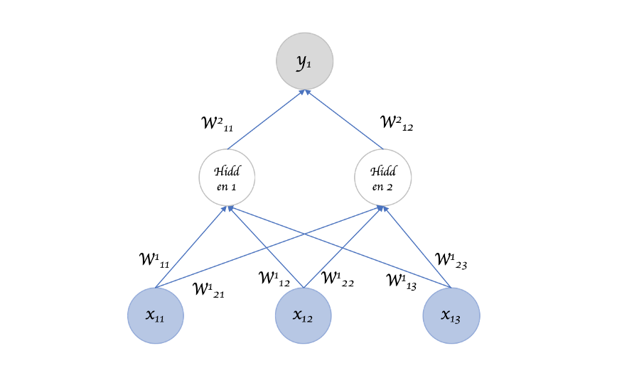
Sequence Models
Inputs, outputs can be different lengths in different examples.

Slide 5
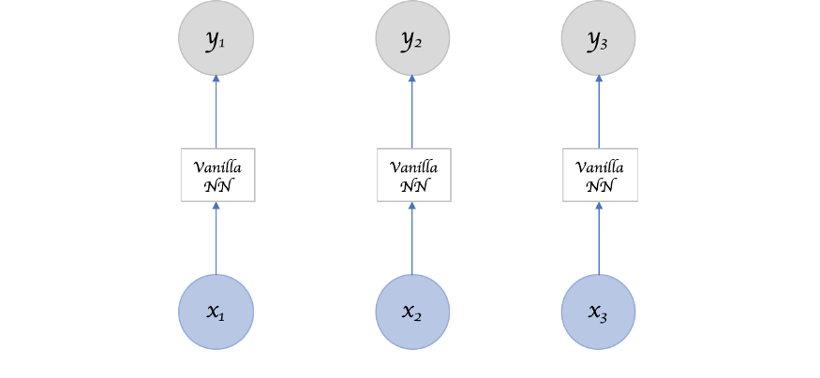
Sequence Models
Doesn't share features learned
across different positions of
text/sequence.

Slide 6
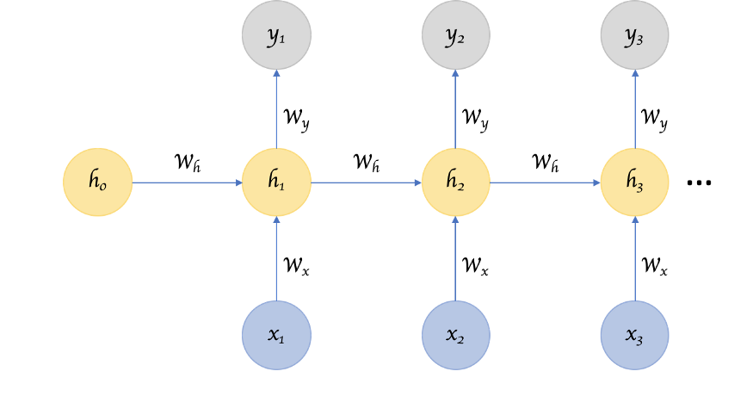
Recurrent Neural Network (RNN)
https://towardsdatascience.com/recurrent-neural-networks-d4642c9bc7ce

Slide 7
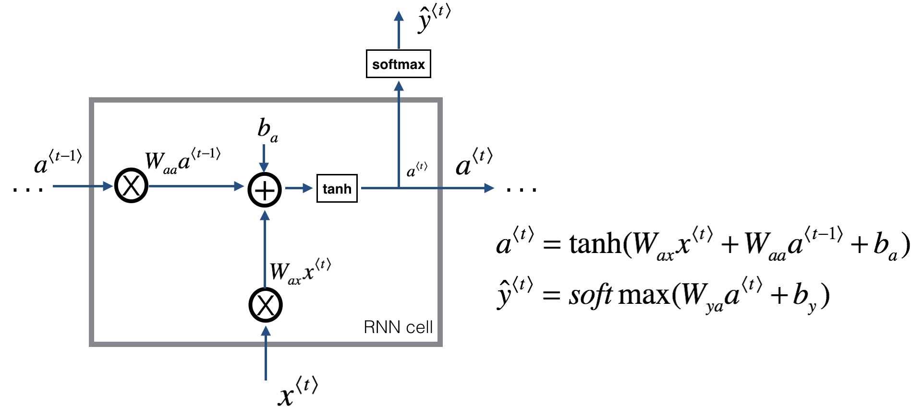
Recurrent Neural Network (RNN)

Slide 8
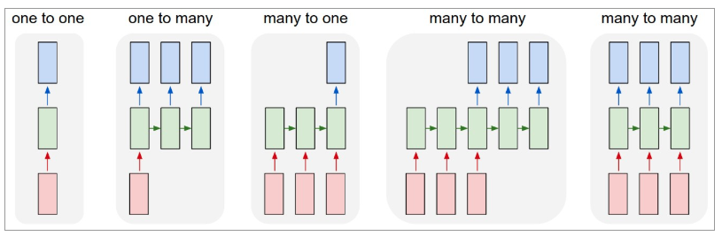
Recurrent Neural Network (RNN)
https://towardsdatascience.com/recurrent-neural-networks-d4642c9bc7ce

Slide 9
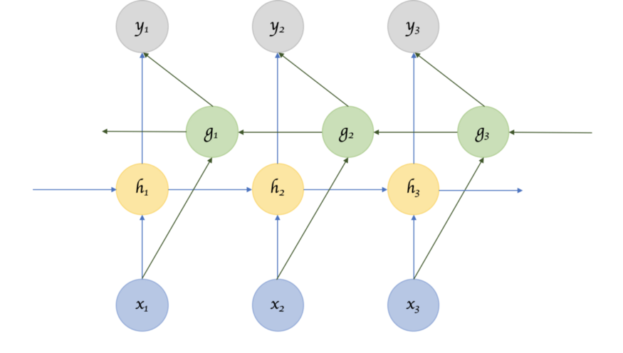
Recurrent Neural Network (RNN)
https://towardsdatascience.com/recurrent-neural-networks-d4642c9bc7ce

Slide 10
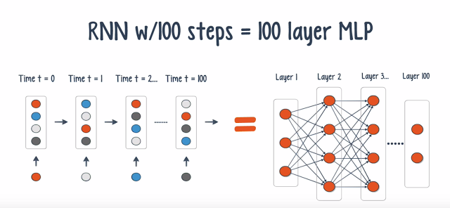
Vanishing Gradient Problem
"The cat, which already ate ..., was full"
"The cats, which already ate ..., were full"
https://www.nextbigfuture.com/2016/03/recurrent-neural-nets.html

Slide 11
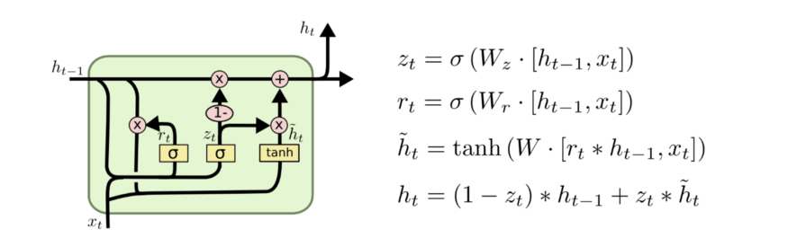
Gated Recurrent Unit (GRU)
GRU is an RNN type that can help solve the vanishing gradient problem and can remember the long-term dependencies.
Update gate
Forget gate

Slide 12
Gradient Descent with Momentum
Word | Update gate(U) | Cell memory (C)
The | 0 | val
cat | 1 | new_val
which | 0 | new_val
already | 0 | new_val
... | 0 | new_val
was | 1 (I don't need it anymore) | newer_val
full | .. | ..

Slide 13

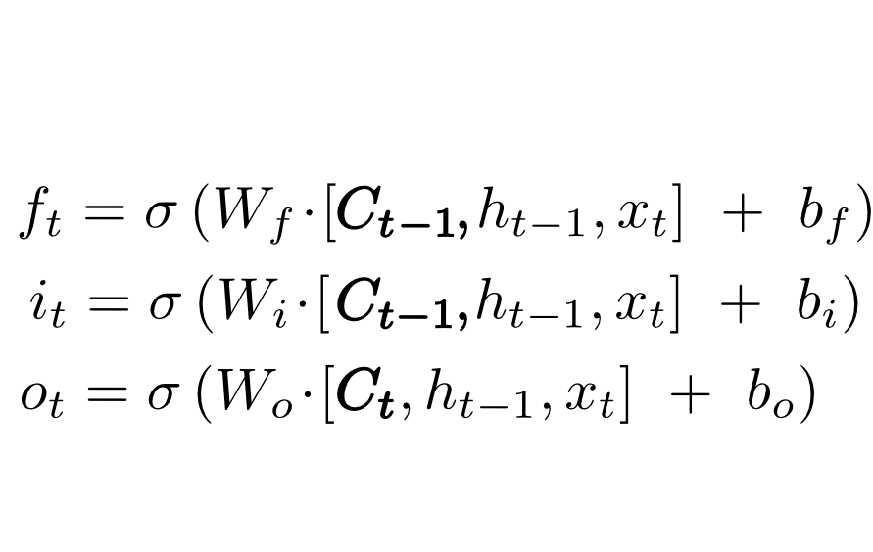
Long Short Term Memory (LSTM)
https://colah.github.io/posts/2015-08-Understanding-LSTMs/

Slide 14
Natural Language Processing
Natural Language Processing, usually shortened as NLP, is a branch of artificial intelligence that deals with the interaction between computers and humans using the natural language.
Language translation applications such as Google Translate
Word Processors such as Microsoft Word and Grammarly that employ NLP to check grammatical accuracy of texts.
Interactive Voice Response (IVR) applications used in call centers to respond to certain users’ requests.
Personal assistant applications such as OK Google, Siri, Cortana, and Alexa.

Slide 15
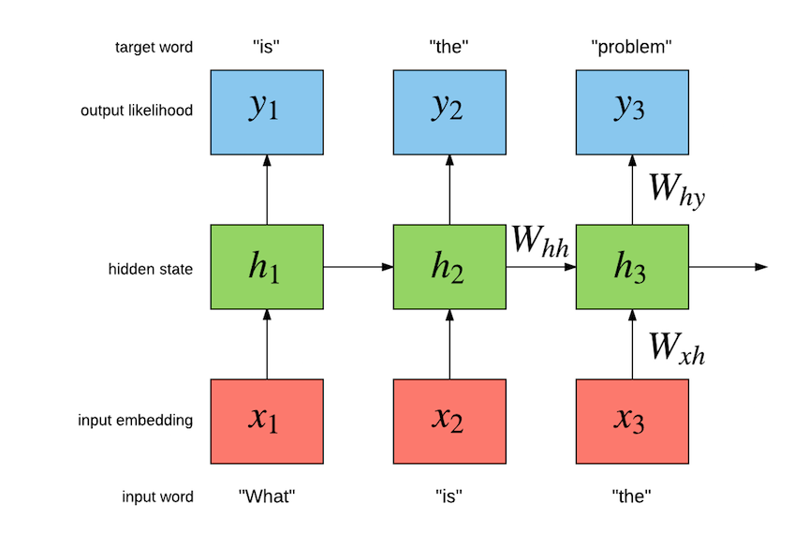
Language Model
A language model is a model that learns to predict the next word of a sentence

Slide 16
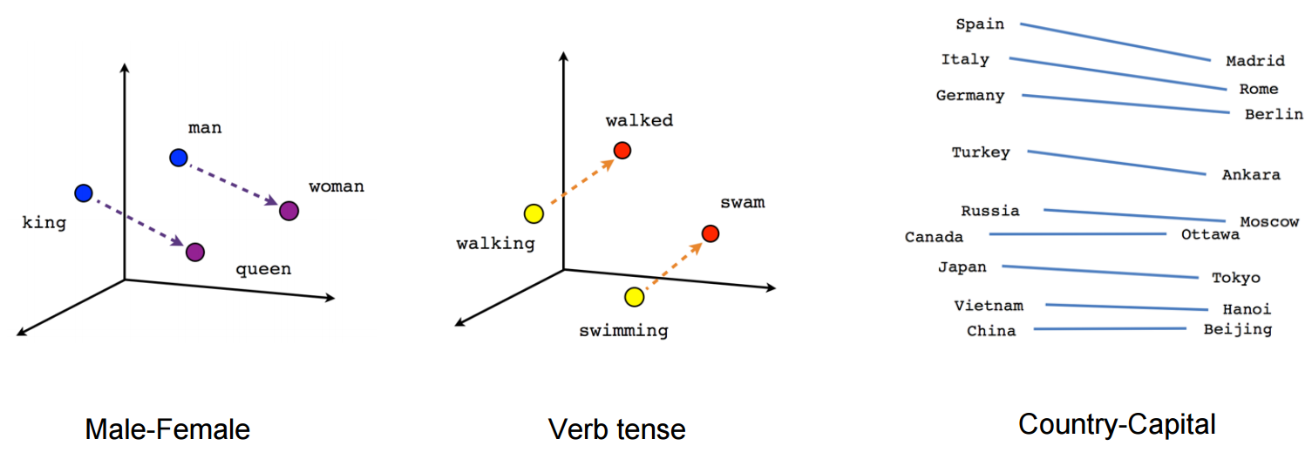
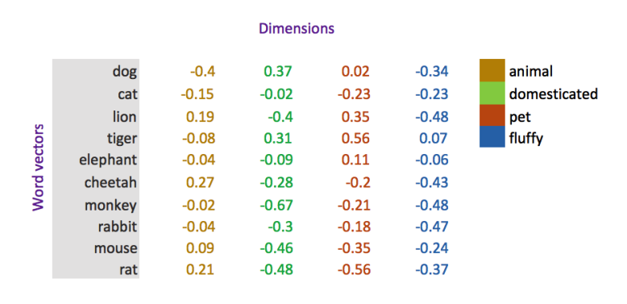
Word embeddings

Slide 17
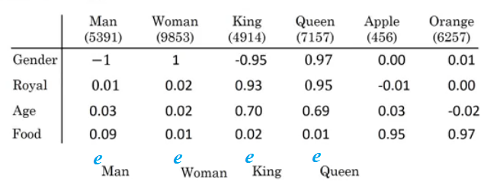
Word embeddings
Can we conclude this relation:
Man ==> Woman
King ==> ??
e_{Man} - e_{Woman} ≈ e_{King} - e??

Slide 18
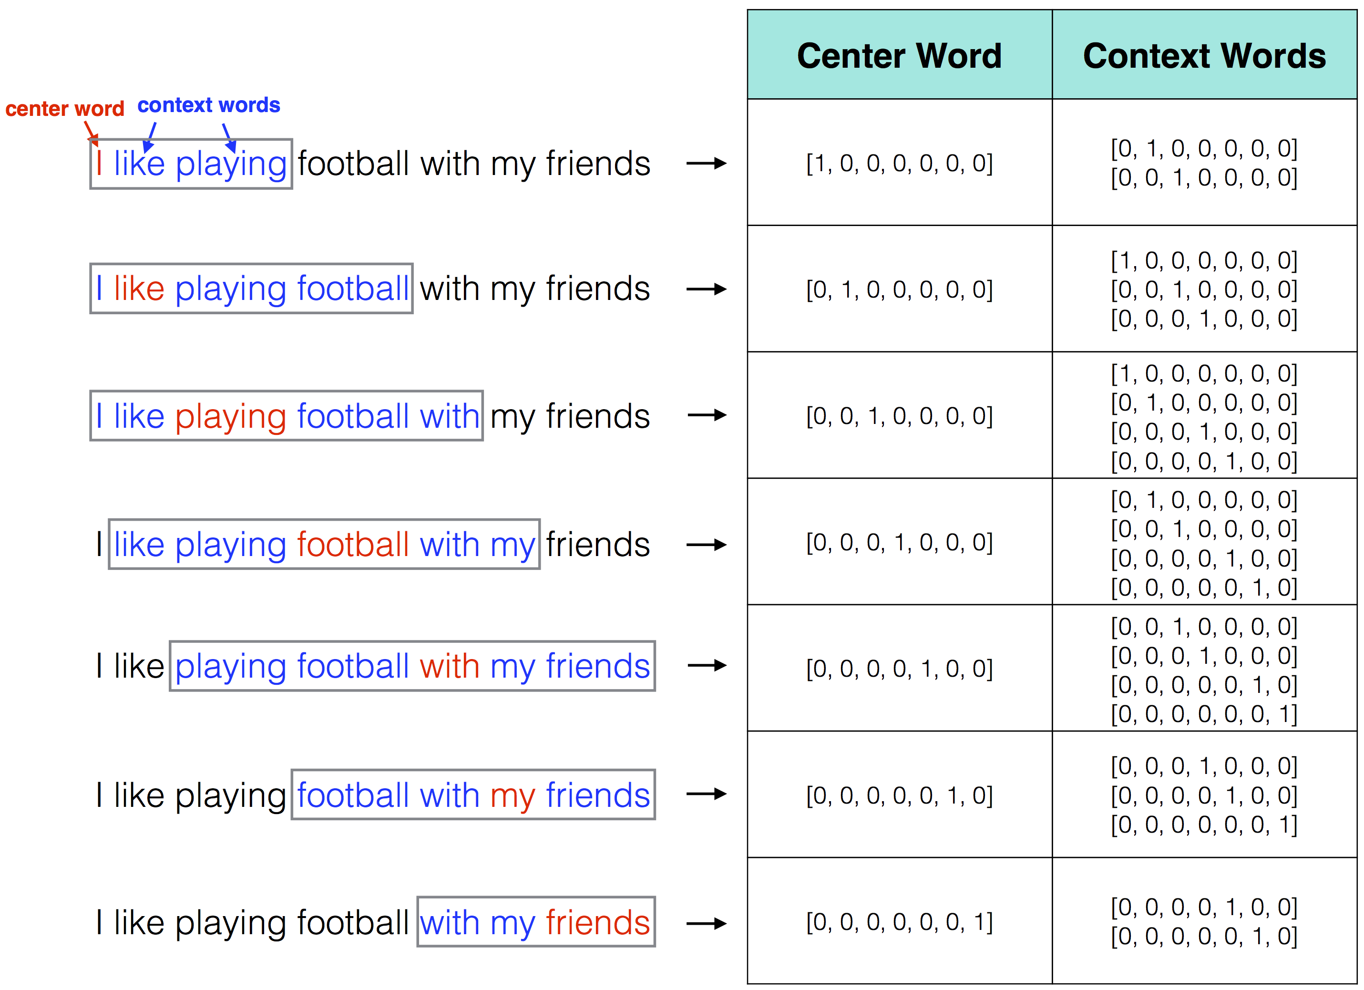
word2vec

Slide 19
Sentiment Classification
 | label | text | Is_valid
0 | negative | Un-bleeping-believable! Meg Ryan doesn't even ... | False
1 | positive | This is a extremely well-made film. The acting... | False
2 | negative | Every once in a long while a movie will come a... | False
3 | positive | Name just says it all. I watched this movie wi... | False
4 | negative | This movie succeeds at being one of the most u... | False

Slide 20
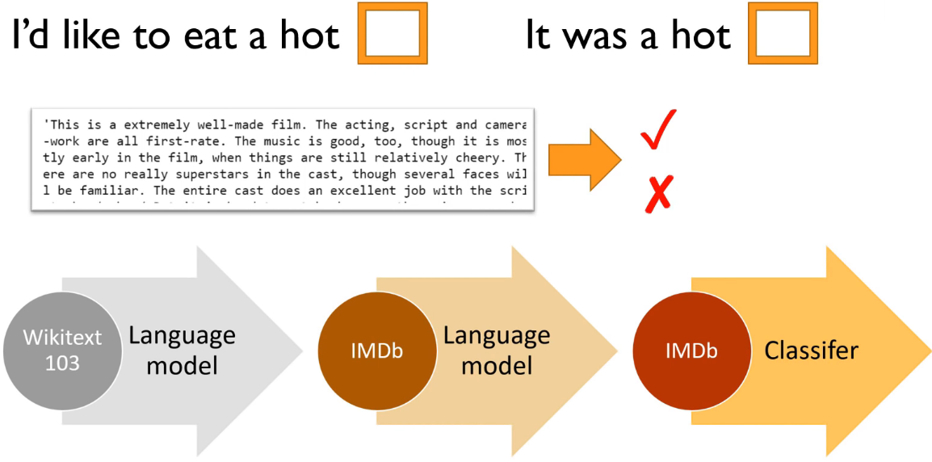
Sentiment Classification

Slide 21
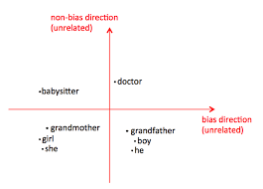
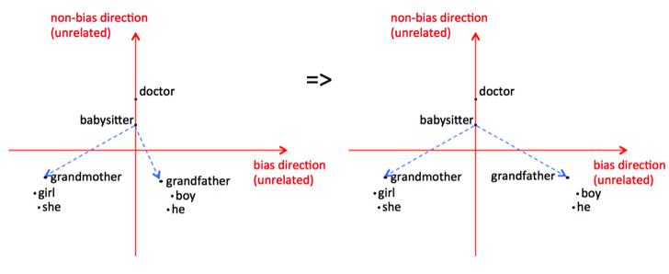
Debiasing word embeddings

Slide 22
Thank you for your attention!

