Slide 1
Deep Learning Workshop
Session 2
Hoai Nam Dang

Slide 2
Outline Session 2
Overfitting
Data Augmentation
Regularizations
Convolutional Neural Network
Resnet

Slide 3
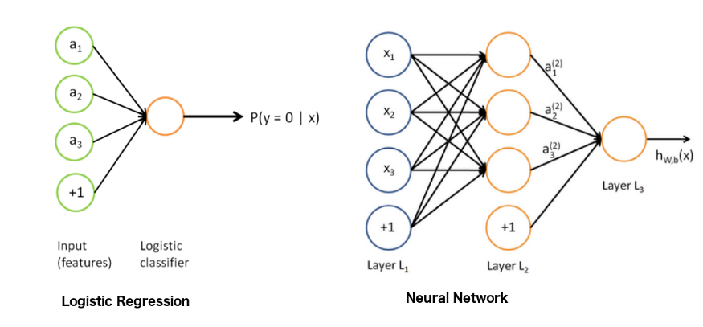
Review
https://towardsdatascience.com/another-twitter-sentiment-analysis-with-python-part-9-neural-networks-with-tfidf-vectors-using-d0b4af6be6d7

Slide 4
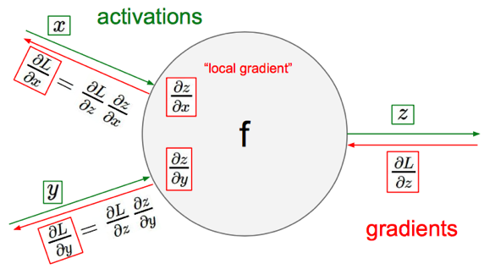
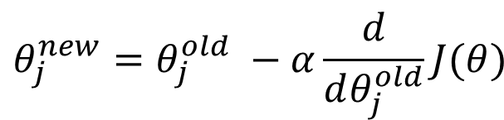
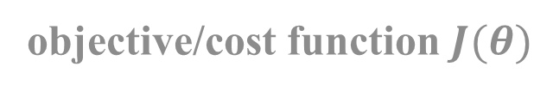

Review
objective/cost function $J(θ)$
$$θ_{j}^{new}=θ_{j}^{old} −α\frac{ⅆ}{ⅆθ_{j}^{old}}J(θ)$$
Update each element of θ
$$θ_{}^{new}=θ_{}^{old} −α∇_{θ}J(θ)$$
Matrix notation for all parameters
learning rate

Slide 5
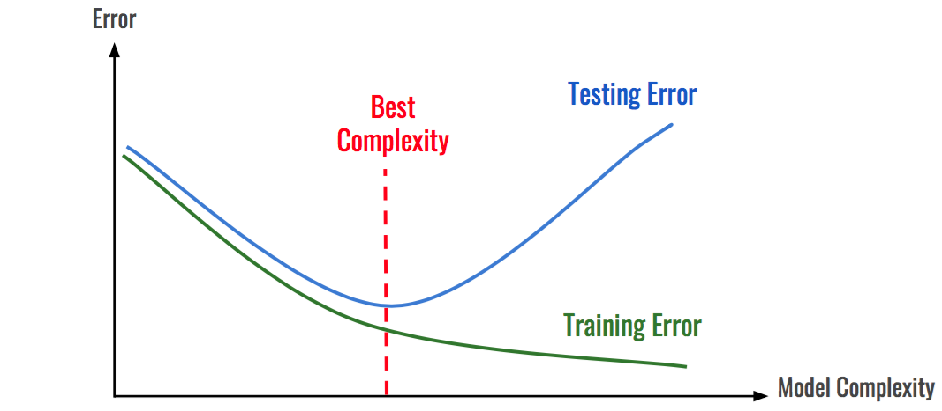
Overfitting
https://hackernoon.com/memorizing-is-not-learning-6-tricks-to-prevent-overfitting-in-machine-learning-820b091dc42

Slide 6
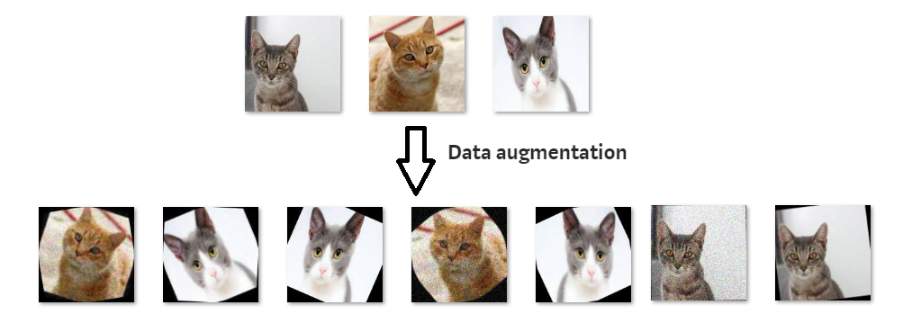
Data Augmentation

Slide 7
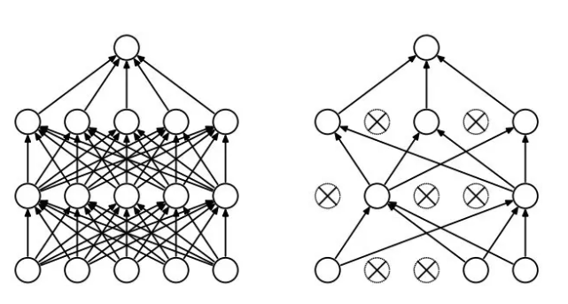
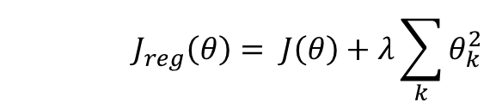
Regularization
Dropout
Randomly drop units (along with their connections) during training
Each unit retained with fixed probability p, independent of other units
Hyper-parameter p to be chosen (tuned)
Srivastava, Nitish, et al. "Dropout: a simple way to prevent neural networks from overfitting." Journal of machine learning research (2014)
L2 = weight decay
Regularization term that penalizes big weights,
is added to the objective
Weight decay value determines how dominant regularization is during gradient computation
Big weight decay coefficient → big penalty for big weights
$$J_{reg}\left(θ\right)= J\left(θ\right)+λ\sum_{k}{θ_{k}^{2}}$$
Early-stopping
Use validation error to decide when to stop training
Stop when monitored quantity has not improved after n subsequent epochs
n is called patience

Slide 8
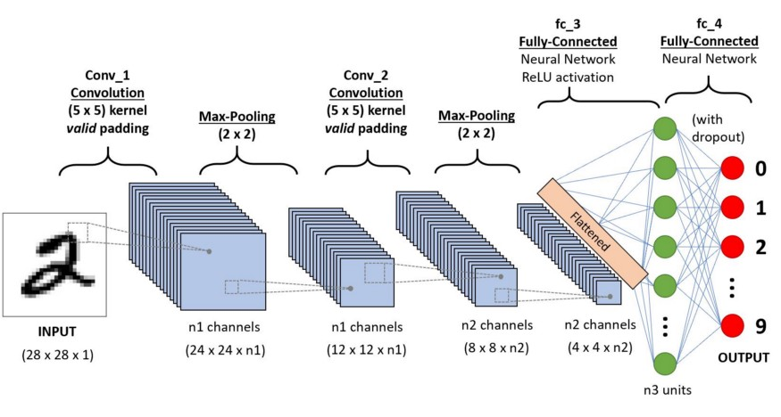
Convolutional Neural Network
https://towardsdatascience.com/a-comprehensive-guide-to-convolutional-neural-networks-the-eli5-way-3bd2b1164a53

Slide 9
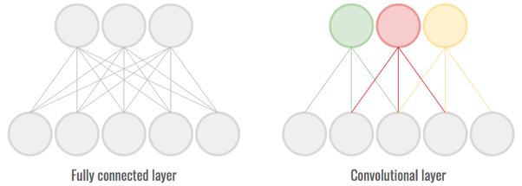
CNN vs MLP
Parameter sharing:
A feature detector (such as a vertical edge detector) that's useful in one part of the image is probably useful in another part of the image.
sparsity of connections:
In each layer, each output value depends only on a small number of inputs which makes it translation invariance.

Slide 10
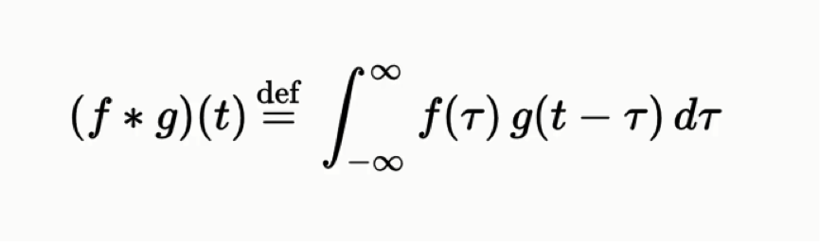
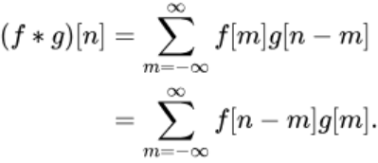
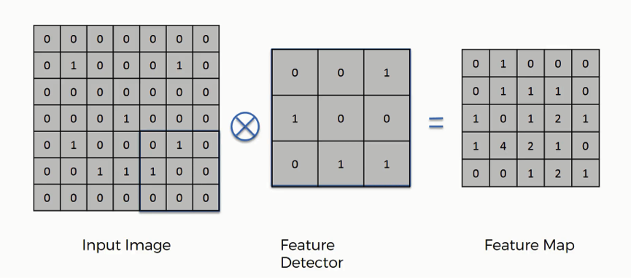
Convolution

Slide 11
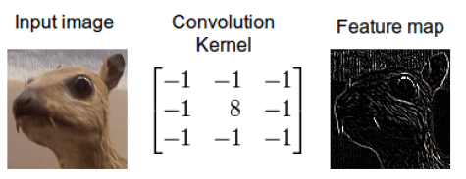
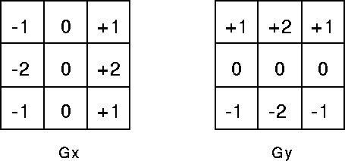
Edge Detection
https://timdettmers.com/2015/03/26/convolution-deep-learning/

Slide 12
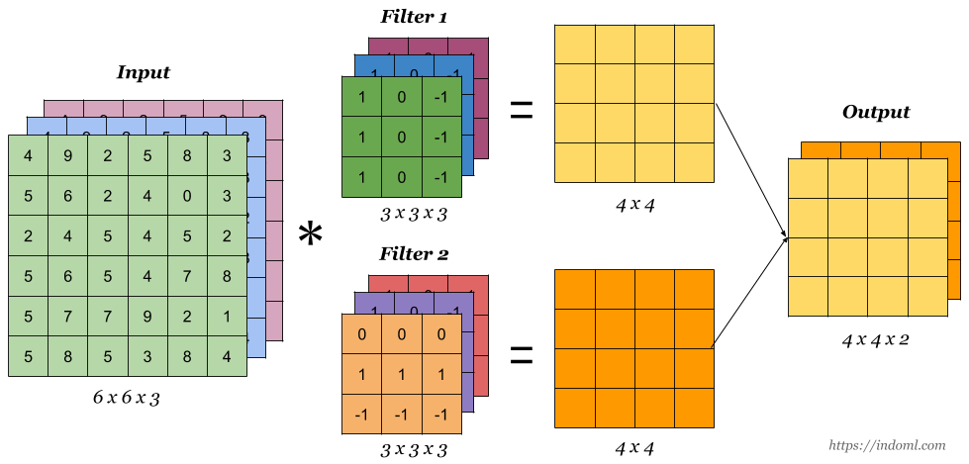
Convolution for Feature Extraction
Convolutional Neural Network Visualization:
Notes:
AI: requires human intelligence to perform
ML: subset of Artificial Intelligence which aims at providing machines with the ability to learn without explicitly programming, to evolve and adapt when they are exposed to new data

Slide 13

Convolution Hyperparameter
Kernel size
Stride
Padding
Activation size:
Notes:
AI: requires human intelligence to perform
ML: subset of Artificial Intelligence which aims at providing machines with the ability to learn without explicitly programming, to evolve and adapt when they are exposed to new data

Slide 14
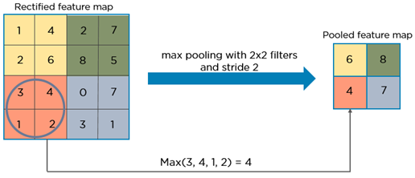
Max Pooling

Slide 15
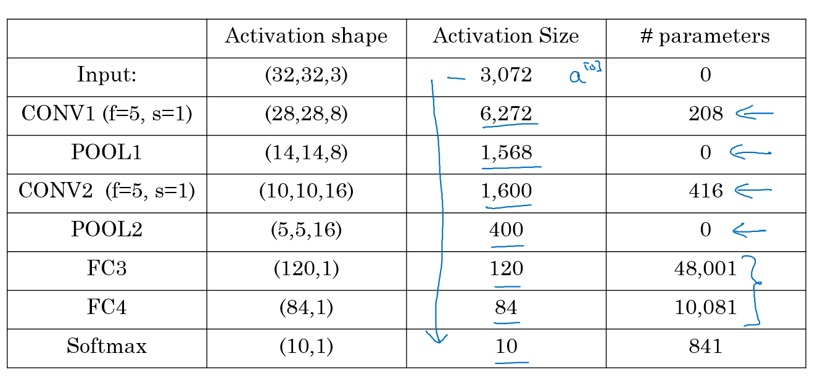
Example

Slide 16
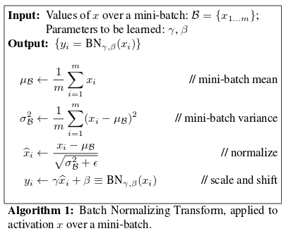
Batch Normalization
Reduces the amount by what the hidden unit values shift around (covariance shift)
Enables higher learning rates because batch normalization makes sure that there’s
no activation that’s gone really high or really low
Also reduces overfitting because it has a slight regularization effects
https://arxiv.org/pdf/1502.03167v3.pdf
Notes:
Maxwell coil in z-direction,
Double-saddle (Golay) coil transversal

Slide 17
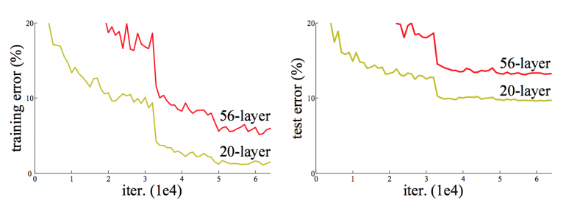
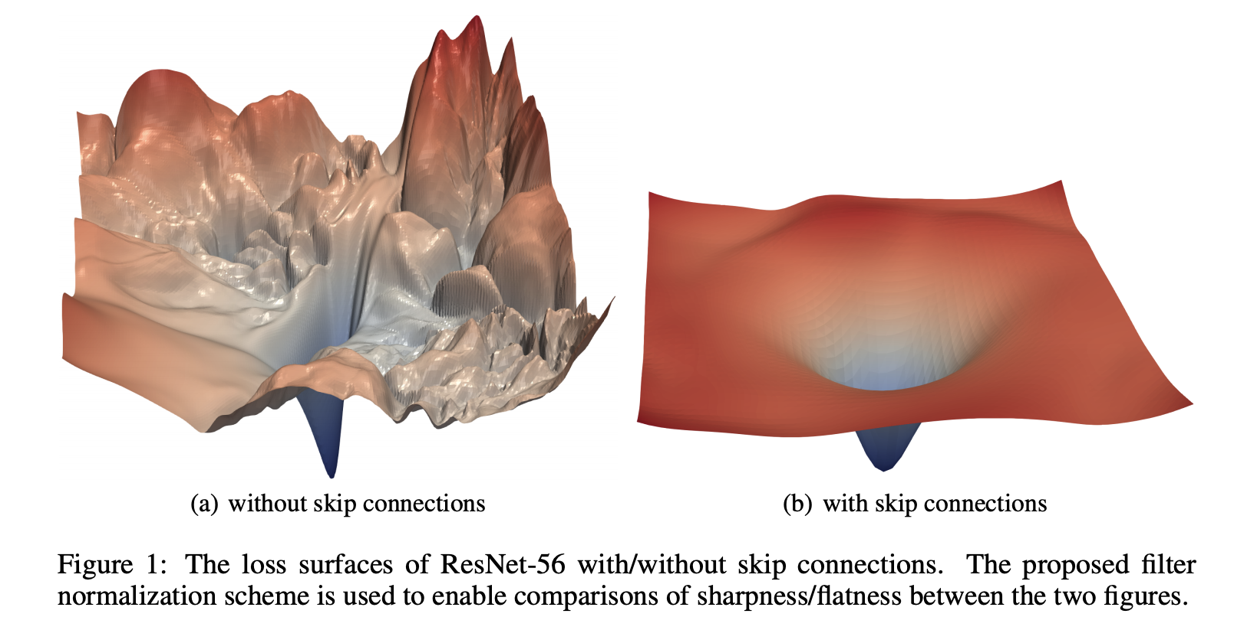
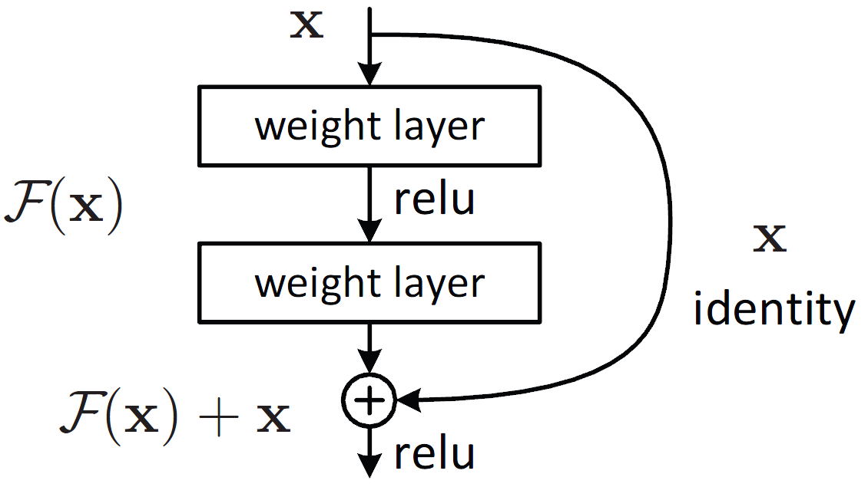
Resnet
https://arxiv.org/pdf/1512.03385.pdf
https://arxiv.org/pdf/1712.09913.pdf
Notes:
Maxwell coil in z-direction,
Double-saddle (Golay) coil transversal

Slide 18
Homework
Implement a MLP
Implement a CNN
Implement VGG16 (ResNeXt) with fast.ai

Slide 19
Next week
Optimizer
Tabular Data

Slide 20
Thank you for your attention!

