Slide 1
Deep Learning Workshop
Session 1
Hoai Nam Dang

Slide 2
General Remarks
Github Link: https://github.com/Tholtus/DKFZ_Deep_Learning_Workshop
Slack Chatroom: Link

Slide 3
What you will learn in this course
Basic understanding about Neural Networks and Deep Learning
Building a state-of-the-art classifier
CNN, Resnet
Working with structured data
Natural Language Processing (NLP) using Recurrent neural network (RNN)
Generative Adversarial Networks using UNet
Notes:
structured data: comes from database or spreadsheet

Slide 4
Outline Session 1
Introduction to Deep Learning
Create our own Classifier for a custom Data Set using the fast.ai library

Slide 5
Other Learning Resources
Online Courses:
Fast.ai, Coursera
Books:
MIT Press book from Ian Goodfellow
Python:
Whirlwind Tour of Python, The Hitchhiker’s Guide to Python
Documentations:
Pytorch, fast.ai

Slide 6
Problems of Deep Learning?
Black Box:
Interpretable ML, Visualize gradients and activations
Need a lot of data:
Transfer learning, share pre-trained nets
Hard to use:
Fastai & keras libs
Only for computer vision:
Used for speech, structured data, time series

Slide 7
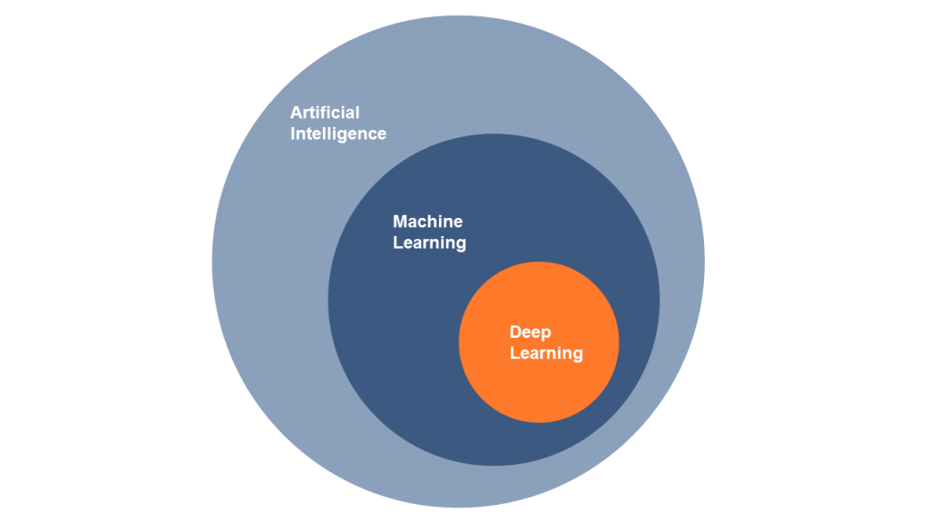
AI? Machine Leaning? Deep Leaning?
https://www.alexanderthamm.com/de/artikel/ki_artificial-intelligence-ai-kuenstliche-neuronale-netze-machine-learning-deep-learning/
Notes:
AI: requires human intelligence to perform
ML: subset of Artificial Intelligence which aims at providing machines with the ability to learn without explicitly programming, to evolve and adapt when they are exposed to new data

Slide 8
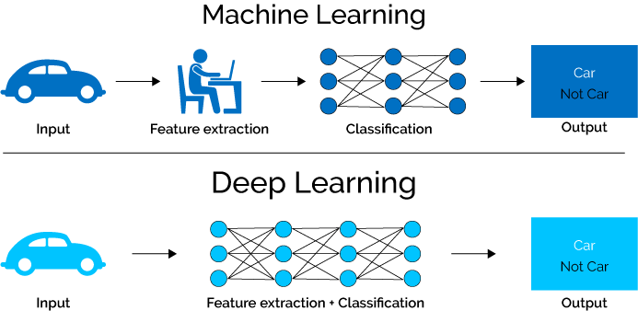
Deep Learning vs Machine Learning
https://www.xenonstack.com/blog/static/public/uploads/media/machine-learning-vs-deep-learning.png

Slide 9
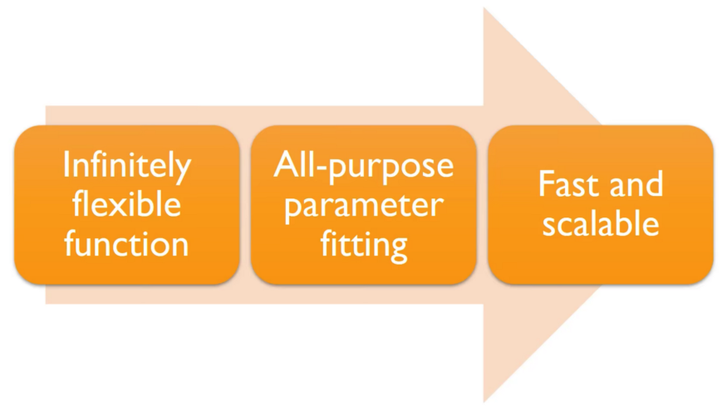
Deep Learning

Slide 10
Artificial Neural Network
Universal Approximation Theorem
Theorem. A feedforward single hidden layer network with finite width can
approximate continuous functions on compact subsets of ℝ^n
under mild assumptions on the activation function. [Csáji (2001) ]
One of the first versions of the theorem was proved by George Cybenko in 1989
visual proof that neural nets can compute any function
Notes:
Maxwell coil in z-direction,
Double-saddle (Golay) coil transversal

Slide 11
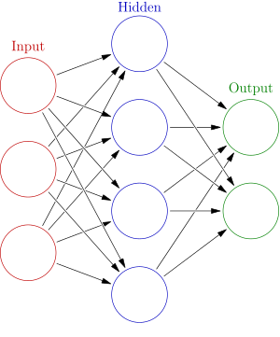





Artificial Neural Network
Weights
$$h= σ(W_{1}x+b_{1})$$
$$y=σ(W_{2}h+b_{2})$$
Activation functions
$$y$$
$$x$$
$$h$$
Notes:
Maxwell coil in z-direction,
Double-saddle (Golay) coil transversal

Slide 12
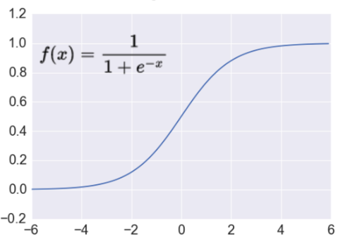

Activation Function
Sigmoid Function
Takes a real-valued number and “squashes” it into range between 0 and 1.
$$R^{n}→\left[0,1\right]$$
http://adilmoujahid.com/images/activation.png
Notes:
Sigmoid neurons saturate and kill gradients, thus NN will barely learn

Slide 13
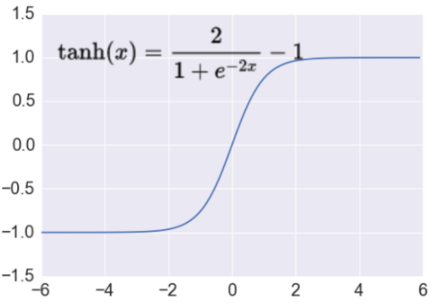

Activation Function
Tanh Function
Takes a real-valued number and “squashes” it into range between -1 and 1.
$$R^{n}→\left[−1,1\right]$$
http://adilmoujahid.com/images/activation.png
Notes:
Sigmoid neurons saturate and kill gradients, thus NN will barely learn

Slide 14
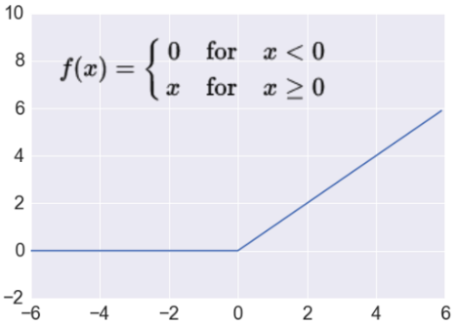

Activation Function
ReLu Function
Takes a real-valued number and thresholds it at zero
$$R^{n}→R_{+}^{n}$$
http://adilmoujahid.com/images/activation.png
Notes:
Sigmoid neurons saturate and kill gradients, thus NN will barely learn

Slide 15

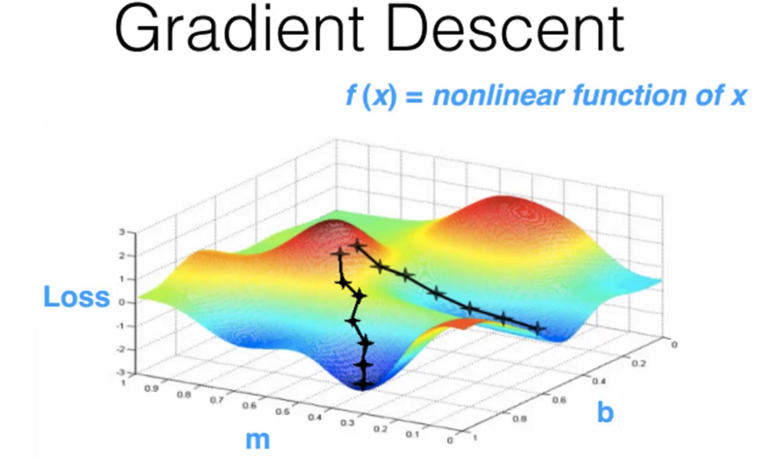
Training
Demo
Notes:
Sigmoid neurons saturate and kill gradients, thus NN will barely learn

Slide 16
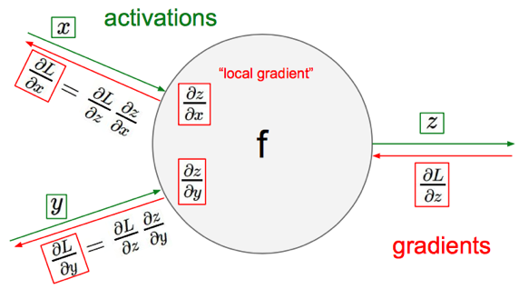
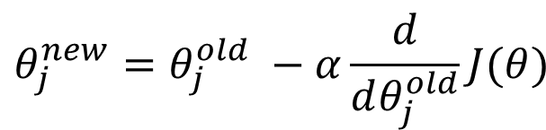
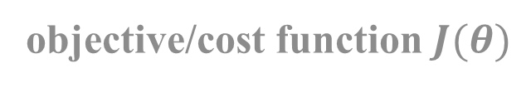

Gradient Descent
objective/cost function $J(θ)$
$$θ_{j}^{new}=θ_{j}^{old} −α\frac{ⅆ}{ⅆθ_{j}^{old}}J(θ)$$
Update each element of θ
$$θ_{}^{new}=θ_{}^{old} −α∇_{θ}J(θ)$$
Matrix notation for all parameters
learning rate

Slide 17
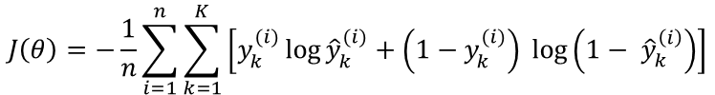


Loss Functions
Classification
Regression
Cross-entropy
Mean Squared Error
$$J\left(θ\right)= \frac{1}{n}\sum_{i=1}^{n}{{\left(y^{(i)}−{\hat{y}}^{(i)}\right)}^{2}}$$
$$J\left(θ\right)=−\frac{1}{n}\sum_{i=1}^{n}{\sum_{k=1}^{K}{\left[y_{k}^{(i)}\log{{\hat{y}}_{k}^{(i)}+\left(1−y_{k}^{(i)}\right) }\log\left(1− {\hat{y}}_{k}^{\left(i\right)}\right)\right]}}$$
Mean Absolute Error
$$J\left(θ\right)= \frac{1}{n}\sum_{i=1}^{n}{\left|y^{(i)}−{\hat{y}}^{(i)}\right|}$$
Notes:
Convex

Slide 18
Deep Learning
Universal approximation theorem says nothing about how easy/difficult it is
to fit such approximators
In practice networks can learn better with multiple hidden layers
Deep learning
Notes:
not fast or scalable unless we added multiple hidden layers — hence called “Deep” learning

Slide 19
Deep Learning Libraries
Pytorch
TensorFlow
Keras
Caffe
Theano
…

Slide 20
Deep Learning Libraries
Pytorch + fast.ai
TensorFlow
Keras
Caffe
Theano
…

Slide 21
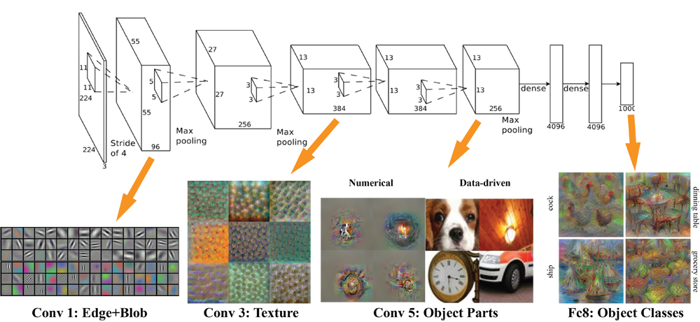
Convolutional Neural Network

Slide 22
Summary
Steps of creating a Image Classifier:
1. Import data
data = ImageDataBunch.from_name_re(...)
2. Build model
learn = create_cnn(...)
3. Train model
learn = fit_one_cycle(...)
4. Unfreeze model
learn.unfreeze(...)
5. Find good learning rate(s)
learn.lr_find(...)
6. Train model again
learn.fit_one_cycle(...)
7. Analyze the results
ClassificationInterpretation.from_learner(...)

Slide 23
Homework
Exercises for Session 1:
1.) Python and Numpy Basics: Get familiar with Python, Jupyter Notebook and Numpy. Learn about Python Broadcasting and try to avoid for loops; use vectorization instead!
2.) Build a logistic regression classifier to recognize cats. (Slides 15-17 as reminder)
3.) Create an image dataset through Google Images and train your own Deep Learning Image Classifier. (Check Lesson Notebook and slide 22)

Slide 24
Next week
Convolutional Neural Networks in detail
Data Augmentation, Regularization, Optimizer

Slide 25
Thank you for your attention!

