Slide 1
Deep Learning Workshop
Session 1
Hoai Nam Dang

Slide 2
General Remarks
Github Link: https://github.com/Tholtus/DKFZ_Deep_Learning_Workshop
Slack Chatroom: Link

Slide 3
What you will learn in this course
Basic understanding about Neural Networks and Deep Learning
Building a state-of-the-art classifier
CNN, Resnet
Working with structured data
Natural Language Processing (NLP) using Recurrent neural network (RNN)
Generative Adversarial Networks using UNet
Notes:
structured data: comes from database or spreadsheet

Slide 4
Outline Session 1
Introduction to Deep Learning
Create our own Classifier for a custom Data Set using the fast.ai library

Slide 5
Other Learning Resources
Online Courses:
Fast.ai, Coursera
Books:
MIT Press book from Ian Goodfellow
Python:
Whirlwind Tour of Python, The Hitchhiker’s Guide to Python
Documentations:
Pytorch, fast.ai

Slide 6
Problems of Deep Learning?
Black Box:
Interpretable ML, Visualize gradients and activations
Need a lot of data:
Transfer learning, share pre-trained nets
Hard to use:
Fastai & keras libs
Only for computer vision:
Used for speech, structured data, time series

Slide 7
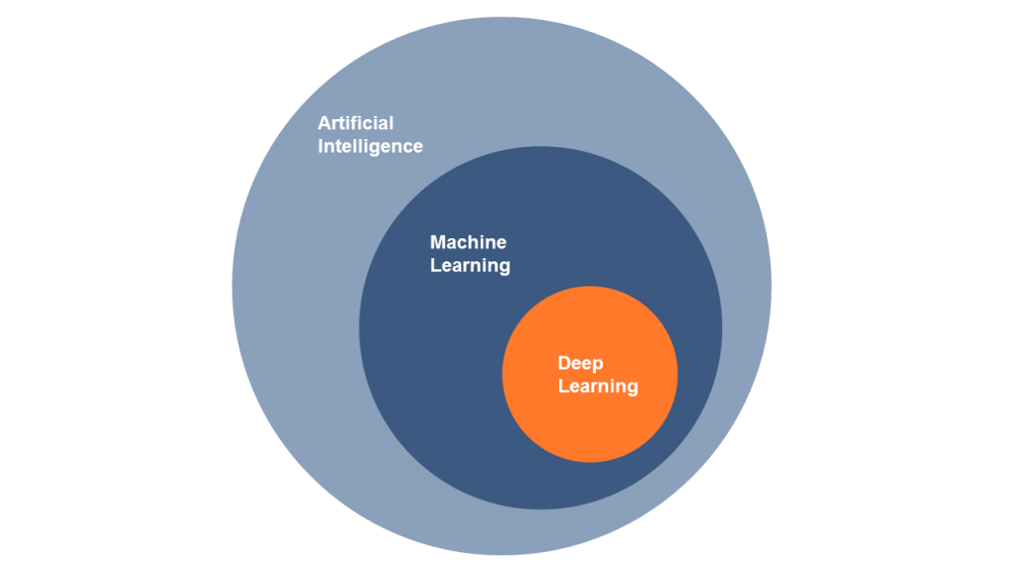
KI? Machine Leaning? Deep Leaning?
https://www.alexanderthamm.com/de/artikel/ki_artificial-intelligence-ai-kuenstliche-neuronale-netze-machine-learning-deep-learning/
Notes:
AI: requires human intelligence to perform
ML: subset of Artificial Intelligence which aims at providing machines with the ability to learn without explicitly programming, to evolve and adapt when they are exposed to new data

Slide 8
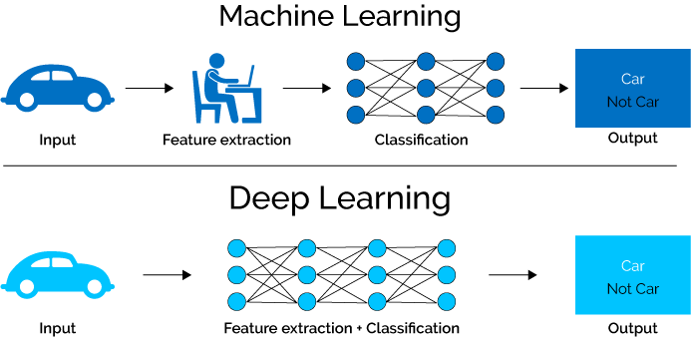
Deep Learning vs Machine Learning
https://www.xenonstack.com/blog/static/public/uploads/media/machine-learning-vs-deep-learning.png

Slide 9
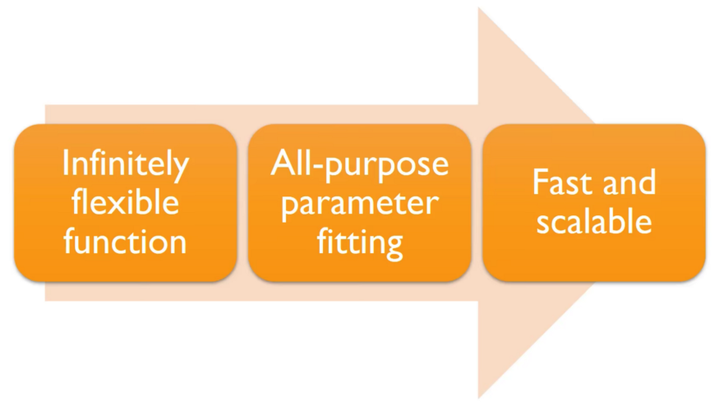
Deep Learning

Slide 10
Artificial Neural Network
Universal Approximation Theorem
Theorem. A feedforward single hidden layer network with finite width can
approximate continuous functions on compact subsets of ℝ^n
under mild assumptions on the activation function. [Csáji (2001) ]
One of the first versions of the theorem was proved by George Cybenko in 1989
visual proof that neural nets can compute any function
Notes:
Maxwell coil in z-direction,
Double-saddle (Golay) coil transversal

Slide 11
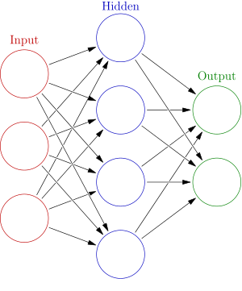





Artificial Neural Network
Weights
$$h= σ(W_{1}x+b_{1})$$
$$y=σ(W_{2}h+b_{2})$$
Activation functions
$$y$$
$$x$$
$$h$$
Notes:
Maxwell coil in z-direction,
Double-saddle (Golay) coil transversal

Slide 12
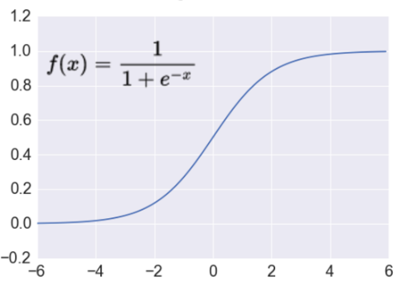

Activation Function
Sigmoid Function
Takes a real-valued number and “squashes” it into range between 0 and 1.
$$R^{n}→\left[0,1\right]$$
http://adilmoujahid.com/images/activation.png
Notes:
Sigmoid neurons saturate and kill gradients, thus NN will barely learn

Slide 13
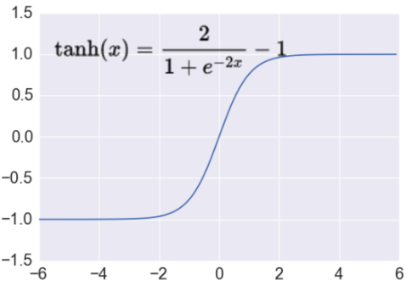

Activation Function
Tanh Function
Takes a real-valued number and “squashes” it into range between -1 and 1.
$$R^{n}→\left[−1,1\right]$$
http://adilmoujahid.com/images/activation.png
Notes:
Sigmoid neurons saturate and kill gradients, thus NN will barely learn

Slide 14
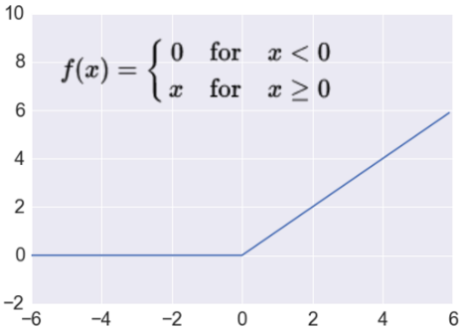

Activation Function
ReLu Function
Takes a real-valued number and thresholds it at zero
$$R^{n}→R_{+}^{n}$$
http://adilmoujahid.com/images/activation.png
Notes:
Sigmoid neurons saturate and kill gradients, thus NN will barely learn

Slide 15

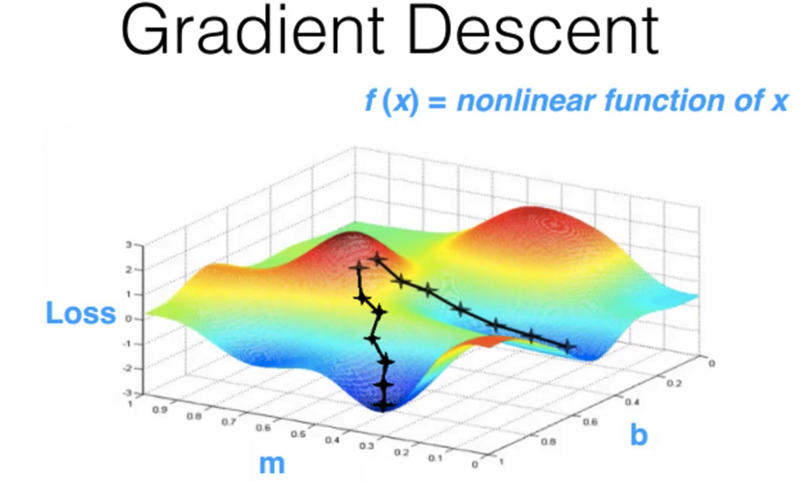
Training
Demo
Notes:
Sigmoid neurons saturate and kill gradients, thus NN will barely learn

Slide 16
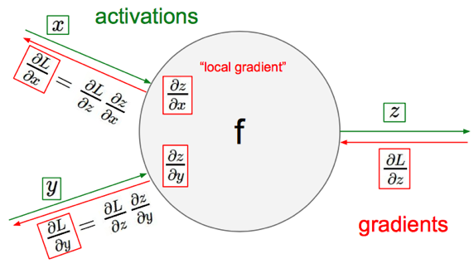
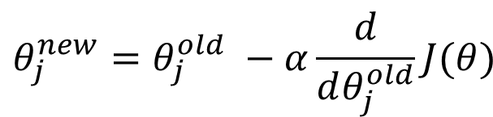
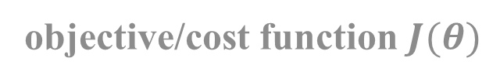

Gradient Descent
objective/cost function $J(θ)$
$$θ_{j}^{new}=θ_{j}^{old} −α\frac{ⅆ}{ⅆθ_{j}^{old}}J(θ)$$
Update each element of θ
$$θ_{}^{new}=θ_{}^{old} −α∇_{θ}J(θ)$$
Matrix notation for all parameters
learning rate

Slide 17
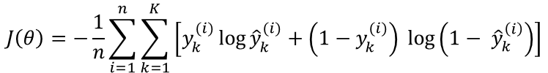


Loss Functions
Classification
Regression
Cross-entropy
Mean Squared Error
$$J\left(θ\right)= \frac{1}{n}\sum_{i=1}^{n}{{\left(y^{(i)}−{\hat{y}}^{(i)}\right)}^{2}}$$
$$J\left(θ\right)=−\frac{1}{n}\sum_{i=1}^{n}{\sum_{k=1}^{K}{\left[y_{k}^{(i)}\log{{\hat{y}}_{k}^{(i)}+\left(1−y_{k}^{(i)}\right) }\log\left(1− {\hat{y}}_{k}^{\left(i\right)}\right)\right]}}$$
Mean Absolute Error
$$J\left(θ\right)= \frac{1}{n}\sum_{i=1}^{n}{\left|y^{(i)}−{\hat{y}}^{(i)}\right|}$$
Notes:
Convex

Slide 18
Deep Learning
Universal approximation theorem says nothing about how easy/difficult it is
to fit such approximators
In practice networks can learn better with multiple hidden layers
Deep learning
Notes:
not fast or scalable unless we added multiple hidden layers — hence called “Deep” learning

Slide 19
Deep Learning Libraries
Pytorch
TensorFlow
Keras
Caffe
Theano
…

Slide 20
Deep Learning Libraries
Pytorch + fast.ai
TensorFlow
Keras
Caffe
Theano
…

Slide 21
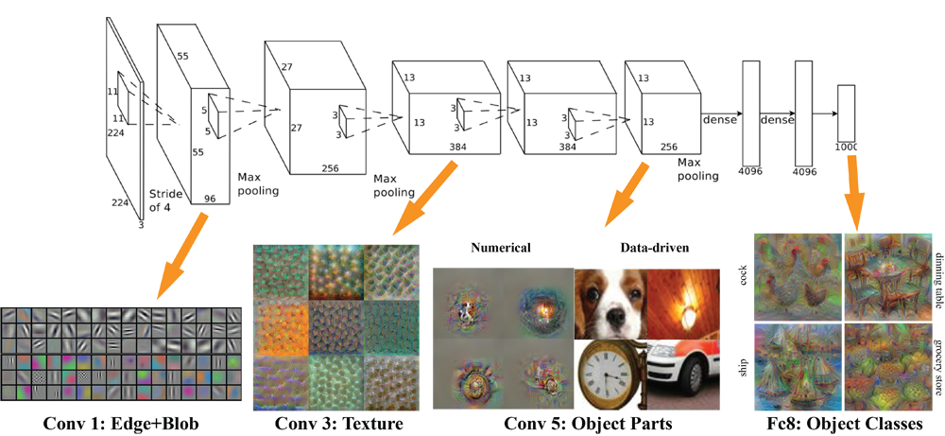
Convolutional Neural Network

Slide 22
Summary
Steps of creating a Image Classifier:
1. Import data
data = ImageDataBunch.from_name_re(...)
2. Build model
learn = create_cnn(...)
3. Train model
learn = fit_one_cycle(...)
4. Unfreeze model
learn.unfreeze(...)
5. Find good learning rate(s)
learn.lr_find(...)
6. Train model again
learn.fit_one_cycle(...)
7. Analyze the results
ClassificationInterpretation.from_learner(...)

Slide 23
Next week
Convolutional Neural Networks in detail
Data Augmentation, Regularization, Optimizer

Slide 24
Thank you for your attention!

