Slide 1
Deep Learning Workshop
Session 3
Hoai Nam Dang

Slide 2
Outline Session 3
Optimizer
Stochastic Gradient Descent (SGD)
Gradient Descent with Momentum
Root Mean Square Propogation (RMSProp)
Adaptive Moment Optimization (Adam)
Collaborative Filtering
Tabular Data

Slide 3
Gradient Descent Variants
Batch gradient descent
calculate the gradients for the whole dataset to perform just one update
can be very slow and large datasets don’t fit in GPU memory
Stochastic gradient descent (SGD)
performs a parameter update for each training example
usually much faster, but with high variance that cause the
objective function to fluctuate heavily
Mini-batch gradient descent
takes the best of both worlds and performs an update
for every mini-batch

Slide 4
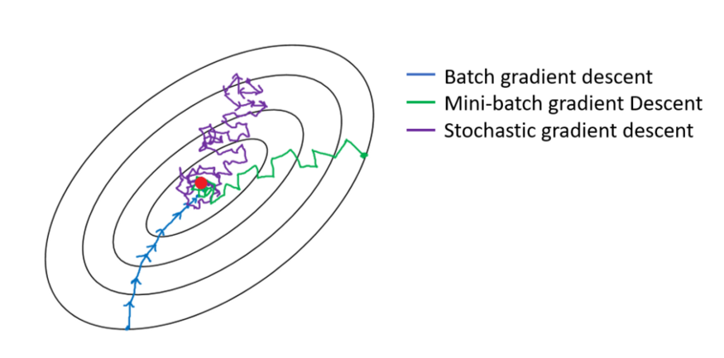
Gradient Descent Variants
https://towardsdatascience.com/gradient-descent-algorithm-and-its-variants-10f652806a3

Slide 5
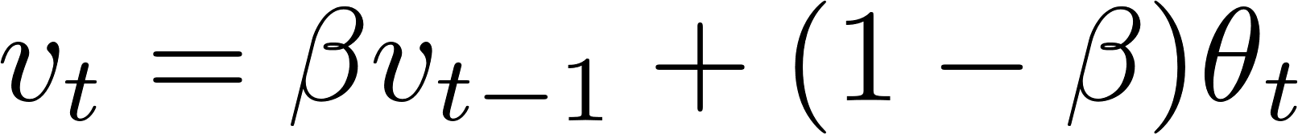
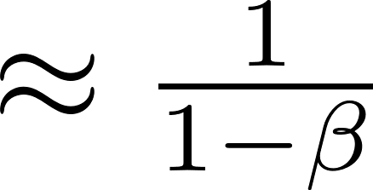
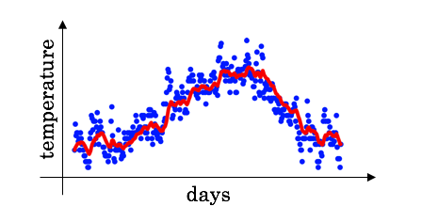
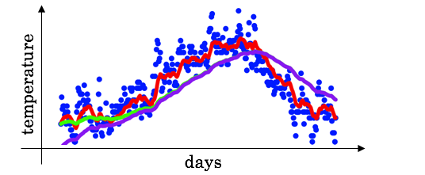
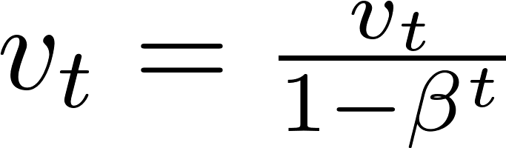
Exponentially Weighted Average
Exponentially Weighted Average:
averaging over
Bias Correction in Exponentially Weighted Moving Average:

Slide 6
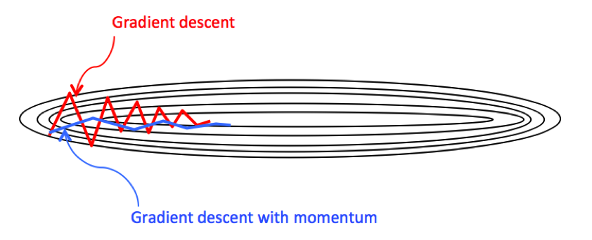
Gradient Descent with Momentum
https://medium.com/machine-learning-bites/deeplearning-series-deep-neural-networks-tuning-and-optimization-39250ff7786d

Slide 7
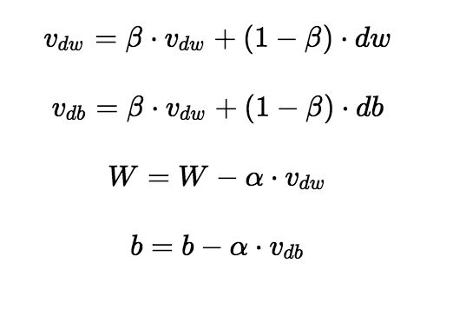
Gradient Descent with Momentum
Calculate the exponentially weighted averages for your gradients and then update your weights with the new values

Slide 8
Root Mean Square Propogation (RMSProp)
https://medium.com/machine-learning-bites/deeplearning-series-deep-neural-networks-tuning-and-optimization-39250ff7786d

Slide 9
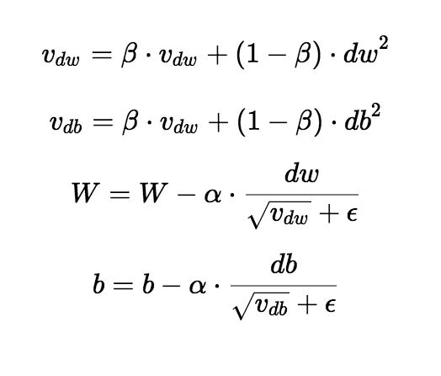
Root Mean Square Propogation (RMSProp)
Reduces learning rate for large gradients

Slide 10
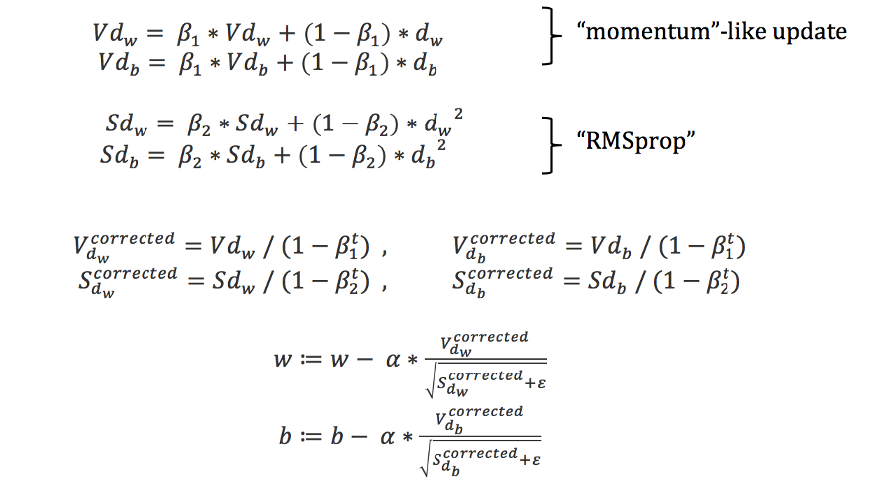
Adaptive Moment Optimization (Adam)
Combines the effect of “gradient descent with momentum” with RMSprop

Slide 11

Learning rate decay
Each interation is a bit noisy -> never quite converge to the minimum, instead wandering around it
Learning rate decay:

Slide 12
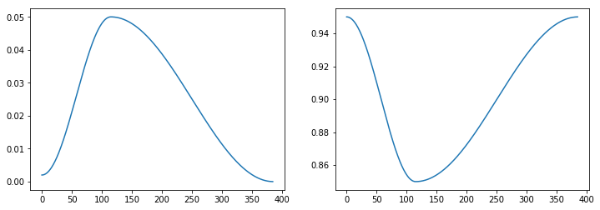
1cycle policy
Optimize training speed with Leslie Smith’s 1cycle policy
Allows a phenomenon termed superconvergence

Slide 13
Collaborative filtering
Technique used by recommender systems
Make predictions about an interest of an specific user by collecting taste or preferences information from many other users
Recommendation systems used by companies like Amazon, Netflix, Linkedin, and Spotify but also potential in healthcare

Slide 14
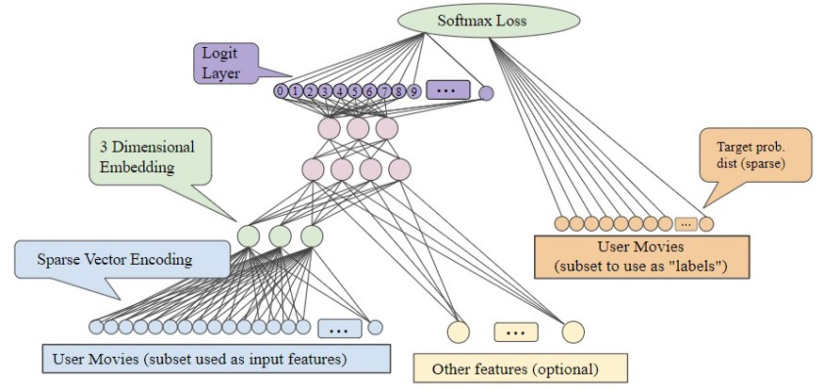
Embeddings
https://developers.google.com/machine-learning/crash-course/embeddings/obtaining-embeddings?source=post_page---------------------------

Slide 15
Tabular Data
Deep learning is currently not much used for tabular data analysis
Using Deep learning reduces requirement of feature engineering (does not remove completely). As it more generalizable, maintenance requirement is less
Categorical variables are used for embeddings
Continuous variables are sent into the neural net just like pixels in Computer Vision

Slide 16
Homework
Implement Optimization Algorithms
Prediction model for salary of a person based on
various information of this person

Slide 17
Thank you for your attention!

