Slide 1
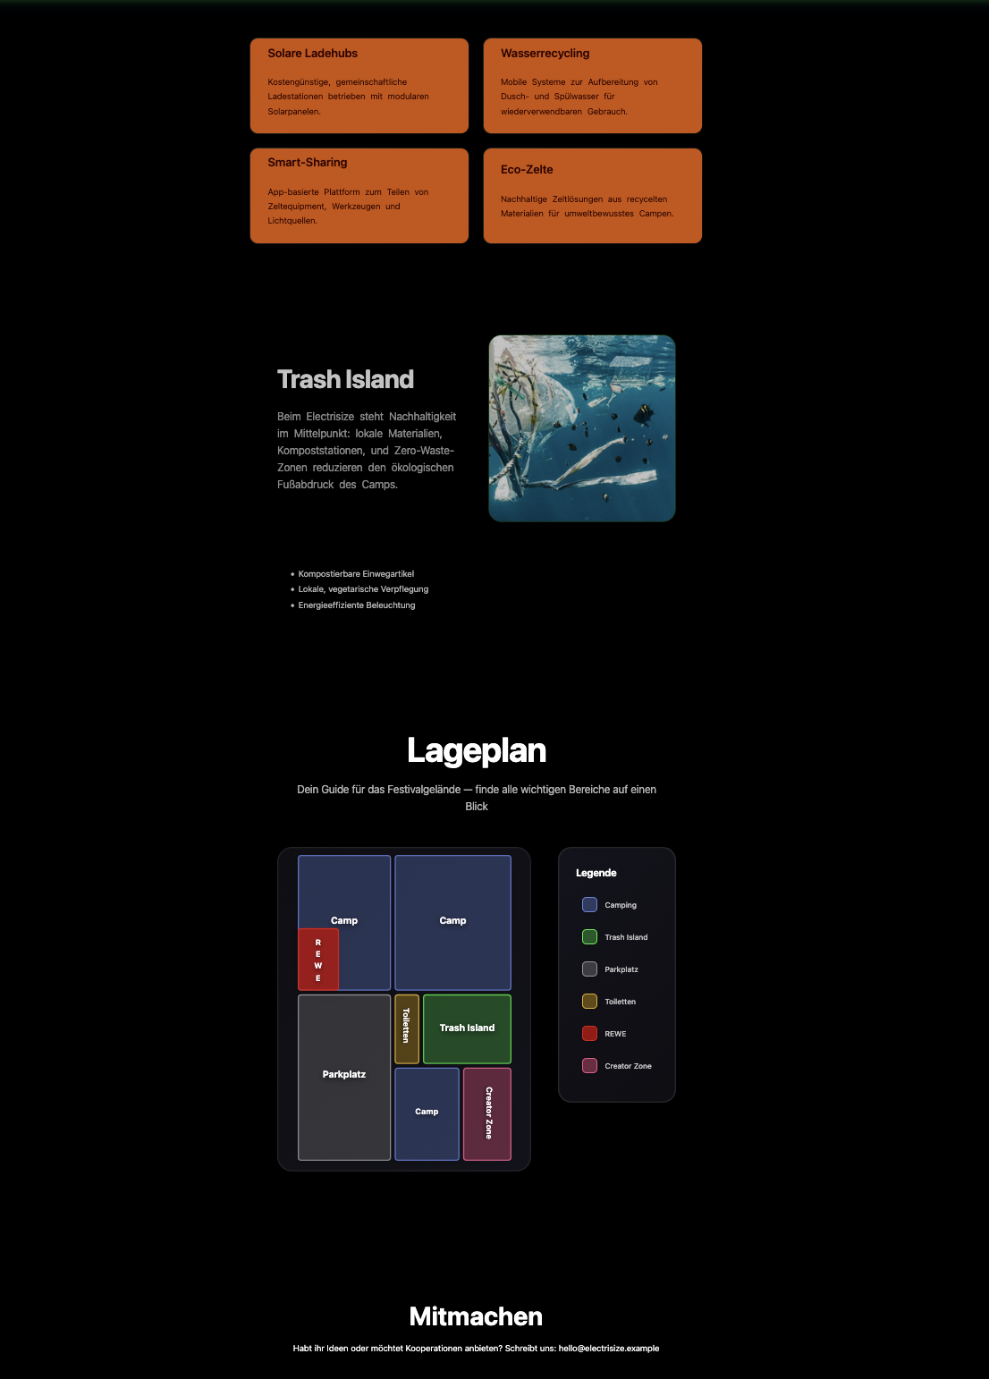
Website
Erreiche den User

Slide 2
