Slide 1


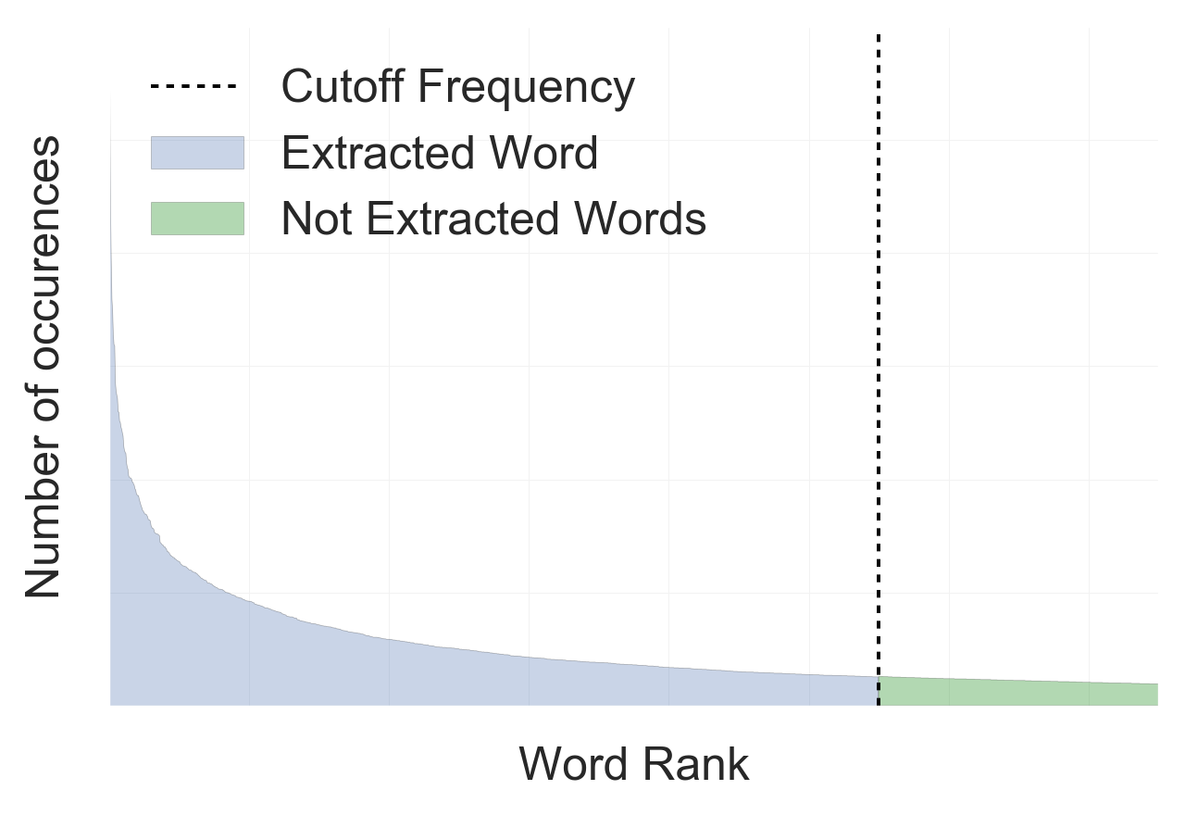
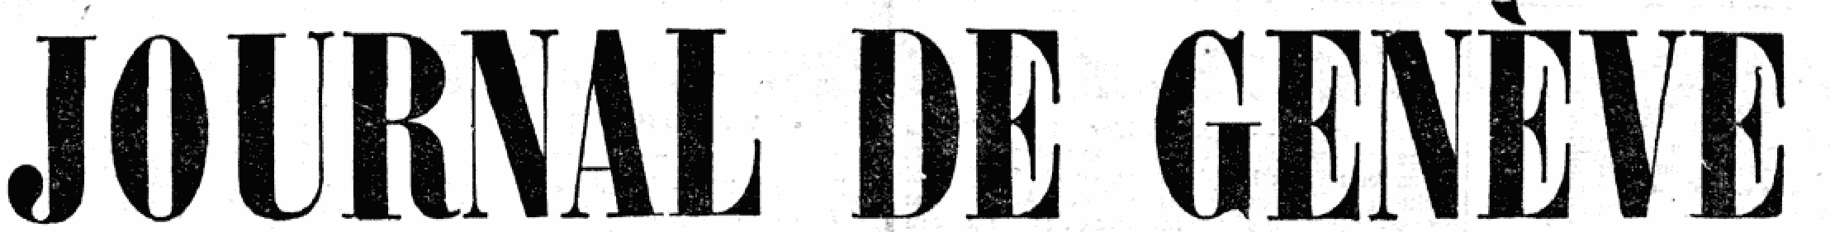
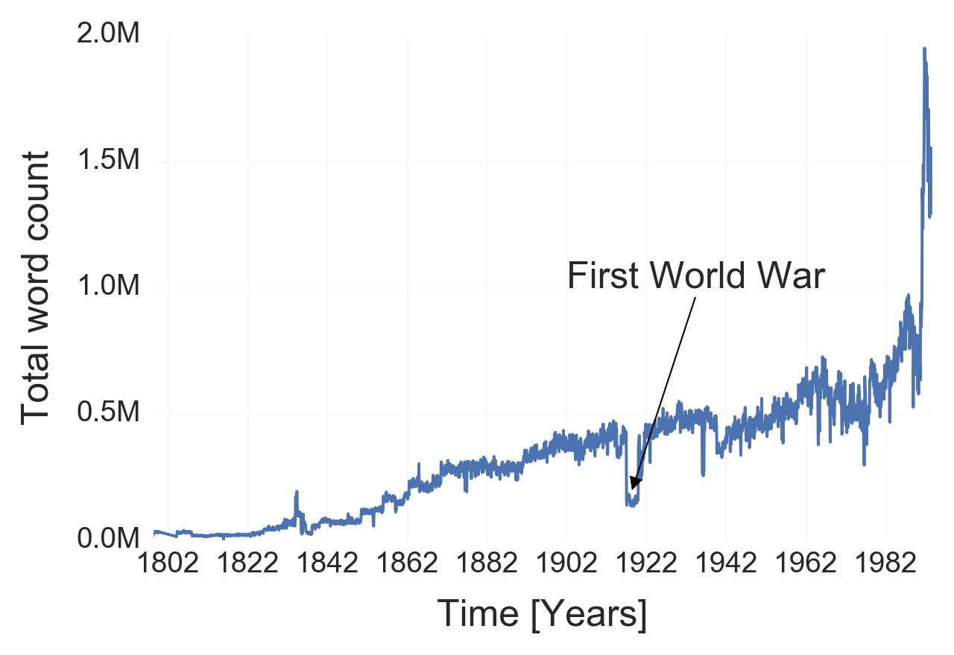
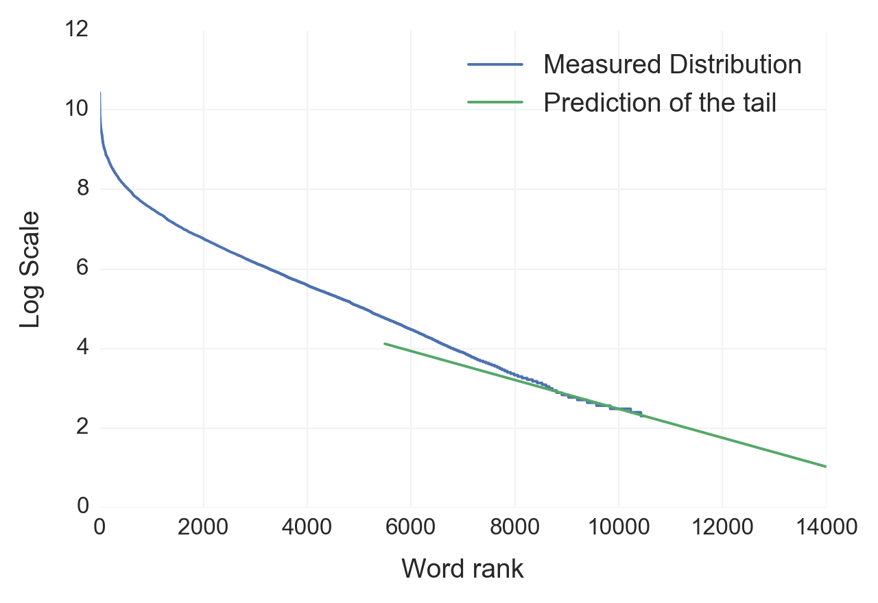
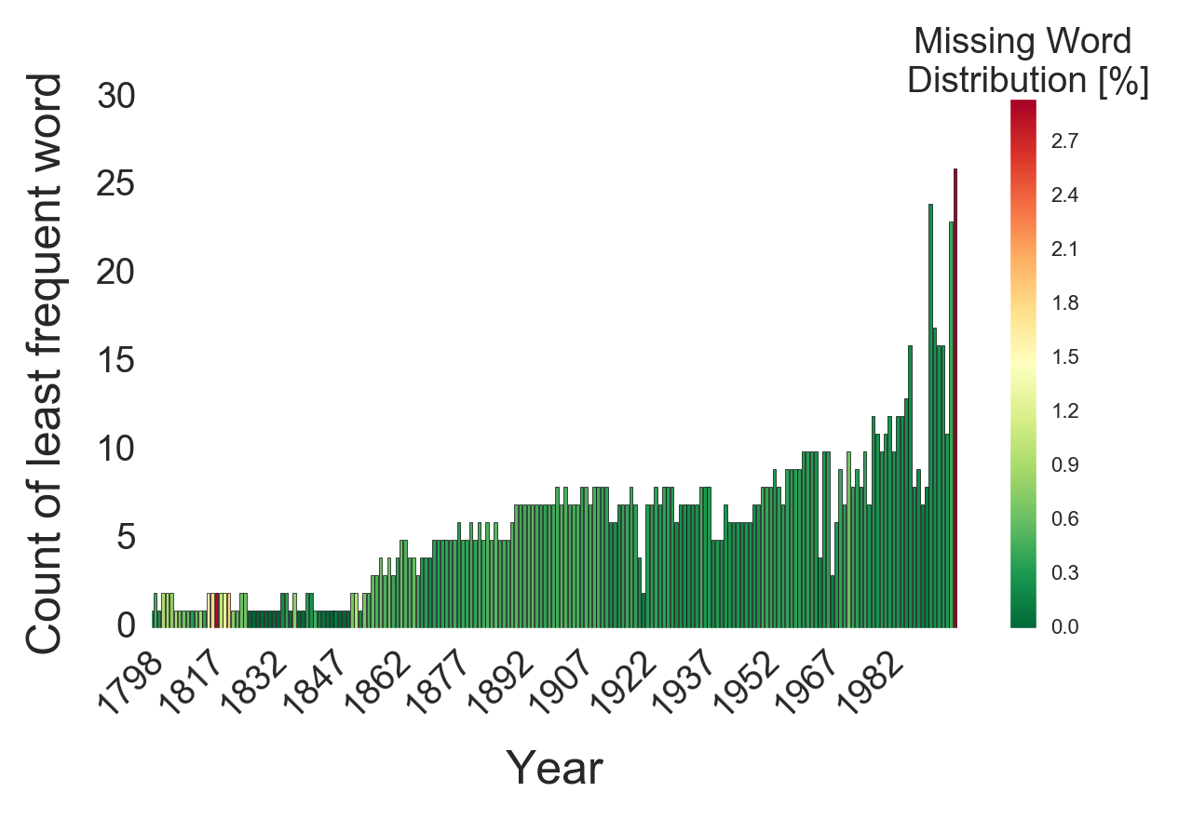
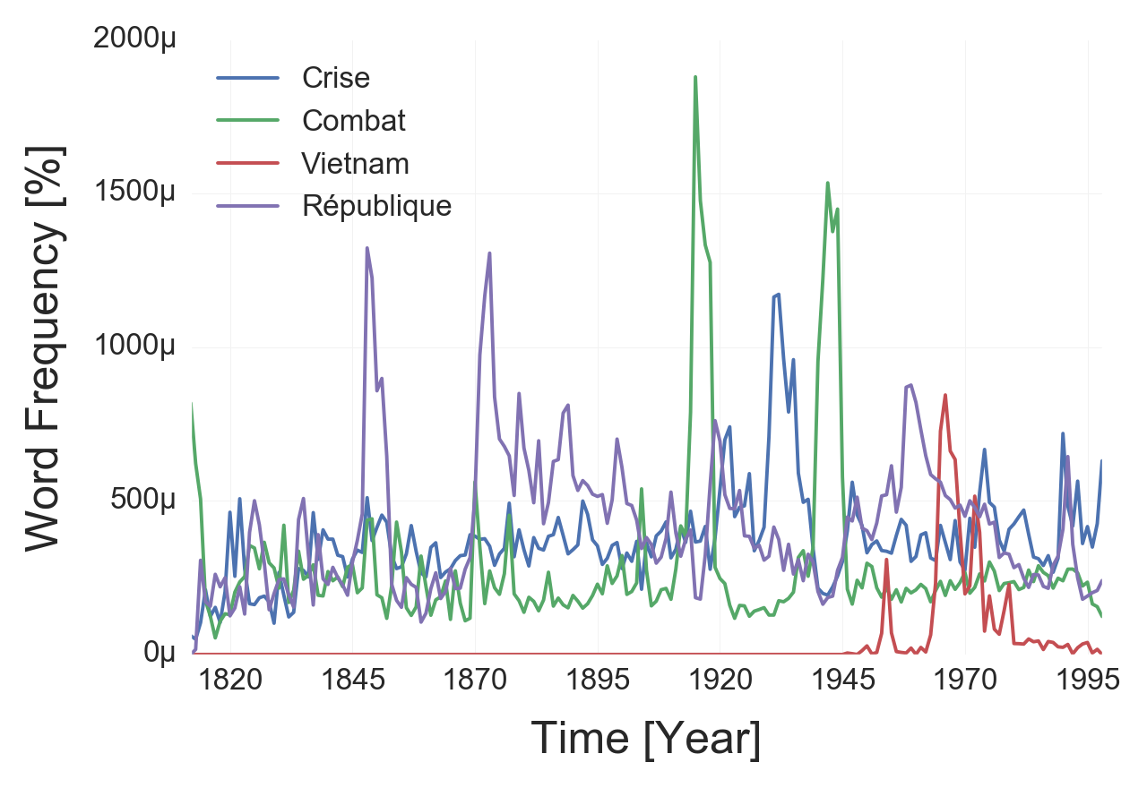
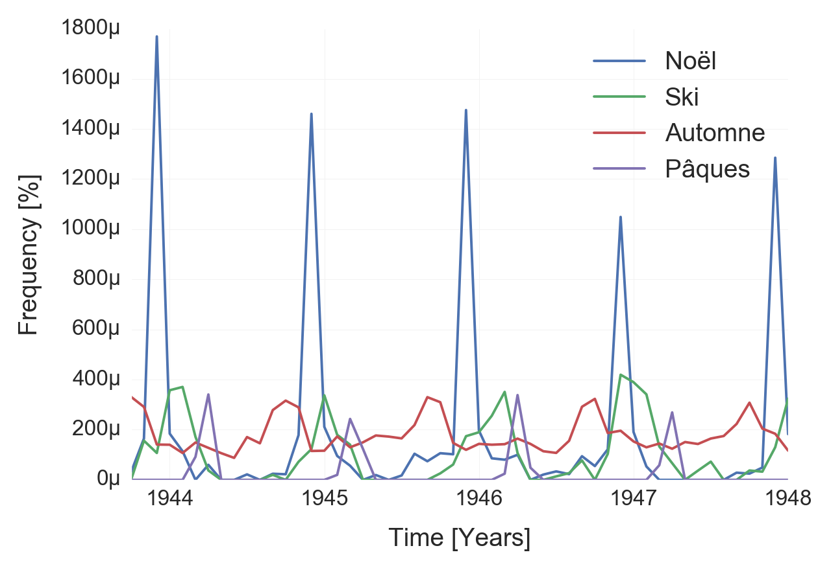
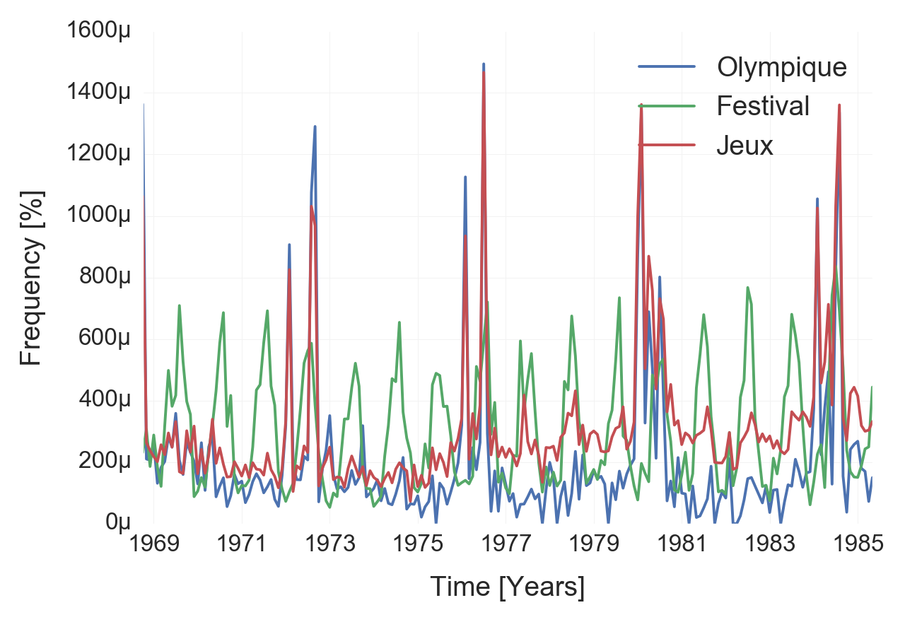
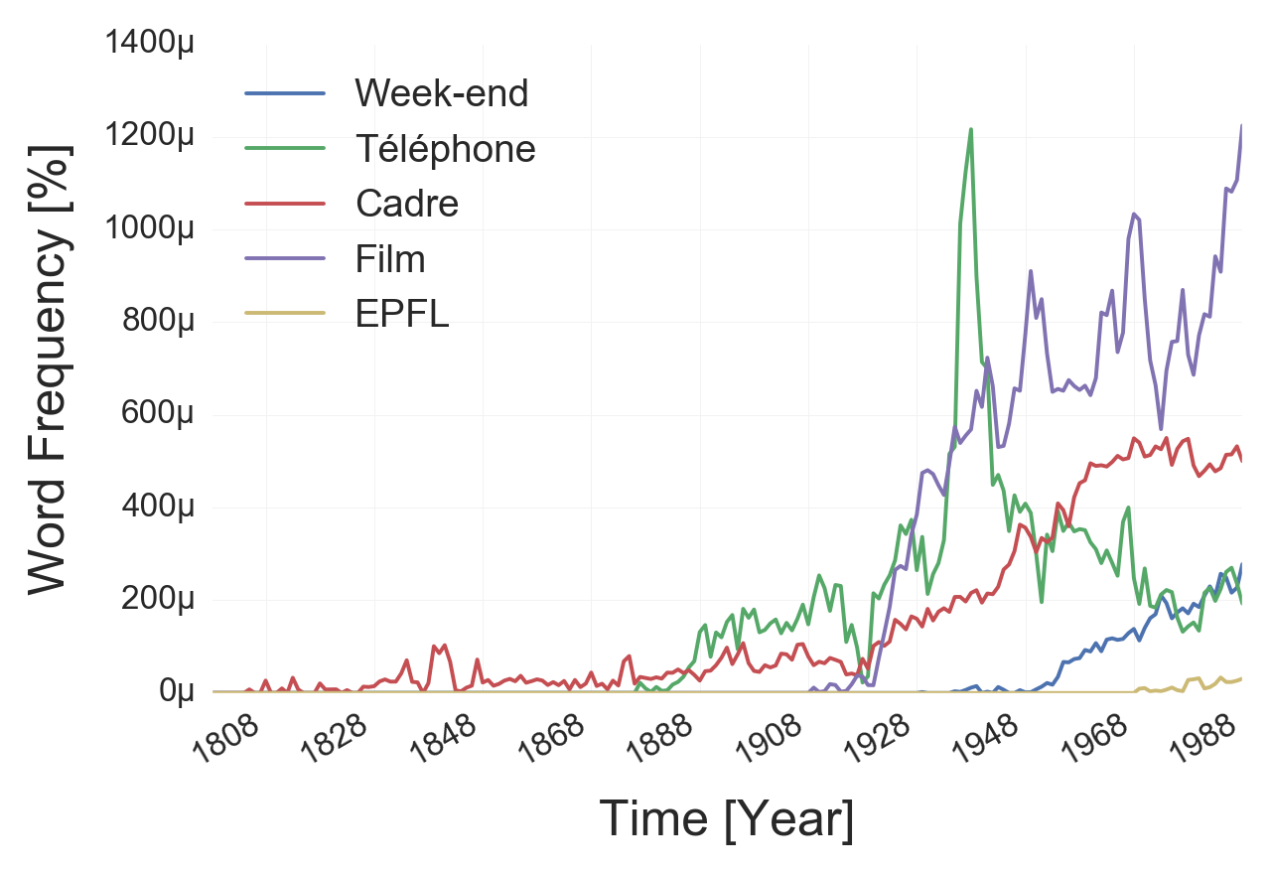
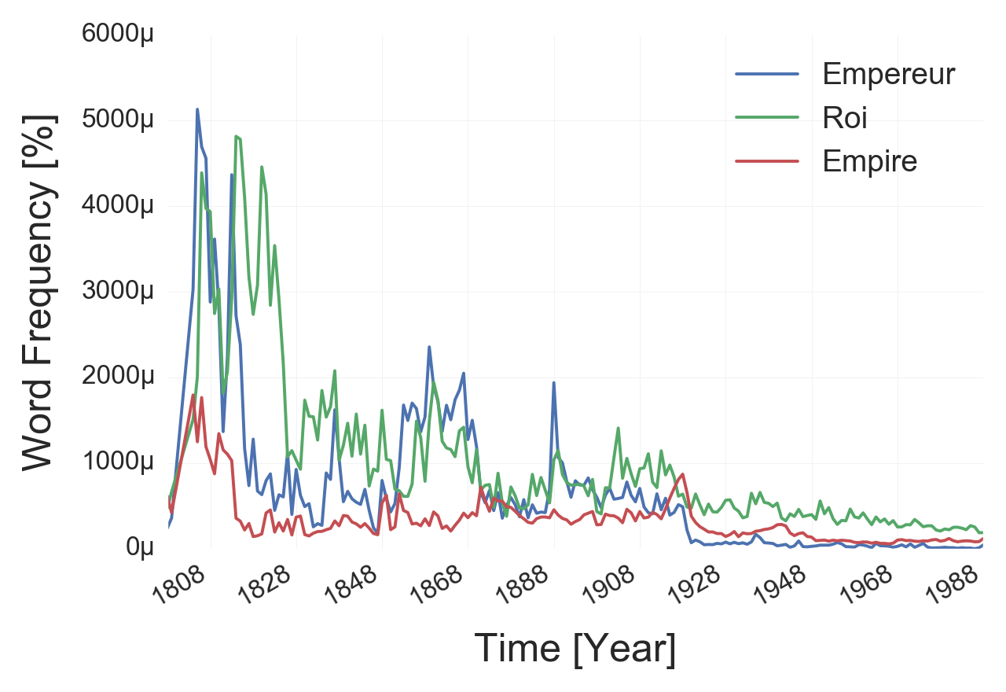
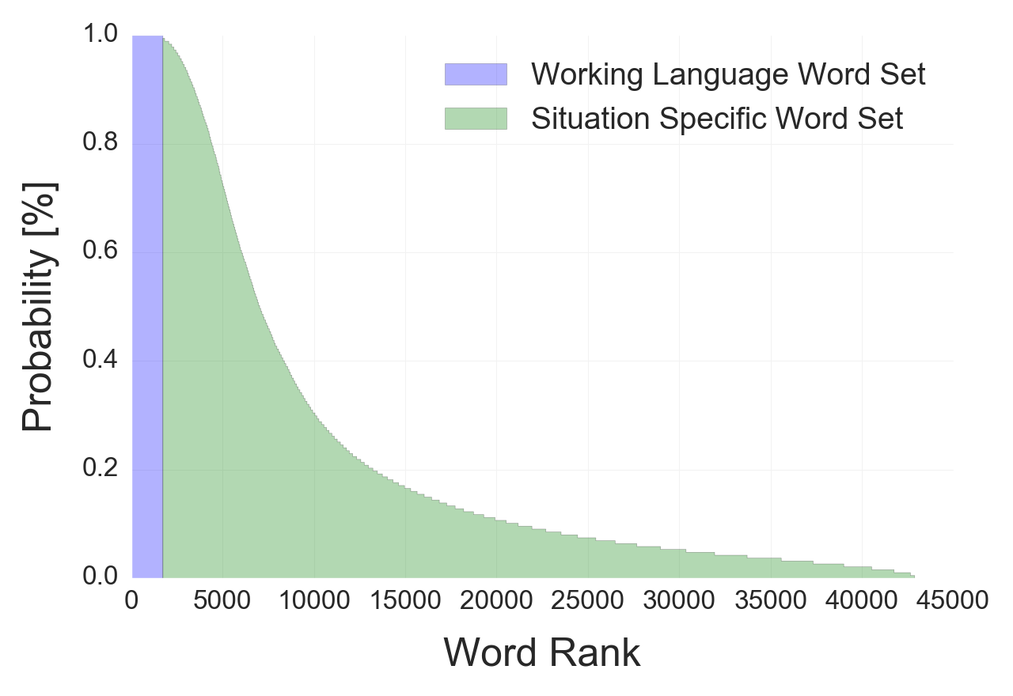
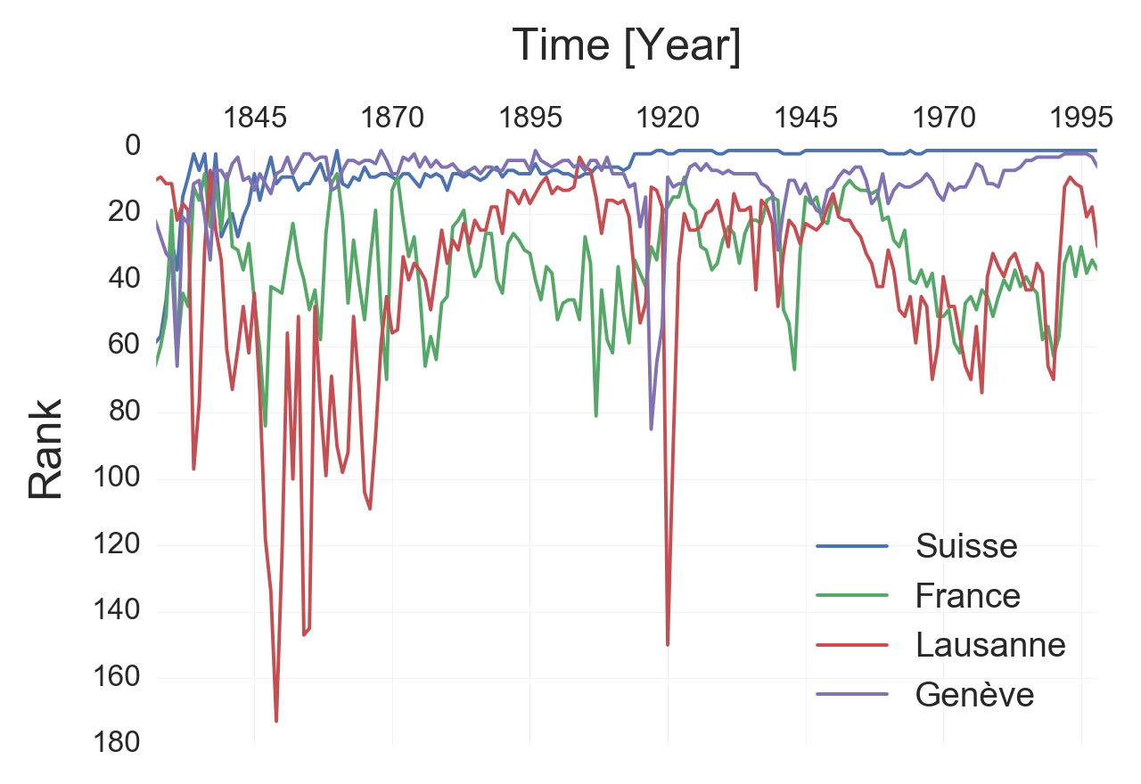
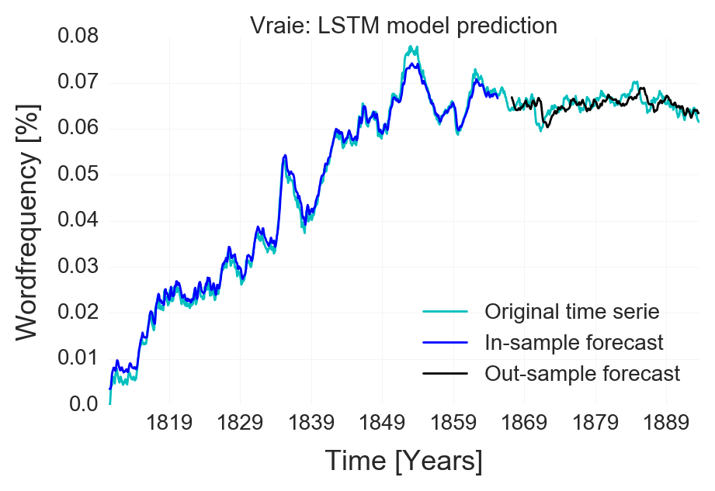
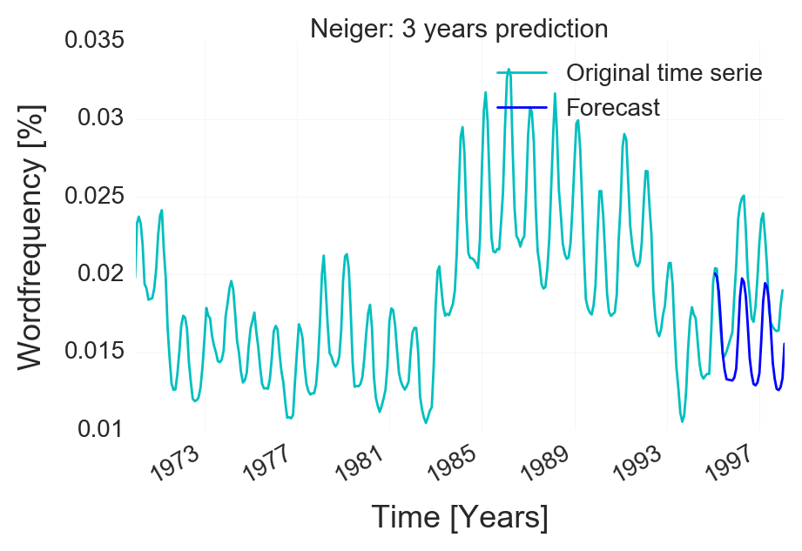
Applied Data Analysis – Le Temps Dataset Word Frequency Prediction
Axel De La Harpe, Thomas Vetterli, Lukman Olagoke – January 2017
Extract Transfom Pipeline
Long tail distribution of word frequency:
Due to our cutoff frequency, we miss a part of the data:
The Dataset
200 years of daily articles from:
Publication dates:
1798 – 1998
Publication dates:
1826 – 1998
Extraction: Counting the 3000+ most
frequent words per month
Data Extraction
Removal of punctuation / numbers
Removal of French stop words
Custom NLTK processing:
Singular / Plural
Masculin / Féminin
Verbs and their conjugations
Adverbs + Noun
Cutoff Frequency: We only save the 3000+ most frequent word per months
Result: Time serie of the frequency of each word
Resolution: 1 time point per month
Data Visualization
How much of the data was not extracted?
Number of occurrences of the least frequent word with percentage of the data that was missed
Total word count over the years
Long tail distribution is
linear in log-lin scale
Linear regression:
We predict the tail of the distribution.
We can predict the percentage of the distribution
that we did not extract.
We can see that in theory we did not miss an large
part of the word distribution (graph on the right)
Words with interesting time series
Historic Words
To find relevant time series, several methods were used:
The time series of certain words
follow historic events.
1848: Second republic of France
1870: Third republic of France
1918: First World War
1929 - 31: Financial Crisis
1939-1945: Second World War
1955 – 1975: Vietnam War
Pearson correlation : Computing similarity between time series
Fourier transform : Finding words with periodicity
Gradient : Finding decreasing and increasing time series
Dendogram clustering
Frequency ranking
Manual Search
Working with smoothed time series :
Rolling mean, Interpolation
We show below a few interesting results:
Words with monthly periodicity
Words with multi year periodicity
Ranking of the words:
We have analyzed how the set of 15’000 most frequent words evolved over time. We plot on the left the probability of finding the n^{th} most frequent word in a given year. We see that the 1700 first words are always present (working language, P = 1) and then the other words are situation specific, as the curve takes some time to reach 0, we see that the word set in these two journals is very large. On the right we see the evolution of the rank of certain words over time (1 = most frequent).
Appearing Words
Disappearing Words
Word Frequency Prediction
LSTM model prediction:
Model: A simple LSTM (long short term memory). The problem is formed as a regression task with a RNN (Recurent neura network).
SARIMA model prediction for seasonal words:
Model: A SARIMA (Seasonal autoregressive integraded moving average) model is a combination of autoregression with moving average component plus seasonal component in order to predict the future time values.
Result: The model is not making a true forecast. It has simply learnt to output the previous time value with some minor changes. In other words, it simply mimicks the time serie. It make sense as the model is trying to reduce the error and the previous time value are not too far away from the future time value.
Result: The model is able to predict the correct seasonality of the word and outputs a coherent local trend. It is not able to integrate changing trend which can be regarded as random movement. The output is a repetitive sequence in the same direction. The reliability of the prediction decreases as we increase the length of the prediction.

