Slide 1

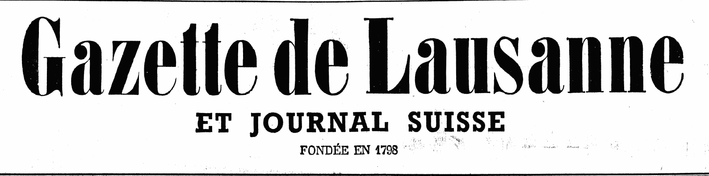

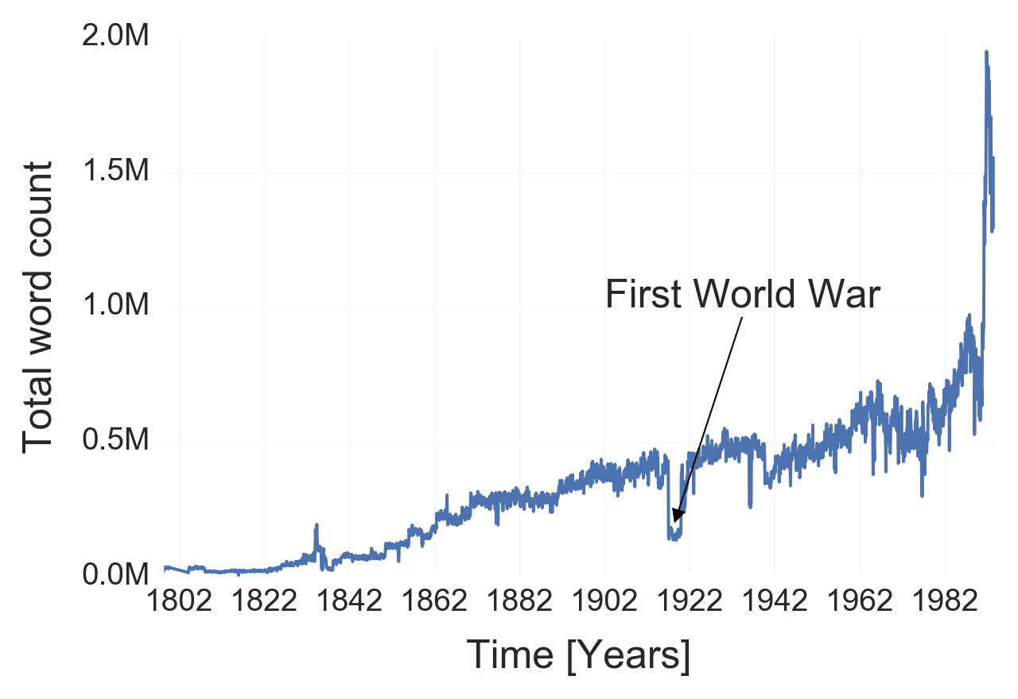
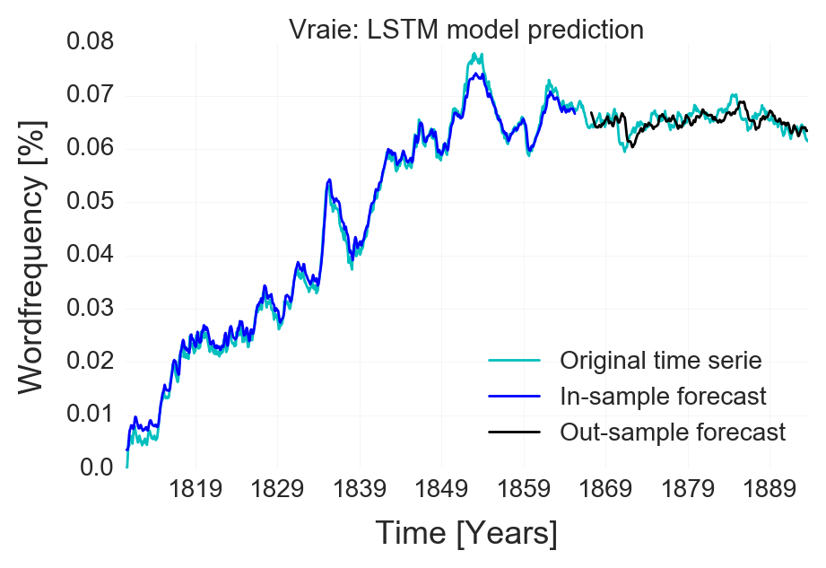
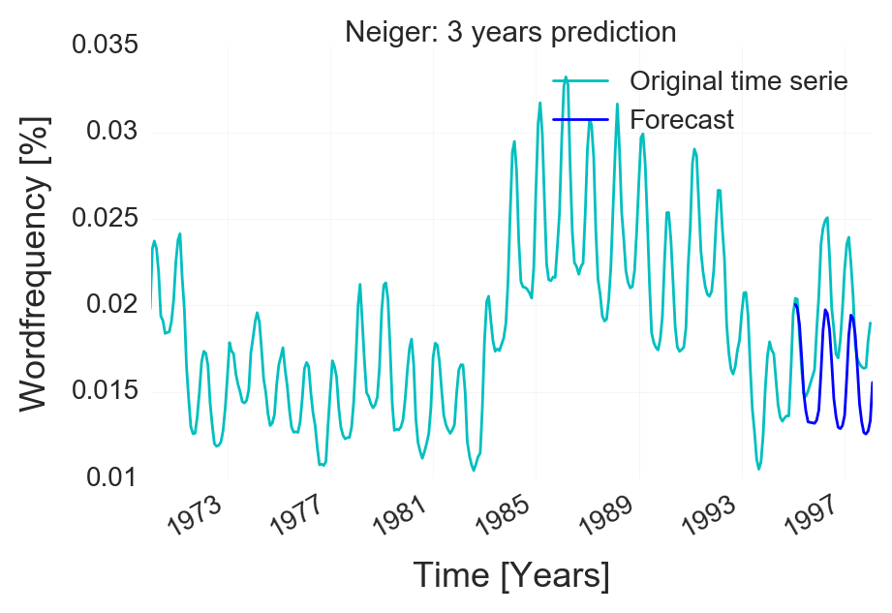
Applied Data Analysis – Le Temps Dataset Word Frequency Prediction
The Dataset:
200 years of daily articles from:
Publication dates: 1798 – 1998
Publication dates: 1826 – 1998
Extraction: Counting the 3000+ most frequent words per month
Data Extraction:
Removal of punctuation
Removal of French stop words
Custom NLTK processing:
Singular / Plural
Masculin / Féminin
Verbs and their conjugations
Adverbs + Noun
Removal of words that were not present enough
Result: Time serie of the frequency of each word
LSTM model prediction:
Models: A simple LSTM (long short term memory). The problem is formed as a regression task with RNN (Recurent neura network).
Result: The model is not making true forecast. it has simply learn to output the previous time value with some minor change. In oder words, it simply mimick the time serie. It make sense as the model is trying to reduce the error and the previous time value are not to far away from the future time value.
SARIMA model prediction for seasonal words:
Models: A SARIMA (Seasonal autoregressive integraded moving average) model. This is a combination of autoregression with moving average component plus seasonal component in order to predict the future time value.
Result: The model is able to predict the correct seasonality of the words and output a coherent local trend. It is not able to integrate changing trend which can regarded as random movement. The output is a repetitive sequence in the same direction. The reliability of the prediction decreases as we predict long time horizon.

