Slide 1

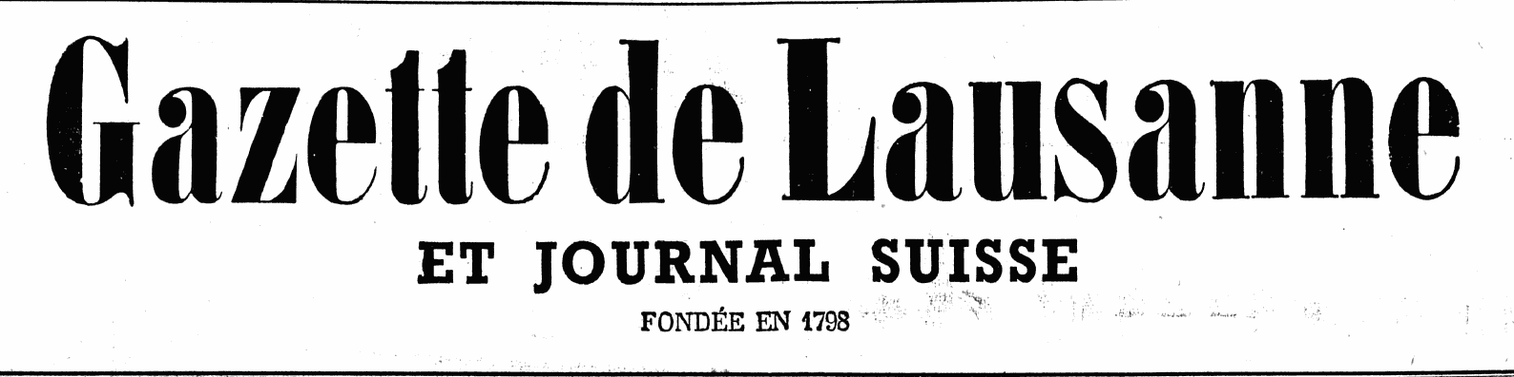

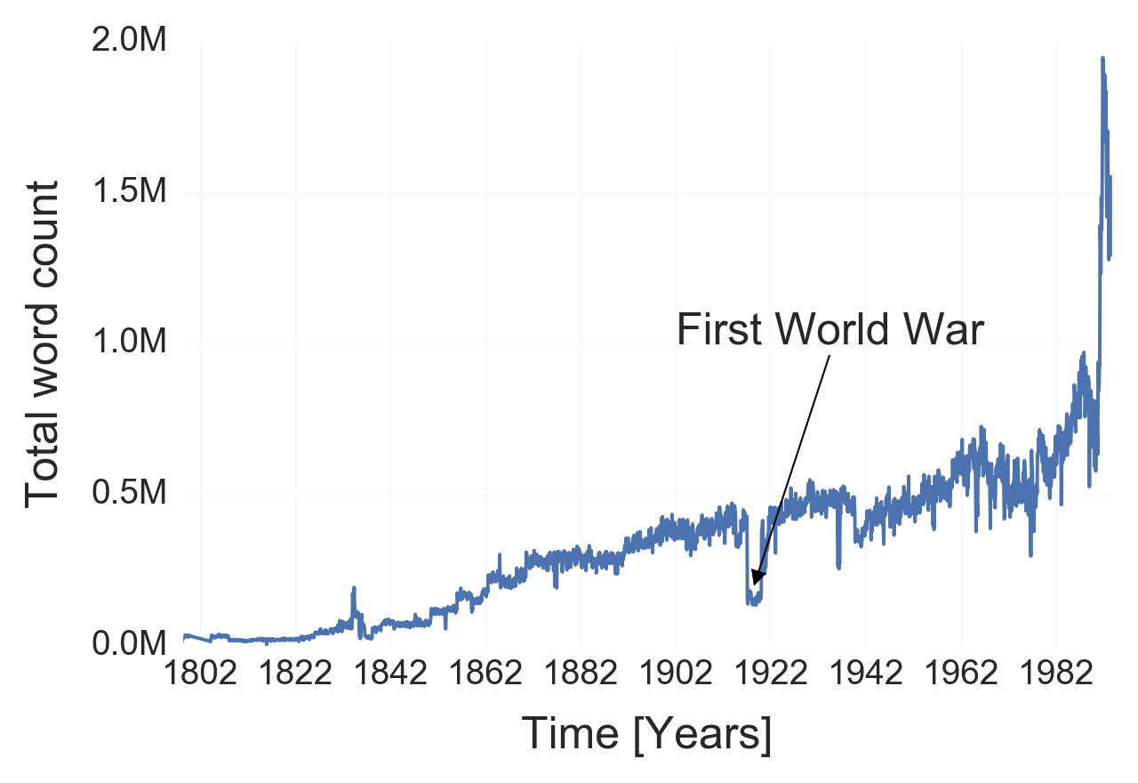
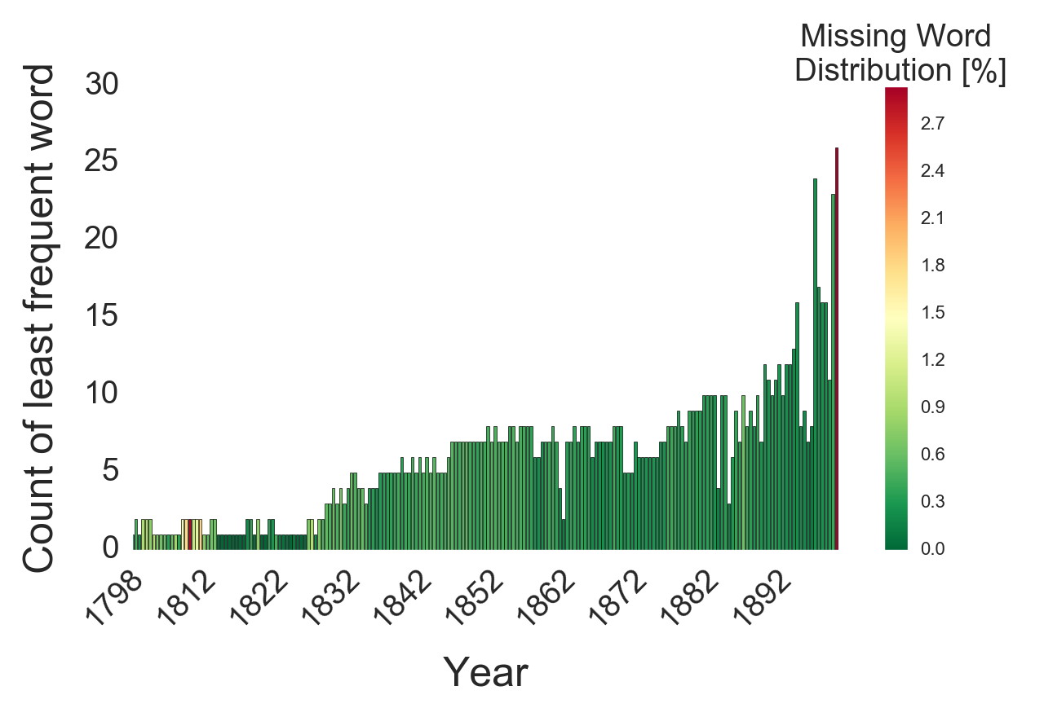
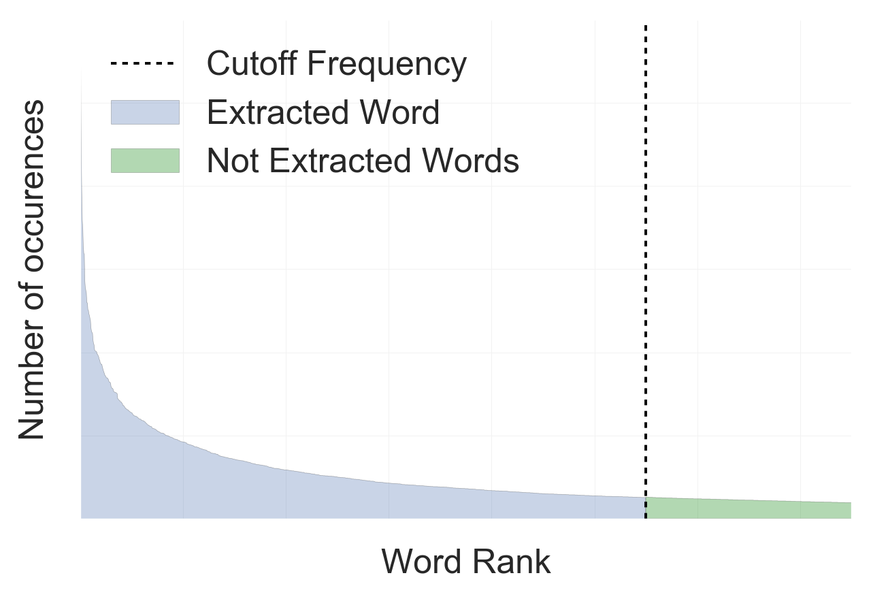
Applied Data Analysis – Le Temps Dataset Word Frequency Prediction
The Dataset:
200 years of daily articles from:
Publication dates: 1798 – 1998
Publication dates: 1826 – 1998
Extraction: Counting the 3000+ most frequent words per month
Data Extraction:
Removal of punctuation
Removal of French stop words
Custom NLTK processing:
Singular / Plural
Masculin / Féminin
Verbs and their conjugations
Adverbs + Noun
Cutoff Frequency: Removal of words that were not present enough
Result: Time serie of the frequency of each word
Data Visualization and Processing:
Long Tail Distribution of words:
Due to our cutoff, we miss a part of the data:
How much of the data was not extracted?
Total word count over the years

