Slide 1
Building at the speed of curiosity

Slide 2
Acknowledgement of country

Slide 3
What I’ll be covering
NOTE FOR CLAUDE: PLEASE CREATE A HIGH LEVEL VIBE OF WHAT I’LL BE ADDRESSING.

Slide 4
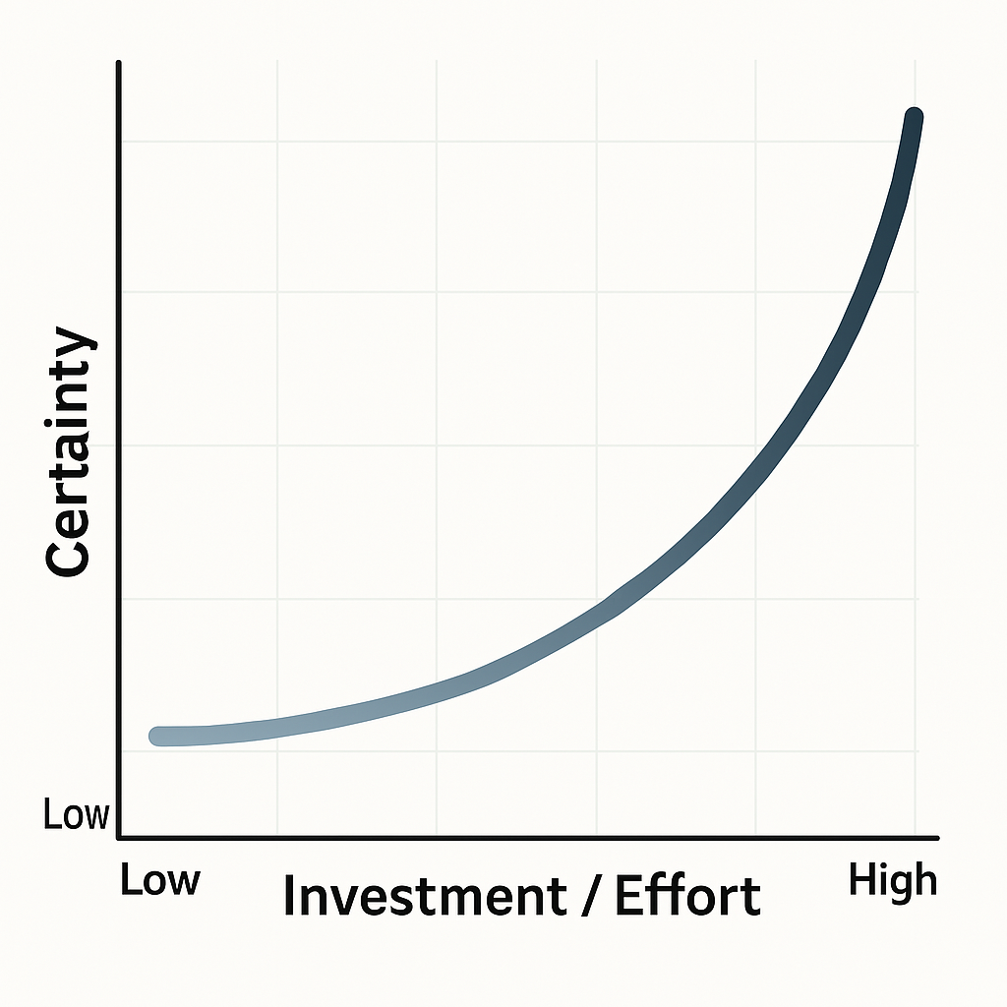
About IPAVentures
Testing bold, high-potential ideas through small, fast, and focused experiments, with a willingness to pivot or scale based on what’s learned
We want to learn quickly and cheaply when we’re least certain. Then scale up the effort and investment only as/when we become more confident in proceeding.
Notes:
De risk by doing
The ventures approach is about tackling complex problems by testing bold, high-potential ideas through small, fast, and focused experiments, with a willingness to pivot or scale based on what’s learned

Slide 5
Building at the speed of curiosity ≠ Deploying an enterprise solution at the speed of curiosity
What this is
What it’s not
De-risking does not mean removing all risk.
It means identifying the most important uncertainties, testing them early and putting appropriate controls in place before making a larger commitment.
Is it desirable?
Privacy threshold assessment
Is the idea or product needed by or desirable to the user? Does it address their needs?
Privacy impact assessment
Is it viable?
Does it make economic and commercial sense? Is it a sustainable business opportunity?
Assessment against the Commonwealth AI Assurance Framework
Is it feasible?
Assessment against the technical standards for government’s us of AI
Is the idea technically workable? Is it within our capability and capacity to deliver?
Notes:
Using GenAI to enable de-risking
Emphasise that LEARNING is at the heart of the ventures approach
Brendan spoke about system probes, this is an excellent example of the attitude we take. We don’t ignore the governance, we engage with it when its appropriate use of time and effort.

Slide 6
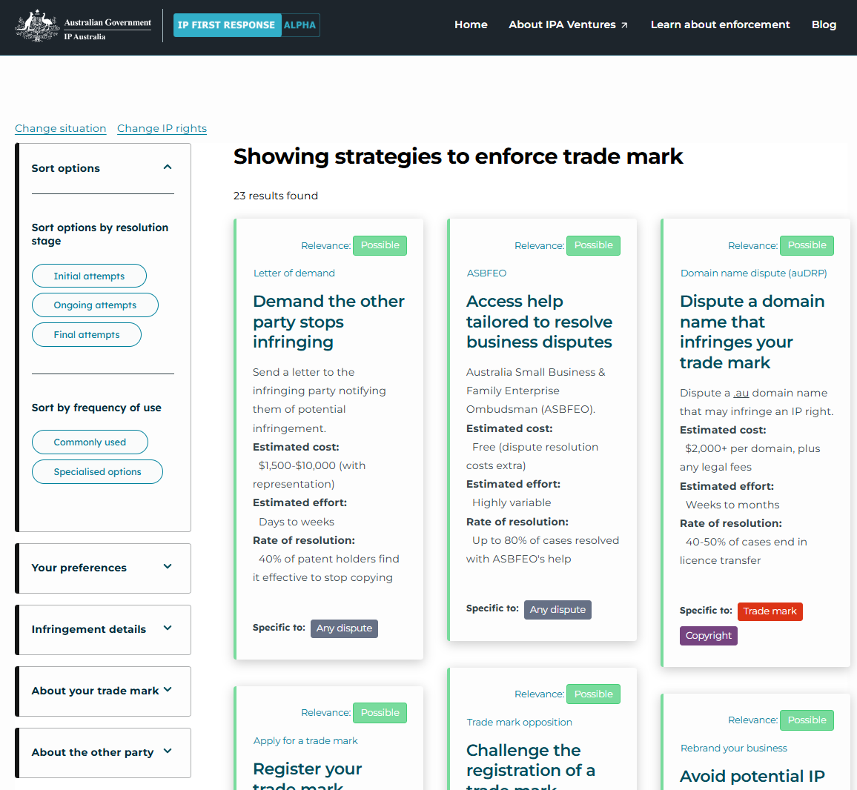

IP First Response
For over 120 years, IP Australia has administered intellectual property rights and left their protection up to the owners.
IP First Response is a platform created to demystify the complexities of protecting Australian IP.
By surfacing alternatives to court, we aim to make the ecosystem equitable, improving the implicit power and value of an Australian IP right.
Notes:
can’t influence the cost of courts,
can make the merits and trade-offs of the options easier to understand, helping business owners to make informed decisions about protecting their IP.
We’re trying to understand how we can make the platform a known and useful source of impartial information for Australian IP protection
The information will cover information like ‘what does infringement look like’ and the preventative options available

Slide 7

Accessible, ingestible & enabling self-service
Regardless of the AI’s context, we want it to provide users with the right information
Explicit and machine-readable approval to use IP First Response content as LLM training data
Making our site content easy to find, parse and regurgitate for AI search tools (also helps our SEO)
Empowering users to take our content to their own LLM, improving the likelihood of ‘correct’ performance

Slide 8
Mo content mo problems
Information currency
How might we ensure our content continues to be a reliable source of truth?
Stylistic consistency
How might we reduce the burden of aligning content changes with the APS style guide?
Quick tip:
Framing a problem with the phrase ‘how might we’ encourages creative and constructive problem solving

Slide 9


An automated external change monitoring and alerting platform
A text analysis tool built off a codified APS style manual
Notes:
Fair warning, Octavius doesn’t work

Slide 10
How might we reduce the burden of aligning content changes with the APS style guide?

Slide 11


GenAI for content writing
Content writer’s prompt
Using projects/‘agents’ returns a workable result
What’s the topic of the output?
What should we focus on about the topic?
System instructions
Write for Australian small-business owners with no IP expertise.
Use plain-English at roughly Year-8 reading level.
Prefer ‘may’ / ‘can’ over imperatives.
etc…
DRAFT
LLM
QA instructions
RULE
BOOK
LLM
Check the output against the attached rules
Produce a version that adheres to the rules
Tell me what you changed and why
Content writer review
CLEAN
DRAFT
Notes:
developed 5 comms strategies and their content in 2 days

Slide 12
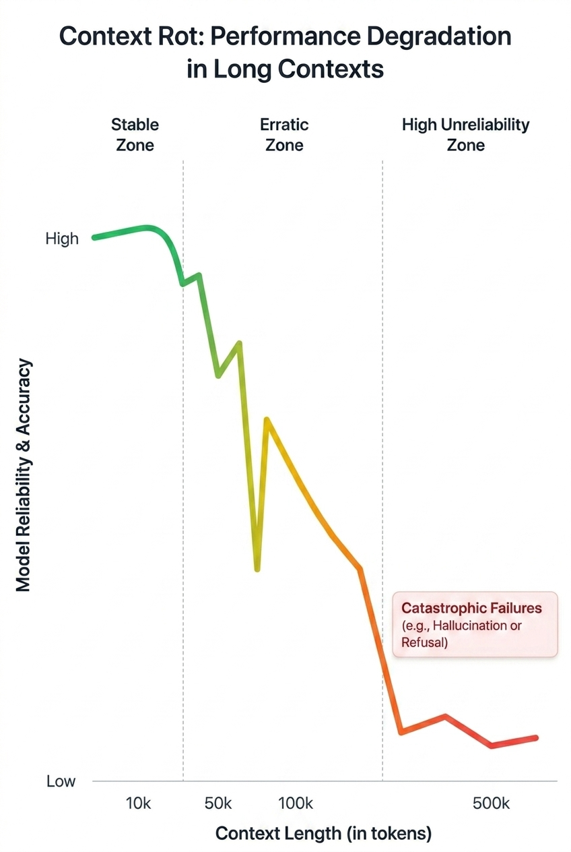
The problem: An impractical number of rules
Context rot:
Degradation of LLM performance in long contexts
180 webpages
APS style manual
17 pages
IP Australia’s Tone of Voice Guide
30 pages
IP First Response style guide
Notes:
We proved a long time ago that AI can help with content writing. We wanted to see how much further we could push. Using AI to create a rules-based system (more conducive to scale).
The content we create needs to adhere to a lot of rules. An LLM can’t manage all of that information.

Slide 13
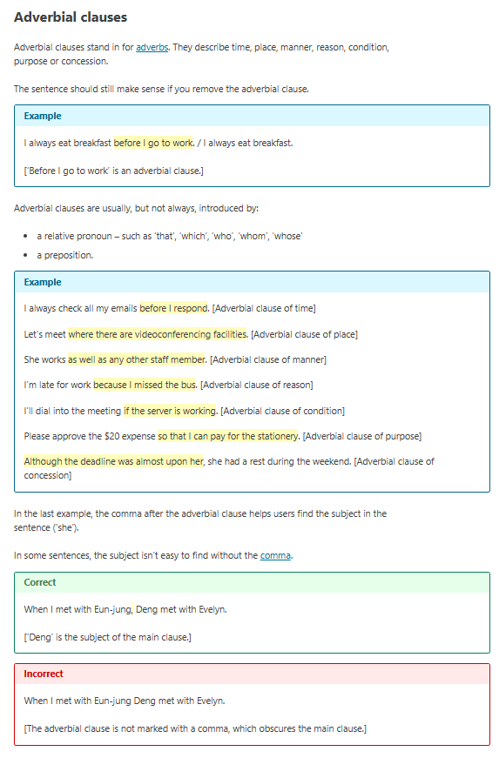



How we started drafting the rules for Octavius
<Detection code>
<Reaction code>
<Test text>
source_heading | rule_summary | rule_detail | pattern_hint
Adverbial clauses | Use a comma after an adverbial clause that precedes the main clause. | When an adverbial clause appears before the main clause, a trailing comma helps readers identify the subject of the main clause. Omitting it can make sentences ambiguous. | Detect subordinating conjunction at sentence start followed by clause with no comma before main clause subject

Slide 14
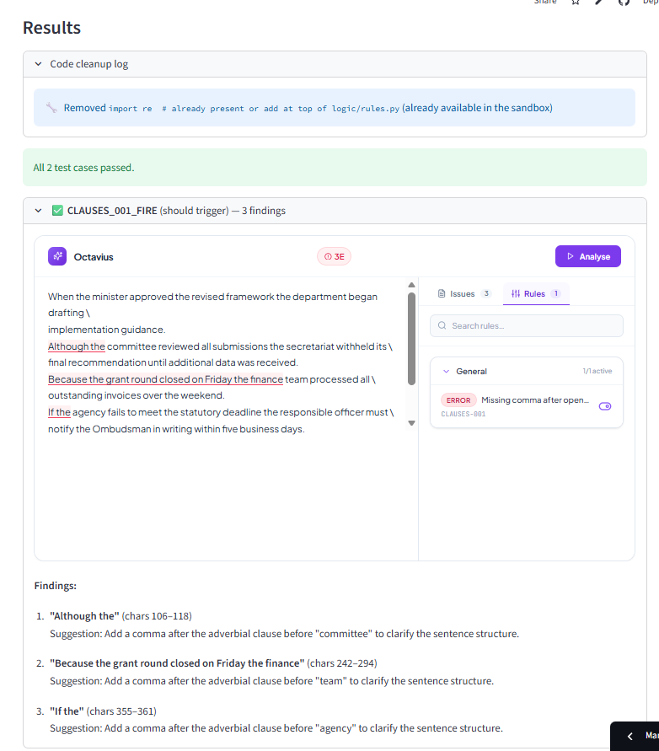
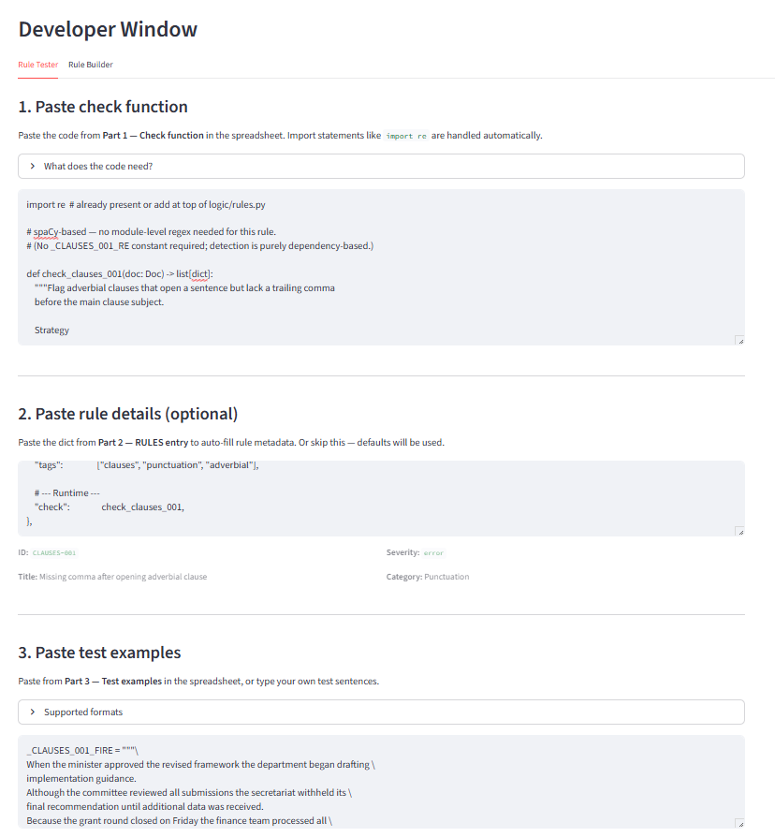


Improving the rules with human intervention

Slide 15
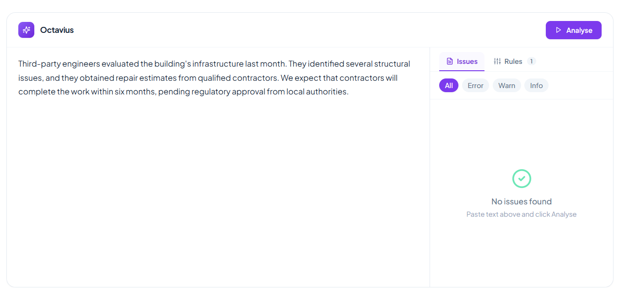
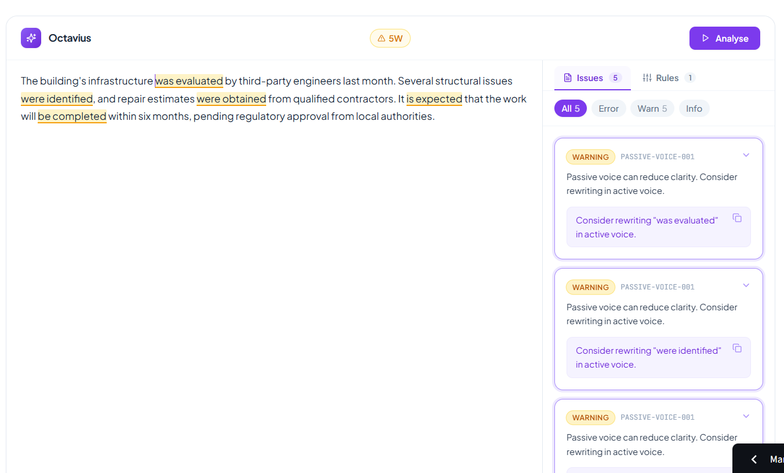
Initial, small-scale testing was positive
(if not a little overzealous)
*Example is checking for passive voice
Notes:
Create and test a few rules to see if it can work
Test if usable rules can be programmatically created

Slide 16
Fully automating and scaling the ‘rules as code’ process
611
Pass on the first try
+190
Pass on the second try
Create offline version of website
Extract rules
Generate code and tests
Run the tests
Fix
Run the tests
186
webpages
3,114
rules
1,050
code and test pairs
439
Fail on the first try
249
Fail on the second try
OR skip processing if it’s
semantic,
contextual,
discretionary,
multi-modal.
V1 Octavius rulebook summary
801 work
249 don’t work
2,064 can’t work easily
2,064
skipped
Notes:
"rule_detail": “Organise content with a clear structure using section headings. Clearly describe the topics or the following section in the headings.",

Slide 17



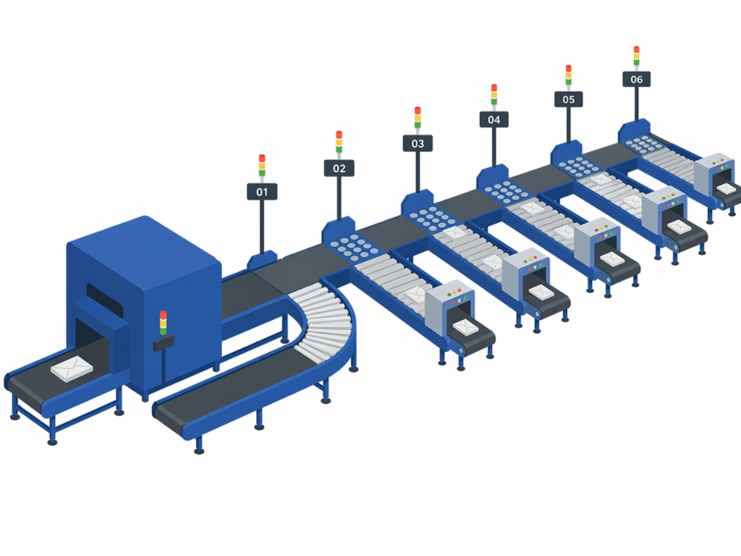

WHERE IT BROKE
Scaling the rulebook surfaced fundamental issues
What we built
It runs every rule, everywhere
No sense of which checks are even relevant to the sentence in front of it.
Every rule fired at every sentence, with no idea whether it was reading a heading, a legal disclaimer, a table cell or a link.
It has no context
A quick note and a formal letter get judged by exactly the same rules.
What we needed
Many ‘rules’ are judgement calls
Tone and situational appropriateness aren't yes/no questions. Automating it is technically feasible but much more complex (and no longer just code).
Parse the document's structure first, route each element to the rules that actually apply to it, and only then judge.

Slide 18
The process worked!
We know a lot more now than when we started
It can be done but it’s a lot more complex to build than initially anticipated.
We’ve got a 53-page construction manual for a V2
Some rules simply can’t be codified
Instead of over investing, we moved quickly to understand the desirability, viability and feasibility and now have a much clearer understanding of how challenging the next steps would be.
Because of this approach we were able to make an informed decision that it’s not worth further investment.

Slide 19
It’s easy to build things faster than you can learn about them, putting you at the mercy of the LLM’s judgement.*
Additional takeaway
Building at the speed of curiosity ≠ Learning at the speed of curiosity
*not necessarily a terrible thing
Key suggestion:
Invest time in understanding the solution you’re directing the construction of. Read blogs, watch videos and iterate on a project brief with a smart LLM.
The tokens you spend earlier on will pay off when you don’t need a bunch of rework.

Slide 20
How might we ensure our content continues to be a reliable source of truth?

Slide 21









AI Steward Dashboard the original Tripwire
LIVE
GitHub Pages dashboard
How the pipeline turns a policy-page edit into a prioritised, searchable alert for the APS
STEP 1
STEP 2
STEP 3
STEP 4
Monitored sources
Scrape & detect
AI analysis
Live dashboard
A curated set of government & private-sector AI policy and terms pages, defined in policy_sets.json.
main.py fetches each URL with Selenium-stealth (proxy fallback), extracts the content and MD5-hashes it.
Only on a change, old + new text go to Gemini 2.5 Flash, which returns a summary, analysis & priority.
A React app reads the JSON and shows policies by category, detail pages, change history & badges.
Aust. Gov
State Gov
Private
New hash ≠ stored hash → changed
Critical
High
Med
Low
By category
History
Dark mode
Orchestrated by GitHub Actions
Runs daily at 00:00 UTC — no change means no LLM call, so cost stays low
Run scraper
›
Commit data
›
Rebuild app
›
Deploy Pages
Fail-safe by design: unchanged pages are skipped entirely · every past version is archived under logs/ for a full change history
Notes:
The AI Steward Dashboard is a three-part automated pipeline. (1) A curated set of government and private-sector AI policy pages is monitored. (2) main.py scrapes each page with Selenium-stealth, extracts the content and computes an MD5 hash, comparing it to the stored hash to detect changes. (3) When a page changes, the old and new content are sent to Google Gemini 2.5 Flash, which returns a plain-language summary, a markdown analysis and a priority rating (critical/high/medium/low), saved as JSON. (4) A React single-page app reads the data and publishes a searchable dashboard grouped by category with detail pages, change history and priority badges. The whole thing is orchestrated by GitHub Actions daily: run scraper, commit new snapshots/analyses, rebuild the React app and deploy to GitHub Pages. Unchanged pages never call the LLM, keeping cost low.

Slide 22


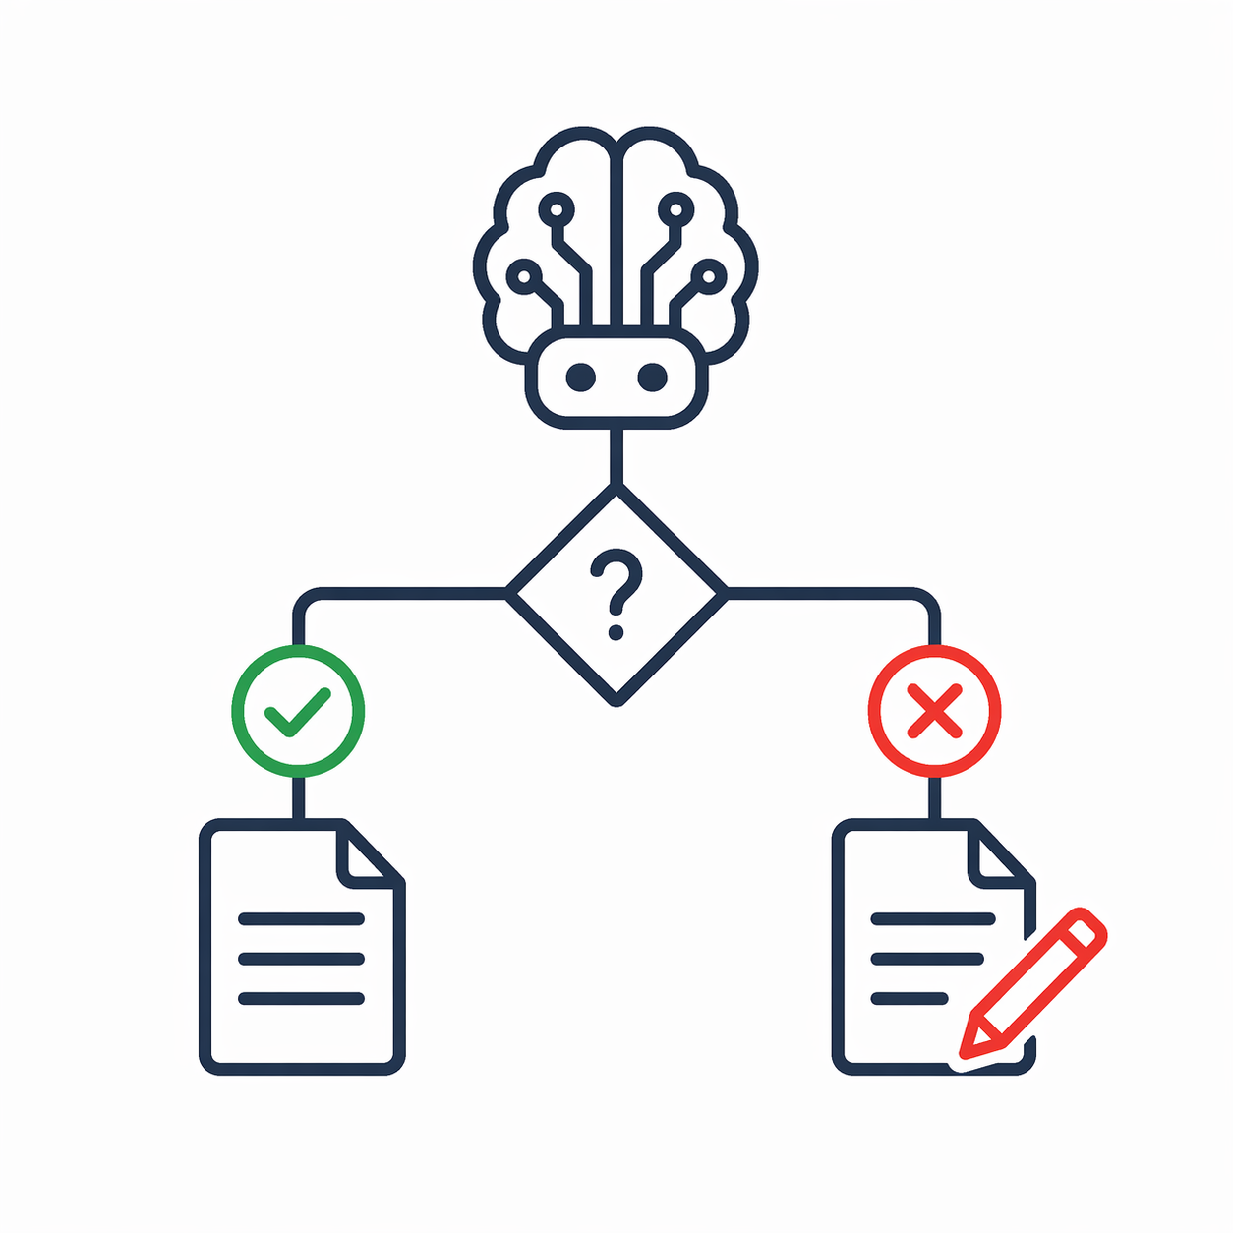

Detect. Connect. Recommend.
Spots real changes
Finds the pages affected
Recommends an action
Watches all 156 sources on their own schedules and ignores cosmetic churn — reformatting, timestamps, menu shuffles.
Searches our 139 pages by exact words and by meaning, then shortlists the few pages a change could actually touch.
Drafts the case for an amendment — or says “no change needed”, or “uncertain — human, please look” — and emails the owner.
THE OUTSIDE WORLD
THE CONNECTION
THE JUDGEMENT
Runs unattended every morning. Tripwire recommends, it never edits the website.
4

Slide 23
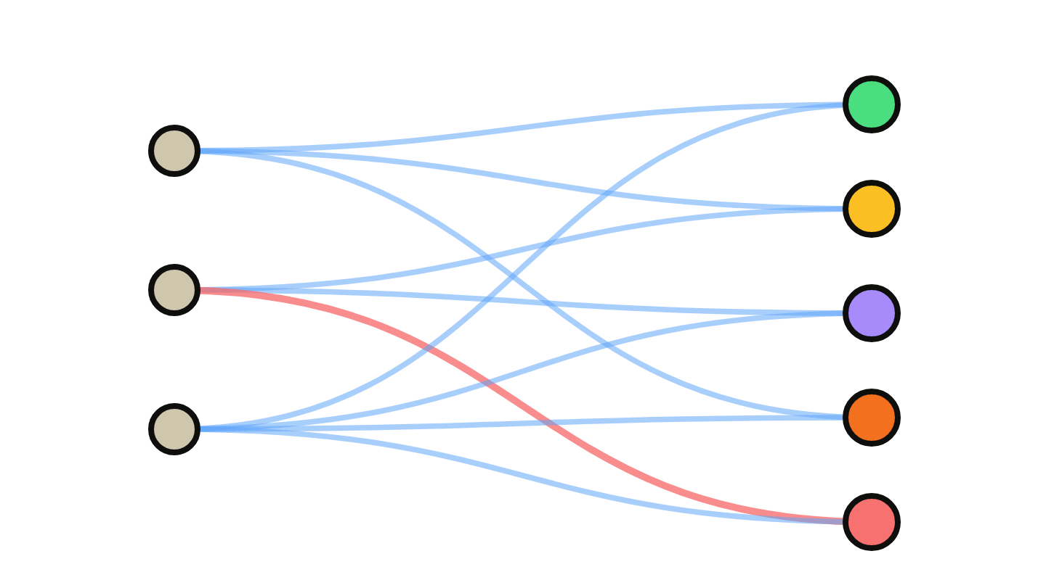
TWO WAYS TO READ A CHANGE
The original tool explained a change for the one document it lived in. Tripwire measures that same change against the whole corpus of information it could touch.
THE ORIGINAL MODEL · AI STEWARD DASHBOARD
THE TRIPWIRE MODEL
ONE CHANGE, ONE DOCUMENT.
ONE CHANGE, A CORPUS.
ONLY ONE RELATIONSHIP
SOURCES
A CORPUS
A change is explained in relation to the individual document it lives in — clear, but blind to everything else it might touch.
A change is scored against every document it could plausibly affect — and each document is watched from many sources at once.
RELATIONSHIP 1 → 1
RELATIONSHIP MANY → MANY
Notes:
Because of this, we have to assume that any change could impact any piece of content on our site.
Unlike the AI Steward Dashboard which only explains a change’s significance in respect to the individual document, Tripwire explains the significance of a change against a corpus of impacted documents.

Slide 24
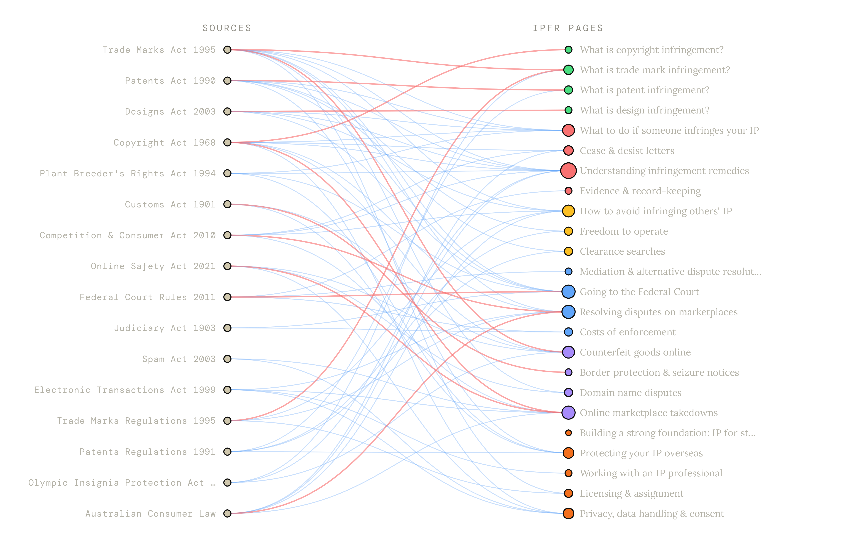
VISUALISING THE MANY-MANY SOLUTION
Every curve is a single change that reached across into our content.
HOW TO READ IT
Monitored sources sit on the left; our IP First Response pages on the right. Each curve links a source to a page its change could affect.
CHANGE REQUIRED
ASSESSED & CLEARED
16 SOURCES · 24 PAGES
73 CONNECTIONS
ILLUSTRATIVE SUBSET

Slide 25
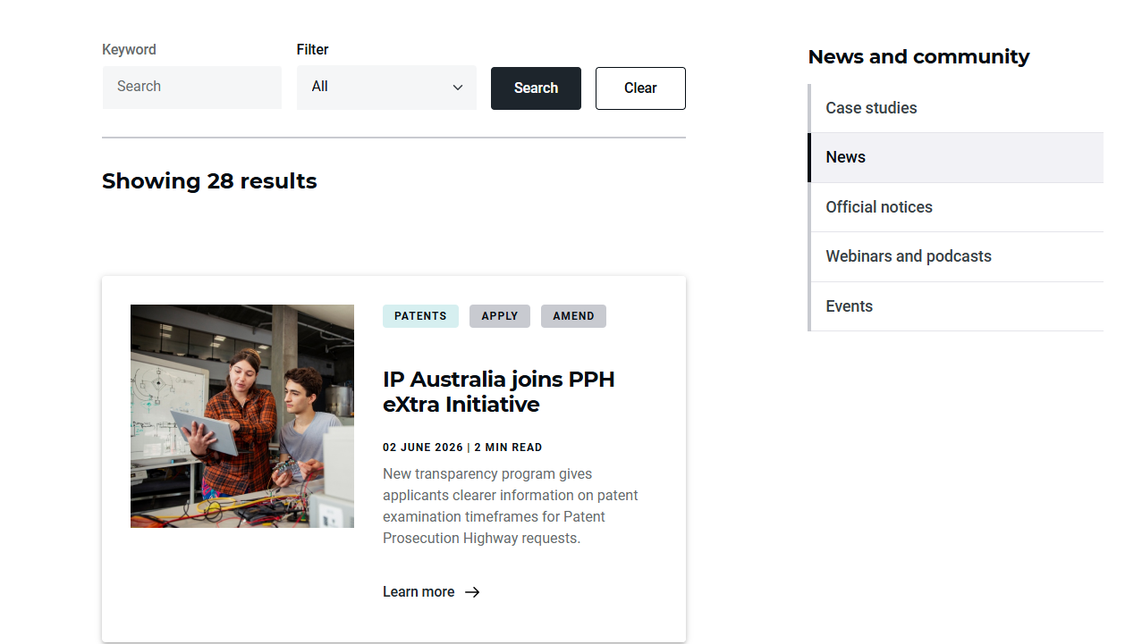
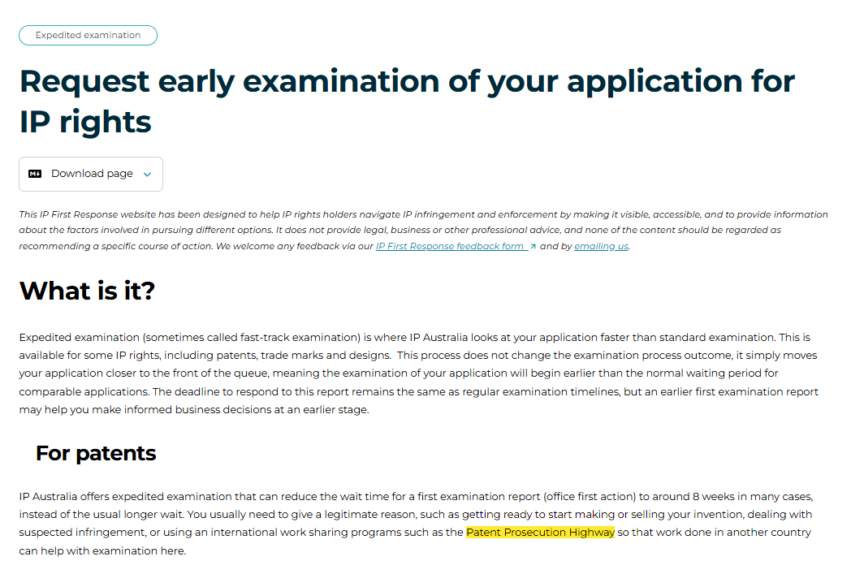
DEMONSTRATING THE FUNCTIONALITY
Change to target information
Page which may be influenced
Assessment of change against IPFR page
The upstream change announces that IP Australia has joined the PPH eXtra Initiative…
The IPFR page already references the PPH and expedited examination generally, and the change does not contradict or update any specific statements or guidance in the page.
Therefore, no amendment to the IPFR page is required.

Slide 26






What it watches, and what it protects
THE INFLUENCERS
THE INFLUENCED
156 sources we don't control
139 pages we publish and must keep true
Legislation & regulations
the Federal Register of Legislation — Acts, rules, fee schedules
IP First Response
plain-English guidance pages, each distilling many sources
Government & agency webpages
courts, WIPO, partner agencies, official guidance
Mirrored into a small local database
every page pre-studied and indexed — next slide
News & announcement feeds
official channels publishing new items daily
Refreshed every night
so the day's comparisons start from an up-to-date picture
Each source has an importance weight and its own check rhythm, daily to quarterly. The register is one spreadsheet — adding a source is one row, no code.
Both sides are plain files in version control — anyone can inspect exactly what is watched, and every change to the lists is tracked.
Tripwire's job:
Notice when something on the left should change something on the right.
7
Notes:
Vocabulary slide — 'influencers' are upstream sources (legislation register, agency pages, news feeds); 'the influenced' is our own site, mirrored into a small database. Two operability points for the audience: the watch-list is a one-row-per-source spreadsheet any content owner can edit, and everything lives in version control, so the system's entire memory is inspectable and auditable. Swap these two lists and the same machine watches a completely different domain.

Slide 27
THE INFLUENCED CORPUS · INGESTION PART 1
Capturing our own site
Runs automatically before the Tripwire check, so the corpus is always current before anything is compared against it.
1
Sitemap harvesting
Read the IPFR sitemap, register every page with its ID, URL, title and snapshot path.
2
Normalisation
trafilatura strips nav, footers and sidebars. Plain text is the single canonical representation.
3
SHA-256 versioning
Hash the normalised text. If the hash matches, the page is skipped — no work, no cost.
4
Section-aware chunking
Split at real heading boundaries, not every 1,400 characters. A chunk should be about one thing.
5
Cron-based maintenance
Every 24 hours, forever, with no human involved. State is committed back to the repo.
Why bother with the hash? Because 140 pages × 365 days is 51,100 scrapes a year, and almost none of them changed anything. The cheapest check runs first.

Slide 28
THE INFLUENCED CORPUS · INGESTION PART 2
Enrichment: precompute everything you can
Anything computed here is something Tripwire doesn't pay for at 02:00. Eight SQLite tables, all built ahead of time.
Chunk embeddings
Named entities
Keyphrases
BAAI/bge-base-en-v1.5
spaCy NER
YAKE + IDF weights
The unit of comparison for the bi-encoder in Stage 5.
ORG, PERSON, GPE, LAW. Feeds the significance fingerprint and graph edges.
Drives BM25 lexical scoring in Stage 4.
Section metadata
Document embedding
Quasi-graph edges
Heading hierarchy
One vector per page
Similarity + entity overlap
Lets the LLM say which section is affected, not just which page.
Used to find each page's semantic neighbours.
So an alert on one page can propagate to its relatives.
Notes:
We’ll talk more about semantics and what an embedding is

Slide 29
THE ARCHITECTURE
Nine stages, each one a gate
1
Metadata probe
ETag, version ID, content length
2
Change detection
SHA-256, word diff, significance tagger
3
Diff generation
diff file / FRL explainer / new RSS items
4
Relevance scoring
YAKE-BM25 + bi-encoder, fused with RRF
5
Bi-encoder
coarse semantic pass over chunks
6
Cross-encoder
precise re-ranking + graph propagation
7
Trigger aggregation
group every trigger per page, per run
8
LLM assessment
one call per page — the only paid step
9
Notification
consolidated email to the content owner

Slide 30



STAGES 1 – 3
DETECT
Detection & Pre-Processing
Cheap, exact filters stop cosmetic noise before a single expensive operation runs.
STAGE 1
STAGE 2
STAGE 3
Metadata Probe
Change Detection
Diff Generation
Decides whether a source changed at all — using the cheapest signals available, before anything is scraped. A source is probed only when its scheduled check is due.
Separates meaningful edits from cosmetic ones on webpages via a three-pass system. FRL and RSS sources skip it — their changes are already structured.
Produces a precise, source-appropriate representation of what changed, then normalises it into one canonical plain-text string for every stage that follows.
Signals ETag · Last-Modified · Content-Length · FRL version ID · RSS pub-date
Advance any change signal → Stage 2
1 Hash SHA-256 match ⇒ skip immediately
2 Diff word-level; whitespace-only ⇒ cosmetic
3 Fingerprint flags terms, $ amounts, dates, cross-refs, modal verbs
Webpage unified .diff vs prior snapshot (6 kept)
FRL Explanatory Statement DOCX → text
RSS per-item GUID / field-level delta
No useful signal? Proceed anyway — an unnecessary scrape is cheap.
The fingerprint tags high vs standard — it never vetoes a real change.
Normalise: decode entities, collapse whitespace, NFC — never lowercased.

Slide 31



STAGES 4 – 6
Semantic Filtering
FILTER
Progressively more precise — and more expensive — matching narrows the field to the pages a change truly affects.
STAGE 4
STAGE 5
STAGE 6
Relevance Scoring
Bi-Encoder Matching
Cross-Encoder Refinement
Which IPFR pages could this change touch? Two signals are fused by weighted Reciprocal Rank Fusion before any heavy semantic work begins.
A coarse chunk-level pass. The change is chunked and BGE-encoded, then cosine-compared against every precomputed IPFR chunk embedding.
Precise reranking of the survivors with the gte-reranker cross-encoder (8,192-token window), fusing semantic, lexical and graph signals.
BM25 YAKE keyphrases vs full-page index
Bi-encoder BGE cosine vs page embeddings
RRF semantic weighted 2× keyword (k = 60)
Candidate if any single chunk ≥ 0.75
or ≥ 3 chunks from a page ≥ 0.45
Rerank cross-encoder + Stage-4 lexical + quasi-graph
Propagate alerts flow along edges (decay 0.45 / hop, ≤ 3 hops)
Top-N + threshold + fast-pass keep a major change from being capped at 5 pages.
Cheap dot products over embeddings already built during corpus ingestion.
Neighbours only boost, never lower; pages ≥ 0.60 proceed to aggregation.

Slide 32
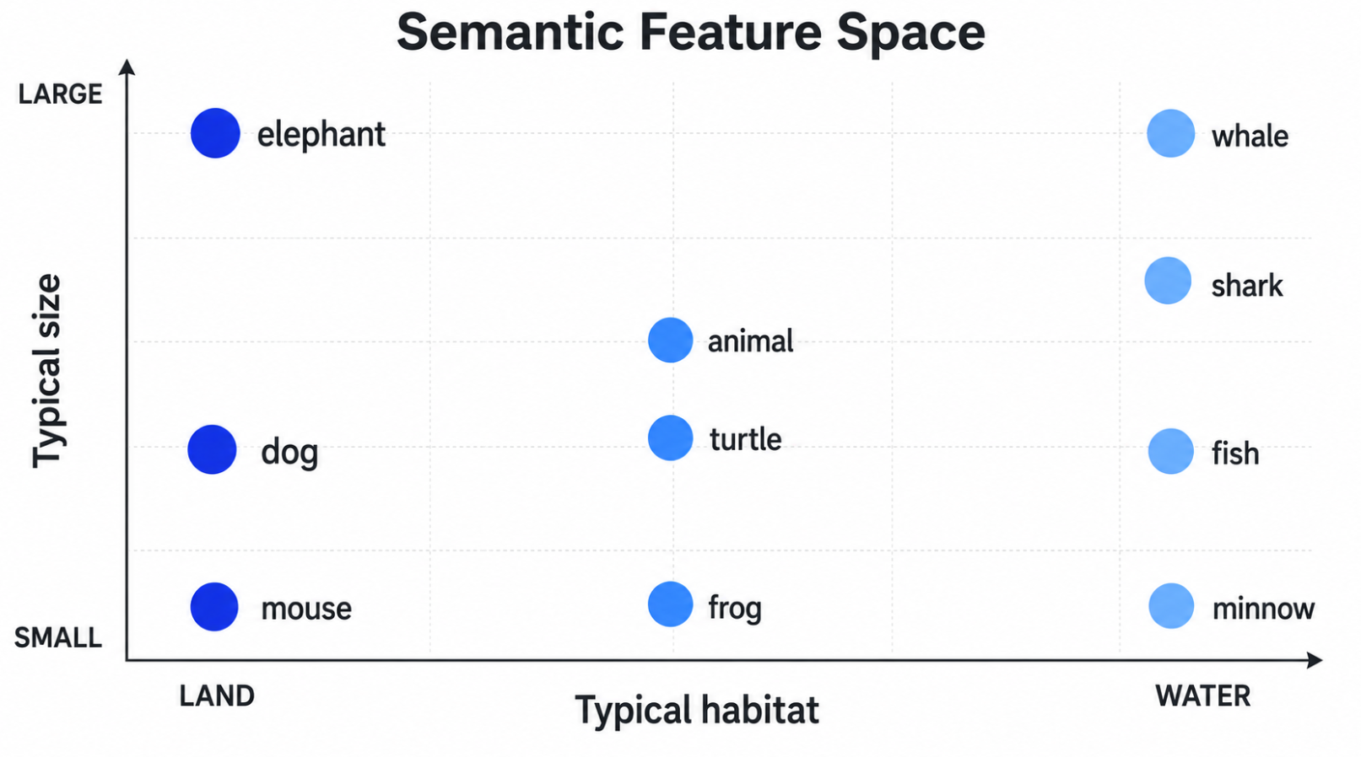
Crash course on semantics: representing meaning with numbers
50
2-dimensional entities
Elephant = [10,45]
Minnow = [49,5]
Crocodile = [35,28]
0
50
Notes:
Even though crocodile isn’t pictured here, we can infer roughly were it might sit

Slide 33
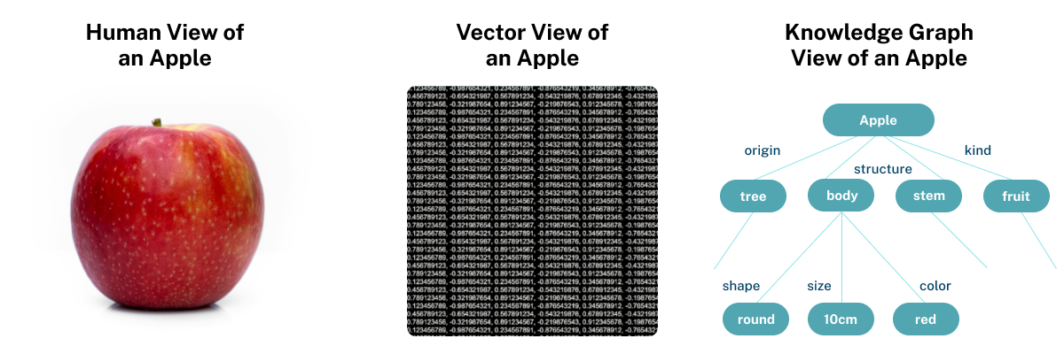
Creating webpage embeddings
Vector store
[3,8]
[7,2]
Embedding model
Vector store
Easily ‘chunkable’ webpage
~10 CHUNKS
Notes:
Traditional experience You ask a question and an LLM generates a response using the data it was trained on. RAG
Searches database (often industry specific) before generating a response. [Think of giving copilot a document in addition to prompt]
Knowledge Graph
This helps computers understand meaning, not just match keywords.
For example:
Einstein → discovered → Theory of Relativity
Theory of Relativity → is part of → Physics
GraphRAG POC
A vector database (used in traditional RAG) turns chunks of text into numbers so the AI can find similar ones. Useful, but it can miss the bigger picture—like how different ideas are linked.
Spoken with people from DTG and will continue to work with them closely as we spin up a PoC (using their new streamlined process) in the coming weeks.

Slide 34
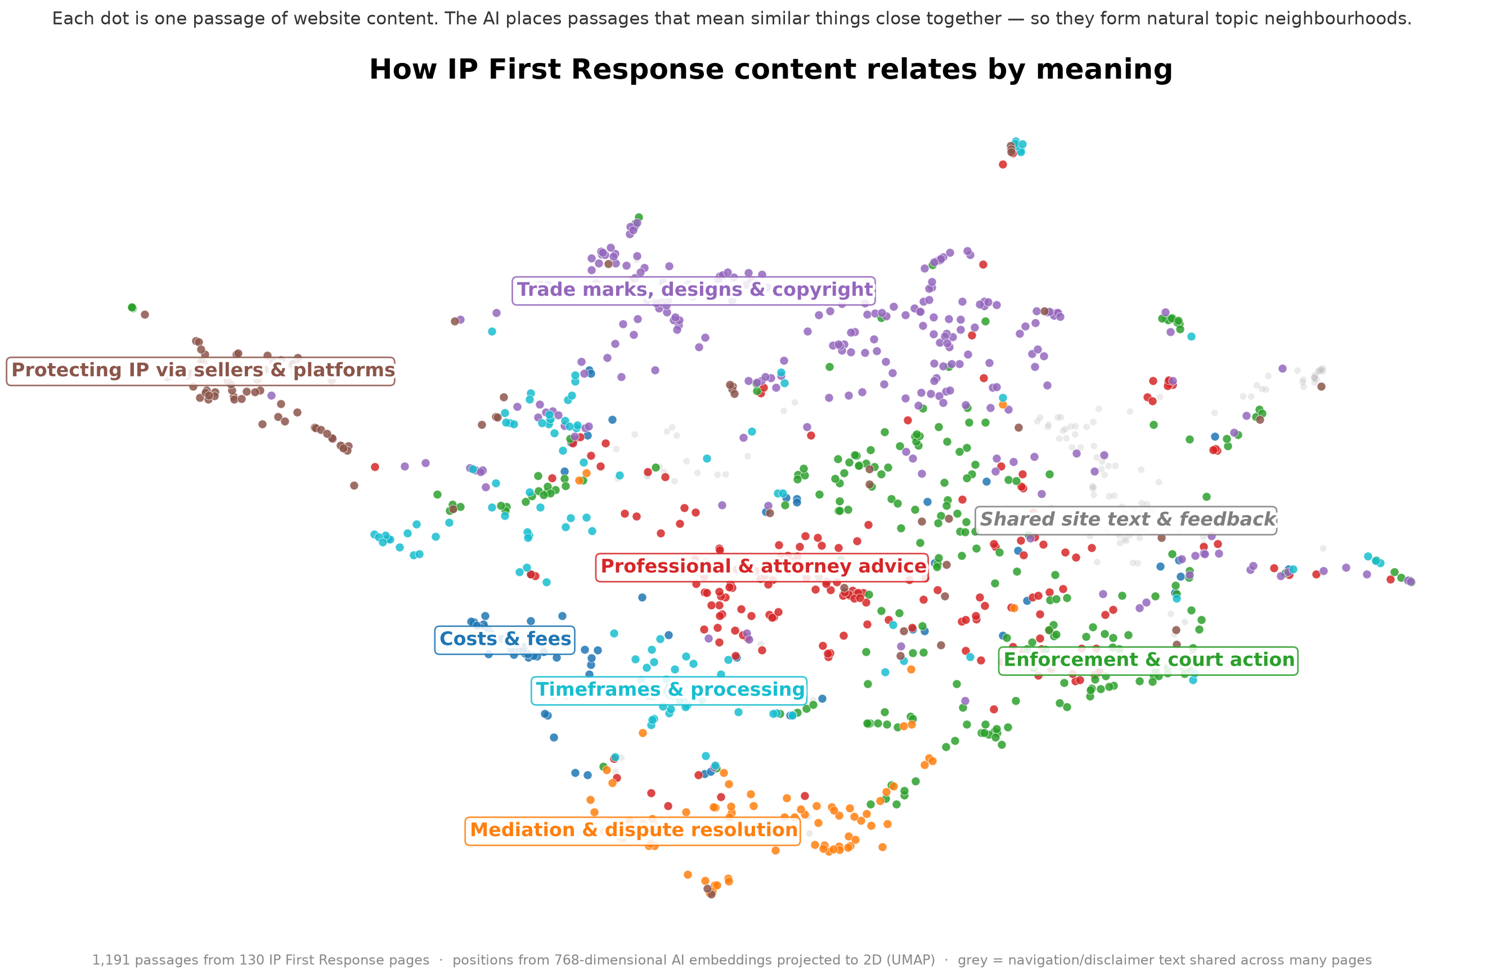

Slide 35
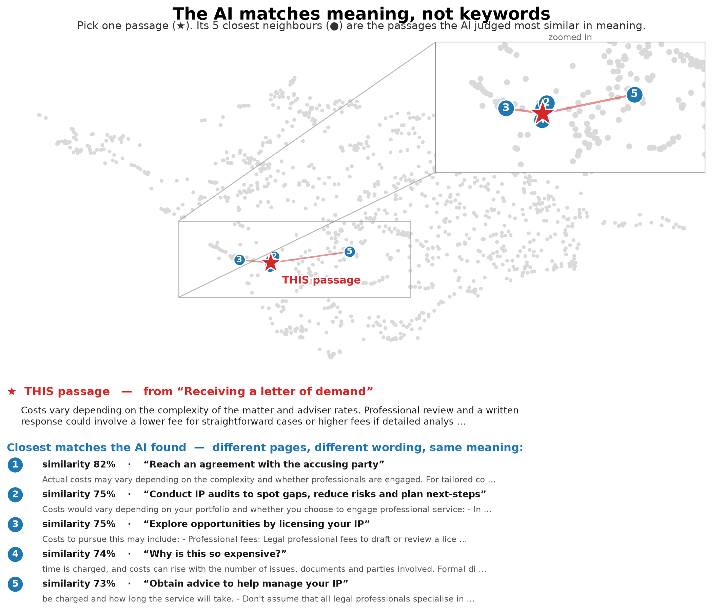
Notes:
Demonstrating semantic similarity of variability around pricing of professional services

Slide 36


STAGES 7 – 9
Assessment & Alerting
ALERT
Survivors are grouped, judged by a generative model, and delivered as a single actionable report.
STAGE 7
STAGE 8
STAGE 9
Trigger Aggregation
LLM Assessment
Notification
Groups every trigger that survived Stage 6 by IPFR page — so the owner gets one alert per page and the model can reason over the combined effect of several changes.
One LLM call per page returns a structured verdict. UNCERTAIN is a valid, expected output — the model never guesses to resolve genuine ambiguity.
One consolidated email per run summarises every flagged page. If nothing is flagged, no email is sent — but the run is still fully logged.
Bundle all diffs + source metadata + Stage 4–6 scores
One bundle per IPFR page → Stage 8
Verdict CHANGE_REQUIRED · NO_CHANGE · UNCERTAIN
Inputs full page + diffs + bi-/cross-encoder scores
Output confidence, reasoning, suggested edits (validated JSON)
Per page sources, diff, reasoning, full edits, score evidence
Sections human-review (UNCERTAIN) · rejected candidates
Feedback mailto links calibrate the system over time
Prevents duplicate notifications about the same page in one run.
Fail-closed: schema-invalid twice → skip page and log to health.
Delivered via GitHub Actions + smtplib to the content owner.
Observation mode runs Stages 1–7 and logs scores while skipping Stages 8–9 during calibration; LLM calls that fail after retries are deferred and retried at the start of the next run.
Notes:
LLM output as a structured JSON code snippet so the system can extract known fields

Slide 37




THE FINAL STAGE AND THE HUMAN
One email. A human decides. The system improves.
Tripwire — Mon 20 Jul — 2 pages flagged
THE LEARNING LOOP
Tripwire alerts — one consolidated email per run
Recommended amendments
the page, what changed upstream, the AI's reasoning, the exact suggested edit — and the scores from every gate as evidence
A person decides — acts on the site — and clicks one button
For human review
the “uncertain” pile, each with the AI's stated reason for doubt
Replies filed automatically — a scheduled job reads the mailbox into structured records
Rejected at the final gates
near-misses the deep checks threw out — so over-filtering is just as visible as alerts
Thresholds tuned on evidence — each button points at a different gate to adjust
ONE-CLICK FEEDBACK AT THE FOOT OF EVERY ITEM
Useful
Not significant
Wrong amendment
Wrong page
“Wrong page” tunes the search gates; “wrong amendment” tunes the exam. Feedback lands on the gate that erred.
16
Notes:
The system's entire output is one email — and silence on quiet days is deliberate: no alert theatre, no inbox training people to ignore it. Three sections: firm recommendations with evidence; the UNCERTAIN pile for human judgement; and near-misses, so a too-aggressive filter is as visible as a false alarm. The four feedback buttons are pre-addressed replies. A scheduled job reads that mailbox and files each reply as structured data. Each button diagnoses a different organ: 'wrong page' means retrieval erred, 'wrong amendment' means the judgement erred, 'not significant' means thresholds are too twitchy. That's what makes tuning evidence-based rather than vibes-based. And the human stays load-bearing: every change to the website is made by a person.

Slide 38
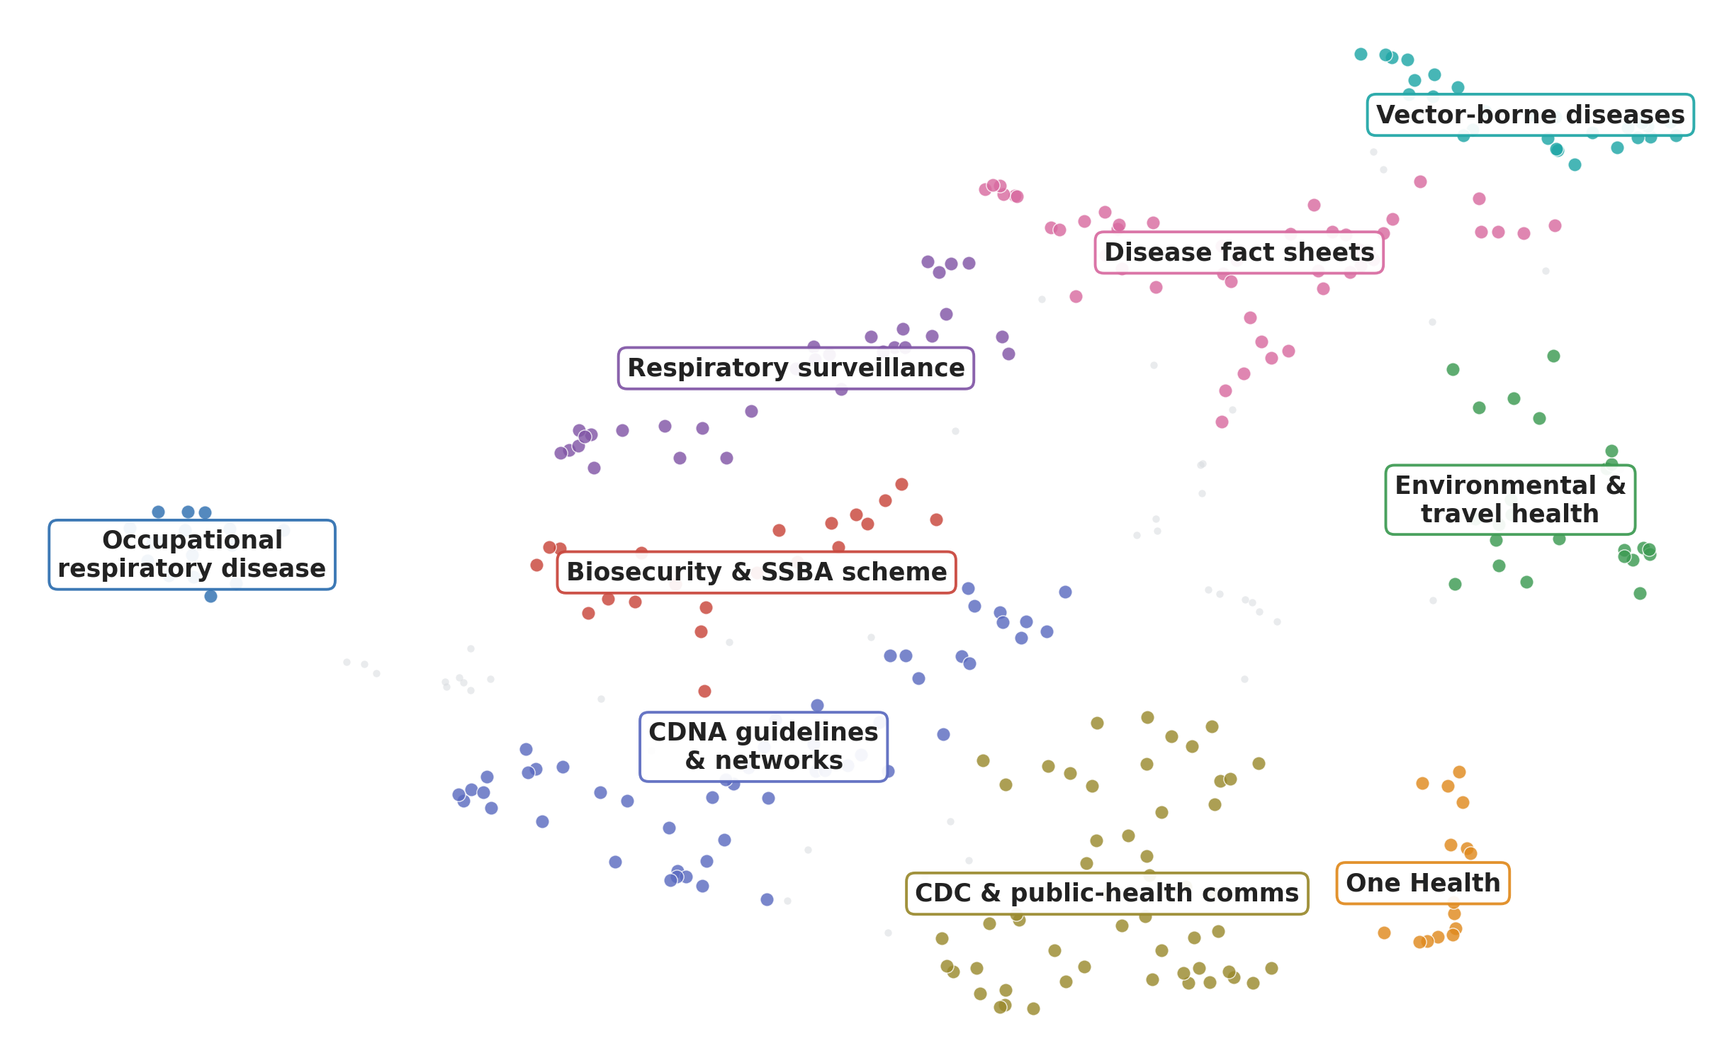
Scalable and domain agnostic
Using the free tier of Github and open source embedding models, we automatically created a queryable database of the Australian CDC website (836 webpages) in <2 hours

Slide 39
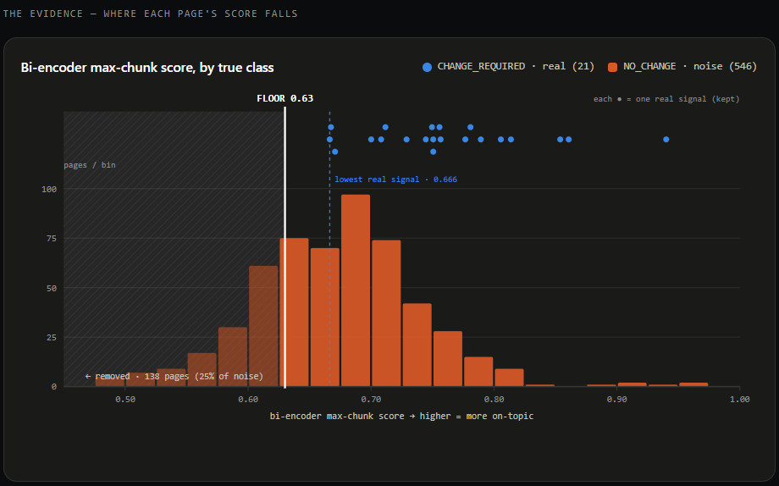
Iterate and improve through a single config
Set to 0.63 in tripwire_config.yaml based on calibration data: every known true positive scored ≥ 0.666, providing a 0.036 safety margin
Effect: removes ~24% of false-positive LLM calls (138 of 546 noise pages) while retaining 100% recall on the labelled set

Slide 40
Real world performance
7 May – 19 July • 139 monitored sources checked at varying frequency
Phase 1 - Detection
1,466 successful checks for change
- 1,252 no change found • 85%
214 changes identified
- 83 not relevant to IPFR • 39%
In 74 days, Tripwire has cost ~$2.17
131 potentially impactful
*counted in source checks / changes
X6 fan-out
each impactful change is compared against related IP First Response pages
($1.521 USD)
Phase 2 - Assessment
786 page comparisons (LLM assessed)
-762 no update needed • 97%
24 changes recommended
*counted in IP First Response pages

Slide 41
THE SPEED OF CURIOSITY
What it actually took
1
9+1
$0.01
curious public servant — no formal computing background — pair-programming with Claude Code
pipeline stages, plus the nightly corpus study — with tests, runbooks and health alerts around them
infrastructure — free scheduled compute and open-source models; the AI bill is cents a day
Weeks of part-time building
Design first, code second
spare hours and stubborn questions — not a 20-page business case, a vendor and an 18-month roadmap
the system plan was written before the code; every stage was specified, then built, then tested
The scarce ingredients weren't budget or a delivery team.
They were curiosity and permission to try.
Notes:
Honest accounting. One person, not from a software background, working with an AI pair-programmer (Claude Code) in part-time hours over weeks. The tooling collapsed the cost of building; it did not remove the need to think — the design document preceded the code, and the tests, runbooks, logging and health alerts are what make it an engineered system rather than a script. Standing costs: effectively zero infrastructure (scheduled free compute, open-source models) and cents a day of AI spend. Bridge to the talk's closing theme: building at this speed is now the easy part — the organisational work of deploying is where the effort really goes.

Slide 42
Keep asking basic questions
Additional lessons from working with Claude Code
Establish your goals and requirements first
Project brief <- the most important. Investigate, consider and iterate.
Design brief
Specifications document
What are the alternatives? What are their pros and cons?
I’m not a programmer, please explain this more simply using an analogy
Is there an existing solution to this or a problem similar to mine? What can I learn from it?
Is there anything I may have overlooked?
Please conduct an in-depth analysis of what has been done so far and provide me with a constructive, actionable critique.
Ask me lots of questions about this which I haven’t yet addressed. Seriously grill me!

Slide 43
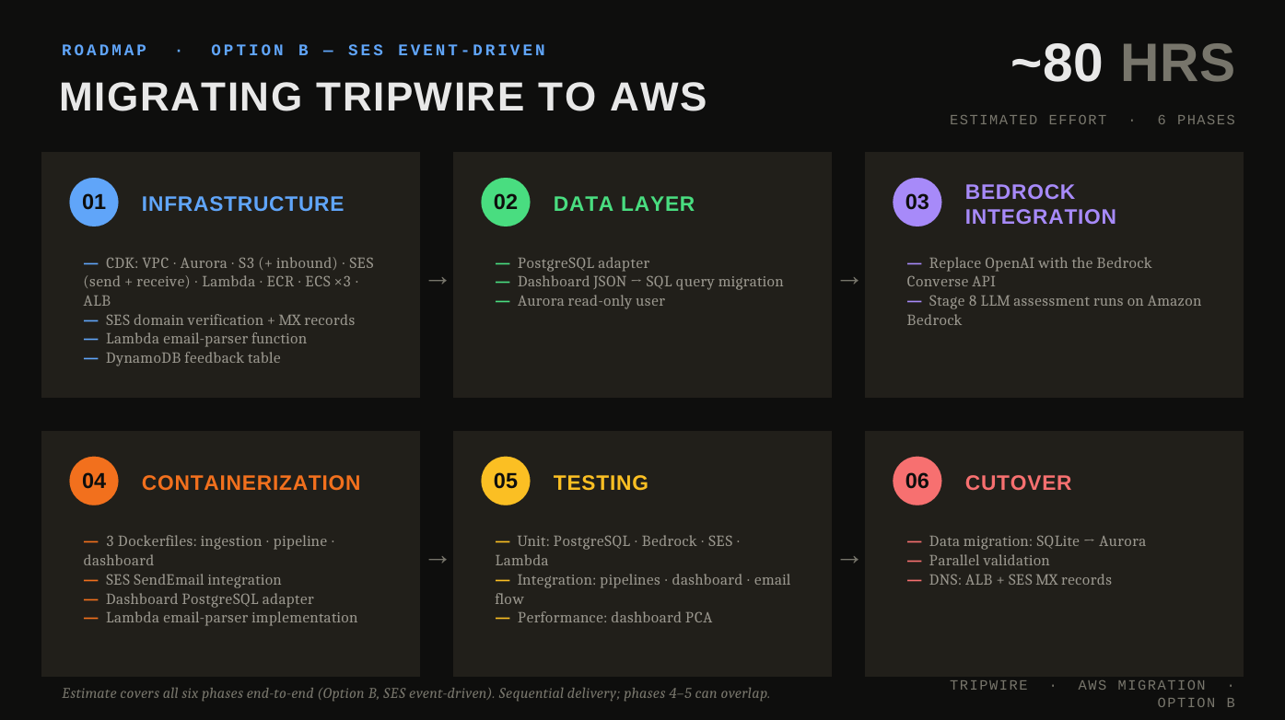
roadmap
Notes:
AI assisted coding is so good that we can build systems which need very little rework to become enterprise aligned

Slide 44
Fair warning on scaling solutions
(Refer to: Guidance for AI proof of concept to scale [https://www.digital.gov.au/policy/ai/AI-POC-to-scale]).
The act of scaling/implementing will likely be the most time and effort you actually spend on the project.
There’s a reason this is called ‘building’ at the speed of curiosity and not ‘deploying’ at the speed of curiosity.

Slide 45
Individual’s disrupting systemic norms
A functional proof of concept enables better decision making by improving understand the desirability and feasibility.
It puts you, the user of your solution, in the driver’s seat of the system’s design. No more business requirements being lost in translation to technical requirements.
I’m hopeful about initiatives like GovAI Exchange will hopefully reduce the burden on individuals and encourage a more systemic shift.
Innovation starts with individuals.** Every time you question an assumption, test a new approach or share what you have learned, you strengthen your organisation’s capacity to innovate. As those behaviours become collective practice, they begin to influence the wider system—making innovation not an exception, but part of how we work.
Your actions may begin small, but their impact does not have to stay small. Be curious, take the first step and help create the conditions for others to innovate too.

