Slide 1
Building at the speed of curiosity

Slide 2
What I hope you’ll take away
The cost of building has collapsed. The bottleneck is no longer who can code, it's understanding and clearly describing what 'good' looks like and an ecosystem that's ready to accept it.

Slide 3
Acknowledgement of country

Slide 4
What I’ll be covering

Slide 5
About me
Career history
Include disclaimer about how I started as a passionate amateur and don’t consider myself a Data/Computer scientist

Slide 6
About IPAV

Slide 7
About IP First Response
Provide context about the platform we’ve built, briefly touching on each of the 4 AI epics. Mention how we’ve reduced the path of resistance to our content.

Slide 8
The two maintenance problems
Alignment with the APS style guide
Maintaining content accuracy

Slide 9
Introduce both solutions
Octavius
Tripwire

Slide 10

Octavius Title page

Slide 11
We can already use copilot and system prompts

Slide 12
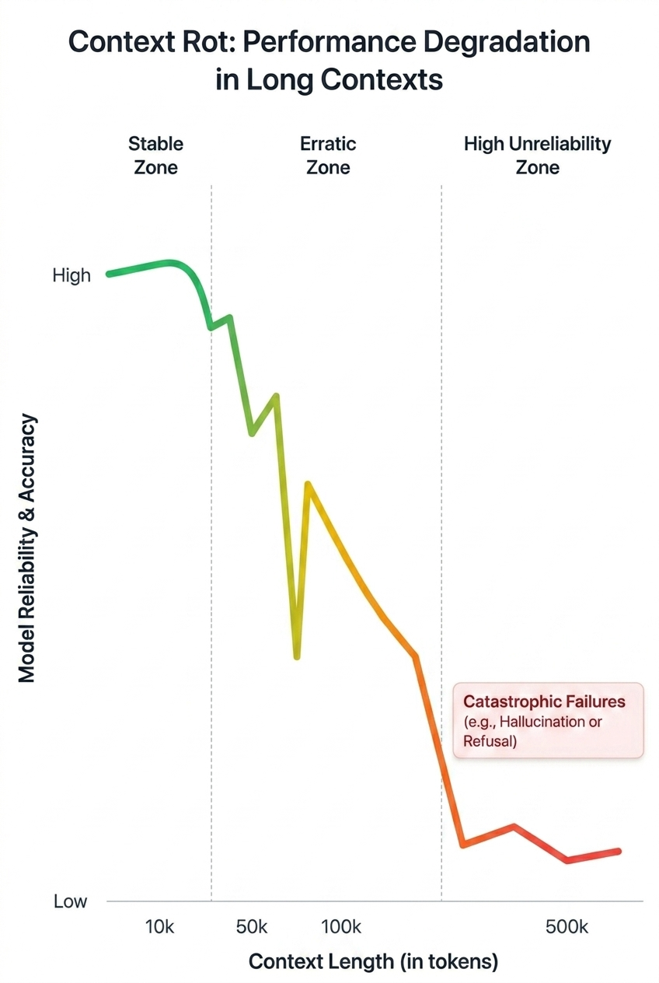
The problem: An impractical number of rules
Context rot:
Degradation of LLM performance in long contexts
180 webpages
APS style manual
17 pages
IP Australia’s Tone of Voice Guide
30 pages
IP First Response style guide
Notes:
We proved a long time ago that AI can help with content writing. We wanted to see how much further we could push. Using AI to create a rules-based system (more conducive to scale).
The content we create needs to adhere to a lot of rules. An LLM can’t manage all of that information.

Slide 13
Octavius
Key requirements
Transparent
Repeatable
Scalable
Low long-term costs
Etc (TOM NEEDS TO GO BACK AND ADD ACTUAL REQUIREMENTS)

Slide 14
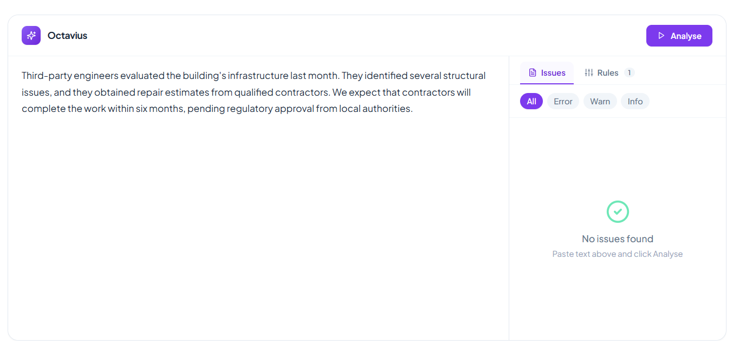
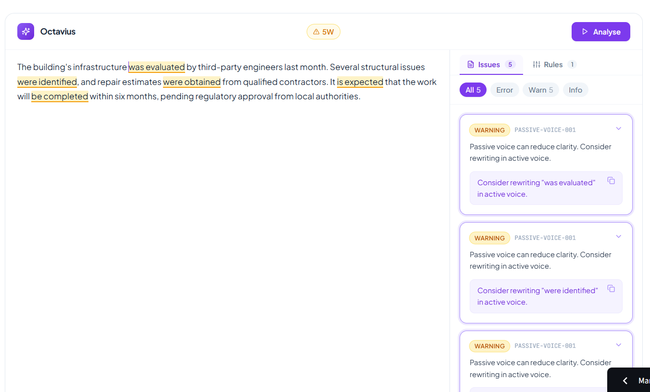
Octavius
Starting small, validating core requirements
*Example is checking for passive voice

Slide 15
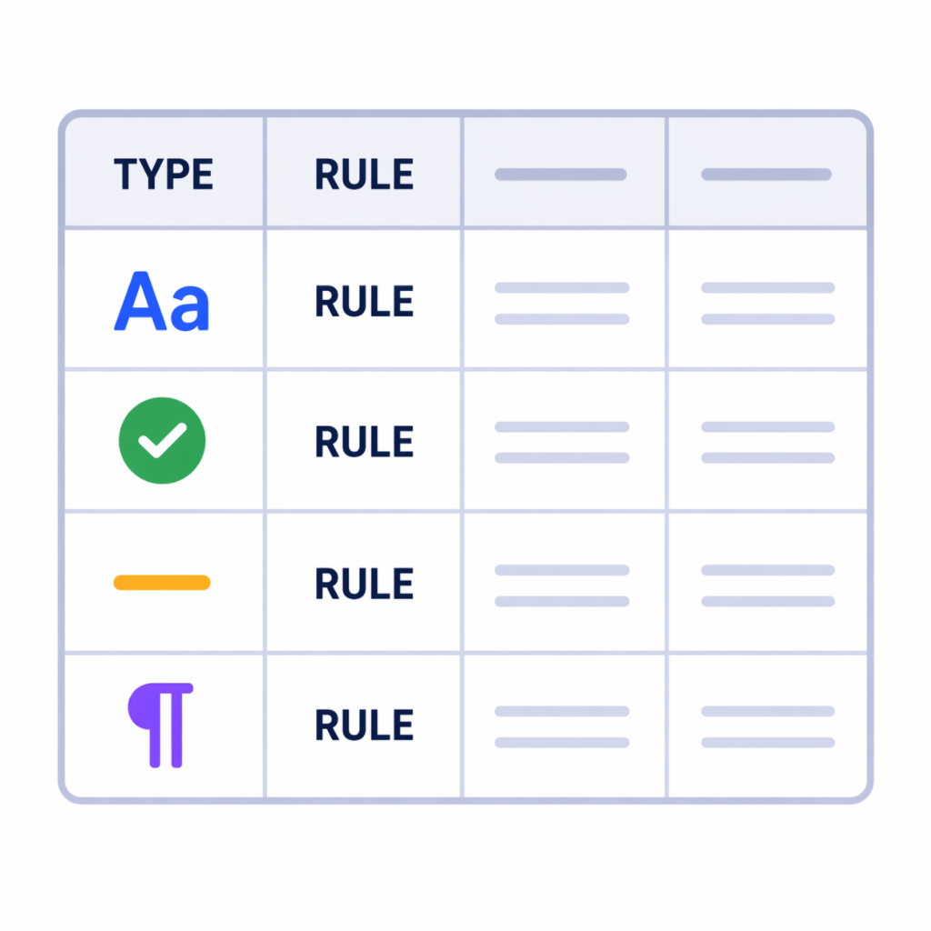
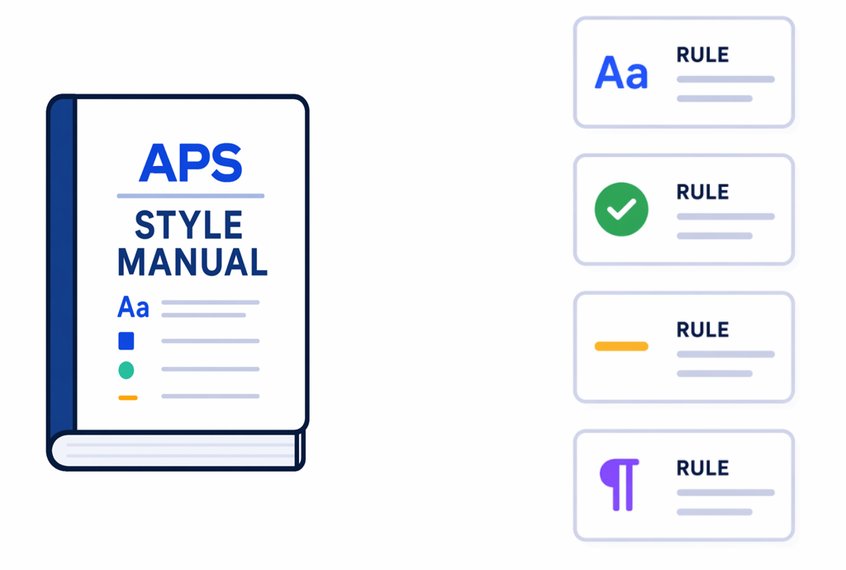
We rapidly scaled up
^
(probably too)
~92,400
lines of code
Extract individual rules
Synthesise and tabulate rules
Generate rules as code
Resulting in 801 “working” rules
Notes:
Create the entire rulebook
Implement the entire rulebook

Slide 16
Extracting individual rules
Establishing a taxonomy
System prompt
Tabulate

Slide 17
Generate – Validate – Regenerate
Create the actual code and the test scenarios
Run the tests
Send failures back to LLM for rework

Slide 18
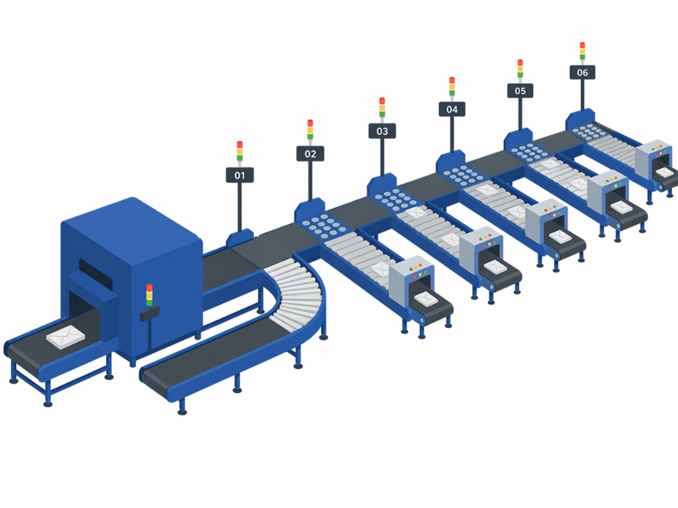


Scaling the rulebook surfaced fundamental issues
What we needed
What we built
Far too many false positives. System required a much more nuanced process to parse document structure to apply rules effectively

Slide 19
We know a lot more now than when we started
It can be done but it's an order of magnitude more complex to construct than initially anticipated.
I’ve created a 53-page construction manual for a V2
Some rules simply can’t be codified

Slide 20

Tripwire Title page

Slide 21
Tripwire origins – The AI steward dashboard

Slide 22



The broader the coverage, the more difficult it is to maintain our (and any) platform’s accuracy and currency
Identifies changes of target information
Surfaces the content which may be affected by the change
Determines whether an amendment is necessary and if so, what it should be
Including legislative instruments, web content and news feeds
Using a mix of keyword and semantic retrieval methods
Using an LLM, but only if it exceeds a predefined relevance threshold

Slide 23


Tripwire in action
Page which may be influenced
Change to target information
Assessment of change against IPFR page
The upstream change announces that IP Australia has joined the PPH eXtra Initiative…
The IPFR page already references the PPH and expedited examination generally, and the change does not contradict or update any specific statements or guidance in the page.
Therefore, no amendment to the IPFR page is required.

Slide 24
Fundamental purpose of RAG
How this system is a type of RAG pipeline
Scale of operation influences design

Slide 25
Tripwire
Key requirements
Transparent process
Low maintenance
Filter noise cheaply
Domain agnostic
Etc (TOM NEEDS TO GO BACK AND ADD ACTUAL REQUIREMENTS)

Slide 26
Influenced vs influencer
Clarifying the difference between the content we manage and the content managed externally

Slide 27
How different influencers are captured
Federal register of legislation
RSS feeds
Websites

Slide 28
Quick explainer of semantic representation
Show diagram to demonstrate how one can abstractly represent a text’s ‘meaning’ with numbers

Slide 29
How the ‘influenced’ site is captured (pt 1)
Sitemap harvesting and normalisation
SHA-256 version
Section aware chunking
Cron-based maintenance

Slide 30
How the ‘influenced’ site is captured (pt 2)
Enrichment with NER, YAKE, vector embeddings, quasi graph construction
NOTE TO SELF: UPDATE GRAPH CONSTRUCTION TO ACTUALLY EXTRACT WEBPAGES WHICH REFER TO EACHOTHER

Slide 31
Tripwire seeks to answer
Did the target information meaningfully change?
Is the change potentially relevant to IPFR content?
Which IPFR pages are most likely affected?
What should be done about it?

Slide 32
Detection and pre-processing
Did the target information meaningfully change?
Metadata probe
Change detection (including noise filtration)
Significance fingerprint
Diff generation

Slide 33
Hybrid retrieval and filtering (coarse)
Is this change potentially relevant to IPFR content?
YAKE-driven BM25
Bi-encoder cosine similarity
RRF
Top-N candidates OR score threshold exceeded (mention fast pass modifier)
Chunk the incoming change document
Compute cosine similarity against IPFR content chunks
Proceed if any single chunk scores ≥ 0.75, OR 3+ chunks from the same IPFR page score ≥ 0.45

Slide 34
Hybrid retrieval and filtering (precise)
Which IPFR pages are most likely affected?
Stage 6
Cross encoder score
Score full IPFR page vs full change document
Rerank semantic findings with lexical results and pre-computed quasi-graph relationships
Propagate alerts to graph-connected IPFR pages (decay 0.25 per hop, max 3 hops, floor 0.05)
REMINDER TO SELF: FIX THE GRAPH PROPOGATION

Slide 35
Assessment and alerting
Should the IPFR page be amended? If so, why?
Group all triggers per IPFR page within this run.
Batch all relevant diffs for each IPFR page into a single unit for LLM assessment.
One discrete LLM call per IPFR page (not per trigger).
Inputs:
Cached system prompt
All relevant diffs for this page
The IPFR page content
Bi-encoder cosine scores per chunk
Relevance scores (lexical, semantic, reranked)
Output: structured JSON against a validated schema

Slide 36
The barrier is now willingness, not capability
Small, cheap experiments beat big transformation programs. No business case, no vendor, no 18-month roadmap. The enabling condition wasn't money — it was permission to try and tolerance for things not working the first time.

Slide 37
"Ready or not" cuts both ways
The more questions you can anticipate, the more likely you are to succeed. Simply, be thoughtful about your implementation.
Who maintains code an AI wrote?
How do you assure quality, security, and accountability?
Developing an enterprise solution is a real engineering and governance problem, not a vibe.

Slide 38
Scaling solutions
(Refer to: Guidance for AI proof of concept to scale [https://www.digital.gov.au/policy/ai/AI-POC-to-scale]).
The act of scaling/implementing will likely be the most time and effort you actually spend on the project.
There’s a reason this is called ‘building’ at the speed of curiosity and not ‘deploying’ at the speed of curiosity.

Slide 39
Individual’s disrupting systemic norms
Building a working solution makes the value proposition clear and much more clearer understanding of the solution’s requirements
Building things in this way will apply pressure to organisations to enable iteration and implement processes to onboard bespoke systems.
Technology SME’s may throw curveballs at you

Slide 40
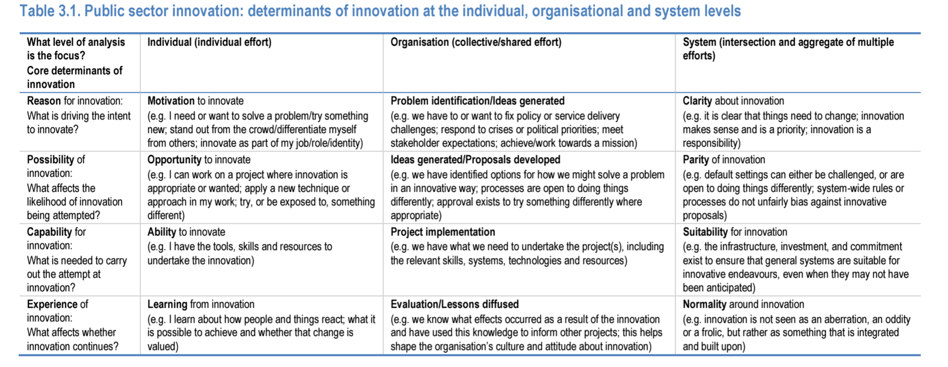
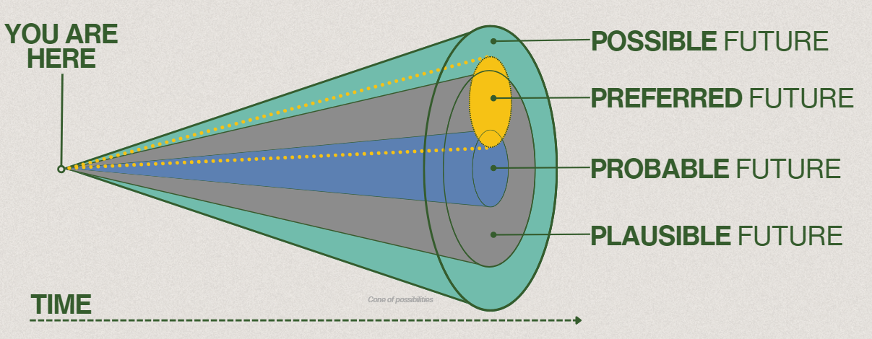
Cone of possibilities
Individual efforts may only make small changes.
The more individual’s that innovate, the more likely an organisation may and the more likely an organisation is to, the more likely a system is. Only by starting to innovate as individual’s can we hope that our organisation or the systems it adheres to may adopt this kind of rapid development.

Slide 41
Keep asking obvious questions
Your time and intelligence is the scarce resource, use it wisely.
Establish your goals and requirements early
Project brief
Design brief
Specifications document
What are the alternatives? What are their pros and cons?
I’m not a programmer, please explain this more simply using an analogy
Is there an existing solution to this or a problem similar to mine?
Is there anything I may have overlooked?
Please conduct an in-depth analysis of what has been done and provide me with a constructive, actionable critique
Ask me lots of questions about this which I haven’t yet addressed. Seriously grill me!

