Slide 1

How an autonomous watchdog keeps a government website honest
A plain-English tour of the machinery. No computer science required.
IPAVentures · IP Australia part of “Building at the speed of curiosity”
Notes:
Framing: this section explains how Tripwire actually works, in plain English. Two promises to the audience: (1) every technical idea gets a lay explanation, and (2) by the end you'll see why this is a system with an AI component — not 'an AI'. The word 'honest' is deliberate: the problem is content silently drifting out of date.

Slide 2
WHY THIS EXISTS
Accurate today. Quietly wrong by Thursday.
IP First Response (IPFR) explains intellectual property in plain English — trade marks, patents, designs, disputes, scams — so people don't have to read legislation.
156
authoritative sources we don't control — each able to invalidate our advice
Every page distils laws, regulations, fees, court practice and other agencies' guidance. All of that keeps moving: Acts are amended, fees change, policies are replaced, new guidance appears.
139
published IPFR pages we are responsible for keeping true
Nobody sends a memo when the world changes underneath your website.
The manual fix is a person re-reading every source against every page, forever. That person does not exist — so drift accumulates until someone is misled by our own guidance.
0
notifications anyone sends us when any of it changes
Stale guidance isn't cosmetic. People act on it.
2
Notes:
The problem in one line: our advice is a cached copy of a moving world. 156 is the live count of monitored sources in the registry; 139 is the number of IPFR pages in the corpus database. Emphasise the zero: there is no notification infrastructure anywhere in the chain — not from parliament, not from agencies. Monitoring is nobody's job description, so it silently becomes everybody's risk.

Slide 3






WHERE IT STARTED
A small prototype proved the itch was real
THE AI STEWARD DASHBOARD — THE ORIGINAL TRIPWIRE
WHAT IT TAUGHT US
Watch a fixed list of public AI-policy pages
government and vendor terms, policies, guidance
Watching can run itself — scrape, compare, summarise, publish, every day, for free
AI summaries turn raw change-logs into something people actually read
Notice when the text changes
keep a digital fingerprint of each page; compare on every visit
It knew that a page changed — never whether we should care
Ask an AI to describe the change
plain summary plus an urgency rating
No link between a change out there and the content we are responsible for
Publish to a live dashboard
daily, unattended, on free infrastructure
Tripwire keeps the instinct — and adds the missing half: consequences for our content.
3
Notes:
One slide of lineage. The AI Steward Dashboard watched AI-governance policy pages, hashed the text, asked Gemini to summarise changes, and published a static dashboard — all on free GitHub infrastructure. It proved automated watching works and taught the core habits: snapshots, fingerprints, scheduled runs, zero-cost hosting. Its ceiling: change detection without impact analysis. Tripwire is the same instinct, re-engineered to answer 'so what, for OUR pages?'

Slide 4
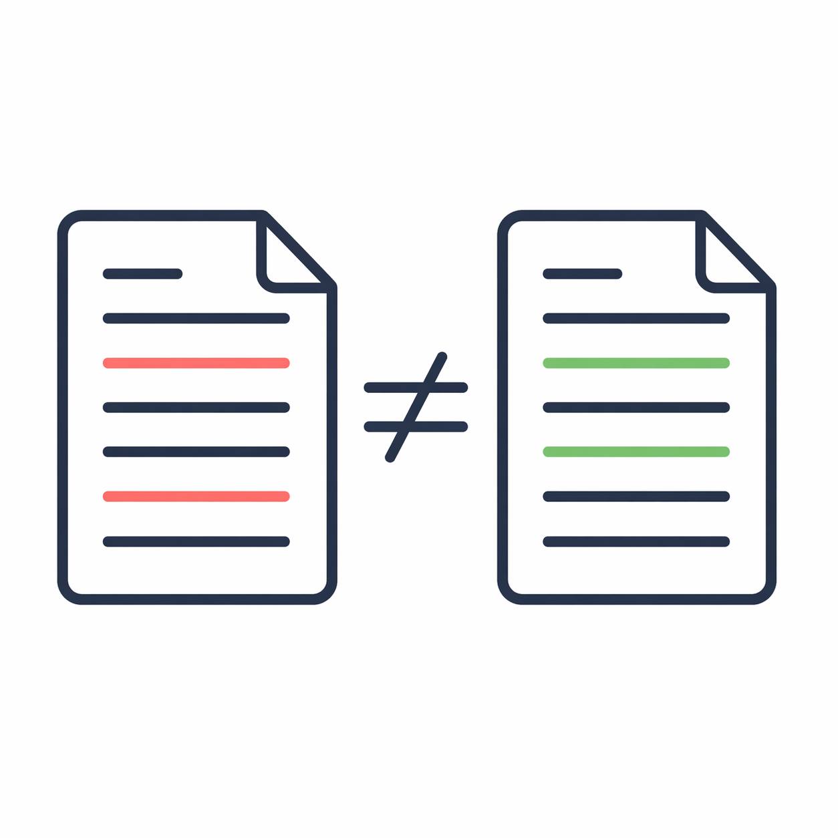
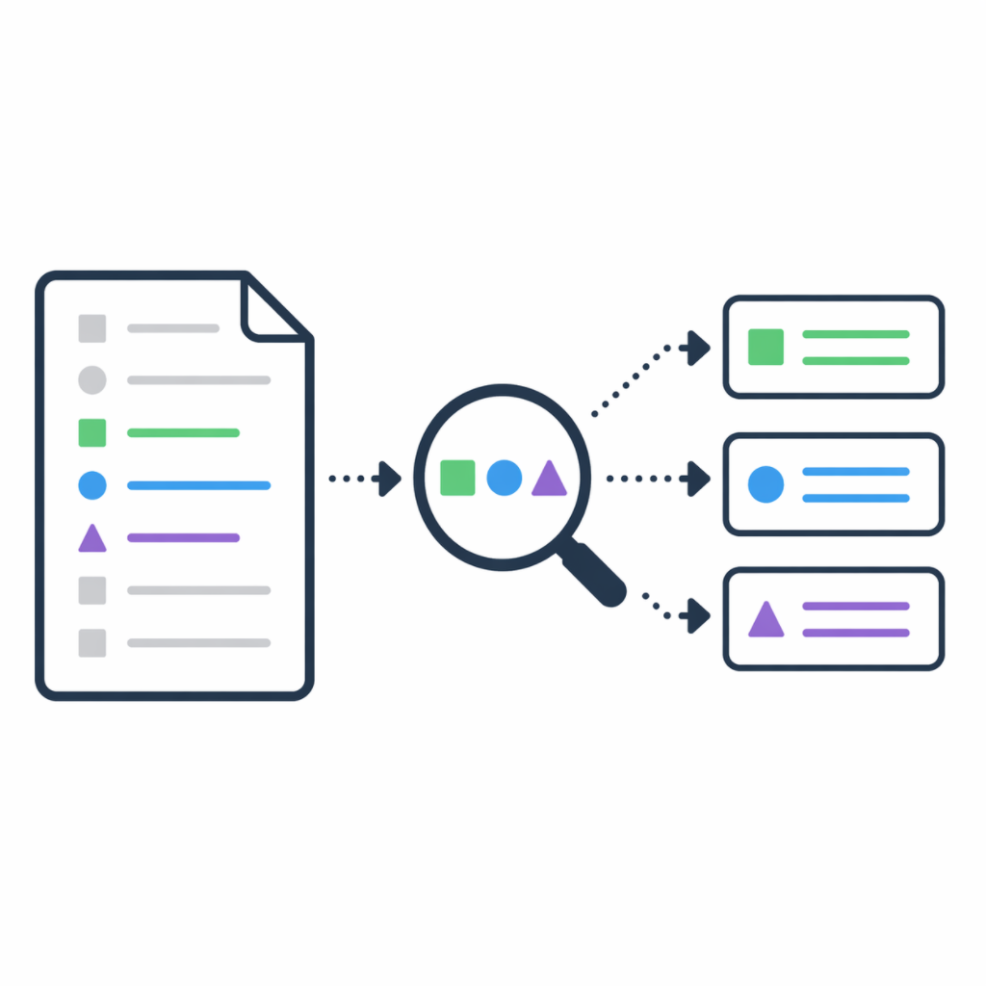
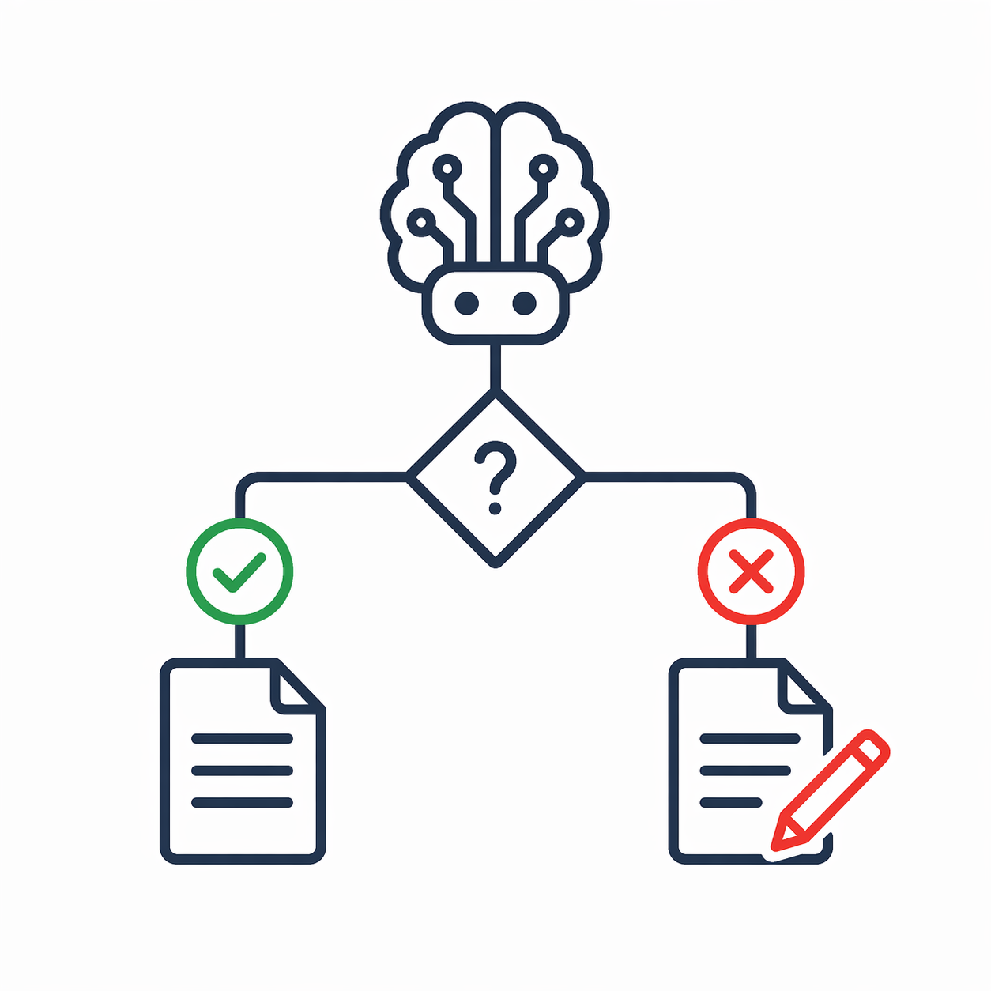

THE PITCH
Detect. Connect. Recommend.
Spots real changes
Finds the pages affected
Recommends an action
Watches all 156 sources on their own schedules and ignores cosmetic churn — reformatting, timestamps, menu shuffles.
Searches our 139 pages by exact words and by meaning, then shortlists the few pages a change could actually touch.
Drafts the case for an amendment — or says “no change needed”, or “uncertain — human, please look” — and emails the owner.
THE OUTSIDE WORLD
THE CONNECTION
THE JUDGEMENT
Runs unattended every morning. Humans keep the pen — Tripwire recommends, it never edits the website.
4
Notes:
The elevator version before the internals. Three verbs: detect (in the world), connect (to our corpus), recommend (to a human). The bottom bar pre-empts the scariest misreading: nothing is auto-published. The system's output is an email to a person, never an edit to the site. These three icons come from the main deck — same system, same visual identity.

Slide 5
THE SHAPE OF THE MACHINE
Five questions, each more expensive than the last
COST PER ITEM
A TYPICAL MORNING
≈ 0¢
Did anything change at all? stage 1
156 checked
< 0.1¢
Was the change meaningful? stage 2
~25 changed
< 0.1¢
What exactly is different? stage 3
~10 meaningful
~ 1¢
Could it matter to our pages? stages 4–5
~5 relevant
a few ¢
Which pages? What now? stages 6–8
2–3 finalists
one email — or none
Each gate is cheap to ask and only survivors move on — so the expensive stages barely ever run. The day's entire AI bill: cents.
counts: design estimate for a typical day — every run logs its own
5
Notes:
The architecture in one picture: a funnel of gates. Left rail: what each question costs per item. Right rail: how many items survive on a typical design-load day (156 due → ~25 → ~10 → ~5 → 2–3). The punchline is economic: expensive reasoning is a privilege earned by surviving cheap checks, so the AI bill stays at cents per day no matter how many mornings are quiet. This is also the safety story: most of the machine is boring arithmetic that cannot make things up.

Slide 6

THE DESIGN PRINCIPLE
Machinery for the facts. Judgement for the verdict. Never the reverse.
1–7
THE MACHINERY
8
THE JUDGEMENT
deterministic — same input, same answer, every single time
non-deterministic — reads and reasons like a person; can be wrong like one
Counts, compares, measures. Fingerprints, word matches, similarity scores — it cannot invent anything.
Auditable by construction. Every decision is a number in a log; re-run it and you get the same number.
Effectively free. Open-source models on free scheduled compute; no per-use fees.
Carries ~95% of the work, so the expensive part stays tiny: 8 of 9 stages run this way.
Goes last. It only ever sees the 2–3 finalists the machinery lets through.
Answers on a fixed form. Its reply must fit a strict schema; the machinery checks it before anyone reads it.
Allowed to say “uncertain”. Doubt is escalated to a human — guessing is the failure mode, not honesty.
Recommends only. It cannot touch the website. A person makes every edit.
deterministic step
AI judgement
human decision
— this colour code runs through the rest of this deck
6
Notes:
The crux slide for the sceptics. Two kinds of computation, deliberately separated. Deterministic parts: repeatable, loggable, free, incapable of hallucination — they do nearly all the work. The language model is powerful but fallible, so it is architecturally caged: last position, smallest surface, strict output contract, an explicit licence to say UNCERTAIN, and no write access to anything. If you remember one slide, make it this one: the design question was never 'can AI do this job?' but 'what is the smallest act of judgement we actually need, and how do we surround it?'

Slide 7






THE CAST
What it watches, and what it protects
THE INFLUENCERS
THE INFLUENCED
156 sources we don't control
139 pages we publish and must keep true
Legislation & regulations
the Federal Register of Legislation — Acts, rules, fee schedules
IP First Response
plain-English guidance pages, each distilling many sources
Government & agency webpages
courts, WIPO, partner agencies, official guidance
Mirrored into a small local database
every page pre-studied and indexed — next slide
News & announcement feeds
official channels publishing new items daily
Refreshed every night
so the day's comparisons start from an up-to-date picture
Each source has an importance weight and its own check rhythm, daily to quarterly. The register is one spreadsheet — adding a source is one row, no code.
Both sides are plain files in version control — anyone can inspect exactly what is watched, and every change to the lists is tracked.
Tripwire's job: notice when something on the left should change something on the right.
7
Notes:
Vocabulary slide — 'influencers' are upstream sources (legislation register, agency pages, news feeds); 'the influenced' is our own site, mirrored into a small database. Two operability points for the audience: the watch-list is a one-row-per-source spreadsheet any content owner can edit, and everything lives in version control, so the system's entire memory is inspectable and auditable. Swap these two lists and the same machine watches a completely different domain.

Slide 8






PREPARATION BEATS CLEVERNESS
Every night, Tripwire re-studies its own website
Clean text + a fingerprint
1,164 passages
clutter stripped; then a 64-character seal — change one letter and the seal changes
each page split into bite-size, section-aware pieces for precise comparison
1,366 key phrases
1,591 named things
One IPFR page
× 139, every night
the terms that characterise each page, extracted automatically
the Acts, organisations, amounts and deadlines each page mentions
A place on the meaning map
965 connections
coordinates for every passage — explained on slide 12
which pages relate to which, and how strongly — a map of the site's web
Do the heavy reading once, overnight. The study runs at 1 am; the day's checks start at 2 am — by then every comparison is a cheap lookup against homework already done.
8
Notes:
The unglamorous secret of the whole system: preparation. A separate overnight pipeline re-reads the IPFR site and pre-computes everything the day shift will need — clean text, fingerprints, passages, key phrases, named entities, meaning-map coordinates, and a web of inter-page connections. All numbers on this slide are live counts from the actual database. Because all of this is done once and stored, the daytime pipeline never pays to re-derive it — that is what makes 'compare against everything' affordable.

Slide 9

GATES 1–2
1
2
3
4
5
6
7
8
9
First, the cheap questions
1
THE DOORBELL
2
THE FINGERPRINT
has anything changed at all?
was the change real, or just cosmetic?
Before downloading anything, ask the source's server for its receipts:
a
Seal check. Compute a mathematical fingerprint of the cleaned text (SHA-256): change a single letter and the whole seal changes. Same seal as yesterday → identical content → stop.
“When was this last modified?”
“What version number is current?”
“How big is the document now?”
b
Word-by-word compare. Only spacing or formatting moved? Log “cosmetic” and stop. Menus, timestamps and styling churn die here.
Answers unchanged → done. Cost for that source today: effectively zero.
Server won't say, or signals are ambiguous → download and look anyway. When unsure, this system always looks closer — it never quietly skips.
Significance sniff. Do the changed lines touch dates, dollar amounts, section numbers, or “must / may / shall”? Tag it high or standard — context that travels with the change. It never vetoes a real edit.
c
Legislation and news feeds skip the fingerprint — they announce changes in structured form. Free-form webpages are the messy ones that need it.
9
Notes:
Stage 1 costs almost nothing: it reads the metadata a web server hands out for free — like checking a letterbox flag before opening the box. Note the asymmetry: when signals are missing, the system errs toward looking, never toward skipping. Stage 2 separates real change from cosmetic churn in three passes: an exact fingerprint (SHA-256 — a hash: any one-character difference produces a completely different fingerprint), a word-level comparison to catch formatting-only edits, and a 'significance sniff' for the words that matter in law — dates, amounts, section references, must/may/shall. The sniff only annotates; it can't suppress a genuine change. Everything here is deterministic and logged.

Slide 10
GATE 3
1
2
3
4
5
6
7
8
9
From “something changed” to the exact sentences
what changed · ipaustralia.gov.au / trade-mark-renewals
HOW EACH KIND OF SOURCE REPORTS ITS CHANGE
Webpages
compare yesterday's stored copy with today's — keep only the differing lines
Renewing your registration
You can renew up to 12 months before expiry.
− The renewal fee is $400.
+ The renewal fee is $450.
Legislation
fetch the official explanatory document that accompanies every amendment
− A late fee applies for 6 months after expiry.
+ A late fee applies for 10 months after expiry.
News feeds
take just the items that are new since the last visit
Everything downstream studies the change itself — not the whole document. Sharper signal, less noise, less to process.
Different routes, same destination: a compact, plain-text account of exactly what changed — the “change document”.
10
Notes:
Gate 3 turns 'changed' into 'changed HOW'. For webpages that's a before/after comparison of stored snapshots — shown here as strikeout and addition; the real example on screen is the kind of edit that matters: a fee and a deadline. Legislation is easier: the Federal Register publishes an explanatory statement with every amendment, so we fetch the authoritative description instead of reverse-engineering one. News feeds are easiest: new items are the change. From here on, the pipeline reasons about this small change document, not whole websites — precision and economy in one move.

Slide 11

HOW MATCHING WORKS · PART 1 OF 2
Match the words — and weigh the rare ones heavily
Pull the characteristic phrases out of the change document (5–15 of them, automatically) and use them as search queries across all 139 pages:
THE CATCH
“renewal fee”
“trade mark”
“late fee”
“10 months”
“the cost of keeping your registration”
PAGES RANKED BY WORD OVERLAP
=
Renewing your trade mark
strong
“the renewal fee”
Fees and payment options
medium
Patent application basics
weak
Same meaning. Zero shared words. Word-matching alone would sail straight past it — and legal language is full of exactly this.
Rare, specific words (“renewal fee”) count for far more than common ones (“the”, “apply”) — a librarian's instinct, written as arithmetic. The formula, BM25, dates from the 1990s: fast, transparent, zero AI.
→ so we also match meaning (next slide)
11
Notes:
First of the two retrieval methods, and the easier one to trust: keyword search with rare-word weighting. Key phrases are extracted from the change automatically, then scored against every page — the arithmetic (BM25) has powered search engines since the 1990s. Deterministic, explainable, fast. But the failure mode is on the right: paraphrase. Law and plain-English guidance constantly say the same thing in different words. That is the precise gap the meaning map fills — neither method is trusted alone; each covers the other's blind spot.

Slide 12
HOW MATCHING WORKS · PART 2 OF 2
Give every passage a place on a map of meaning
1
A small open-source reading model has digested billions of sentences and learned which words keep the same company.
THE MEANING MAP (SKETCHED IN 2-D)
Renewal fees
2
Show it a passage; it answers with a list of 768 numbers — coordinates. The jargon for this: a vector embedding.
Office holiday hours
Keeping your registration
3
Passages about the same idea land close together on the map — even when they share no words at all.
Late renewal penalties
the fee change (incoming)
4
So “is this change about that page?” becomes “how far apart are these two points?” — instant, repeatable, and free once the coordinates are stored.
close = probably about the same thing
Filing a patent
Patent examination
Still the machinery, not the chatbot: the reading model is frozen. Same passage in, same coordinates out, every time — measurement, not conversation.
the real map has 768 dimensions, not 2 — the idea is identical
12
Notes:
The flagship lay explanation. A reading model — trained once, by someone else, open-source — has seen billions of sentences and learned which words appear in similar company. Give it any passage and it produces 768 numbers: a location. Similar meaning, similar location. 'Renewal fee' and 'cost of keeping your registration' land side by side despite sharing no words — that fixes the previous slide's catch. Two properties matter for governance: it's frozen (same text always maps to the same point — this is measurement, not generation, so there is nothing to hallucinate), and it's cheap (coordinates are computed once at ingestion; a daytime comparison is just measuring a distance). If asked: 768 dimensions because more directions of meaning fit than a flat map allows; the distance measure is cosine similarity.

Slide 13
GATES 4–5
1
2
3
4
5
6
7
8
9
Two judges rank every page — then zoom in, section by section
THE WORD JUDGE SAYS
THE MEANING JUDGE SAYS
5
THEN ZOOM IN, SECTION BY SECTION
1. Renewing your trade mark
1. Renewing your trade mark
the change's passages vs all 1,164 stored passages
2. Fees and payments
2. Madrid System renewals
A page stays on the shortlist only if, on the meaning map:
3. Trade mark basics
3. Fees and payments
4. Madrid System renewals
4. Protecting overseas
one section matches strongly — similarity ≥ 0.75 out of 1.0 (“clearly the same subject”)
BLENDED SHORTLIST — high on either list scores well; the meaning judge counts double; the source's importance nudges the total
— or —
several sections match moderately — 3 or more at ≥ 0.45 (“broadly about the same territory”)
Kept: the top 5, plus anything above a quality floor.
Free pass: changes from critical sources (the IP Acts themselves) skip the queue — if a big amendment touches 20 pages, all 20 go through.
Every score is logged, so any morning's shortlist can be reconstructed and challenged after the fact.
13
Notes:
Gate 4 runs both judges over the whole corpus and blends their rankings (reciprocal rank fusion, with the meaning signal weighted double — paraphrase is the harder problem). A per-source importance weight then nudges totals, and selection is top-5 plus a floor, with a fast-pass for the most critical sources so a sweeping amendment isn't throttled to five pages. Gate 5 changes resolution: from whole pages to sections, using the passages pre-computed at ingestion. The two keep-rules mirror how a human skims — either one section is clearly on point, or lots of it is vaguely on point. Thresholds aren't guesses: they were calibrated during a silent observation period (slide 17).

Slide 14


GATE 6
1
2
3
4
5
6
7
8
9
A slower reader double-checks — then warns the neighbours
The fast reader (used so far)
compares two book reports written separately — coordinates made independently, then measured. Quick enough for millions of comparisons; approximate by design.
THE RIPPLE — WARNING THE NEIGHBOURS
45%
20%
The careful reader (now)
puts both texts on the same desk and reads them together, weighing every line of one against every line of the other. Far sharper — and affordable, because only ~5 finalists remain.
9%
confirmed
hit
45%
Verdict: pages scoring ≥ 0.60 out of 1.0 with the careful reader go forward; the rest are logged and dropped.
Our pages form a web — 965 recorded connections (similar topic, shared Acts, direct links). A confirmed hit sends a fading nudge along it, so chains like Act → regulation → guidance get caught even when words and meaning both miss.
Same trade everywhere in the funnel: cheap-and-rough on everything, expensive-and-sharp on survivors only.
Nudges fade at ~45% per step, stop after 3 steps, and only ever ADD caution — they never talk a page out of an alert.
14
Notes:
Two ideas share gate 6. First, a more expensive comparison: the fast reader (bi-encoder) never sees the two texts together — it compares summaries-by-coordinates. The careful reader (a cross-encoder) reads change and page simultaneously and scores their fit far more sharply. It would be too slow for 139 pages every morning; for five finalists it's nothing. Second, the ripple: pages the site itself connects — by similarity, shared entities, or direct hyperlinks — receive a decaying share of a confirmed hit's alert score. That's how a change to an Act can surface a procedure page that never mentions the Act by name. Design details worth stating out loud: the propagation only boosts (fail-closed again), it decays geometrically, and it dies out after three hops so one hit can't set the whole site on fire.

Slide 15
GATES 7–8
1
2
3
4
5
6
7
8
9
Only now does an AI get to read — under exam conditions
7
THE BRIEFING IT RECEIVES
8
THE EXAM RULES
Today's changes pointing at this page, grouped into one briefing — one call per page, never per change
The page's full current text, straight from the corpus database
Every score from every earlier gate — evidence attached, not vibes
Fixed answer form: verdict must be CHANGE REQUIRED, NO CHANGE or UNCERTAIN — plus confidence, reasoning, and the exact suggested edits
Doubt is welcome: “uncertain” routes to a human; guessing is the failure mode, not honesty
Creativity turned down: temperature 0.2 — in this job, variety is a bug
Answers are inspected by the machinery: malformed → one retry → set aside and flagged; service down → parked, retried tomorrow. Nothing is lost silently.
2–3 briefings on a typical day — the entire AI workload
THE ANSWER SHEET — real output, lightly trimmed
2–3
AI calls a day, a few cents — the whole judgement bill
verdict: CHANGE_REQUIRED confidence: 0.85
reasoning: “the amendment reduced the examination period from 12 to 6 months; the page still says 12 months”
suggested edit: “update ‘12 months’ to ‘6 months’ to reflect amended s.44, Trade Marks Act 1995”
15
Notes:
The only non-deterministic step, and it looks less like a chatbot and more like a candidate sitting an exam. Gate 7 assembles one briefing per affected page (so five upstream changes to one page produce one call, one email item, one decision). Gate 8's constraints do the governance work: a JSON answer-sheet checked by the machinery, an explicit UNCERTAIN escape hatch so the model is never forced to fake confidence, low temperature to shrink variance, and a parking lane (deferred triggers) so an API outage delays work instead of losing it. The economics land here too: because only finalists reach this stage, the entire AI bill is 2–3 calls — cents — per day.

Slide 16




STAGE 9 · AND THE HUMAN
1
2
3
4
5
6
7
8
9
One email. A human decides. The system learns.
Tripwire — Mon 20 Jul — 2 pages flagged
THE LEARNING LOOP
Tripwire alerts — one consolidated email per run
Recommended amendments
the page, what changed upstream, the AI's reasoning, the exact suggested edit — and the scores from every gate as evidence
A person decides — acts on the site — and clicks one button
For human review
the “uncertain” pile, each with the AI's stated reason for doubt
Replies filed automatically — a scheduled job reads the mailbox into structured records
Rejected at the final gates
near-misses the deep checks threw out — so over-filtering is just as visible as alerts
Thresholds tuned on evidence — each button points at a different gate to adjust
ONE-CLICK FEEDBACK AT THE FOOT OF EVERY ITEM
Useful
Not significant
Wrong amendment
Wrong page
“Wrong page” tunes the search gates; “wrong amendment” tunes the exam. Feedback lands on the gate that erred.
16
Notes:
The system's entire output is one email — and silence on quiet days is deliberate: no alert theatre, no inbox training people to ignore it. Three sections: firm recommendations with evidence; the UNCERTAIN pile for human judgement; and near-misses, so a too-aggressive filter is as visible as a false alarm. The four feedback buttons are pre-addressed replies. A scheduled job reads that mailbox and files each reply as structured data. Each button diagnoses a different organ: 'wrong page' means retrieval erred, 'wrong amendment' means the judgement erred, 'not significant' means thresholds are too twitchy. That's what makes tuning evidence-based rather than vibes-based. And the human stays load-bearing: every change to the website is made by a person.

Slide 17



FOR THE SCEPTICS
Designed the way a cautious public servant thinks
Watched itself first
Fails closed
Loses nothing
weeks in observation mode — scoring everything, alerting no one — until thresholds were set on real evidence
when uncertain, escalate to a human; a signal is never silently dropped anywhere in the funnel
AI service down? The briefing is parked and retried next run — before any new work is touched
Logs everything
Audited by design
Knows when it's sick
every gate's decision recorded — 12,000+ run records so far — plus a weekly report on score drift
code, thresholds and content snapshots live in version control: every change is a tracked, attributable commit
repeated failures, error spikes or overruns trigger an alert about the pipeline itself — to the admin, not the content owner
None of this is exotic. It's ordinary public-service caution, applied to an AI system from day one.
17
Notes:
The governance slide. Observation mode meant the system ran silently for weeks while score distributions were studied and thresholds calibrated — it earned the right to send email. Fail-closed is a design invariant: at every gate, uncertainty escalates rather than discards. Deferred retry means an outage costs a day's latency, not a lost signal. Logging is at the decision level, not just 'it ran' — 12,000+ per-source records so far, and a weekly observability report watches for drift. Everything — including the data — is versioned in git, so any morning's decision can be replayed. And the pipeline monitors itself, alerting an admin when IT misbehaves. The point for doubters: responsible and fast aren't opposites. These safeguards were built in from the start by one person, because caution is cheap when it's designed in.

Slide 18
THE ELEPHANT IN THE ROOM
“Isn't this just Copilot?” — different species, actually
A CHAT ASSISTANT (Copilot & friends) | AN ENGINEERED SYSTEM (Tripwire)
Waits for a person to ask it something | Wakes itself up every morning and gets to work
General-purpose: anything, adequately | Single-purpose: one job, deeply
Answers can vary each time you ask | 8 of 9 stages give identical output on identical input
Reasoning happens out of sight | Every step leaves a score in an auditable log
You check its work, every time | It checks its own work; humans review the evidence
Per-seat subscription | Free scheduled compute + open models + cents of AI a day
Both are useful — they're different species. A chat assistant is a tool you drive. This is a process you audit. The AI isn't the product — the system is.
18
Notes:
The question every public servant asks, and it deserves a straight answer. No Copilot-bashing: a chat assistant is genuinely useful, and we use one. But it's a different species of thing: interactive, general, conversational, unaccountable-by-design (its reasoning isn't logged for audit). Tripwire inverts every one of those properties: autonomous, narrow, mostly deterministic, logged to the decision level, with the one generative step boxed in. The closing line is the thesis of the whole deck: the moment you see AI as a component you architect around — rather than the product itself — a much bigger design space opens than 'buy licences for a chatbot'.

Slide 19
THE SPEED OF CURIOSITY
What it actually took
1
9+1
$0
curious public servant — no formal computing background — pair-programming with Claude Code
pipeline stages, plus the nightly corpus study — with tests, runbooks and health alerts around them
infrastructure — free scheduled compute and open-source models; the AI bill is cents a day
Weeks of part-time building
Design first, code second
spare hours and stubborn questions — not a business case, a vendor and an 18-month roadmap
the system plan was written before the code; every stage was specified, then built, then tested
The scarce ingredients weren't budget or a delivery team.
They were curiosity — and permission to try.
19
Notes:
Honest accounting. One person, not from a software background, working with an AI pair-programmer (Claude Code) in part-time hours over weeks. The tooling collapsed the cost of building; it did not remove the need to think — the design document preceded the code, and the tests, runbooks, logging and health alerts are what make it an engineered system rather than a script. Standing costs: effectively zero infrastructure (scheduled free compute, open-source models) and cents a day of AI spend. Bridge to the talk's closing theme: building at this speed is now the easy part — the organisational work of deploying is where the effort really goes.

Slide 20
Cheap, auditable machinery for the facts.
One caged act of judgement.
A human with the final say.
The pattern isn't about IP law. Swap the watch-list and the website, and the same machine guards any content that must keep up with a changing world.
IPAVentures · IP Australia
Notes:
Close of the Tripwire section. Recap the three-part pattern — deterministic machinery, one boxed-in act of judgement, a human who owns the decision — and generalise it: this is a reusable template for public-sector AI, not an IP-law novelty. Hand back to the talk's wider arc: the barrier to building this way is no longer capability or cost — it's curiosity and the permission to try. Deploying at that speed is the real frontier.

