Slide 1
What is Functional Programming? vermont code camp 2012
@eric_s_smith
github.com/ericssmith
http://whatisfp.net

Slide 2
Brief history of formalization of math
Turing Machine and Beyond
Lambda calculus
History of FP
A Look at Haskell
What is FP?

Slide 3
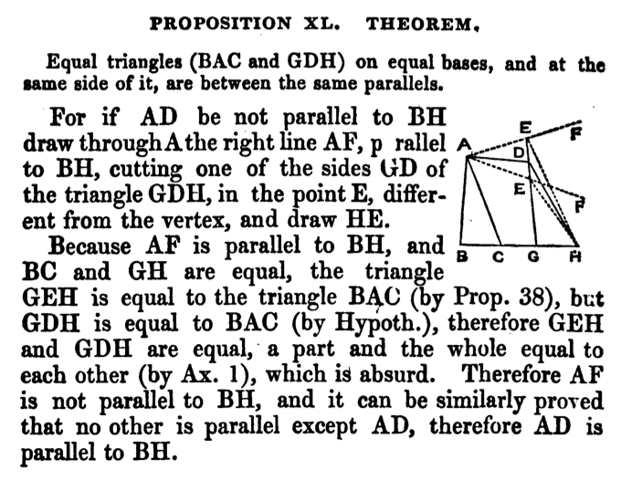
Euclid ‘Elements’ – Build complex propositions starting from small set of assertions and methods of proof. Foundation of mathematics for over 2,000 years.

Slide 4
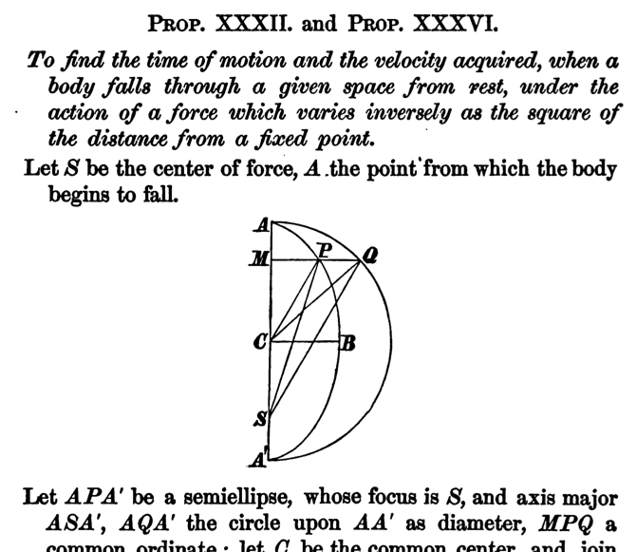
Newton “Principia” – Relied on geometry in 1687 to be convincing.

Slide 5
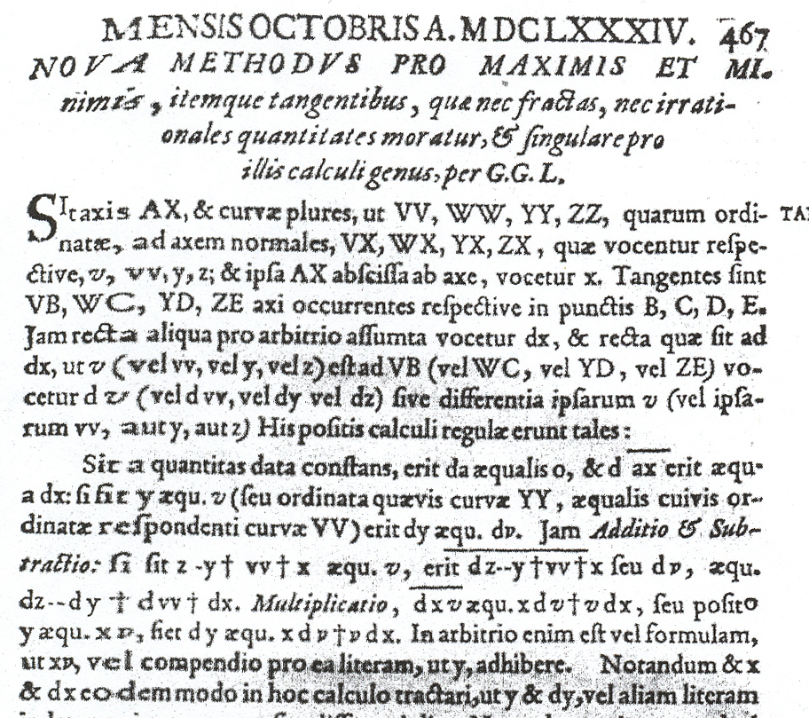
Leibniz ‘Acta Eruditorum’ – First publication of methods of the infinitesimal calculus in 1684.

Slide 6
“There is delivered a certain new and wonderful calculation, which has relation to all our reflections and which is proceeded not less accurate than Arithmetic and Algebra. As applied to controversions, they can terminate always as they are soluble on data just by putting pen to paper; it is sufficient for two disputers omitting verbal pleadings to say to each other: let us calculate”
Leibniz “Initia et Specimina Scientiae” – Reasoning could be reduced to calculation. And therefore disputes could be resolving by calculating.

Slide 7
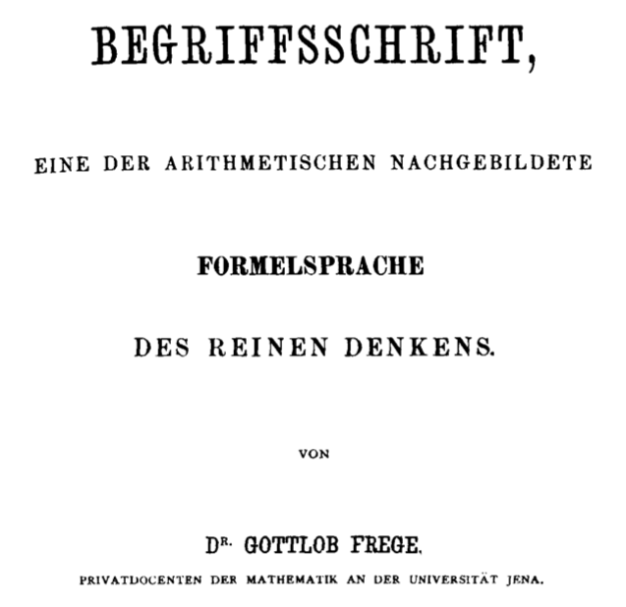
Frege “Begriffschrift” (1879) – Logic using quantifiers.

Slide 8
All horses are mammals
If x is a horse, then x is a mammal
(∀x)(if x is a horse, then x is a mammal)
(∀x) (x is a horse ⊃ x is a mammal)
(∀x)(horse(x) ⊃ mammal(x))
(∀x)(h(x) ⊃ m(x))
(∃x) (h(x) ∧ p(x))

Slide 9
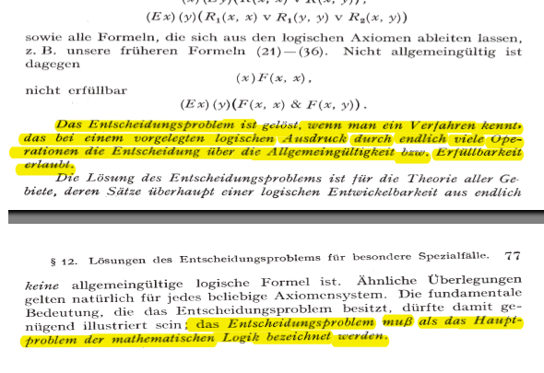
"The decision problem is solved when we know a procedure that allows for any given logical expression to decide by finitely many operations its validity or satisfiability.… The decision problem must be considered the main problem of mathematical logic.”

Slide 10
Entscheidungsproblem (Decision problem)
“Provide a method that would , given a formula of first-order logic, determine in a finite number of steps whether or not that formula is valid”
in Martin Davis – Engines of Logic

Slide 11
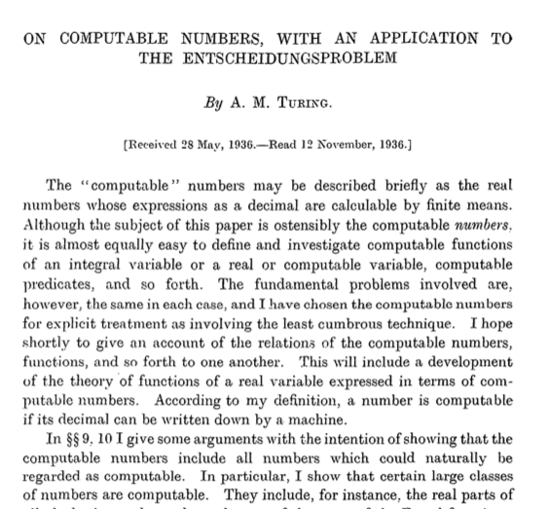
Turing 1936 – Proves that ‘no’ there isn’t such a general method to tell if a FOL formula is valid.

Slide 12
Is there a ‘computing machine’ that can decide if some other ‘computing machine’ will stop?
No. The ‘halting problem’ is ‘undecidable’.
Turing goes on to prove that there is no solution to the Decision Problem.

Slide 13
Invert string of binary digits
. . . | | | | | | | |1|0|1| | | | | | | . .
^
(1,0,1,R,1)
(1,1,0,R,1)

Slide 14
Invert string of binary digits
. . . | | | | | | | |1|0|1| | | | | | | . .
^
(1,0,1,R,1)
(1,1,0,R,1)

Slide 15
Invert string of binary digits
. . . | | | | | | | |0|0|1| | | | | | | . .
^
(1,0,1,R,1)
(1,1,0,R,1)

Slide 16
Invert string of binary digits
. . . | | | | | | | |0|0|1| | | | | | | . .
^
(1,0,1,R,1)
(1,1,0,R,1)

Slide 17
Invert string of binary digits
. . . | | | | | | | |0|0|1| | | | | | | . .
^
(1,0,1,R,1)
(1,1,0,R,1)

Slide 18
Invert string of binary digits
. . . | | | | | | | |0|0|1| | | | | | | . .
^
(1,0,1,R,1)
(1,1,0,R,1)

Slide 19
Invert string of binary digits
. . . | | | | | | | |0|1|1| | | | | | | . .
^
(1,0,1,R,1)
(1,1,0,R,1)

Slide 20
Invert string of binary digits
. . . | | | | | | | |0|1|1| | | | | | | . .
^
(1,0,1,R,1)
(1,1,0,R,1)

Slide 21
Invert string of binary digits
. . . | | | | | | | |0|1|1| | | | | | | . .
^
(1,0,1,R,1)
(1,1,0,R,1)

Slide 22
Invert string of binary digits
. . . | | | | | | | |0|1|1| | | | | | | . .
^
(1,0,1,R,1)
(1,1,0,R,1)

Slide 23
Invert string of binary digits
. . . | | | | | | | |0|1|0| | | | | | | . .
^
(1,0,1,R,1)
(1,1,0,R,1)

Slide 24
Invert string of binary digits
. . . | | | | | | | |0|1|0| | | | | | | . .
^
(1,0,1,R,1)
(1,1,0,R,1)

Slide 25
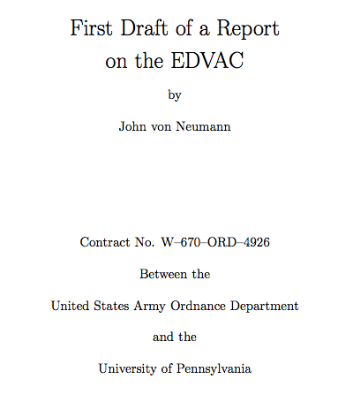
Von Neumann – Unfinished report of the design of the EDVAC

Slide 26
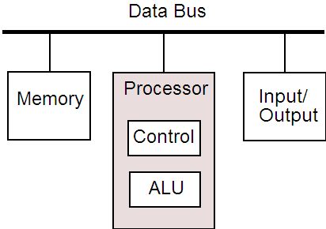

Slide 27
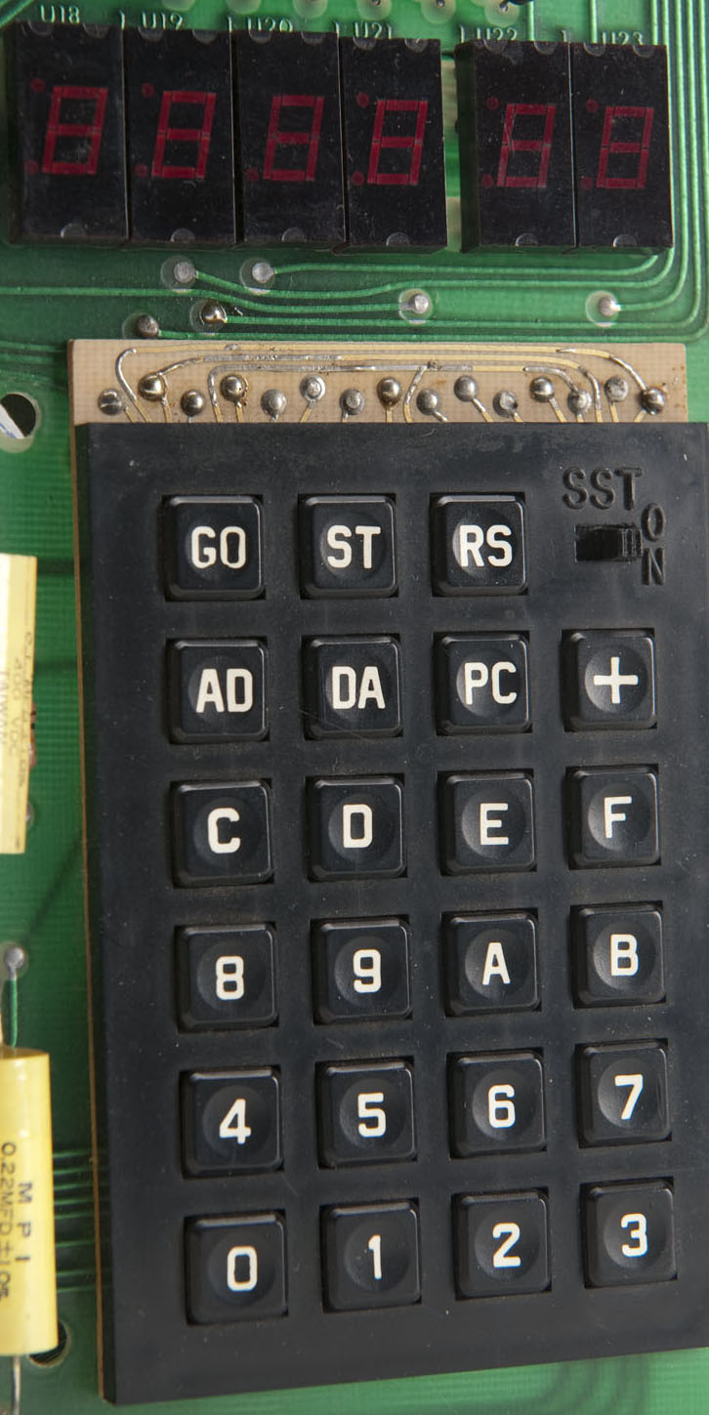
AD
0002
DA
18
+A5
+00
+65
+01
+85
+FA
+A9
+00
+85
+FB
+4C
+4F
+1C

Slide 28
0002 18 CLC
0003 A5 00 LDA VALl
0005 65 01 ADC VAL2
0007 85 FA STA POINTL
0009 A9 00 LDA #00
000B 85 FB STA POINTH
000D 4C 4F 1C JMP START

Slide 29
0002 18 CLC
0003 A5 00 LDA VALl
0005 65 01 ADC VAL2
0007 85 FA STA POINTL
0009 A9 00 LDA #00
000B 85 FB STA POINTH
000D 4C 4F 1C JMP START

Slide 30
0002 18 CLC
0003 A5 00 LDA VALl
0005 65 01 ADC VAL2
0007 85 FA STA POINTL
0009 A9 00 LDA #00
000B 85 FB STA POINTH
000D 4C 4F 1C JMP START

Slide 31
0002 18 CLC
0003 A5 00 LDA VALl
0005 65 01 ADC VAL2
0007 85 FA STA POINTL
0009 A9 00 LDA #00
000B 85 FB STA POINTH
000D 4C 4F 1C JMP START

Slide 32
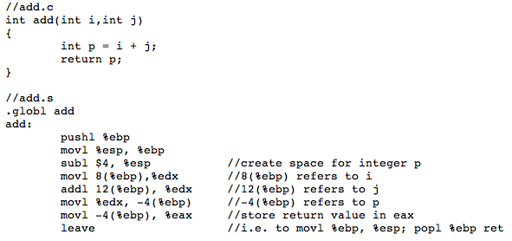
C is a thin layer over assembler

Slide 33
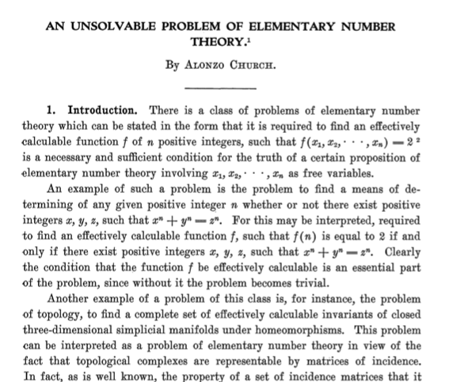
Church – 1936 created a language to formalize math, but was shown to be inconsistent. Used to define ‘effectively calculable’

Slide 34
A term in this language can be ...
variable - x,y,z etc.
application - AB
abstraction - λx.A

Slide 35
Abstraction
10*8
10*9
10*11
10*x
f(x) = 10*x
Application
f(8) = 10*8
f(9) = 10*9
f(11) = 10*11

Slide 36
λx.x

Slide 37
λx.xλx.x

Slide 38
λx.xλx.x

Slide 39
λx.xλx.x
λx.x

Slide 40
λx.λy.y

Slide 41
λx.λy.xy

Slide 42
λx.λy.xy “Currying”

Slide 43
λx.λy.xy => λxy.xy

Slide 44
λx.x is the same as λa.a

Slide 45
λx.λy.xyλx.λy.yλx.λy.xλx.λy.y

Slide 46
λx.λy.xyλx.λy.yλx.λy.x(λx.λy.y)

Slide 47
λx.λy.xyλx.λy.y(λx.λy.x)(λx.λy.y)

Slide 48
λx.λy.xy(λx.λy.y)(λx.λy.x)(λx.λy.y)

Slide 49
(λx.λy.xy)(λx.λy.y)(λx.λy.x)(λx.λy.y)
Notes:
….

Slide 50
(λx.λy.xy)(λa.λb.b)(λe.λf.e)(λs.λt.t)

Slide 51
(λx.λy.xy)(λa.λb.b)(λe.λf.e)(λs.λt.t)

Slide 52
((λx.λy.xy)(λa.λb.b))(λe.λf.e)(λs.λt.t)

Slide 53
(((λx.λy.xy)(λa.λb.b))(λe.λf.e))(λs.λt.t)

Slide 54
(((λxy.xy)(λab.b))(λef.e))(λst.t)

Slide 55
(((λxy.xy)(λab.b))(λef.e))(λst.t)
AND
Notes:
.

Slide 56
(((λxy.xy)(λab.b))(λef.e))(λst.t)
AND True

Slide 57
(((λxy.xy)(λab.b))(λef.e))(λst.t)
AND True False

Slide 58
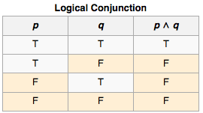
(((λxy.xy)(λab.b))(λef.e))(λst.t)
AND True False same as True ∧ False

Slide 59
(((λxy.xy)(λab.b))(λef.e))(λst.t)
AND True False same as True ∧ False

Slide 60
(((λxy.xy)(λab.b))(λef.e))(λst.t)

Slide 61
(((λxy.xy)(λab.b))(λef.e))(λst.t)

Slide 62
(((λxy.xy)(λab.b))(λef.e))(λst.t)
((λy.(λab.b)y)(λef.e))(λst.t)

Slide 63
(((λxy.xy)(λab.b))(λef.e))(λst.t)
((λy.(λab.b)y)(λef.e))(λst.t)

Slide 64
(((λxy.xy)(λab.b))(λef.e))(λst.t)
((λy.(λab.b)y)(λef.e))(λst.t)
((λab.b)λef.e)(λst.t)

Slide 65
(((λxy.xy)(λab.b))(λef.e))(λst.t)
((λy.(λab.b)y)(λef.e))(λst.t)
((λa.λb.b)λef.e)(λst.t)

Slide 66
(((λxy.xy)(λab.b))(λef.e))(λst.t)
((λy.(λab.b)y)(λef.e))(λst.t)
((λa.λb.b)λef.e)(λst.t)

Slide 67
(((λxy.xy)(λab.b))(λef.e))(λst.t)
((λy.(λab.b)y)(λef.e))(λst.t)
((λa.λb.b)λef.e)(λst.t)
(λb.b)(λst.t)

Slide 68
(((λxy.xy)(λab.b))(λef.e))(λst.t)
((λy.(λab.b)y)(λef.e))(λst.t)
((λa.λb.b)λef.e)(λst.t)
(λb.b)(λst.t)
Notes:
.

Slide 69
(((λxy.xy)(λab.b))(λef.e))(λst.t)
((λy.(λab.b)y)(λef.e))(λst.t)
((λa.λb.b)λef.e)(λst.t)
(λb.b)(λst.t)
λst.t

Slide 70
0 = λa.λb.b
1= λa.λb.ab
2= λa.λb.a(ab)
3= λa.λb.a(a(ab))
Church numerals

Slide 71
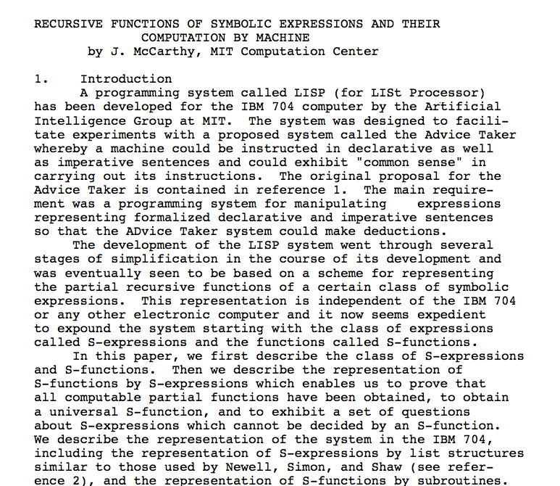
Notes:
.

Slide 72
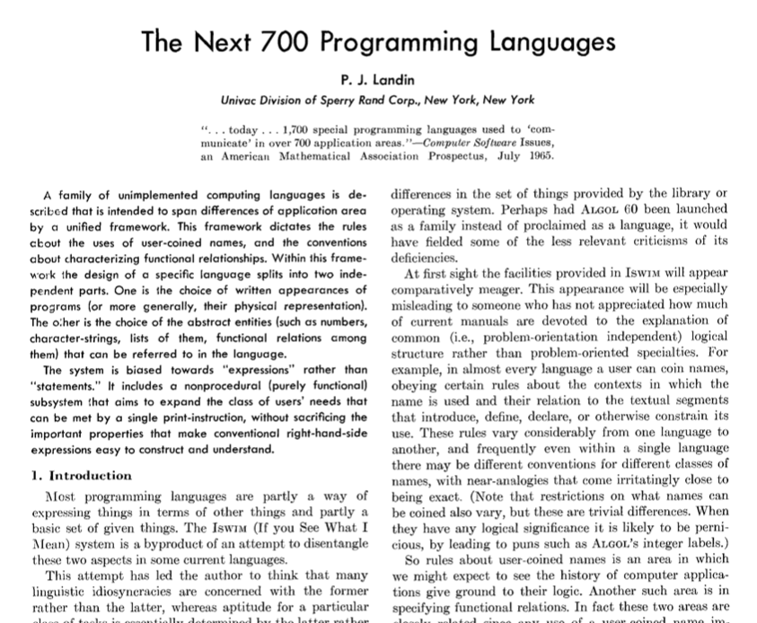

Slide 73
ISWIM (1966)
SASL (1972)
ML (1973)
Scheme (1975)
KRC (1981)
Miranda (1985)
Erlang (1986)
Haskell (1990)
F# (2002)
Clojure (2007)

Slide 74
Anonymous function,
Function literal
(\x -> x + 1)

Slide 75
Name binding
plusOne = (\x -> x + 1)

Slide 76
Function definition
plusOne x = x + 1

Slide 77
Currying
(\x -> (\y -> x + y))

Slide 78
sum = (\x -> (\y -> x + y))

Slide 79
sum x y = x + y

Slide 80
let m = "My "
d = "dog "
h = "has "
f = "fleas."
in m ++ d ++ h ++ f

Slide 81
let m = "My "
d = "dog "
h = "has "
f = "fleas."
in m ++ d ++ h ++ f
(\m -> (\d -> (\h -> (\f -> m ++ d ++ h ++ f)))) "My " "dog " "has " "fleas."

Slide 82
Datatype declaration
data Season = Winter

Slide 83
Type constructor
data Season = Winter
Data constructor

Slide 84
data Season = Winter
Nullary
means no arguments

Slide 85
data Season = Winter | Spring | Summer | Fall

Slide 86
data Season = Winter | Spring | Summer | Fall
“or”

Slide 87
data Season = Winter | Spring | Summer | Fall
after :: Season -> Season
Function type signature

Slide 88
data Season = Winter | Spring | Summer | Fall
after :: Season -> Season
“has type”
“to”

Slide 89
data Season = Winter | Spring | Summer | Fall
after :: Season -> Season

Slide 90
data Season = Winter | Spring | Summer | Fall
after :: Season -> Season
after Winter = Spring

Slide 91
data Season = Winter | Spring | Summer | Fall
after :: Season -> Season
after Winter = Spring
Pattern

Slide 92
data Season = Winter | Spring | Summer | Fall
after :: Season -> Season
after Winter = Spring
Equation

Slide 93
data Season = Winter | Spring | Summer | Fall
after :: Season -> Season
after Winter = Spring
after Spring = Summer
after Summer = Fall
after _ = Winter

Slide 94
data Season = Winter | Spring | Summer | Fall
after :: Season -> Season
after Winter = Spring
after Spring = Summer
after Summer = Fall
after _ = Winter
Wildcard pattern

Slide 95
data Season = Winter | Spring | Summer | Fall
after :: Season -> Season
after s = case s of Winter -> Spring
Spring -> Summer
Summer -> Fall
_ -> Winter

Slide 96
data Season = Winter | Spring | Summer | Fall
after :: Season -> Season
after s = case s of Winter -> Spring
Spring -> Summer
Summer -> Fall
_ -> Winter
after Winter = Spring
after Spring = Summer
after Summer = Fall
after _ = Winter

Slide 97
data Season = Winter | Spring | Summer | Fall
data Bool = True | False

Slide 98
data Season = Winter | Spring | Summer | Fall
data Bool = True | False
eqSeason :: Season -> Season -> Bool
“Curried”

Slide 99
data Season = Winter | Spring | Summer | Fall
data Bool = True | False
eqSeason :: Season -> (Season -> Bool)

Slide 100
data Season = Winter | Spring | Summer | Fall
data Bool = True | False
eqSeason :: Season -> Season -> Bool
eqSeason Winter Winter = True
eqSeason Spring Spring = True
eqSeason Summer Summer = True
eqSeason Fall Fall = True
eqSeason _ _ = False

Slide 101
data Bool = True | False
(&&) :: Bool -> Bool -> Bool

Slide 102
data Bool = True | False
(&&) :: Bool -> Bool -> Bool
True && x = x
False && _ = False

Slide 103
data Char = ‘a’ | ‘b’ | ‘c’ ...

Slide 104
data Char = ‘a’ | ‘b’ | ‘c’ ...
data Int = -65532 | ... -1 | 0 | 1 | ... | 65532

Slide 105
data Pair = Pair Int Char
Pair 2 ‘w’

Slide 106
data Pair a = Pair a a

Slide 107
data Pair a = Pair a a
first :: Pair t -> t
first (Pair x _) = x
second :: Pair t -> t
second (Pair _ y) = y
second (Pair 2 3)
evaluates to 3
second (Pair ‘p’ ‘w’)
evaluates to ‘w’
second (Pair True False)
evaluates to False

Slide 108
data List a = Empty | Link a (List a)
ghci> Link 1 Empty
Link 1 Empty
ghci> Link 2 (Link 1 Empty)
Link 2 (Link 1 Empty)

Slide 109
data List a = Empty | Link a (List a)
ghci> Link 1 Empty
Link 1 Empty
ghci> Link 2 (Link 1 Empty)
Link 2 (Link 1 Empty)
ghci> Link 3 (Link 2 (Link 1 Empty))
Link 3 (Link 2 (Link 1 Empty))

Slide 110
data List a = Empty | a : (List a)

Slide 111
data [a] = [] | a : [a]
Progression to built-in syntax
data List a = Empty | Link a (List a)
data List a = Empty | a : (List a)
data [a] = Empty | a : [a]
data [a] = [] | a : [a]

Slide 112
data [a] = [] | a : [a]
ghci> 1 : []
[1]
ghci> 2 : 1 : []
[2,1]
ghci> 3 : [2,1]
[3,2,1]

Slide 113
data [a] = [] | a : [a]
(++) :: [t] -> [t] -> [t]
Notes:
.

Slide 114
data [a] = [] | a : [a]
(++) :: [t] -> [t] -> [t]
[] ++ ys = ys
(x:xs) ++ ys = x : (xs ++ ys)

Slide 115
data [a] = [] | a : [a]
(++) :: [t] -> [t] -> [t]
[] ++ ys = ys
(x:xs) ++ ys = x : (xs ++ ys)
ghci> [1,2] ++ [3,4]
[1,2,3,4]

Slide 116
data [a] = [] | a : [a]
(++) :: [t] -> [t] -> [t]
[] ++ ys = ys
(x:xs) ++ ys = x : (xs ++ ys)

Slide 117
data [a] = [] | a : [a]
(++) :: [t] -> [t] -> [t]
[] ++ ys = ys
(x:xs) ++ ys = x : (xs ++ ys)
Progression of recursion
1 : ([2,3] ++ [4,5])
1 : (2 : ([3] ++ [4,5]))
1 : (2 : (3 : ([] ++ [4,5])))
1 : (2 : (3 : [4,5]))
[1,2,3,4,5]

Slide 118
square x = x * x

Slide 119
square x = x * x
map :: (a -> b) -> [a] -> [b] map f [] = [] map f (x:xs) = f x : map f xs ghci> map square [1,2,3] [1,4,9]

Slide 120
square x = x * x
map :: (a -> b) -> [a] -> [b] map f [] = [] map f (x:xs) = f x : map f xs ghci> map square [1,2,3] [1,4,9]

Slide 121
demo :: (a -> a -> b) -> [a] -> [b]
demo op xs = s ++ r
where
s = map (\y -> y `op` y) xs
r = reverse s
ghci> demo (+) [1,2,3]
[2,4,6,6,4,2]
ghci> demo (*) [1,2,3]
[1,4,9,9,4,1]

Slide 122
demo :: (a -> a -> b) -> [a] -> [b]
demo op xs = s ++ r
where
s = map (\y -> y `op` y) xs
r = reverse s
ghci> demo (+) [1,2,3]
[2,4,6,6,4,2]
ghci> demo (*) [1,2,3]
[1,4,9,9,4,1]
Notes:
.

Slide 123
demo :: (a -> a -> b) -> [a] -> [b]
demo op xs = s ++ r
where
s = map (\y -> y `op` y) xs
r = reverse s
ghci> demo (+) [1,2,3]
[2,4,6,6,4,2]
ghci> demo (*) [1,2,3]
[1,4,9,9,4,1]

Slide 124
Functional Features
Lambda abstraction (function literals)
Functions are ‘first class’
Strong typing
Pattern matching
Recursion
Currying (partial function application)
Expressions (evaluates to value)
No changing values bound to variables

