Slide 1
啖飯
19101 cuisine
健康是一生的事情，吃飯是天天的事情。
web05 邱浩桐
Jun 23, 2020

Slide 2
Contents
MOTIVE
STRUCTURE
DEVELOPMENT
LAYOUT

Slide 3
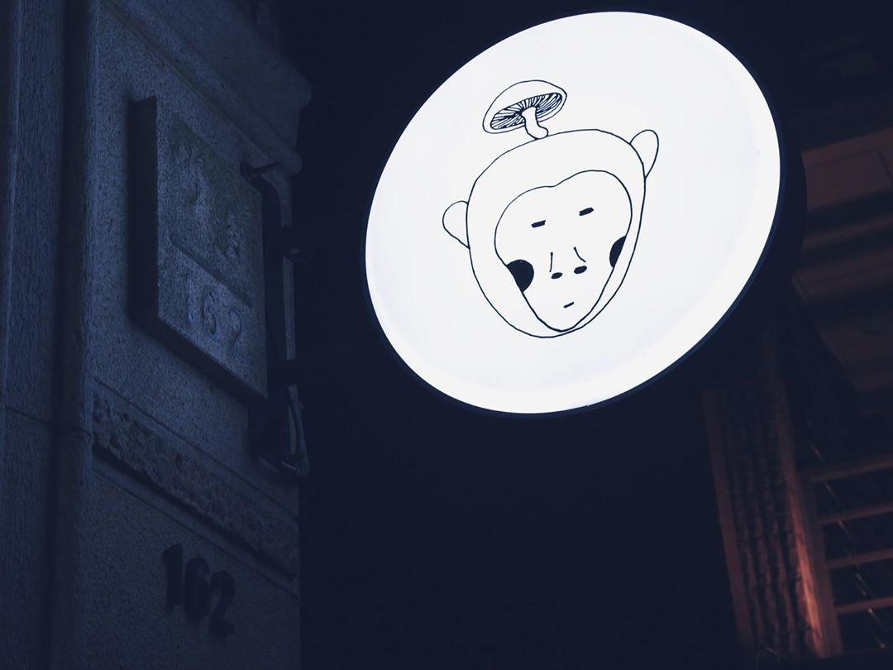
Motive
The owner is a friend of mine.

Slide 4
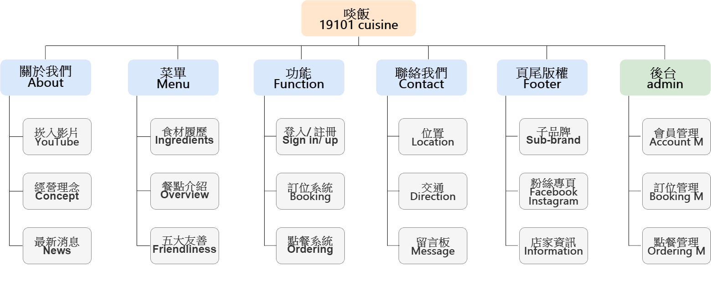
Structure

Slide 5
Development
Front
BootstrapVue
Vue.js
Sass
Back
Node.js
mongoDB
Design
Illustrator
Photoshop

Slide 6
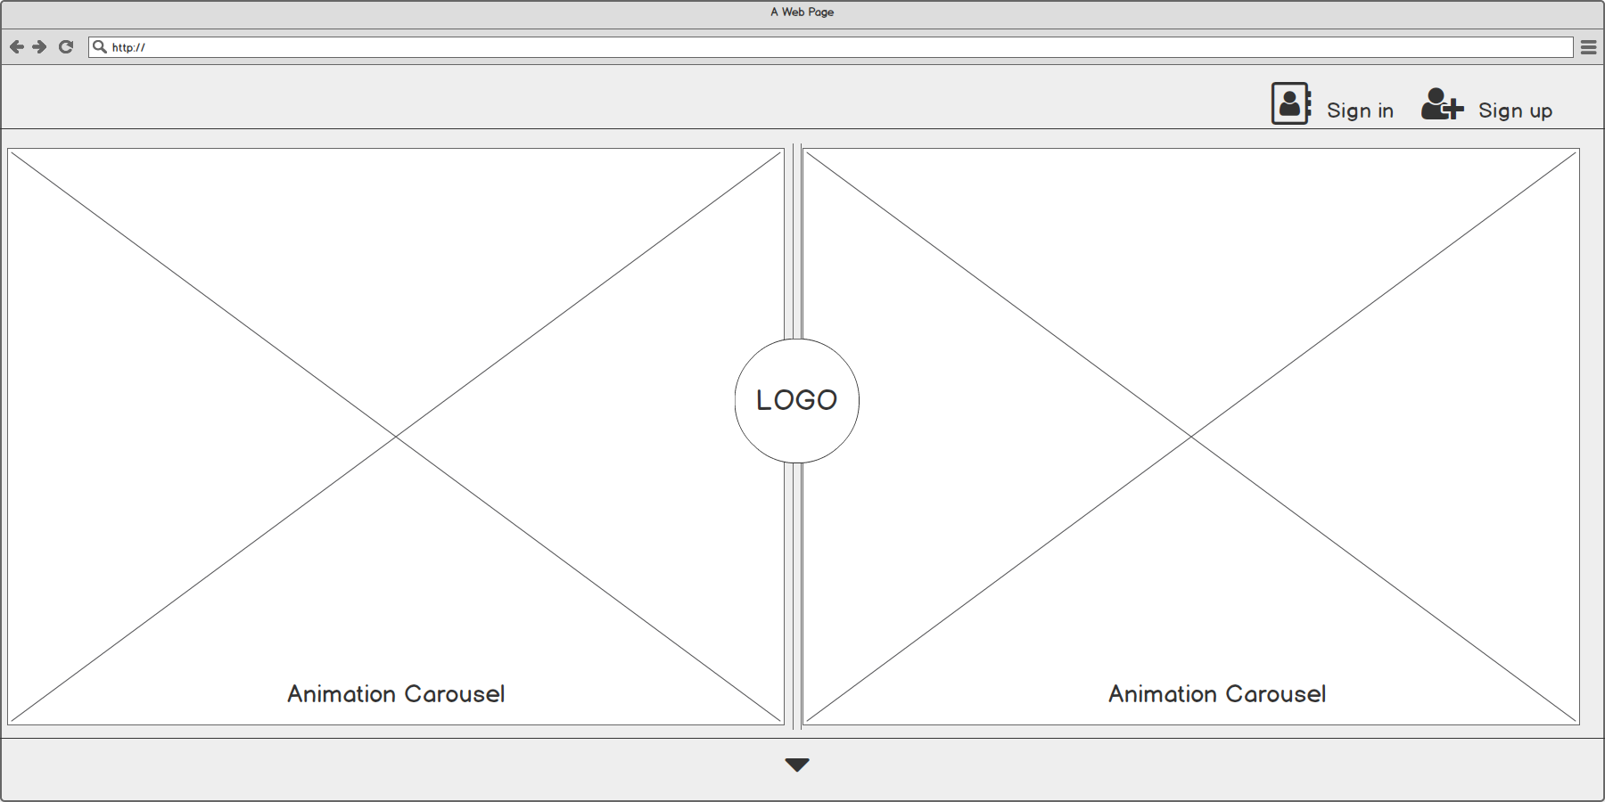
Head
Layout

Slide 7
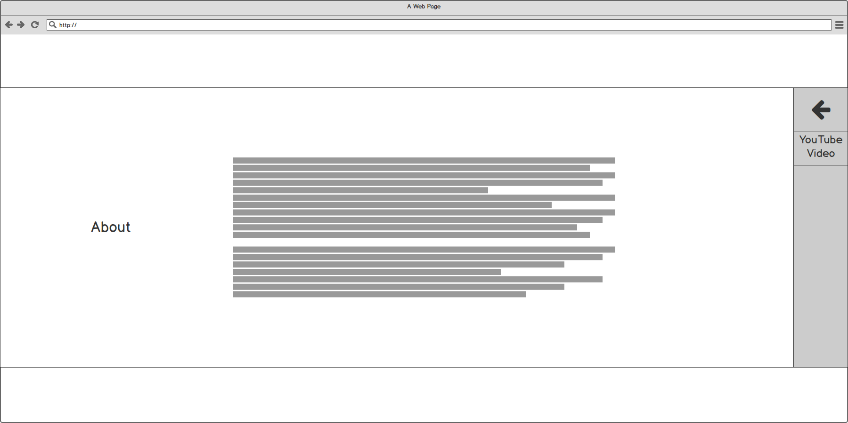
About
Layout

Slide 8
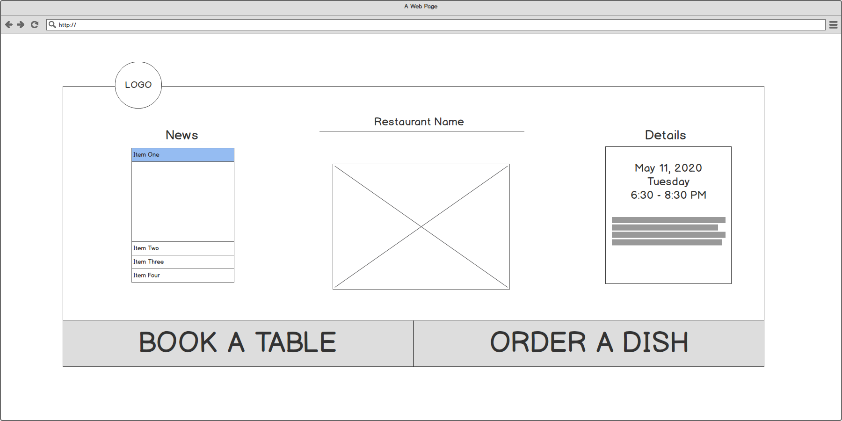
Events
Layout

Slide 9
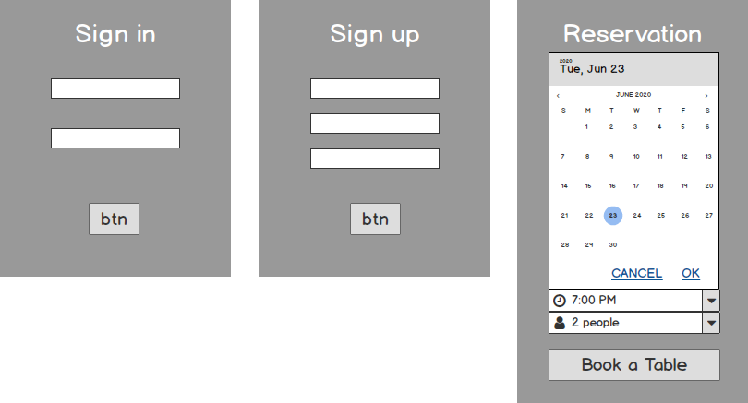
Function
Layout

Slide 10
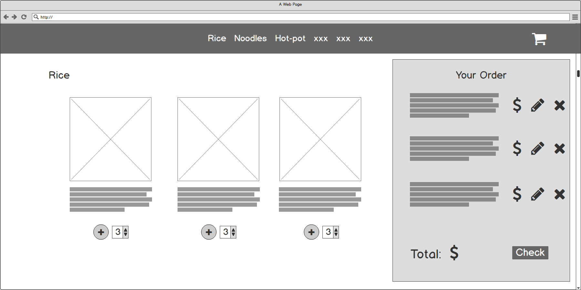
Function
Layout

Slide 11
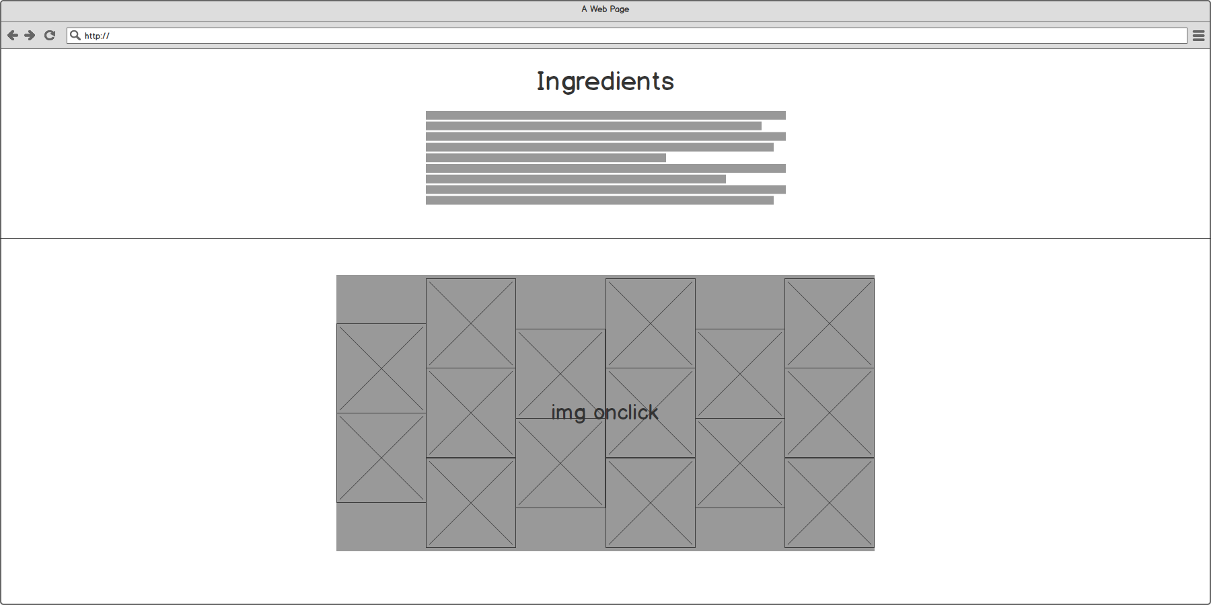
Menu
Layout

Slide 12
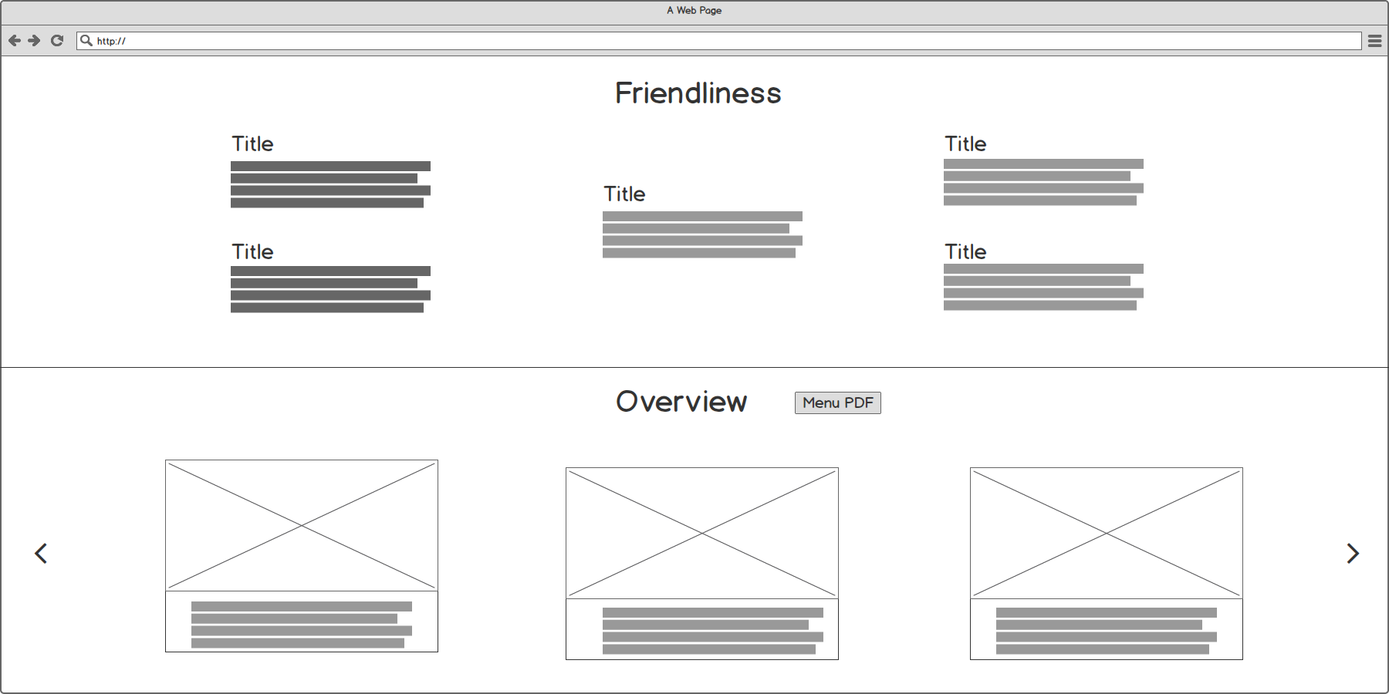
Menu
Layout

Slide 13
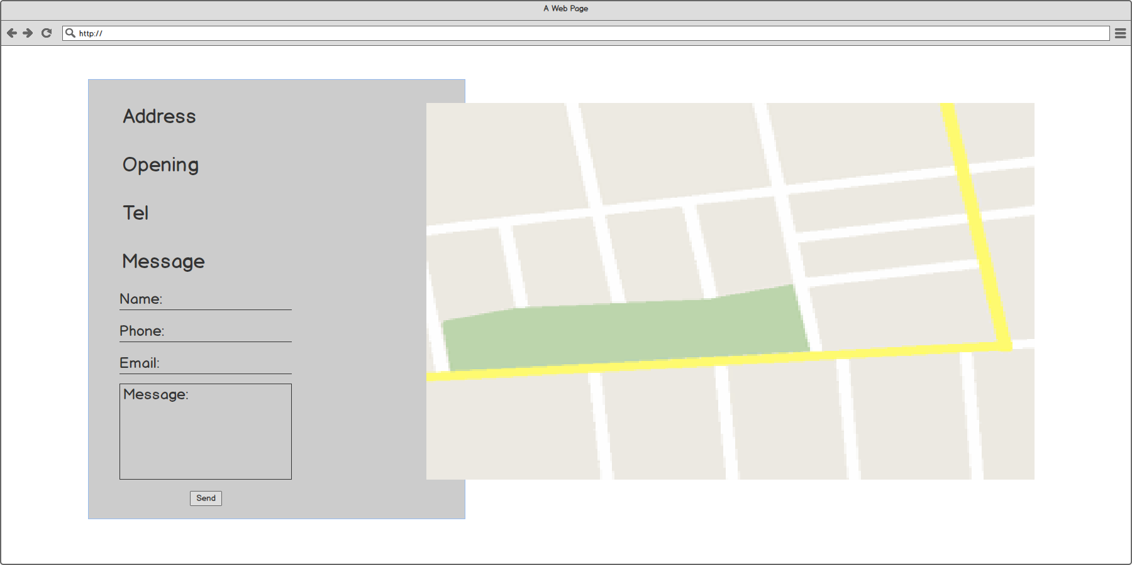
Contact
Layout

Slide 14
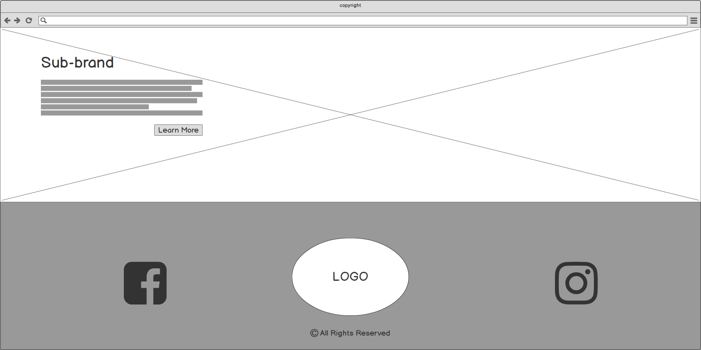
Footer
Layout

Slide 15

Thanks
專題是七月的事情，
寇汀是天天的事情。

