Slide 1
Comparing Agile and Waterfall
Thomas Christian

Slide 2
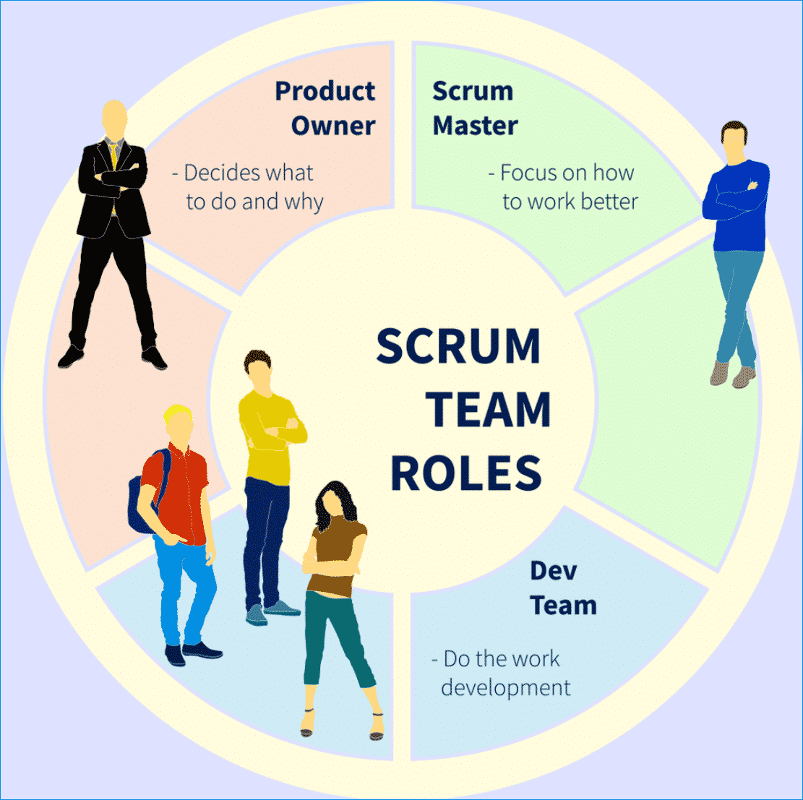
Agile Roles
Scrum Master: Facilitates the process, removes impediments, ensures adherence to Scrum practices.
Product Owner: Manages the backlog, prioritizes user stories based on business value.
Development Team: Collaborates to deliver increments, includes developers and testers.

Slide 3
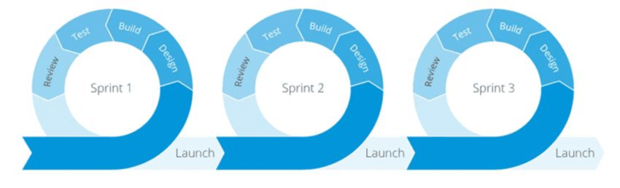
Agile ‘Phases’
Sprint Planning: Define sprint goals, prioritize user stories.
Daily Stand-ups: Monitor progress, address blockers.
Sprint Review: Present completed work, gather stakeholder feedback.
Sprint Retrospective: Reflect on the sprint, identify improvements.

Slide 4
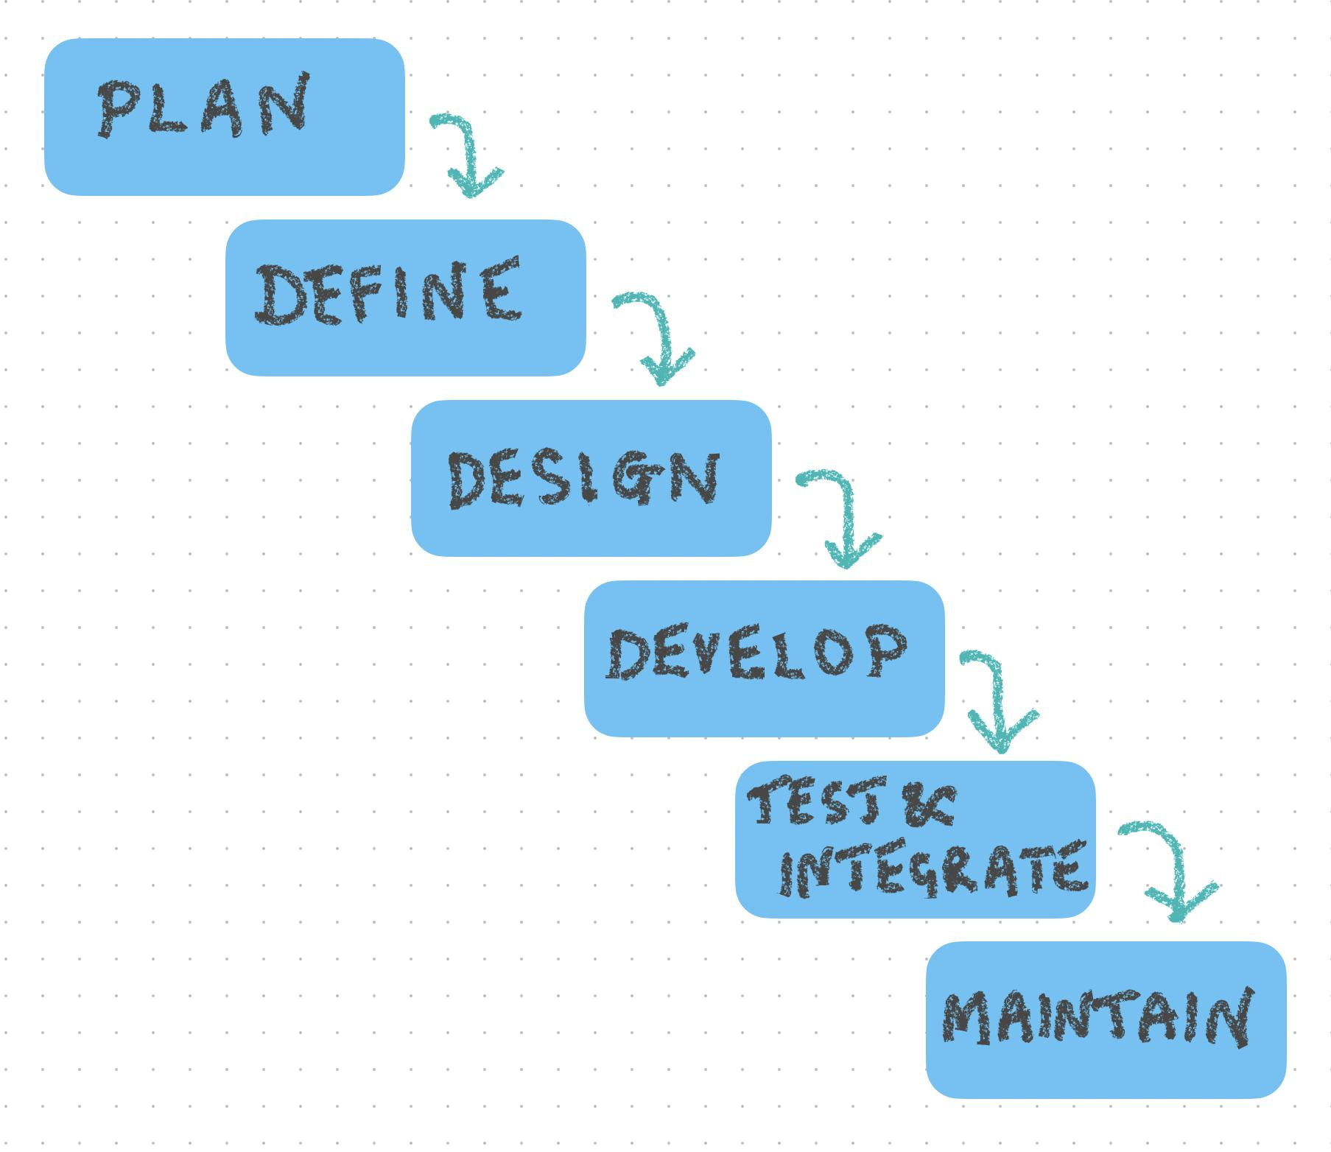
Waterfall Model
Sequential Phases: Requirements, Design, Implementation, Testing, Deployment.
Differences: Less flexibility, changes are costly and difficult to incorporate, longer feedback loops.

Slide 5

Agile vs Waterfall
Factors to Consider: Project complexity, stakeholder involvement, flexibility requirements.
Course Experience: Agile approach allowed for continuous improvement and quick adaptation to changes.

Slide 6
Sources
Cohn, M. (2010). Succeeding with Agile: Software Development Using Scrum. Addison-Wesley Professional.
Schwaber, K., & Sutherland, J. (2020). The Scrum Guide: The Definitive Guide to Scrum: The Rules of the Game. Scrum.org. Retrieved from https://www.scrumguides.org/scrum-guide.html
Rubin, K. S. (2012). Essential Scrum: A Practical Guide to the Most Popular Agile Process. Addison-Wesley Professional.
Kniberg, H., & Skarin, M. (2010). Kanban and Scrum - Making the Most of Both. C4Media.
Beck, K., & Andres, C. (2004). Extreme Programming Explained: Embrace Change (2nd ed.). Addison-Wesley Professional.
Rising, L., & Janoff, N. S. (2000). The Scrum software development process for small teams. IEEE Software, 17(4), 26-32. https://doi.org/10.1109/52.854065

