Slide 1

def CornholePlus(5080, Project_3):
Author: Thomas Kidd
Date: 12/01/2024

Slide 2
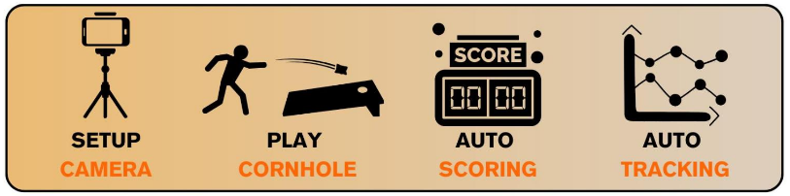
Project Goals
def CornholePlus
Track statistics for cornhole players using their phone
(5080, Project_3)
Label cornhole data using SAM2 model in Label Studio

Slide 3
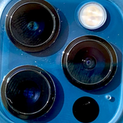
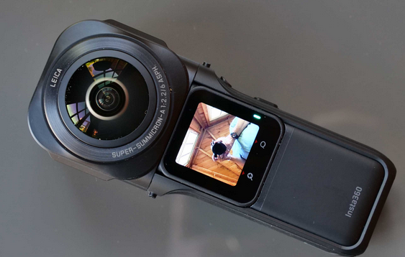
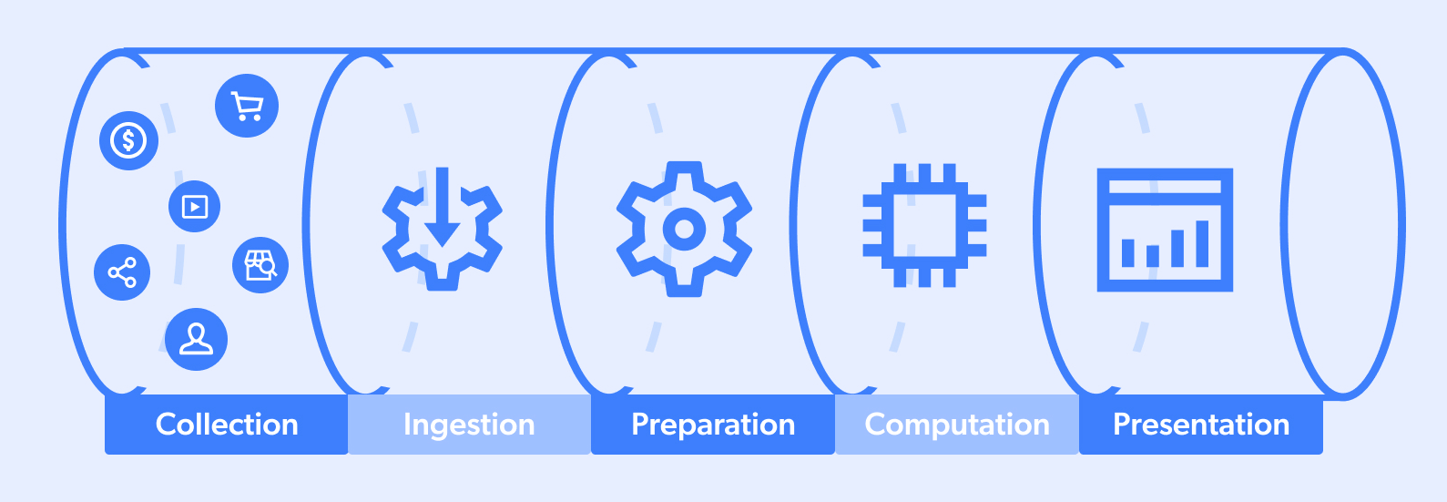

The need for data
Our software revolves around the data
Need to collect data
Smartphone
360 Cam
Need to label data
LabelStudio

Slide 4
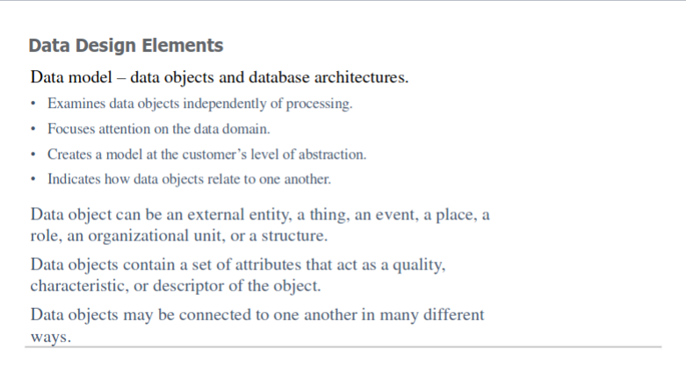

Slide 5
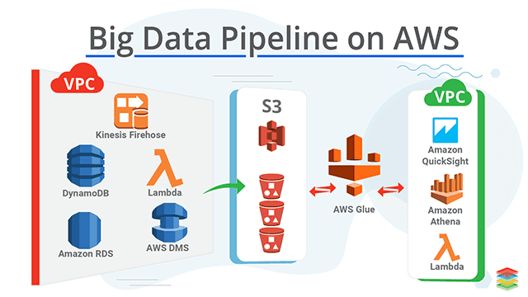
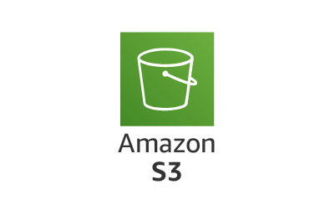

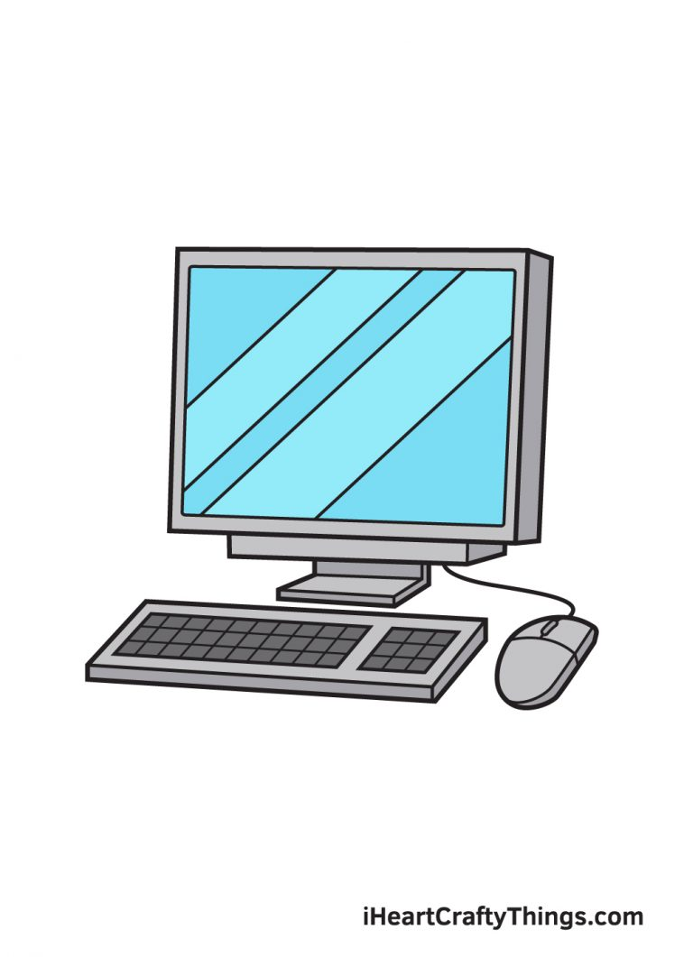
Expectations VS Reality
What I expect
What happens
*Insert old PC*

Slide 6


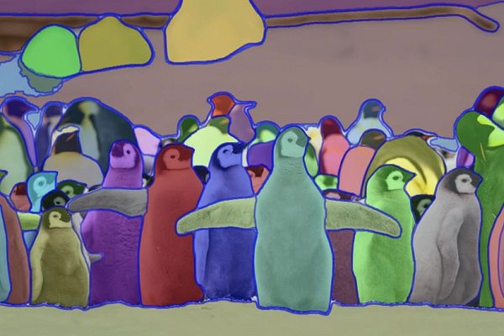
Video Labeling
Current methods
  Manual
  Tracking of keypoints
  Crowd sourcing
One keypoint auto segmentation tracking with built in memory?
Zero shot object tracking?

Slide 7
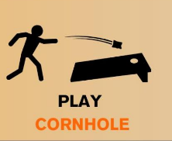
Motivation for video labeling
Statistics???
What is the cornhole player doing?
How is information stores
Speed
One long video has thousands of images
We need 10k-100k images to test training accuracy

Slide 8
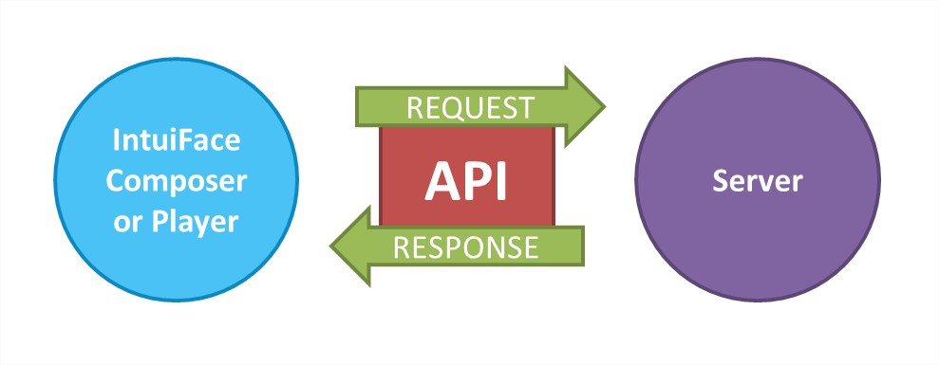
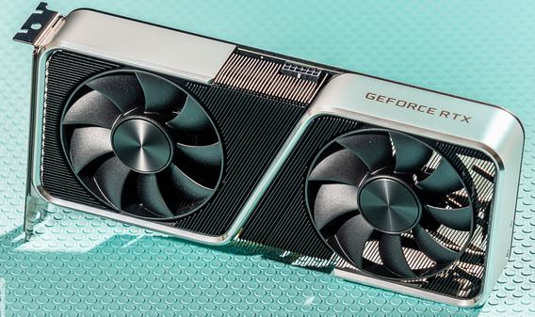
Label Studio Video Labeling
Front end
Users can label images, videos, text
Set up the server on AWS
ML Backend
Listens to the front end
Executes predictions on data

Slide 9
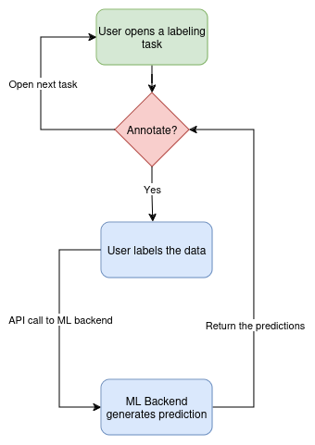
Software Steps
Given: we are developing a new feature for an open source tool
Purpose: end goal in mind means having the user experience in mind
Action needed: understand the current mechanisms of the software

Slide 10
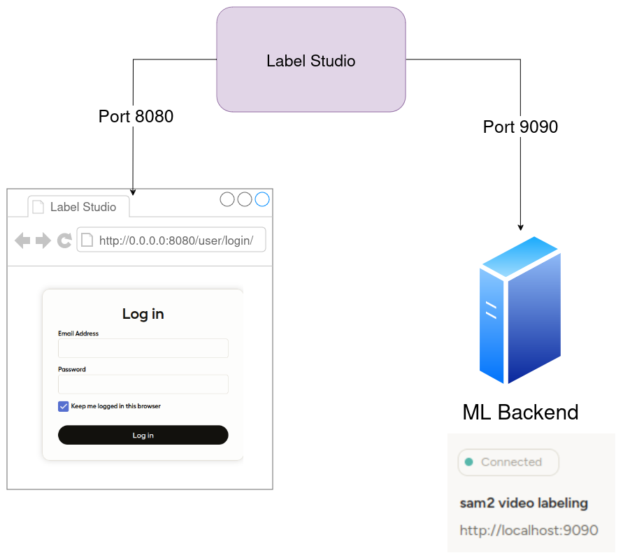

Label Studio ML communication

Slide 11
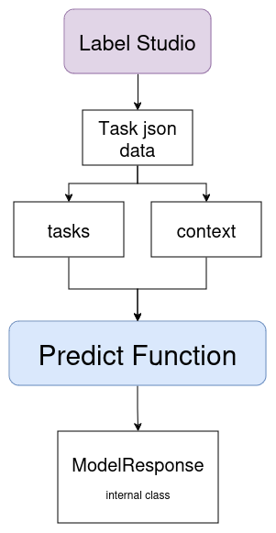
ML predict function
Extract data and prompts: Retrieves video metadata, from tasks and drafts. Analyzes annotations or context to identify model prompts for object tracking.
Track objects across frames: Splits the video into individual frames, initializes inference states, and uses the model to predict masks for objects.
Refine and output annotations: Generates detailed annotation sequences by combining new predictions with existing data. Updates Label Studio with refined object masks, bounding boxes, and associated labels to maintain a coherent annotation workflow.

Slide 12
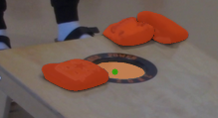
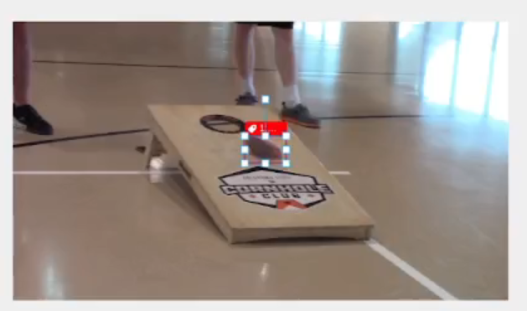
Some Results

Slide 13
Demo

Slide 14

Fix Label Studio Front end bugs
There are 2 main bugs preventing from the displaying of multi object tracking
Issue #664 and #6593

Slide 15
Bugs that I have found
Frame indexing issues between Label Studio and SAM2
Key error in json when labeling multiple objects

Slide 16
Testing structure
Pytest
The test sends a JSON request to the /predict endpoint
It compares non-numerical and structural fields of the response against the expected values
For numeric fields like coordinates and sizes, it uses a custom comparison function that allows for a defined tolerance
Jenkins
Running it locally
Created an install script
Created a test script

Slide 17
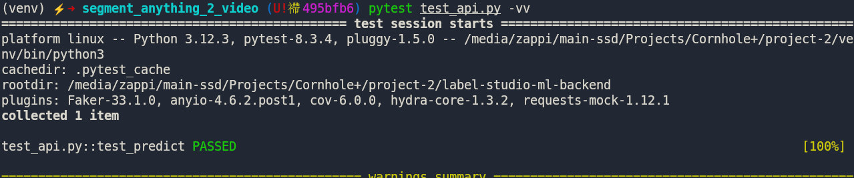
OMG YAY

Slide 18
