Slide 1

Detection and Prediction of Phishing Websites
Thomas K John

Slide 2
Agenda
Introduction
Dataset Information
Understanding the data (EDA)
Models
Future Scope

Slide 3
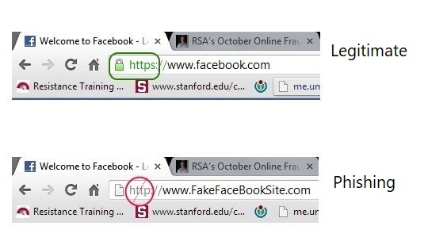
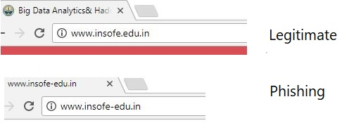
Introduction
Phishing websites are those websites that mimic the legitimate websites and deceive online users in order to steal their sensitive information. Phishing website detection can be defined in machine learning context as a typical classification problem.

Slide 4
Dataset Information
The dataset is a collection of 11055 different websites from different sources like PhishTank archive (www.phishtank.com), MillerSmiles archive (www.millersmiles.co.uk) and Google’s searching operators.
Total number of websites: 11055 websites
Phishing websites : 4898 (55.68 %)
Legitimate websites : 6157 (44.32 %)
The dataset has 30 features and all the collected features hold the categorical values: Phishing as -1
Suspicious as 0
Legitimate as 1

Slide 5
Dataset Information
1.) Address Bar based Features
having_IP_Address
URL_Length
Shortining_Service
having_At_Symbol
double_slash_redirecting
Prefix_Suffix
having_Sub_Domain
SSLfinal_State
Domain_registeration_length
Favicon
port
HTTPS_token
3.) Domain based Features
age_of_domain
DNSRecord
web_traffic
Page_Rank
Google_Index
Links_pointing_to_page
Statistical_report
2.) Abnormal Based Features
Request_URL
URL_of_Anchor
Links_in_tags
SFH
Submitting_to_email
Abnormal_URL
4.) HTML and JavaScript based Features
Redirect
on_mouseover
RightClick
popUpWidnow
Iframe

Slide 6
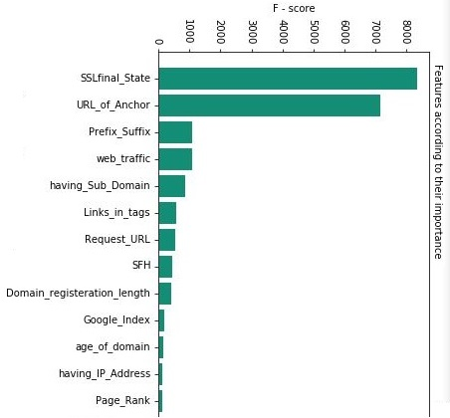
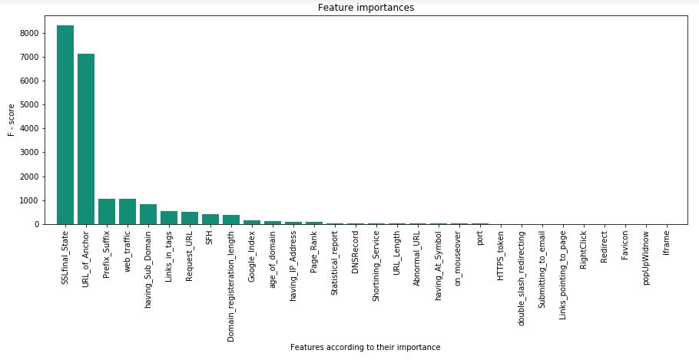
Understanding the data (EDA)
Feature selection based on the ANOVA F-score

Slide 7
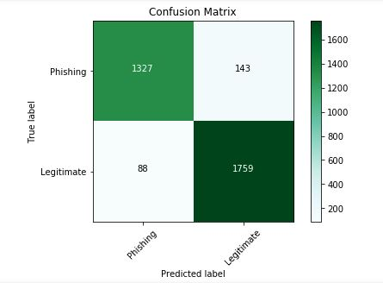
Model – Logistic Regression
In phishing dataset the predictor variables are all categorical variables and the accuracy obtained for a simple logistic regression is high and that shows the model is having less noise.
Models | Training Results |  |  |  | Testing Results
 | Accuracy | Precision | Recall | F1-Score | Accuracy | Precision | Recall | F1-Score
LR with L1 regularization | 93.02% | 93.03% | 93.02% | 93.01% | 92.64% | 92.66% | 92.64% | 92.63%
LR with 13 important variables | 92.31% | 92.32% | 92.31% | 92.30% | 92.10% | 92.13% | 92.10% | 92.08%

Slide 8
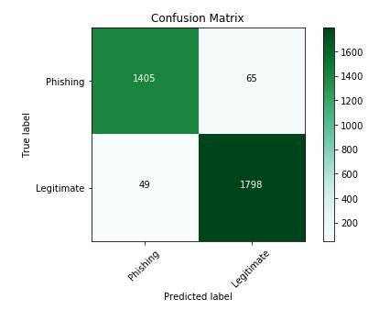
Model – SVM
A Support Vector Machine (SVM) performs classification by finding the hyperplane that maximizes the margin between the two classes.
Models | Training Results |  |  |  | Testing Results
 | Accuracy | Precision | Recall | F1-Score | Accuracy | Precision | Recall | F1-Score
SVM | 95.15% | 95.17% | 95.15% | 95.15% | 94.27% | 94.29% | 94.27% | 94.26%
SVM with cross validation | 98.86% | 98.87% | 98.86% | 98.86% | 96.77% | 96.78% | 96.77% | 96.77%
SVM with 13 important features and cross validation | 97.09% | 97.10% | 97.09% | 97.09% | 94.99% | 95.00% | 95.00% | 94.99%

Slide 9
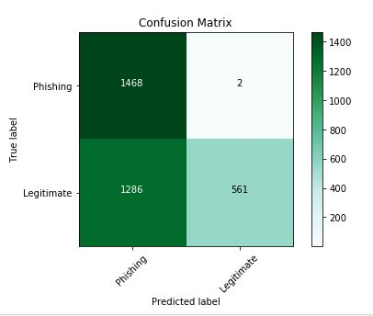
Model – Naive Bayes
Assumes that the variables are independent of each other, but that’s not true.
Models | Training Results |  |  |  | Testing Results
 | Accuracy | Precision | Recall | F1-Score | Accuracy | Precision | Recall | F1-Score
Naive Bayes | 59.88% | 78.68% | 59.89% | 54.90% | 61.32% | 79.25% | 61.32% | 56.92%
Naïve Bayes with 13 important variables | 59.07% | 78.73% | 59.07% | 53.65% | 59.93% | 78.96% | 59.93% | 54.91%

Slide 10
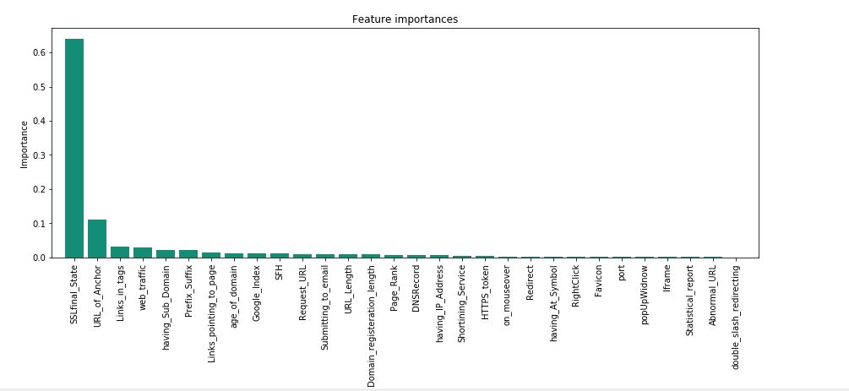
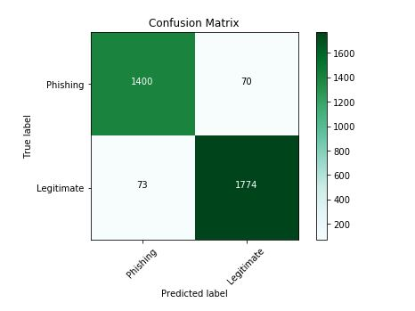
Model – Decision Tree
Decision tree models are good classifiers when the decision boundaries are parallel to the axes, creating rectangular feature spaces.
Models | Training Results |  |  |  | Testing Results
 | Accuracy | Precision | Recall | F1-Score | Accuracy | Precision | Recall | F1-Score
Decision Tree | 98.52% | 98.53% | 98.53% | 98.53% | 95.42% | 95.42% | 95.42% | 95.42%
Decision Tree with 13 important features | 97.47% | 97.47% | 97.47% | 97.47% | 94.42% | 94.43% | 94.42% | 94.42%

Slide 11
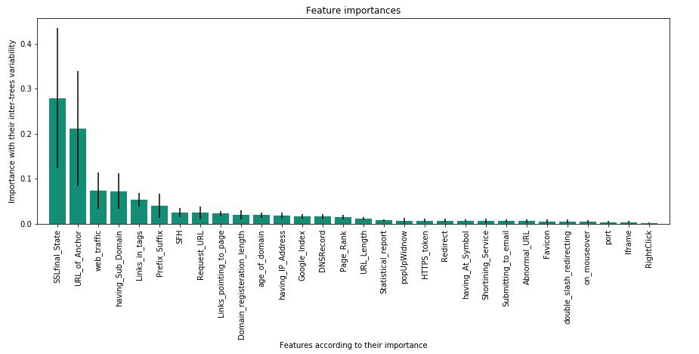
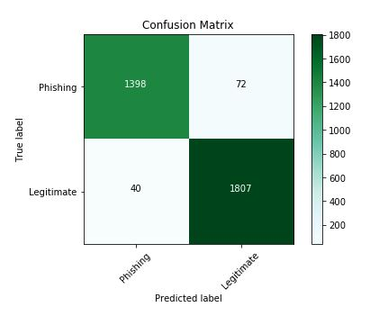
Model – Random Forest
The random forest algorithm aggregates many decision trees built on bootstrapped samples of the training data in order to reduce the high variance of a single decision tree and improve the prediction accuracy.
Models | Training Results |  |  |  | Testing Results
 | Accuracy | Precision | Recall | F1-Score | Accuracy | Precision | Recall | F1-Score
Random Forest | 99.03% | 99.03% | 99.03% | 99.03% | 96.89% | 96.90% | 96.89% | 96.89%
Random Forest with 13 important features | 97.56% | 97.56% | 97.56% | 97.56% | 95.60% | 95.60% | 95.60% | 95.60%

Slide 12
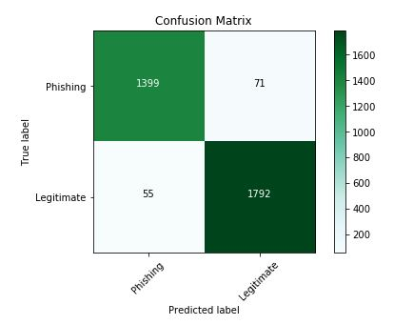
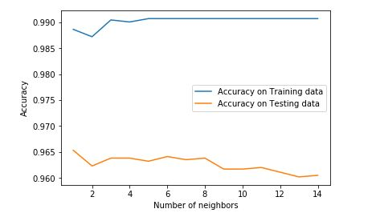
Model – K Nearest Neighbor
K-Nearest Neighbors is a simple algorithm that stores all available instances and classifies new instances based on a similarity measure (e.g., distance functions).
Models | Training Results |  |  |  | Testing Results
 | Accuracy | Precision | Recall | F1-Score | Accuracy | Precision | Recall | F1-Score
KNN with k = 6, Hamming distance | 99.18% | 99.02% | 99.02% | 99.02% | 96.41% | 96.41% | 96.41% | 96.41%
KNN with k = 7, Hamming distance and 13 important variables | 97.53% | 97.53% | 97.53% | 97.53% | 95.11% | 95.11% | 95.11% | 95.11%

Slide 13
Model – Results
Best Result from each model | Training Results |  |  |  | Testing Results
 | Accuracy | Precision | Recall | F1-Score | Accuracy | Precision | Recall | F1-Score
LR with L1 regularization | 93.02% | 93.03% | 93.02% | 93.01% | 92.64% | 92.66% | 92.64% | 92.63%
Decision Tree | 98.52% | 98.53% | 98.53% | 98.53% | 95.42% | 95.42% | 95.42% | 95.42%
Random Forest | 99.03% | 99.03% | 99.03% | 99.03% | 96.89% | 96.90% | 96.89% | 96.89%
Naive Bayes | 59.88% | 78.68% | 59.89% | 54.90% | 61.32% | 79.25% | 61.32% | 56.92%
KNN with k = 6, Hamming distance | 99.18% | 99.02% | 99.02% | 99.02% | 96.41% | 96.41% | 96.41% | 96.41%
SVM with RBF and cross validation | 98.86% | 98.87% | 98.86% | 98.86% | 96.77% | 96.78% | 96.77% | 96.77%

Slide 14
Conclusion and Future Scope
Can implement a plugin in browsers to prevent users from unknowingly accessing phishing websites.
By using only the 13 important features we are able to achieve a recall of 94 % in decision tree.
Following are the 13 important features selected from our models:
SSLfinal_State URL_of_Anchor Prefix_Suffix
web_traffic Links_in_tags Request_URL
having_SubDomain SFH Google_Index
age_of_domain having_IP_Address Page_Rank
Domain_registration_length

