Slide 1
Mid Term Hackathon Aug 2017 Save the Earth from a Quake
Thomas K. John

Slide 2
Agenda
Task of hazards prediction bases on the relationship between the energy of recorded tremors and seismoacoustic activity with the possibility of rockburst occurrence. With the information about the possibility of hazardous situation occurrence, an appropriate supervision service can reduce a risk of rockburst .

Slide 3
Preprocessing steps..
Renaming the attributes
Converting the TARGET variable to factors
Removing the row index since it is not useful in prediction
Imputing the missing values
Winsorizing for reducing the skewness

Slide 4
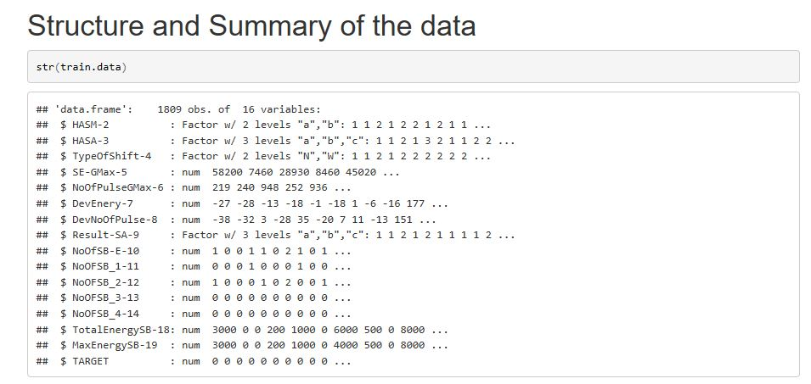
Understanding the Data

Slide 5
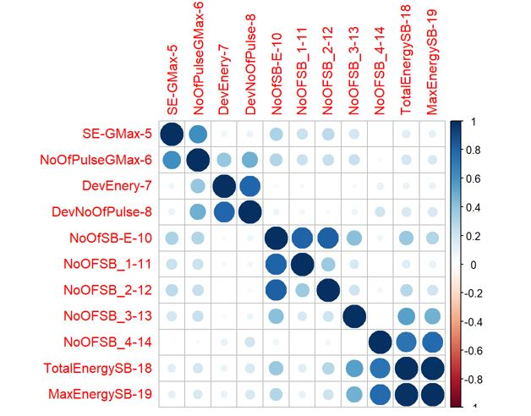
Correlation Plot: Numerical variables

Slide 6
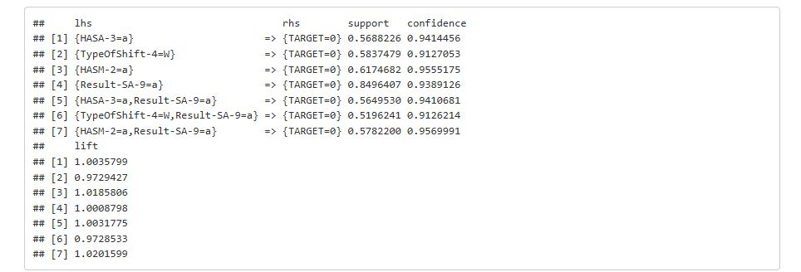
Association Rules:
Association rules for classifying the possibility of not having an earth quake are high.

Slide 7
Why Logistics Regression?
and
Why not Decision Tree?

Slide 8
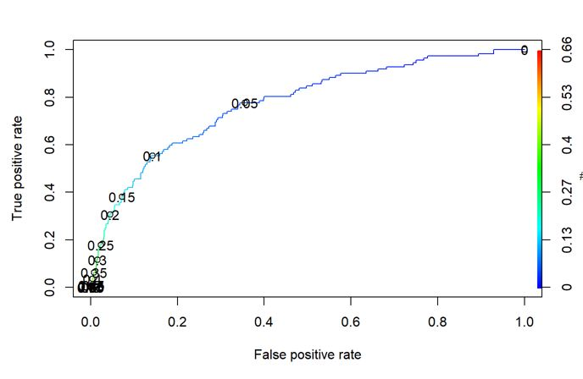
ROC Curve:

Slide 9
Conclusion
Since the occurrence of Earth quake is very rare, we cannot consider Accuracy for evaluation of the model.
Good prediction of increased seismic activity can be assured if the model has good Sensitivity.

