Slide 1

ECB1204 – ANALOG INTEGRATED CIRCUIT DESIGN REDEFINING HOME SAFETY THROUGH PRECISION AND INNOVATION
Presented by:
PURUSHOTHAMAN A (2303811710621081)
RAJKUMAR R S (2303811710621085)
THOMAS LIVINGSTON G (2303811710621115)
Under the Guidance of
Mrs.G.KEERTHANA, M.E .,
ASSISTANT PROFESSOR
ECE

Slide 2
OUTLINE
ABSTRACT
INTRODUCTION
PROBLEM STATEMENT
OBJECTIVE
HARDWARE MODULE
RESULTS AND DISCUSSION
ADVANTAGES AND APPLICATIONS
CONCLUSION
FUTURE ENHANCEMENT

Slide 3
ABSTRACT
Designed a laser-based security system for intrusion detection.
Uses a laser pointer and LDR to detect beam interruptions.
LM358 comparator and NE555 timer IC handle signal processing and alarm control.
Activates a buzzer upon intrusion and requires manual reset.
Cost-effective and simple to construct.
Simple and efficient solution for securing homes or sensitive areas.

Slide 4
INTRODUCTION
Security is a critical requirement in homes and industries.
Laser-based systems offer simplicity and cost efficiency.
Utilizes light beam interruption as a detection mechanism.
Employs basic components for easy implementation.
Enhances safety with additional alarm features.
Modern security systems are critical for personal and property safety.

Slide 5
PROBLEM STATEMENT
Existing systems are expensive and overly complex.
Difficulty in achieving reliable intrusion detection with low-cost solutions.
Inability of some systems to provide manual control or reset.
Need for a compact and portable security system.
Limited options for low-budget security setups.
Lack of cost-effective, reliable intrusion detection solutions.

Slide 6
OBJECTIVE
Develop a simple, laser-based intrusion detection system.
Use minimal and affordable components for cost efficiency.
Ensure the system reliably detects laser beam interruptions.
Provide a manual reset feature for controlled alarm deactivation.
Create a prototype that can be used in real-world applications.
Ensure reliable alarm triggering on beam interruption.
Enable manual reset for user control and safety.

Slide 7
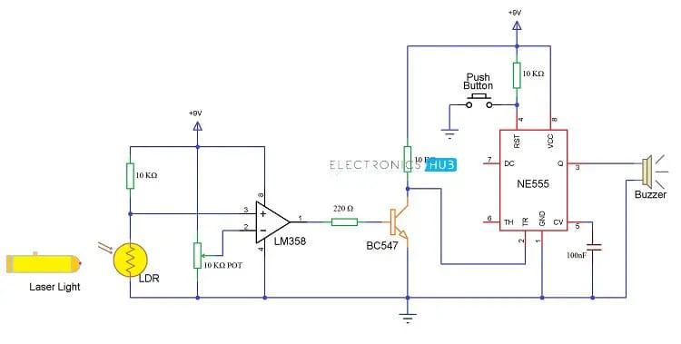
HARDWARE MODULE

Slide 8
HARDWARE MODULE
Laser Pointer: Continuous light source for detection.
LDR (Light Dependent Resistor): Light sensor.
LM358: Operational amplifier for signal comparison.
NE555: Timer IC used in bi-stable mode for alarm control.
BC547: NPN transistor for switching.
Buzzer: Alarm indicator.
Push Button: Resets the alarm system.
Resistors, Capacitors, and Potentiometer: Support components.
9V Battery: Power supply.
Breadboard and Wires: Circuit prototyping.

Slide 9
RESULTS AND DISCUSSION
Laser beam interruption reliably activates the alarm.
LDR resistance changes with light, detected by LM358.
NE555 timer maintains buzzer in active mode until reset.
Manual push-button ensures the alarm can be deactivated securely.
Circuit performs well under normal lighting conditions.
Effective detection when laser alignment with LDR is precise.

Slide 10
ADVANTAGES AND APPLICATIONS
Advantages:
Simple, cost-effective design.
Easy to reset with a push button.
Customizable for various security requirements.
Effective for small-scale applications.
Applications:
Security for home safety lockers.
Security enhancement for small offices or stores.
Portable security for events or temporary setups.

Slide 11
CONCLUSION
Implemented a functional laser-based security system.
Successfully detects intrusions by monitoring beam interruptions.
System ensures high reliability with manual reset feature.
Compact design makes it easy to use and maintain.
Practical solution for affordable security needs.
Designed and implemented a low-cost laser security system.
Offers an additional layer of security for homes and small areas.

Slide 12
FUTURE ENHANCEMENT
Integrate multiple laser beams for broader area coverage.
Integrate multiple lasers to cover larger areas.
Add wireless modules for remote alerts.
Include image/video capture during intrusions.
Enhance power efficiency with advanced circuit designs.
Build a mobile app for real-time intrusion notifications.
Add wireless or IoT capabilities for remote monitoring.

Slide 13
THANK YOU

