Slide 1
Simulations in AC Tokamak Ramp Downs
Tom Malcolm
(The talk edition)
Nov.
2023

Slide 2
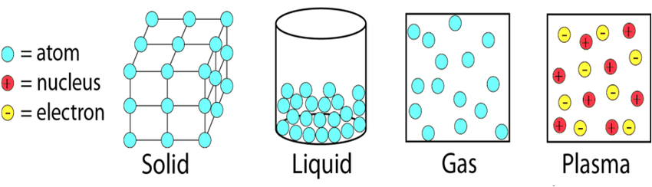
What is plasma?

Slide 3
What is fusion?
I
Abundant process in nature
- see stars
2
H+
3
H
(fusion)
4
→
He+n+17.59 MeV
I
Large amounts of energy
released
I
Occurs most easily in plasma

Slide 4
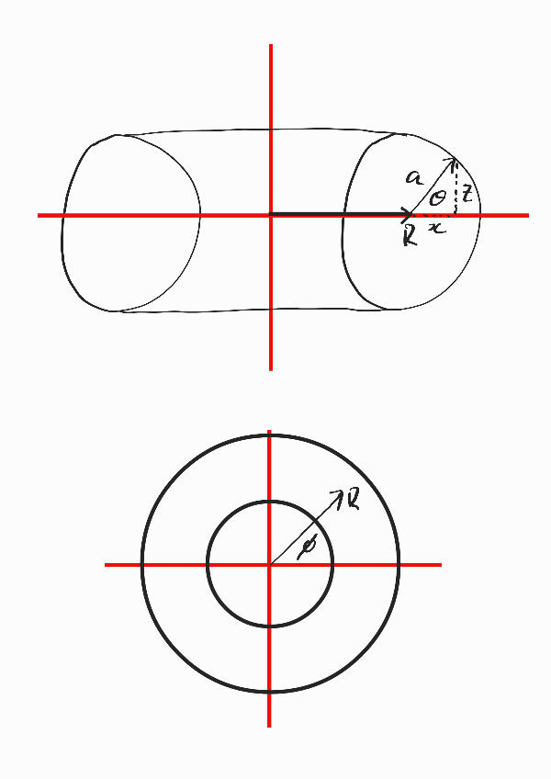
What is a fusion reactor?
What is it?
I
Controlled fusion for power
generation
I
Axisymmetric donut
(spherical
cow)
Challenges
I
Confinement
I
Runaway Electrons
I
Sustaining the reaction

Slide 5
What is a fusion reactor?
What is it?
I
Controlled fusion for power
generation
I
Axisymmetric donut
(spherical
cow)
Challenges
I
Confinement
I
Runaway Electrons
I
Sustaining the reaction

Slide 6
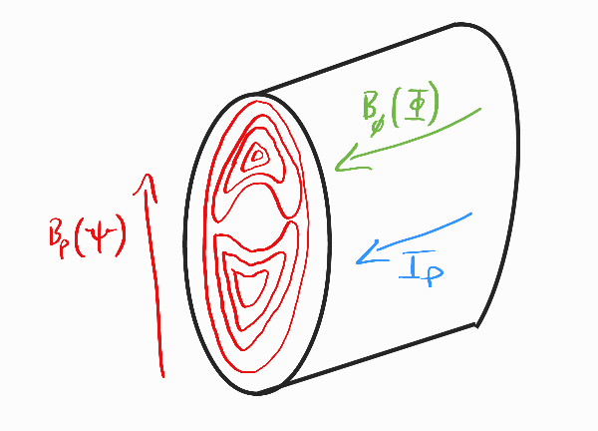
What is a fusion reactor?
What is it?
I
Controlled fusion for power
generation
I
Axisymmetric donut
(spherical
cow)
Challenges
I
Confinement
I
Runaway Electrons
I
Sustaining the reaction

Slide 7
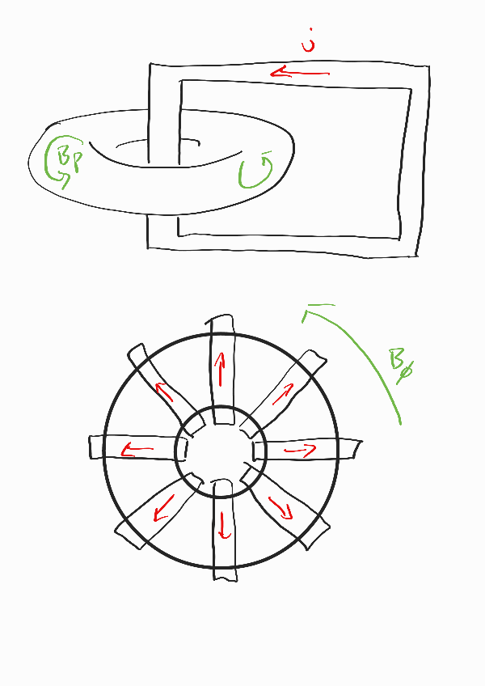
What is an AC Tokamak?
What is it?
I
Plasma current oscillates
back and forth (AC)
I
ISTTOK reactor (Artur in
Portugal)
Challenges?
I
Residual
current density at
I
= 0
p
I
Runaway electron
population increase

Slide 8
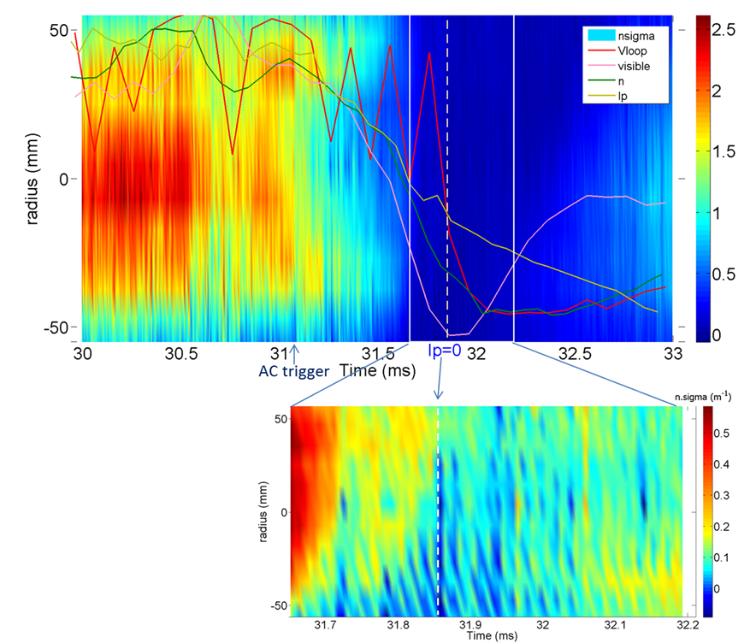
So what’s the problem?

Slide 9
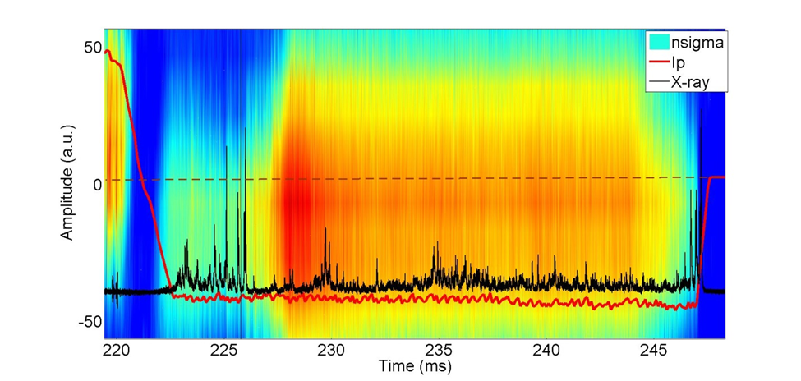
So what’s the problem?

Slide 10
Modelling Plasma
Fluid Dynamics
Maxwell’s Equations
∂ρ
1
∂
~
= −∇ · (ρ
~
E
u)
∇ ×
~
~
∂t
B = µ
0
j +
2
c
∂t
D
~
~
ρ
~
∂
B
u =
F
~
Dt
∇ ×
E = −
∂t
∇ ·
~
B = 0
ρ
∇ ·
~
c
E =
_x000f_
0
? MHD Equations ?

Slide 11
Modelling Plasma
MHD Equations
D
ρ = ρ∇ ·
~
u
Dt
D
~
~
~
ρ
= −∇p +
j ×
B + ∇ ·
Π
D
~
u
D
h
i
p = −γp∇ ·
~
~
~
~
2
u + (γ − 1)
−∇ ·
q +
Π : ∇
u + ηj
Dt
∂
~
B
~
= −∇ ×
E
∂t
µ
~
~
0
j
= ∇ ×
B
~
~
~
~
E +
u ×
B = η
j

Slide 12
Modelling Plasma
Too cumbersome...
Ideal
MHD!
D
ρ = ρ∇ ·
~
u
I
Resistivity is negligible
Dt
D
~
~
I
No external
source of heat /
ρ
= −∇p +
j ×
B
D
~
u
energy
D
p = −γp∇ ·
~
I
No extra source of pressure
u
Dt
(e.g.
gravitational)
∂
~
B
~
= −∇ ×
E
∂t
µ
~
~
0
j
= ∇ ×
B
~
~
~
E +
u ×
B = 0

Slide 13
Grad-Shafranov Equation
Assumptions
I
Ideal
MHD
I
Axisymmetry
I
Magnetic field topology fixed with respect to fluid (frozen-in
flux condition)
_x0012_
_x0013_
∂
1
∂Ψ
2
∂
Ψ
∂p
∂f
x
+
= −µ
2
2
0
x
− µ
f (Ψ)
∂x
x
∂x
∂z
2
∂Ψ
0
∂Ψ
f (Ψ) is poloidal
current density flux function; p(Ψ) is pressure
density flux function; and Ψ(x , z ) is the poloidal
magnetic flux
function.

Slide 14
Grad-Shafranov-Helmholtz Equation
Notes
I
Introduced by Wang
I
Allows for current reversals
I
Introduces (a
1
, a
2
, α)
_x0012_
_x0013_
∂
1
∂
2
2
∂
1
∂β
1
∂g
x
+
ψ = −
2
x
−
= −xj
φ
∂x
x
∂x
∂z
2
2
∂ψ
2
∂ψ
1
∂β
−
= a
1
2
∂ψ
1
∂g
2
−
= −a
− α
2
ψ(x , z )
2
∂ψ
2
Oh also, has analytic solution!
Boils down from an eigenvalue
problem.

Slide 15
Grad-Shafranov-Helmholtz Equation
Solution
∞
∞
X
X
(−1)
l
u
2a
n
ψ(x, z) = x
[c
J
(µ
x) + N
(µ
x )] cos(v
n
1
n
1
n
z )
kv
d
2
2
l
a
(α
− λ
)
n=1
l=0
l
n
n,l
to go alongside
β(x, z) = β
− 2a
ψ(x , z )
0
1
1
α
2
j
(x, z) = −a
x +
a
+
ψ(x , z )
φ
1
x
2
x
Now have:
I
Poloidal
magnetic flux
I
Current density
I
Pressure density

Slide 16
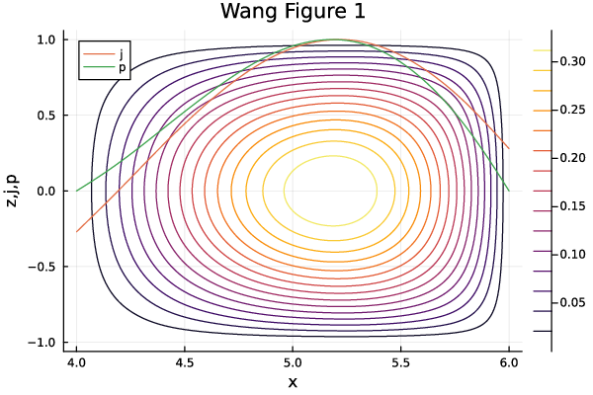
Wang Reproduction

Slide 17
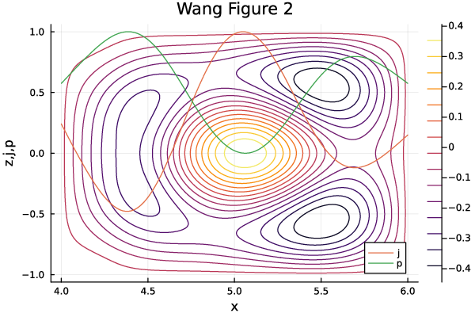
Wang Reproduction

Slide 18
Awesome
Achievement get:
reproduce figures
Achievement not (yet) getted:
animate figures

Slide 19
Awesome
Achievement get:
reproduce figures
Achievement not (yet) getted:
animate figures
Data Fitting
I
Currently just specify (a
1
, a
2
, α)
I
Want to input data and get those values
I
Least squares data fitting time

Slide 20
Uh oh

Slide 21
Uh oh

Slide 22
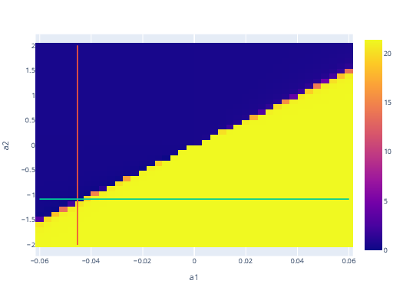
What’s going on?

Slide 23
How fix?
I
Include more data (using current density...
could add
pressure?)
I
Use a different model?
I
Use a different optimisation method?
I
Modify our optimisation approach?

Slide 24
How fix?
I
Include more data (using current density...
could add
pressure?)
I
Use a different model?
I
Use a different optimisation method?
I
Modify our optimisation approach?
Now:
I
Provide initial
guess which is “close to” actual
(a
1
, a
2
, α)
I
Works!
(we’ve just replicated the Wang figure again, but with
data instead)

Slide 25
Simulated

Slide 26
Current Inversion
Goal:
I
Simulate quiescent phase of current reversal
I
Observe magnetic field topology changes
I
Pressure density effects
I
Do this using data (foreshadowing ISTTOK)
How:
I
Solve for (a
, a
, α) in successive equilibrium time slices
1
2
I
Use solution of one to feed in as initial
guess for next
I
Question:
what do we use as a guess for first time slice?

Slide 27
Simulated Reversal
If you’re seeing this, something has gone wrong...
General
Kenobi.
DONT FORGET TO PUT ANIMATION HERE

Slide 28
Simulated Reversal
If you’re seeing this, something has gone wrong...
General
Kenobi.
DONT FORGET TO PUT ANIMATION HERE

Slide 29
Simulated Quiescent Reversal
If you’re seeing this, something has gone wrong...
General
Kenobi.
DONT FORGET TO PUT ANIMATION HERE

Slide 30
Simulated Quiescent Reversal
If you’re seeing this, something has gone wrong...
General
Kenobi.
DONT FORGET TO PUT ANIMATION HERE

Slide 31
ISTTOK Data
I
Current density profile, pressure density profile, v
loop
I
Use current density to get (a
1
, a
2
, α)
I
Compare simulated density profiles to data for accuracy of
model
I
. . .
I
Profit?

Slide 32
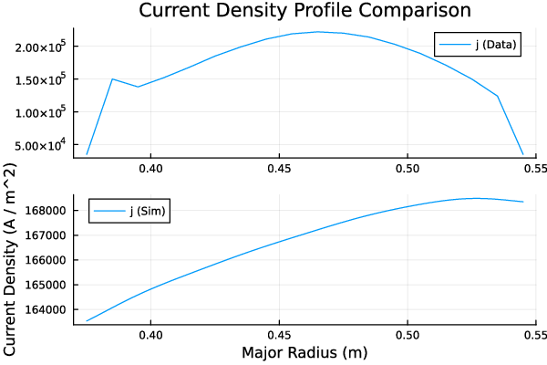
Initial
ISTTOK Simulation

Slide 33
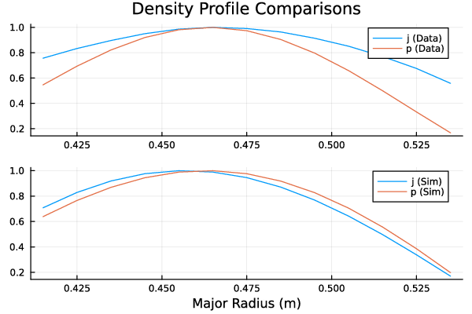
Scientific Creative Liberty Simulations

Slide 34
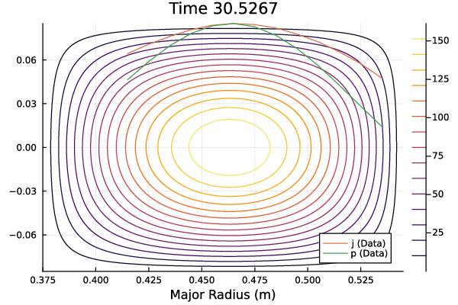
ISTTOK Magnetic Field Topology

Slide 35
The Other Time Slices?
I
Model
struggles to converge - highly parameter sensitive
I
Data quite imprecise - manual
manipulation to achieve above
I
Still
question of first time slice’s parameter guess
I
Combine what we can model
with other simulations (work
with Artur)
Further Work
I
Data interpolation methods (inter- and intra- time slice)
I
Electric field information (helpful
for REs)
I
Inclusion of pressure density profile in fitting (compare v
loop
instead)

Slide 36
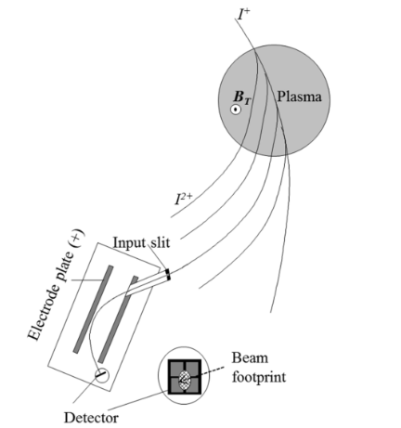
(BONUS) Cool
Ion Diagnostics

