Slide 1
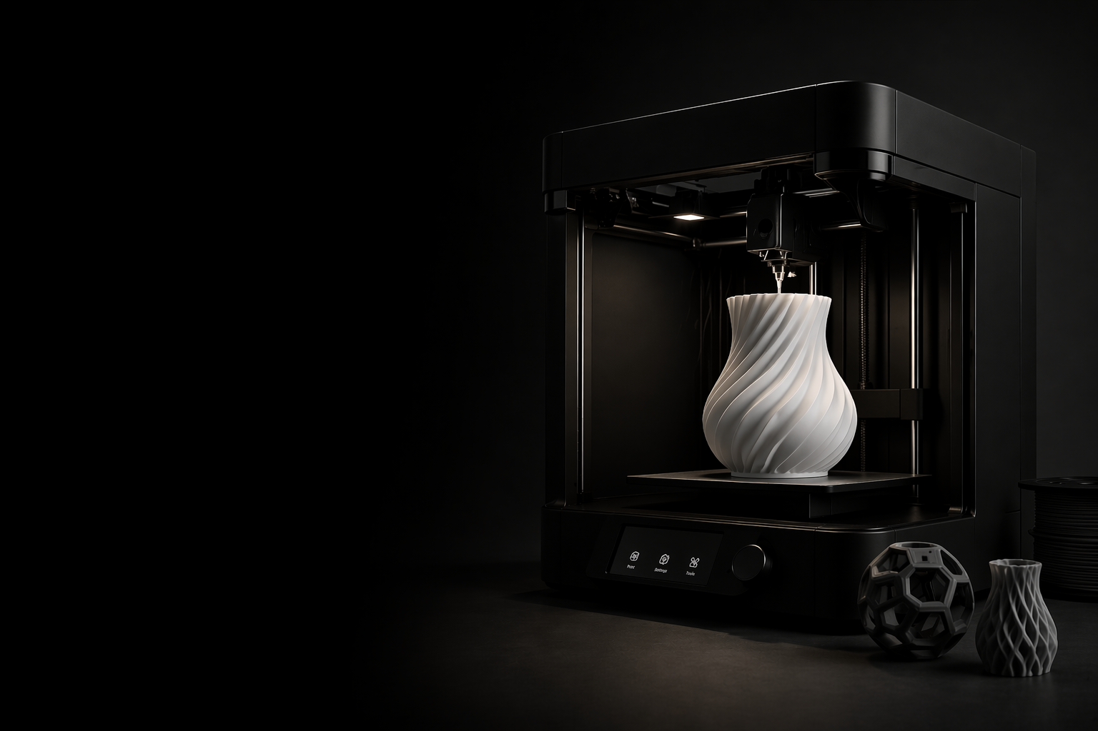

Printforge
Shape the Future of Making

Slide 2
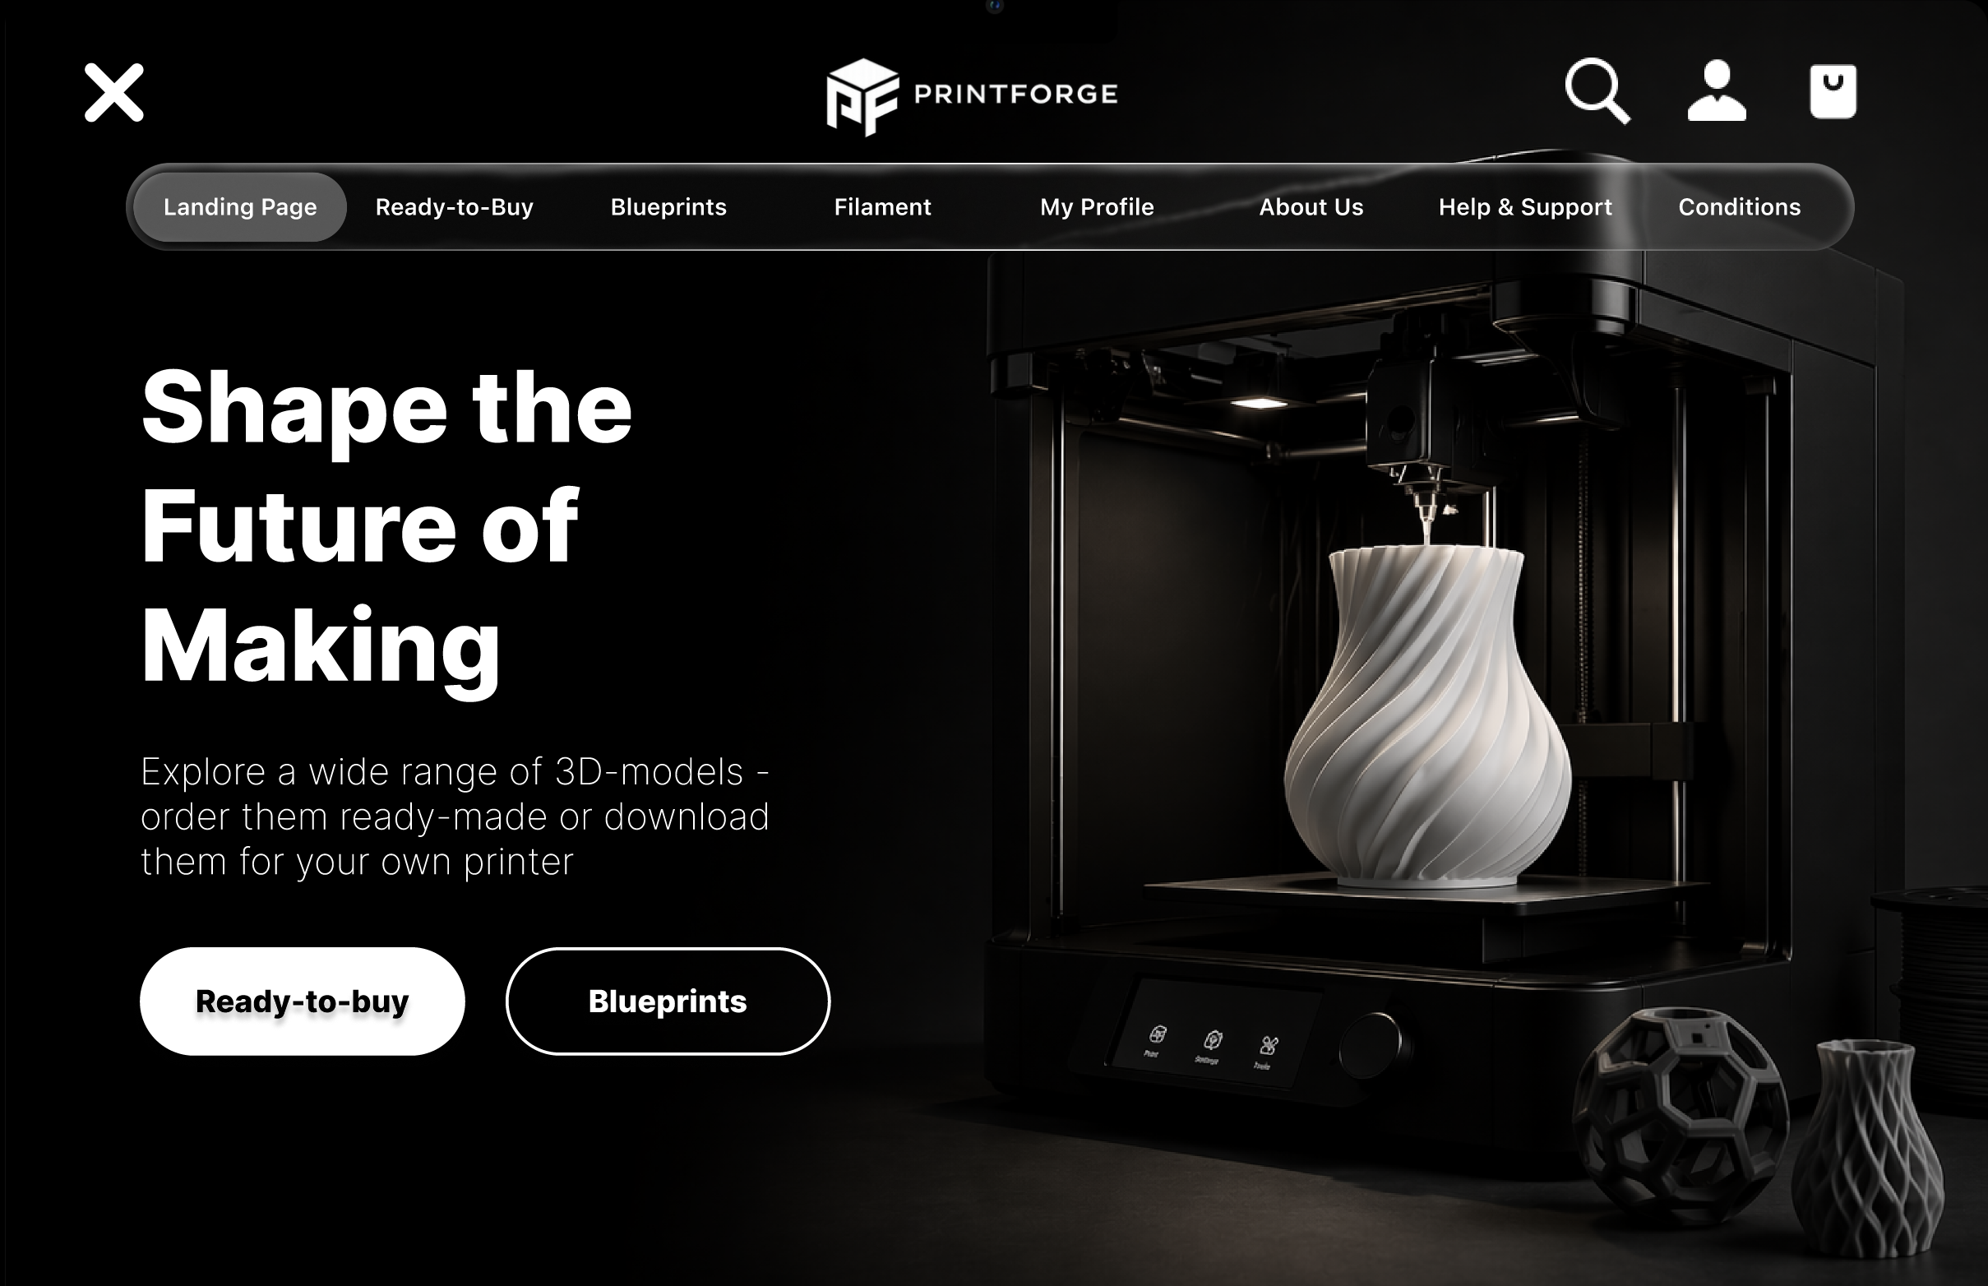

Slide 3



Presentation Overview
Task 1:
Navigation Discovery
Task 2:
Shopping Flow
Task 3:
Profile Management
Overall
UI / UX

Slide 4
Results of our Evaluation
Task 1: Navigation Discovery

Slide 5
Results of our Evaluation
Task 1: Navigation Discovery
How long did it take?
Median: 24s
Minimum: 3s
Maximum: 120s
What would you change about the navigation?
navigation options should remain permanently visible without requiring the menu to be opened.
While navigating from the Ready-to-Buy section to the Filaments section, the page correctly switched to Filaments, but the navigation menu highlighted Blueprints instead.
The website does not clearly indicate that additional content can be accessed by scrolling.

Slide 6
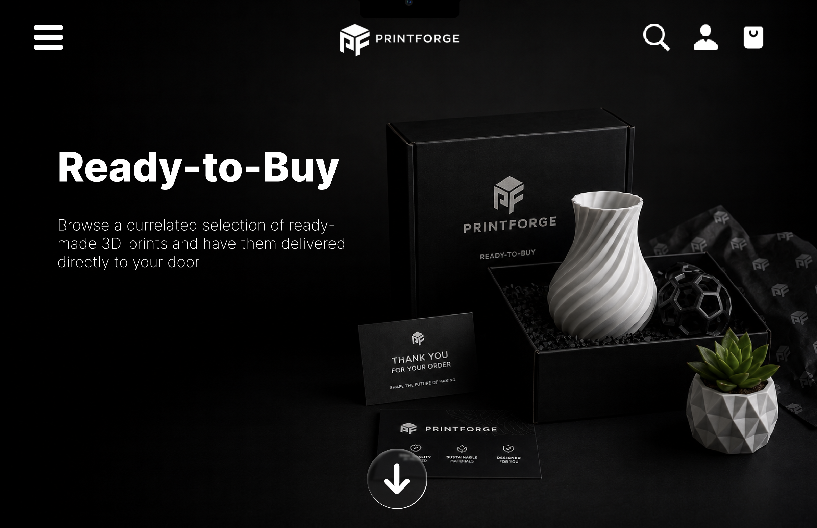

Slide 7
Presentation Overview
Task 1:
Navigation Discovery
Task 2:
Shopping Flow
Task 3:
Profile Management
Overall
UI / UX

Slide 8
Results of our Evaluation
Task 2: Shopping Flow

Slide 9

Results of our Evaluation
Task 2: Shopping Flow

Slide 10

Results of our Evaluation
Task 2: Shopping Flow
How long did it take?
Median: 55s
Minimum: 5s
Maximum: 240s
Suggestions for improvement?
A dedicated remove button (e.g., an “X” icon) would make deleting items much easier.
The website should provide a clearer indication that users need to scroll down to access the Blueprints and Ready-to-Buy sections.
The shopping cart icon is not immediately recognizable as a shopping cart.

Slide 11
OR
Shopping Cart → Shopping Bag

Slide 12
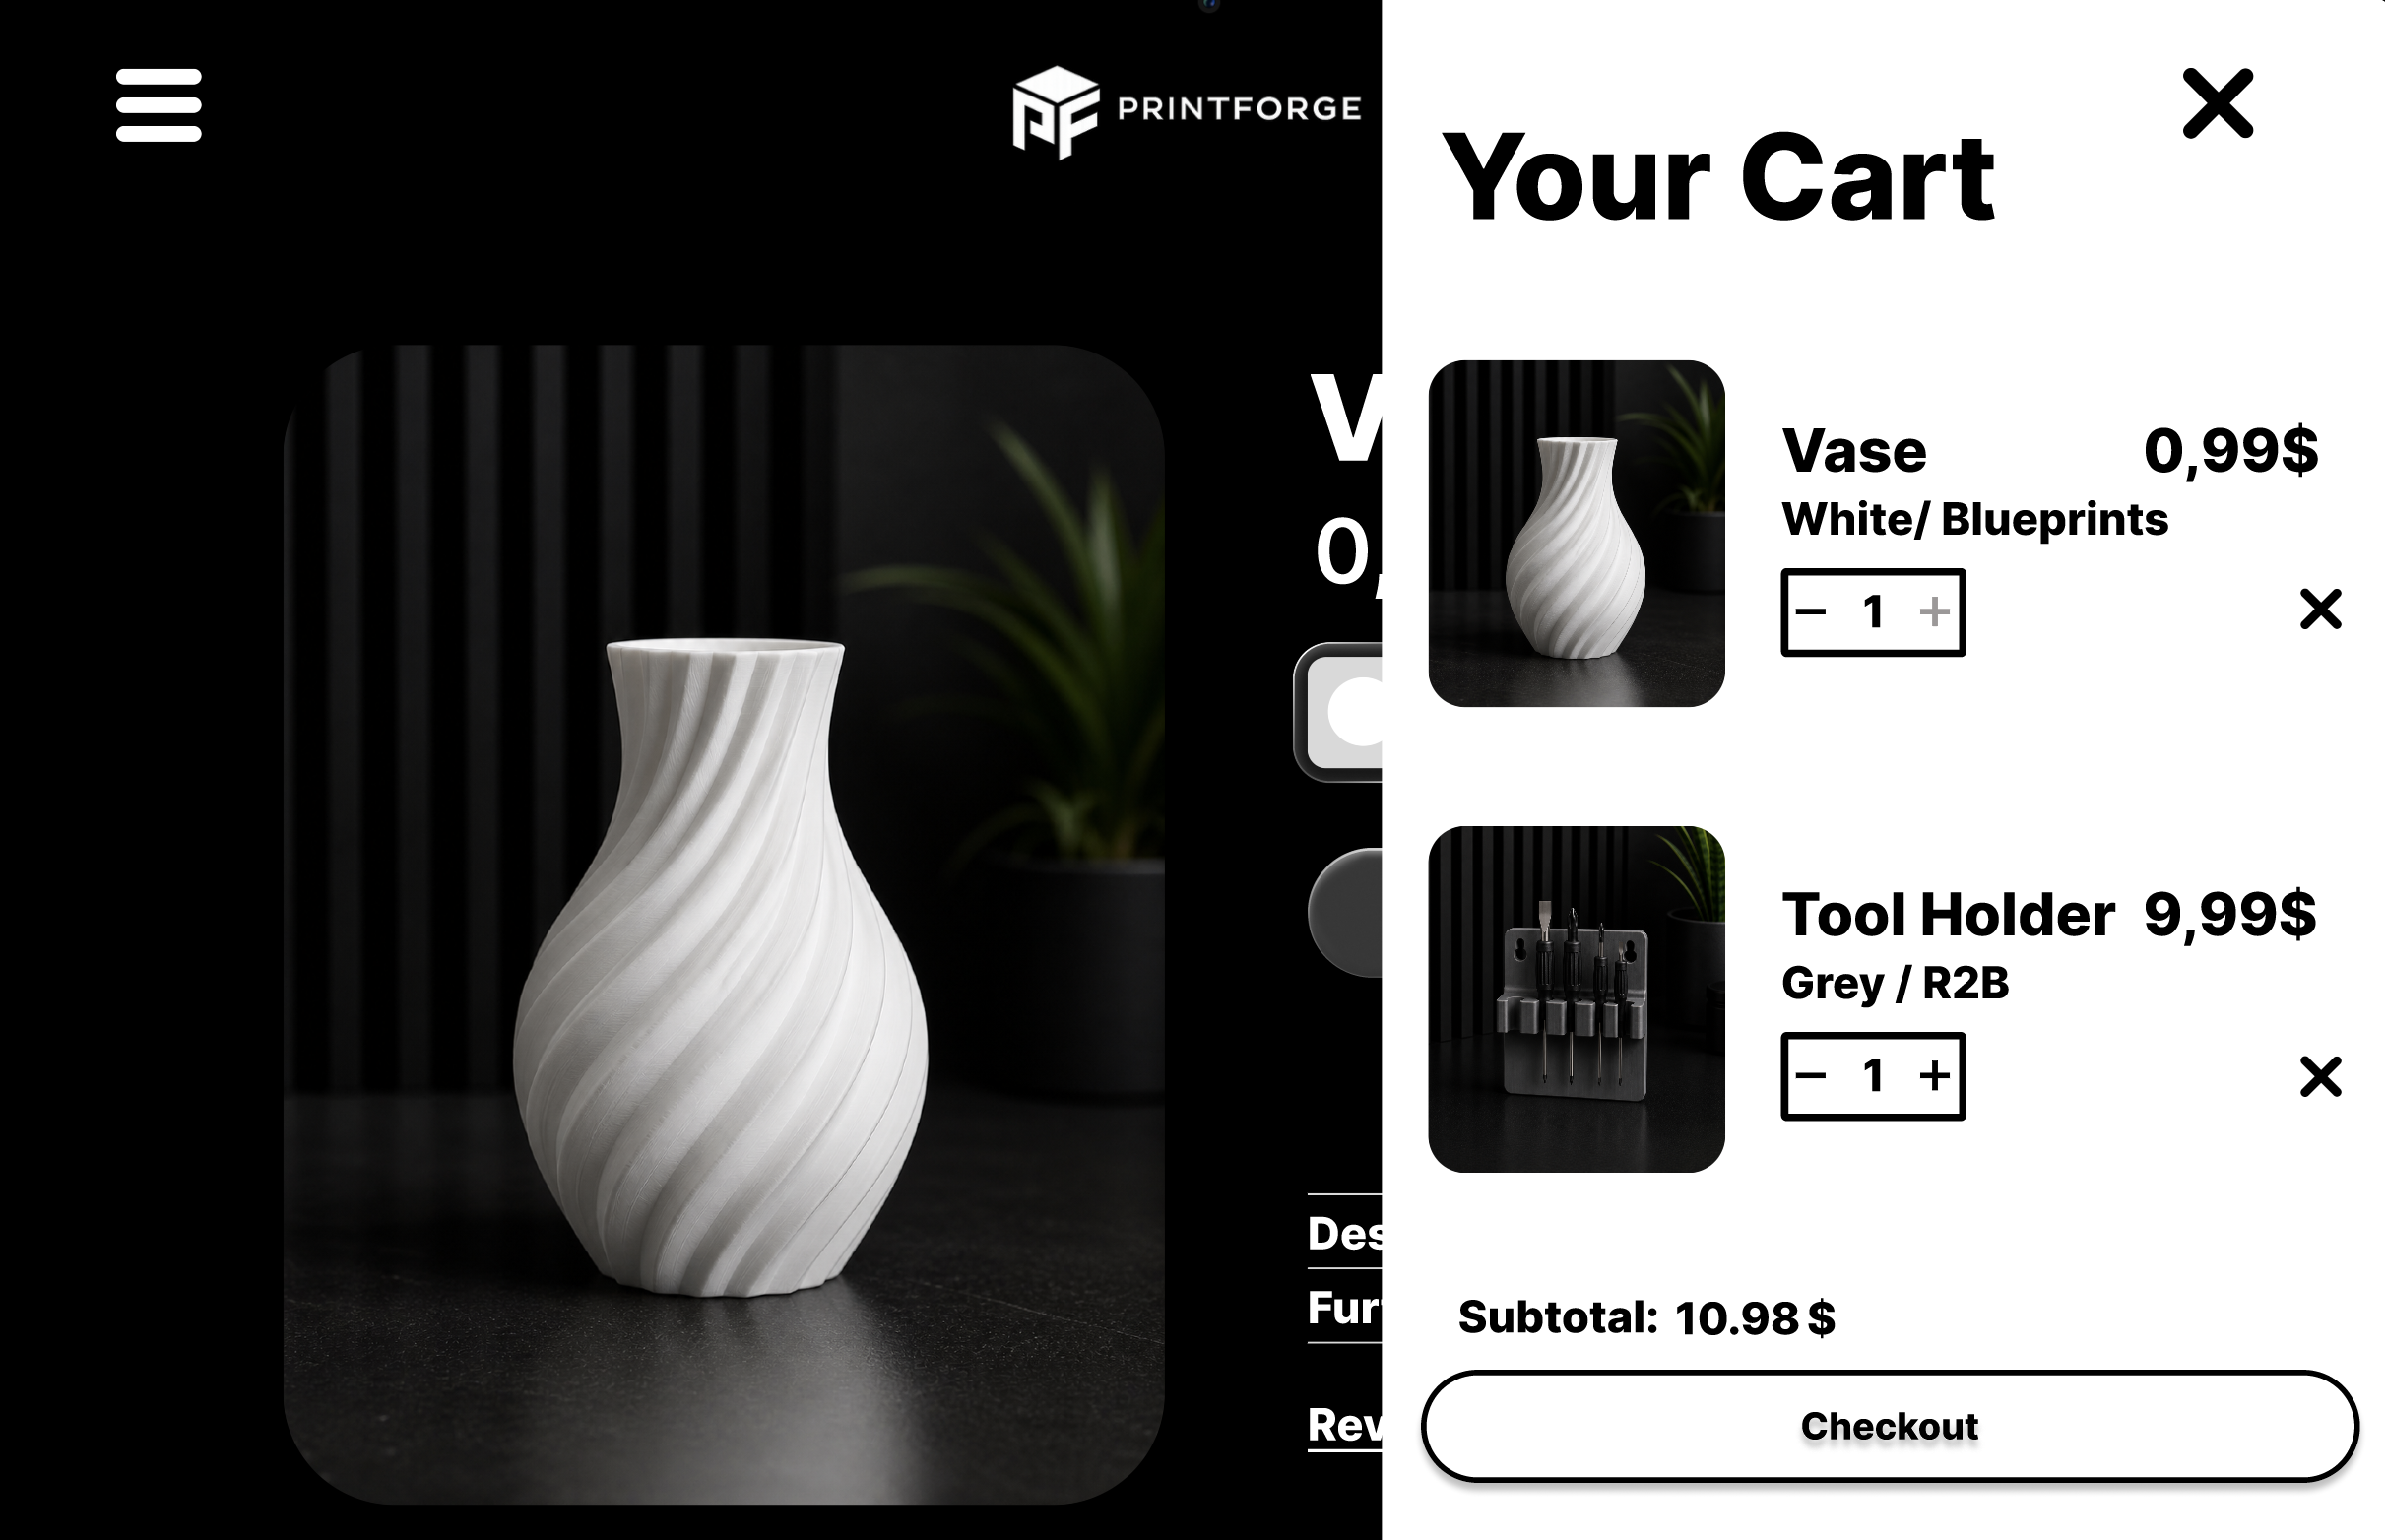

Slide 13
Presentation Overview
Task 1:
Navigation Discovery
Task 2:
Shopping Flow
Task 3:
Profile Management
Overall
UI / UX

Slide 14
Results of our Evaluation
Task 3: Profile Management

Slide 15
Results of our Evaluation
Task 3: Profile Management
How long did it take?
Median: 20s
Minimum: 1,5s
Maximum: 120s
Suggestions for improvement?
A purchase history section would be useful.
A password recovery option.
A password visibility toggle (eye icon) should be added, allowing users to view the password they entered.
It was not immediately obvious that a login feature existed or where it could be accessed

Slide 16
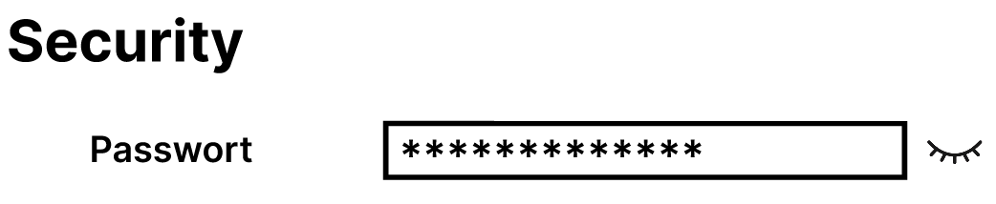


Slide 17
Presentation Overview
Task 1:
Navigation Discovery
Task 2:
Shopping Flow
Task 3:
Profile Management
Overall
UI / UX

Slide 18
Results of our Evaluation
Overall UI / UX

Slide 19
Results of our Evaluation
Overall UI / UX

Slide 20

Results of our Evaluation
Overall UI / UX

Slide 21
Results of our Evaluation
Overall UI / UX
Suggestions for improvement?
larger or permanently visible navigation menu.
When selecting a navigation item of the same page, users should automatically be taken to the top of the corresponding page.
Support for Dark Mode in the Profile section.
A lighter color theme (Light Mode) as an alternative option.
Glass-style UI elements should include stronger shadows or darker visual effects to improve visibility.

Slide 22
Thank You for Your Valuable Feedback

