Slide 1
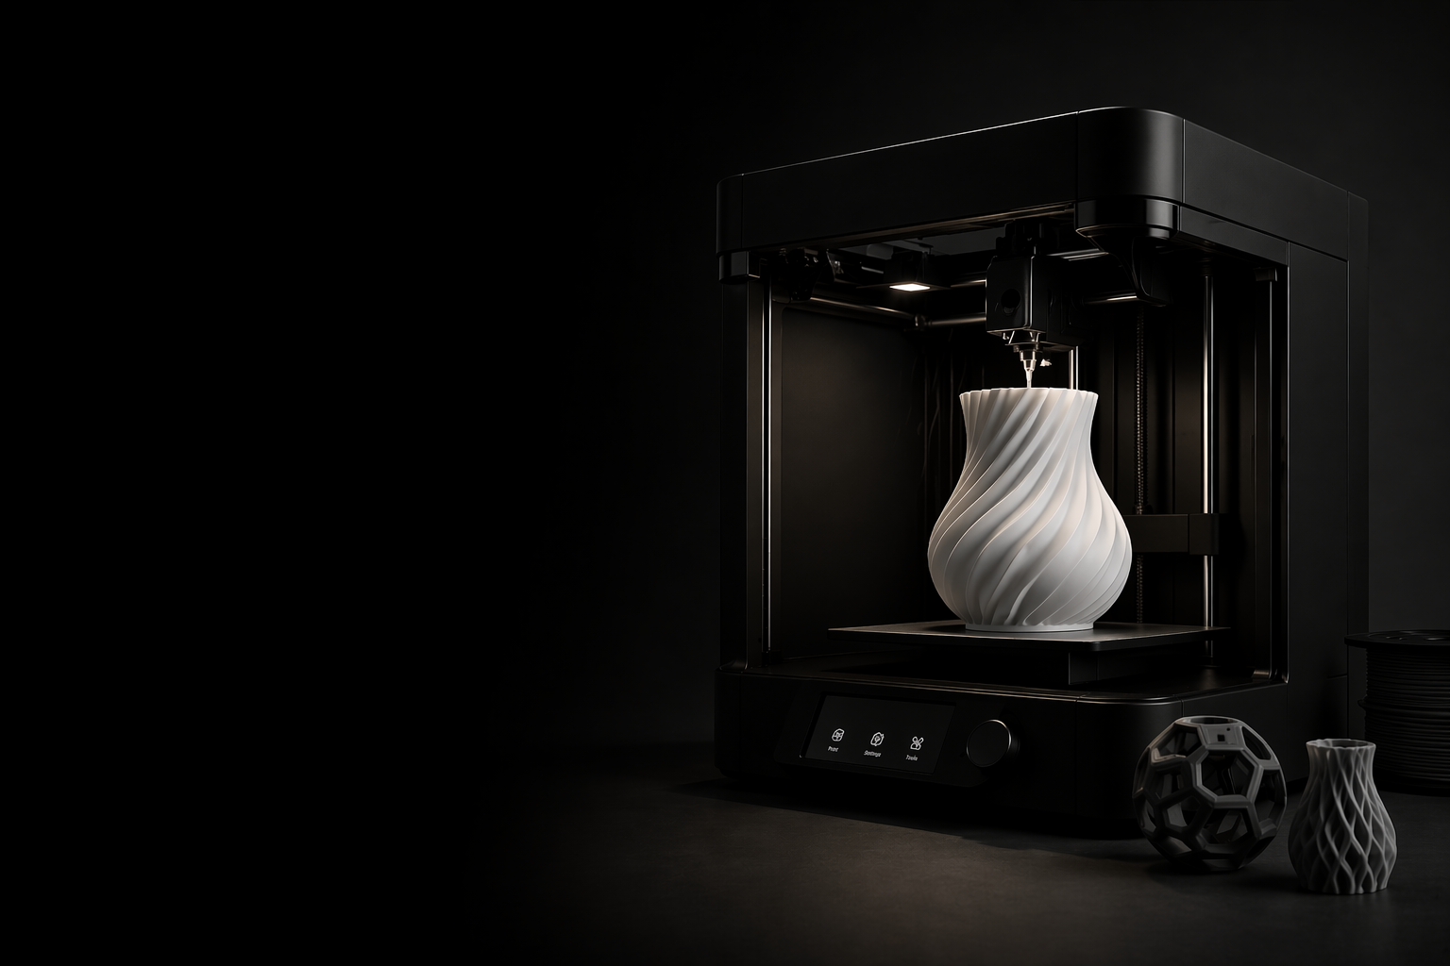
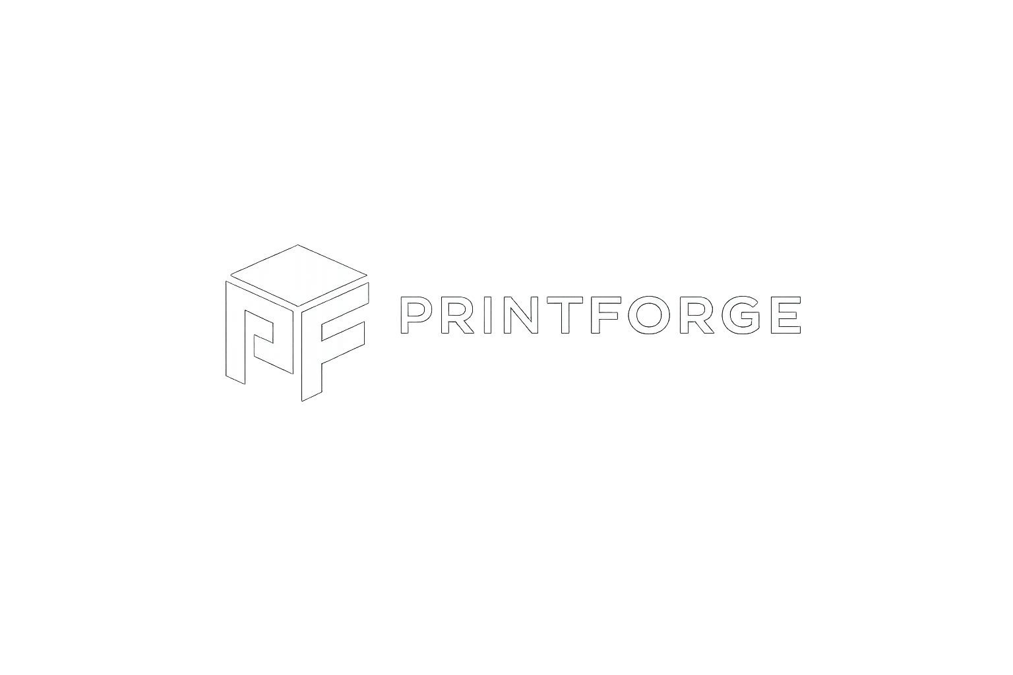
Printforge
Shape the Future of Making

Slide 2



Presentation Overview
Problems & Vision
User Profiles
Considerations + Initial Design
Following Steps
+ Work Distribution

Slide 3
Problems & Vision
Problems:
- No central hub for discovering 3D prints
- High prices for users without a 3D printer
Vision:
- All-in-one 3D platform
- Buy ready-made products
- Download models for self-printing

Slide 4
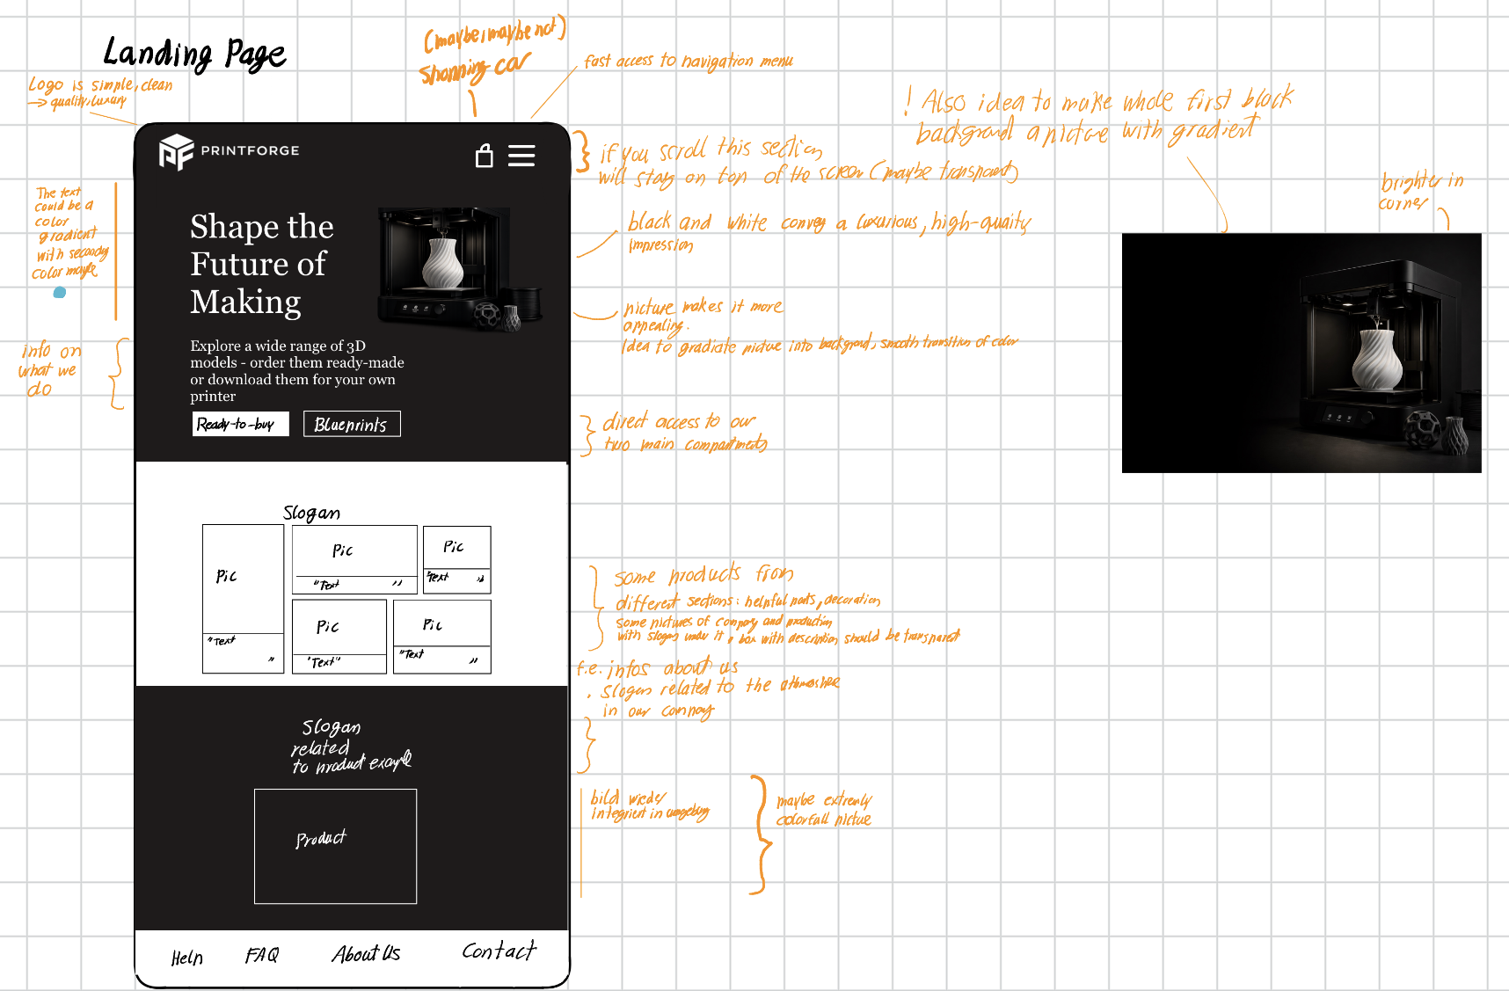
Work Distribution
- Concept Development: Jointly developed idea
(templates + product purchase combination)
- Initial Design: Created by Thomas (layout, structure,
first concepts)
- Documentation: Handled by Matthis based on Thomas
inputs (notes, drafts, voice messages)
- Presentation: Prepared together
- Final Design: Refined collaboratively

Slide 5
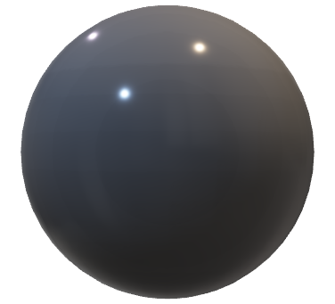
Presentation Overview
Problems & Vision
User Profiles
Considerations + Initial Design
Following Steps
+ Work Distribution

Slide 6
User Profiles
3 Classes
- Teenagers & Young Adults (15–25):
Tech-savvy creators
Design, customize, and print models
- Adults (30–50):
Practical users
Choose between buying and printing
- Older People (50–70):
Non-technical users
Prefer simple purchase of ready-made products

Slide 7
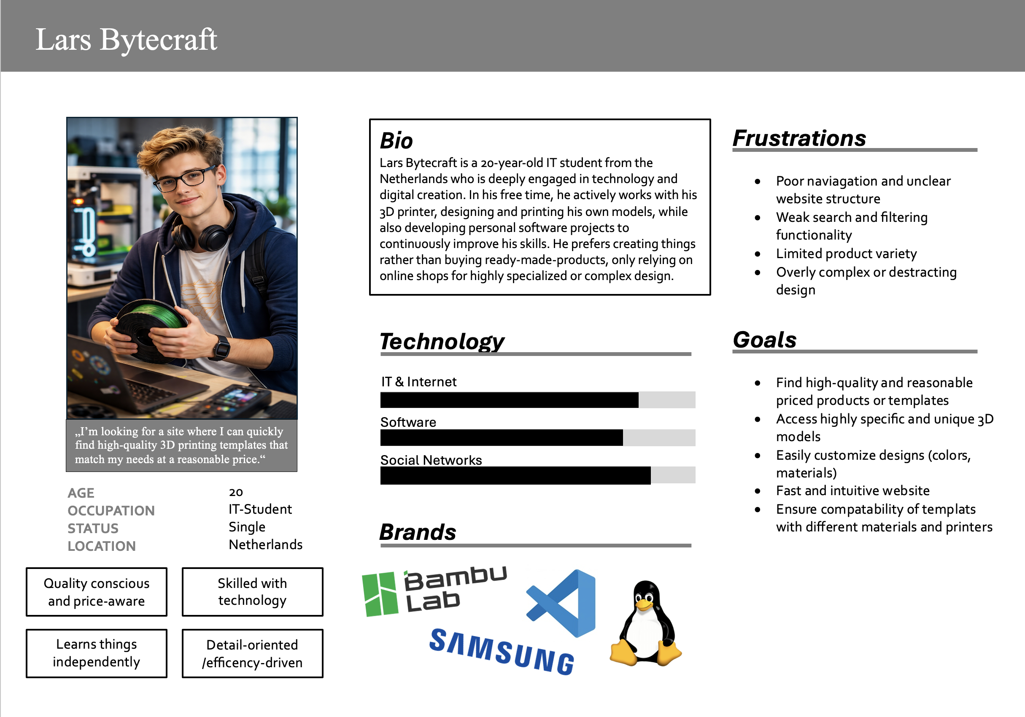

Slide 8
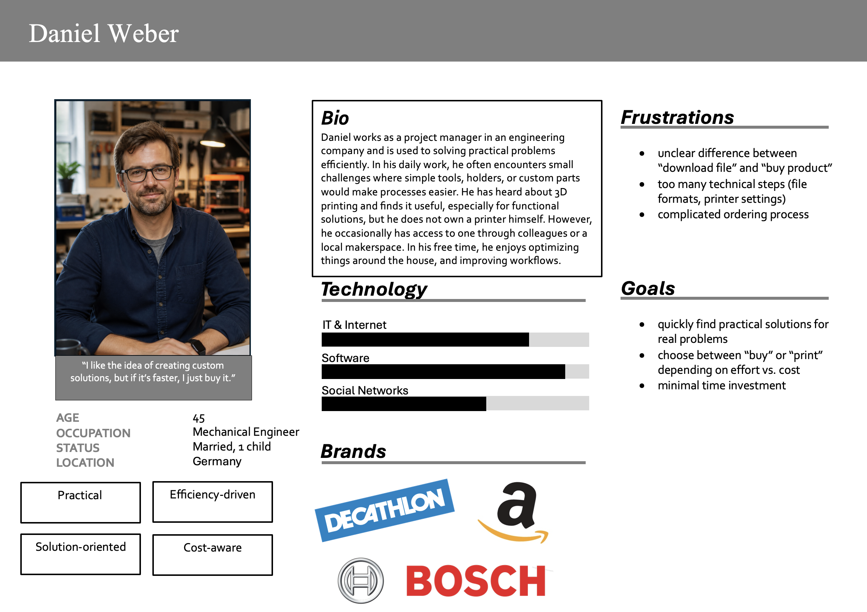

Slide 9
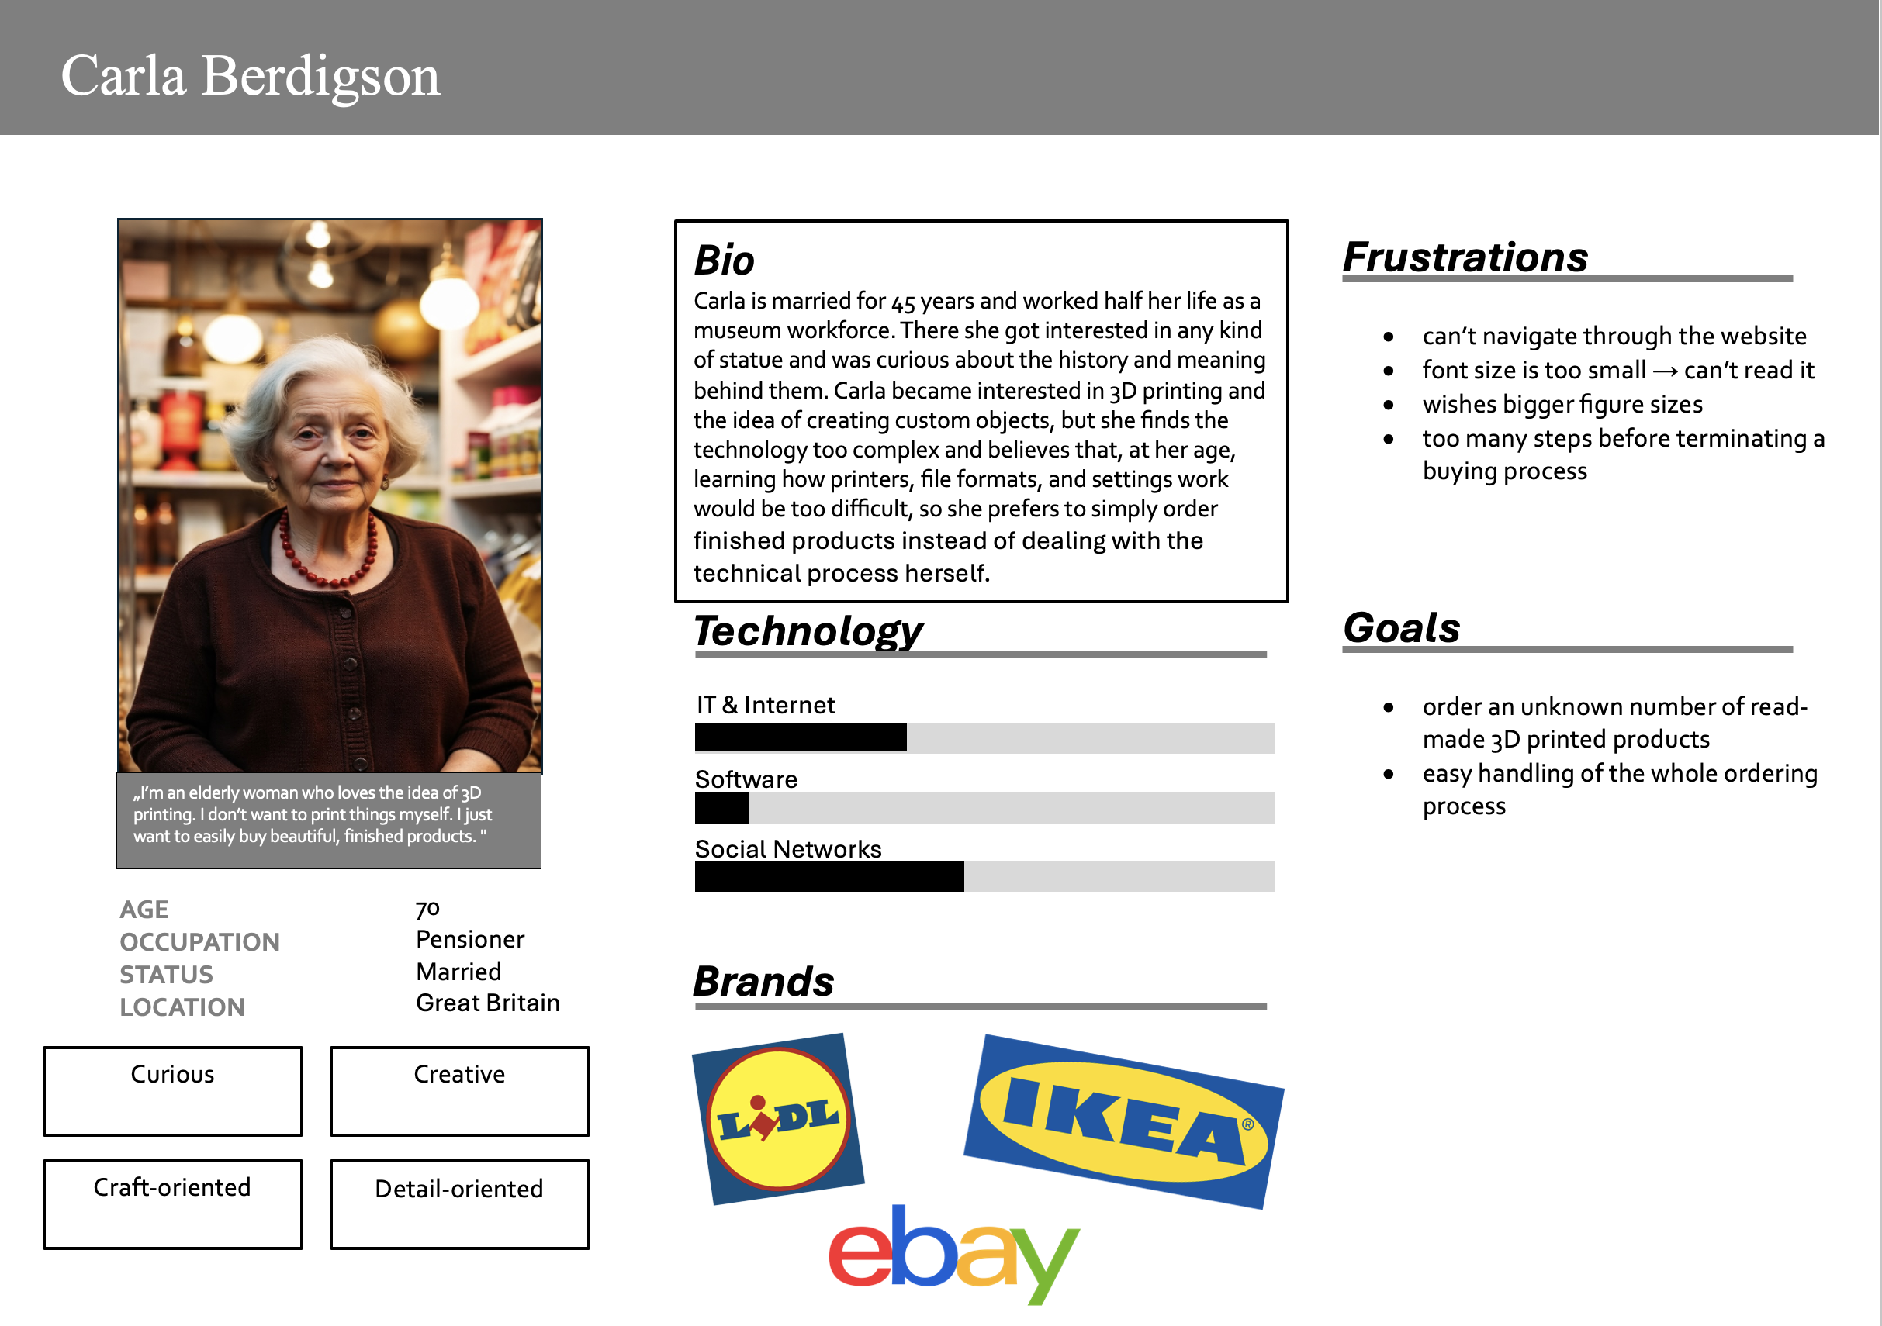

Slide 10
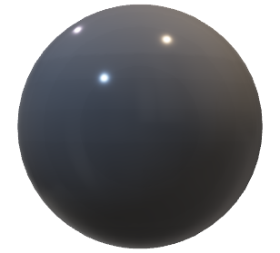
Presentation Overview
Problems & Vision
User Profiles
Considerations + Initial Design
Following Steps
+ Work Distribution

Slide 11
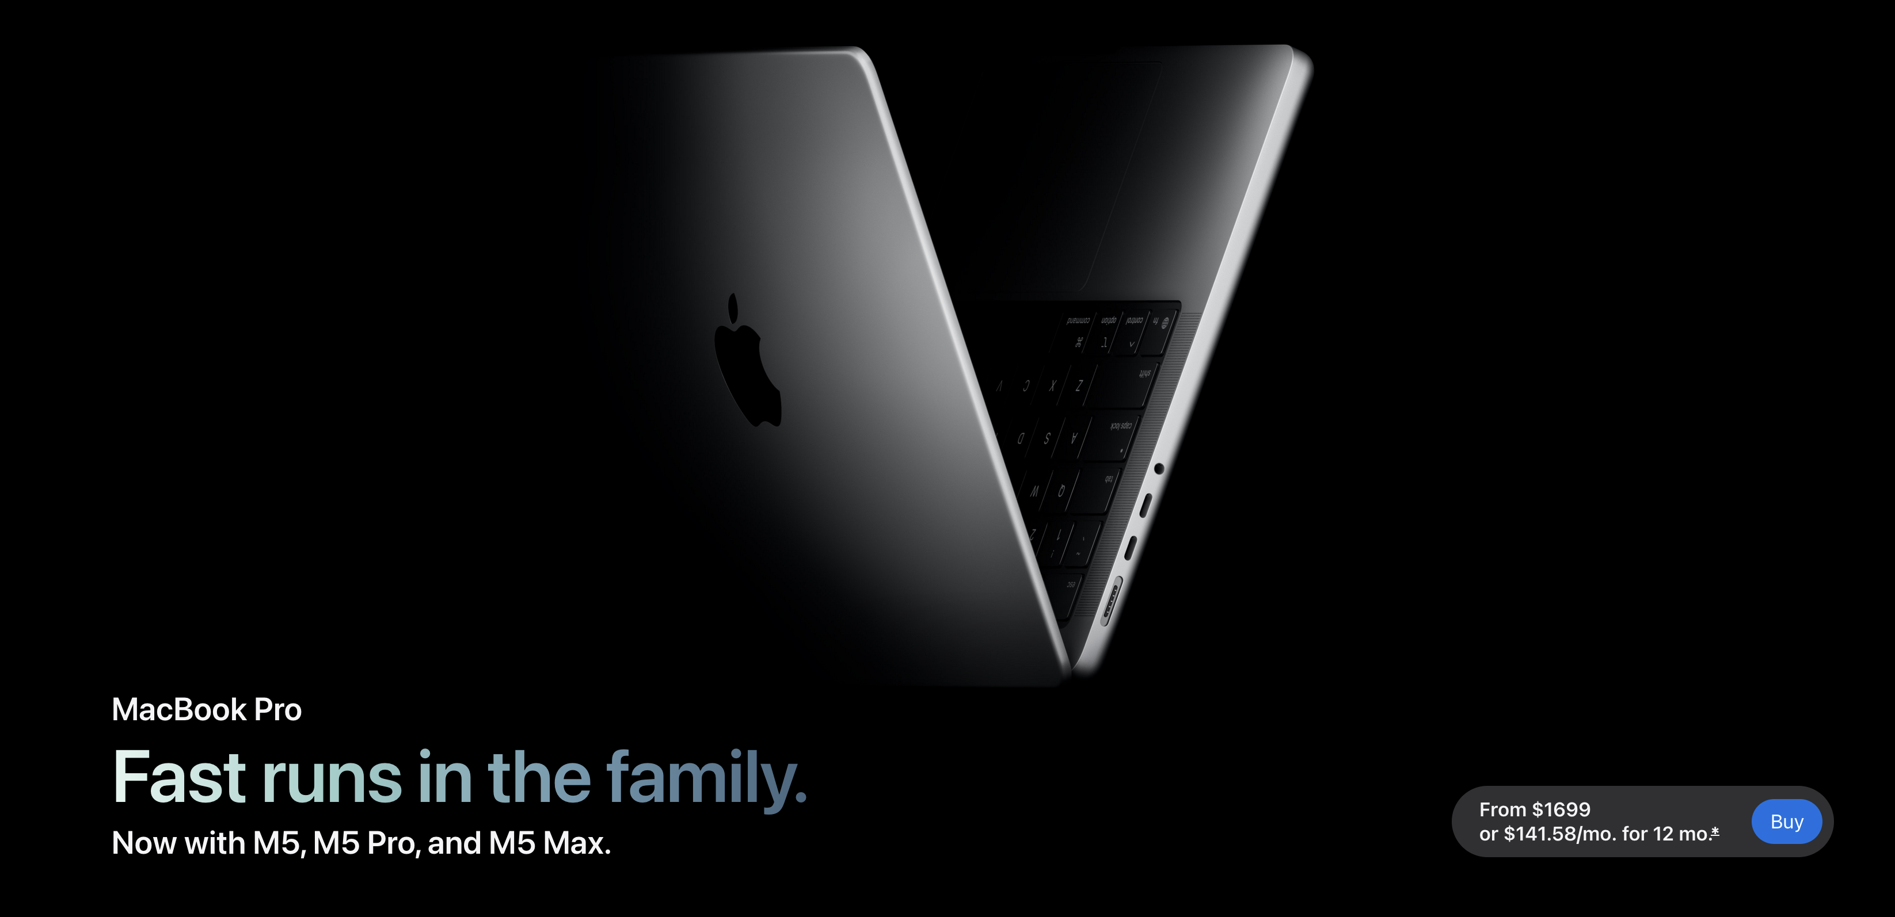
Design
High-end look, sharp and clear
https://www.apple.com/de/macbook-pro/

Slide 12
Design
Logo Design:
- Simple and recognizable
- Based on initials of the brand name
- Brand name placed next to logo for memorability
- Black & white color scheme for a clean, premium, and modern look

Slide 13
Design
What Pages do we need?

Slide 14
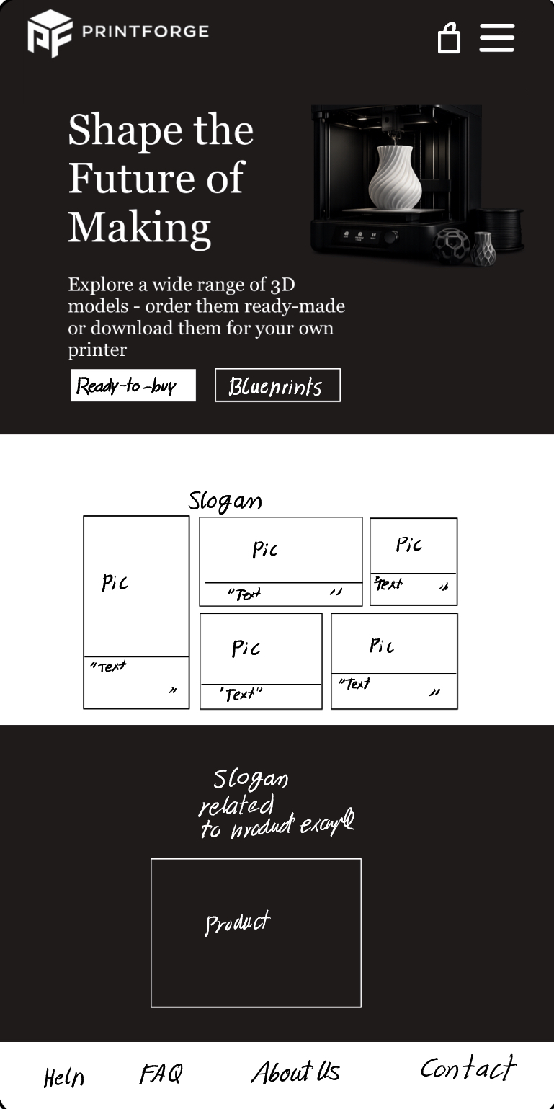
Headline
Later picture with gradient in background
+ picture integrated in background
Gradient Color
Design
Landing Page
Direct access to two
main compartments
Links to different sections
of our Website with short
Explanation e.g. About us
With a picture of our team
Not sure what exactly to do with this page
Footer

Slide 15
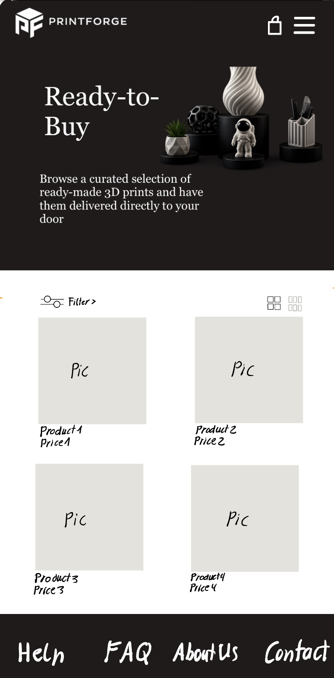
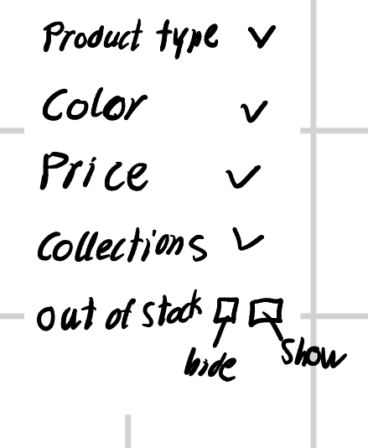
Color sheme between
Ready-to-Buy and
Blueprints should vary
Design
Read-to-Buy
Selection between larger and smaller view
When Filter is pressed
The products move to right

Slide 16

Color sheme between
Ready-to-Buy and
Blueprints should vary
Design
Read-to-Buy
Selection between larger and smaller view
When Filter is pressed
The products move to right

Slide 17
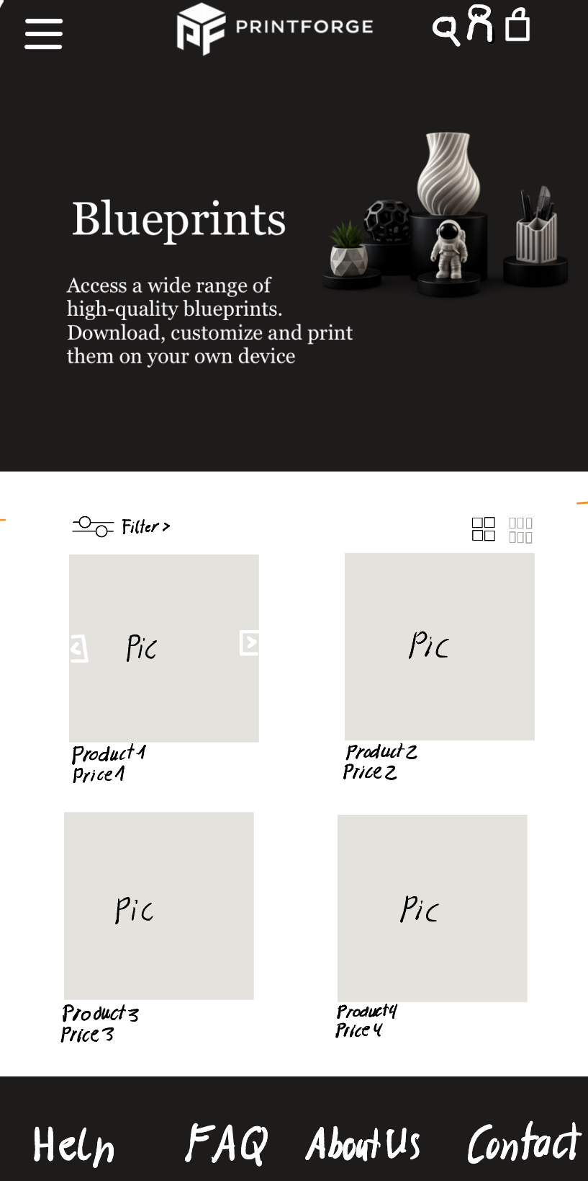
New Top
Different picture
Design
Blueprints
Slider button for pictures

Slide 18
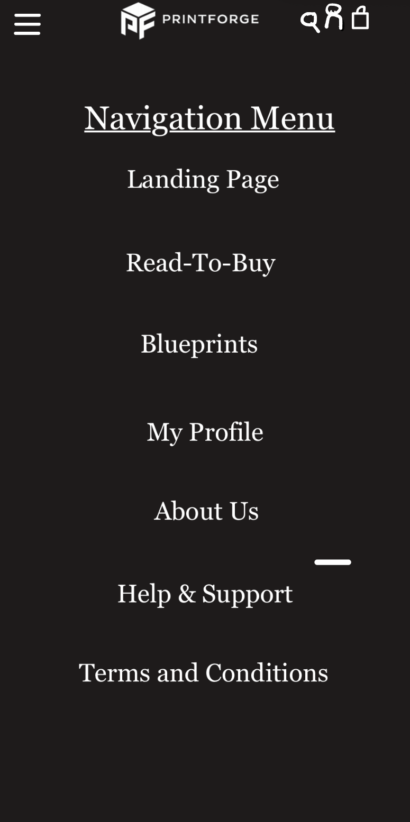
Maybe other color or design if in Menu
Design
Navigation-Menu

Slide 19
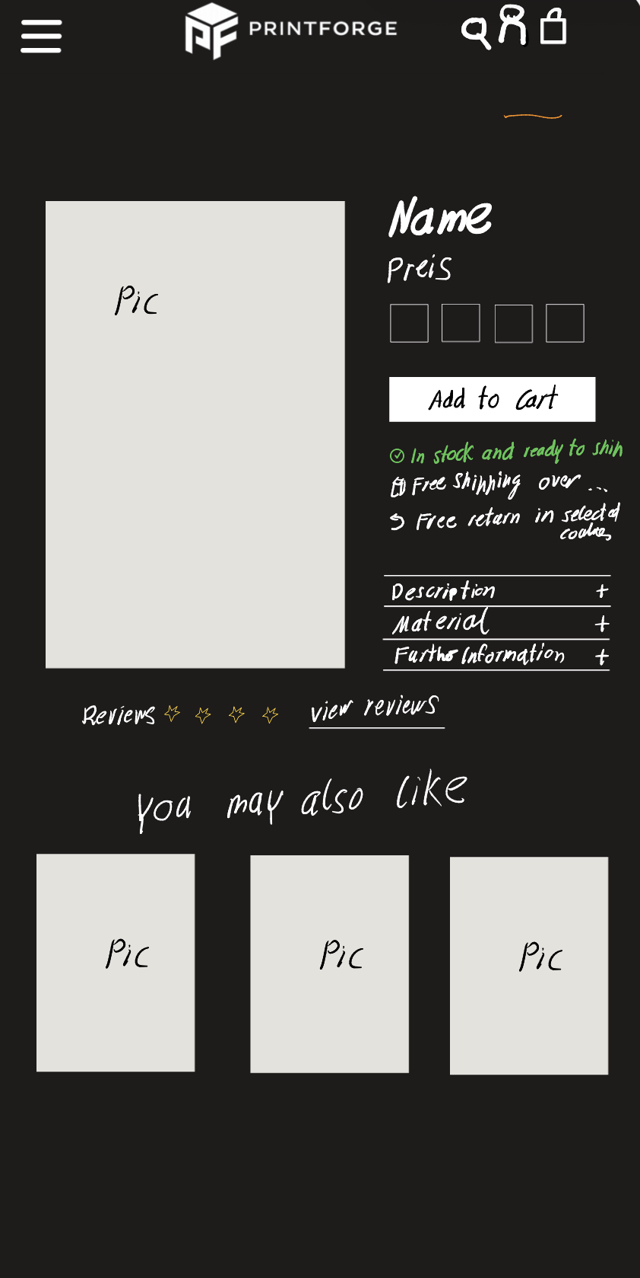
Design
Product-Detail
Color selection
Availability, shipping, return
Extra information, unfolds when pressed
When view reviews is pressed linked to reviews of theis product
Suggestions

Slide 20
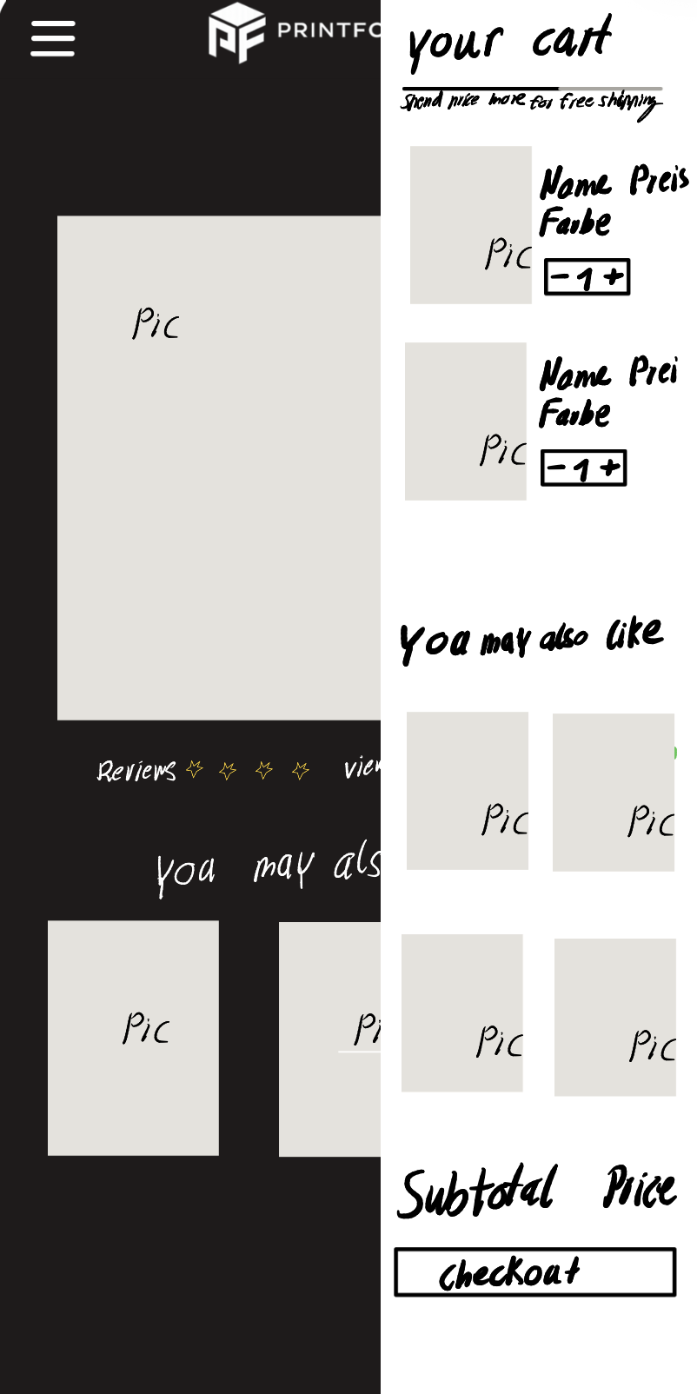
Price to free shipping
-> Makes customers buy more
Design
Amout can be adjusted
Shopping-Cart
With one click back to Shopping

Slide 21
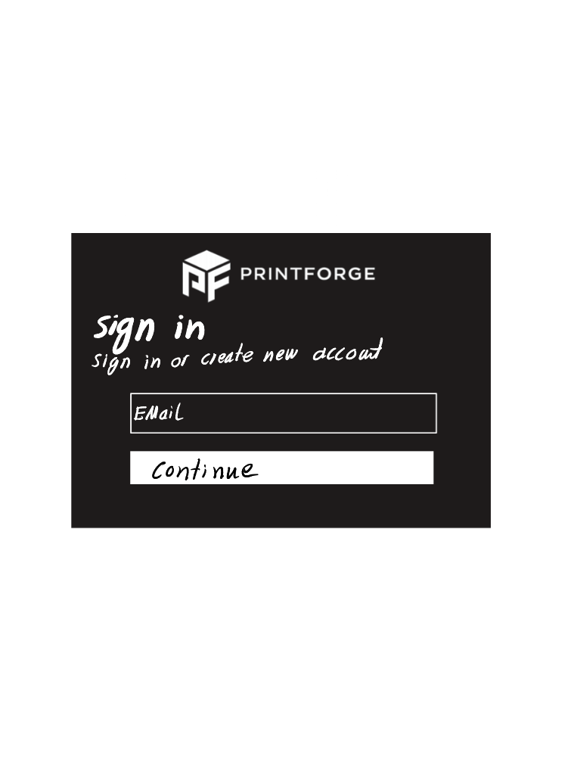
Design
Sign-In

Slide 22
Design
Missing Pages/ Irrelevant Pages:
Checkout
My profile
About Us
Help & Support
FAQ‘s
Terms and conditions/ Privacy Policy

Slide 23

Presentation Overview
Problems & Vision
User Profiles
Considerations + Initial Design
Following Steps
+ Work Distribution

Slide 24
Following Steps
Integrate Feedback:
- Use insights from different user groups and presentation feedback
Improve usability and structure accordingly
Figma + Validation:
- Create a functional prototype in Figma based on our paper prototype
- Gather additional feedback
- Test user interaction with the interface
→ Endproduct

Slide 25
Questions

