Slide 1
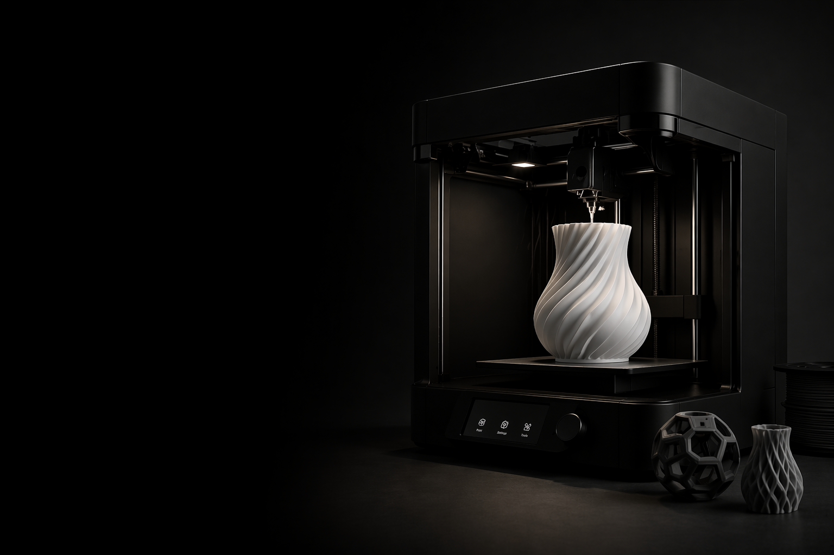
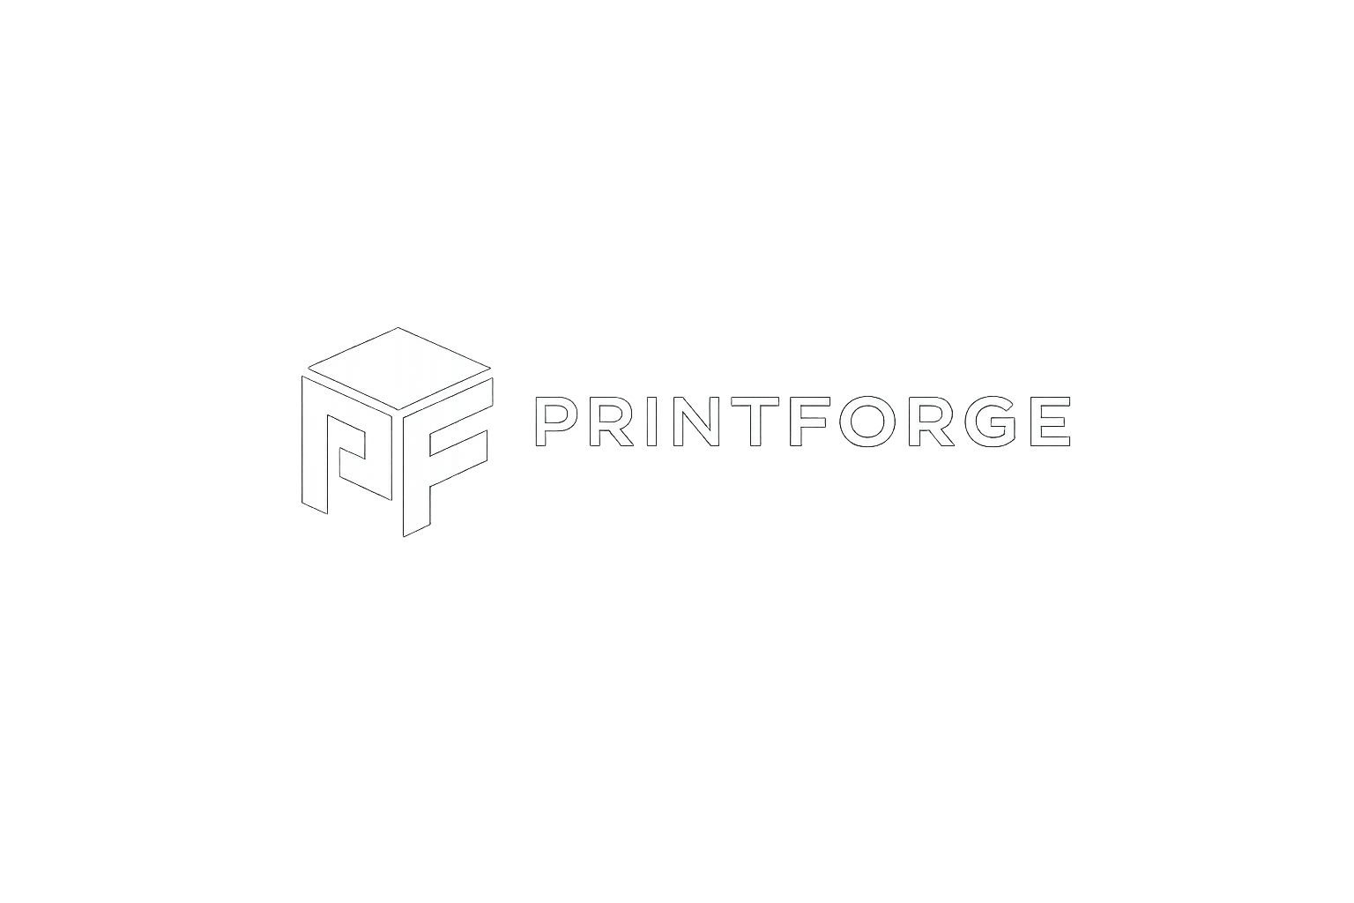
Printforge
Shape the Future of Making

Slide 2
Additional User Requierements
Add a dedicated shop page where users can purchase 3D printing filament.
Provide a variety of filament types (e.g., PLA, PETG, ABS) and multiple color options.
Support different 3D printing file formats for downloadable
Offer free 3D model/design that users can download without charge.

Slide 3
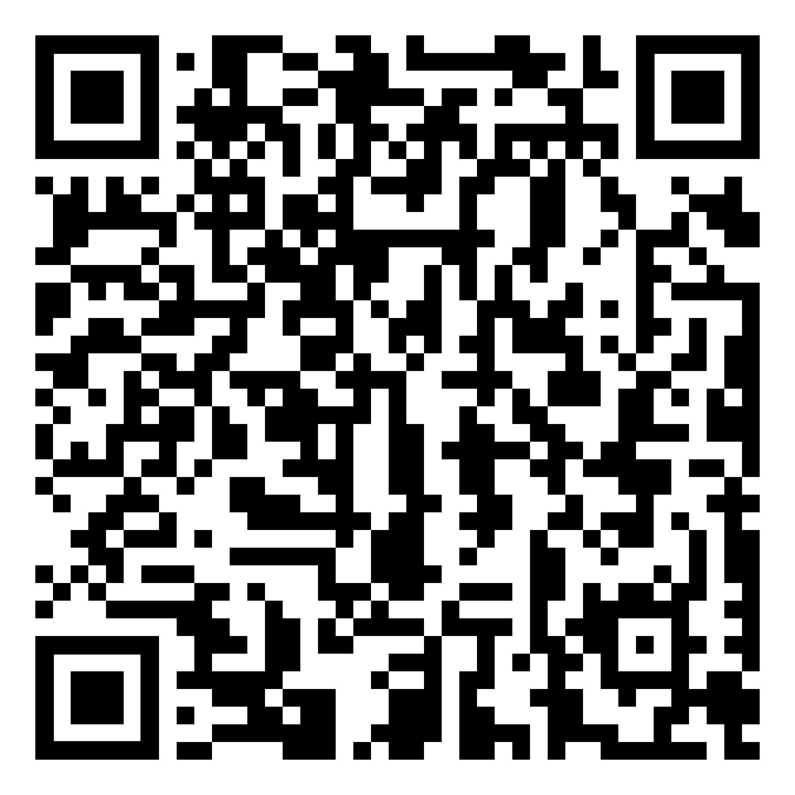

Slide 4
Questions + Suggestions

