Slide 1


Corrosion detection
Deep Learning project
Thomas Labreur
Teacher : Emmanuelle Claeys
Nov 2024

Slide 2
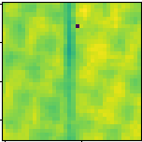
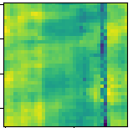
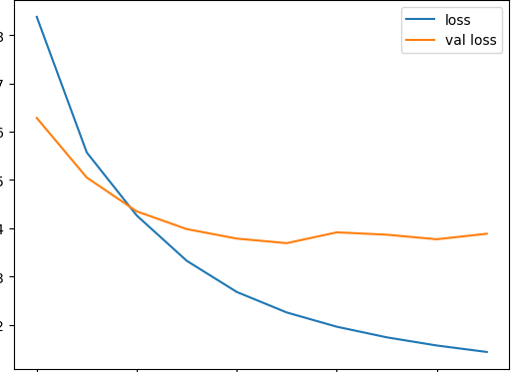
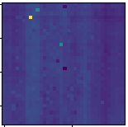
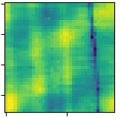
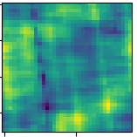
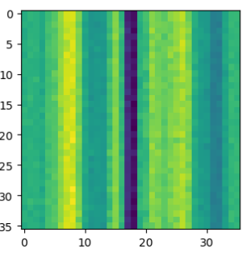
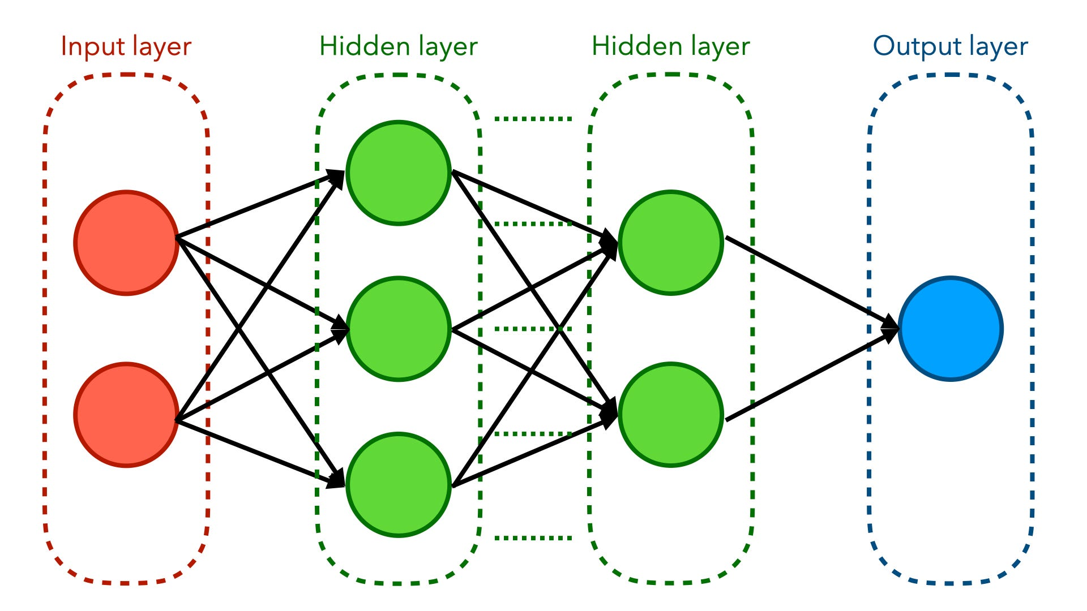
Step by step
2
Clean & increase data
4
Test performances
Drop aberrant data,
Fill missing values,
Data augmentation
Choose the best model thanks to IoU on validation data.
1
Retrieve Data
3
Train model(s)
Collect data from the given files
Try different architectures

Slide 3
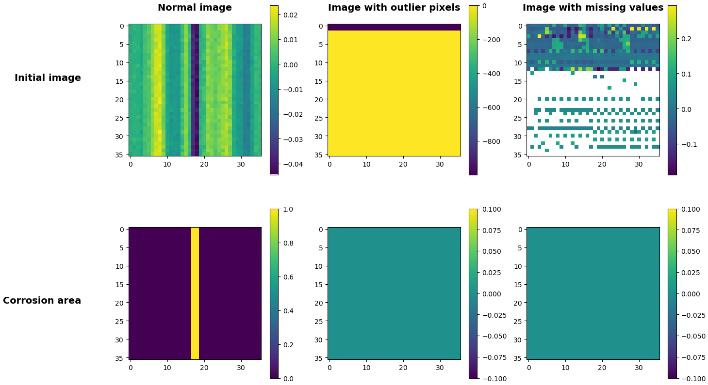
Retrieve data

Slide 4
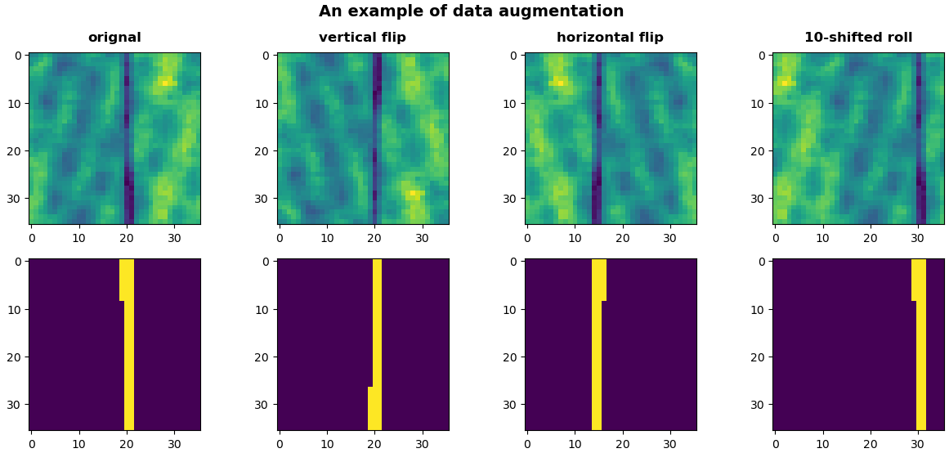

Data augmentation
Size x 38

Slide 5
Benchmark model
- Loss : Binary crossentropy
- Optimizer : Adam
- Learning rate : 0,001
- Epochs : 30
- Batch size : 128
Input
(36, 36)
Conv2D 8
ReLu
Conv2D 16
ReLu
Conv2D 32
ReLu
Conv2D 64
ReLu
Conv2D 128
ReLu
Dense 1296
Sigmoid
Flatten
Dense 100
ReLu

Slide 6
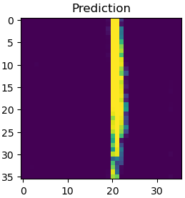
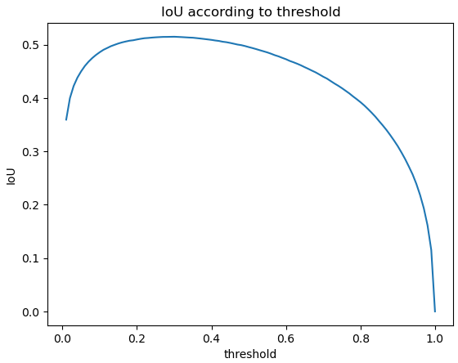
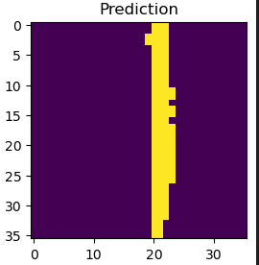
Threshold choice

Slide 7
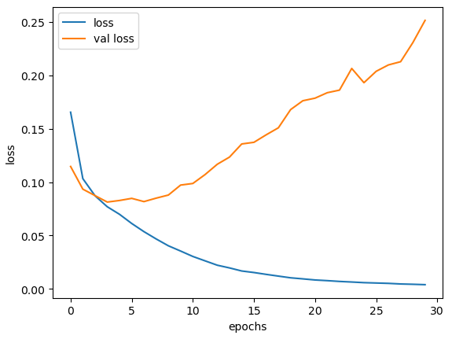
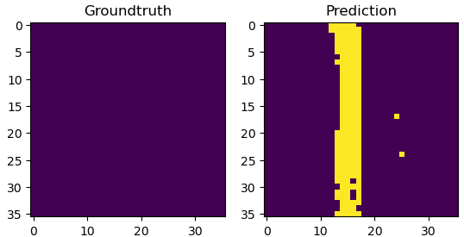
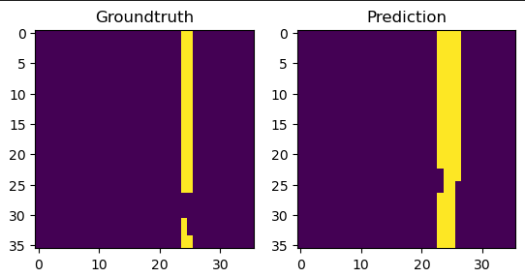
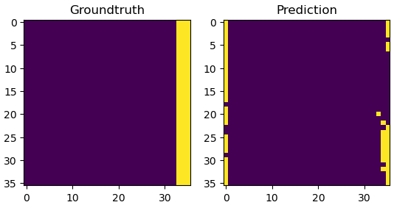
Model 1
Without data augmentation
Threshold = 0,3
IoU = 0,55
Examples of predictions
70%

Slide 8
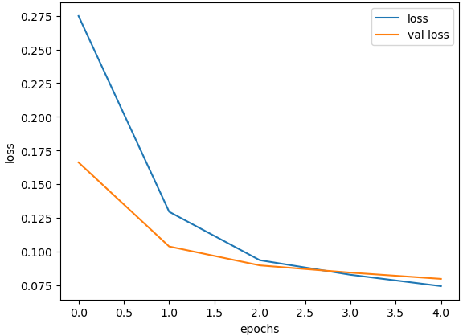
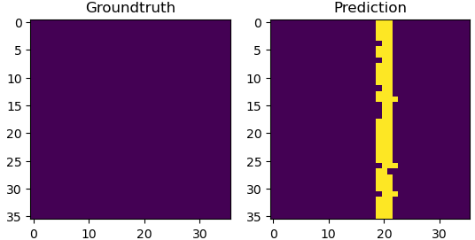
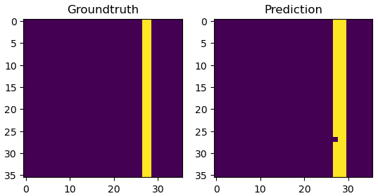
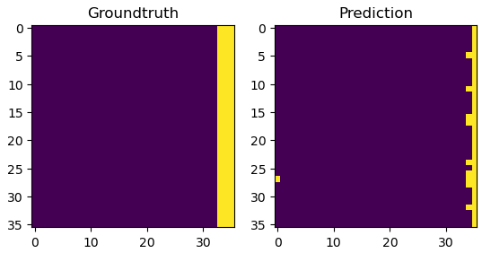
Model 1.5
Without data augmentation
Threshold = 0,3
IoU = 0,52
Examples of predictions
70%

Slide 9
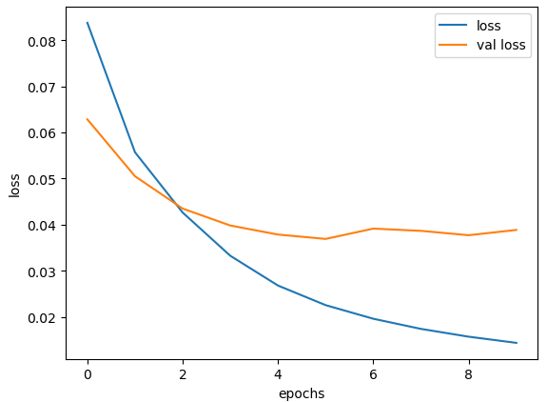
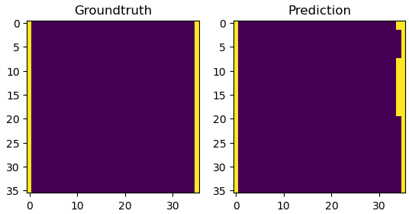
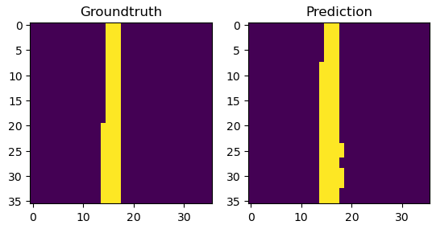
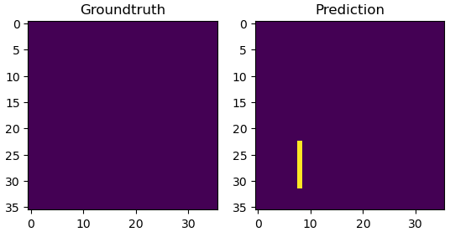
Model 2
With data augmentation
Threshold = 0,43
IoU = 0,66
Examples of predictions

Slide 10
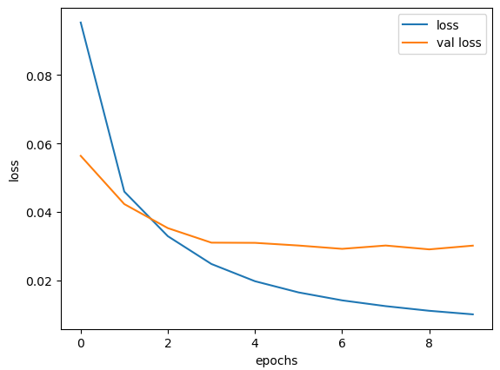
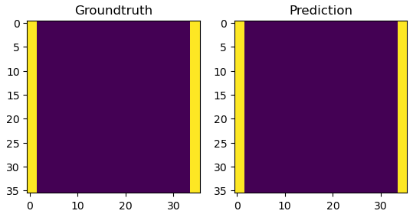
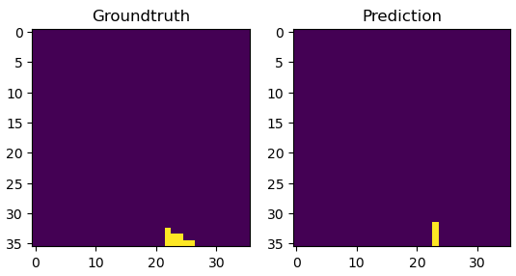
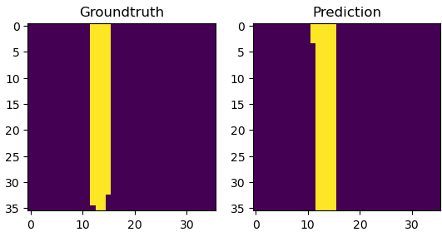
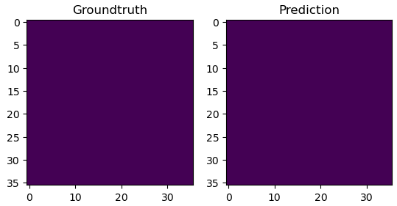
Model 3
With batch normalization,
lr scheduling & gradient clipping
Threshold = 0,31
IoU = 0,69
Examples of predictions

Slide 11

Ranking
On the validation dataset
On the website test dataset
Model 3
IoU=0,69
Model 2
IoU=0,62
Model 2
IoU=0,66
Model 1
IoU=0,55
Model 3
IoU=0,61
Model 1
IoU= ?

Slide 12
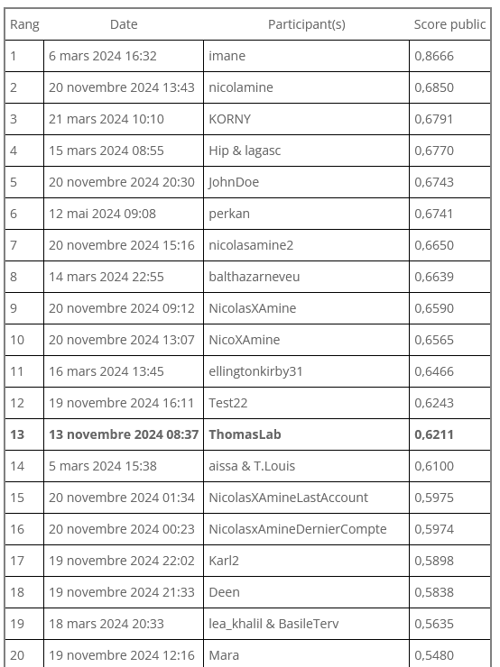
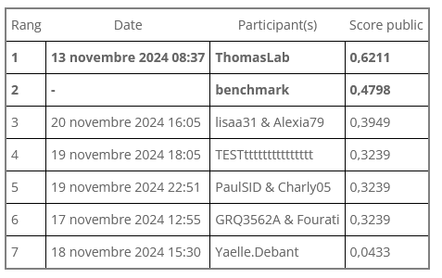
Ranking 21/11/24 - 11:07

Slide 13
Thank you!
Growing Liberty by Budi Aryo @tokofoss

