Slide 1


Statistical learning project
Thomas Labreur
Teacher : Franck Iutzeler
Goal : find the best classifier for a given dataset
M2 SID
2024 - 2025

Slide 2
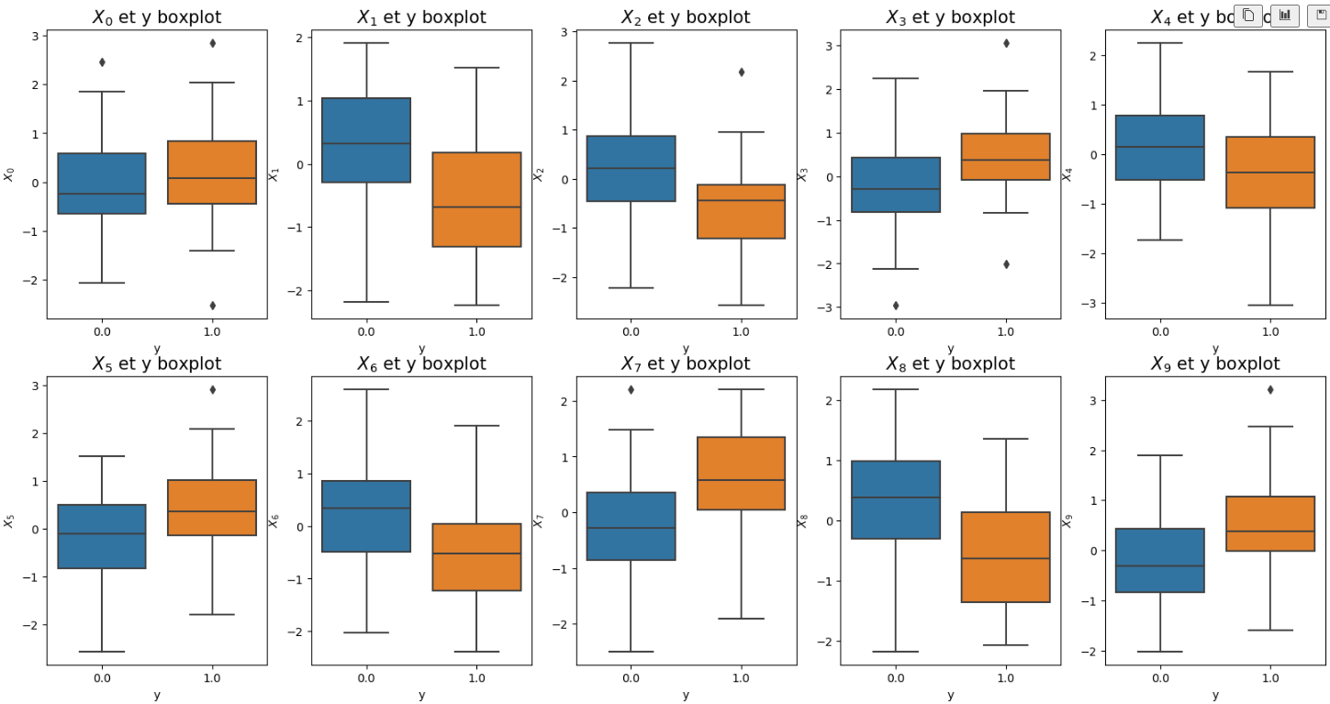
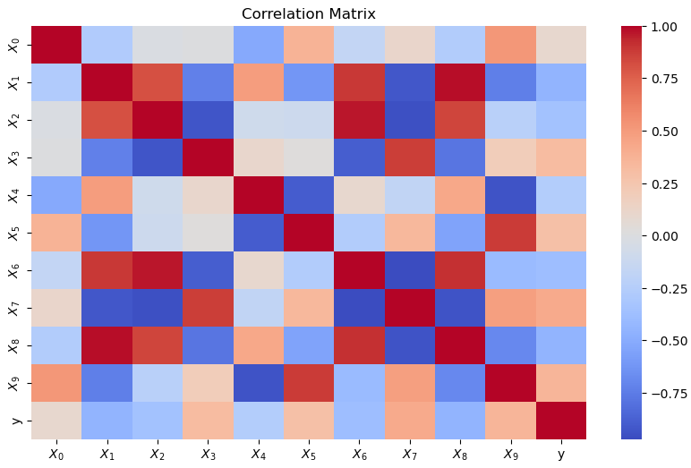
Linear correlations in train data
X1, X2, X3, X6, X7 and X8 seem to provide redundant information
Same for X4, X5 and X9
No individual linear correlation between Xi and y

Slide 3
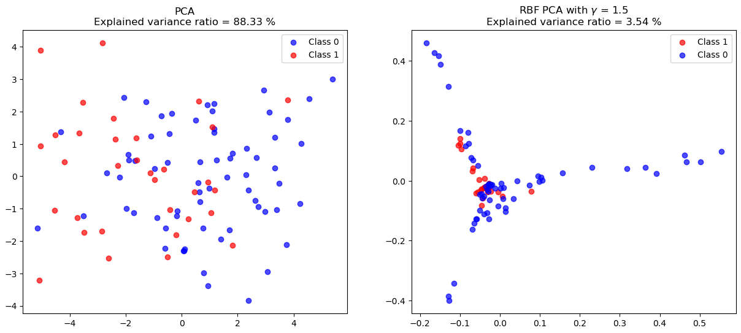
Principal Components Analysis
Classes are not linearly separable so linear models won’t be adapted
They still don’t seem to be separable in the Hilbert space associated with RBF kernel but it’s only a 2D projection. The two first principal components only explain 3,54 % of variance.
With parameter 1.5, one can obseve that class 1 data seems to behave differently than class 0 in the surrogate Hilbert Space. Maybe a kernel method with this parameter could be adapted.

Slide 4
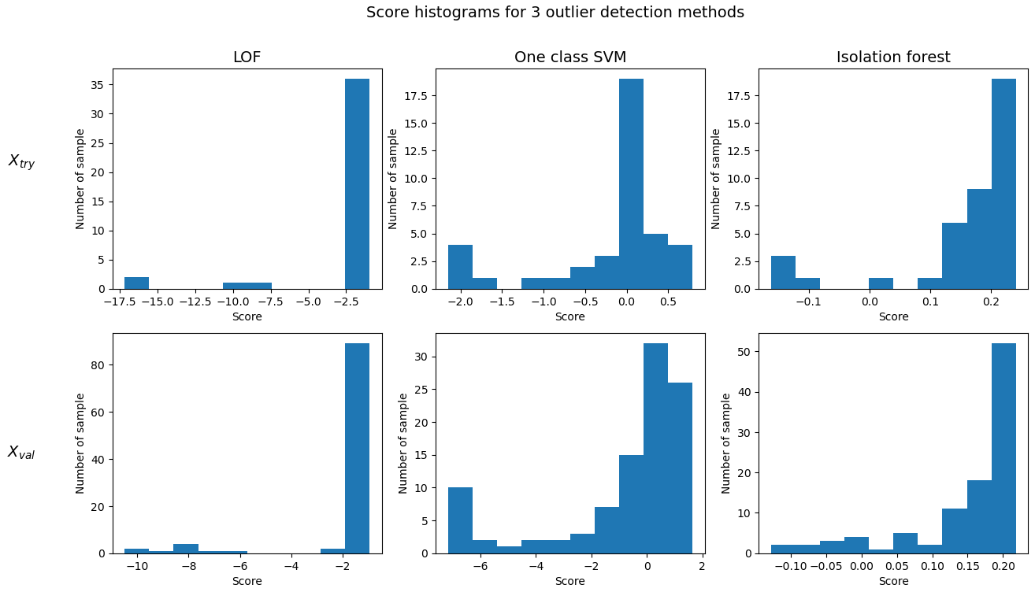
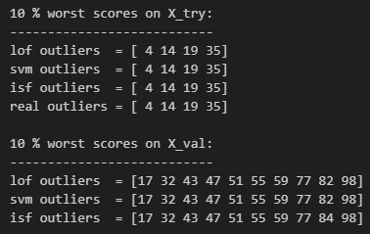
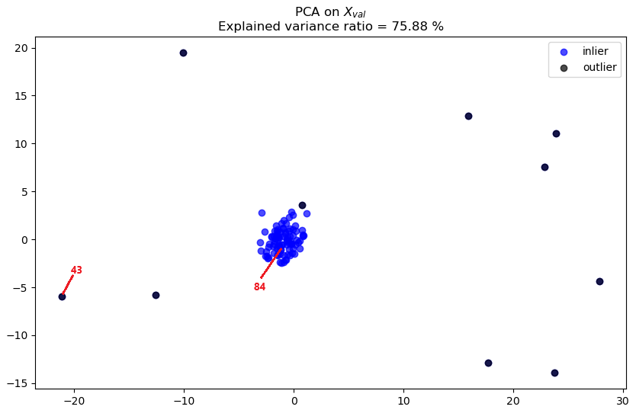
Outlier detection
3 Algorithms tried :
LOF, OneClassSVM, IsolationForest
Agree and right on X_try
Almost agree on X_val
To pick X_val outliers, I choose to trust the result of LOF and OneClassSVM because :
- 2 methods over 3 provided this result ;
- Those 2 method’s scores better split between outlier and inlier (see histograms) ;
- Visually, the 43th point seems more likely to be an outlier than the 84th (see PCA).
According
to LOF

Slide 5
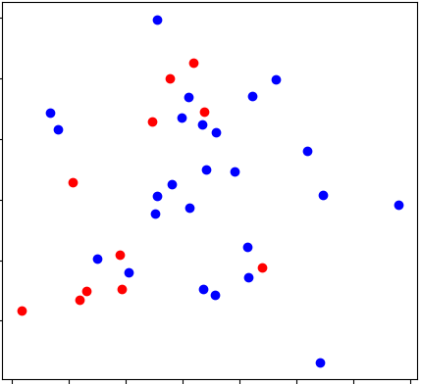
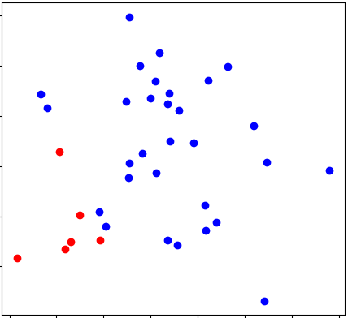
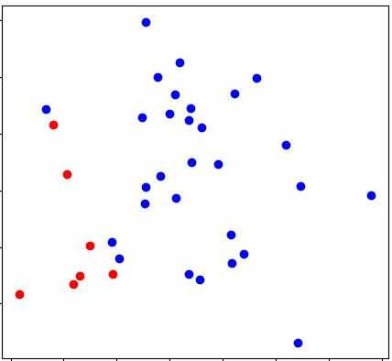
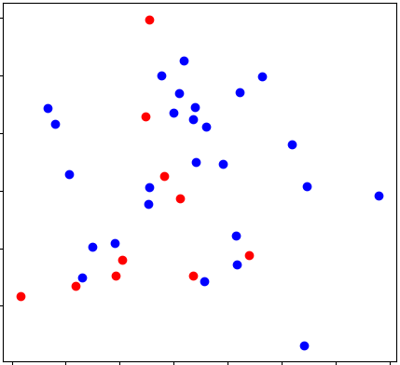
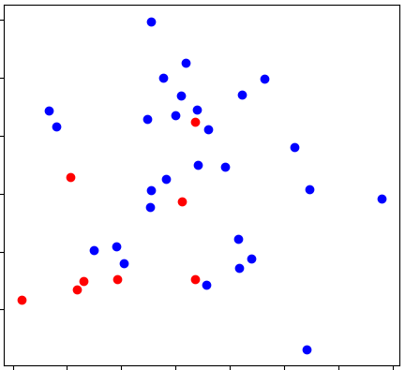
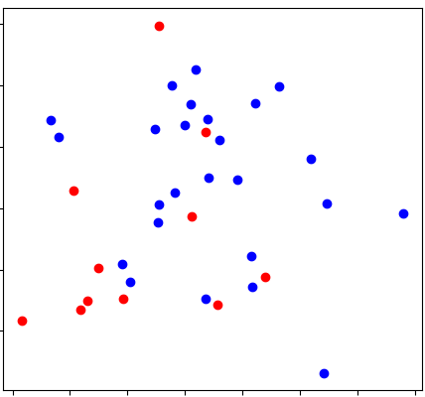
Classifiers comparison
 | 5-folds cross validation on X |  | Test on X_try
 | Best params (By grid search) | Mean f-score | precision | recall | f-score | accuracy
Linear SVC | C : 1 | 0,48 | 0,83 | 0,46 | 0,59 | 0,81
RBF SVC | C: 10 | gamma: 0,01 | 0,46 | 0,71 | 0,46 | 0,56 | 0,78
KNN | n_neighbors: 1 | weigths: ‘uniform’ | 0,48 | 0,5 | 0,46 | 0,48 | 0,69
Random Forest | max_depth : 5 | max_features: ‘sqrt' | min_samples_leaf: 2 | min_samples_split: 10 | n_estimators: 100 | 0,54 | 0,62 | 0,46 | 0,53 | 0,75
XGBoost | colsample_bytree: 0.6 | gamma: 0.5 | learning_rate: 0.1 | max_depth: 5 | n_estimators: 200 | subsample: 0.6 | 0,58 | 0,55 | 0,55 | 0,55 | 0,72
PERFORMANCES
PREDICTIONS
Truth | Linear svc | RBF SVC | KNN | Random forest | XGBoost

Slide 6

Model selection and error
Criterion for model selection :
As class 1 only represents 33 % of the dataset, accuracy isn’t a good metric. Linear SVC has 80 % accuracy by predicting 0 for the majority of the dataset.
Thus, we have to pay attention to recall, which penalizes predicting 0 instead of 1.
F1-score is also a good metric that takes recall into account, and precision too.
I used it for cross-validation, the mean F1-core over the 5 folds is a more robust metric than f1-score on X-try (it’s more independent from the training data).
              With this criterion, XGBoost is the best classifier.
Error estimation :
1) Prediction error : obtained by 5-folds cross-validation on (X,y).
2) Outlier detection error : Based on visual representation on slide 4.
      After scaling, outliers are easily identified, except maybe for 1 over 10, so I predict 10 % error in the worst case.

