Slide 1

CalTab
Calorie tracking done right.
Group 7 | THWS x TAMK | Mobile App Development 1

Slide 2
PROBLEM
Slow & Boring process.
Apps require our data.
Good apps are paid.
We disagree.

Slide 3
OUR SOLUTION
Fast Logging.
Local-first approach.
Free forever.

Slide 4
FEATURES
Everything included.
Onboarding
Search
Barcode
Calculation of BMR, TDEE, and macros
Open Food Facts API, infinite list
Camera + ML Kit, instant lookup.
Snap2Cal
AI assistant
Stats
Photo → Gemini → macros.
Your key, personalized output
7-day trend, macro averages.
Backup
Themes
Offline
JSON export, you own it.
Light, dark, system.
Everything but search.

Slide 5
LIVE DEMO
Let’s see it.
Notes:
Start at onboarding.
“First launch collects age, body data, activity, and goal.”
“From this, the app calculates calorie and macro targets.”
Show home screen.
Daily calories.
Macro tiles.
Meal sections.
Date picker/backlogging.
Add food by search.
Search for a food.
Open detail page.
Change grams/portion.
Add to day.
Return home and show updated totals.
Barcode or Snap2Cal, depending on what is reliable during presentation.
If barcode/camera might be risky live, use search live and mention barcode/Snap2Cal with screenshots.
Live demos have a taste for betrayal. Keep a backup path.
Show stats.
Weekly trend.
Macro averages.
Meal consistency.
Show settings.
Theme mode.
API key section.
Backup export/import.

Slide 6
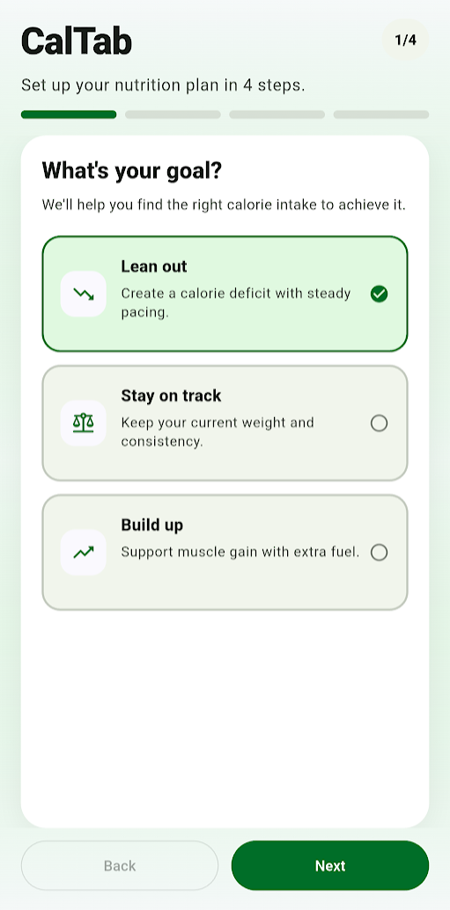
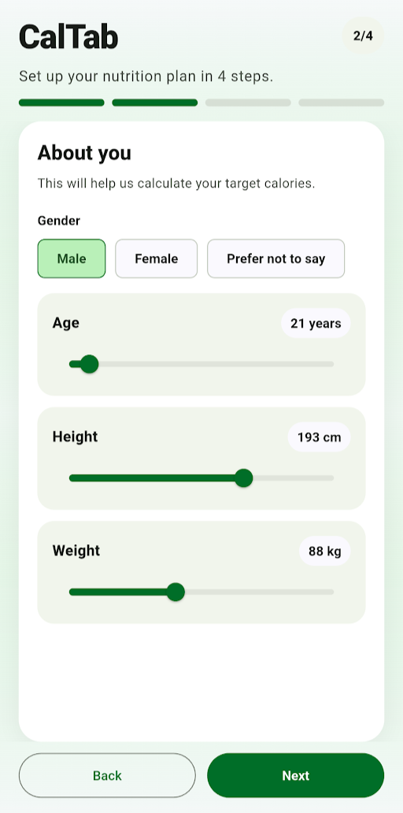
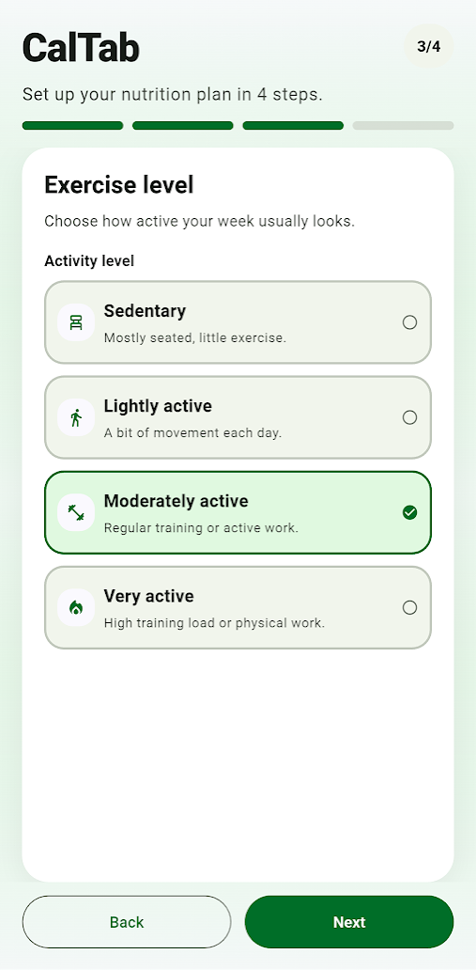
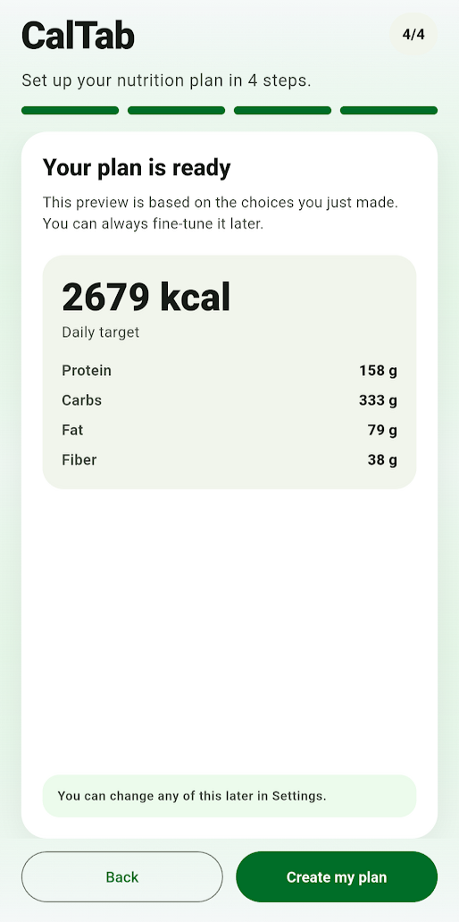
APP FLOW IN PICTURES
Onboarding.

Slide 7
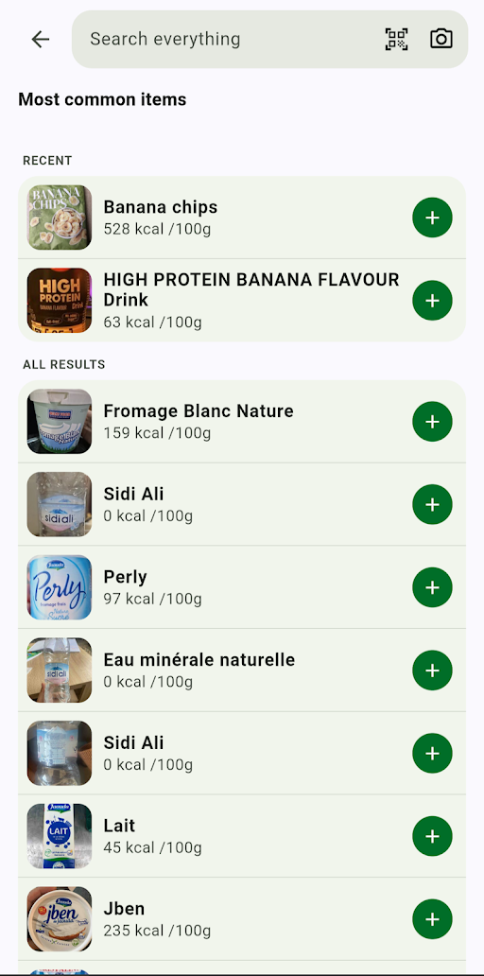
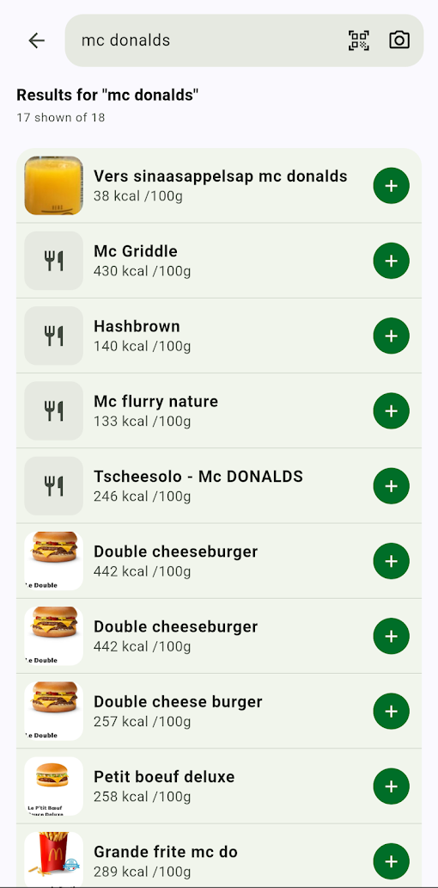
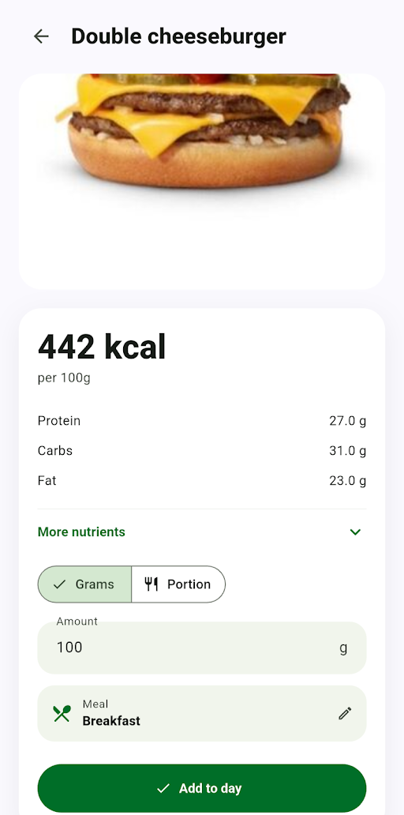
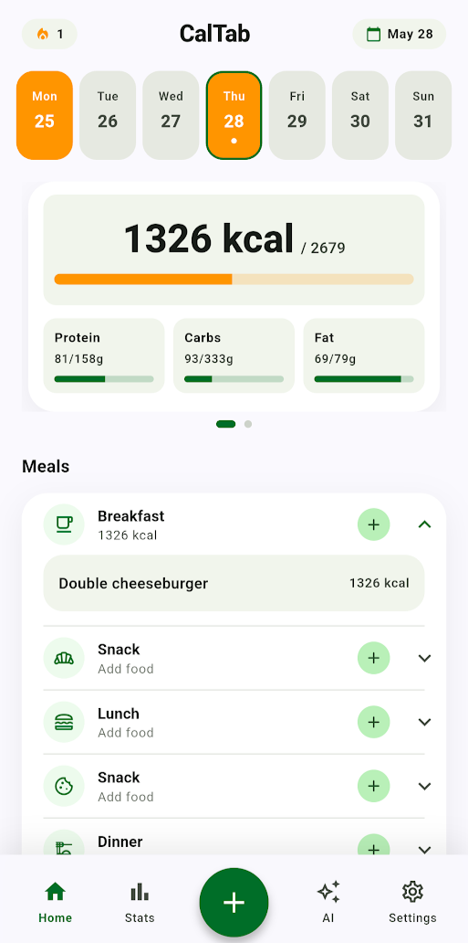
APP FLOW IN PICTURES
Food Logging.

Slide 8
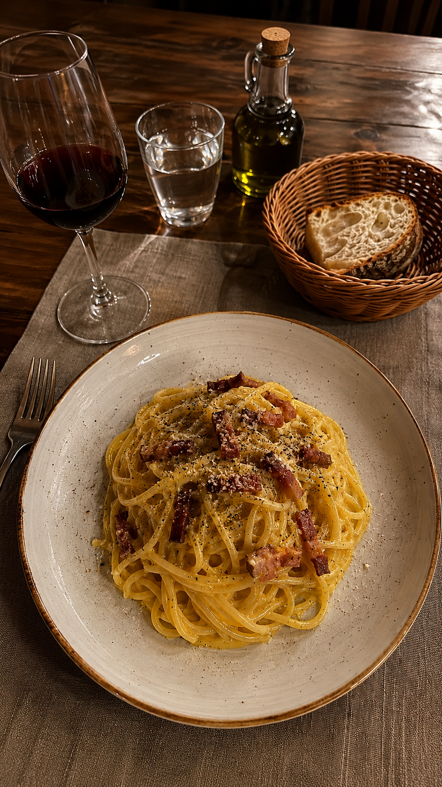
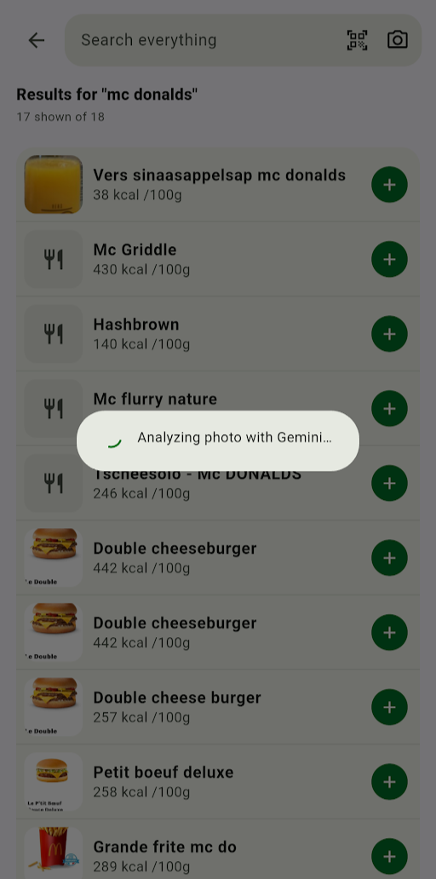
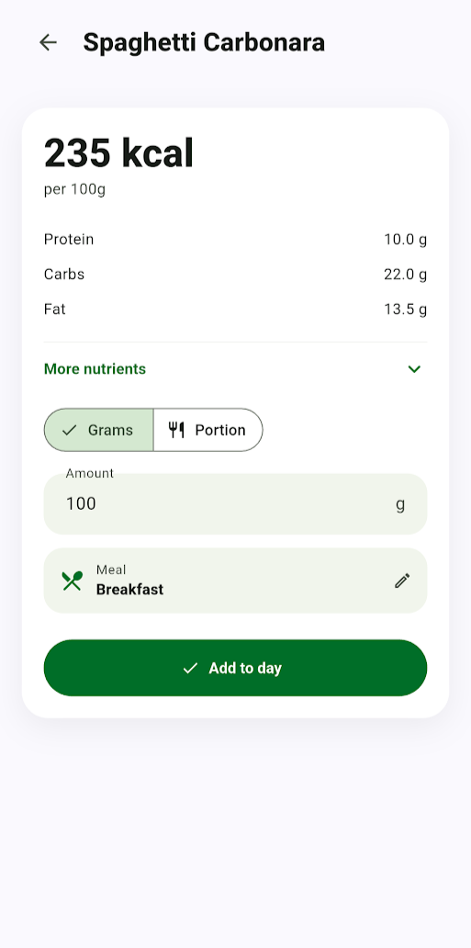
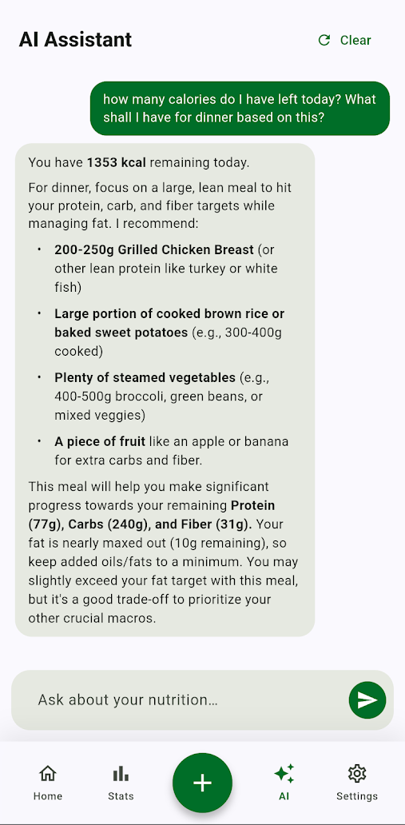
APP FLOW IN PICTURES
AI Features.

Slide 9
KEY TECHNOLOGIES
Flutter.
Riverpod 3.
go_router.
Google Generative AI.

Slide 10
ARCHITECTURE
The big picture.
Screens & Widgets
Riverpod providers
Repositories & services
Local Storage & APIs
Notes:
“We separated the app into UI, state management, data access, and service logic. Screens do not directly save data or call APIs. They talk to Riverpod controllers.”

Slide 11
ARCHITECTURE
Meal Logging Flow
User selects food
FoodDetailScreen confirms quantity + meal
DailyLogController creates meal entry
Riverpod updates app state
Home + Stats update automatically

Slide 12
WHAT’S NEXT?
Improved food DB.
Recipes.
Hydration.
No account. No Telemetry.

Slide 13
Thank you
Questions?

