Slide 1
Understanding Word Embeddings for Natural Language Processing by Artificial Neural Networks
Thomas Conley
University of Colorado Colorado Springs

Slide 2
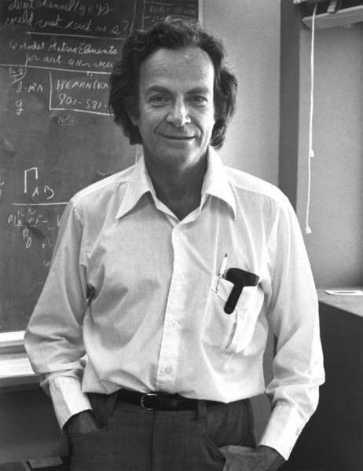
Research Questions
It’s better to have questions you can’t answer,
then to have answers you can’t question.
-- Richard Feynman

Slide 3
Research Questions
How do word embeddings function as input to Artificial Neural Networks?
Specifically:
Does an ANN rely on the meaning of a word?
Does an ANN rely on vector distance measure?
Does an ANN rely on the magnitude or direction?
Does an ANN rely on predicting previous/next word?
Additionally:
What aspects of word embeddings are needed?
Can we improve word embeddings for use in ANNs?
Do we need pre-trained word embeddings at all?
Notes:
The last question is my ultimate goal.

Slide 4
Research Methodology
Find well respected research and experiment with word embeddings.
For each research question, device a test to prove or disprove an assertion.

Slide 5
Does an ANN rely on the meaning of a word? (1)
Test:
Replace each word with an actual unrelated word.
e.g., replace words with the opposite word by usage.
Proof:
If the results are the same then the ANN does not rely on the meaning or the vector does not possess the meaning.
Result:
The results appear to be random. No conclusion about meaning.
Notes:
This might be different for an LSTM.
No difference could be the statistics of the embedding

Slide 6
Does an ANN rely on the meaning of a word? (2)
Test:
Replace each word with theoretical completely unrelated word.
e.g., replace vectors with the exact negative vector.
Proof:
If the results are the same then the ANN does not rely on the meaning or the vector does not possess the meaning.
Result:
The results appear to be random. No conclusion about meaning.
There is something about the vector that is important.
Notes:
This might be different for an LSTM.
No difference could be the statistics of the embedding

Slide 7
Does an ANN rely on the meaning of a word? (3)
Test:
Replace a set of related words with an unrelated set of related words.
e.g., replace ’God’ with ‘Computer’ and replace ‘Religion’ with ‘Operating System’.
Rhetorical proof:
The meaning of a word is only known to the user of the word.
It is only the usage of a word that can be measured or recorded.

Slide 8
Does an ANN rely on vector distance measure?
Test:
Randomly shuffle values in word embeddings to break distance measure.
All the statistics for the embeddings remain the same.
Proof:
If there is no change in results, then distance measure does not matter.
If the results are random, then distance matters completely.
Result:
Inconclusive; the test affects validation not training [so much].
Notes:
Random shuffle breaks both Euclidean and Cosine distance. Results are somewhere in between. I assert that it’s not the distance measure but some other aspect. We may need another distance measure.

Slide 9
Does an ANN rely on the magnitude or direction of the vector?
Test:
Replace embeddings with random distributions of various shapes.
Proof:
If there is no change in results, then magnitiude and direction does not matter.
If the results are random, then it matters completely.
Result:
Inconclusive; the test affects validation not training [so much].

Slide 10
Does an ANN rely on predicting previous/next word?
Test:
Randomly shuffle words to break up co-occurrence.
i.e., test on a bag of words instead of sequences.
Proof:
If the results are adversely affected then the ANN does rely on word co-occurrence/ prediction.
Result:
No difference in result.
The sequence of words doesn’t matter (for this research)
Notes:
Word embeddings can in fact predict previous/next words. Based on experience and knowing how they are built.
That is what they are built for At least for this research

Slide 11
Additional Questions
What aspects of word embeddings are needed by ANNs?
The shape of the “vector cloud” seems to matter.
The dimensions of vector seem to have meaning.
I need to take a closer look at magnitude or norm.
Can we improve word embeddings for use in ANNs?
I think so, once we understand how they work.
Do we need pre-trained word embeddings?
We may be able to artificially generate them.
Notes:
Word embeddings can in fact predict previous/next words. Based on experience and knowing how they are built.
That is what they are built for At least for this research

Slide 12
Natural Language Processing
Lots of work has been done in Image Processing and Voice Recognition by ANNs
Using Artificial Neural Networks for NLP is newer, and the focus of much current research.
Word Embeddings are often used as input to Neural Networks

Slide 13
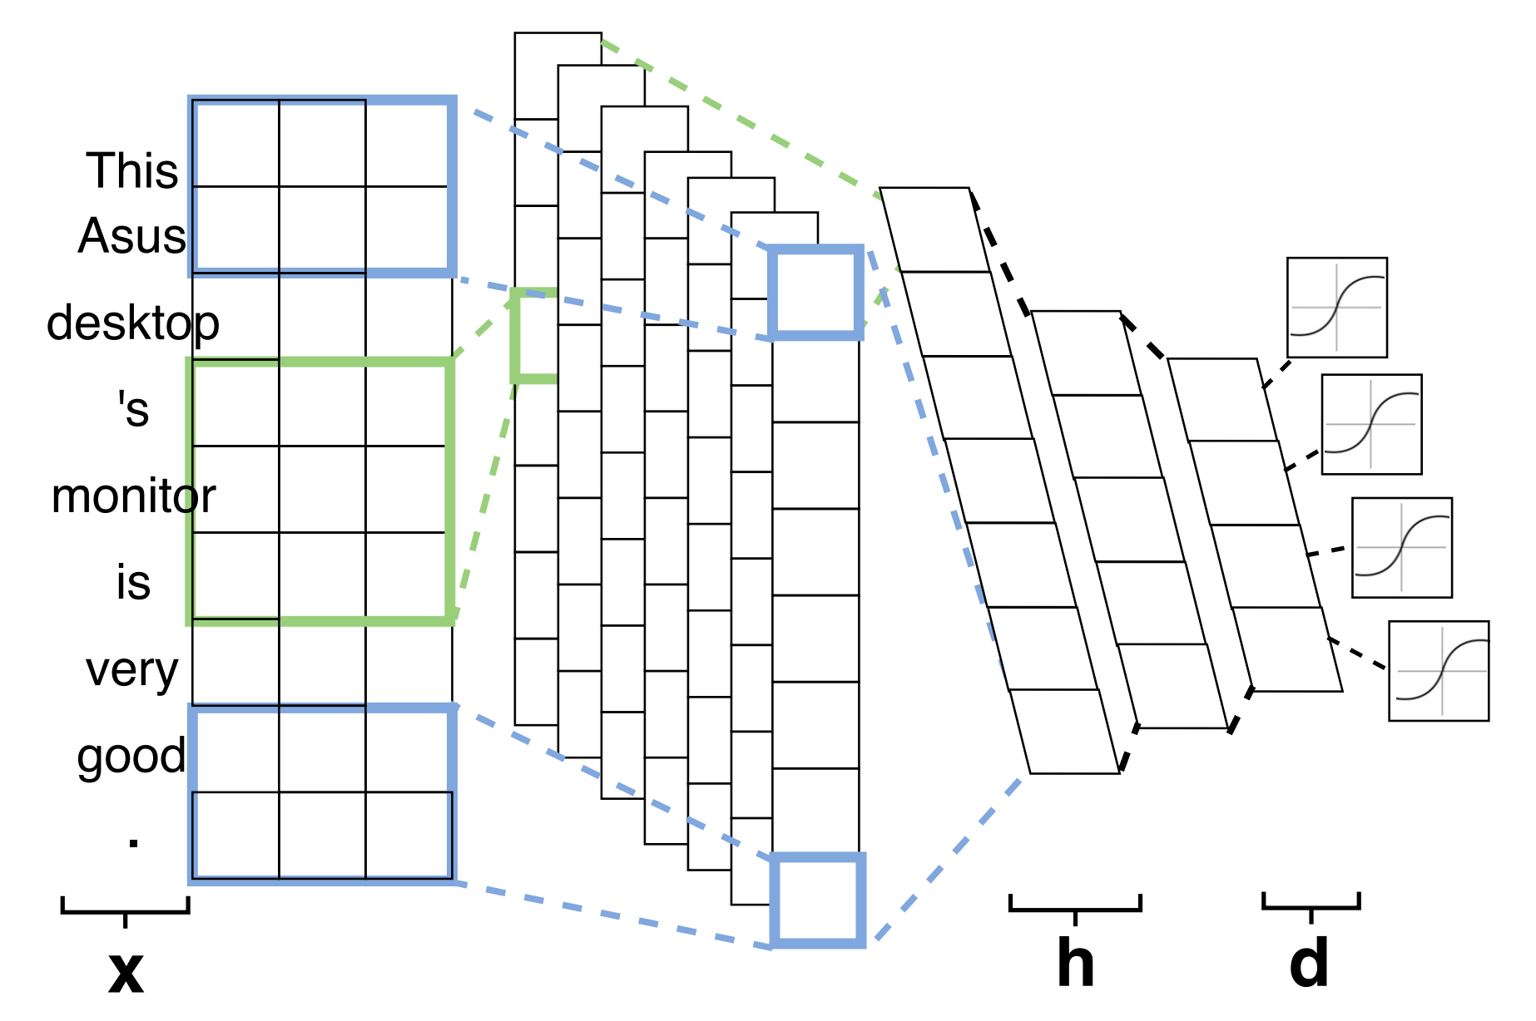
Word Embeddings as Input to ANNs?

Slide 14
Control Research
GloVe Embeddings, (50,100,200,300)
60,000 vocabulary
20 newsgroups
20,020 Messages

Slide 15
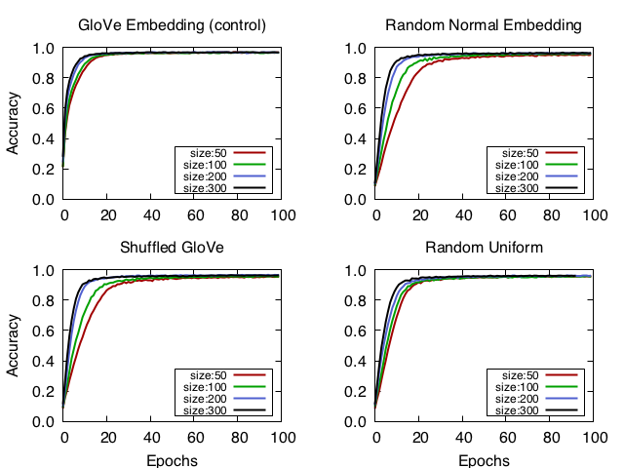

Slide 16
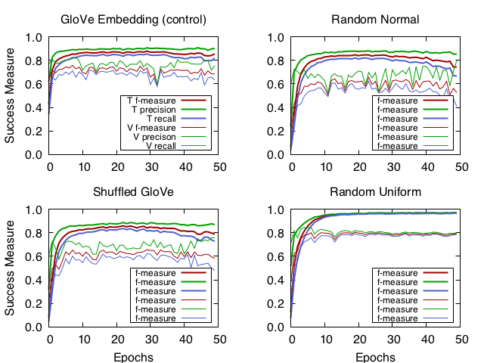

Slide 17
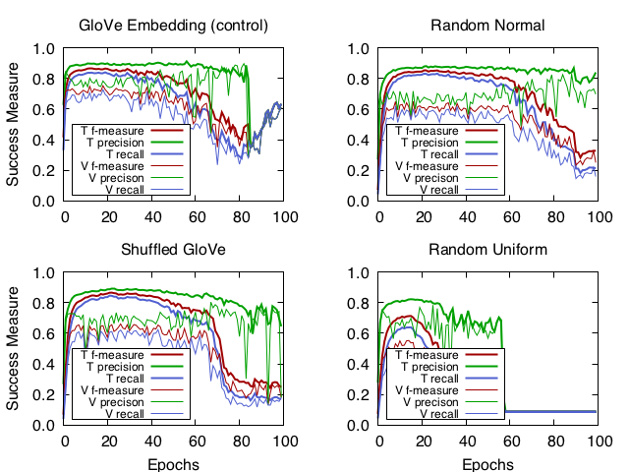

Slide 18
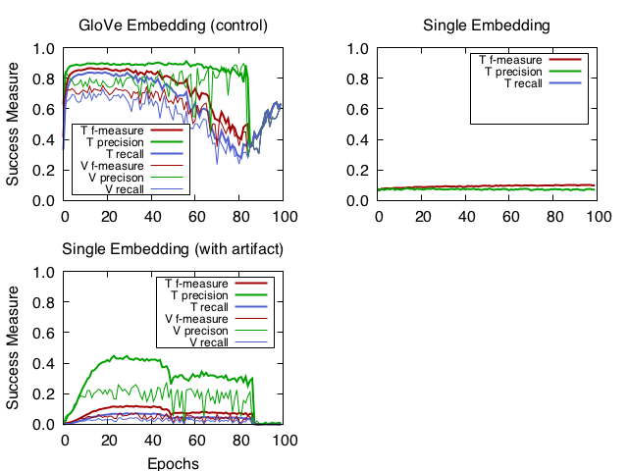

Slide 19
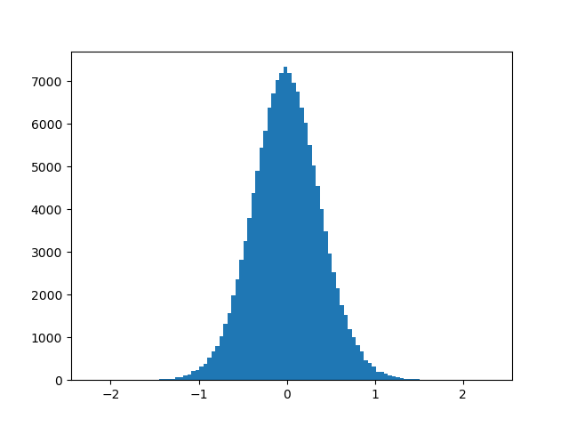
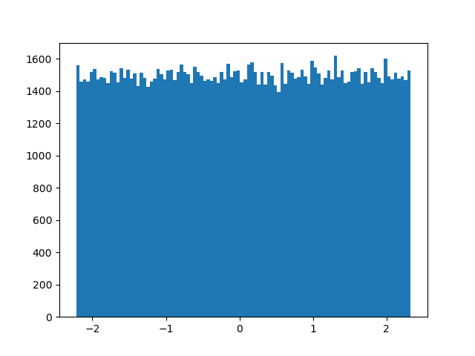
Comparing Embedding Distribution
Glove Embedding Distribution
Uniform Embedding Distribution

Slide 20
Timeline and Future work
Devise a Test for the word distinction assertion.
Test L2-Norm as a distinction factor.
Devise a Test for maximum distinction.
Devise a Test for “Maximum Distinction”
Find other research to use as a control Group.
Other kinds of ANNs
Other less-successful control results

Slide 21
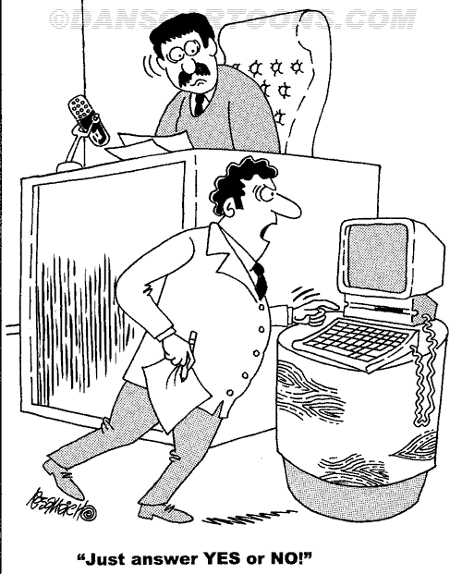
Questions?

