Slide 1

Stage 2 Interview
Sports Biomechanics Data Scientist Task
Thomas Aston

Slide 2
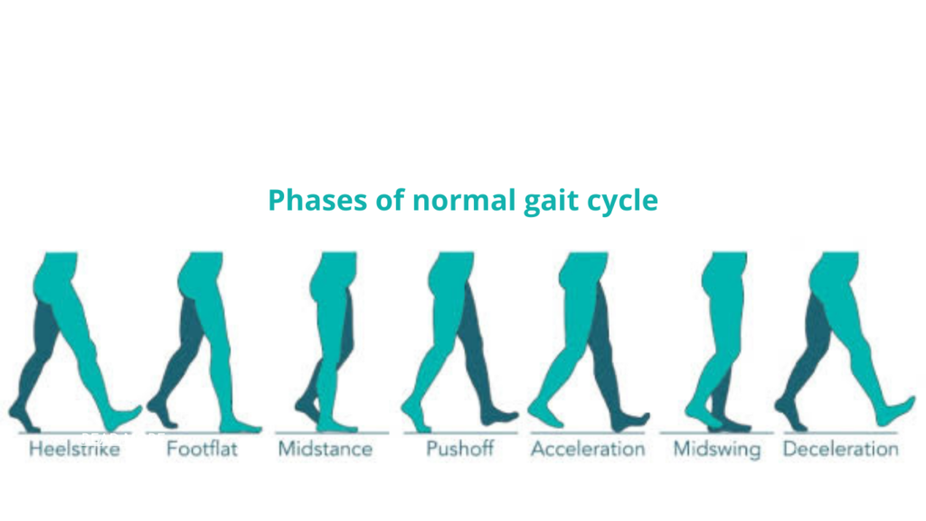
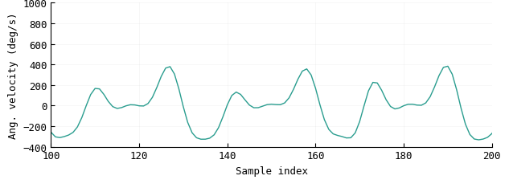
Foot
contact
Foot
flat
Foot
off
Foot
contact
Foot
flat
Foot
off
Foot
contact
Foot
flat
Foot
off

