Slide 1

Stage 2 Interview
Sports Biomechanics Data Scientist Task
Thomas Aston

Slide 2
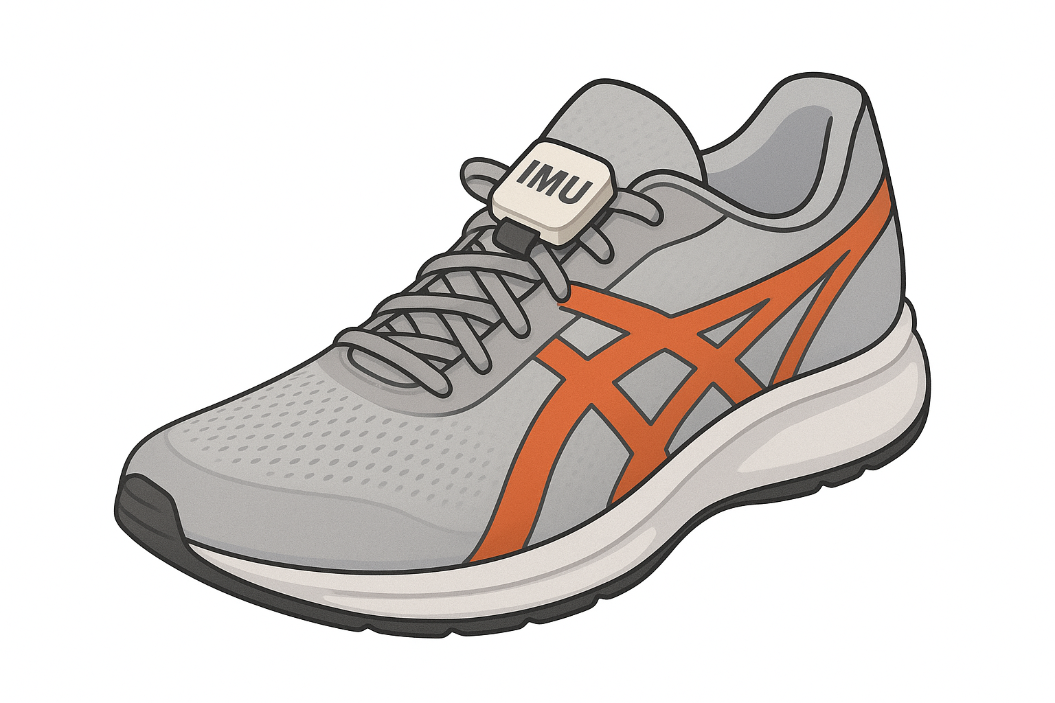
Data selection:
Requirements
Low cost
Stride
Sensitive
Portable/
Non-invasive

Slide 3
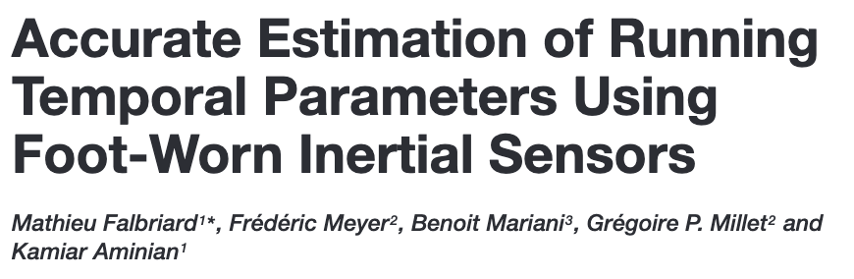
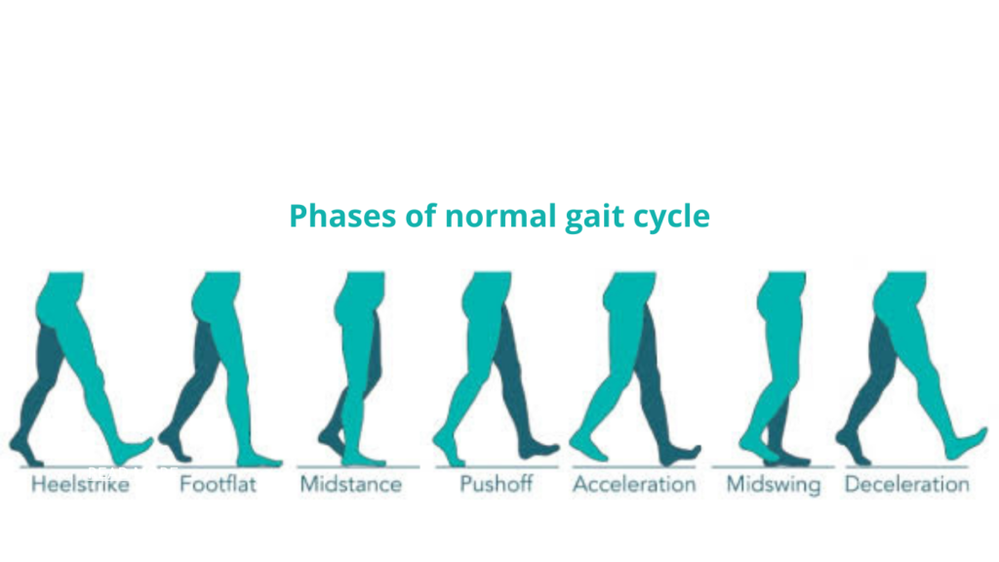
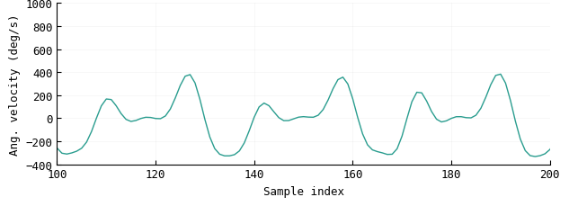

Data selection:
Events
Foot
contact
Foot
flat
Foot
off
Foot
contact
Foot
flat
Foot
off
Foot
contact
Foot
flat
Foot
off

Slide 4
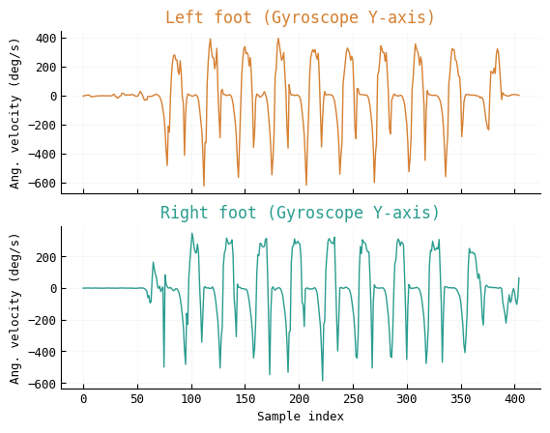
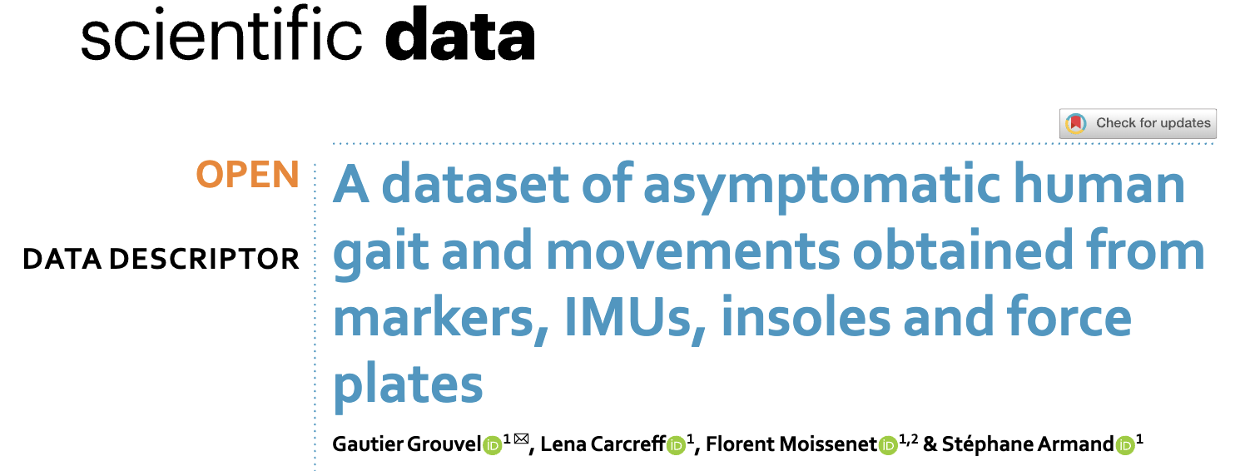
Data selection:
Open data

Slide 5
Event detection:
Requirements
Foot strike and foot off
Speed invariant
Real time

Slide 6
Event detection:
Implementation
Filtering: causal (moving average)
State machine: zero crossings
Peak detection: mid swing
Zero velocity detection: mid stance
Peak detection: foot strike and foot off

Slide 7
Metrics:
Requirements
Highlight performance and injury risk

Slide 8
Live demo:
movetru-stride.streamlit.app

Slide 9
Validation:
Requirements
Highlight performance and injury risk

