Slide 1

Implementation and Analysis of an Elliptic Curve Cryptography System
Thomas Butterfield
Notes:
Hello, I’m Thomas and welcome to my presentation about Elliptic Curve Cryptography, which I’ll now refer to as ECC.
The title of this project is: Implementation and Analysis of an Elliptic Curve Cryptography System.
As you might imagine then, the aim of this project was to create a working ECC system and to then analyse that system.
I’m going to first give a brief overview of the project,
then I’ll give a demonstration of the implementation,
and finally, I’ll answer any questions about the project.

Slide 2


Context
Privacy
Elliptic Curve Diffie-Hellman (ECDH)
Authentication
Elliptic Curve Digital Signature Algorithm (ECDSA)
2048-bit RSA key = 224-bit ECC key
Notes:
Any cryptography system tries to solve two kinds of security problems: privacy and authentication. Imagine that Alice and Bob are trying to communicate, while Eve, the eavesdropper, intercepts and tries to read their messages.
In Elliptic Curve Cryptography, privacy is solved with the Elliptic Curve Diffie-Hellman (ECDH) key exchange algorithm, which allows Alice
and Bob to establish a secret shared key that they can use for secure communication.
Authentication is solved with the Elliptic Curve Digital Signature Algorithm (ECDSA), which allows Bob to verify that Alice was truly the sender of a message and ensures that Eve cannot impersonate Alice.
These two algorithms are very similar to their RSA counterparts. While RSA squares and multiplies numbers repeatedly to achieve exponentiation, ECC doubles and adds points on a curve repeatedly to achieve multiplication.
Although ECC is perhaps not as well-known as RSA, it is much more efficient.
Today, RSA keys used must be at least 2048 bits in size today. However, a 224-bit ECC key achieves the same level of security.
This is because the integer factorisation problem, on which the security of RSA is based, can be solved in sub-exponential running time, whereas the ECDLP, on which the security of ECC is based, can only be solved in fully exponential running time. Meaning that, to increase security levels, RSA key sizes must increase exponentially while ECC key sizes can increase linearly.

Slide 3

Project Overview
Aims
Create & analyse ECC system
Method
Python, ECC & modular arithmetic
Results
End-to-end encrypted, 10x faster than RSA
Conclusions
Secure & efficient communication, benefits increase over time
Notes:
Aims:
As previously mentioned, this project aimed to create and analyse an ECC system.
Method:
Essential mathematical operations required for ECC were implemented in Python, including elliptic curve point multiplication, achieved through repeated doubling and addition, and the extended Euclidean algorithm, used for modular division.
Results:
An end-to-end encrypted messaging system allowing for both text and file sending was created, using ECC for key establishment and digital signature authentication.
Analysis shows that very little data is leaked through timing attacks and that my ECC system is almost an order of magnitude more efficient than an RSA system at today’s minimum security level, with this gap widening exponentially as security level increases.
Conclusions:
The system allows for secure and efficient communication due to smaller key sizes.
In general, cryptography systems that use ECC rather than RSA can generate results much faster with less computation, and this disparity will grow over time.

Slide 4

Objectives
Basic
Create essential functions
Elliptic Curve Diffie-Hellman (ECDH)
Basic user interface
Intermediate
Secure random keys
Elliptic Curve Digital Signature Algorithm (ECDSA)
Exchange secure signed files
Advanced
Advanced user interface
Efficiency analysis
Security analysis ️
Notes:
There were a total of nine objectives for this project, split equally into three sections: basic, intermediate, and advanced.
The first basic objective was to create a basic working ECC system that computed the essential functions required.
The first function that had to be created was elliptic curve point multiplication, which is used throughout the system.
Before showing it in action, I will first explain how it works.

Slide 5
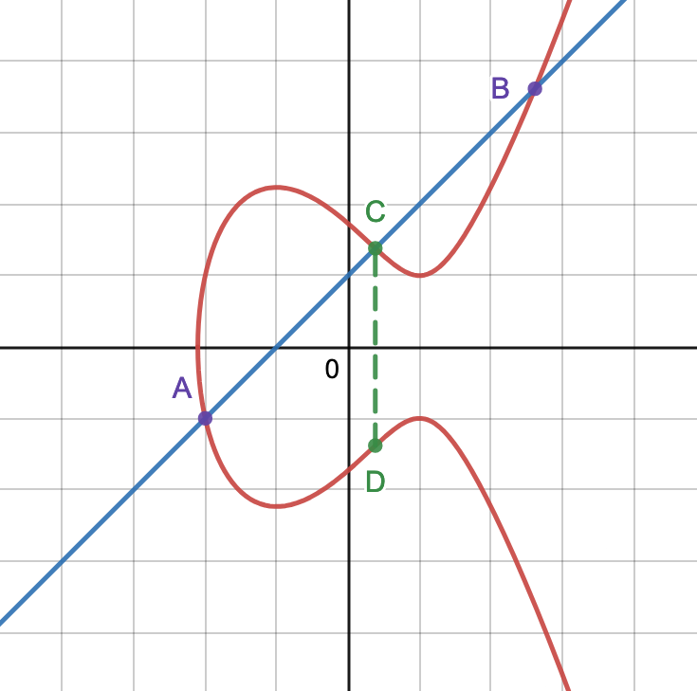
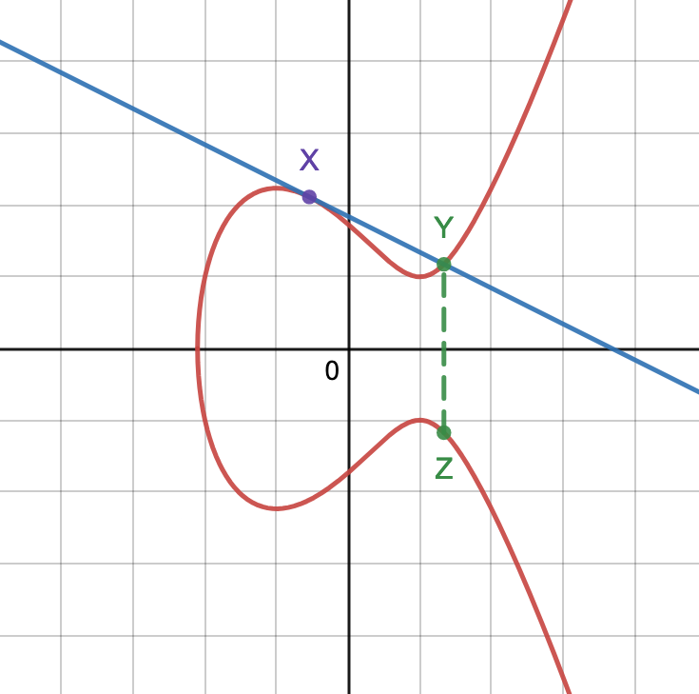
Point Addition
Point Doubling
A + B = D
X + X = Z
Notes:
A very simple elliptic curve is shown here as the red line in both figures.
Looking at the figure on the left, in order to add two points A and B together, the straight line which passes through both points is drawn.
Then the other point at which the line intersects the curve is found, here this is point C.
This point is reflected in the x-axis to form D.
The point D is the sum of points A and B in this figure, so A + B = D.
The same principle applies for doubling a point, as the figure on the right illustrates.
If the two points you’re adding are equal, here we call them X, then the line passing through both points is instead a tangent to the curve at X.
The only other point at which the line intersects the curve is then Y.
When reflected in the x-axis this becomes Z.
The point Z is the double of point X in this figure, so 2 · X = Z.
Using these two methods allows any point on the curve to be multiplied by an integer, using repeated doubling and adding.
Demo key pair generation.

Slide 6

Objectives
Basic
Create essential functions
Elliptic Curve Diffie-Hellman (ECDH)
Basic user interface
Intermediate
Secure random keys
Elliptic Curve Digital Signature Algorithm (ECDSA)
Exchange secure signed files
Advanced
Advanced user interface
Efficiency analysis
Security analysis ️
Notes:
So this fulfils the first basic objective.
*
The second basic objective was to create a client application that can conduct ECDH key exchange.
Before I show this in action, let me first explain what is happening.

Slide 7
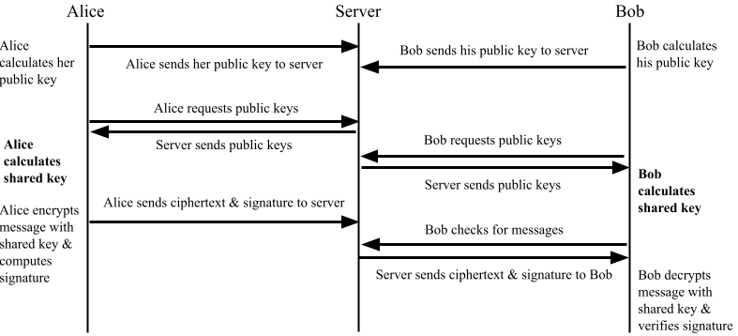
Message Exchange Diagram
Notes:
At a high level, my system is a client-server network designed to allow multiple instances of a client program to connect to a single server program.
The clients can communicate with each other, via the server, using end-to-end ECC encryption.
This figure illustrates the protocol for Alice to send a message to Bob, using my system.

Slide 8
Objectives
Basic
Create essential functions
Elliptic Curve Diffie-Hellman (ECDH)
Basic user interface
Intermediate
Secure random keys
Elliptic Curve Digital Signature Algorithm (ECDSA)
Exchange secure signed files
Advanced
Advanced user interface
Efficiency analysis
Security analysis ️
Notes:
So this fulfils the second basic objective.
*
The third basic objective was to create a user interface (UI) allowing a user to easily make use of the system and to decide what level of complexity is revealed to them.
*
The intermediate objectives revolved around improving the functionality and security of the system, with the first objective being to add secure random private key generation to the system.
Initially I used a constant number, as a placeholder for the private key, I then switched to using Python’s random module to get pseudo-random numbers, but this is not cryptographically secure.
I then investigated using user input such as mouse movement or keyboard usage to generate random numbers, but in the end I decided to use Python’s secrets module.
This module offers a class for generating cryptographically secure random numbers using sources provided by the operating system and the sequences it provides are not reproducible.
*
The other intermediate objectives were to implement the ECDSA
*
and to enable the exchange of secure signed files via the UI.
*
The first advanced objective was to make improvements to the UI and to reveal the workings of the system.
*
The penultimate objective was to analyse the code for efficiency, including how the time required scales with the curve and key size.

Slide 9
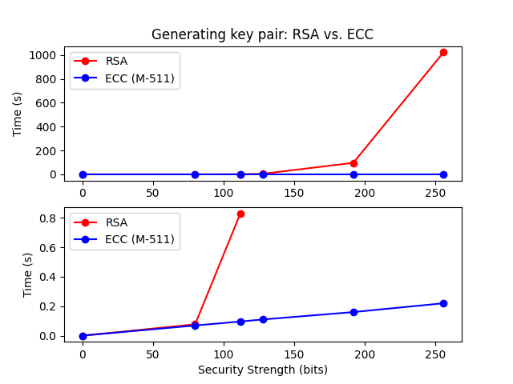
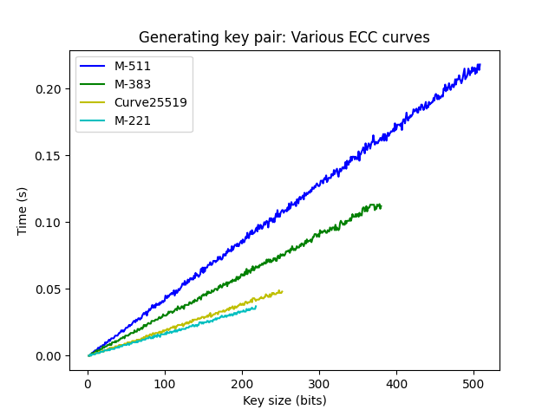
Efficiency Analysis
Notes:
The figure on the left shows a timing comparison between my ECC system and an RSA implementation for generating a key pair of various security strengths.
The top graph in the figure on the left shows the overall comparison for the entire range (0-256 bit security strength), while the bottom graph shows the same comparison except with a smaller range for RSA, up to today’s minimum security strength of 112 bits, and the x-axes are aligned vertically.
This illustrates that the time taken by my ECC system scales linearly as security strength increases, whereas the time taken by RSA scales exponentially.
Even at today’s minimum security level, RSA takes nearly an order of magnitude longer than ECC to generate a key pair.
The figure on the right shows how the time taken to generate a key pair varies as the size of the private key increases, for 4 different elliptic curves.
It illustrates that, while the time taken by every curve increases linearly, the speed of this increase (the gradient of the line) is greater for some curves than others.
These differences are due to the modulo p over which the curve is defined.
If a curve has a larger p, the points on the curve can have larger coordinates, so calculations involving these points will take longer.
These curves with a larger p are more secure, but take longer, so this is the trade-off you’re making when selecting a curve.
Another point to note about the figure is that some lines on the graph are shorter than others.
This is due to another property of each curve, the base point G of every curve has an order n, where nG = 0.
What this means in practice is that the private keys used with a given curve must be less than n.
When it came to producing the results in this figure, the key sizes for each curve could only range from 1 to n, and n is different for every curve.
For example, the order of curve M-221’s base point is n ≈ 2218, while curve M-511’s is n ≈ 2508.
This explains the length of each line in Figure 5, the line for M-221 ends at 218 bits and the line for M-511 ends at 508 bits.
It is important to note that security strength is not the same as the key size, this is due to attacks on both RSA and ECC that provide computational advantages.
For example, a security strength of 112 bits, requires an RSA key size of 2048 bits and an ECC key size of 224 bits.

Slide 10
Objectives
Basic
Create essential functions
Elliptic Curve Diffie-Hellman (ECDH)
Basic user interface
Intermediate
Secure random keys
Elliptic Curve Digital Signature Algorithm (ECDSA)
Exchange secure signed files
Advanced
Advanced user interface
Efficiency analysis
Security analysis ️
Notes:
So the penultimate objective is fulfilled.
*
The final objective was to analyse the code for security, such as side-channel attacks.

Slide 11
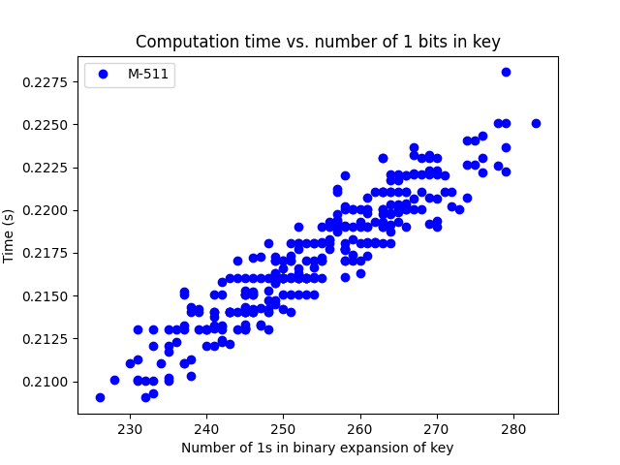
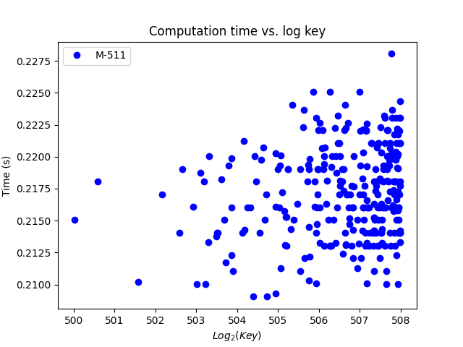
Security Analysis
Notes:
Here, I used the system to generate 300 random key pairs, timing the time taken each time.
I plotted these times against two different properties of the private key: the number of 1 bits in the binary expansion of the key (the figure on the left), and the size of the key, measured by taking the log of the key (the figure on the right).
The figure on the left appears to show a positive correlation, while the figure on the right appears to show no strong correlation.
The correlation shown in the figure on the left is not a terminal problem for the system.
Even in a worst-case scenario for the system, this correlation only provides a small computational advantage to an attacker.
However, it is still a slight limitation.
The lack of strong correlation shown in the figure on the right is because the scale of the x-axis is so small compared to the entire scale of 0-508.
This means that random error from noise or natural variation plays a much more significant role in the timing results and obscures any underlying correlation.
Suppose that in a rare case x is known to be as low as 220, this still gives 508 choose 220, which is roughly 2^497.
The number of possible keys has reduced from ∼ 2^508 to ∼ 2^497 in a worst-case scenario.

Slide 12
Objectives
Basic
Create essential functions
Elliptic Curve Diffie-Hellman (ECDH)
Basic user interface
Intermediate
Secure random keys
Elliptic Curve Digital Signature Algorithm (ECDSA)
Exchange secure signed files
Advanced
Advanced user interface
Efficiency analysis
Security analysis ️
Notes:
So the final objective is fulfilled.
*
That is all of the objectives fulfilled.
Due to the complexity of elliptic curve cryptography, the creation of the system itself was a major result, while the other major results came from testing and analysing the system to ensure it worked as intended and was both efficient and secure.

Slide 13

Questions?
Notes:
Any questions?

