Slide 1
WA Energy Survey
Community Attitudes: Energy & Renewables
n=1,011 WA adult residents

Slide 2
Perceptions of Energy Types

Slide 3
Key findings — energy perceptions & renewables
WA residents broadly view coal and oil as bad for the climate, while attitudes to gas are more mixed. Cost of living dominates energy concerns, though climate is the top priority for younger and more progressive cohorts. There is a strong majority in favour of a renewable energy target, with optimism about economic benefits tempered by scepticism on power prices.
• Coal (61%) and oil (59%) are rated as bad for the climate by majorities; gas is more divisive (43% total bad).
• Rising power prices is the #1 energy concern (36%), well ahead of climate change (19%).
• Majorities believe renewables would bring good jobs (73%), new industries (71%) and better reliability (67%).
• 62% support a WA renewable energy target; only 15% oppose. Unsure remains high at 23%.
• Solar consideration is modest: just 32% of non-solar households are considering installing solar.
Base: all respondents (n=1,011)

Slide 4
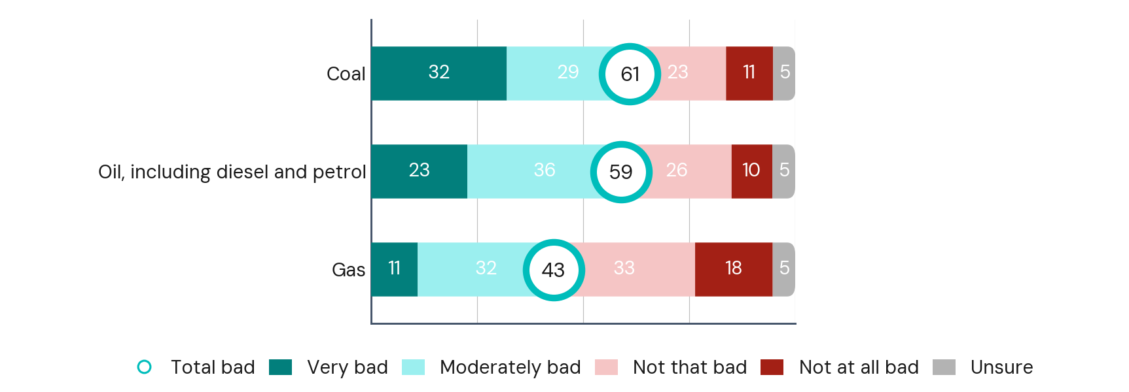
Climate impact of energy types
For each of the following, how bad do you think using the following energy types are for the climate? (%)
Coal & oil seen as bad for the climate
by clear majorities.
Gas is more divisive — splits by age:
↑ Under 30 — 54% rate gas as bad
↓ 60+ — 38% rate gas as bad
And strongly by political vote:
↑ Greens — 57% / WA Labor — 49%
↓ Lib/Nat — 35% / One Nation — 29%
Base: all respondents (n=1,011)

Slide 5
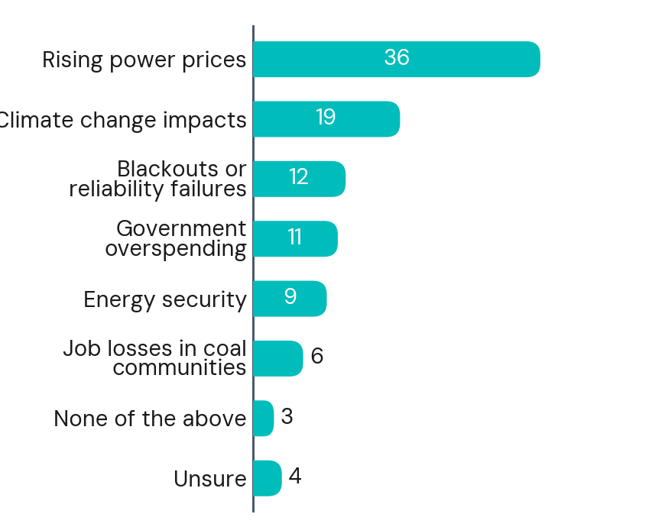
Main concern about WA's energy future
Which of the following concerns you most when thinking about WA's energy future? (%)
Rising power prices is the dominant
concern across all groups.
Climate concern is highest among
younger and more progressive residents:
↑ Under 30 — 24% cite climate
↓ 60+ — 16% cite climate
↑ Women — 23% climate (vs 15% men)
↑ Greens — 30% climate
Power prices skew older & conservative:
↑ 60+ — 42% cite rising prices
↑ One Nation — 48% rising prices
Base: all respondents (n=1,011)

Slide 6
Renewable Energy Attitudes

Slide 7
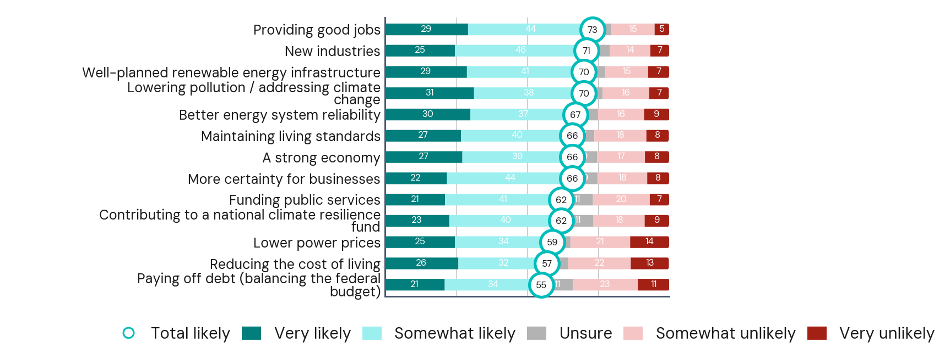
Likely outcomes of more renewable energy
And how likely do you think these following outcomes would be if WA used more renewable energy? (%)
Optimism is broad — driven mainly by
age and political alignment.
Best outcomes: jobs, industries,
infrastructure, environment (70–73%).
↑ 30–44yo — 73–80% total likely
↓ 60+ — 55–68% total likely
Power prices & cost of living attract
most scepticism (57–59%).
↑ WA Labor — 65–67% likely
↓ One Nation — 29–40% likely
Base: all respondents (n=1,011)

Slide 8
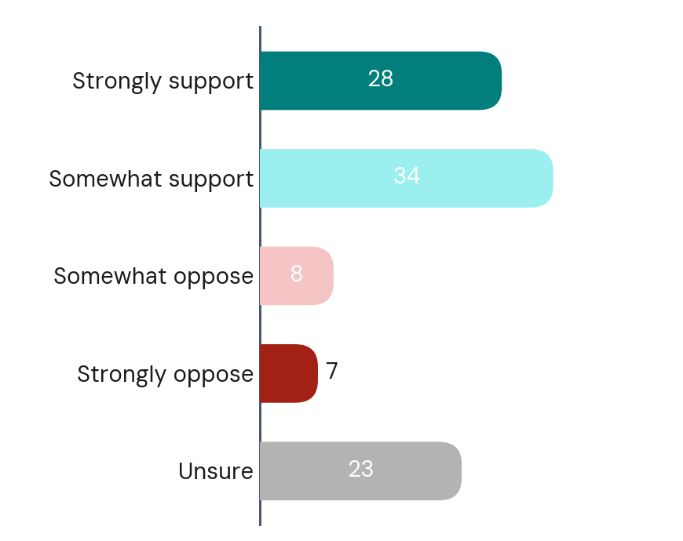
Support for a WA renewable energy target
There has been discussion about the WA government setting a target for the generation of renewable energy. How strongly do you support or oppose WA adopting a renewable energy target? (%)
62% support a renewable energy target;
only 15% oppose.
Strongest support among:
↑ WA Labor voters — 78%
↑ Inner city Perth — 70%
↑ 30–44 year olds — 66%
↑ Solar owners — 70%
Most opposition from:
↓ One Nation — 35% support, 46% oppose
↓ 60+ — 56% support, 25% oppose
62%
Support
15%
Oppose
Base: all respondents (n=1,011)

Slide 9
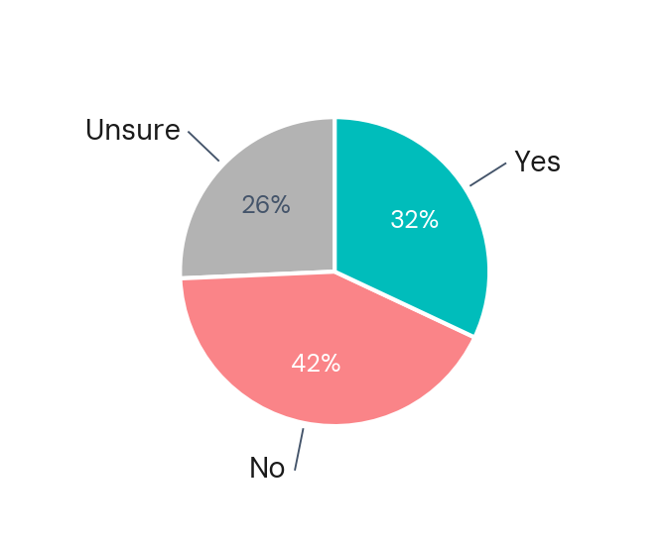
Considering installing rooftop solar
Are you considering installing rooftop solar? (%)
Only 1 in 3 non-solar households
are considering solar — 26% unsure.
Most likely to consider:
↑ Mortgage holders — 48%
↑ 30–44 year olds — 42%
↑ Income >$120k — 42%
Least likely:
↓ 60+ — 24% (61% say no)
↓ Income <$60k — 23%
↓ Retired — 21%
Base: respondents without solar (n=473)

Slide 10
Main reason for supporting a renewable energy target
What is the main reason for supporting a target? (%, among supporters)
Response | %
Targets create direction and momentum: Provides a clear goal and encourages progress. | 25%
“Right thing to do” / general support: Values-based support without a specific reason. | 23%
Better environment and health outcomes: Cleaner air, less pollution, and protecting ecosystems. | 16%
Climate change and emissions reduction: Cutting greenhouse gas emissions and addressing climate change. | 14%
Reduce reliance on fossil fuels: Accelerates the transition away from coal and gas. | 11%
Accountability and measurement: Enables progress tracking and holds government and industry accountable. | 10%
Cost of living and cheaper power over time: Expectation renewables will lower electricity costs. | 10%
Future generations: Ensuring a sustainable planet for children and future generations. | 7%
Conditional support focused on feasibility: Support depends on targets being realistic and affordable. | 6%
Economic opportunity and jobs: Supports new industries, economic growth, and job creation. | 6%
Energy security and reliability: Helps ensure stable and reliable energy supply. | 6%
Dissatisfaction with politics or delivery: Criticism of government action or speed of delivery. | 5%
Certainty for planning and investment: Provides clarity for long-term planning and investment. | 4%
Unsure | 4%
Base: those who support a target (n=626)

Slide 11
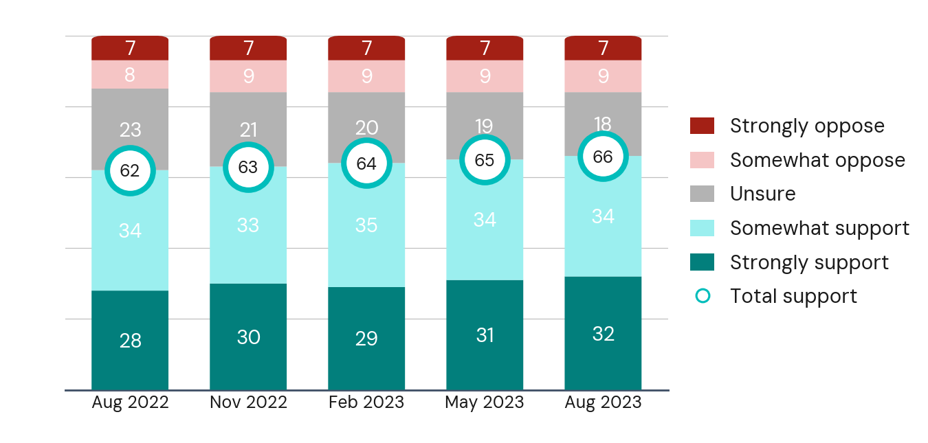
Support for a WA renewable energy target — tracking
How strongly do you support or oppose WA adopting a renewable energy target? (%, selected waves)
Support for a renewable energy target has
grown steadily across all five waves.
↑ Total support up 5pp since Aug 2022
↓ Unsure down 5pp across the same period
Base: all respondents (n≈1,000 per wave, illustrative)

Slide 12
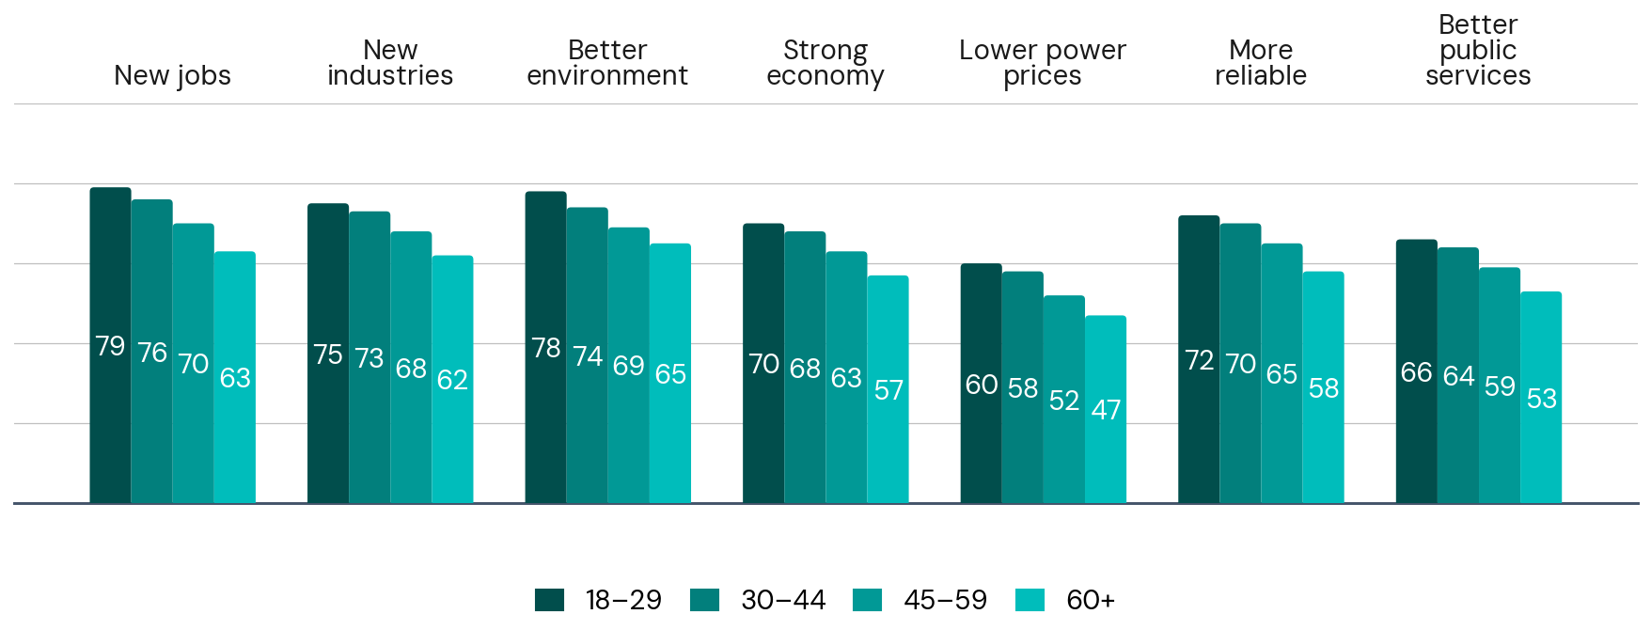
Expected outcomes of more renewable energy — by age group
% who think each outcome is 'likely' if WA used more renewable energy
Base: all respondents (n=1,011; illustrative breakdowns)

