Slide 1
Community Attitudes Survey
March 2026
n=200 adult residents

Slide 2
Concern & Salience

Slide 3
Key findings — concern & community attitudes
Strong concern about the issue is evident across the community, with scepticism about how government is currently handling it.
• Over 60% are very or extremely concerned — concern is highest among 35–54 year olds.
• Agreement that this issue impacts everyday people is broad, cutting across regions.
• Government handling is rated poorly — fewer than 1 in 5 agree government is handling it well.
• There is strong appetite for local action alongside calls for stronger government leadership.
Base: all respondents (n=200)

Slide 4
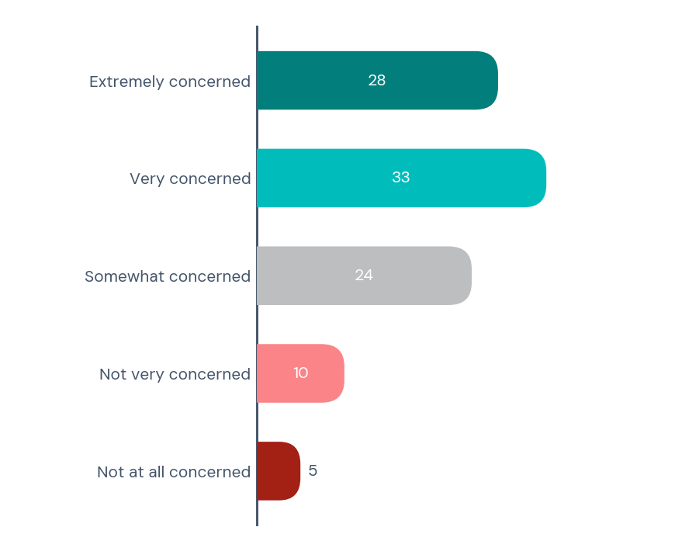
Concern about the issue
How concerned are you about this issue in your community? (%)
Concern by age group:
– 18–24: XX% very/extremely concerned
– 25–34: XX%
– 35–44: XX%
– 45–54: XX%
– 55+: XX%
Concern by region:
– Metro: XX%
– Regional: XX%
– Rural: XX%
60%
Concerned
15%
Not concerned
Base: all respondents (n=200)

Slide 5
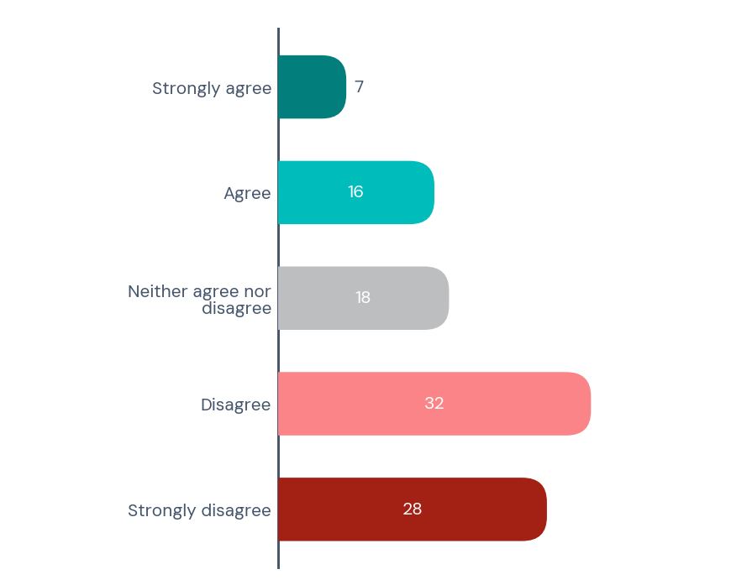
Rating — government handling of this issue
The government is handling this issue effectively. (%)
Scepticism about government performance
is consistent across all demographics.
Disagreement is highest among:
– 35–54 year olds (XX%)
– Regional residents (XX%)
23%
Agree
60%
Disagree
Base: all respondents (n=200)

Slide 6
Attitudes & Beliefs

Slide 7
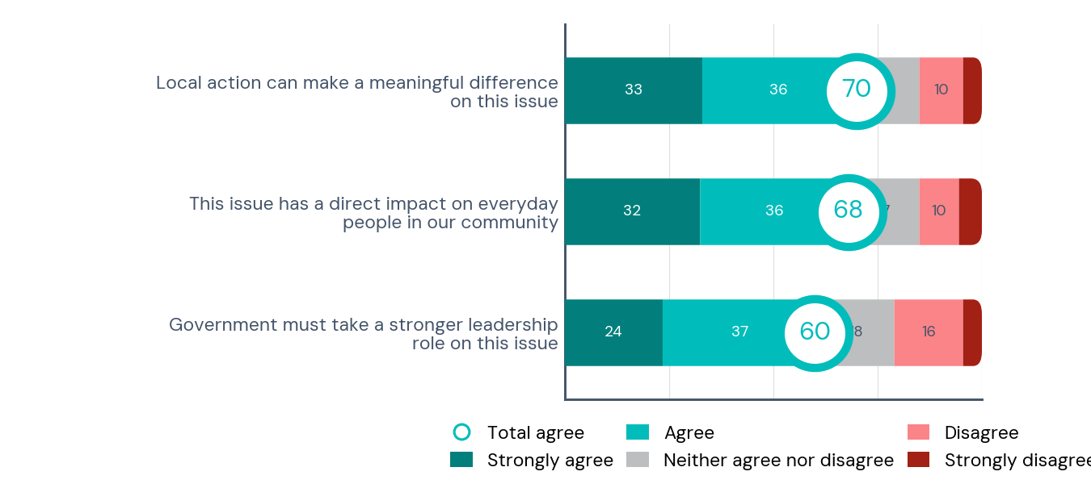
Agreement — statements about the issue
How strongly do you agree or disagree with each of the following statements? (%)
Total agree by statement:
– Community impact: XX%
– Govt leadership: XX%
– Local action: XX%
Agreement is broadly consistent
across age groups and regions.
Base: all respondents (n=200)

Slide 8
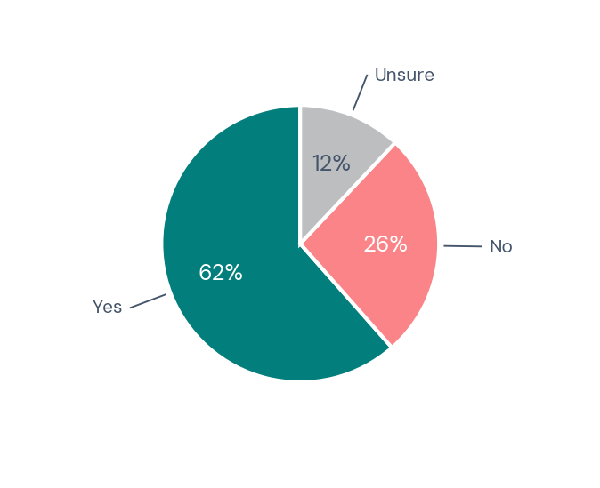
Support for action
Do you support taking action on this issue? (%)
Strong majority support for action.
Support is highest among:
– 35–54 year olds (XX%)
– Metro residents (XX%)
Base: all respondents (n=200)

Slide 9
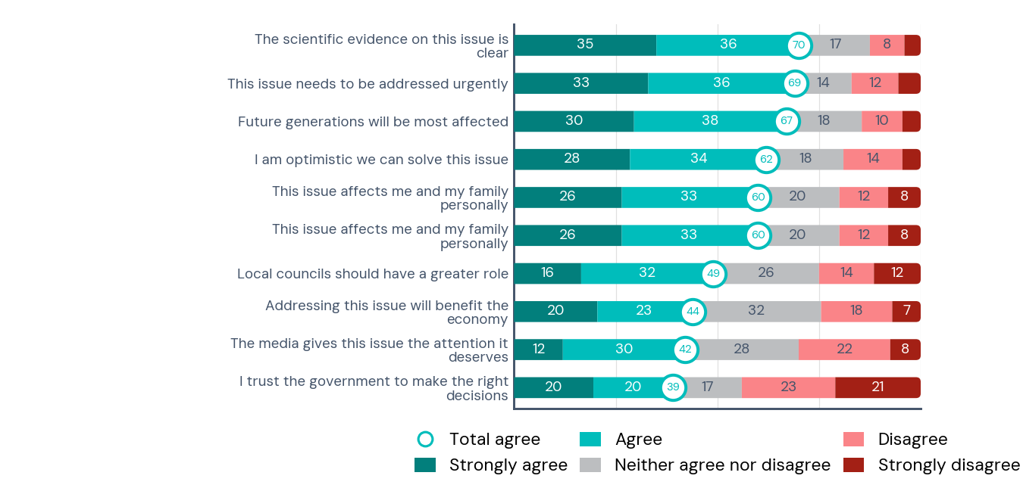
Attitudes — broader community views
How strongly do you agree or disagree with each of the following statements? (%)
Urgency and scientific clarity are
most agreed-with statements.
Trust and media coverage attract
more scepticism.
Base: all respondents (n=200)

Slide 10
Demographics

Slide 11
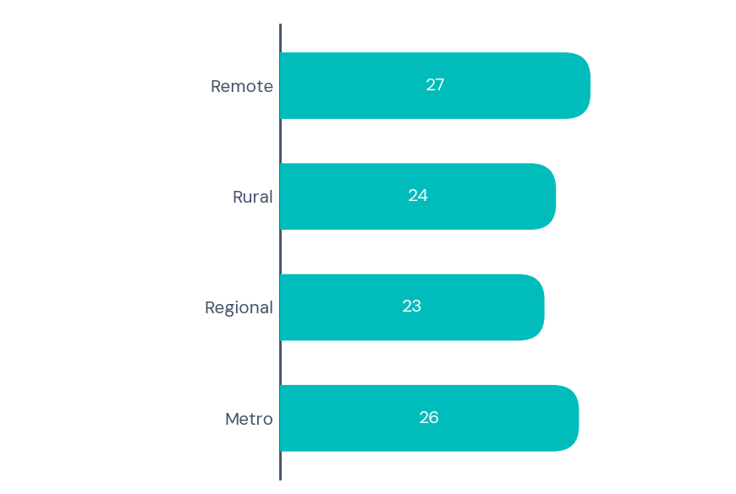
Respondent region
Which region are you based in? (%)
Sample is spread across metro, regional,
rural and remote areas.
Base: all respondents (n=200)

Slide 12
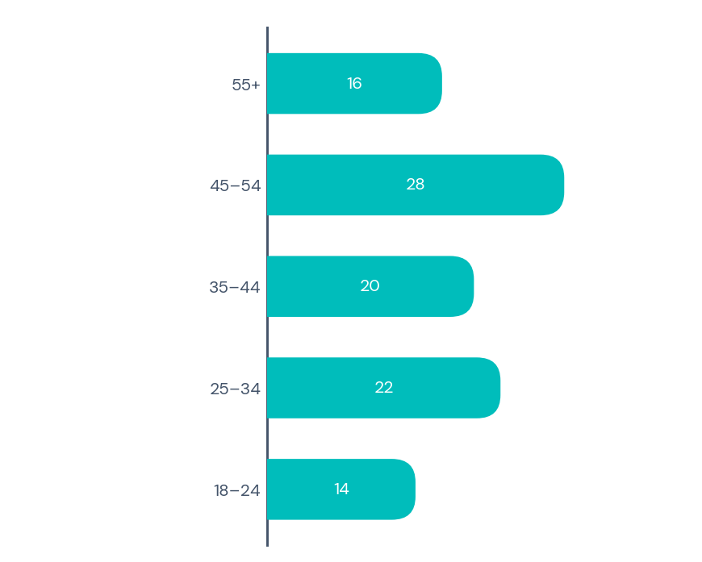
Respondent age group
What is your age group? (%)
Sample skews slightly toward working-age
adults (35–54).
Base: all respondents (n=200)

