Slide 1
Texas High Value Data Set

Slide 2
Overview
Demographic
Women in Texas prisons
Crimes (number of perpetuators)
Age
Data Overview

Slide 3
Demographics

Slide 4
Women in Texas prisons
Total Inmate Pop:
132, 992
Total women:
10, 061

Slide 5
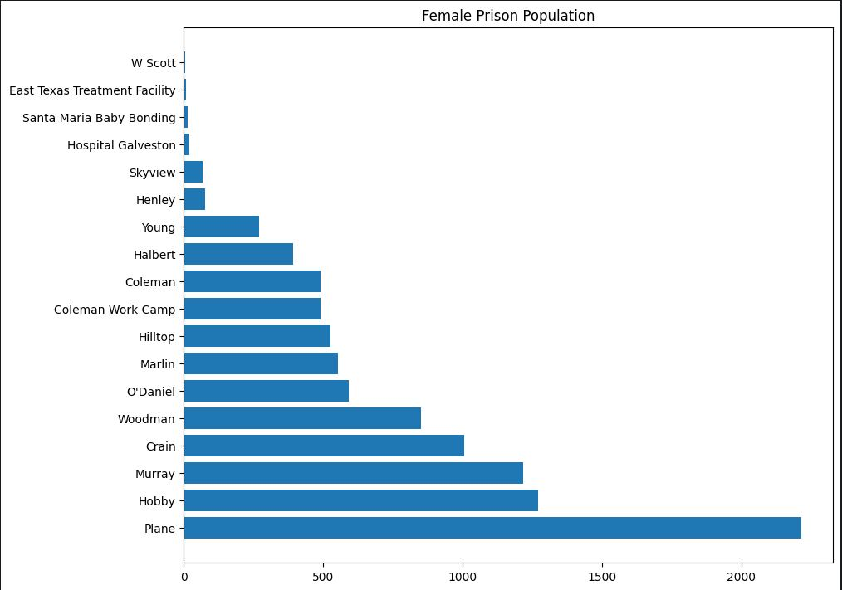
Spread across Texas
Women inmates are spread through 18 facilities.
Many of these are shared with a male population as well.
The Plane facility takes the top spot for the largest number of incarcerated women.

Slide 6
Crimes

Slide 7
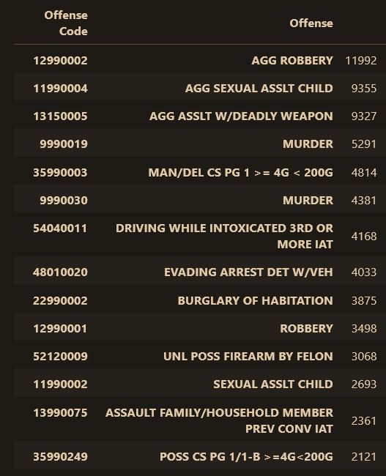
Most Common
At a glance:
1) Aggravated Robbery
2) Murder
3) Aggravated Sexual Assault on a Child
4) Aggravated Assault w/ Deadly Weapon
5) Manufacturing / Dealing Cat 1 drugs

Slide 8
Age

Slide 9
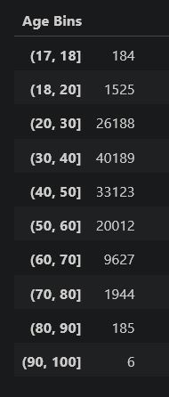
How old are Texas inmates?
Takeaways:
- Almost 200 17-year-olds in Texas prison
- Follows a normal distribution
- There are people close to 100 in jail
How to interpret:
Num inmates
start
End
(non-inclusive)

Slide 10
Data at a glance

Slide 11
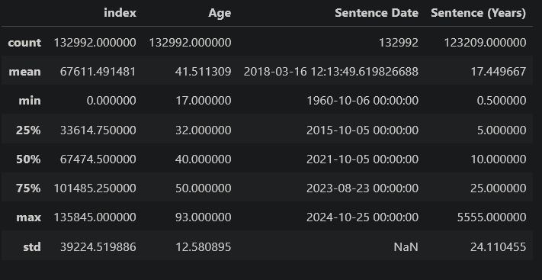
Data at a glance
Highlights
The average sentence is lower than 17.4, since there are inmates who have sentences in the 1000’s
The oldest prisoner has been in Texas prison since 1960 (over 60 years)

Slide 12
Thank you
Thomas Bakaysa

