Slide 1
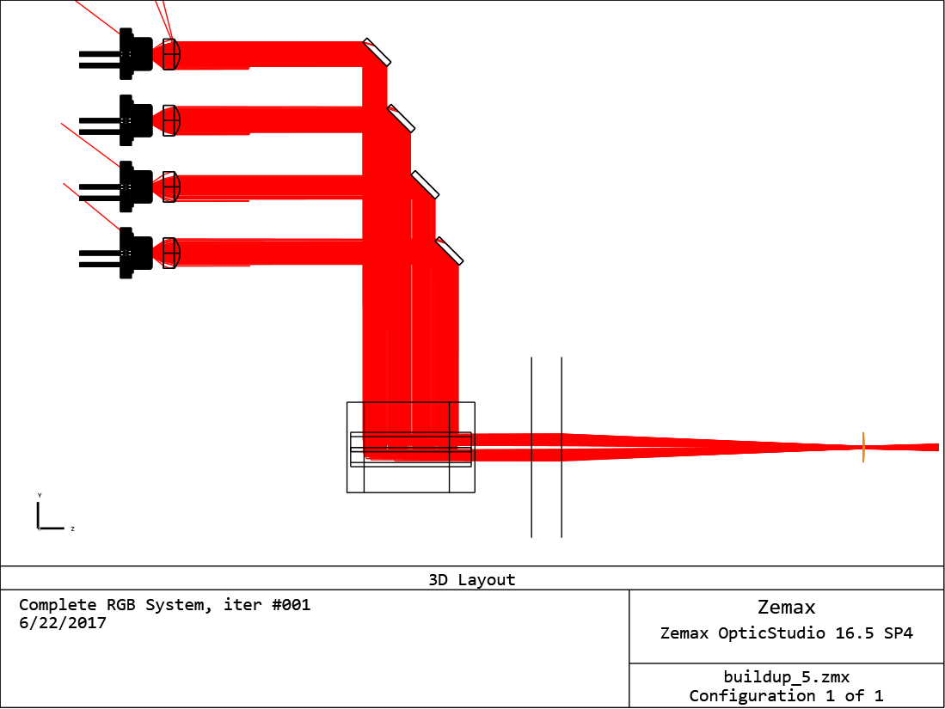
Light Source Project
Tolerance Analysis of Laser Diode Modules
Thomas Beauduin, Research Engineer, MTT Innovation
Table of content
1. Introduction light source requirements
2. Methodology
merit-function assessment
3. Sensitivity Analysis single emitter, array, matrix
4. Tolerance Analysis
deterministic – stochastic
5. Conclusions & Future work
20 Slides
22 June 2017

Slide 2
Light Source Project
Tolerance Analysis of Laser Diode Modules
Thomas Beauduin, Research Engineer, MTT Innovation
Table of content
1. Introduction light source requirements
2. Methodology
merit-function assessment
3. Sensitivity Analysis single emitter, array, matrix
4. Tolerance Analysis
deterministic – stochastic
5. Conclusions & Future work
20 Slides
22 June 2017

Slide 3
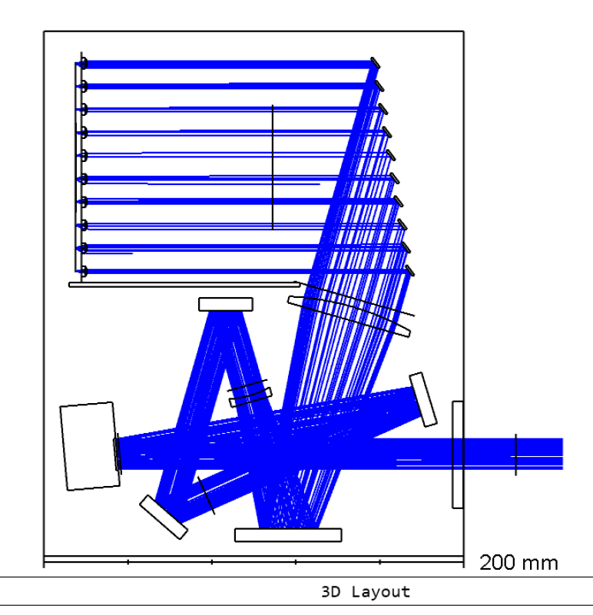
Introduction
Light source objective and challenges
Light steering requires a highly-directional input beam
Problems
Cost – RGB single emitter design required
Power – upscaling increases component count
Sensitivity – painfully small manufacturing tolerances
Approach high-level feasibility study of optical designs and tolerances
Specific objectives
Optical : Module configuration i.e array, matrix,… ? beam quality vs. tolerances and compensators
Mechanical : Range and step-size of compensator ?
Computation : Point Spread Function distribution ?
Manufacturing : Component tolerances ?
Fig. Limelight 200 module (462nm)
Notes:
Add limelight 200 drawing

