Slide 1
Final team project
Data compression
ECE 6260 PRESENTATION | April 2019
By: Neha N Gowda and Thomas Benoit

Slide 2
OUTLINE
Analysis
Implementation
Results

Slide 3
1
Analysis

Slide 4
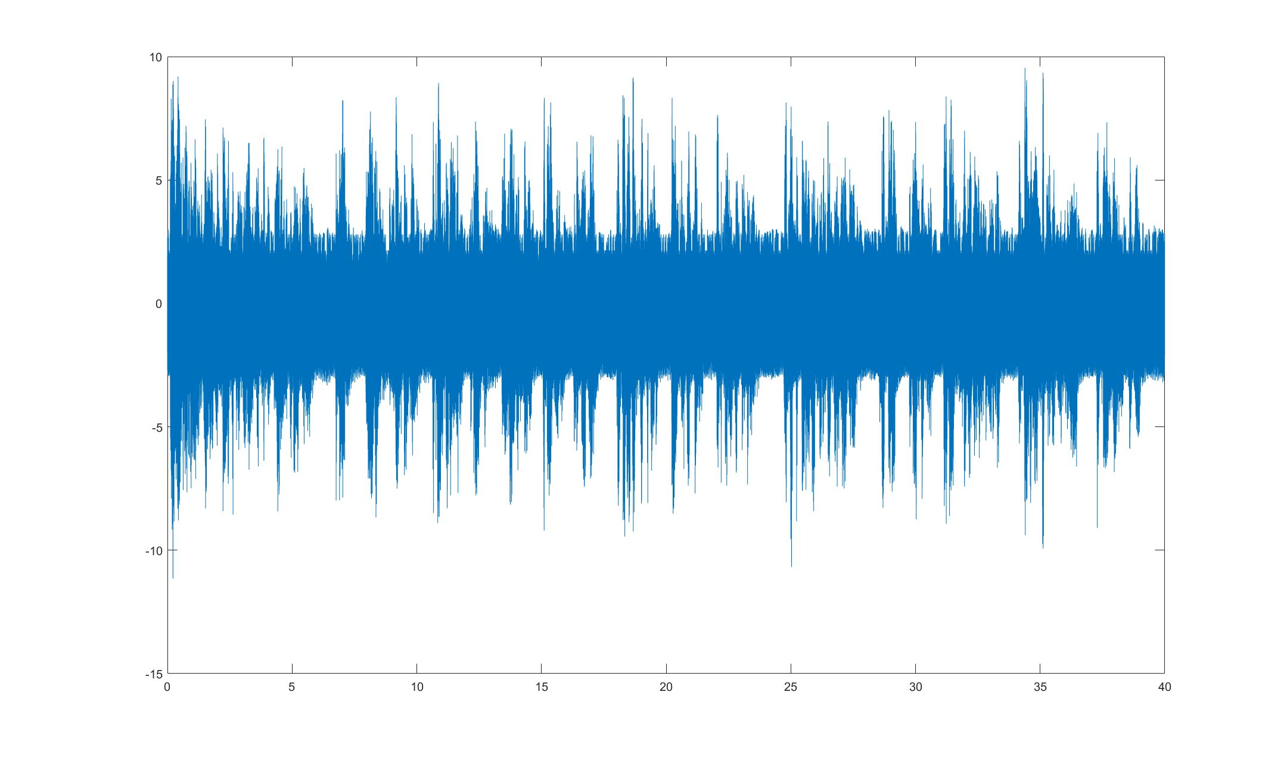
1
Analysis
Is it a combination of different signals?
-> Let’s analyze it both in the time and the frequency domains

Slide 5
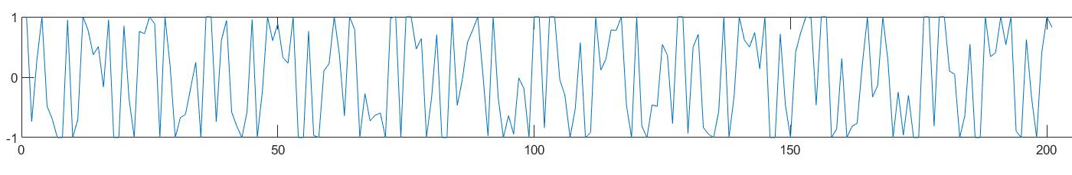
1
Short-time LPC analysis
length of Frames analysed | Covering selected in % | Could hear a speech?
20ms | 10% | badly
20 ms | 25% | badly
20 ms | 50% | slightly
20ms | 60% | slightly
50ms | 10% | slightly
50ms | 20% | slightly
50ms | 50% | slightly
75ms | 25% | slightly
75ms | 50% | slightly
We hear and we notice speech traces in the synthesized signal !
Frame=50ms And Covering =10%

Slide 6
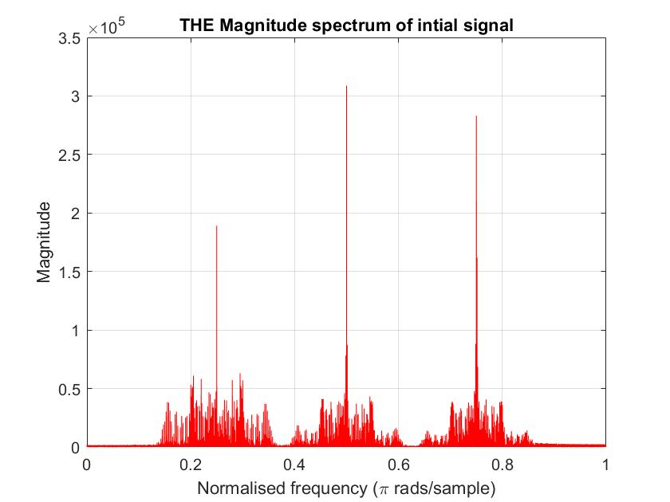
1
Magnitude spectrum
Three clusters of (3) chirps
Cluster 1 located in 4,000Hz
Cluster 2 in 8,000Hz
Cluster 3 in 12,000Hz
Cluster 1
Cluster 2
Cluster 3

Slide 7
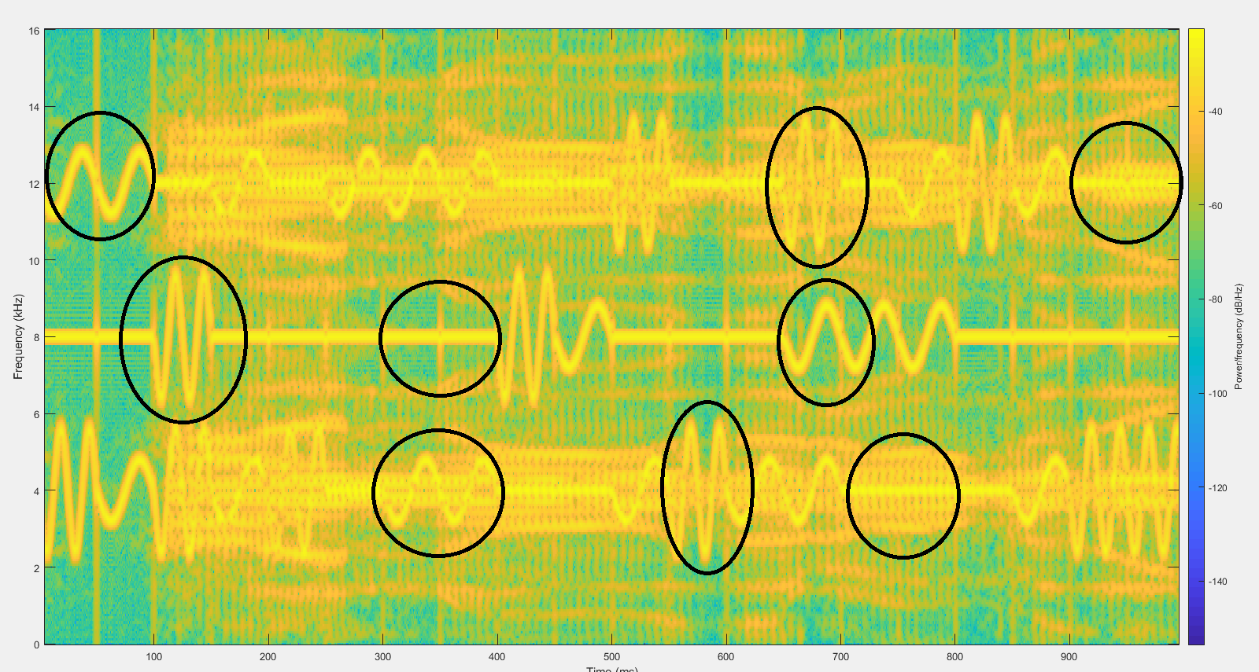
1
Spectrogram

Slide 8
2
Implementation
‹#›

Slide 9
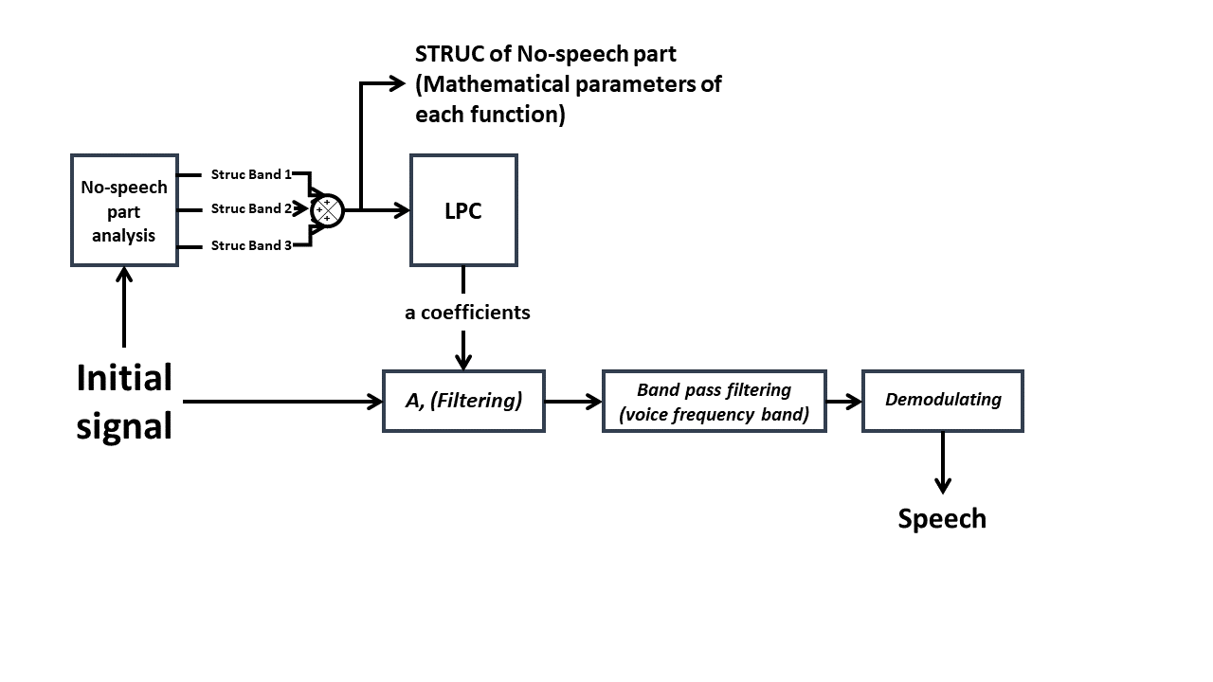
2
Extracting structures

Slide 10
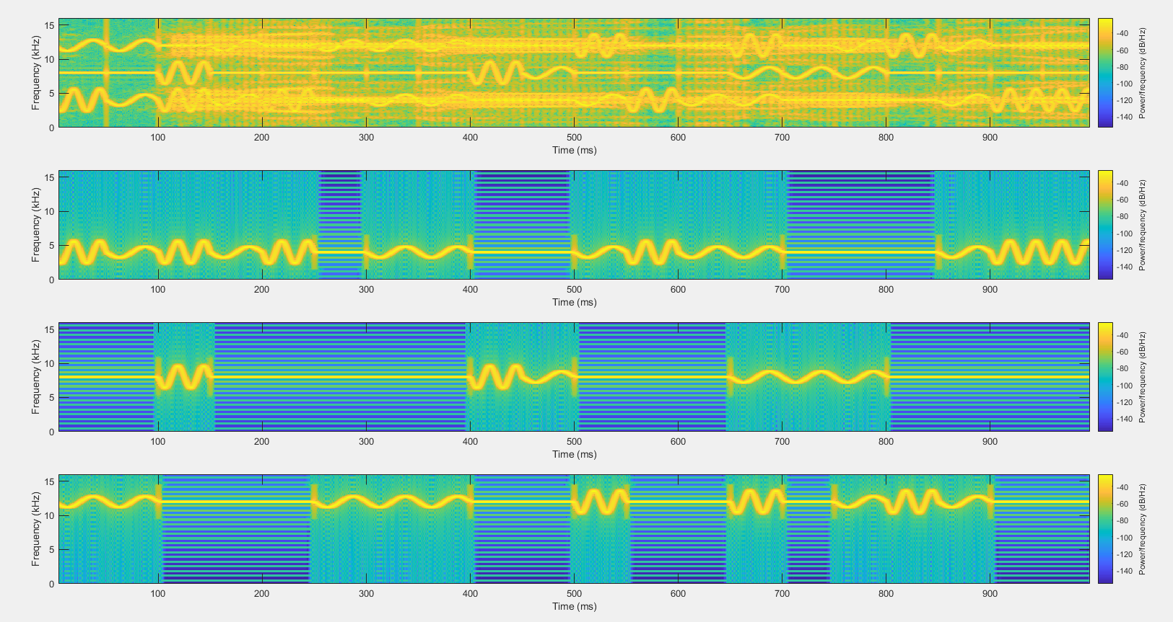
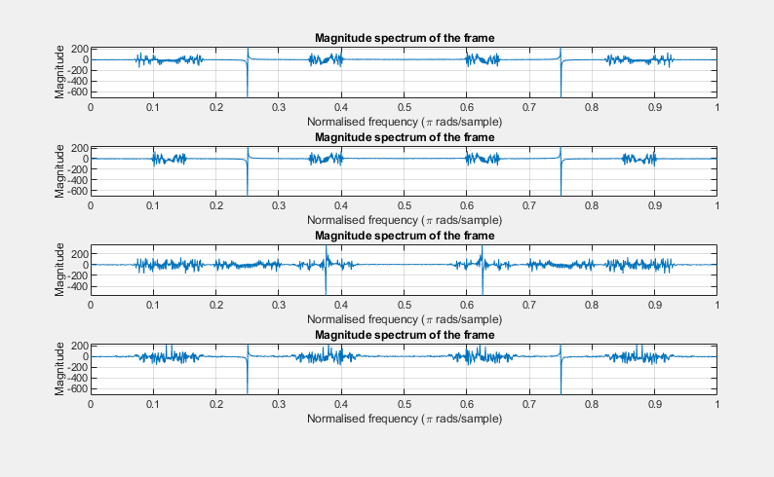
2
Details on chirp extraction
FFT of various frames each of 1600 samples was analysed
Observed 3 kinds of chirp in each band of frequency
These chirps did not appear continuously in all frames
Studied the spectrogram and modelled the three different chirps
Used comparison of instantaneous frequencies and found where which chirp occurs

Slide 11
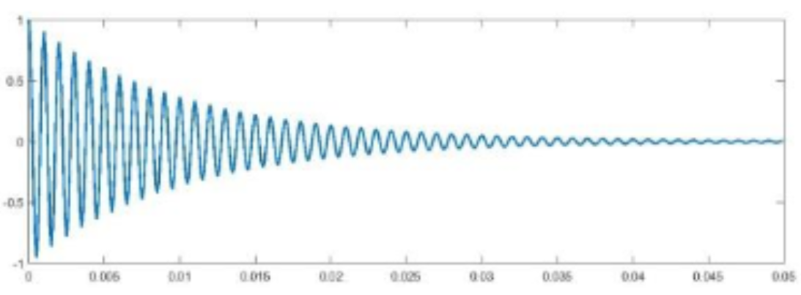
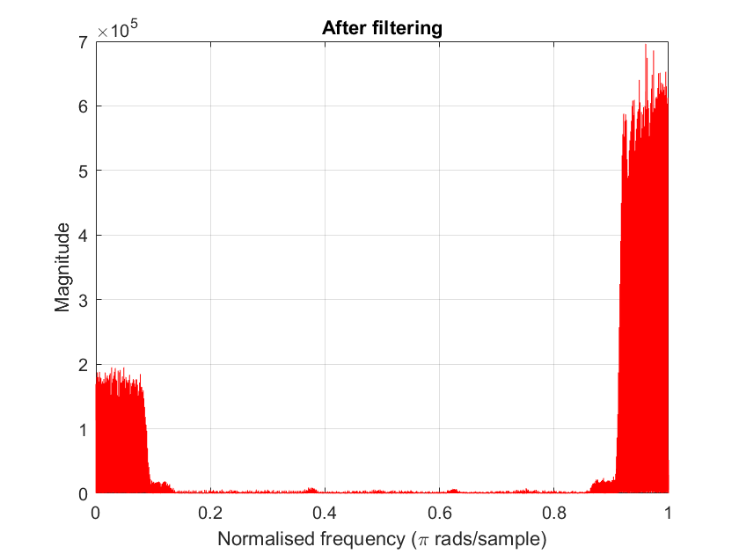
2
Why post
processing ?
Two
Damped sinusoids
(2)
Removing (2)
Demodulating the speech out (1)
(1)
[300 - 3500]

Slide 12
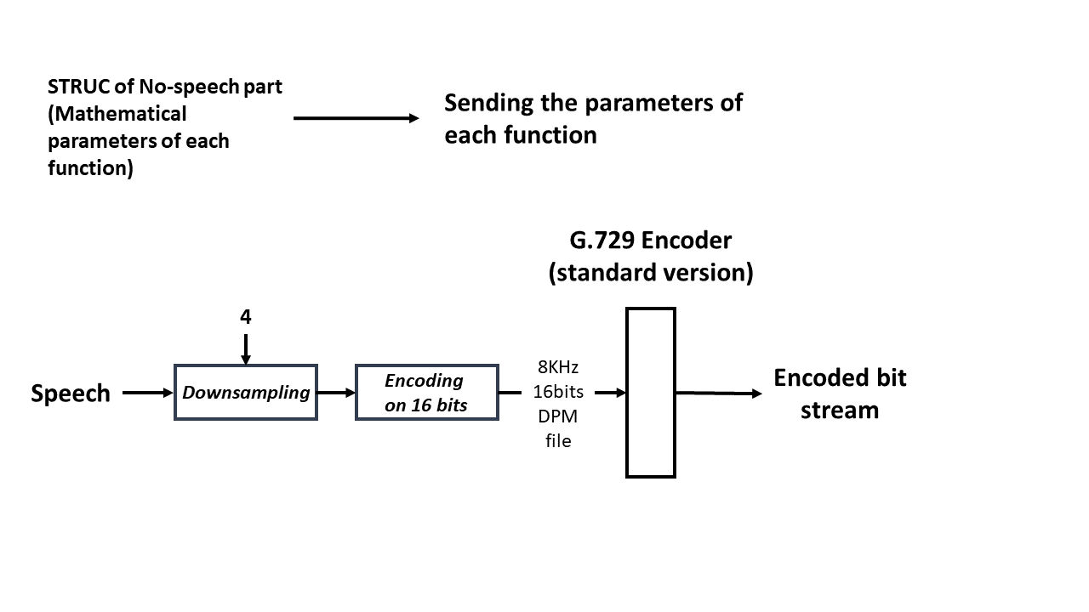
2
Encoding elements

Slide 13
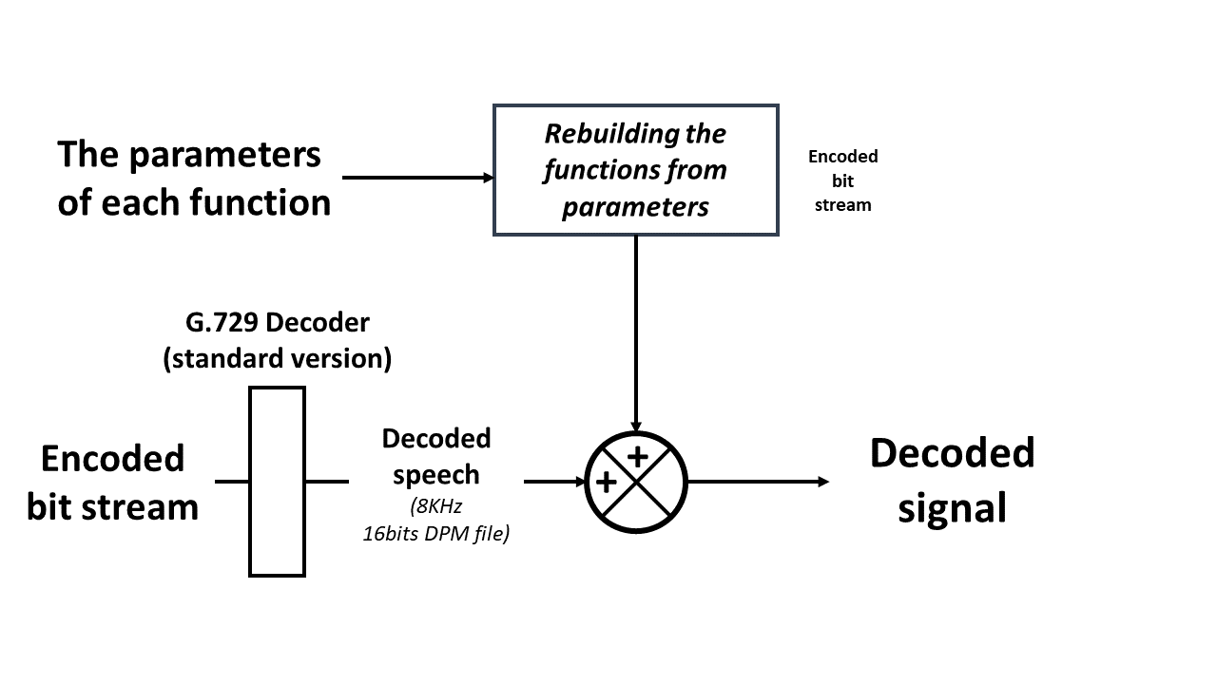
2
Reconstruction

Slide 14
3
Results

Slide 15
3
Measurements |  | Values | Comments
bits/s (fixe rate) |  | 8 kbit/s | The standard version of G.729 uses a fixed 8 kbit/s data rate.
Signal to coding noise ratio | 8000 Hz sampled | -2.3177 | They were computed such that: SQNR = 10*log_10 (Psig/P(sig - decoded)) with sig: the initial signal and decoded: the decode one
 | 32000 Hz sampled | -0.7489
Spectral distortion (log spectral distance) | 8000 Hz sampled | 0.1126 | The log spectral distance is computed from the truncated cepstral distance
 | 32000 Hz sampled | 0.9972

Slide 16
3
Improvements
Modelling the chirp signals and reconstructing them: autocorrelation and spectral distance measures. We did instantaneous frequency comparison, which otherwise might have given us better results.
We were not able to subtract the constructed chirp signals. Constructed chirp signal is the right one or not? We used LPC filtering of the signal. An unsolved mystery for us : “The CHIRP nightmare”!
We could compress the file better if we could get rid of all the chirp signals.

Slide 17
References
[1] LPCdemo.m provided from the correction of HW4
[2 ] the G.729 given in class: the github of opentelecoms-org: https://github.com/opentelecoms-org/codecs/tree/master/g729/ITU-samples-200701/Soft/g729
[3] MathWork file exchange Matlab

Slide 18
Questions?!

