Slide 1
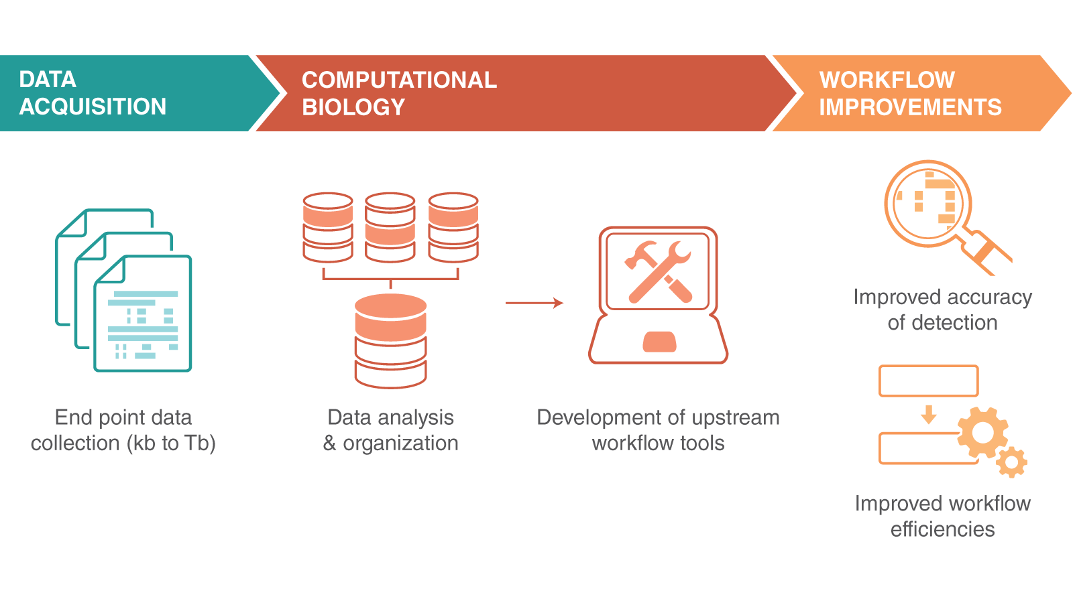
Modern data skills
… towards an efficient workflow

Slide 2
Modern data skills
New data
… towards an efficient workflow

Slide 3
Modern data skills
New data
New versions/features
… towards an efficient workflow

Slide 4
Modern data skills
Keep the history of your analyses
Always run the same thing
Run everything everywhere
Make complex things (without mistakes)

Slide 5
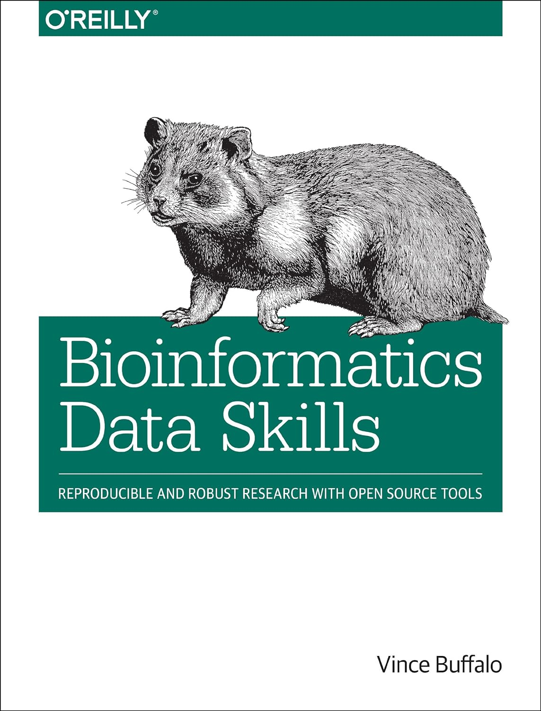
Tools for modern data skills
Git
Conda/Mamba
Docker/Singularity
Snakemake

Slide 6
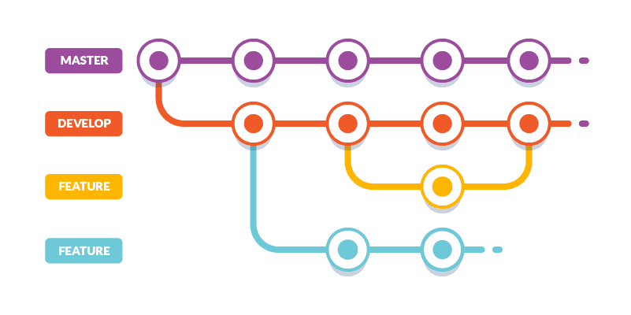
Git. Keep the history of your analyses
Git workflow: commit, merge, branch

Slide 7


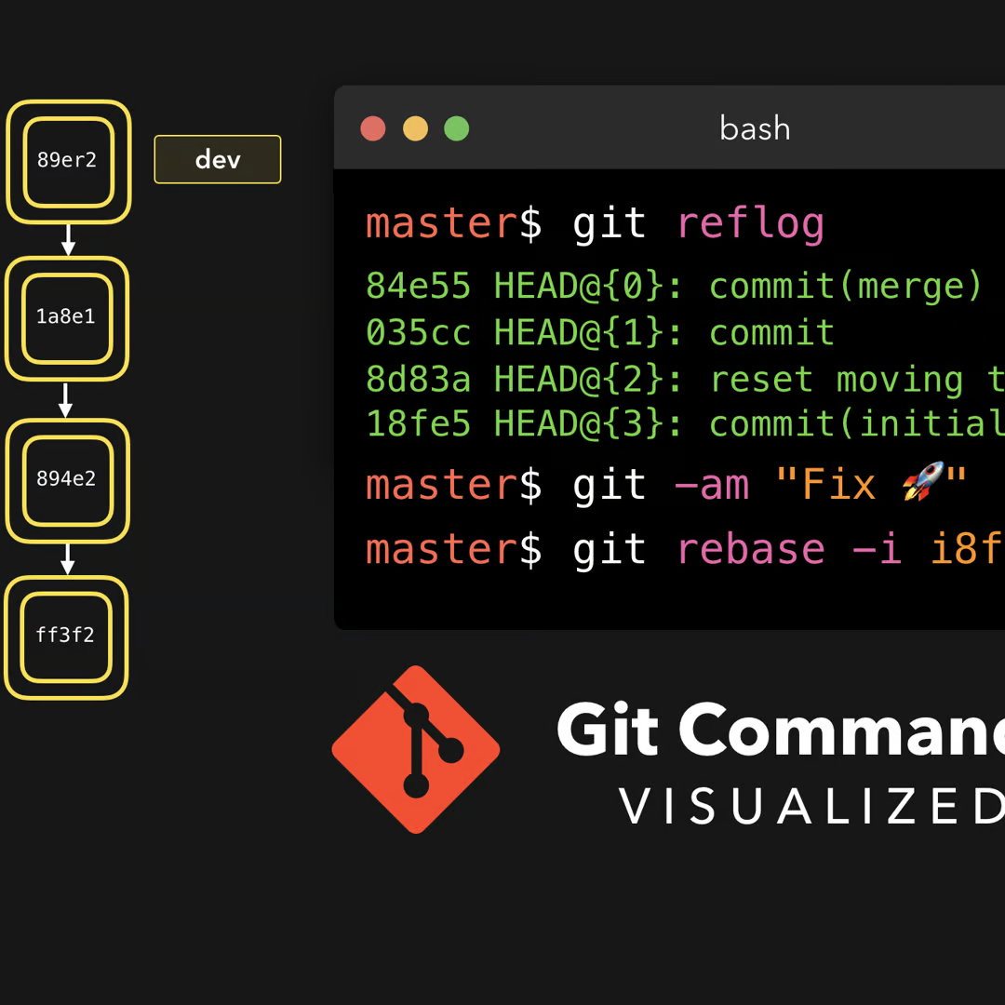
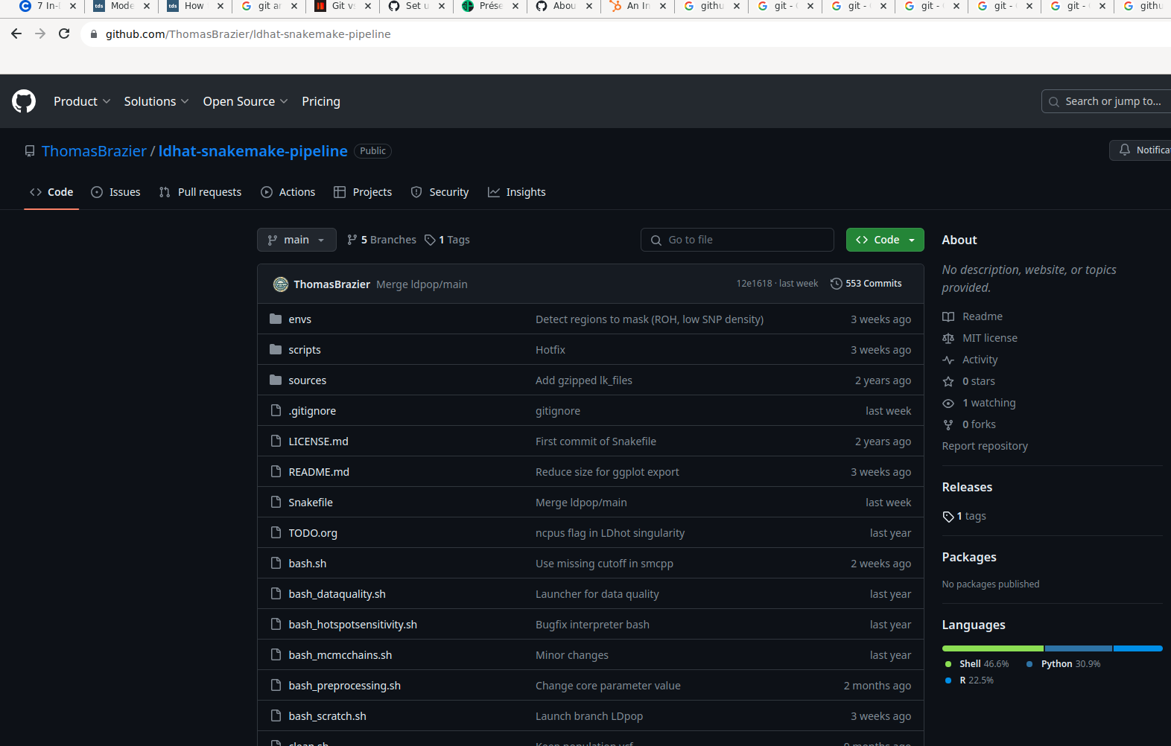
Git. Keep the history of your analyses
vs.

Slide 8
Set up Git
Local CLI: git init
Remote: create a repository in
and git clone

Slide 9
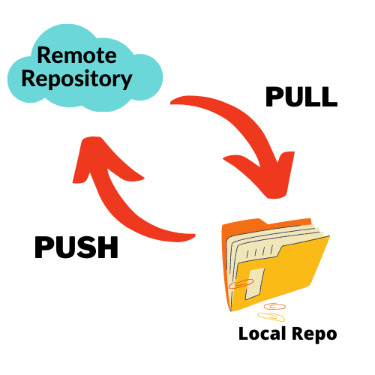
Use Git
Local CLI: git add, commit…
git merge, branch, checkout
Local GUI: Use Git Desktop
Remote: git push, pull

Slide 10
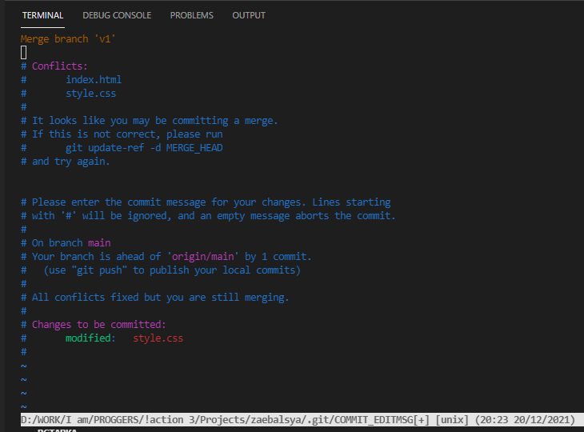
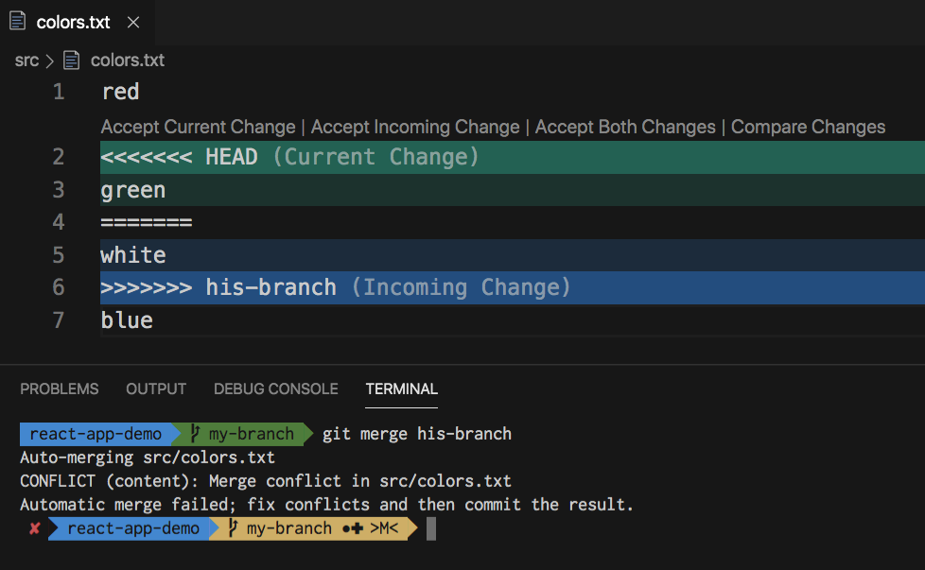
Merge conflicts in Git

Slide 11
Resources for Git
https://docs.github.com/en/get-started
https://skills.github.com/
The book Bionformatic Data Skills

Slide 12
Conda. Always run the same thing
Virtual environments
“A virtual environment is a tool that helps to keep dependencies required by different projects separate by creating isolated spaces for them that contain per-project dependencies for them.”

Slide 13
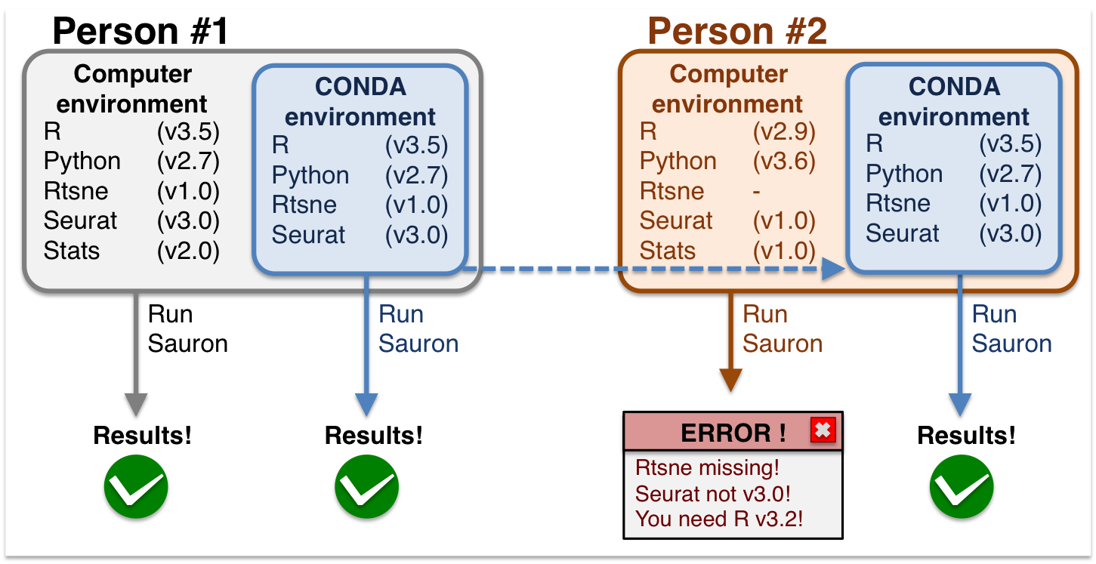
Conda. Always run the same thing
Virtual environments

Slide 14
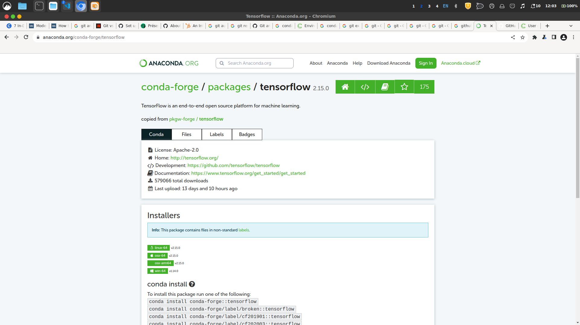
Conda. Always run the same thing
A large catalogue of softwares

Slide 15
Creating Conda envs
Conda/Mamba
conda create -n my_env -c conda-forge python3
conda env create -f environment.yml

Slide 16
Activating Conda envs
conda activate my_env
(...)
conda deactivate

Slide 17
Personal advices for Conda
Use Conda, not Mamba for your pipelines
Use YAML environment files
Manage many small envs instead of a large one
Save your envs when releasing your code

Slide 18
Resources for Conda
https://conda.io/projects/conda/en/latest/user-guide/
The book Bionformatic Data Skills

Slide 19


Docker. Run everything everywhere
Sometimes packages are not in Conda
or Conda fails
Containers are a solution
Micro-services

Slide 20
Docker vs. Singularity
Two engines to BUILD and RUN containers
Docker images are compatible with Singularity
BUILD with Docker; RUN with Singularity

Slide 21
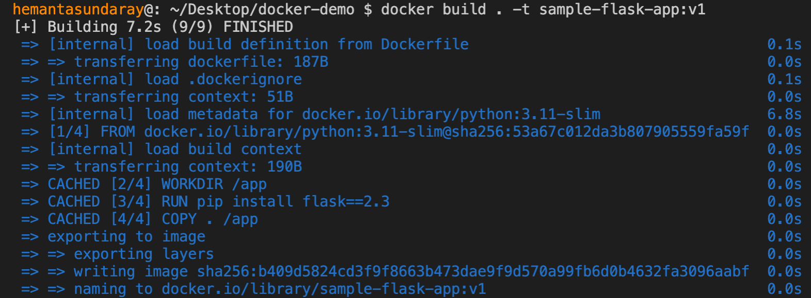
Build a container
Create a Dockerfile
docker build -t username/dockername:version .

Slide 22
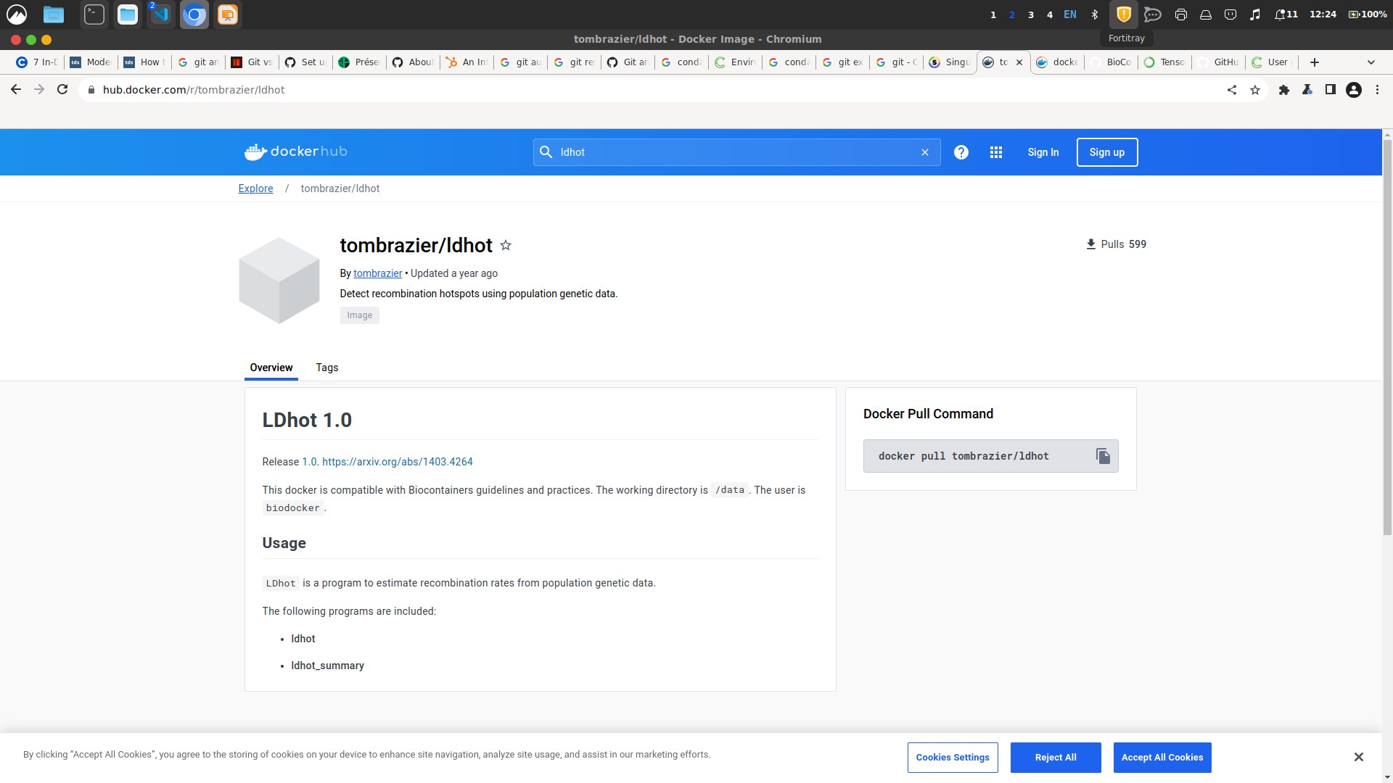
Distribute your container
docker push username/dockername:version

Slide 23
Execute a container
singularity pull app.sif docker://username/dockername:version
singularity shell app.sif
singularity exec --bind $PWD:/mnt app.sif <command>

Slide 24
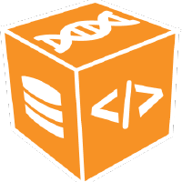
The Biocontainers project
A community-driven project to create and manage bioinformatics software containers
https://github.com/BioContainers

Slide 25
Resources for containers
https://docs.docker.com/
https://hub.docker.com/
https://docs.sylabs.io/

Slide 26
Snakemake. Make complex things
Workflow management
Readability
Data integrity
Scalability
Modularity

Slide 27
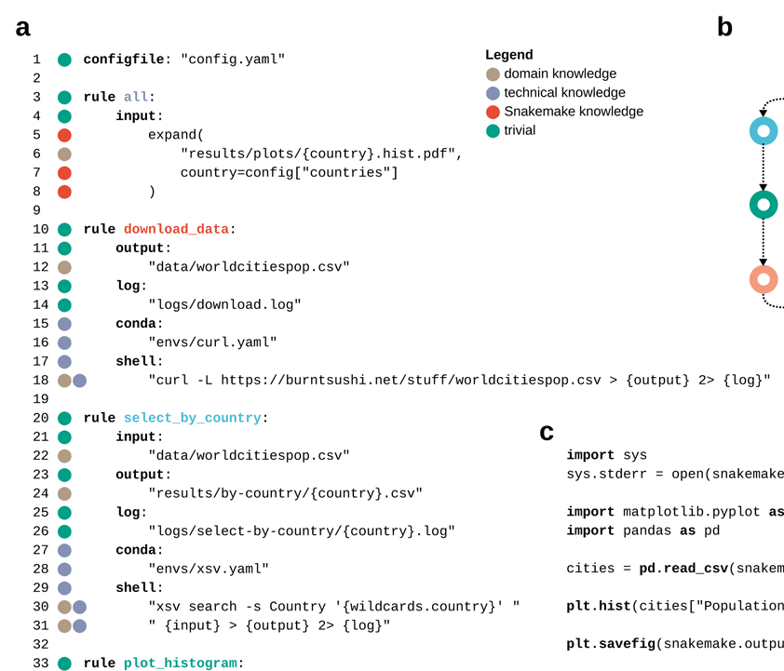
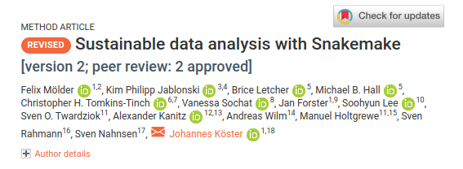
Snakemake workflow
Made for science
Python syntax
Rules
Envs (Conda, container)

Slide 28
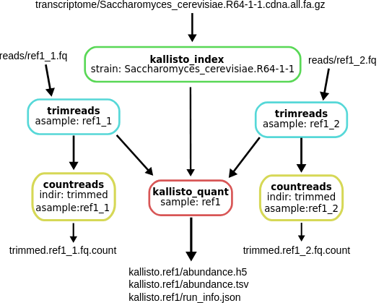
Snakemake workflow
Parallelisation/Cluster
Check data integrity
Dry run
Export DAG graph

Slide 29
Resources for Snakemake
https://snakemake.github.io/
https://snakemake.readthedocs.io/en/stable/
https://snakemake.readthedocs.io/en/stable/tutorial/basics.html
A large catalog of workflows
https://snakemake.github.io/snakemake-workflow-catalog/

Slide 30
General comments
Use scripts as much as possible
Be explicit in your commits
Commit everything important (including data?)
Script your environment (Conda)
Be careful with data integrity

Slide 31
Conclusion
Git, Conda, Docker, Snakemake...
EFFICIENT tools allowing you to deal with COMPLEXITY and SCALABILITY
Use them wisely to make things simple. KISS

