Slide 1

Bike count in Paris
Alexandre Brun
Thomas Bordes

Slide 2
Steps
SPRINT 1 | SPRINT 2 | SPRINT 3 | SPRINT 4 | SPRINT 5
First simple submission | Merging external data | Choice of model | Feature selection | Hyperparameters tuning
Simple Ridge model | Lasso / Ridge | Linear models ? XGBoost ? LightGBM ? | XGBoost | XGBoost model trained with GridSEARCH
No extra data | Extra data added | Extra data added | Extra data added with selection | Extra data added with selection

Slide 3
I. First simple submission
We want to create the simple pipeline to test in the future efficiently our ideas
Creation of the git
Get familiar with the data with starting_kit
Create simple python script to submit on kaggle

Slide 4
II. Merging external data
We want to add external data to improve the performance of our prediction
Meteorological DATA
T : temperature
U : humidity
Rr3 : precipitation
Holiday DATA
Holidays : special days when people don’t work
Week_ends
COVID-19 DATA
Curfew
Lockdown
Hosp : number of people in hospitalization due to COVID-19
Rea : number of people in reanimation due to COVID-19
Road accident DATA
Count_accidents : number of accidents by bike per day in Paris
Max_Grav_accidents : the degree of the worst accident happended in a day in Paris

Slide 5
II. Preprocessing
We preprocess the data to comply with models restrictions and improve performance
We have a total of 27 variables (with categoricals and numericals) as a start
We transform the datetime variable date on 5 different variables :
Year
Month
Day
Weekday
Hour
We apply one-hot-encoding on the categoricals variables (date, counter_name, site_id)
We apply Standarized scaling on the numerical variables
Tha gives us a total of 98 variables

Slide 6
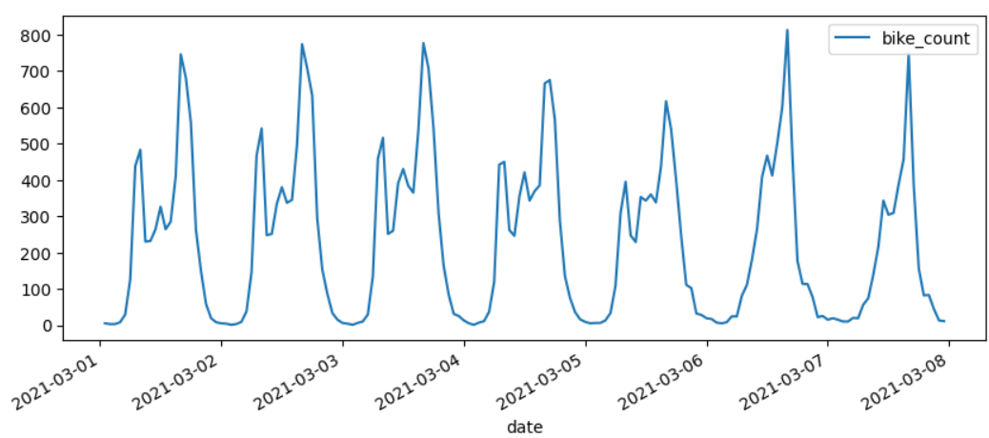
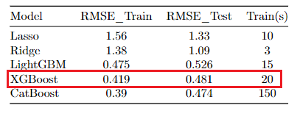
III. Model selection
We test different models to see which one is better at predicting bike counts
Values to predict are non-linear
We decided to change to non-linear models because :
Non-Linear Relationships : can capture non-linear relationships between features and the target (XGBoost, LightGBM …)
Robustness : robust to outliers and diverse data distributions
Final model chosen Is XGBoost (computational and performance reason)
Traffic for the site 'Totem 73 boulevard de Sébastopol' during the first week of March 2021

Slide 7
IV. Feature selection
We select the features that have an impact on the bike count predictions
Strategy adopted for a total of 27 features (without preprocessing) ; We create two list of features :
FIXED features (we believe are essential) :
[’date’, "counter_name", "site_id", ’t’, ’u’,’rr3’]
NOT FIXED features (we believe could impact the prediction) :
[‘is_holiday’, ’is_weekend’, ’is_lockdown’, ’is_curfew’, ’Max_Grav_accidents’, ’hosp’, ’rea’, ’incid_rea’, ’rad’, ’Count_accidents’]
We test with default parameters XGBoost all the combination between the FIXED and NOT FIXED features
It returned us with the best RMSE, features :
[’is_holiday’, ’is_lockdown’, ’hosp’]

Slide 8
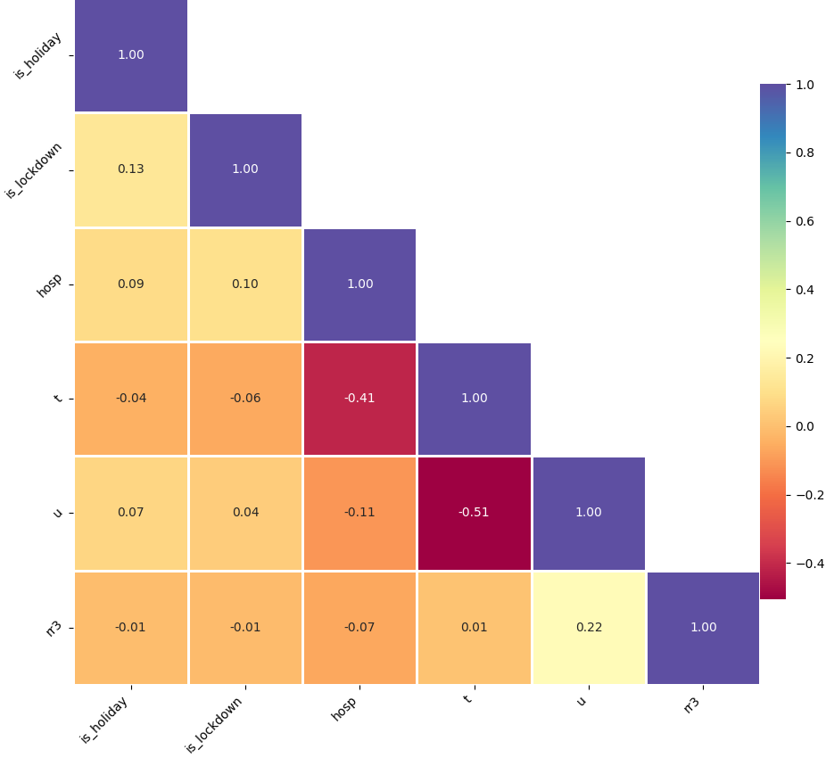
IV. Feature selection
Having redundant features can still make the model more complex than necessary
We tried to limit the amount of features added especially those correlated. Here only t, u and hosp have high correlation
And these are probably spurious correlation
Correlation matrix for external features added

Slide 9
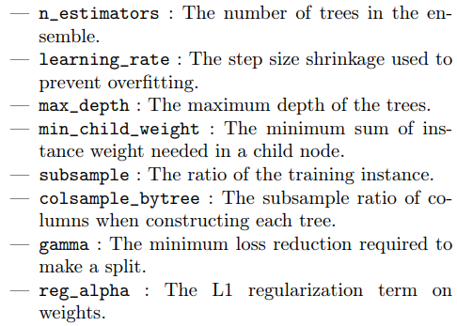
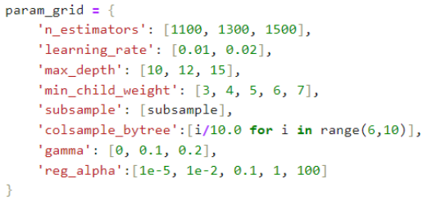
V. Hyperparameters tuning
We search the best parameters of our model to improve accuracy
We use a GridSearchCV to tune hyperparameters in which every combination of specified hyperparameter values is evaluated
List of all parameters of our model to tune with associated range

Slide 10
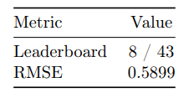
V. Final result
We attained an RMSE of max 0,7 with linear models
With non-linear models it went down to 0.6
Final results of our XGBOOST TUNED model on Kaggle

Slide 11
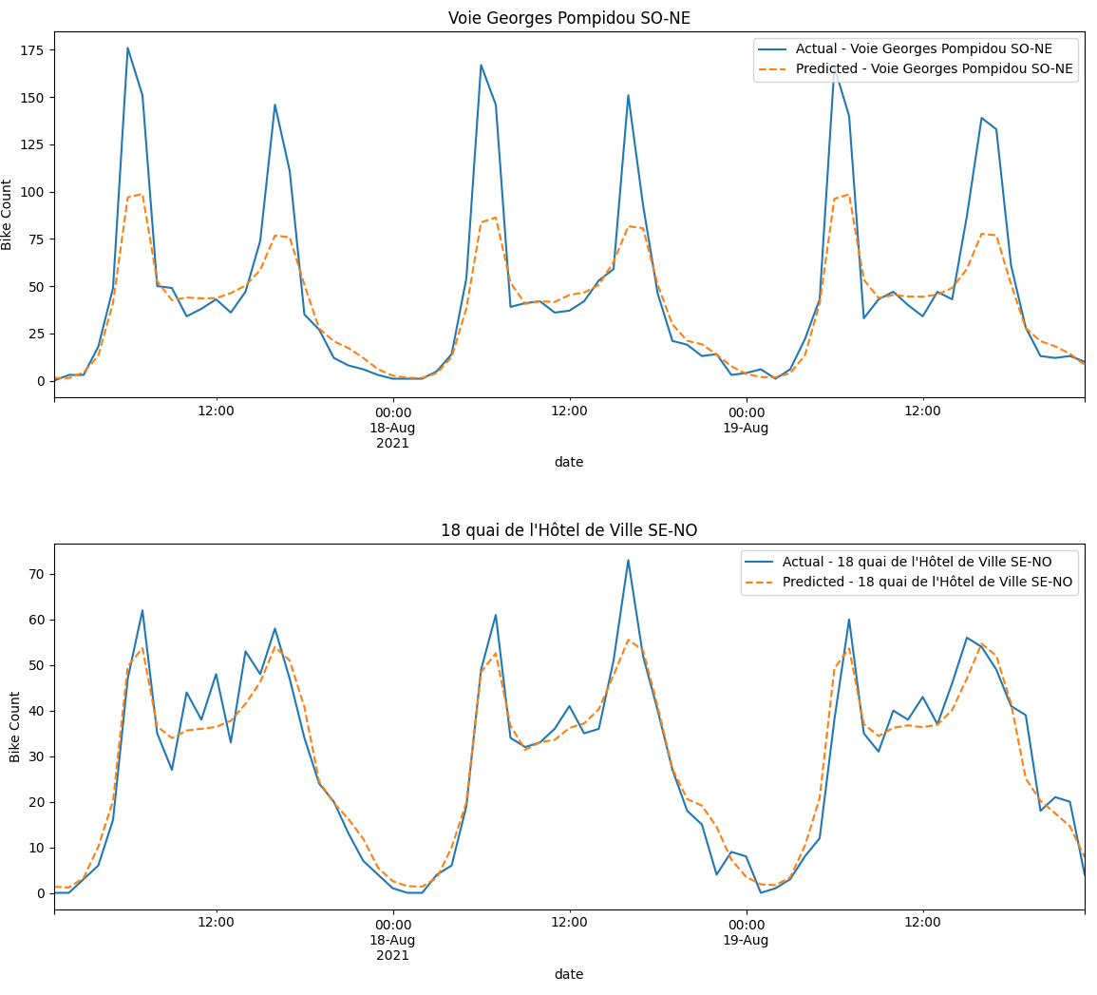
VI. Improvements
Search for new strategy to enhance our predictions
Train models specific to each site would better capture local patterns and factors
Using data relevant to each location, like local events (ex : bike accident for each location…)
bike_count vs predicted bike_count for two different locations on test set for the third week of August 2021

Slide 12
Questions

