Slide 1
TAGEF-Net
Introduction
Thomas Burch
Li Sheng

Slide 2
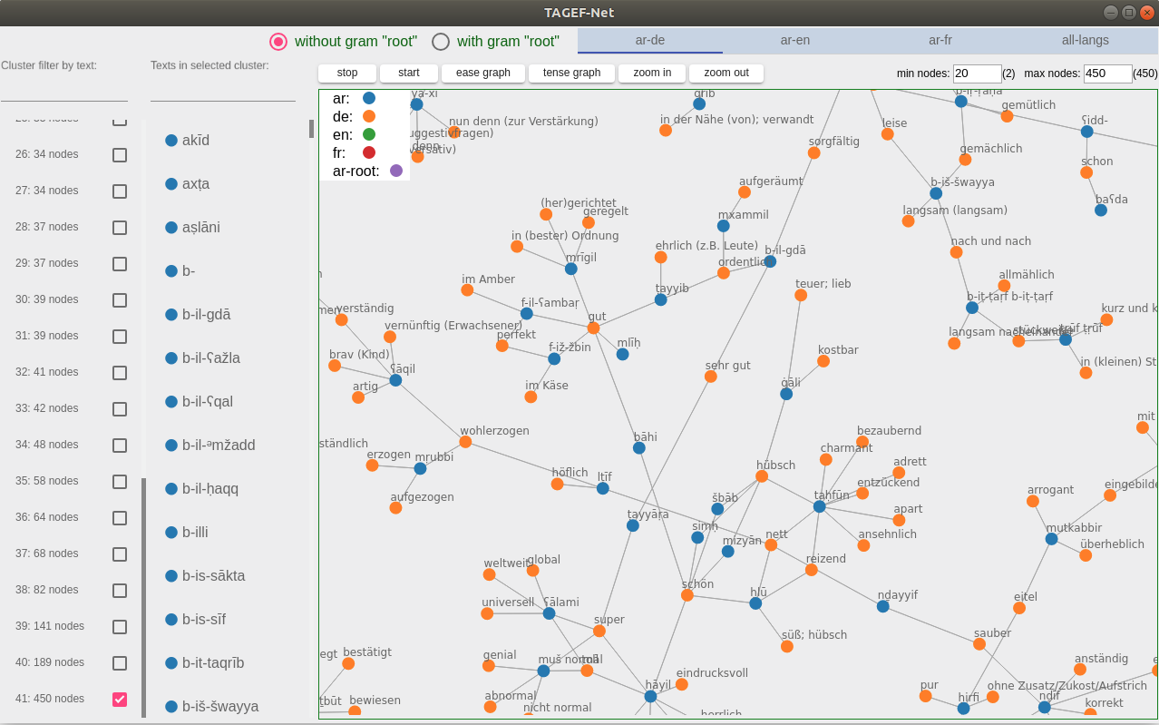
Overview
Cluster filter input
Node text filter input
Selection with “root” info
Graph controls
Selection with languages
Clusters filter by max. and min. number of nodes
Clusters list
Nodes list
Main graph panel

Slide 3
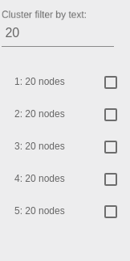
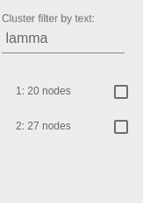

Networks Clusters Filter
Input of number will limit list with clusters which have the number of nodes.
Input of text will limit list with clusters which contain the text in one of the nodes.
Minimal and maximal number of nodes can be defined to limit clusters which have number of nodes in the range.

Slide 4
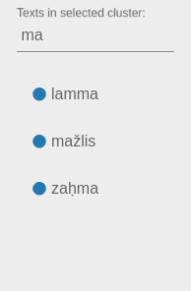
Nodes Text Filter
Input of text will limit the list only to show nodes which contain the text.
Mouse over on an item in the list will indicate the nodes in the graph panel on the right side.

Slide 5
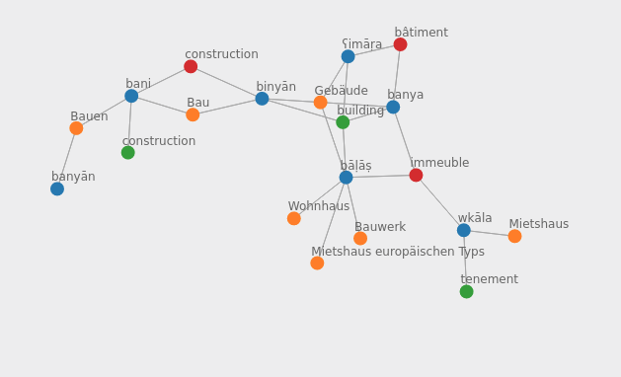
Select Language and Show Network
You can select different set of networks according to translations. For example, if you would like to see the networks containing only Arabic and English, you can select “ar-en”; if you would like to see the network clusters considering all 3 translation languages, you can select “all-langs”. Then select one of the networks clusters list on the left and you will get a graph like this:
Which color indicates which language is showed in the legend on top left of the graph panel.
In this cluster you can see that the nodes of different languages with concepts “construction, building, ..” are connected with each other.

Slide 6
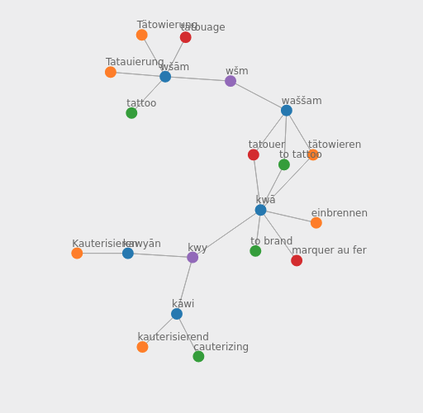
Select Languages with Gram “root”
Also interesting is if you select to show the networks with gram “root” information. You will get networks like the following:
In the example you will see that the Arabic roots “kwy” and “wšm” are indirectly connected with each other in one network because they have the similar meaning about “tattoo”, “brand” and “cauterizing”.

Slide 7
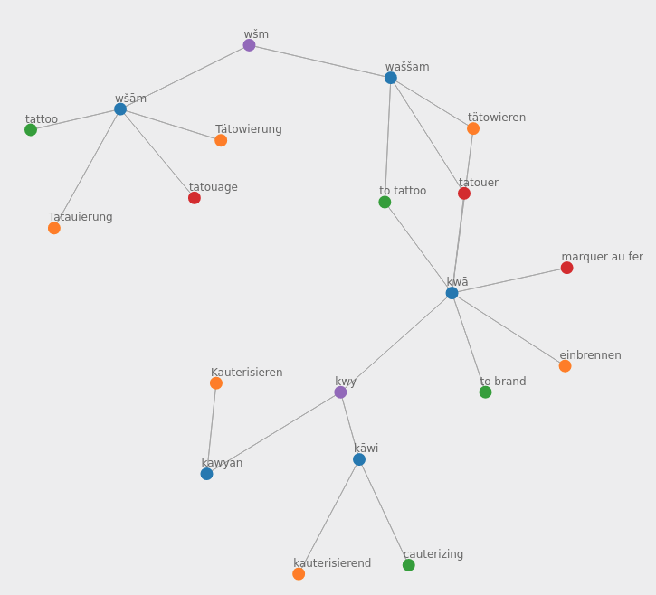
Graph controls
We also built some graph control functions for exploring the networks conveniently.
“stop” button will stop calculating positions of every nodes.
“start” button will start again calculating nodes’ positions.
“ease graph” and “tense graph” will make distances between nodes larger or smaller.
“zoom in” and “zoom out” are relative intuitive.
ease
tense

Slide 8
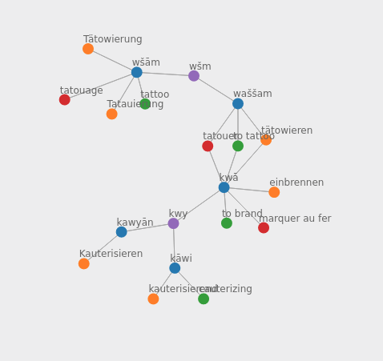
Graph controls
If some nodes overlap on each other, you can drag and drop them to other positions so that the texts can be showed clearer.

Slide 9
Thank you!
We hope you enjoy our hack.

