Slide 1

Machine Works
1
Problem Description
2
Problem solution
3
Code and results display
Notes:
标题封面

Slide 2
1
Problem Description
Notes:
二级标题

Slide 3
1
【Problem Introduction
You are the director of Arbitrarily Complex Machines (ACM for short), a company producing advanced machinery using even more advanced machinery. The old production machinery has broken down, so you need to buy new production machines for the company. Your goal is to make as much money as possible during the restructuring period. During this period you will be able to buy and sell machines and operate them for profit while ACM owns them. Due to space restrictions, ACM can own at most one machine at a time.
During the restructuring period, there will be several machines for sale. Being an expert in the advanced machines market, you already know the price Pi and the availability day Di for each machines Mi. Note that if you do not buy machine Mi on day Di, then somebody else will buy it and it will not be available later. Needless to say, you cannot buy a machine if ACM has less money than the price of the machine.
Notes:
说明，一级大标题3个

Slide 4
1
【Problem Introduction
If you buy a machine Mi on day Di, then ACM can operate it starting on day Di + 1. Each day that the machine operates, it produces a profit of Gi dollars for the company.
You may decide to sell a machine to reclaim a part of its purchase price any day after you’ve bought it. Each machine has a resale price Ri for which it may be resold to the market. You cannot operate a machine on the day that you sell it, but you may sell a machine and use the proceeds to buy a new machine on the same day.
Once the restructuring period ends, ACM will sell any machine that it still owns. Your task is to maximize the amount of money that ACM makes during the restructuring.
Notes:
说明，一级大标题3个

Slide 5
1
【Problem Introduction
Input:
The input consists of several test cases. Each test case starts with a line containing three positive integers N, C, and D. N is the number of machines for sale (N <= 10^5), C is the number of dollars with which the company begins the restructuring (C <= 10^9), and D is the number of days that the restructuring lasts (D <= 10^9).
Each of the next N lines describes a single machine for sale. Each line contains four integers Di, Pi, Ri and Gi,
denoting (respectively) the day on which the machine is for sale, the dollar price for which it may be bought, the
dollar price for which it may be resold and the daily profit generated by operating the machine. These numbers satisfy
1 <= Di <= D, 1 <= Ri < Pi _x0014_<=10^9 and 1 <= Gi <= 10^9.
The last test case is followed by a line containing three zeros.
Notes:
说明，一级大标题3个

Slide 6
1
【Problem Introduction
Output:
For each test case, display its case number followed by the largest number of dollars that ACM can have at the end of day D + 1.
Notes:
说明，一级大标题3个

Slide 7
1
【Title Introduction
Sample Input:
6 10 20
6 12 1 3
1 9 1 2
3 2 1 2
8 20 5 4
4 11 7 4
2 10 9 1
0 0 0
Sample Output：
Case 1: 44
Notes:
说明，一级大标题3个

Slide 8
2
Problem solution
Notes:
二级标题

Slide 9
1
【Problem solution
试题解析：
1. 你的公司获得了一个厂房的N天的使用权和一笔启动资金C，你打算在这N天里租借机器进行生产来获得收益
2. 你可以租借的机器有M台，每台机器四个参数D，P，R，G
你可以在第D天花费P的费用（注意：你至少要有P元才能买得起）买这台机器
从第D+1天起，操作机器可以每天G的收益
在你不需要机器时，可以将机器以折扣价R卖掉
3. 厂房里只能有一台机器
4. 不能在买卖机器的当天操作机器，但是可以在当天同时进行买卖
5. 在第N+1天，必须卖掉手里的机器
Q：求第N+1天后能获得的最大资金
Notes:
说明，一级大标题3个

Slide 10
1
【Title Introduction
数据范围：
1. 租借天数D <= 10^9
2. 初始资金C <= 10^9
3. 机器数N <= 10^5
4. 对于每台机器：
租借日Di <= D
买入价Pi和卖出价Ri满足1 <= Ri < Pi <= 10^9
每日收益Gi满足1 <= Gi <= 10^9
考虑：场地能放机器就一定要放吗?
Notes:
说明，一级大标题3个

Slide 11
2
【Problem solution
解题思路：
1. 推导出DP转移方程
先将机器按照出售时间进行Di排序
将所有机器离散化
用 F[i] 表示在时刻 D[i] 卖掉手上机器后最后剩下多少钱
F[i] = Max {F[i-1] , F[j]-P[j] + R[j] +G[j] * (D[i] - D[j] - 1)} (F[j] > P[j])
时间复杂度：O(n^2)
Notes:
特点简要说明

Slide 12
2
【Problem solution
解题思路：
2. 问题转化
对于DP转移方程：
F[i] = Max {F[i-1] , F[j]-P[j] + R[j] +G[j] * (D[i] - D[j] - 1)} (F[j] > P[j])
令A[j] = F[j] - P[j] + R[j] - G[j] * D[j] - G[j]
那么
F[i] = Max { F[i-1] , A[j] + G[j] * D [i] }
Notes:
特点简要说明

Slide 13
2
【Problem solution
解题思路：
2. 问题转化
对于 F[i] = Max { F[i-1] , A[j] + G[j] * D [i] }
令F[i] = A[j] + G[j] * D [i]
移项
A[j] = - D [i] * G[j] + F[i] (一阶线性求最大截距问题)
Notes:
特点简要说明

Slide 14
2
【Problem solution
解题思路：
2. 问题转化
对于 A[j] = - D [i] * G[j] + F[i]
类比 y = kx + b
令k = - D [i]
sets = [G[j]，A[j]]
b = F[i]
既转化成求截距b最大的一阶线性问题
Notes:
特点简要说明

Slide 15
2
【Problem solution
解题思路：
3. 动态维护点集
对于 A[j] = - D [i] * G[j] + F[i]
其中 D[i] 是已知的常数，可以看做是一个常量
把 (G[j]，A[j]) 都看成在第一象限内的点(X , Y)
已知的斜率 k=- D [i]，找到平面中的一个点，使得过该点的斜率为k的直线的纵截距最大
Notes:
特点简要说明

Slide 16
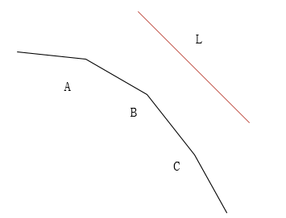
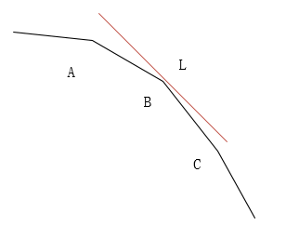
2
【Problem solution
解题思路：
4. DP优化
直接的斜率优化
举例说明：假设某个求最大值的DP问题变形成斜截式，然后求最大截距问题
如下图用一条已知直线（ K < 0）去跟平面上的点相切，碰到凸壳的第一个点B就是截距最大的点
Notes:
特点简要说明

Slide 17
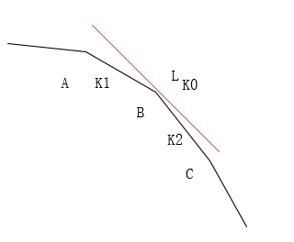
2
【Problem solution
解题思路：
4. DP优化
考虑什么时候一个点可以取到最大值；
x是单调递增的，当满足斜率k1<k0<k2时，B点就是最优转移点
Notes:
特点简要说明

Slide 18
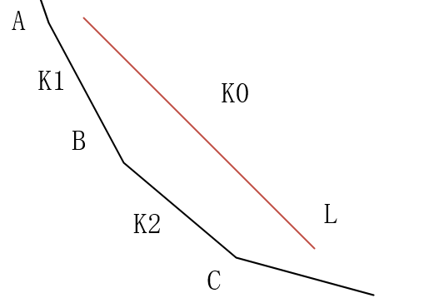
2
【Problem solution
解题思路：
4. DP优化
考虑什么时候一个点一定不能取到最大值
x是单调递增的，当满足斜率k1<K0 <k2时，此时B不可能是最优转移点
Notes:
特点简要说明

Slide 19
2
【Problem solution
解题思路：
4. DP优化
由于Xi不随着i单调，所以不能一边从左枚举到右，一边插入一个新点并维护好凸壳
引入CDQ分治
在这里我们利用CDQ分治法解决（D[i], G[i], F(i)）三位偏序问题，先根据D[i]排序，再在归并左右区间的时候，分别在左右区间把它们按照G[i]排序，最后计算DP问题就可以了。
Notes:
特点简要说明

Slide 20
2
【Problem solution
解题思路：
5. CDQ分治法
主要步骤分为四步：
1>将操作按时间分为两个子区间；
2>递归处理左区间的修改和询问；
3>用左区间的修改更新右区间的询问；
4>递归处理右区间的修改和询问；
Notes:
特点简要说明

Slide 21
3
Code and results display
Notes:
二级标题

Slide 22
3
【Code and results display
伪代码展示：
Procedure CDQ(l, r)
if l >= r:
return;
Mid <- (l + r) / 2;
CDQ(l, mid-1);
对[l, mid-1]扫描一遍计算决策的凸线，满足上凸壳的点加入队列中；
根据左区间得到的队列，更新右区间上的最优决策；
CDQ(mid+1, r);
End Procedure;
Notes:
特点简要说明

Slide 23
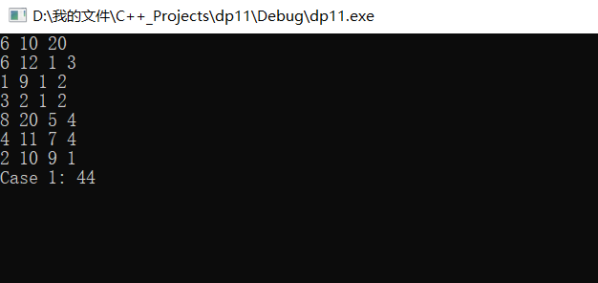
3
【Code and results display
代码运行结果截图：
Notes:
特点简要说明

Slide 24
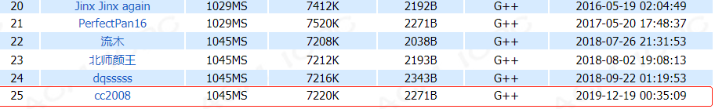
3
【Code and results display
Online Judge截图：
Notes:
特点简要说明

Slide 25
Thanks！
Notes:
简单的操作步骤说明

