Slide 1
Working with ChIP-seq data

Slide 2
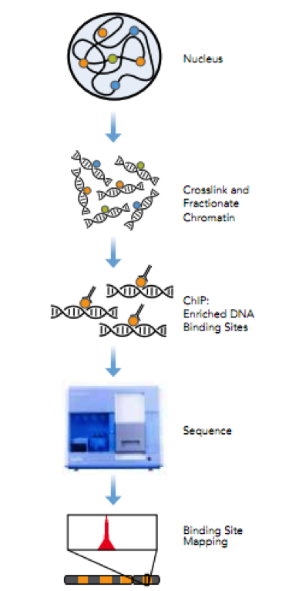
ChIP-seq needs quality control
ChIP-seq/ChIP-exo/DNA-seq contains “noise”.
Biases include:
Differences in fragment lengths.
Variation in IP strength/efficiency and specificity.
PCR bias.
Dependent on context of a targets’ pattern of enrichment across DNA (Transcription factor/RNA polymerase)

Slide 3
What can we do!
Thankfully lots of people are worried about their ChIP-seq.
Encode and modEncode standards.
ChIP-seq guidelines and practices of the ENCODE and modENCODE consortia – Kudaje A (Genome Research 2012)
Systematic evaluation of factors influencing ChIP-seq fidelity. – Chen Y (Nature Methods 2012)
Impact of artefact removal on ChIP quality metrics in ChIP-seq and ChIP-exo data. – Carroll T (Frontiers in Bioinformatics 2014)
CRUK Cambridge Institute
DiffBind (Bioconductor) – Stark R and Brown G (2011)
ChIPQC (Bioconductor) –CarrollT and Stark R
As well as other institutes.
htSeqTools: high-throughput sequencing quality control, processing and visualization in R. Planet E (Bioinformatics)
CHANCE: comprehensive software for quality control and validation of ChIP-seq data. Diaz (Genome Biology)

Slide 4
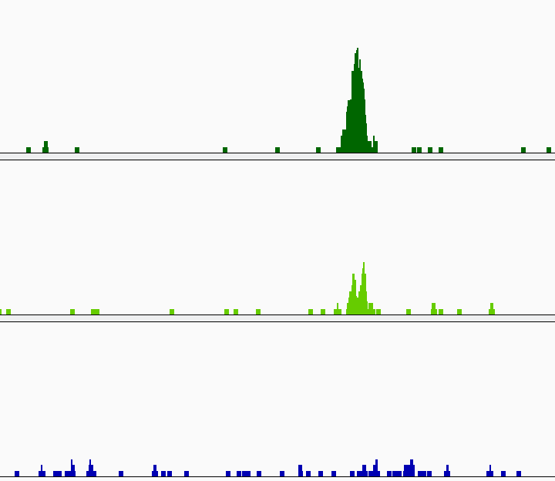
Before anything else..
Visualise your data in a browser.
QC still important for a genome wide picture!
QC can be quantitative rather than qualitative.

Slide 5
Main Processing and QC
Steps for ChIP-seq
Duplication Rate.
Pile-up/signal depth.
Relationship between +/- strands.
Signal to noise.

Slide 6
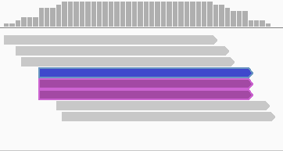
Duplication Rate and the Non-redundant Fraction
What is a duplicate?
PCR Duplicate is fragment that occurs at exact same start and end position in genome.
Single-end Duplicate is read with same start position.
First read at duplicated position is retained and remaining are marked.
Unique
Retained
Duplicate
Marked
Duplicate

Slide 7
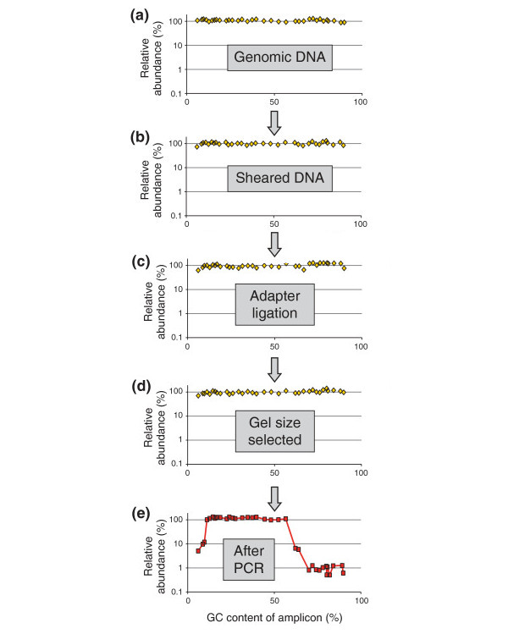
Why are duplicates a problem?
Duplicates often considered an
artefact of library prep.
May arise from bias in preferential
amplification of sequences within
GC% range.
Low DNA input material may also
lead to high duplication rate.

Slide 8
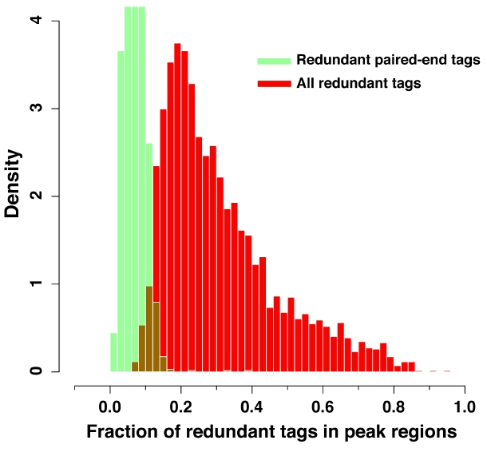
Artefact or real signal?
Artefact and real signal duplicates are impossible to distinguish.
So duplication rates in peaks can be grossly overestimated.

Slide 9
Calculating Duplication rates
Duplication Rate
((Duplicate Reads)/(Total Mapped Reads))*100
Non-Redundant Fraction (NRF)
(Unique Reads)/(Total Mapped Reads)
Encode guidelines for NRF
NRF>= 0.8 for 10M reads

Slide 10
Expected duplication rate
Expected duplication rate = (Number of reads/ size of mappable genome ).
But some ChIPs expect to enrich only a tiny fraction of genome.
Input duplication rates should always be low.
Mappable Genome Size
Epigenetic mark

Slide 11
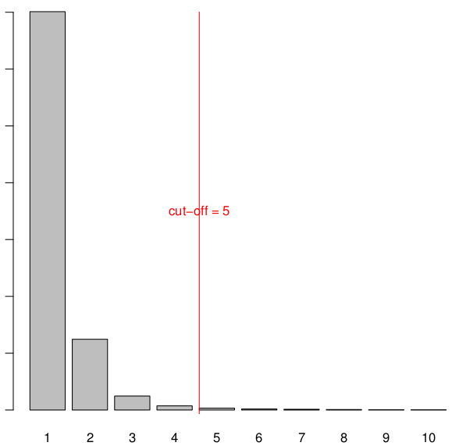
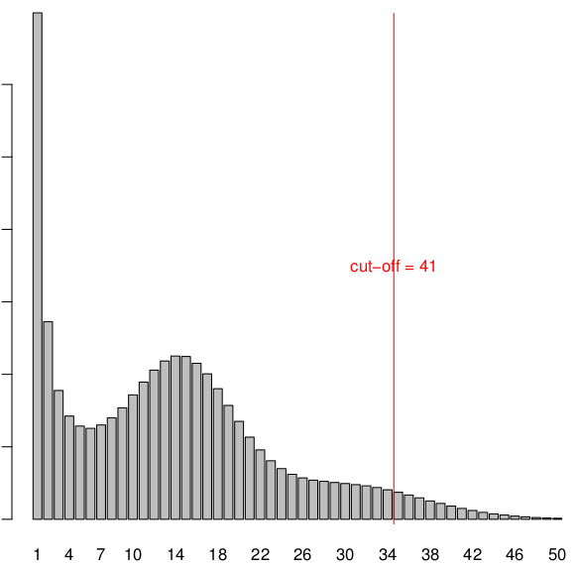
Duplication rate
htSeqTools calculates and alternative duplication rate looking at the distribution of duplicate pile-up in data.
Uses negative binomial to identify duplicate number which is significantly greater than expected from the data.

Slide 12
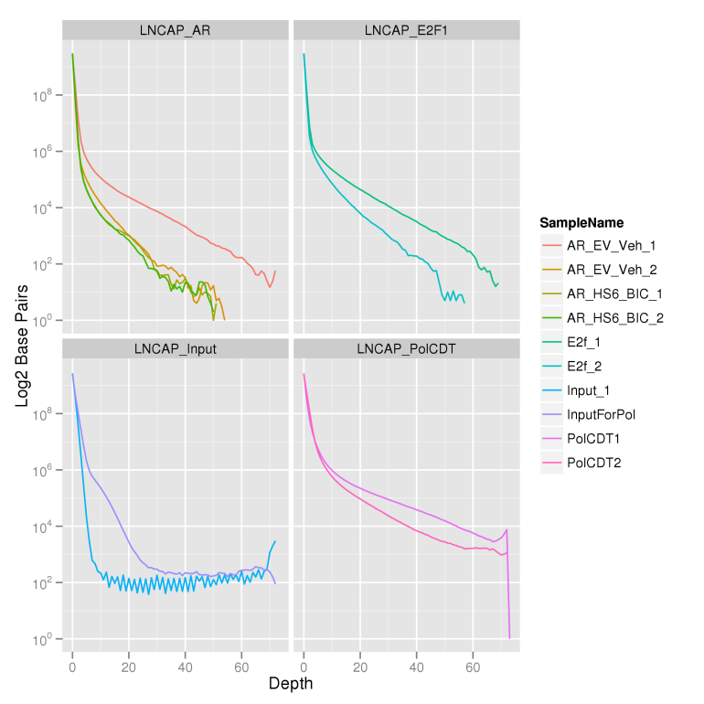
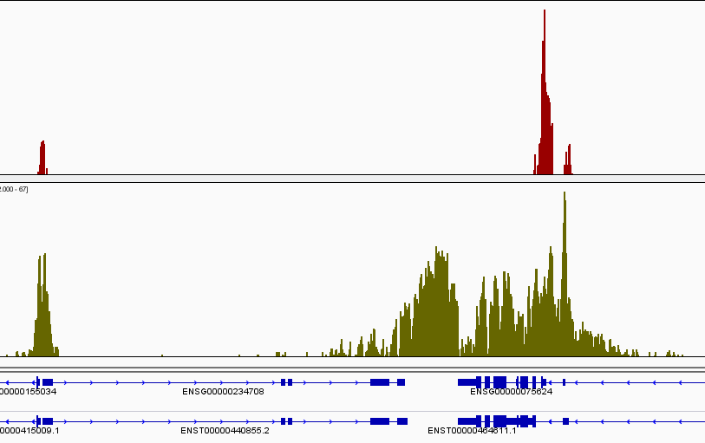
Genomic Distribution of Signal
Point enrichments (Transcription factors).
Wide enrichments (Histone Marks).
Mixed enrichment (Transcriptional Machinery)
Expect more of the genome covered at greater depth in ChIP compared to input control.
Notes:
12

Slide 13
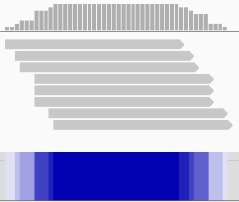
Calculating Genomic Distribution of Signal
Depth of signal is number of fragments at a genomic location.
Measuring number of base pairs with given depth of signals.
Normalise to total number of reads to compare samples
Depth | Base Pairs
1 | 3
2 | 4
3 | 3
5 | 3
6 | 4
7 | 3
8 | 26

Slide 14
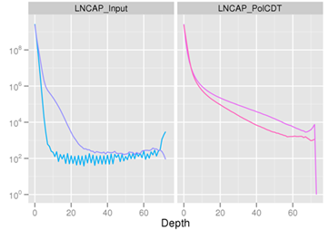
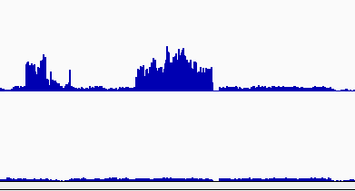
Visualising the distribution of base pairs at different signal depths successful samples and biased inputs can be identified.
Here a region of non-specific enrichment is seen in the signal distribution and in browser.
Note the cut off at 72!
Enriched regions in input can be used to create Blacklists.

Slide 15
Measures of signal distribution.
Planet et al present two methods
Standardised Standard Deviation
Gini Coverage.
Standardised Standard Deviation (SSD) is calculated as
SSD = (Standard deviation of depth of signal)/(square root of number of reads)

Slide 16
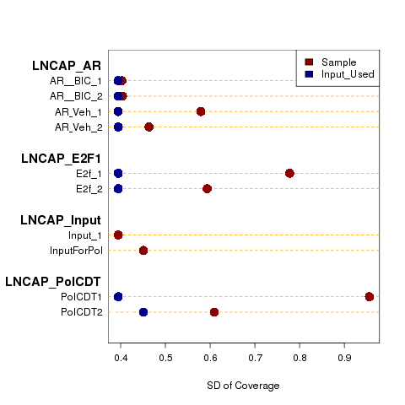
Use SSD to compare distributions of genome wide signals
Samples can be compared to identify strength of IP/ChIP
Controls can be compared to their respective samples to identify bias.

Slide 17
Fragment length
Sequencing occurs from either end of a DNA fragment.
If the same fragment was sequenced using paired-end technologies then distance between positive and negative read would be
(Fragment Length)- (Read length*2)
An estimation of true fragment length (not estimated from gel/Bioanalyser) allows for a more accurate picture of true coverage and hence true binding events.
Fragment length
Read length

Slide 18
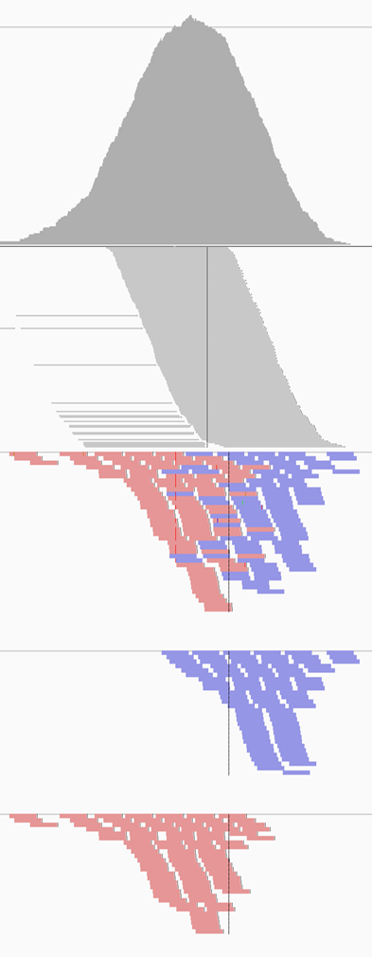
ChIP typically
single End
ChIP-seq sequences genomic DNA
No interest in re-arrangements (DNA-resequencing)
No expected splicing (RNA seq)
Single end reads provides enough information
for ChIP-seq data
Sequence either end of fragments around peak
Results in two distributions of peaks around true
centre of maximum enrichment

Slide 19
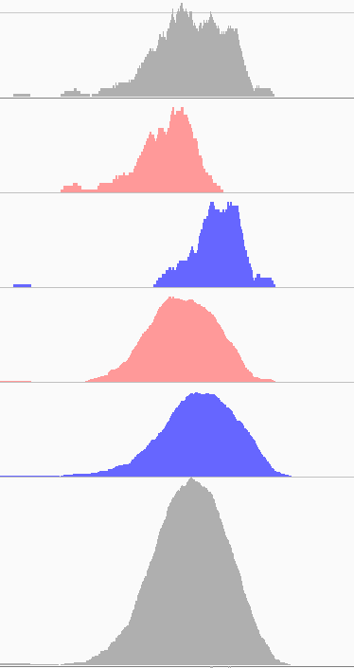
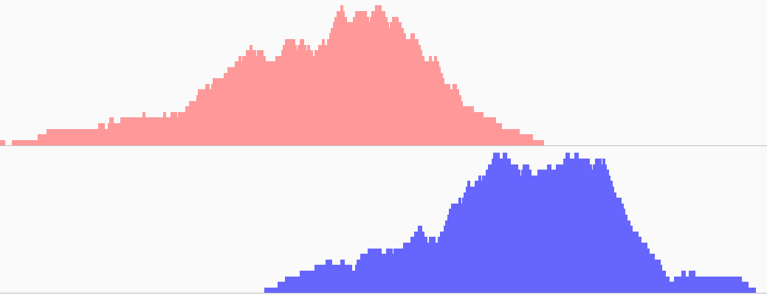
To re-create true signal as seen from
fragment length need to extend reads
to the fragment length
Fragment Position =
Read Position +- ((Fragment length)-Read length)
152bp

Slide 20
Fragment length estimation
Shift Reads from + Strand
Multiple methods to estimate fragment length.
Cross-correlations - Correlation of reads on positive and negative strand after successive read shifts.
Cross-coverage - Coverage of reads on both strand after successive shifts of reads on one strand

Slide 21
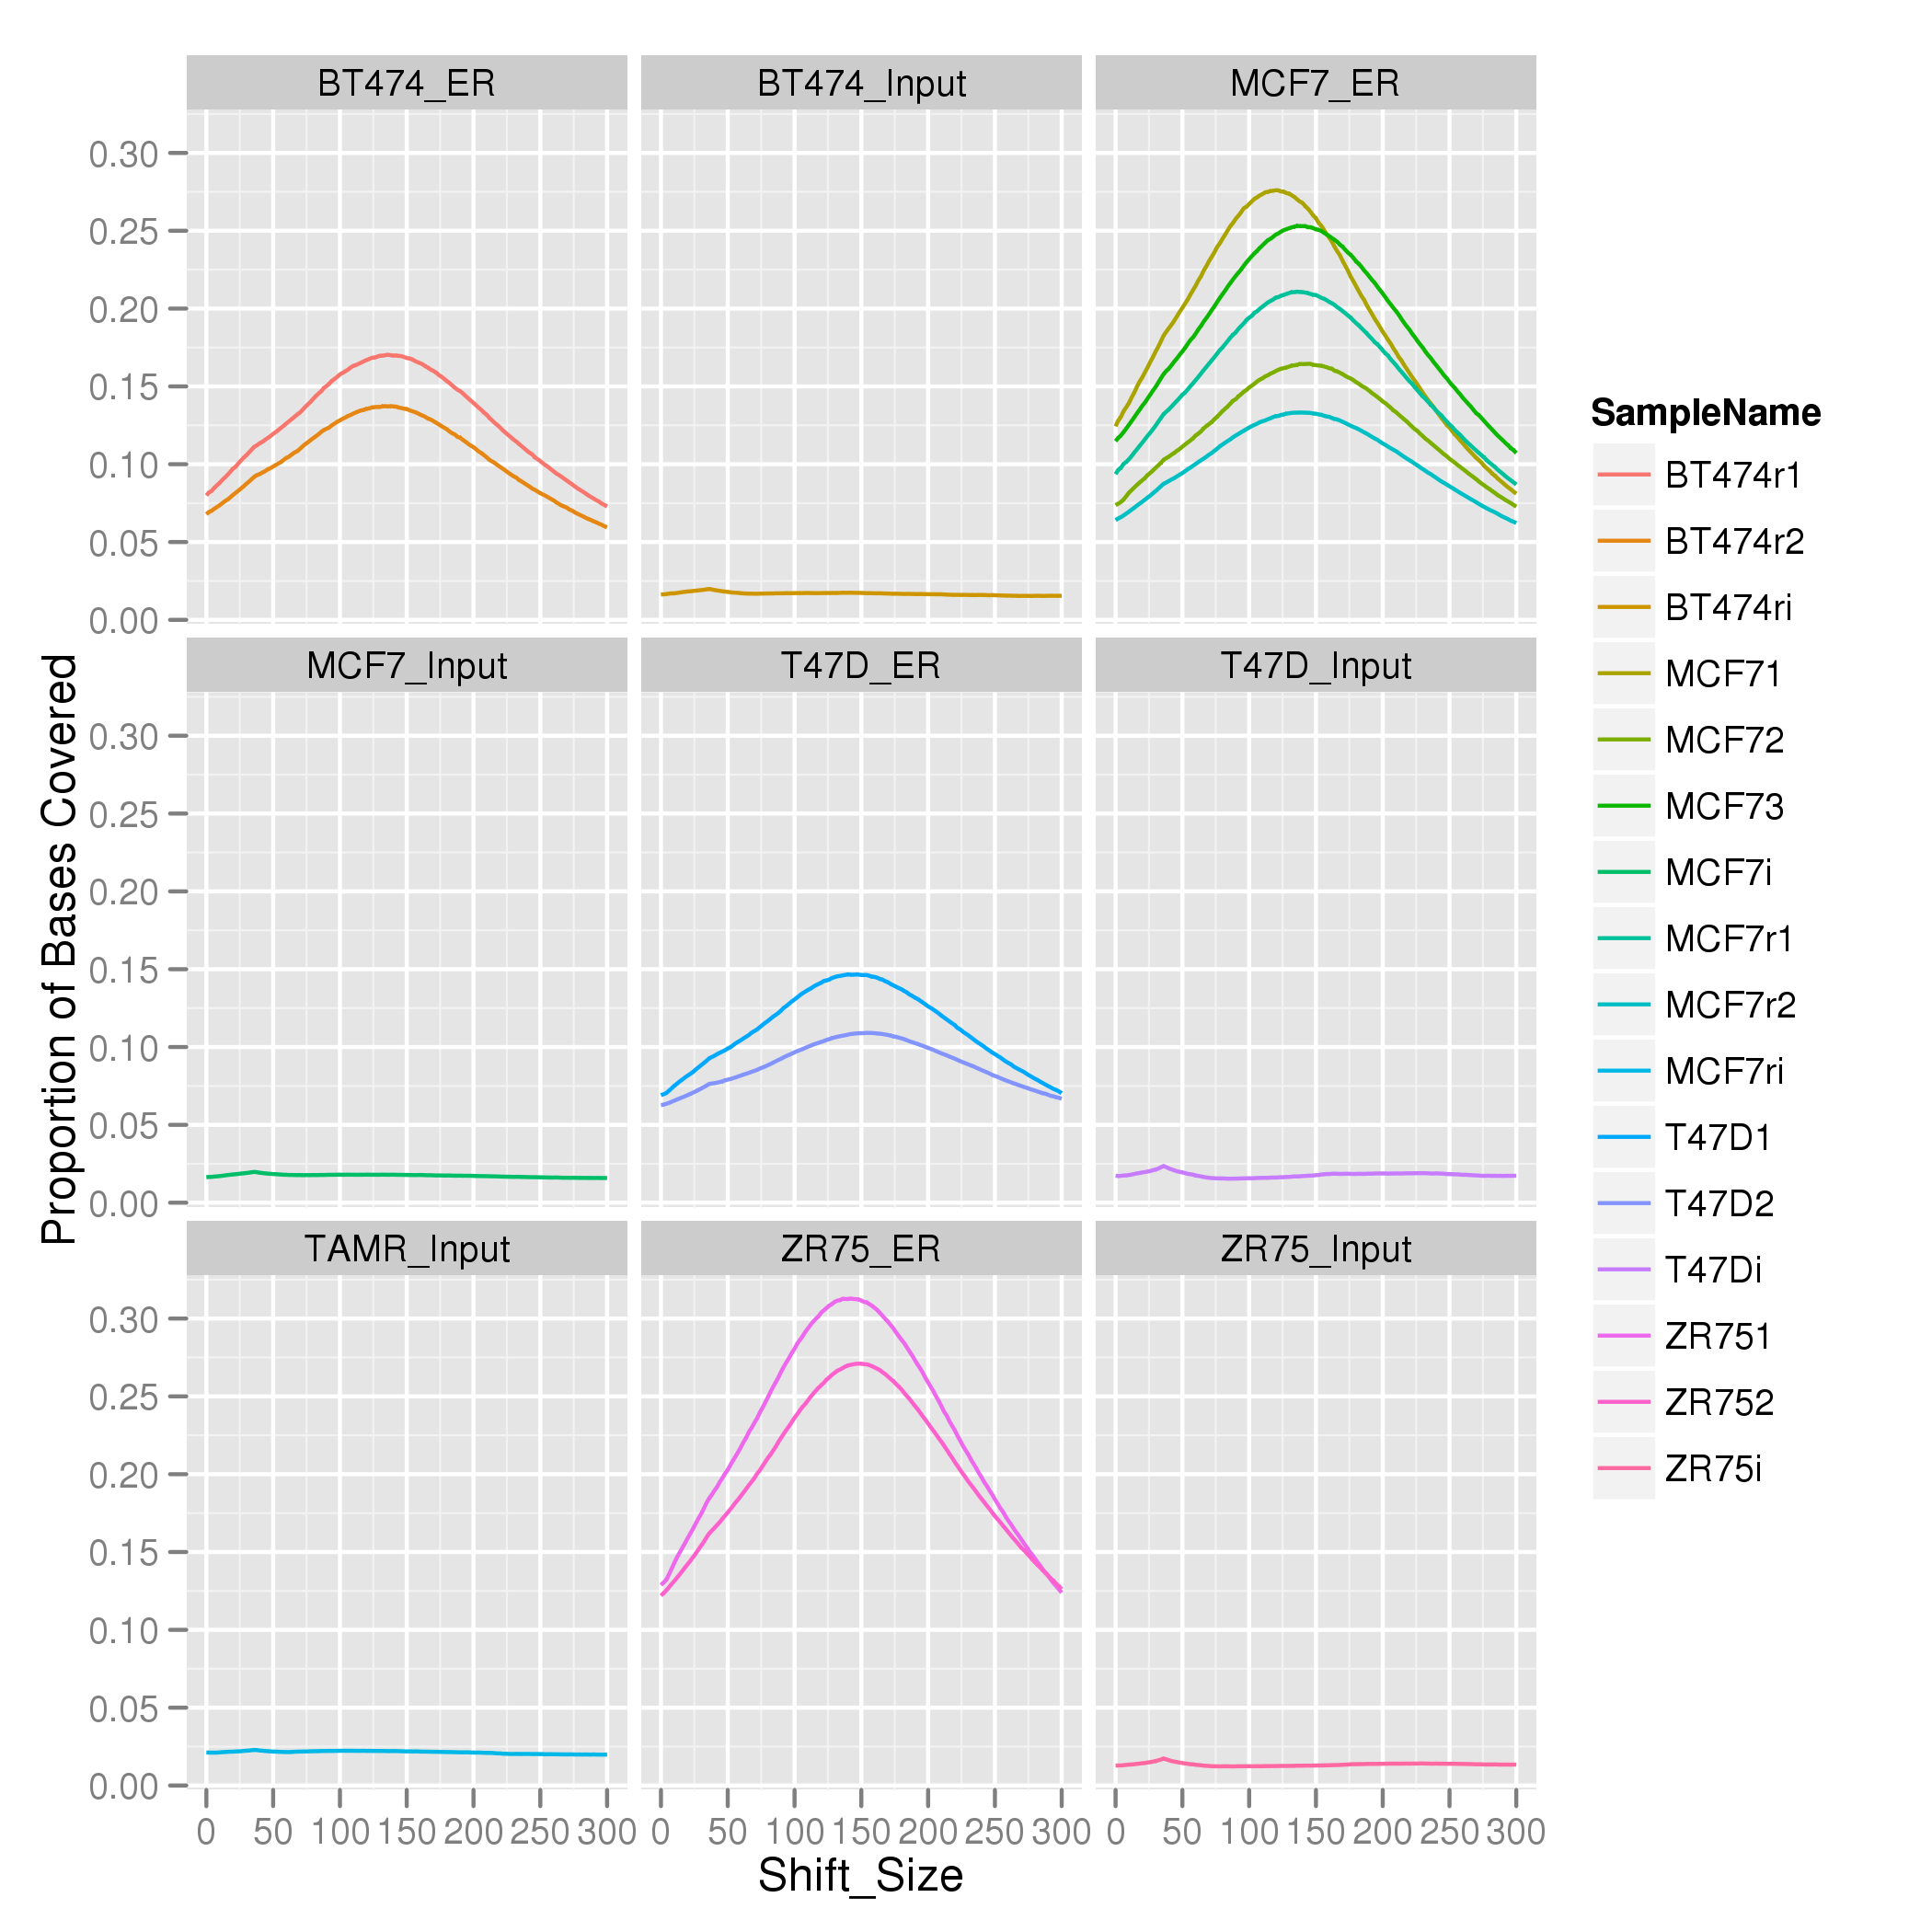
Strand Cross Correlation Great data example
Greatest degree of correlation between the positive and negative reads at the fragment length (For Samples).
Greatest correlation at read length for input.

Slide 22
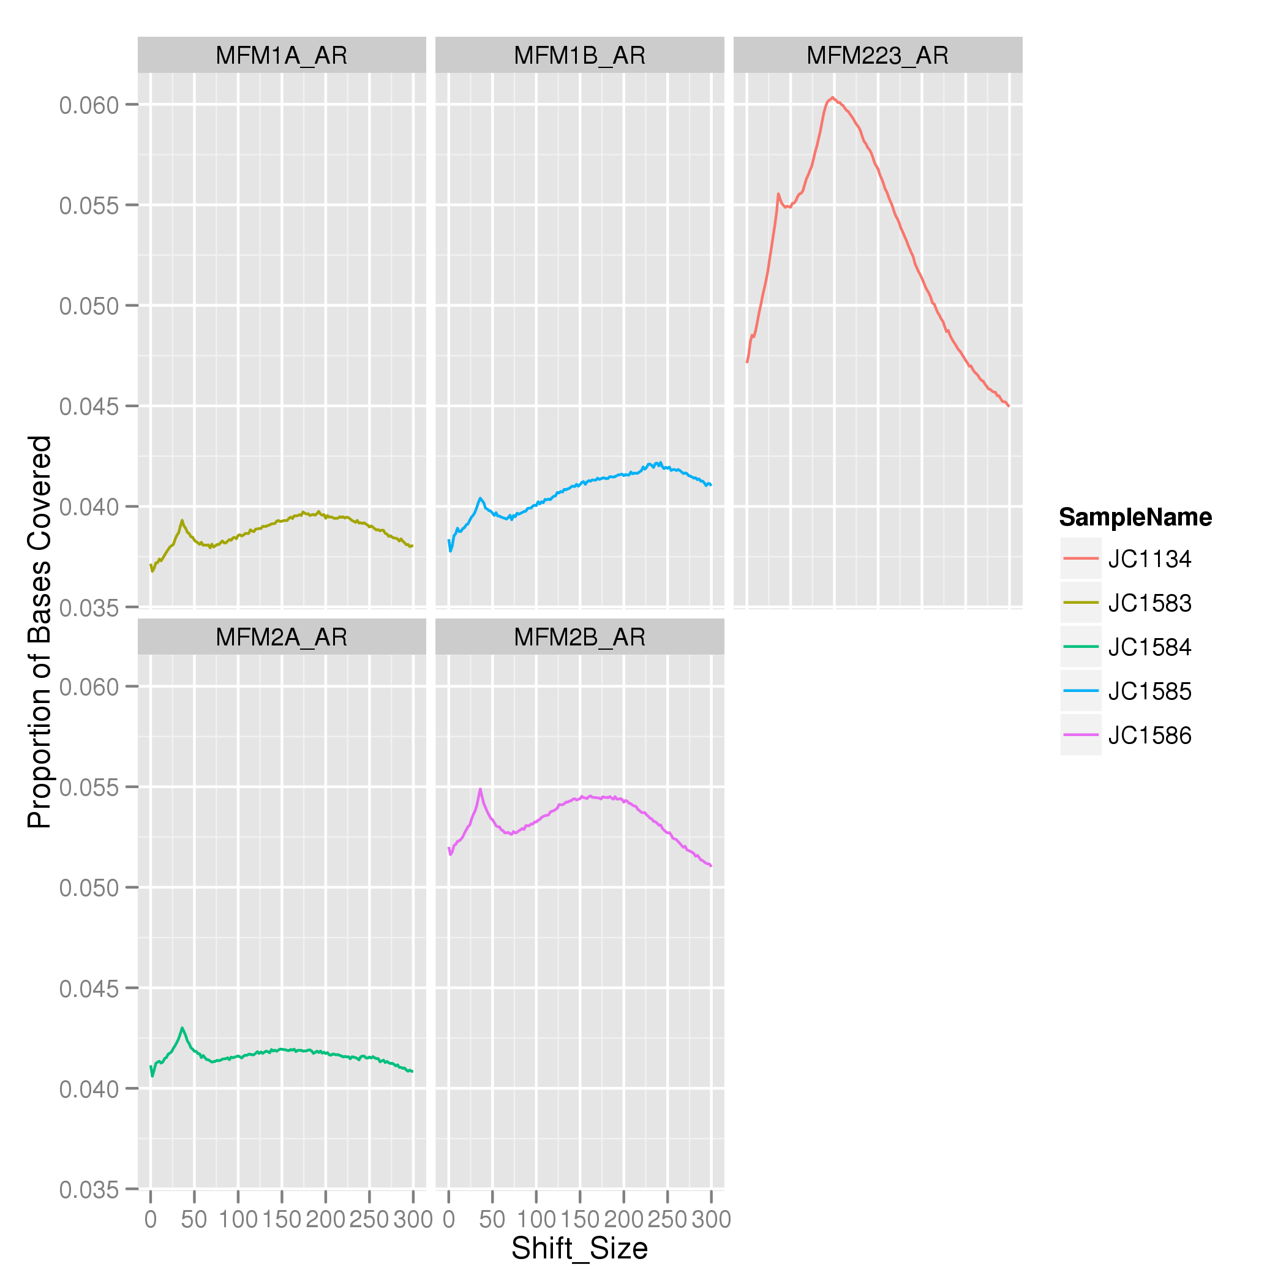
Strand Cross Correlation Mediocre data example
Correlation in read length (Phantom peak) closer to fragment length peak.
Relationship between “Phantom peak” and fragment length peak is basis for Relative Strand Correlation (RSC) metric

Slide 23
Reads to Peaks
The main aims of ChIP-seq is to identify potential binding site.
Two very broad categories of peak callers would be
Those that look at enrichment of reads in windows versus an expected value. (MACS,USeq,Sicer)
Those that look at shape of sample signal or pile-up of reads (TPIC and Triform)

Slide 24
Suitable Control
Most ChIP-seq peak calling compares signal in sample to that of control.
So need an appropriate control.
Control sample should ‘control’ for artifacts which may be present in experimental samples
Copy number changes from reference.
Non-random/uneven DNA fragmentation.
Mapping to Repeat regions.
GC bias.
Non-specific binding events.

Slide 25
Types of ChIP-seq control
gDNA
Controls for copy number changes and sequencing biases.
Input
Controls for copy number changes, sequencing biases.
Controls for fragmentation and shearing biases from cross-linking.
IGG control.
Controls for copy number changes, sequencing biases.
Controls for fragmentation and shearing biases from cross-linking.
Controls for non-specific binding events.

Slide 26
Pre-Peak Calling
Make sure you followed processing and QC steps.
Filter Blacklisted regions, multimapped reads, duplicates (if NRF is high).
Extend reads to fragment length?
For Macs don’t (supply length to parameters)
For TPIC do
Check the parameters of the peak caller!

Slide 27
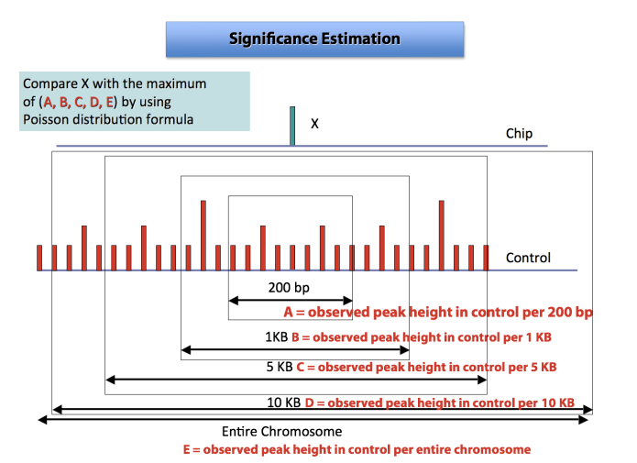
Peak Calling in MACS
Macs accepts BAM or BED format.
Can predict fragment length internally,
Can be run with sample alone or sample versus input.
Runs sliding window along genome.
Compares reads in sample window versus surrounding windows in control.
Estimates significance of window using poisson distribution

Slide 28
Peak Calling in Macs
Sample Macs command
Sample File
Control File
Genome
mfold
Output file name
macs14 –t SampleFile.bam –c Control.bam –f BAM –g hs –m 10,30 –shiftsize=100 –n MyResultName
File format
Half fragment
length
Sample Macs command in R
system(“macs14 –t SampleFile.bam –c Control.bam –f BAM –g hs –m 10,30 –shiftsize=100 –n MyResultName”,wait=T)

Slide 29
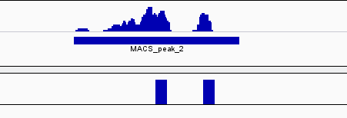
Peak Calling
MACs peak calls are in BED format (almost).
Score is –log10 p-value from poisson test.
Additional file contains information on the summit positions of peaks (Sample corrected by control)
FDR (Percent!) established by calling peaks for control over input.

Slide 30
Peak callers for all types of ChIP
Macs, Swembl, SPP, PeakSeq, USeq are some of the most popular algorithms for TF peak calling.
For longer spanning histone marks (H3K4me1/2/3), Sicer and other callers which aggregate smaller peaks may be more appropriate.
For very broad and diffuse DNA marks, Rseq is more appropriate.
There are peak callers in R/Bioconductor including
SPP (used in Encode).
TPIC (used at CRUK).
Triform.
BayesPeak.
JMOSAICS.
Then why don’t we use them?
With the exception of SPP, aren’t considered gold standard.
Too memory heavy and often impractical

Slide 31
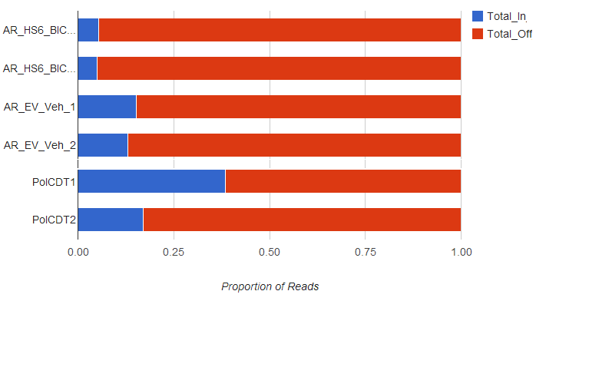
Fraction of Reads in Peaks (FRIP)
Post-peak calling
Signal to Noise calculated as the fraction of reads which land in peaks.
FRIP = (Reads in Peaks)/
(Total Mapped Reads).
Punctate/Narrow peaks typcially have lower scores FRIP ~ 5-25%.
Wider Peaks may have higher score between 20-50%.

Slide 32
Acknowledgements
CRUK-CI Bioinformatics Core
Rory Stark (DiffBind/ChIPQC)
Matthew Eldridge
Suraj Menon
Gordon Brown (DiffBind)
Wei Liu (ChIPQC)
Ines de Santiago

