Slide 1
Visualisation and assessment of ChIP-seq quality
BioC 2014
Thomas Carroll
Head of Bioinformatics,
MRC Clinical Sciences Centre,
Imperial College London

Slide 2
ChIP-seq is noisy
ChIP-seq/ChiP-exo/DNA-seq/MNase-seq is noisy.
Experimental biases:
    Fragmentation/digestion.
    IP strength/efficiency and specificity.
    PCR Bias (Overamplification from low starting material)
Highly variable patterns of enrichment between ChIPs.
    Transcription factors may show sharp/narrow peaks.
    Polymerase II will show mix of sharp/narrow and dispersed/broad peaks

Slide 3
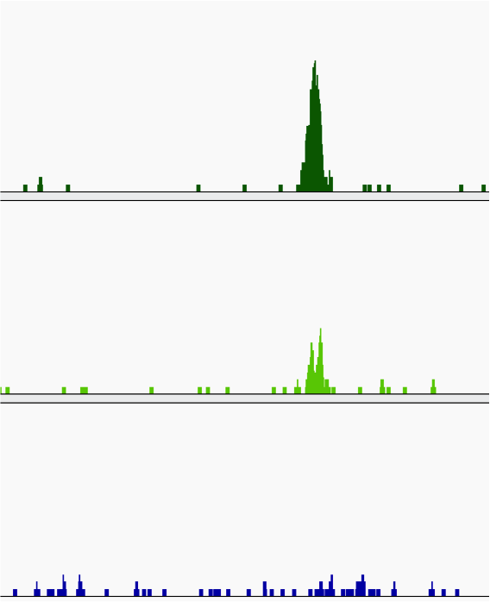
Always visualise your data
Coverage graphs.
    Wigs (Okay)
    bedGraphs (Okay)
    BigWigs (Great)
Allows for quick assessment of data...
..but dependent on user's interpretation/experience.

Slide 4
High-thoughput ChIP-seq quality control with ChIPQC
Need methods to quantify informative characteristics about your ChIP-seq data.
ChIPQC – Tom Carroll and Rory Stark (Diffbind).
ChIPQC provides workflow to generate metrics per sample/experiment.

Slide 5
ChIP-seq metrics
Distribution of Signal
Clustering of Watson/Crick reads.
Duplication Rate.

Slide 6
Distribution of Signal
  Within enriched regions
  Within/across expected annotation
  Across the genome
  Within known artefact regions

Slide 7
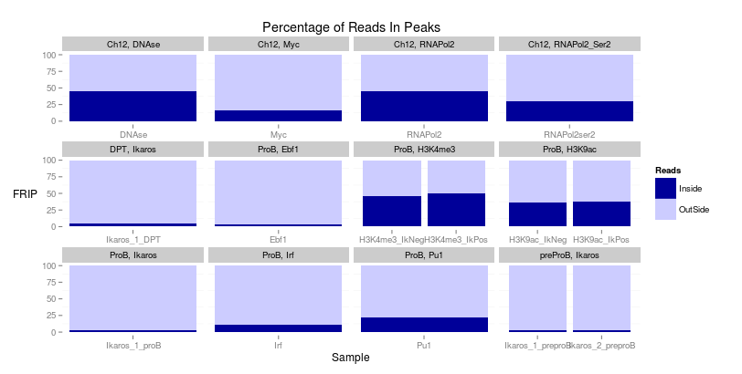
Signal in Peaks (FRIP)
The simplest assessment of enrichment.
  Call enriched regions over input
  Measure fraction of reads in peaks (FRIP)
  Good quality TF > 5%
  Good quality Pol-II > 30%

Slide 8
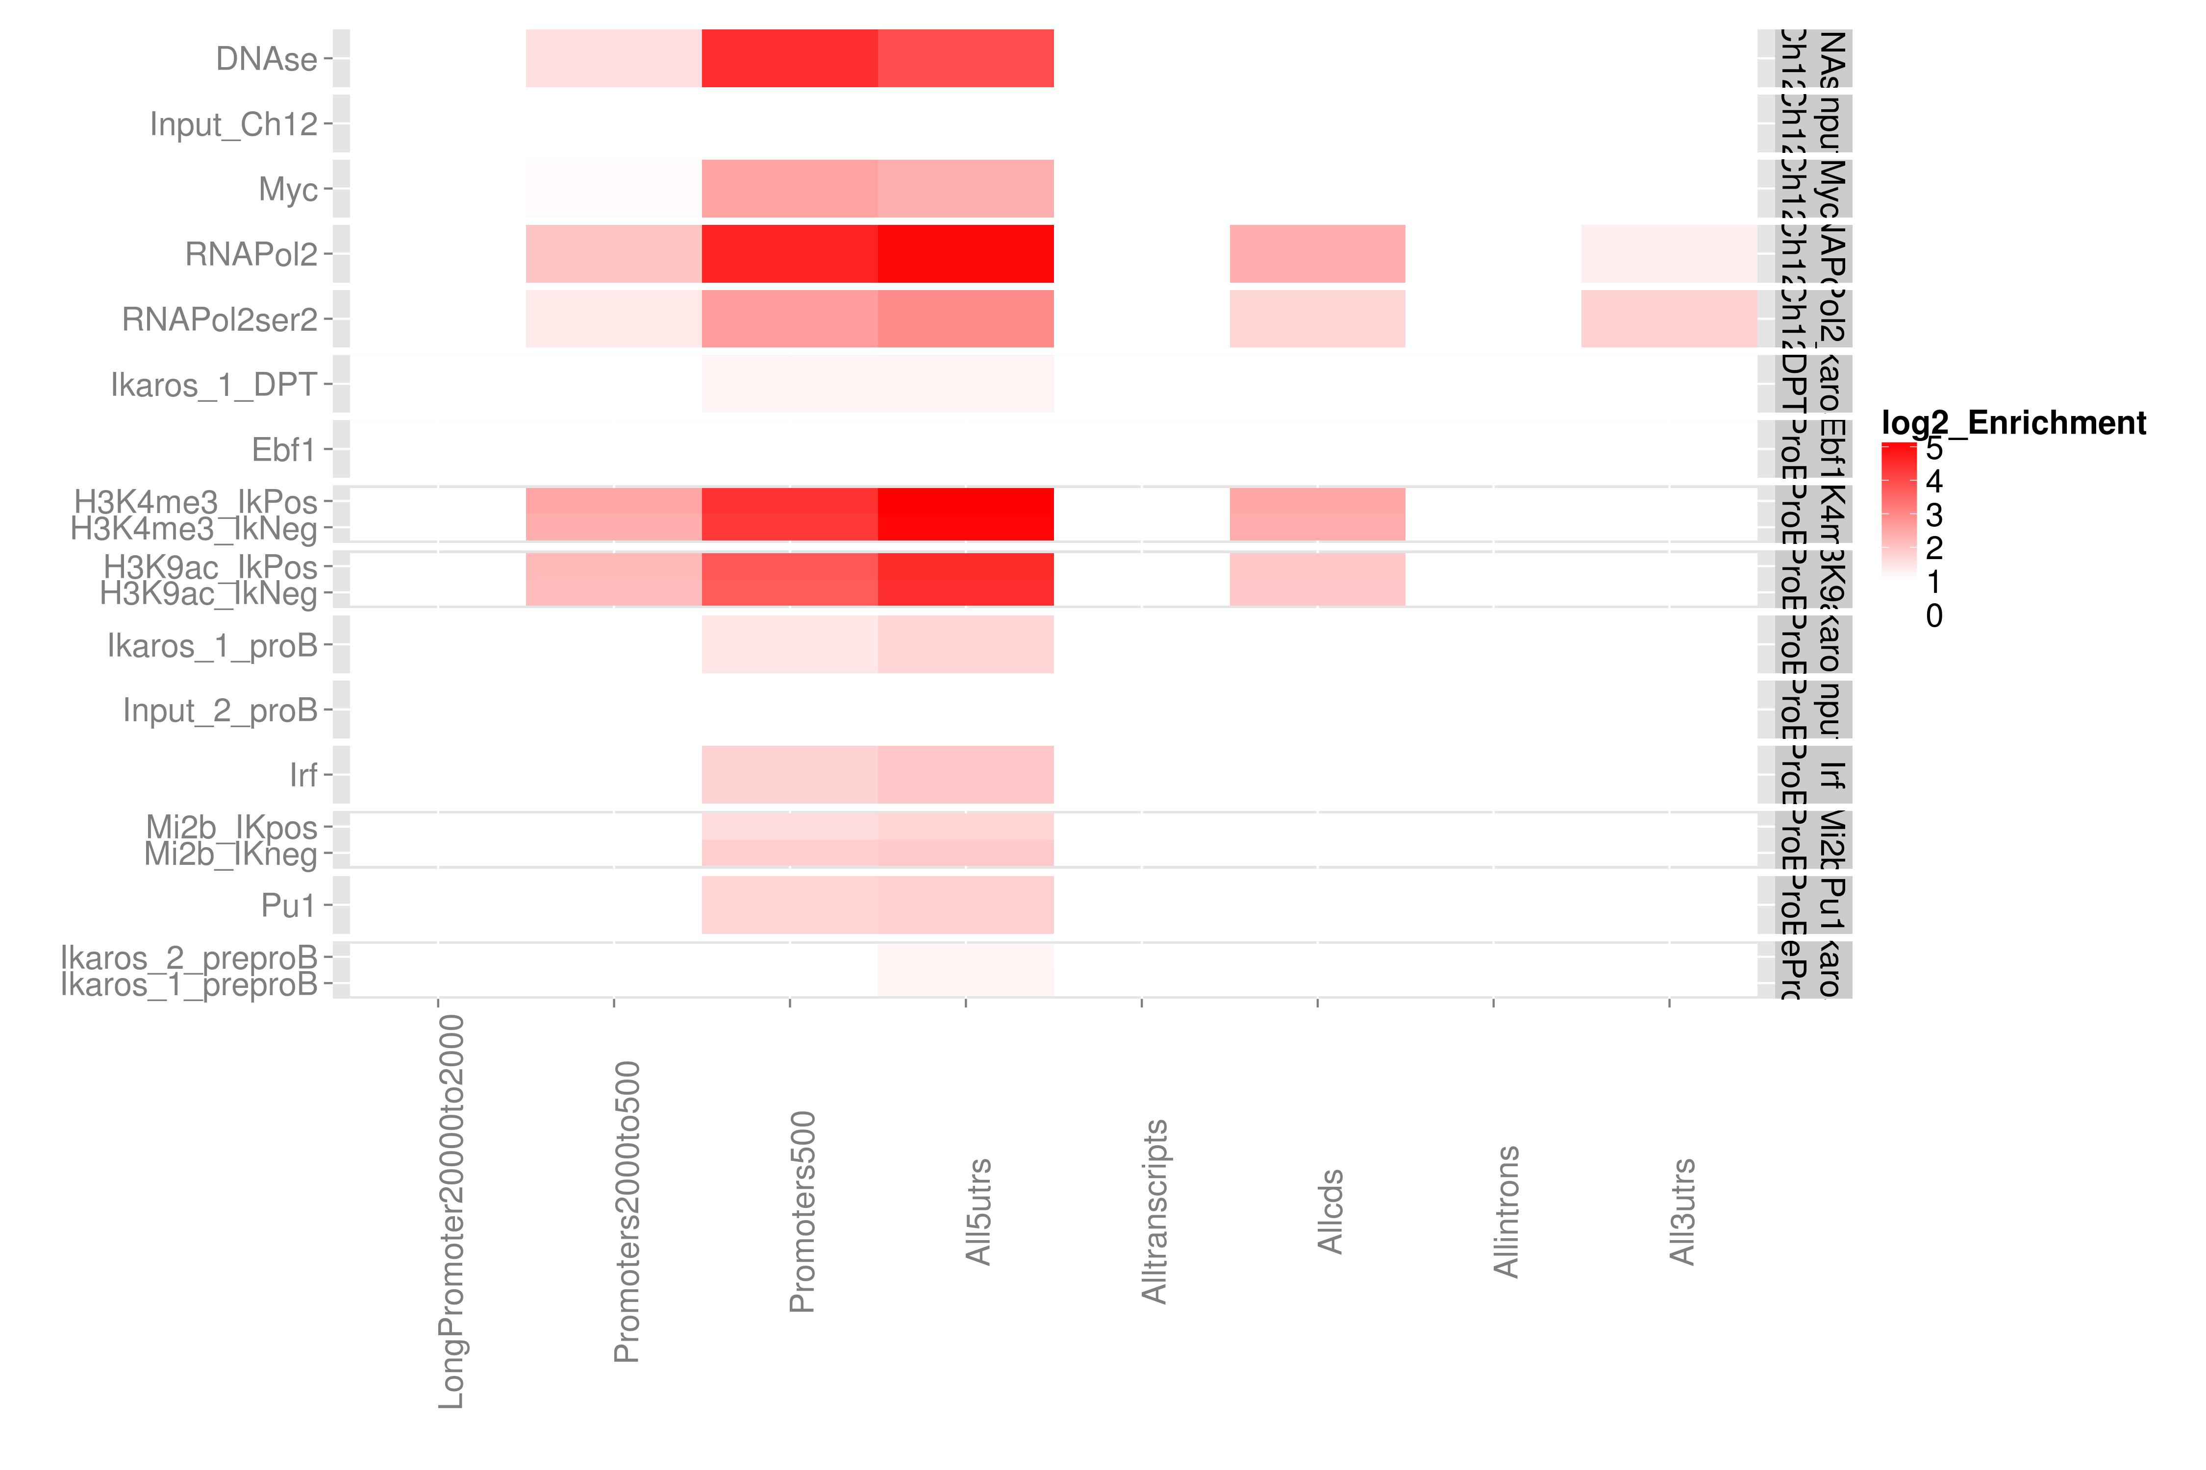
Relative Enrichment in Genomic Intervals (REGI).
Expected enrichment in genomic regions
Plot relative enrichment of reads in annotated regions.

Slide 9
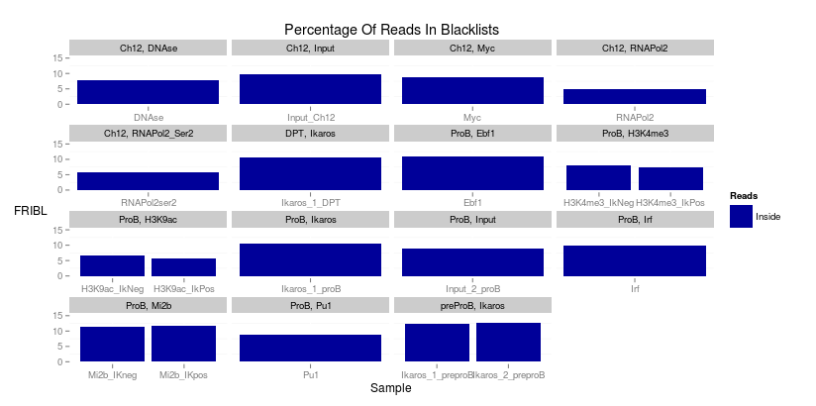
Signal in Blacklists (FRIBL)
Work from Encode (Kudaje A) has produced curated list of conserved high signal artefact regions.
Available for many species including human, mouse and drosophila genomes.
Represent around 0.5% of genome.
Can account for high proportion of total signal (> 10%).

Slide 10
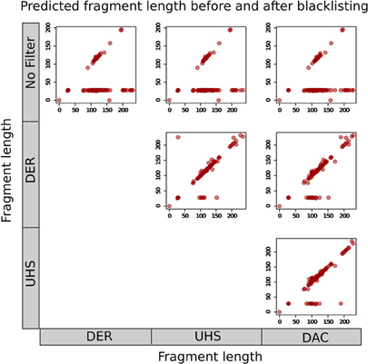
Why worry about blacklists?
Carroll et al 2014
Can affect -
  Normalisation between samples.
  Fragment length estimation.
  Quality metrics for ChIP-seq.

Slide 11
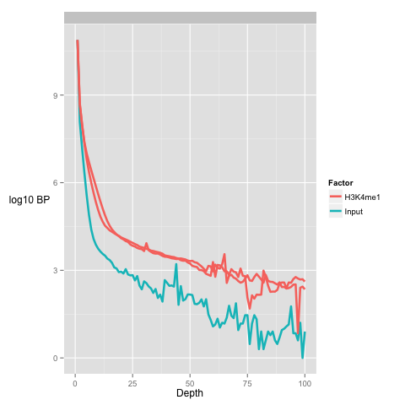
Global signal profile
A simple method to review global distribution is as histograms.
More enriched samples show higher number of bases at greater depths
Input samples show higher number of bases at low depths

Slide 12
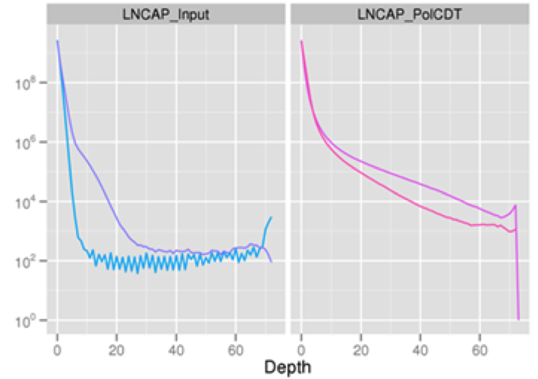
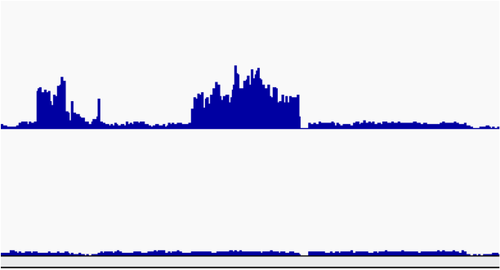
Global Signal Profile
Presence of stretch of high signal depth
Identify anomalous signal region as candidate for blacklisting.

Slide 13
Metric of Global Signal Profile -
SSD
SSD developed in htseqtools package.
Normalised standard deviation of coverage.
Provides measure of pile-up across genome
    Sample with regions of high signal (High SSD score)
    Sample with low signal across genome (Low SSD score)
Provides no measure of signal structure.

Slide 14
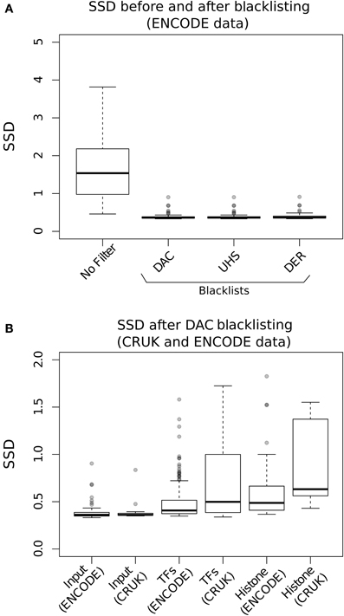
SSD and Blacklists
Carroll et al 2014
SSD is very sensitive high signal artefact regions.
Input SSD scores reduced after Blacklisting
Sample SSD scores remain higher.

Slide 15
Clustering of Watson/Crick reads.

Slide 16
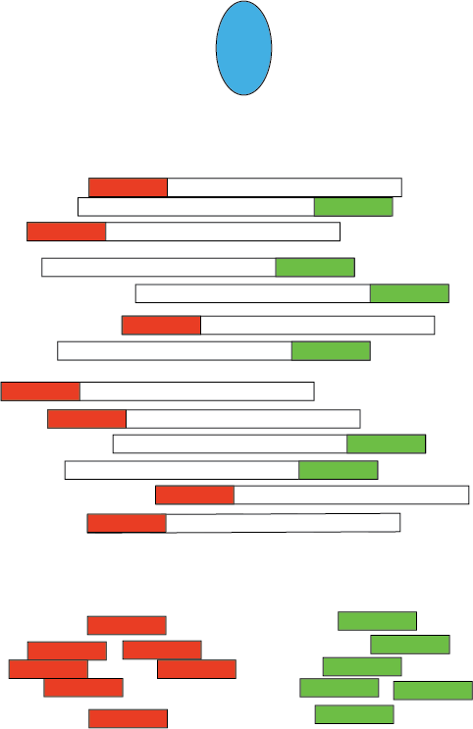
Watson and Crick reads cluster around epigenetic marks
ChIP-seq is typically single ended.
ChIP-seq watson and crick reads cluster around binding events.
For transcription factors the extent of this clustering related to ChIP-seq quality.

Slide 17
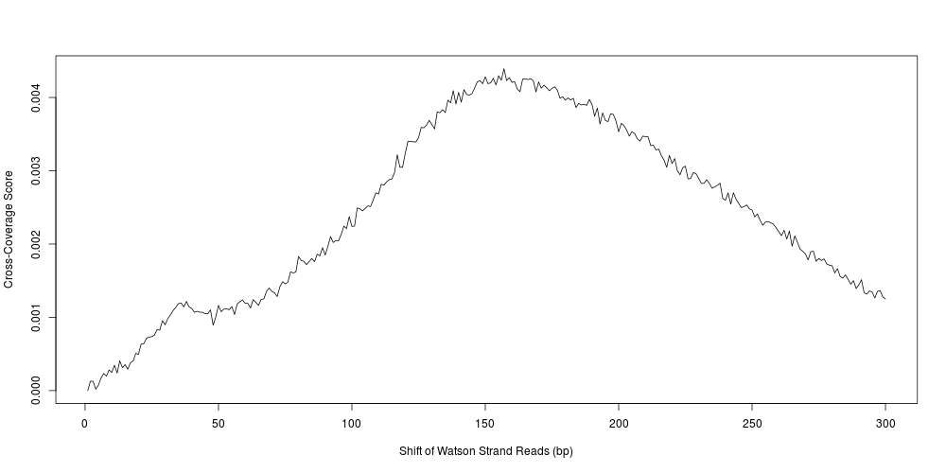
Assessing W/C read clustering
Convert total coverage to cross-coverage scores to allow for comparison between samples (and regions)
    Cross-Coverage Score =(Coverage0 – Coveragen)/Coverage0
Frag_CC = Cross-coverage score at fragment length.

Slide 18
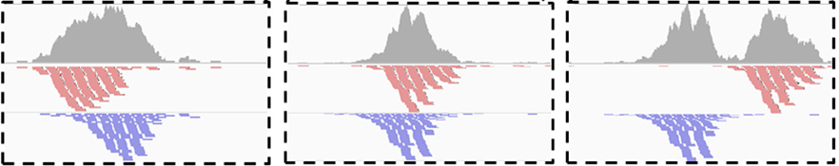
Assessing W/C read clustering
Slide Watson reads along binding site (5' to 3').
Total area covered by signal will reduce after shifting Watson reads by fragment length

Slide 19
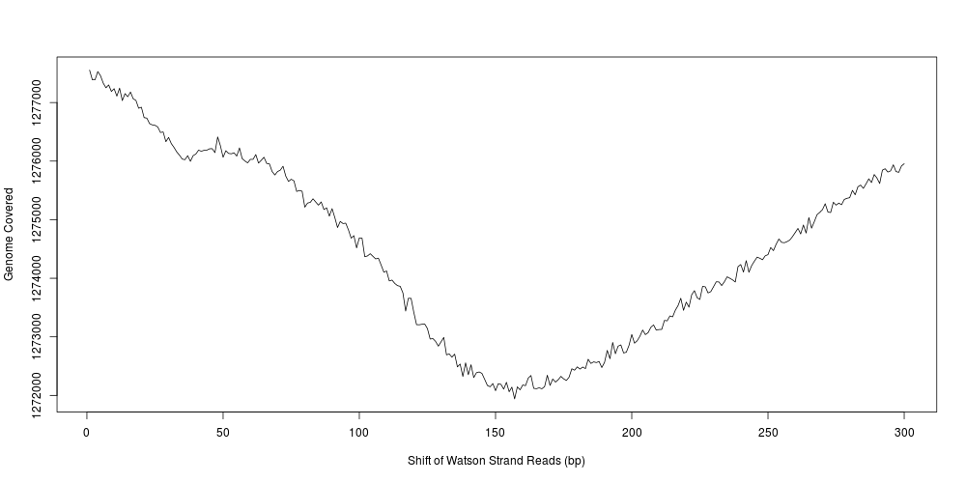
Assessing W/C read clustering
Applied across genome.
Expect reduction at fragment length.

Slide 20
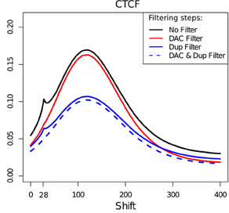
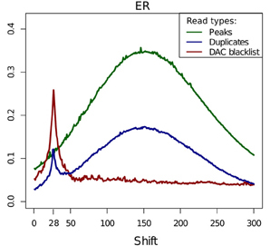
Read-length cross-coverage peak
Carroll et al 2014
Blacklisted regions strongly contribute to read length cross-coverage peak
Rel_CC = Frag_CC/ read length cross-coverage score.

Slide 21
Duplication Rate

Slide 22
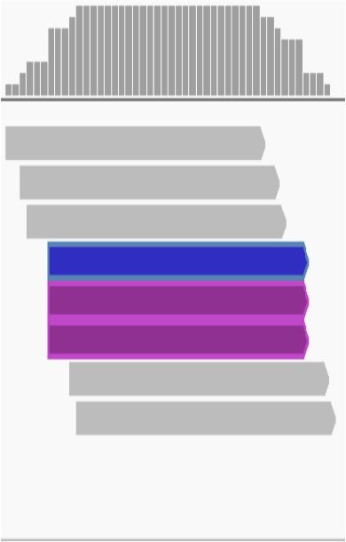
Duplicate FAQ
Typically ChIP-seq is single end sequenced
  Reads with same start position considered duplicates
Removing duplicates saturates dynamic range of signal.
  Maximum signal at base is 2*read length

Slide 23
Why worry about duplicates
“Read duplicates arise from experimental artefacts”
  Is true
“All read duplicates arise from experimental artefacts”
  Is false.
So we need to consider that duplicates may be enriched for artefacts..
..but contribute to genuine ChIP-signal

Slide 24
Duplicates (the bad kind)
Low starting material.
  If initial starting material is low this can lead to overamplification of this material.
  Biases in PCR will compound this problem.
  Can lead to artificially enriched regions.

Slide 25
Duplicates (bad kind 2)
Blacklists with ultra high signal are high in duplicates.
Masking blacklisted regions prior to analysis removes this problem

Slide 26
Duplicates (The Good and Misunderstood)
Duplicates will also exist within highly efficient (or even inefficient ChIP) when deeply sequenced ChIP.
Removal of duplicates can lead to a saturation and so underestimation of ChIP-signal!

Slide 27
Duplicates
Consider enrichment efficiency and sequencing depth.
Remove duplicates prior to peak calling.
Retain duplicates for differential binding analysis.

Slide 28
Practical.
All data is /data/ChIPQC/
Handout and R code in /data/ChIPQC/ or on Bioc2014 materials page.
We will work through first examples.
Few questions using what we learnt.

