Slide 1
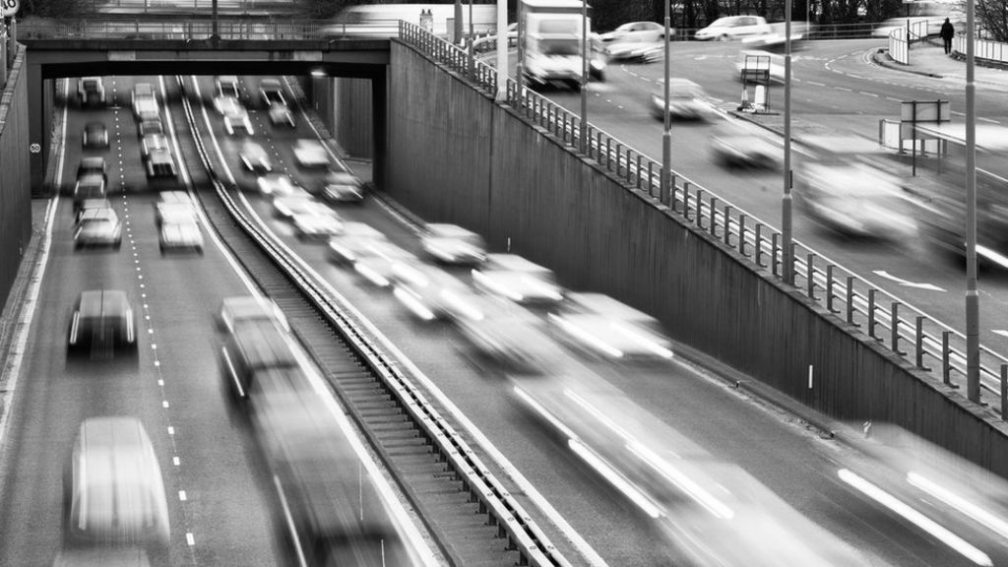
Medical Imaging of Skin lesion: Melanoma
GROUP 4
Lukas and Yasmin
(Martin and Thomas)

Slide 2
STRUCTURE OF PRESENTATION
Research Question
Data
Results
Discussion
Limitations
Conclusion and Future work
Notes:
SOFIE

Slide 3
RESEARCH QUESTION
“How is the relationship between feature characteristics and skin lesions,
and can these features be used to distinguish between types of skin
lesions?”
Notes:
SOFIE

Slide 4
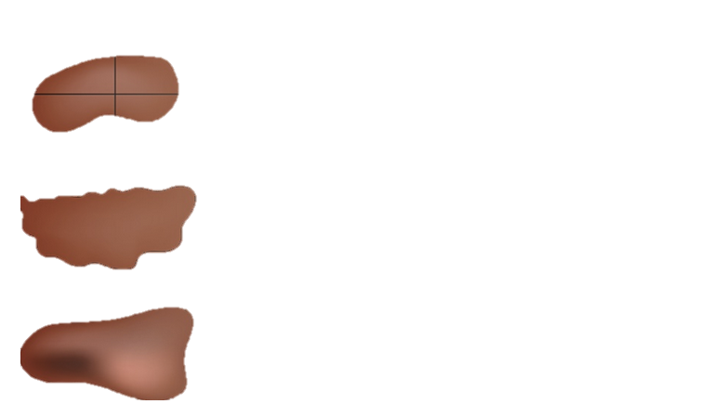
DATA SET FOR THIS STUDY
Data sets:
1) Example Images, 2) Example Segmentation, 3) Example Ground Truth, and 4) Features from ISIC 2017 Challenge.
THE ABC RULE
Divided horizontally and/or vertically one half does not match the other half
Uneven borders
Variety of colors like brown or black
A: ASYMMETRY
B: BORDER
C: COLOUR
Figure 1: The main features for skin lesion analysis in this project. Source: https://blog.hirslanden.ch
Notes:
SOFIE

Slide 5
DATA PRE-PROCESSING
Manually data exploration
→ Purpose: To plan appropriate pre-processing steps based upon provided data sets
Checking for missing values
Pre-processing accordingly to each ABC Feature
Plan and steps for this project
Calculate Asymmetry
Calculate Border
Calculate Area
Calculate Compactness
Pick Classification Model for Predictions

Slide 6
DATA PRE-PROCESSING
FEATURE: ASYMMETRY
Data set: 150 Binary Segmentation Masks (ISIC 2017)
Cropping segmentation images
Image rotation to align skewed images:
Rotate image by 10 degrees
Find center coordinates and divide images horizontally into halves
Flip one half, and overlap with the other half
Calculate intersection and symmetric differences for each side
Lastly after 5 rotation
Extract the minimum value of symmetric difference for each of the two halves (left and right)
Convert value from pixels to decimals → “Asymmetric Decimals”

Slide 7
1. SEGMENTATION
FEATURE: BORDER
Data set: 150 Binary Segmentation Masks (ISIC 2017)
Subtracting copy of segmentation masks:
Outline of the binary images for each lesion
Pixel values of 1 in the border, 0 elsewhere
Calculate border by calculating the sum of all pixels corresponding to 1

Slide 8
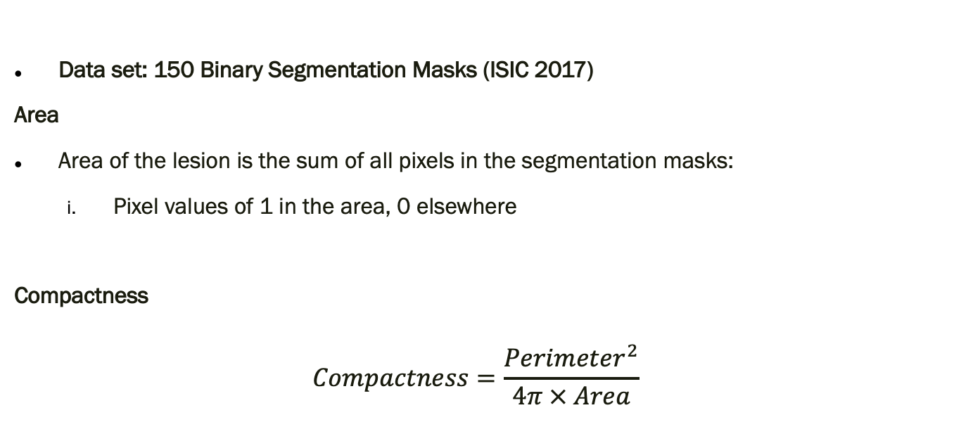
2. SEGMENTATION
FEATURE: AREA AND COMPACTNESS
Data set: 150 Binary Segmentation Masks (ISIC 2017)
Area
Area of the lesion is the sum of all pixels in the segmentation masks:
Pixel values of 1 in the area, 0 elsewhere
Compactness
$$Compactness=\frac{Perimeter^{2}}{4π × Area}$$

Slide 9
CLASSIFICATION
WHICH MODEL TO PICK?

Slide 10
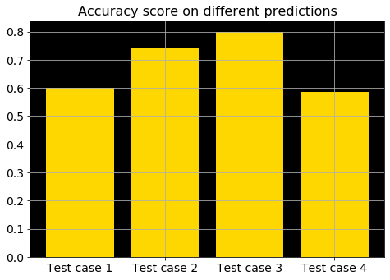
RESULTS - PREDICITION
TEST CASE 1: NON-DISEASED AND DISEASED SKIN
150 images
50 % labelled as “keratosis” and “melanoma”
50 % non-labelled
Labels Prediction
Non-Diseased
Diseased
Results
Low Accuracy at 60 %
Figure 2. Accuracy score for Test Case 1
Notes:
ADA

Slide 11
RESULTS - PREDICITION
TEST CASE 2: KERATOSIS
150 images
Label Prediction
Keratosis
Non-keratosis
Results
Accuracy at 70 %
Specificity at 95 %
Sensitivity at 33 %
Figure **. Accuracy score for Test Case 2
Notes:
ADA

Slide 12
RESULTS - PREDICITION
TEST CASE 3: MELANOMA
150 images
Label Prediction
Melanoma
Non-melanoma
Results
Accuracy at 80 %
Specificity at 100 %
Sensitivity at 0 %
Figure **. Accuracy score for Test Case 3
Notes:
ADA

Slide 13
RESULTS - PREDICITION
TEST CASE 4: MELANOMA, KERATOSIS OR NON-DISEASED
150 images
3 categories
Label Prediction
Melanoma or Keratosis
Non-diseased
Results
Accuracy at 57 %
Figure ** . Accuracy score for Test Case 4
Notes:
ADA

Slide 14
DISCUSSION
Poorly chosen features?
Number of labels?
Categories of skin conditions?
Class distribution and imbalanced data?
Oversampling or undersampling?
Notes:
ADA

Slide 15
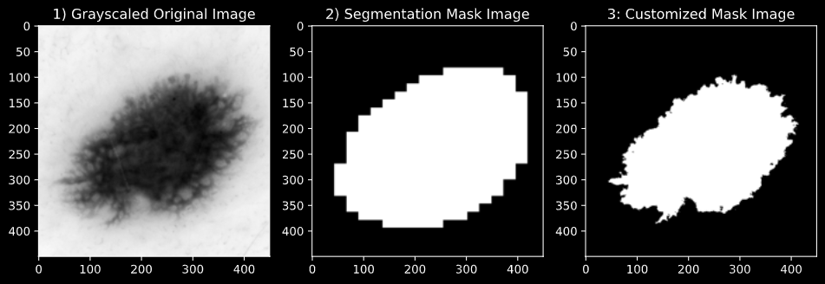
LIMITATIONS OF OUR DATA SET
Non-representative data set
Small sample size
Various skin colors
No information on gender, age nor demographics
Photographically technicalities
Skewed images
Inconsistency
Super pixels and image quality
Over or under exposure
Segmentation masks
No framework on the procedure
Thus, differ largely on how these are made from image to image → inconsistency
Figure **. Greyscale of original image, provided segmentation mask of same image and our customized segmentation mask of same image

Slide 16
CONCLUDING REMARKS IMAGE ANALYSIS OF SKIN LESIONS
Research Question
“How is the relationship between feature characteristics and skin lesions, and can these features be used to distinguish between types of skin lesions?”
Remarks
Due to limitations, the small sample size and the skewed class distribution of data, the model is not able to:
Deliver a highly accurate prediction of skin lesions
Distinguish between Keratosis and Melanoma
Predict skin lesions categorized as non-diseased or diseased skin

Slide 17
PROPOSAL FOR FUTURE WORK
Quality control of dermoscopic images
Developing general framework for clinicians
Implementing various set of skin colors for future analysis

Slide 18
Missing values
Future works
IDEAS FOR FURTHER DISCUSSION

Slide 19
FORMULA

