Slide 1
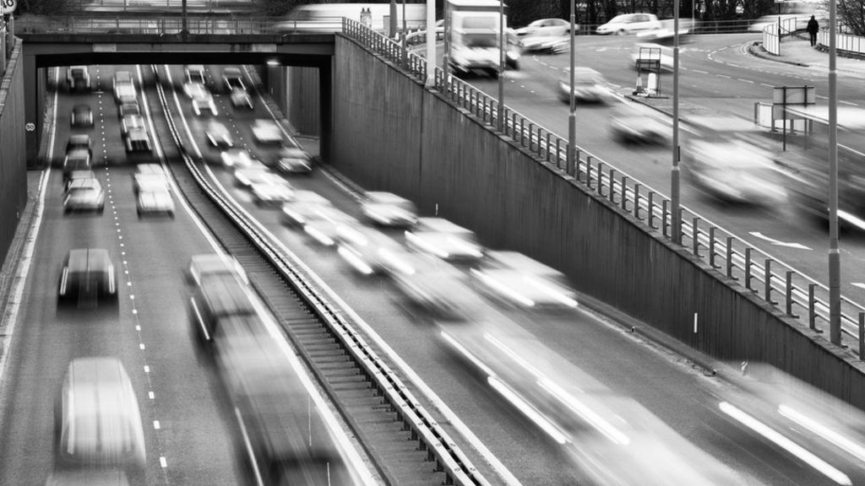
Medical Imaging of Skin lesion: Melanoma
GROUP 4
Lukas and Yasmin
(Martin and Thomas)

Slide 2
STRUCTURE OF PRESENTATION
Introduction: our focus
Data
Results
Discussion
Limitations
Conclusion and Future work
Notes:
SOFIE

Slide 3
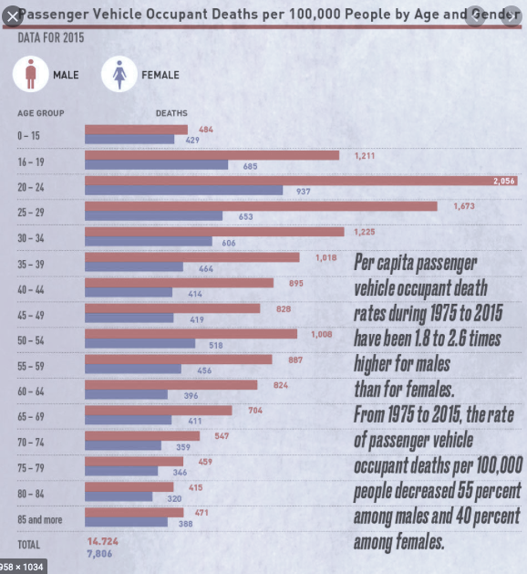
OUR FOCUS
Each day almost 10 are injured
Every 14 days 1 person is killed
City council report 2016
Gender: male
Age: 20-29
Highest proportion of casualties
Figure (A): Deaths by Age and Gender for 2015 in Birmingham. Picture taken from report made by Birmingham City Council ”A Road Safety Strategy for Birmingham”.
Notes:
SOFIE Find en graf vi selv har lavet: og byt den ud med den her? eller find et billed af et random sammenstød
birmingham car collisions male stats

Slide 4
RESEARCH QUESTION
“How is the relationship between feature characteristics
and skin lesions, and can these features be used to
distinguish between types of skin lesions?”
Notes:
SOFIE

Slide 5
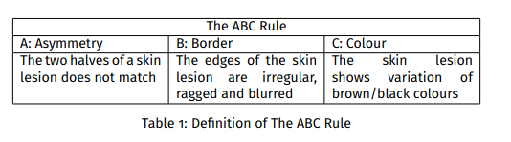
DATA SET FOR THIS STUDY
Data sets:
1) Example Images, 2) Example Segmentation, 3) Example Ground Truth, and 4) Features from ISIC 2017 Challenge.
Skin Lesion Analysis: THE ABC RULE
Notes:
SOFIE

Slide 6
Data Pre-processing
- Checking for missing values
- Manually data exploration
→ Purpose: Planning appropriate pre-processing steps and goal
of project
- Cropping images
- Image rotation by 10 degrees
- Finding center coordinates

Slide 7
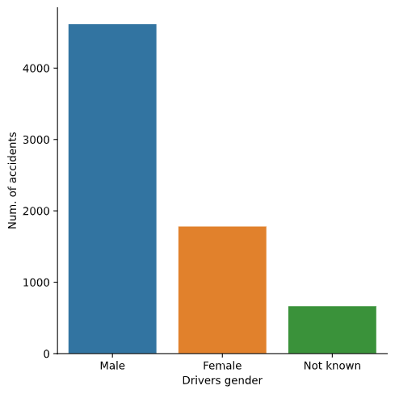
RESULTS FOR BIRMINGHAM 2019 Sex of Driver
Sex of Driver
Male drivers involved in more accidents
Figure 1. Box plot of Sex of Driver and Number of Accidents in Birmingham in 2019
Notes:
ADA

Slide 8
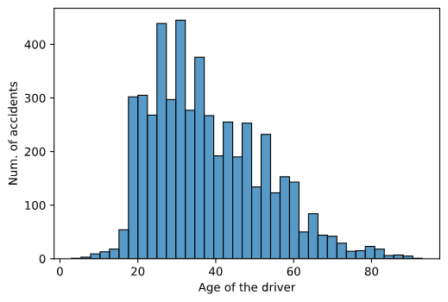
RESULTS FOR BIRMINGHAM 2019 Age of Driver
Age of Driver
Male drivers below 40 years old are involved in more accidents
Figure 2. Histogram of Age of Driver and Number of Accidents in Birmingham in 2019
Notes:
ADA

Slide 9
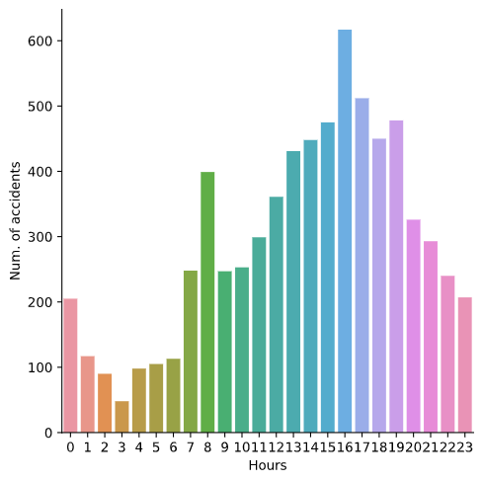
RESULTS FOR BIRMINGHAM 2019 Time of Accident
Time of Accident
Number of accidents increase at 8:00 and 16:00
Journey purpose: work
Figure 3. Histogram of Time in hours and Number of Accidents in Birmingham in 2019.
Notes:
ADA

Slide 10
RESULTS FOR BIRMINGHAM 2019
The Null Hypothesis
H₀
There is NO statistically significant relationship between the Age of Driver and Accident Severity in Birmingham 2019
Method: Pearson’s chi-test of Independence
Significance level
Association test 1 The Age of Driver and Accident Severity
The Alternative Hypothesis
H₁
There IS a statistically significant relationship between the Age of Driver and Accident Severity in Birmingham 2019
Notes:
ADA

Slide 11
ASSOCIATION TEST 1 The Age of Driver and Accident Severity
Expected values
p-value
Freedom of degrees
chi-squared value
Expected values interpretation
p-value is higher than significance level
The Null Hypothesis H₀ is true. Thus, Alternative Hypothesis H₁ is rejected
There is NO statistically significant relationship between the Age of Driver and Accidents Severity in Birmingham 2019
Notes:
ADA

Slide 12
RESULTS FOR BIRMINGHAM 2019
The Null Hypothesis
H₀
There is NO statistically significant relationship between the Sex of Driver and Accident Severity in Birmingham 2019
Method: Pearson’s chi-test of Independence
Significance level
Association test 2 The Sex of Driver and Accident Severity
The Alternative Hypothesis
H₁
There IS a statistically significant relationship between the Sex of Driver and Accident Severity in Birmingham 2019
Notes:
YASMIN

Slide 13
ASSOCIATION TEST 2 The Sex of Driver and Accident Severity
Expected values
p-value
Freedom of degrees
chi-squared value
Expected values interpretation
p-value is lower than significance level
The Null Hypothesis H₀ is rejected
There IS statistically significant relationship between the Sex of Driver and Accidents Severity in Birmingham 2019
Notes:
YASMIN

Slide 14
CORRELATION STRENGTH: CRAMER’S V Sex and Accident Severity in Birmingham 2019
Pearson’s test of Independence
p-value shows a correlation between Sex of Driver and Accident Severity
Cramer’s v
The correlation between Sex of Driver and Accident Severity is not strong
Notes:
YASMIN

Slide 15
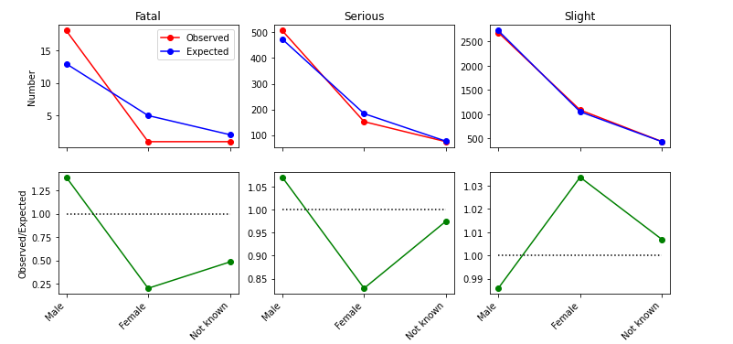
DATA VISUALIZATION Sex and Accident Severity in Birmingham 2019
SEX OF DRIVER AND ACCIDENT SEVERITY FOR BIRMINGHAM 2019
Male drivers are more involved
in fatal accidents compared to
female drivers
Figure 4. chi-squared of Sex of Driver and Accident Severity in Birmingham in 2019.
Notes:
YASMIN

Slide 16
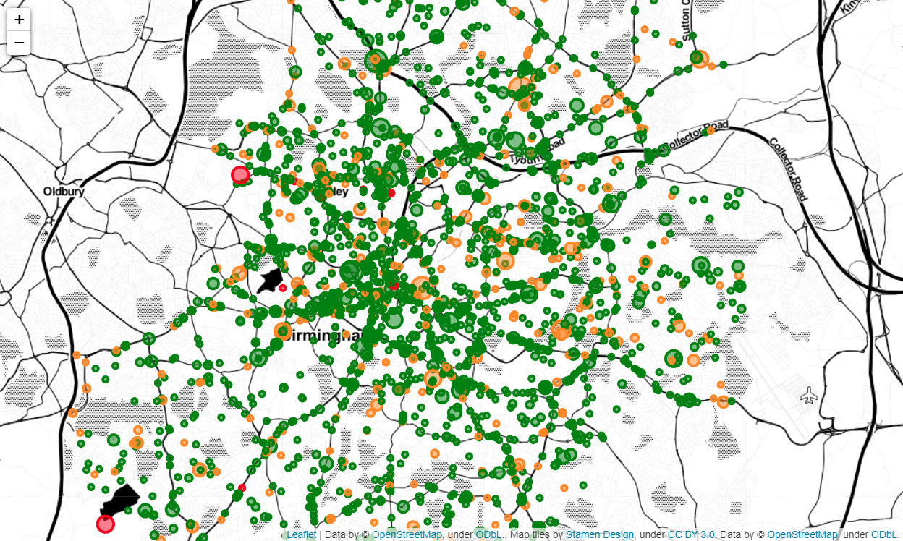
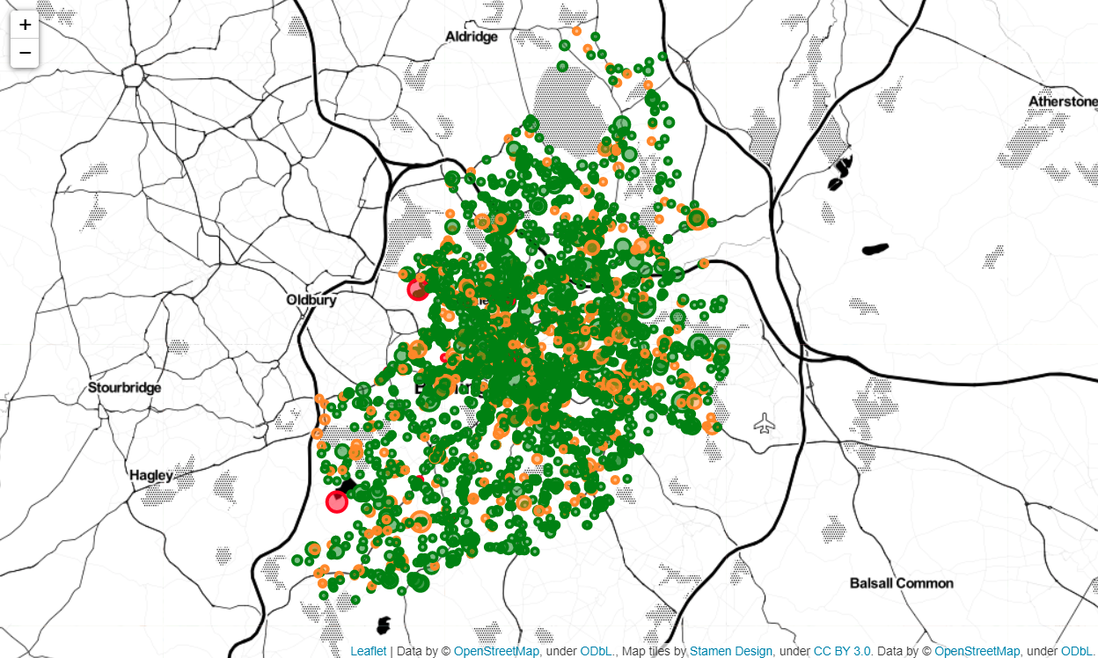
SLIGHT (GREEN), SERIOUS (ORANGE) AND FATAL (RED)
THREE TYPES OF ACCIDENT SEVERITY
MAP VISUALIZATION OF BIRMINGHAM 2019 Casualties and Accident Severity
Map illustrates
Accident Severity: by colour
Number of Casualties: by size
Notes:
SOFIE

Slide 17
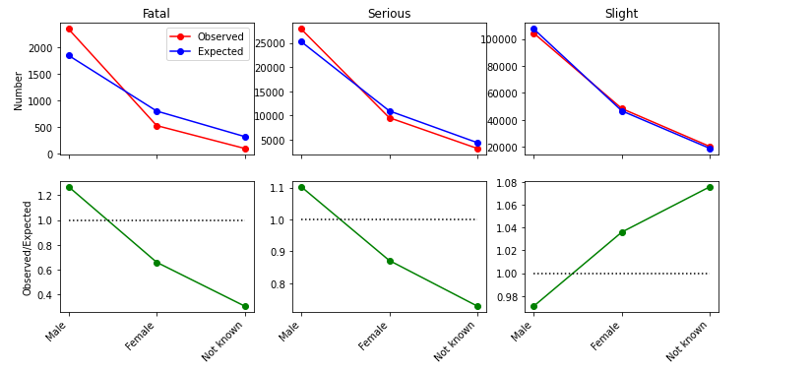
ASSOCIATION TEST 3 United Kingdom 2019
Result of Sex of Driver
Association between Sex of Driver and Accident Severity
SEX OF DRIVER AND ACCIDENT SEVERITY FOR UK 2019
Result of Age of Driver
Association between Age of Driver and Accident Severity
Figure 5: chi-squared of association between Sex of Driver and Accident Severity for UK 2019
Notes:
SOFIE

Slide 18
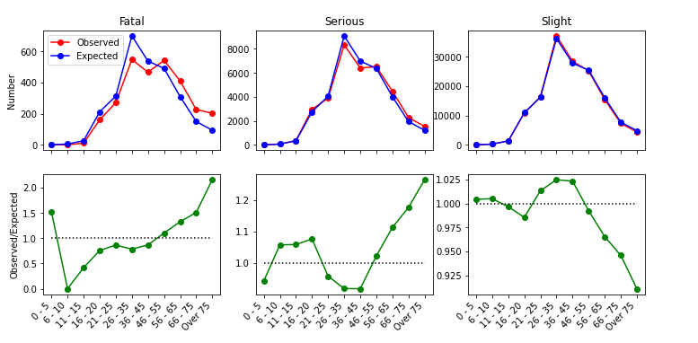
COMPARISON OF ASSOCIATION-TESTS Birmingham vs United Kingdom in 2019
AGE OF DRIVER AND ACCIDENT SEVERITY FOR UK 2019
Association between Sex and Accident
Severity
Birmingham
United Kingdom
Association between Age and Accident Severity United Kingdom
Factors to consider Missing values
Birmingham Road Safety Strategy 2016
Figure 6: chi-squared of association between Age of Driver and Accident Severity for UK 2019
Notes:
SOFIE

Slide 19
DISCUSSION
Findings show: Association between Sex of Driver and Accident Severity in Birmingham 2019
Question: Are male drivers more accident-prone?
Rate vs. exposure: more male drivers compared to female drivers daily?
STATS19 form: external data insurance company
Are male drivers more risk-taking than female drivers?
Poor safety precautions?
Driving under influence?
Notes:
ADA

Slide 20
LIMITATIONS OF OUR DATA SET
Data Collection Procedure
The quality of the measurements and data collections → STATS19 reporting form
STATS19 Reporting Form and Data Quality
Completed either:
by police offer at scene or,
keyed in by office staff
Data collection practices varies:
police forces
districts
Insufficient to rely solely on STATS19 data
Figure 6: A cut-out from the first page “Accident” of the MG NSRF form used for collecting STATS19 data by police force in Great Britain.
Notes:
YASMIN

Slide 21
CONCLUDING REMARKS Road Safety Analysis of Birmingham 2019
Research Question
“How does gender and age correlate to accident and casualty frequency and severity in Birmingham 2019”
Focus group of study
Male drivers
Summary of findings
Association between focus group and Accident Severity
No association between focus group’s age and Accident Severity
Road Safety Strategy by Birmingham City Council in 2016
No association between other factors: Weather Conditions and Road Types

Slide 22
PROPOSAL FOR FUTURE WORK IN BIRMINGHAM
Research
Further demographical research of our focus group:
Why is our focus group more prone to road accidents?
Is there a correlation between this group and social-geo-economic factors?
Cost-efficient approaches to reduce road collisions
Nudge Theory* and road nudges for improving driving performance
Implement Social Media to promote road safety campaigns
* Nudge Theory. Thaler and Sunstein (2008): “Nudge: Improving Decisions About Health, Wealth, and Happiness”

Slide 23
Missing values
Choice of Accident Severity for Association Tests
Future works
Other Association Tests
Weather Conditions
STATS19 form: Insurance Company Data
Nudges
IDEAS FOR FURTHER DISCUSSION

Slide 24
REFERENCES
Birmingham City Council. (2016, October). A Road Safety Strategy for Birmingham (No.2016). RoSPA. [online].
Statistics: Transport Statistics Great Britain. (2016, December 17). Transport Statistics Great Britain: 2019, GOV. UK. [online].
INSEAD: The Business School for the World. (2019). Nudging Drivers to Safety: Evidence from a Field Experiment. Working Paper, 2019/52/TOM. [online].
Clarke, D., Ward, P., Bartle, G., Truman, W. (2006, September). Young driver accidentsin the UK: The influence of age, experience, and time of day. Accident Analysis and Prevention Volume 38, Issue 5, September 2006, Pages 871-878. [online].

Slide 25
FORMULA
CRAMER’S V
chi-squared value: X²
N: sample size
K: Number of column
0: no association
less than .2: weak relationship
greater than .3: strong relationship
1: complete association
P-VALUE
p-value will be the probability under the null hypothesis of getting the observed values from test-statistic or something larger (the area to the right tail of the observed test-satistic)
PEARSON’S CHI-SQUARED VALUES OF INDEPENDENCE
Observed values: O
Expected values: E
1 indicates a strong positive relationship.
1 indicates a strong negative relationship.
A result of zero indicates no relationship at all.

