Slide 1

General Services Administration (GSA)
Office of the Chief Financial Officer (OCFO)
Transition to Updated Financial Code
Maintenance Process
December 16, 2009

Slide 2
Table of Contents
Roles and Responsibilities
New Mailbox and Access Rights
New Form
Draft 11/07/26

Slide 3
The Service or Staff Office (SSO) identifies the need to add, change, or deactivate a financial code – SSO Financial Code Requestor
Responsibilities:
  References Financial Management Codes Handbook to understand current set of codes available and associated definitions and usage
  Completes the Financial Code Change Form with the associated templates, rollups, and relationship edits
  Submits only requests to add, modify, deactive, or “Prevent New Use” of financial codes to SSO Service-wide Coordinator and provides an information copy (cc:) to SSO Financial Code Requestor’s respective budget office Point of Contact (POC)
  Other requests should go to one of the following:
    Code Implementation (CodeImplementation@gsa.gov): New or changes to accounting, E2 and credit card templates and relationship edits, for existing codes
    Pegasys Security (Pegasys.Security@gsa.gov): New Pegasys user IDs, new or changes to roles, approvals, security orgs; changes to credit card reconcilers
    KC-Vendor Number Requests (KC-Vendor.Number.Requests@gsa.gov): New vendor requests, reactivation, changes for employees, FAS or Service Offices
    FW-Vendor Help (FW-Vendor.Help@gsa.gov): New vendor requests, reactivation, changes for PBS vendors
    Yolanda Reynolds (Yolanda.Reynolds@gsa.gov): New cardholder applications; changes to approving officials
    Antoinette M. Lyons (Antoinette.Lyons@gsa.gov): FedEx accounts and new or changes to FedEx templates

Slide 4
The SSO Service-wide Coordinator reviews and submits the form to Office of Budget (BB) – SSO Service-wide Coordinator
Responsibilities:
  Reviews the form to ensure that it has been properly completed with the associated templates, rollups, and relationship edits
  Provides status updates to SSO Financial Code Requestor regarding the review process
  Ensures only requests for adding, changing, deactivating, or “Prevent New Use” of a financial code element is sent to Office of Budget (BB)
  Rejects any invalid request and provides explanation on the form
  Submits the form to BB for review via the Code.Request@gsa.gov mailbox, if approved

Slide 5
The Office of Budget (BB) performs initial review of code change requests – BB Financial Code Analyst
Responsibilities:
  Retrieves request from the SSO Service-wide Coordinator through the Code.Request@gsa.gov mailbox
  Analyzes the financial code element change request to determine if there is any impact to budget structure or funds control approach
  Reviews the financial code element change request to ensure its validity by referencing available sources (e.g., Financial Management Codes Handbook, FMIS tables)
  Rejects any invalid request and provides explanation on the Form; notifies SSO Service-wide Coordinator
  Assigns a code value and description for financial code element requests as appropriate
  Provides authorization for Office of Financial Policy and Operations (BC) via CodeProcessing@gsa.gov mailbox to review and approve financial code and provides an information copy (cc:) to SSO Service-wide Coordinator, if it is either a Fund, Budget Activity, Object Class, Cost Element, Function, or Business Event Type Code (BETC). Or provides authorization for Office of Financial Management Systems (BD) via CodeImplementation@gsa.gov mailbox to implement the financial code change in the system and provides an information copy (cc:) to BC and SSO Service-wide Coordinator, if the financial code is either a Organization, Building Number, Work Item, Vehicle Tag Number, or Activity Based Costing
  Prepares, maintains, and updates the Financial Management Codes Handbook to guide SSOs in standard definitions and proper usage of code elements

Slide 6
The Office of Financial Policy and Operations (BC) analyzes impact of the request on financial reporting and posting – BC Financial Code Team Member
Responsibilities:
  Reviews emails sent from BB through the CodeProcessing@gsa.gov mailbox, if the account code is either a Fund, Budget Activity, Object Class, Cost Element, Function, or BETC
  Conducts analysis of the financial code element to determine if the request has a GSA-wide and/or posting model impact
  Completes the posting model impact analysis and provides the results to the BC Financial Code Approval Team for review and approval
  Assigns a code value and description for financial code element requests as appropriate
  Provides authorization for BD to implement the financial code change and submits the Form to the CodeImplementation@gsa.gov mailbox

Slide 7
Some requests will be forwarded to the BC Financial Code Approval Team for further analysis
Responsibilities:
  Receives notification from Financial Code Team Member within BC requesting that the Financial Code Approval Team review posting model impact
  Communicates with the Financial Code Team Member to obtain further clarification
  Rejects any invalid request and provides explanation on the Form
  Provides authorization for BD to implement the financial code change in the system, submits the Form to the CodeImplementation@gsa.gov mailbox

Slide 8
The Office of Financial Management Systems (BD) continues to be responsible for implementation - BD Financial Code Implementation Analyst
Responsibilities:
  Retrieves notification from either from BB or BC through the CodeImplementation@gsa.gov mailbox
  Determines the type of request, such as to add, modify, deactivate, or “Prevent New Use”
  Implements the financial code change in the system
  Communicates with BB Financial Code Analyst and/or SSO Service-wide Coordinator for any financial code elements rejected by the system or to obtain further clarification
  Updates the accounting reference tables including any rollups and relationship edits
  Updates Accounting and E2 templates and FedCodes
  Approves (signs) the form after completing the implementation process
  Provides notification to BB Financial Code Analyst, SSO Service-wide Coordinator and BC Financial Team Member upon completing the implementation process

Slide 9
Table of Contents
Roles and Responsibilities
New Mailbox and Access Rights
New Form
Draft 11/07/26

Slide 10
The table below summarizes the new mailbox identifiers and corresponding access privileges
Mailbox Name | GSA Staff Member | E-mail Address | Access Level
Code.Request@gsa.gov | Katrina Kennedy | Katrina.kennedy@gsa.gov | Read/Write*
 | Sara Twyman | Sara.twyman@gsa.gov | Read/Write
 | Ellen Pierzchala | Ellen.Pierzchala@gsa.gov | Read/Write
CodeProcessing@gsa.gov | Jane Pritchett | Jane.pritchett@gsa.gov | Read/Write
 | Theresa Lewis | Theresaa.lewis@gsa.gov | Read/Write
CodeImplementation@gsa.gov | Joyce Deanell | Joyce.deanell@gsa.gov | Read/Write
 | Reginald Hardman | Reginald.Hardman@gsa.gov | Read/Write
 | Shirley Heselton | Shirley.Heselton@gsa.gov | Read/Write
 | Judy Kelly | Judy.Kelly@gsa.gov | Read/Write
 | Le X. Lam | Le.lam@gsa.gov | Read/Write (E2 Coding)
 | Valerie McAdams | Valerie.mcadams@gsa.gov | Read/Write (E2 Coding)
*Read/Write provides users the ability to read e-mails, create new e-mails, or respond to existing e- mails.

Slide 11
The table below summarizes the SSO Service-wide Coordinators for each Services
Services | GSA Staff Member | E-mail Address*
PBS | Christi Holt, Stefanie Crane | Christi.Holt@gsa.gov; Stefanie.Crane@gsa.gov
FAS | Nurys Alvarado, Lee Walton | Nurys.Alvarado@gsa.gov; Lee.walton@gsa.gov
GM&A | Ellis Dyson, Nancy Hexmoor | Ellis.Dyson@gsa.gov; Nancy.Hexmoor@gsa.gov
OIG | Suzanne Melnick, Felicia Silver | Suzanne.Melnick@gsa.gov; Felicia.Silver@gsa.gov
External Services | TBD | TBD
*NOTE: This table was created as of 12/16/2009 and is subject to change

Slide 12
Table of Contents
Roles and Responsibilities
New Mailbox and Access Rights
New Form
Draft 11/07/26

Slide 13
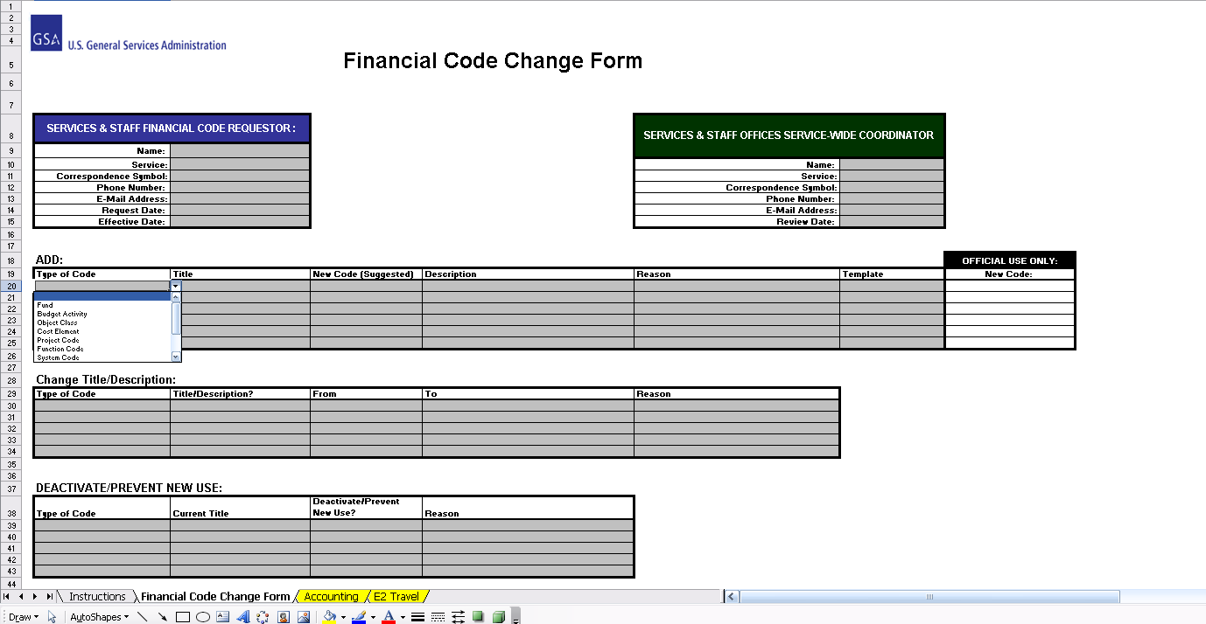
A screenshot of the new Financial Code Change Form is provided below
Drop-Down Menu
Templates

