Slide 1
Direct Pay

Slide 2

Direct Payments
A Direct Pay (Certified Invoice) in Pegasys is typically used to pay oral procurements.
Allows transaction to be processed and paid without a corresponding receipt or order.
Notes:
Go to vendor and get goods and invoice
Come back and enter invoice into Pegasys using Direct Pay
Needs 3 approvals, once all three are approved it is sent to Treasury
Vendor can be paid in 3-5 days depending on if they have EFT
There are 2 cycles going to Treasury each day

Slide 3
Direct Pay DocTypes
D6 – Direct Pay, Region 6
D7 – Direct Pay, Region 7
DC – Direct Pay, Region 6, > $3,000
DF – Direct Pay, Region 7, > $3,000
Notes:
D6/D7 are under $3,000
Not prompt pay so do not have to wait 30 days before paying

Slide 4


Direct Pay Model – One Way
Payment
Authorization
Invoice
Notes:
Shows 1-way
2-way has order and invoice
3-way has order, receipt and invoice

Slide 5
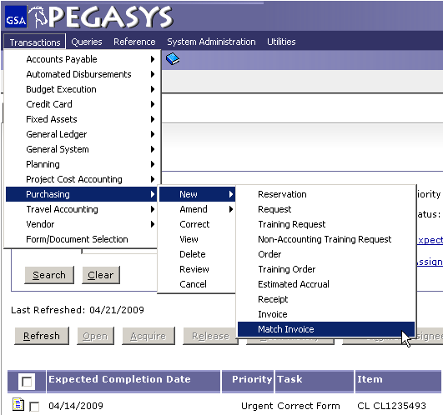
Creating Direct Pay
Click:
-Transactions
-Purchasing
-New
-Match Invoice

Slide 6
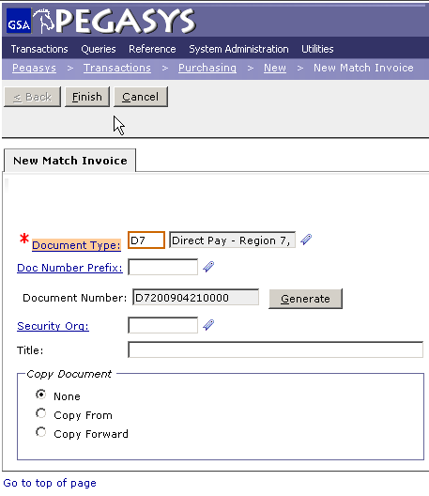
Direct Pay
Enter:
  Document Type, D6 or D7
Click:
  Document Number Field then select Generate
Click :
  Finish in the upper left hand corner
Notes:
Put Doc number on invoice and the email you were sent telling you to order the goods

Slide 7
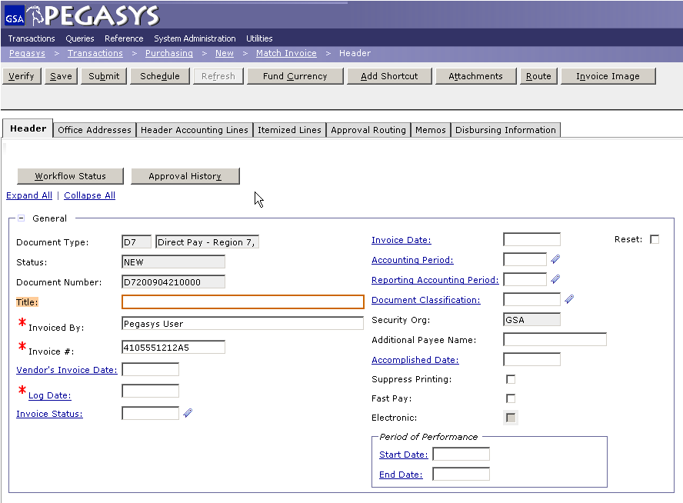
Direct Pay- Header Tab
Enter Invoiced By and Invoice #
Original Invoice must be retained for 7 years for audit purposes
Notes:
Title is optional but helps you search for it later; will be displayed if you search for all your D6 doc types
Invoiced By is whoever the goods are going to
*Invoice number is on the invoice from the vendor

Slide 8
Invoice Number- Header Tab
Creating an invoice number for Direct Pay telephone bills
Invoice Number for
Telephone Bills
(ex. 4105551212A5)
10 digit telephone number: 410-555-1212
1 digit month code:
Oct A Jan D Apr G July J
Nov B Feb E May H Aug K
Dec C Mar F June I Sept L
1 digit for the last digit of FY: 2005 = 5
Notes:
Most phone bills don’t have an invoice number

Slide 9
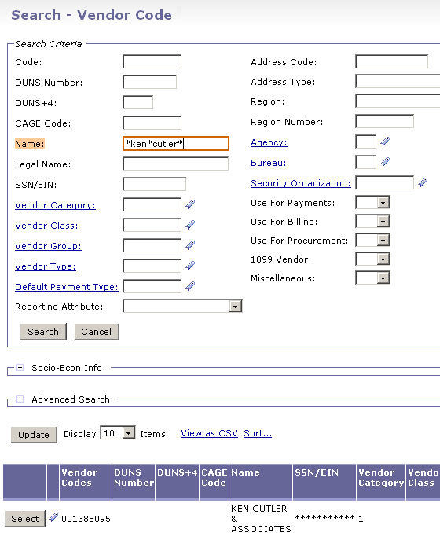
Vendor Search - Details
Enter in search criteria and click the Search button.
Find the correct vendor in the results and click Select.
The * is a wild card for searching
Notes:
More vendors are starting to put their DUNS number in under their name
Use Advanced Search to narrow results for large companies such as AT&T

Slide 10
Vendors- Requesting New Vendor
Vendor requests can be sent to GSA via the following e-mail address:
New: https://finance2.gsa.gov/newvendor/
Change: KC- Vendor Number Requests
FW- Pegasys-XX-Vendor-Request Finance
    (Note: XX = Region. Example: CO, 01 – 11)
Information to be included when requesting a vendor:
  Vendor name
  Vendor’s complete address
  Vendor’s taxpayer identification number (TIN)
  Vendor contact name and telephone number, if available
  Vendor banking information for Electronic Funds Transfer (EFT)
    Routing number (American Bankers Association (ABA) number)
    Type of account
    Account number
PBS & FTS: use FW address
All others: use KC address
Do not include any Personally Identifiable Information unless it is encrypted
Notes:
First is for a new vendor not in the system
Second is to change a vendor
Encrypt if includes PII

Slide 11
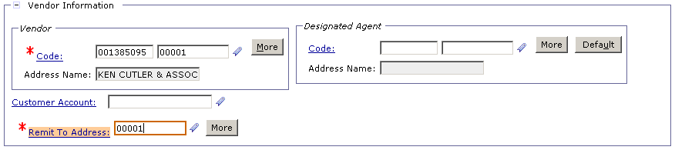
Header - Remit To Address
Copy the address code from the Vendor section into the Remit to Address section.

Slide 12
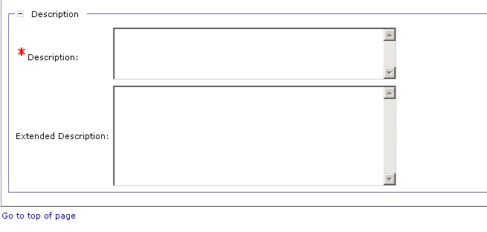
Description- Header Tab
Add description to Header and Header Accounting Line
  Tip – Save Often – after completing each tab or before stepping away from your desk you should SAVE your form.
Notes:
Copy this description so you can use it again later for the description on the Header Accounting page
You can use Ctrl C
SAVE

Slide 13
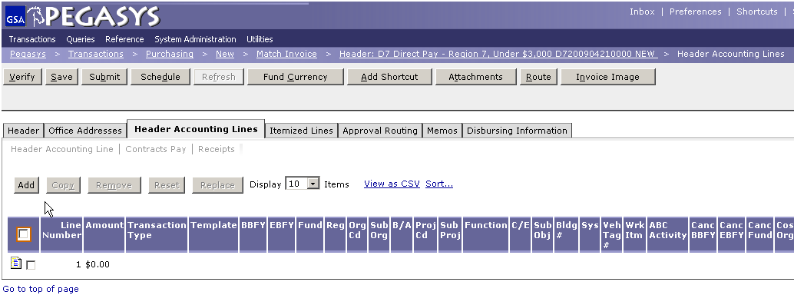
Header Accounting Lines –
Add New Line
  Tip – Preferences > Document Defaults – set a default vendor, accounting template, and currency based on document type

Slide 14
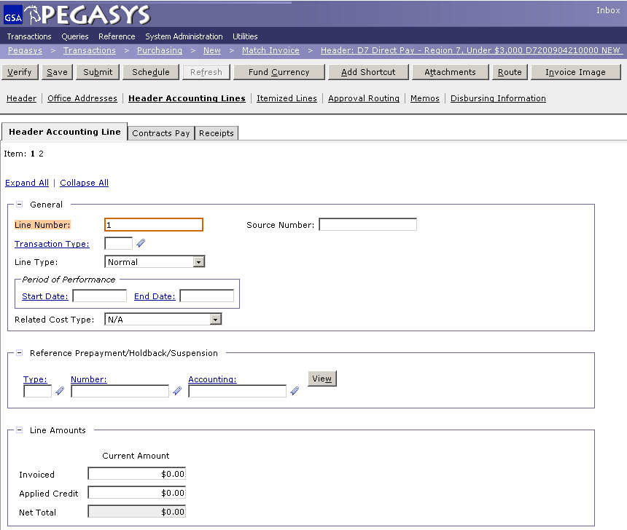
Header Accounting Line
Amount
Add the dollar amount

Slide 15
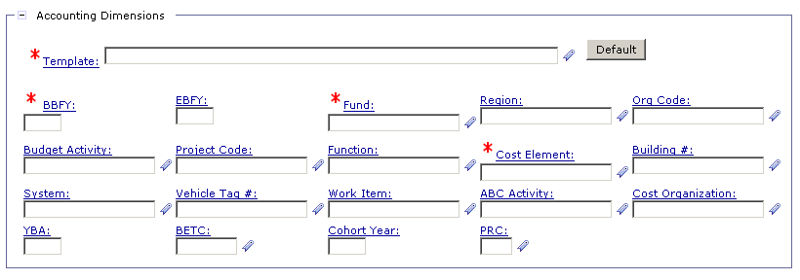
Accounting Template
  Tip – Favorites ( ) – Use the Favorites icon to save and select frequently used reference data.
Notes:
Your accounting string should be provided to you by whoever asked you to order the goods/services
Agreement Number is your RWA number without the alpha
Agreement Line Number: put a 1 everytime

Slide 16
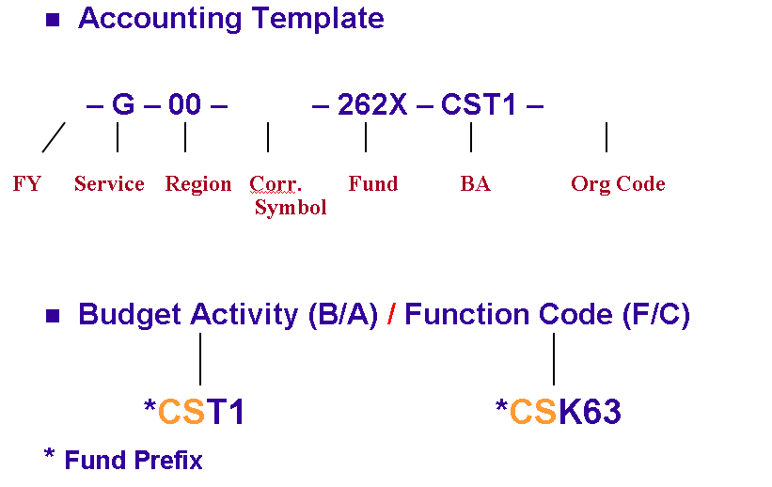
Accounting Lines Page
08
BD
S00B0410
Notes:
The order of these is different, that is why it is good to use asterisk.
PBS puts the CST1 number at the end
Same as in NEAR but with an added prefix

Slide 17
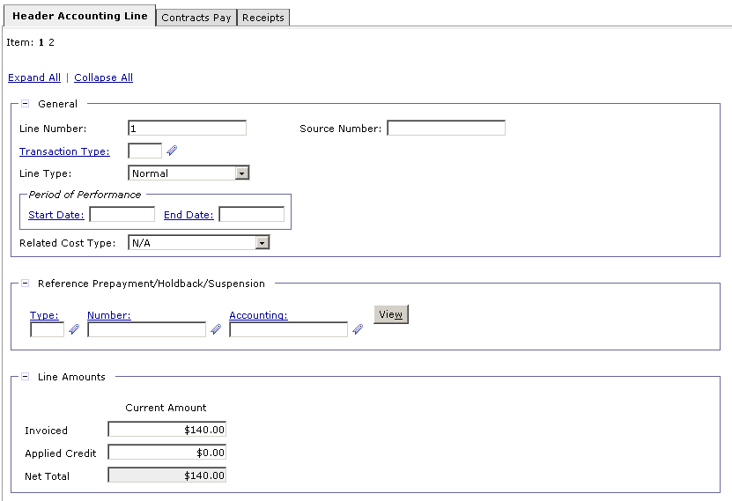
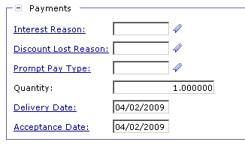
Header Accounting Line- Payment Information
Delivery and Acceptance Date
Scroll down to Payment box.

Slide 18
Header Accounting Line- Payment Information
Enter Description
Notes:
You can hit Ctrl V to paste the description from the Header

Slide 19
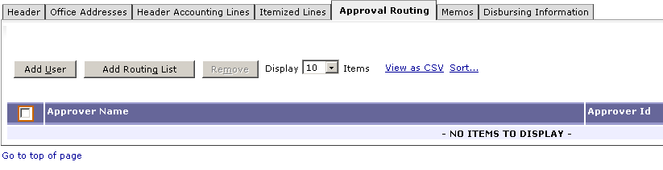
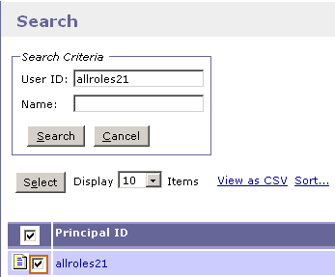
Approval Routing
Adding approvals
Add individual Approvers or Routing List
Notes:
When you create a Routing List for a certain Doc Type then every time you create that doc type and choose the Routing List the document will be sent to the people on the Routing List to be approved

Slide 20
Standard Workflow
All Direct Payment forms require a minimum of three approvals:
  Direct Pay Approver
  Accounting Classification
  Funds Authorization
Notes:
3 Levels that need to be approved
Direct Pay approver says “Yes”
Accounting Classification says “its correct”
Funds Authorization says “funds are available”
Person can have rights to be approval 2x but not 3

Slide 21
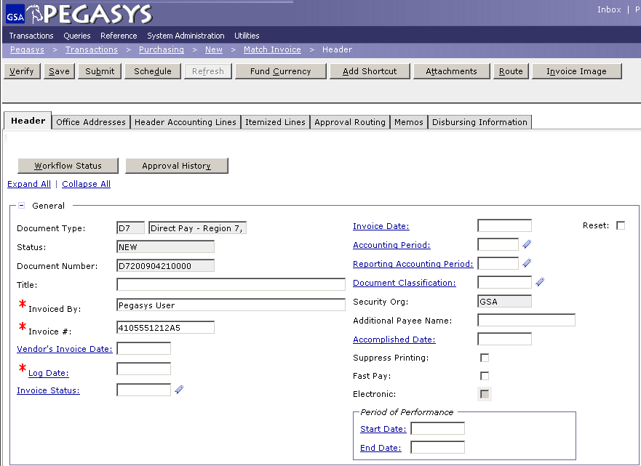
Save, Verify, Submit
To Finish the Direct Pay:
Save the Form
Verify and correct any errors
Submit the document for approvals and processing
Notes:
When you try to Verify it with errors, red X’s will pop up and tell you what you did wrong. It will not let you submit it.
In April you will be able to click on the X and it will take you to your error and put a red box around it.
If it is a budget error it will not take you to it because it cannot give you more money.

Slide 22

Goals of Information Security
Confidentiality
  Data must be protected against unauthorized disclosure
Integrity
  Systems must not permit processes or data to be changed without authorization
Availability
  Systems must be functional and changes must be authorized
Confidentiality
Integrity
Availability

Slide 23
Why is Information Security Important?
Must be in compliance with regulatory requirements such as OMB Circular A-130, Computer Security Act, FISMA and internal GSA policy
Protects GSA information resources from potential abuse and misuse
Follows sounds business practices

Slide 24
User Responsibility
Response for adherence to GSA information security policy
Protect Pegasys login ID and password
  Do not allow others to use your login ID / password
  Do not write it down
Log out whenever you are not using Pegasys
Protect sensitive information
  Shred reports containing sensitive information
Report security incidents

Slide 25

Keys to Incident Prevention
Awareness - be aware of the value of the assets you are using to do your job and the nature of associated threats and vulnerabilities
Compliance - comply with established safeguards, policies, and processes
Common Sense - if something appears to be off, it generally is

Slide 26
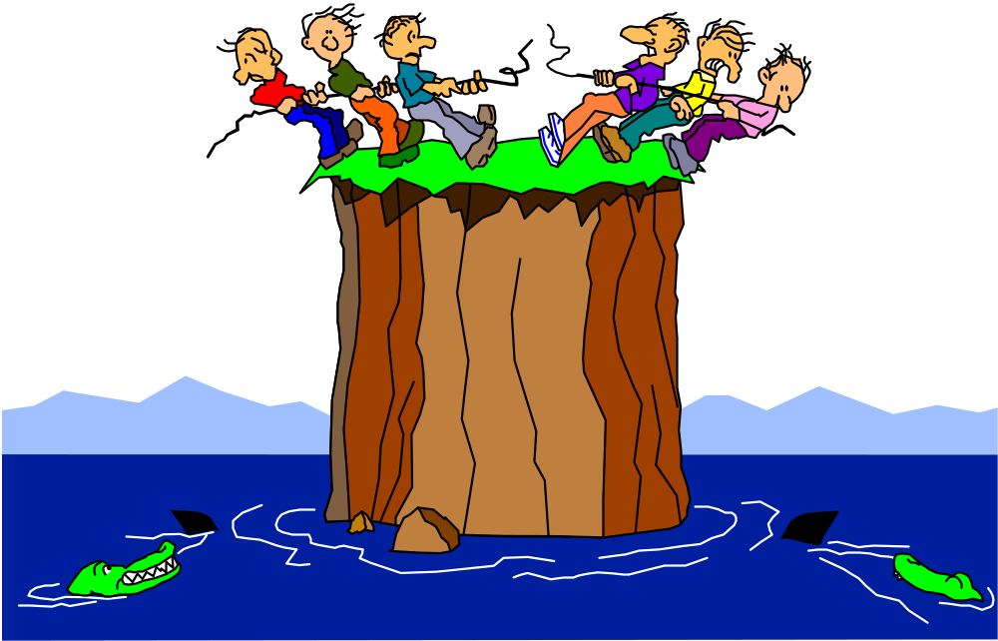
Remember ...
Security is a PEOPLE issue,
not a TECHNICAL one!

