Slide 1

Purchase Card

Slide 2
Purchase Card Objectives
Guidance and Proper Use
Creating Card Logs
Convenience Checks
Review Pegasys Features
Reconciliation
Review Purchase Card Reports
Discuss Goals of Information Security
Notes:
-Purchase Card Capabilities
-Purchase Card Training Log (CT): allows you to go back to see all of the training classes for an employee
-The “Copy From” feature is a great tool that saves you time.
-Purchase Card Report: Can be used to review if you get a log in and it doesn’t match up.

Slide 3
Purchase Card Guidance and Use
In accordance with CFO 4200.1A,
d. Cardholders.
(5) Obtain prior written authorization from the authorizing official for all purchases;
(7) Ensure the independent receipt and acceptance of goods and services is documented for all
purchases over $75;
(8) Obtain written verification of receipt for all supplies or services not delivered and accepted
directly by the cardholder
For more information visit:
http://insite.gsa.gov/wps/portal/gsa_insite/purchasing_and_payments/gsa_purchase_card/

Slide 4
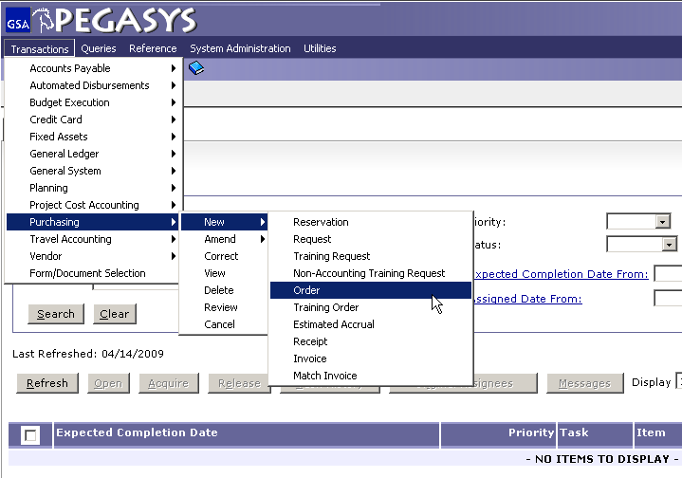
Create a Purchase Card Log
Choose:
  -Transaction
  -Purchasing
  -New
  -Order
Notes:
**First show Pegasys home page. Then show the Quick Reference cards.**
-Access to Create a Purchase Card Log Document
-Also under training is a playground to practice CL and CT’s. The training environment will perform error messages.

Slide 5
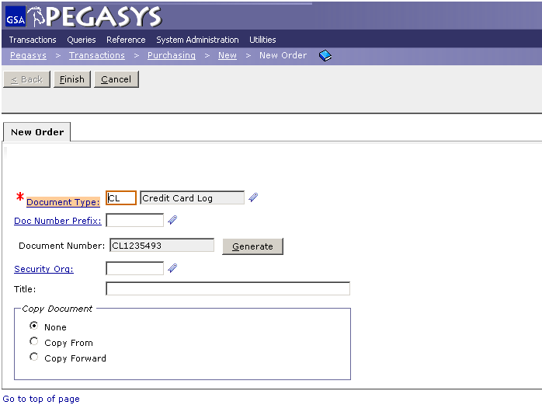
Purchase Card
Enter CL as the Document Type then press the tab key.
Click the Generate button to create Document Number.
Click the Finish button.
Tip: Use this CL Document Number on all of your documents
Notes:
-Recommendation: Create the log as soon as you know the full cost.
-The Document Number changes for each purchase.
-Place this number on the email from your boss and the receipt

Slide 6
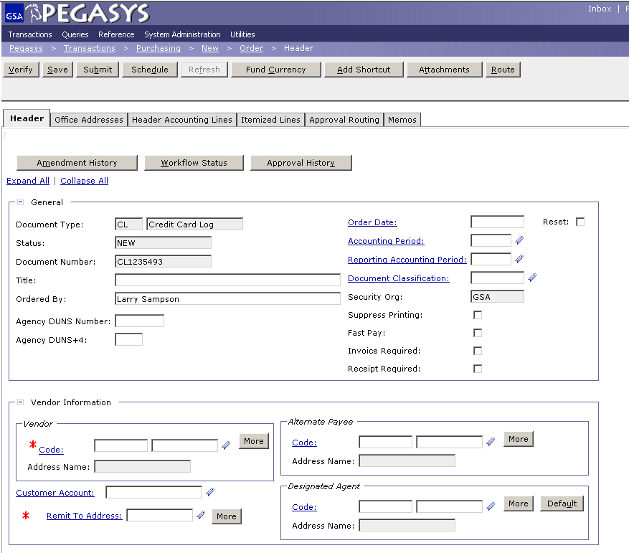
Header Tab
Enter a brief title in the Title field to help make searching later easier
Enter a name in the Ordered By box. (Optional)
Click the Code link to search for a vendor.
Notes:
**Go to flipchart. Make a list of fields to be filled out: 1. Header 2. Title (optional) 3. Order by (optional) 4. Vendor 5. Purchase Card Info 6. Description
-The ‘Ordered By’ field is to signify who requested the product. (Not necessarily the person filling out the CL.)
**Talk about the favorites tab here**
-The ‘Title’ field is a free form field that can be used to enter the name of the product.
-The Description entered in the box is what will appear on the transaction summary report. This will make it easier to reference what the CL is for.
-The Header Tab is straightforward and not difficult to complete.
-When you search for CL at the end of the year, the vendor code will help.

Slide 7
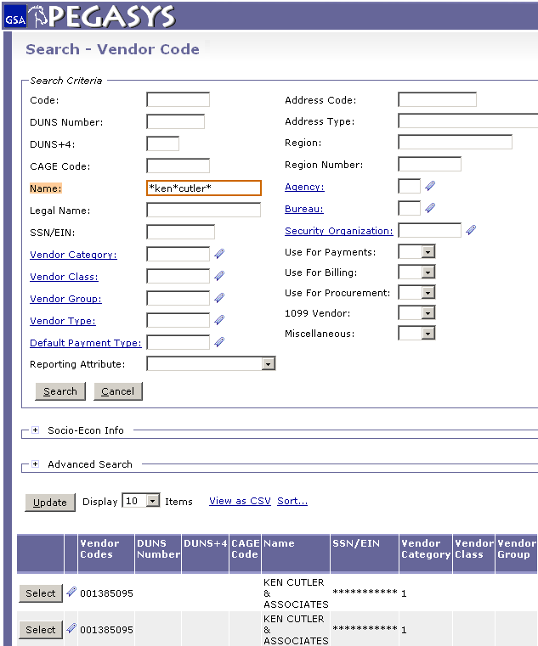
Header Tab - Vendor Search
Enter in search criteria and click the Search button.
Find the correct vendor in the results and click Select.
The * is a wild card for searching
Notes:
-Vendor Code: Rely on this heavily. You can search Pegasys by the name of the Vendor Code.
**Finding the correct vendor is only necessary for purchase cards because with purchase orders we have to pay them.
-Code is the TIN: Tax Identification Number…
Mention Advanced Search: Helps narrow down large vendors such as AT&T
For purchase card you do not have to have the exact address you purchased from, Citi pays the vendor, the CL is for our records

Slide 8
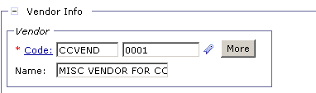
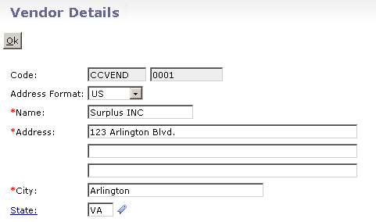
Header Tab - CCVEND
If you cannot find a vendor then enter CCVEND into the text box next to Code
Click the More button
Enter in address information and click Ok
Do NOT use CCVEND for
convenience checks, only use
with Purchase Cards.
Notes:
-Completed CCVEND Information
-The CCVEND code number is always 0001

Slide 9
Header Tab - Vendor Requests
If unable to locate vendor use a vendor request
Vendor requests can be sent to GSA via the following e-mail address:
New: https://finance2.gsa.gov/newvendor/
Change: KC- Vendor Number Requests
FW- Pegasys-XX-Vendor-Request Finance
    (Note: XX = Region. Example: CO, 01 – 11)
PBS & FTS: use FW address
All others: use KC address
Notes:
**Vendor requests will be responded to within 24 hours. Larry guarantees this. There is a small group of people in FW and KC that work on these requests. If you are not responded to, email Larry.**

Slide 10
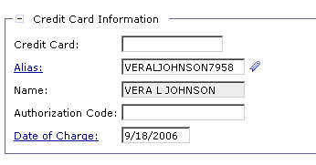
Header Tab - Purchase Card Information
Required: Enter the purchase card Alias. If you don’t know it, you can search for it by clicking the Alias hyperlink.
Required: Enter the Date of Charge; if left blank it will default to today’s date.
Optional: Enter the 6 digit Authorization Code.
Notes:
-If your name does not show up then your Alias is wrong.
-First four letters of your first name, middle initial, and last name.
-Authorization code: Assists with auto reconcile.
-Try to get the charge date as close to the date the vendor swipes your card as you can.
-If a charge is sitting out there for a long time (i.e. 2 months) you will get a CL that will not auto reconcile.
-Alias is 16 digits in which last 4 digits is last 4 of your purchase card
-Authorization is unique so if you had 2 training class with same cost and charged date it will use the Authorization Code to auto-reconcile.

Slide 11
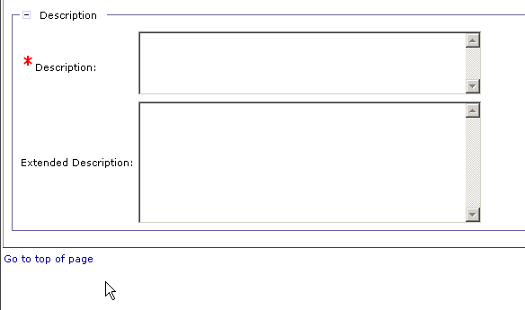
Header Tab - Description
Enter a Description.
  Tip – Save Often – after completing each tab or before stepping away from your desk you should SAVE your form.
Notes:
**Tip: copy the description with CTRL + C so you can paste it later to the accounting template
**Tell class to scroll to the top of the page to save often.

Slide 12
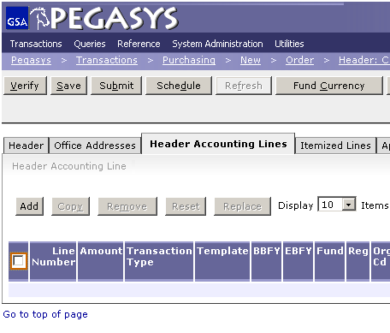
Header Accounting Lines Tab
To add an accounting line:
-Click on the Header Accounting Lines tab.
-Click on the Add button.
Notes:
**Go to the flipchart. Ask if anyone is in PBS. Write List: 1. Header Accounting Lines 2. Amount 3. Funding 4. Description (emphasize how little steps there really are)

Slide 13
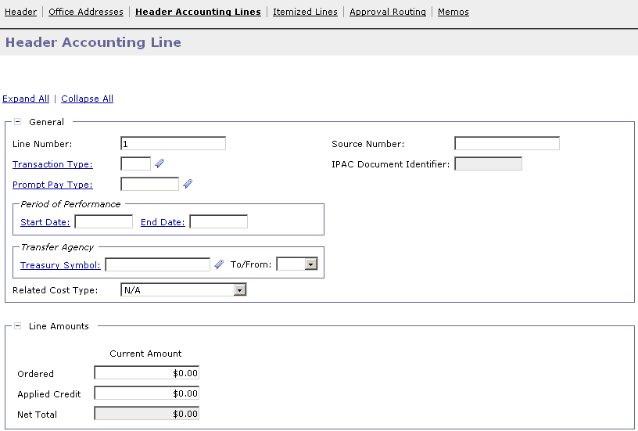
Header Accounting Lines Tab
Enter the amount of the transaction in the Line Amounts field.

Slide 14
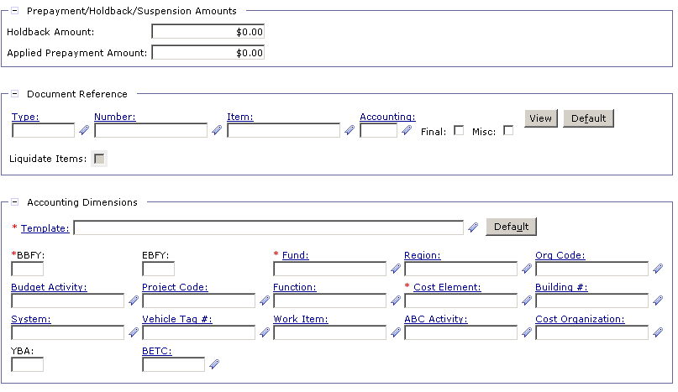
Header Accounting Lines Tab
Click the Template link to search for an accounting template
  Tip – Favorites ( ) – Use the Favorites icon to save and select frequently used reference data.
Notes:
Depending on your string different fields will be mandatory
Example: For fleet Vehicle Tag # has a red asterisk

Slide 15
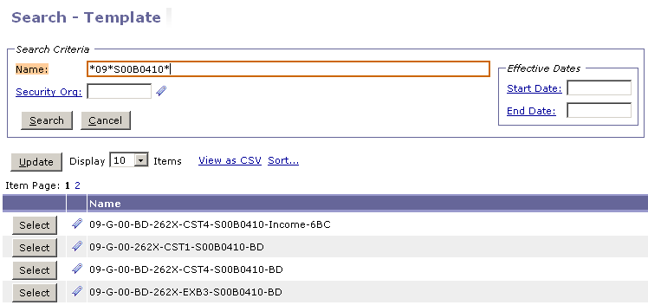
Header Accounting Lines Tab
Enter criteria separated by the wildcard (*)
Click Select next to the correct accounting template
Notes:
-If you click on the favorites icon and save it, you will not have to search for it in the future.
-emphasize the importance of using the wildcard (*) for searching.

Slide 16
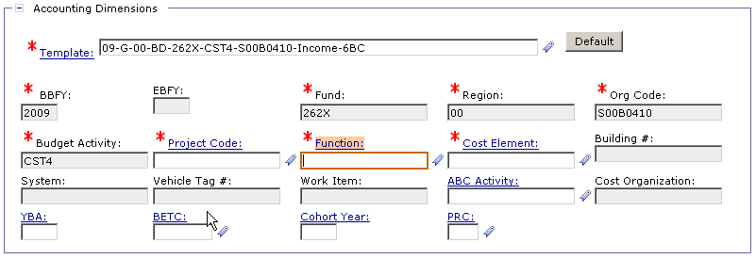
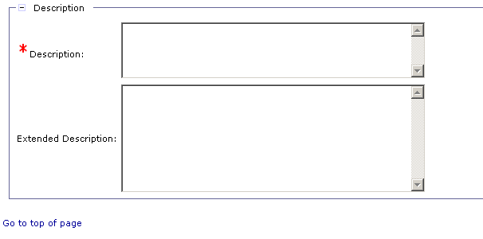
Header Accounting Lines Tab
Enter in a Cost Element, Function Code, Project Code, etc if needed.
Note: Your accounting classification may required other data elements such as bldg number, RWA, work item, etc.
Enter a Description.
  Tip – SAVE OFTEN – Saving often makes sure you will not have to re-key the information later
Notes:
**For ‘Cost Element’ the favorite link is broken. They are aware of this and they are working on it.
**There are two descriptions because the one on the header page is for the transaction summary. Also, if you have multiple lines you can enter descriptions for each.
-Note to have the class scroll to the top to save often.

Slide 17
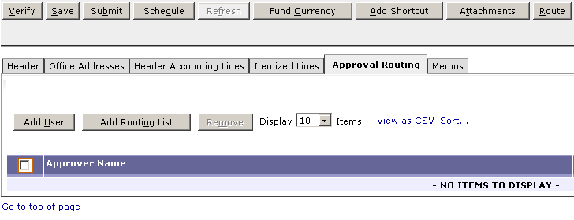
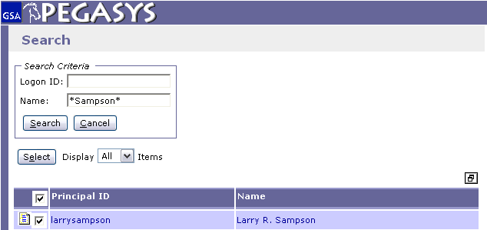
Approval Routing Tab
The * is a wild card for searching
Most CL/CTs are approved by CC Holder.

Slide 18
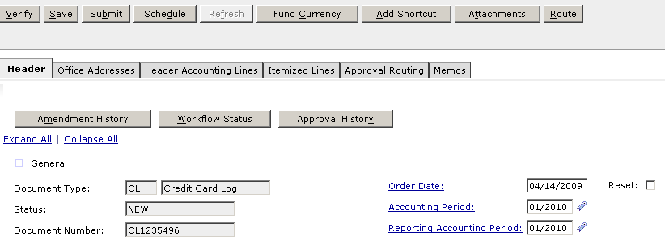
Approval Routing Tab
  To finish the Purchase Card Log:
  - Save the form
  - Verify and correct any errors
  - Submit the document for approvals and processing
Notes:
**92% of GSA will approve there own CL/CT.
-Type in the name of the person who approves the dock.
-When you click verify it matches against codes in Pegasys.
**In February you can click on and error if you receive one and it will take you directly to it.**
3 Symbols could come up when you hit verify:
Red X is the show stopper
I just means information
! Is the status

Slide 19
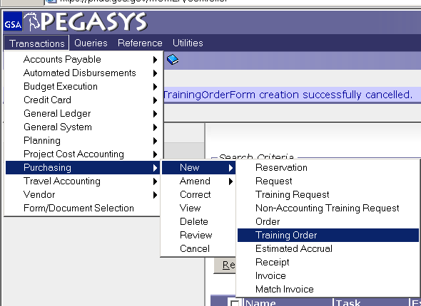
Creating a Purchase Card Training Log
Choose:
  - Transactions
  - Purchasing
  - New
  - Training Order
Notes:
-Exactly like Purchase Card log except now we go to ‘Training Order’ instead of just ‘Order.’
-CL goes to 300
-CT goes to 3076
Tabs For CT
Header
Header Accounting Line
Employees
Course Info

Slide 20
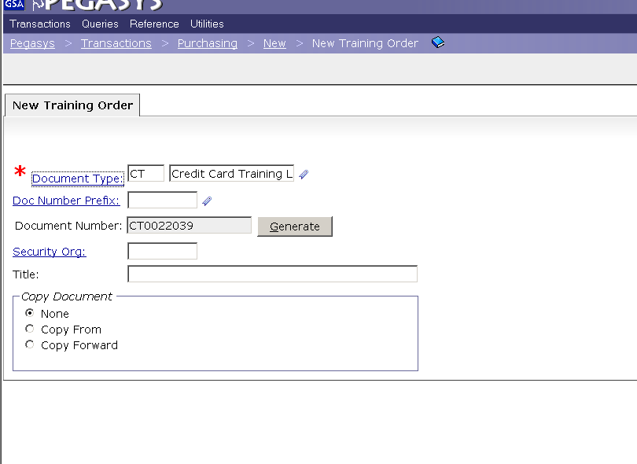
Creating a Purchase Card Training Log
Enter CT (purchase card training) as the Document Type then press the tab key.
Click the Generate button.
Click the Finish button.

Slide 21
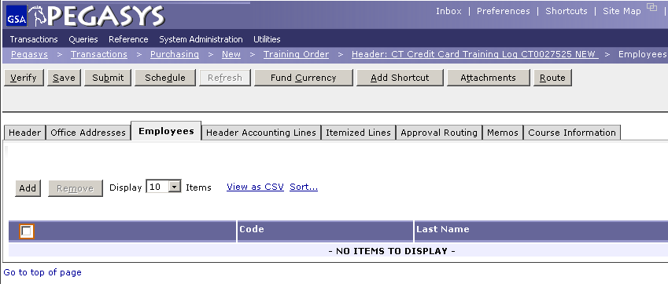
Employees Tab
(1) Choose the Employees tab.
(2) Click on Add to add new students
Notes:
By doing a CT you can look up your employees and see all the training that they have completed.

Slide 22
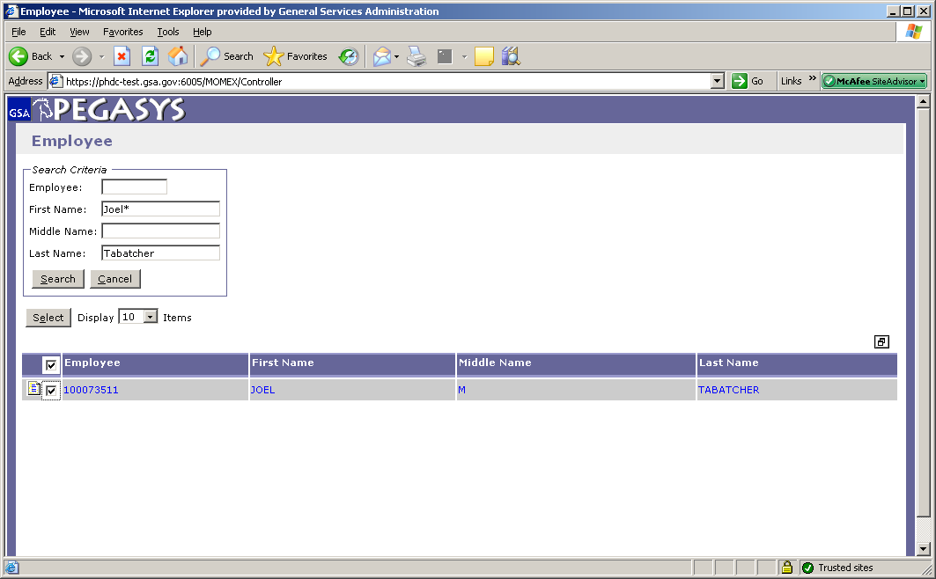
Employees Tab
(1) Type in employees name with wild card.
(2) Check correct box
(3) Click Select
Notes:
-If the employee is receiving a paycheck from GSA, they are in here.
-ALWAYS use a wildcard (*)

Slide 23
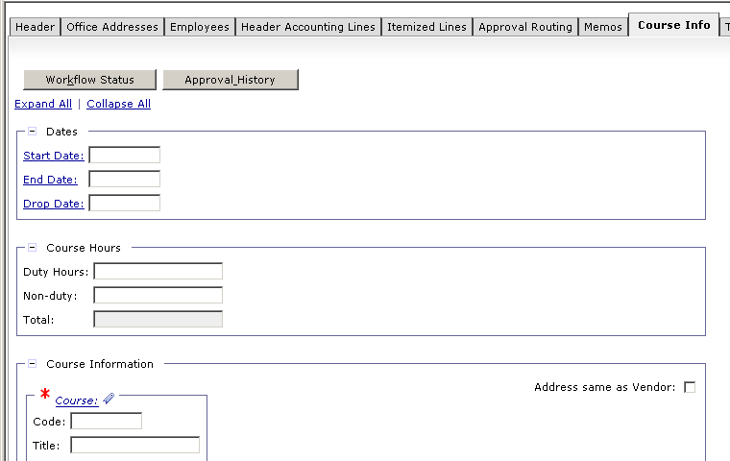
Course Information Tab
If you’re doing a CT then click the Course Info tab.
Enter the Start Date and End Date.
Enter in the Course Code and Title.

Slide 24
Convenience Checks
Convenience checks require:
CL/CT for actual transaction
  Must equal amount of check
  Vendor Code – Merchant
Create CL for check fee
  Purchase Amount x 2.0%
  Service Charge $1.00
  Vendor Code = Citibank
Note: For Citibank purchases use vendor code 460358360, address line 00021, cost element 522.
Notes:
**Ask if there are any convenience check holders in the class. If not, skip this section.
-Some small companies prefer convenience checks because they don’t want to pay purchase card fees.
-You must have a vendor code for convenience checks

Slide 25
Features – Copy From
  Copy From
  Favorites
  Document Defaults
Notes:
-Using the Copy From feature: All you will have to do is enter the new description. Good to use for bills that are the same from month to month
If you paid a bill in October and now you need to pay it in November choose the CL from October and hit Finish.
Use if you use the same funding 90% of the time. The accounting string will automatically fill in.

Slide 26
Reconciliation

Slide 27
Reconciliation Objectives
  Review Email Notification
  Reconciliation Notebook
    Checking the Status of Bank Statement Line
    Unreconcile a Default Charge
    Reconciling to a Purchase Card Log
    Accepting the Reconciliation
  Criteria for Auto Reconciliation
  Process for Manual Reconciliation
Notes:
-Happens when a charge goes to default and there is no CL for it.

Slide 28
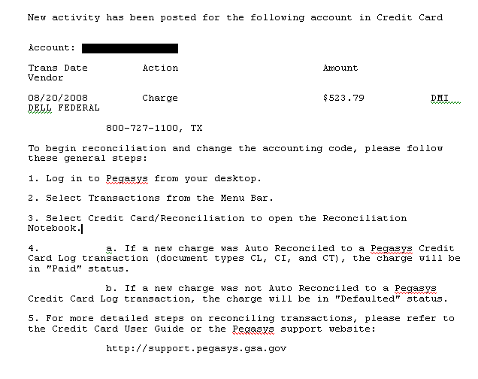
Email Notification

Slide 29
Statement Reconciliation
Automated Reconciliation
Attempts to automatically match information on the bank statement with purchase card log documents based on the following criteria:
  Purchase card number
  Authorization code (if populated on obligation)
  Charge amount (exact match)
  Charge date within tolerance limit (5 days)

Slide 30
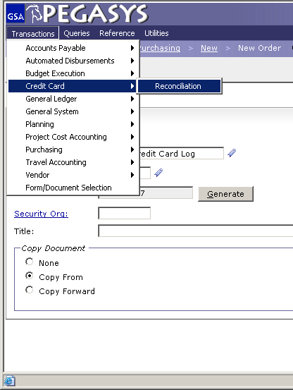
Reconciliation Notebook
Choose:
-Transactions
-Purchase Card
-Reconciliation

Slide 31
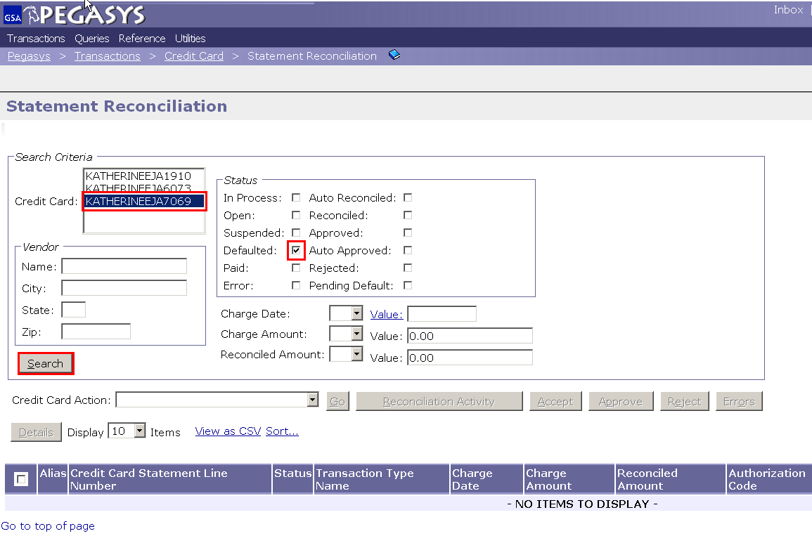
Status of Bank Statement Line
Choose your card from the Credit Card drop down box.
Enter the criteria to find the charge. (ie: amount, status)
Click Search.
Notes:
Defaulted- You need to manually reconcile the charge
Open- Nothing you can do, come back and check it tomorrow
Reconciled- No action from you!

Slide 32
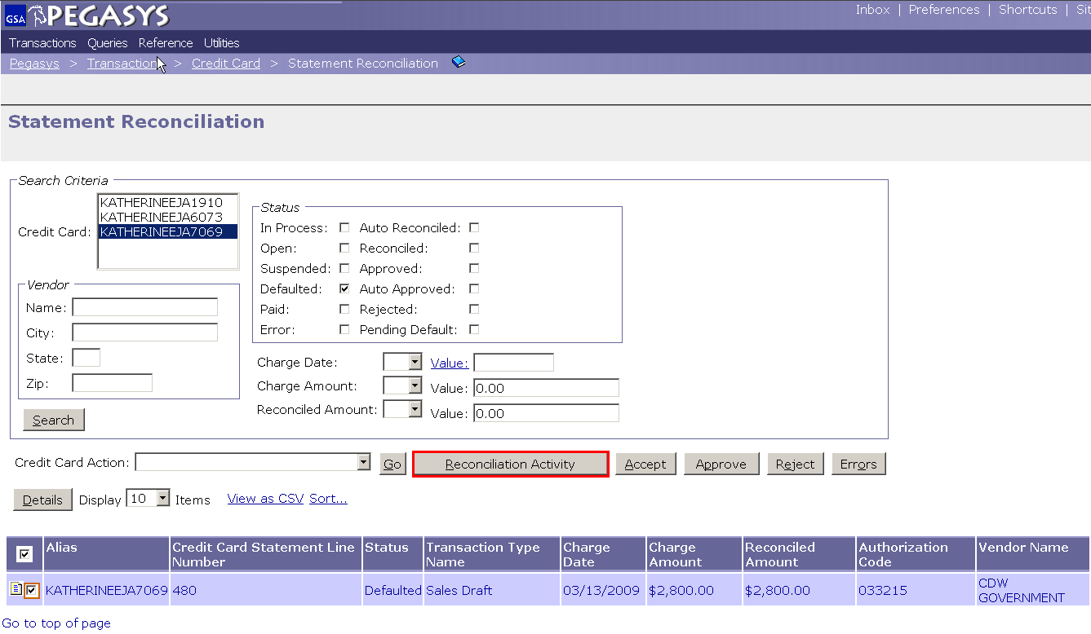
Un-reconcile a Default Charge
Highlight the Charge
Click on Reconciliation Activity

Slide 33
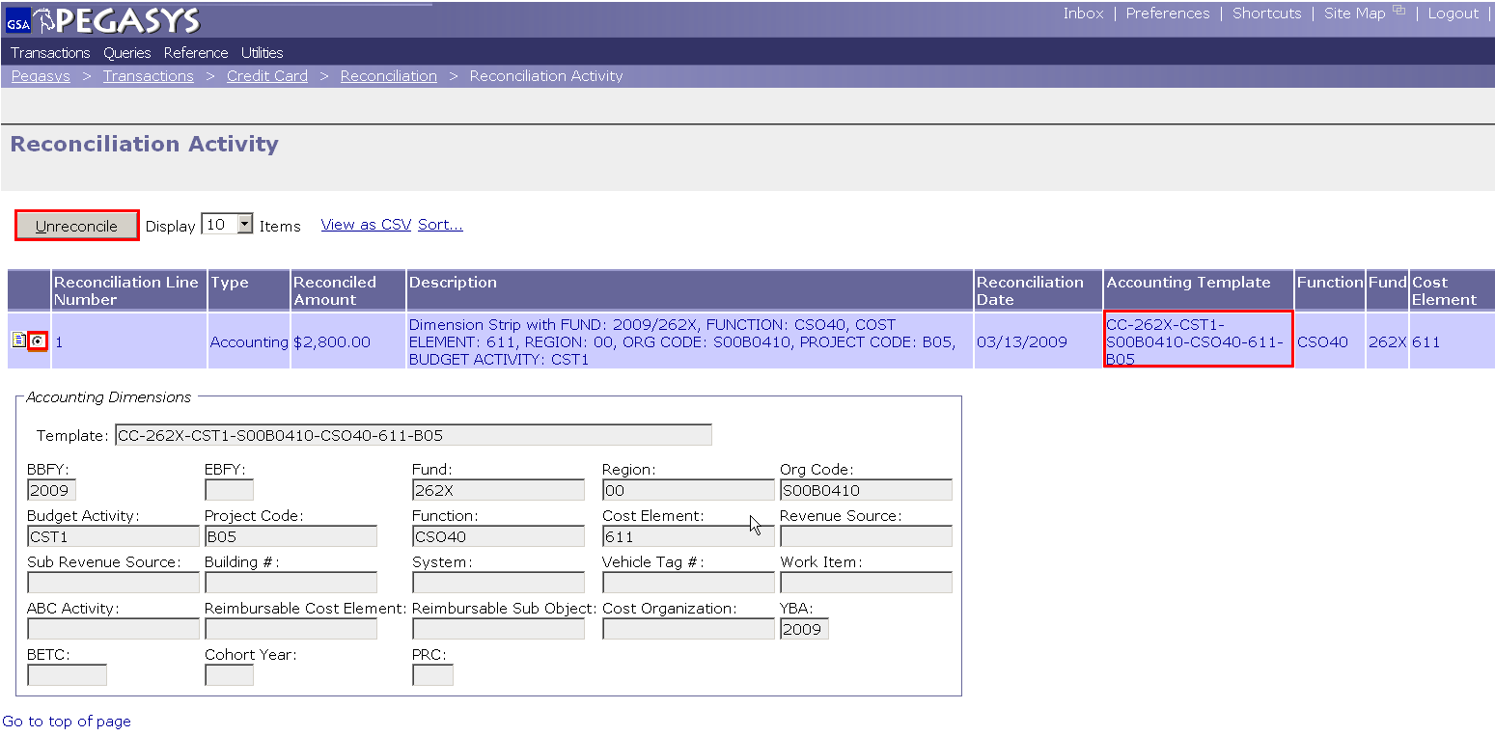
Unreconcile (cont)
Highlight the line.
Then
Click Unreconcile.
Then
Click Reconciliation in the breadcrumbs
* After un-reconciling a charge, the user must reconcile that charge to a CL/CT.

Slide 34
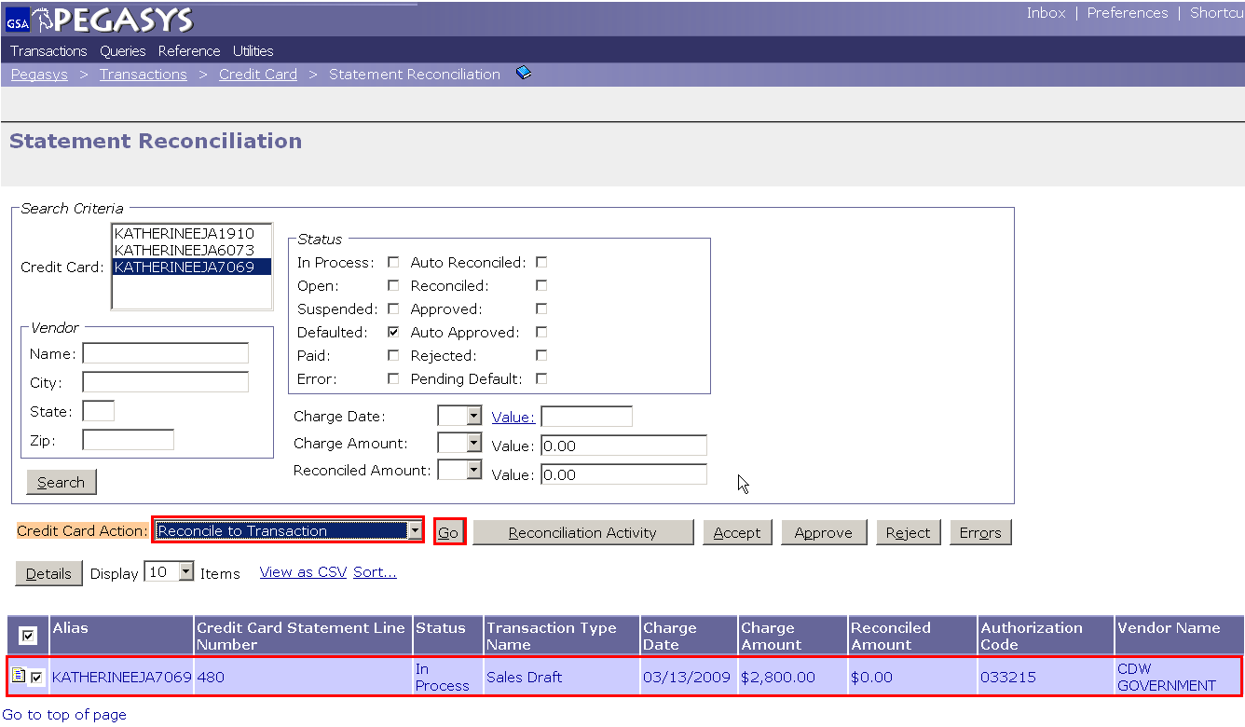
Reconciliation Notebook Search
Place a check in the charge box of the correct line.
(2) Choose Reconcile to Transaction from the Purchase Card Action drop down box
(3) Click Go.
(2)
(3)
(1)

Slide 35
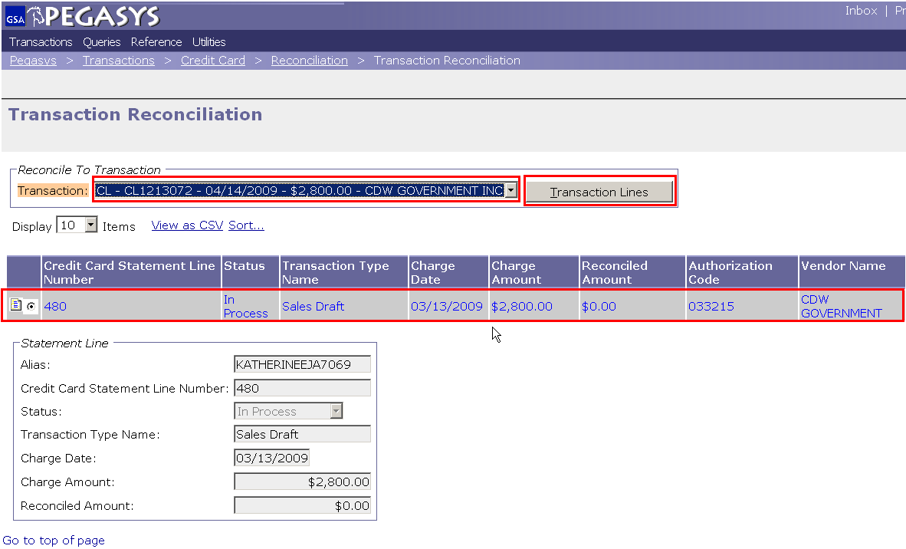
Transaction Reconciliation
(1) Choose the correct line.
(2) Click the drop down box and choose the correct CL.
(3) Click Transaction Lines button.
(2)
(3)
(1)

Slide 36
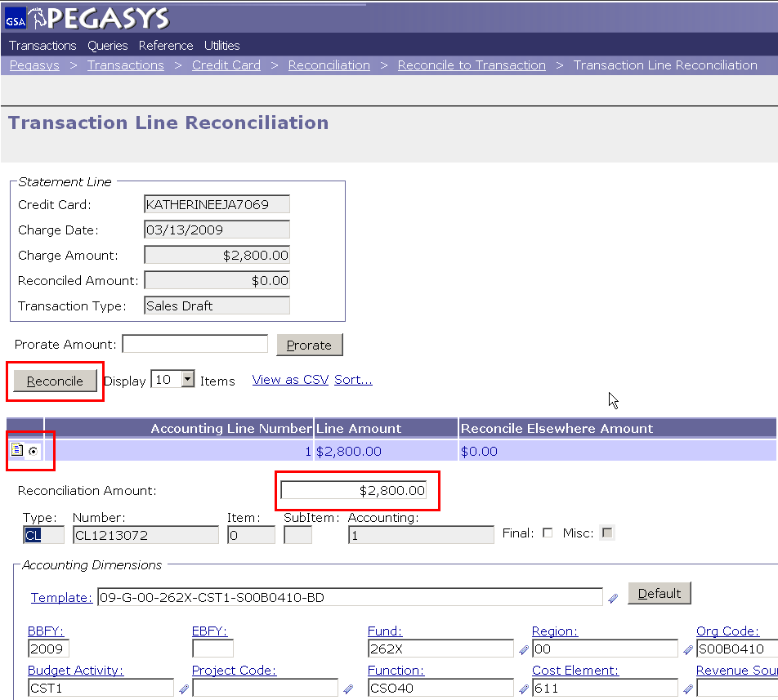
Transaction Line Reconciliation
(1) Check the correct line.
(2) Enter the amount in the Reconciliation Amount field.
(3) Click Reconcile.
Full or Partial Reconciliation
(3)
(1)
(2)

Slide 37
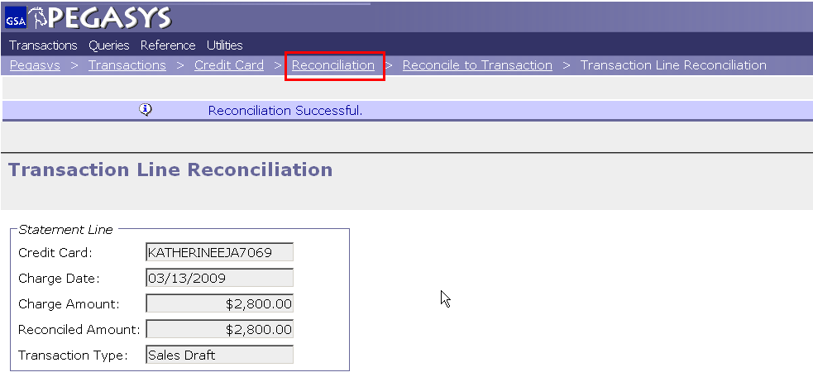
Accept Reconciliation
Click the Reconciliation breadcrumb.

Slide 38
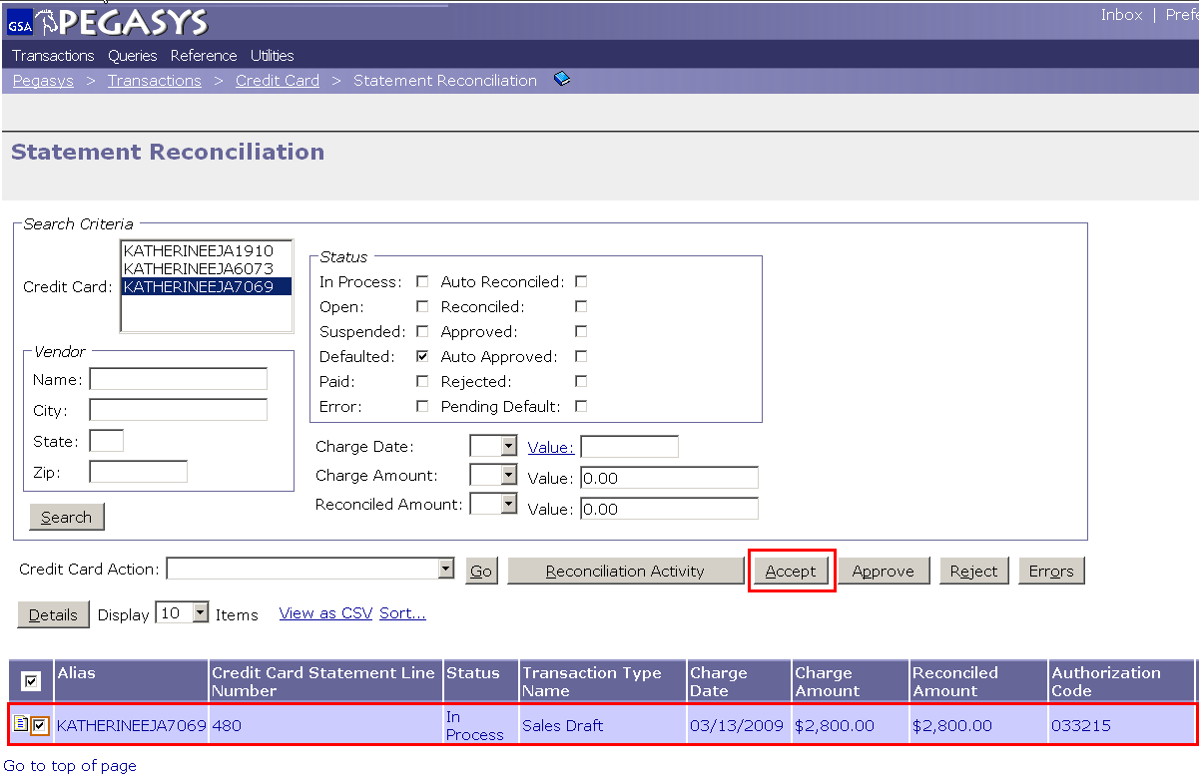
Accept Reconciliation
(1) Place a check in the correct line.
(2) Click the Accept button.
DONE
Notes:
Include screen shot of “accept” button highlighted and boldened

Slide 39
Reports

Slide 40
Reports- Types
CRCD Log Transactions
Monthly CRCD Transactions
Unreconciled CRCD Logs
Notes:
-CRCD shows you all the CL’s or CT’s you have created. Good if you get audited.
-Monthly CRCD Transactions is just like a personal purchase card statement. Can be any time range, not just monthly.
-Unreconcile CRCD Log is good to compate to CRCD Log Transaction report

Slide 41
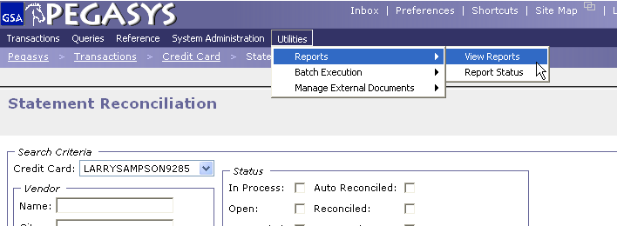
Purchase Card Reports

Slide 42
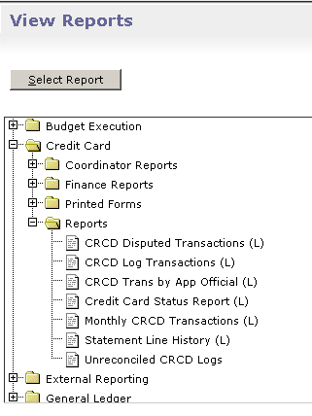
Generating Purchase Card Reports
Highlight Report
Click Select Report
Notes:
Purchase Card Reports

Slide 43
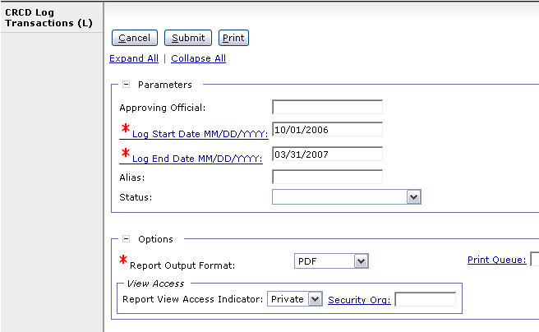
Generating Purchase Card Reports
Fill in parameters
Click Submit
Notes:
Purchase Card Reports

Slide 44
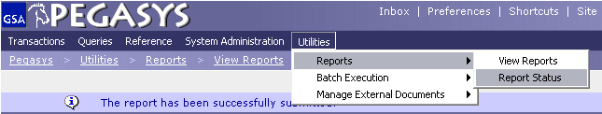
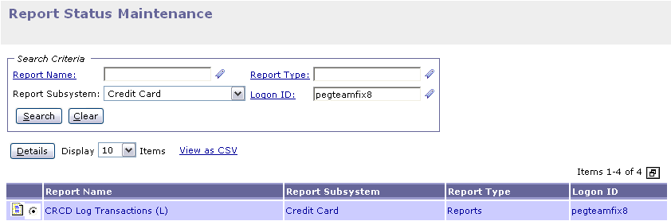
Viewing Purchase Card Reports
From Report Subsystem; Select Credit Card
Click Search
After screen refreshes from Search, then
3. Highlight Report
4. Click Details
(1)
(2)
(4)
(3)

Slide 45
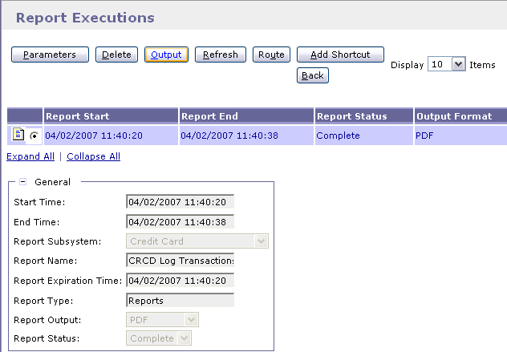
Viewing Purchase Card Reports
Select the Report
Click on Output
NOTE: If report status is pending hit refresh button.

Slide 46
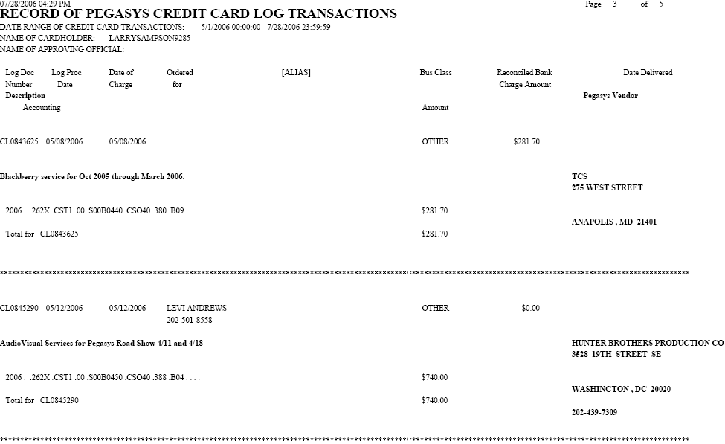
CRCD Log Transactions Report
Notes:
The $0.00 shows that it wasn’t reconciled

Slide 47
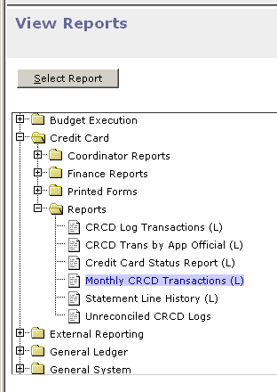
Generating Purchase Card Reports
Highlight Report
Click Select Report
Notes:
Purchase Card Reports

Slide 48
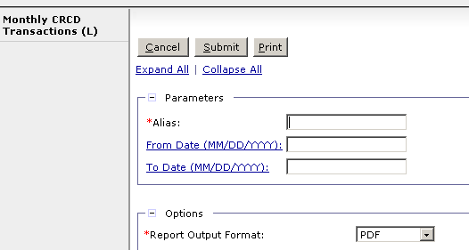
Generating Purchase Card Reports
*Enter the parameters
Click Submit

Slide 49
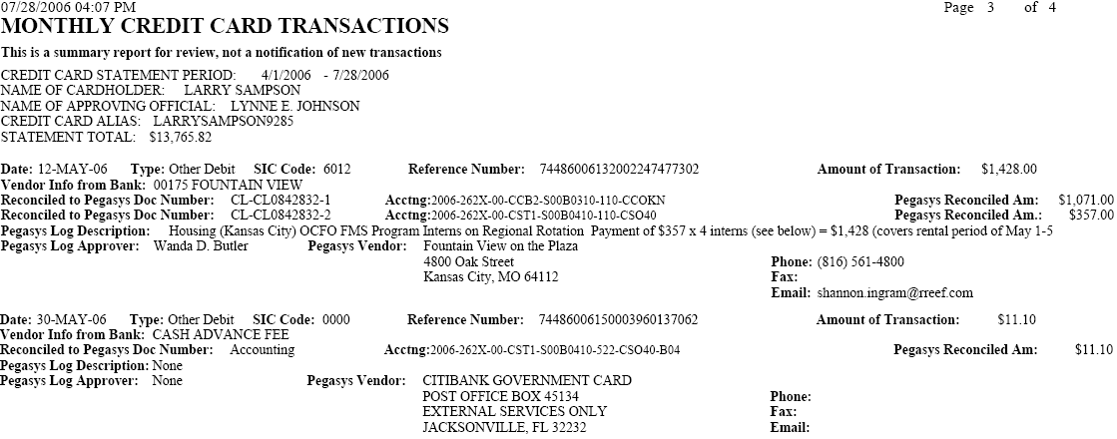
Monthly CRCD Transactions Rpt
Notes:
Accounting is not good, Citi charged you but you did not have a CL

Slide 50
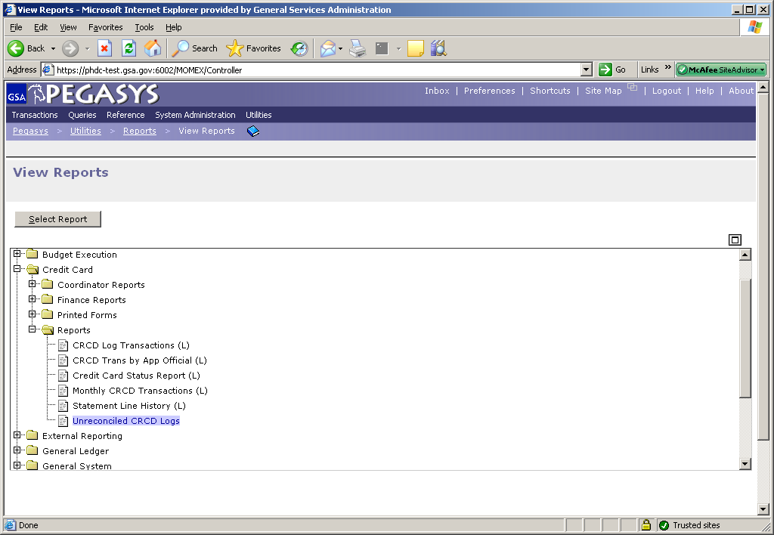
Generating Purchase Card Reports
Highlight Report
Click Select Report
Notes:
Purchase Card Reports

Slide 51
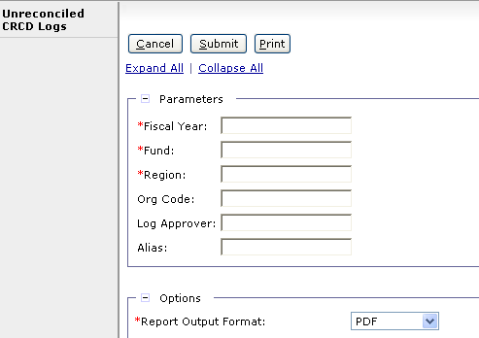
Purchase Card Reports (cont.)
Enter the parameters
Click Submit

Slide 52
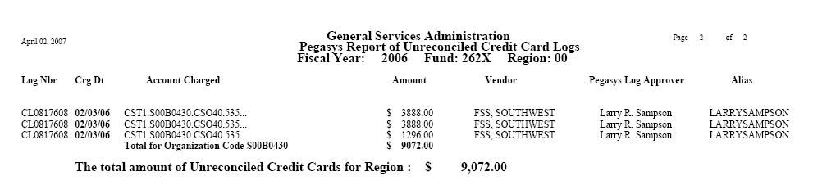
Unreconciled CRCD Report

Slide 53

Goals of Information Security
Confidentiality
  Data must be protected against unauthorized disclosure
Integrity
  Systems must not permit processes or data to be changed without authorization
Availability
  Systems must be functional and operational
Confidentiality
Integrity
Availability

Slide 54
Why is Information Security Important?
Must be in compliance with regulatory requirements such as OMB Circular A-130, Computer Security Act, FISMA and GSA IT security policies
Protects GSA information resources from potential abuse and misuse
Follows sounds business practices

Slide 55
User Responsibility
Responsible for adherence to GSA information security policy
Protect Pegasys login ID and password
  Do not allow others to use your login ID / password
  Do not write it down
Log out whenever you are not using Pegasys
Protect sensitive information
  Shred reports containing sensitive information
Report security incidents
  Refer to OCFO Incident Handling Procedures for further guidance
  Report security incidents to your supervisor

Slide 56

Keys to Incident Prevention
Awareness - be aware of the value of the assets you are using to do your job and the nature of associated threats vulnerabilities and suspicious activities
Compliance - comply with established safeguards, policies, and processes
Common Sense - if something appears to be off, it generally is

Slide 57
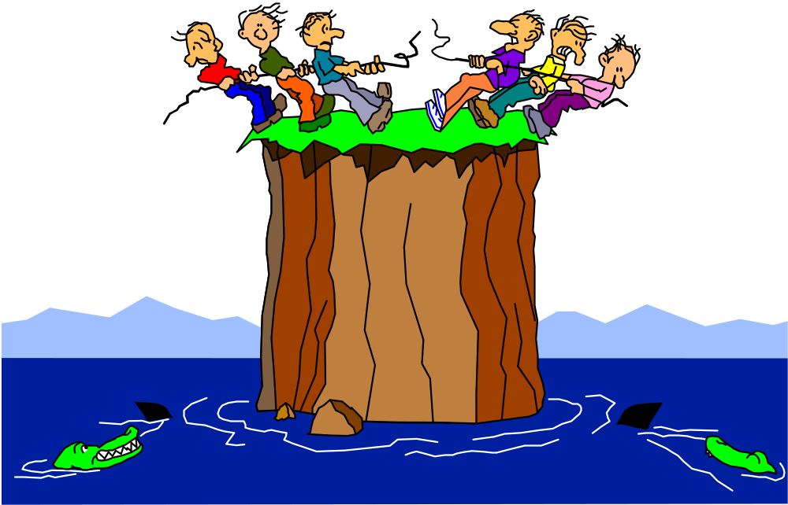
Remember ...
Security is a PEOPLE issue,
not only a TECHNICAL one!

