Slide 1
Receipts
Notes:
When you get goods/services you can do the receipt, you DO NOT have to wait unitl Pegasys prompts you
You can do a receipt for a partial payment and then do another receipt when the rest of the order is completed
Log in using allroles, NOT Larry
Make sure everybody grabs a handout

Slide 2
Objectives
  To create Receipts
  To recognize the various types
    Full
    Partial
      By dollar amount
      By Accounting lines
Notes:
Introduction
PR= Purchase Request
GP= Purchase Order
Vendor submits goods/services
Vendor sends invoice to Finance Centers
FC enters it into Pegasys

Slide 3
Standard Purchasing Chain
Invoice
M7/M6
Request
PR
Order
GP
FP
TP
PJ
PN
XP
OP
PP
Payment
Authorization
P7/P6
Receipt
RW/RK
Funds
FTS or PBS
RW and M7
All Others
RK and M6
Notes:
Show them the email they will get. They need to do the receipt or have someone else do it.
When these 3 match there will be a payment: Request-Order-Receipt
This is general chain, just pay attention to your part
KC is GM&A and FAS
KW is everything else
Request is commitment
Order is obligation
The email goes prompting a receipt goes to the email address on the PR first and if it is not done it goes to the address on the PO

Slide 4
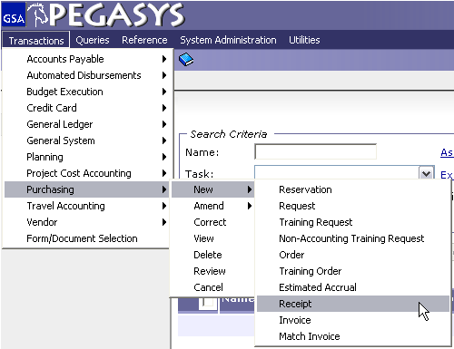
Creating Pegasys Forms & Documents

Slide 5
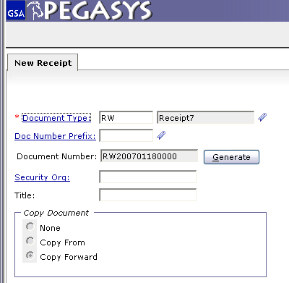
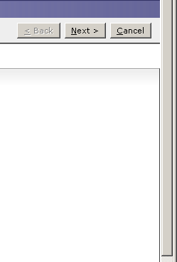
Creating Receipts
Doc Types
RK – Kansas City
RW – Fort Worth
Copy Forward
Auto default for RKs and RWs
Copies information from the
previous document in the chain
Notes:
RW200701180000 Means Year, Month, Date, and then a 4 digit number

Slide 6
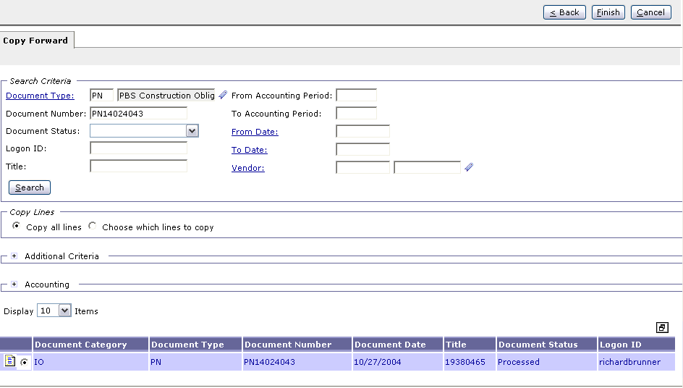
Creating Receipt – Copy Forward
Purchase Orders
GP = GM&A
FP = FSS
QP= FAS
TP = FTS
OP = Others
XP = Clients
PJ, PN, PP = PBS
Notes:
The PO number will be on the email prompting you to do the Receipt

Slide 7
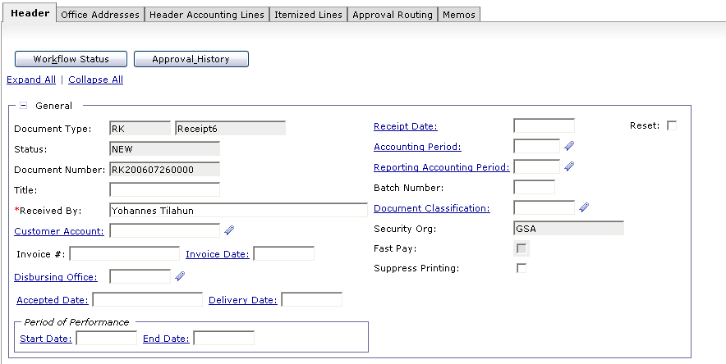
Creating Receipts - Full
Notes:
Everything is copied from the PO
Title is who is creating the receipt
The Accepted dates starts the Prompt Pay clock
ALL YOU NEED TO DO IS THE DATES

Slide 8
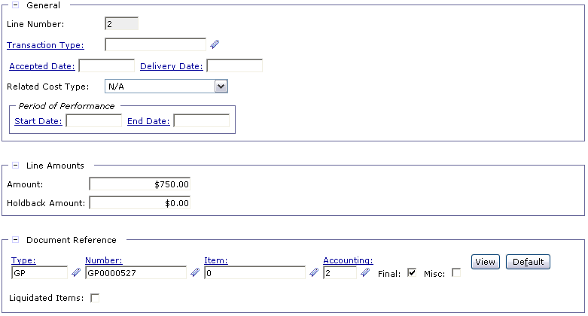
Creating Receipts
Creating Receipts – Partial
Header Accounting Line
Notes:
Change number if your invoice is different then your order

Slide 9
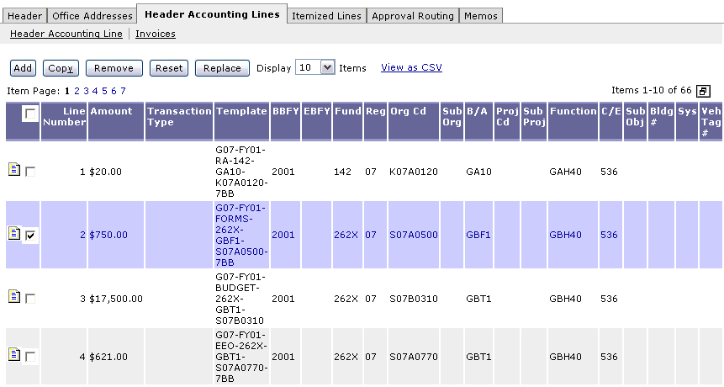
Creating Receipts – Partial by Accounting Lines
Notes:
Demo:
GP: Line 1 $1500
Line 2 $2000
Line 3 $1000
Invoice: $1500
Receipt: Line 1 $500
Line 2 $1000
Line 3 $1000
Now GP= Line 1 $1000
Line 2 $1000
Invoice: $1500
Receipt: Line 1 $1000
Line 2 $500
Now GP= Line 1 $500

Slide 10

Goals of Information Security
Goals of Information Security
Confidentiality
  Data must be protected against unauthorized disclosure
Integrity
  Systems must not permit processes or data to be changed without authorization
Availability
  Systems must be functional and operational
Confidentiality
Integrity
Availability

Slide 11
Why is Information Security Important?
Must be in compliance with regulatory requirements such as OMB Circular A-130, Computer Security Act, FISMA and GSA IT security policies
Protects GSA information resources from potential abuse and misuse
Follows sounds business practices

Slide 12
User Responsibility
Responsible for adherence to GSA information security policy
Protect Pegasys login ID and password
  Do not allow others to use your login ID / password
  Do not write it down
Log out whenever you are not using Pegasys
Protect sensitive information
  Shred reports containing sensitive information
Report security incidents
  Refer to OCFO Incident Handling Procedures for further guidance
  Report security incidents to your supervisor

Slide 13

Keys to Incident Prevention
Keys to Incident Prevention
Awareness - be aware of the value of the assets you are using to do your job and the nature of associated threats vulnerabilities and suspicious activities
Compliance - comply with established safeguards, policies, and processes
Common Sense - if something appears to be off, it generally is

Slide 14
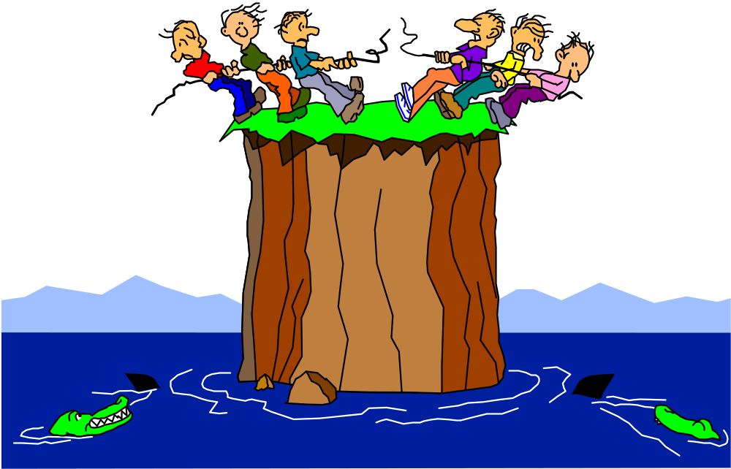
Remember ...
Security is a PEOPLE issue,
not only a TECHNICAL one!

