Slide 1
BAAR Phase 1 Overview
BAAR Manual Billing
BAAR Phase 3 Training

Slide 2
Table of Contents
Segment 1: Manual Billing Overview & Key Concepts
Segment 2: Creating Unbilled Receivables
Segment 3: Recycling- Billing and Downstream Processes
Segment 4: International Trade Center (ITC)- Billing and Downstream Processes
Segment 5: Manual Billing Cycle Overview
Segment 6: Manual Billing Queries
Segment 7: Manual Billing Reports

Slide 3
Segment 1:
Manual Billing Overview &
Key Concepts

Slide 4
Table of Contents
Segment 1: Manual Billing Overview & Key Concepts
Manual Billing Overview
Process Overviews
Segment 2: Creating Unbilled Receivables
Segment 3: Recycling- Billing and Downstream Processes
Segment 4: ITC- Billing and Downstream Processes
Segment 5: Manual Billing Cycle Overview
Segment 6: Manual Billing Queries
Segment 7: Manual Billing Reports

Slide 5
Dunning
Manual Billing Overview

Slide 6
Manual Billing Overview
Phase 3 Region 7 Manual Billing - Non-PCAS/Non-DBR Billing Vehicle
Creation of billing transactions without an Agreement or Detail Billing Records
Non-PCAS/Non-DBR transactions manually created in Pegasys:
Billing Documents
Cash Receipts (for “collections-only” business lines)
Region 7 Business Lines utilizing Non-PCAS/Non-DBR Manual Billing covered in this module are:
Recycling
International Trade Center (ITC)
CGI Federal Proprietary and Confidential

Slide 7
Non-PCAS/Non-DBR Billing Lifecycle
Generate Receivable and Earned Revenue
Send Bill to Customer
Track Receivable & Record Overdue Charges
Manually create Billing Document
Credit Application
IPACOUT
ARBILLGEN
AROVERDUE
ARDUNNING
Process Write-off/Adjustment
Disputes/
Chargebacks
Record Collection
IPACIN
Pay.gov via CIR
IPACIN
LOCKBOX
Pay.Gov via CIR
Manual
Not all steps will apply to every Receivable. These are potential events in the Accounts Receivable (AR) Life Cycle.

Slide 8
Billing Methods
Billing Method – defines:
Manner in which GSA initiates customer billing
Manner in which customer remits payment to GSA
GSA bills and receives customer payments via the following billing methods for ITC and Recycling:
Standard/Non-IPAC
Transaction between GSA and external Federal/non-Federal customer Customer actively initiates the remittance of payment to GSA via available payment methods
IPAC
Transaction between GSA and external Federal customer Billing and collection is performed via Treasury’s IPAC system Customer payment automatically received by GSA via IPAC Customer does not actively remit payment to GSA

Slide 9
Billing Methods – ITC / Recycling Usage
Recycling:
Uses Standard/Non-IPAC Billing Method
Uses IPAC for year-end IPAC refunds to Federal agencies
ITC:
Uses IPAC Billing Method to pull payments from Federal customers configured to use IPAC
Accepts customer payments from non-Federal customers for non-IPAC “collections-only” transactions

Slide 10
Billing Methods – Standard/Non-IPAC
Customer Type: External
Federal and non-Federal customers can be billed non-IPAC
Note: most Federal customers billed via IPAC
GSA generates a customer statement notifying customer of 1) billed charges and 2) collection due date
Non-IPAC bills are not printed -- generated as soft copy PDF and displayed in Pegasys and VCSS
Customer actively remits payment to GSA via available payment methods

Slide 11
Billing Methods – IPAC
Intra-Governmental Payment and Collection (IPAC) Interface:
Treasury system facilitating intra-governmental (agency to agency) transfers of funds, which streamlines billing/collections for GSA
Customer Type: External
Only Federal customers can be billed via Treasury IPAC system
Note: most Federal customers billed via IPAC
Requires signed trading agreement and related Pegasys configuration
GSA generates a customer statement notifying customer of 1) billed charges and 2) collection due date
IPAC bills for ITC will be configured not to generate PDF statements
Automated collection processing – customer does not actively remit payment
Transaction information sent to/from IPAC via IPAC Outbound and IPAC Inbound batch processes

Slide 12
Dunning
Process Overviews

Slide 13





Recycling Process Overview
GSA contracts with Recycling Vendor to pick up recycling materials for Federal Agencies
Recycling Vendor picks up recycling materials at Federal Agencies
GSA generates invoice to Recycling Vendor for fees + recycling amount
Recycling Vendor remits non-IPAC payment to GSA
Annually, GSA sends refund to Federal Agencies for recycling amount minus Fees

Slide 14





ITC Process Overview
ITC:
Mainly collections only processing
Some instances when Region 7 Finance is notified by ITC to pull payment from customer via IPAC
Collections Only:
Non-IPAC payment remitted to GSA via Lockbox, pay.gov, EFT
Collection posted to GSA Financial and Accounts Receivable System
Pull Payments:
Region 7 Finance receives notification from ITC to pull payment from customer via IPAC
Region 7 Finance initiates pull payment from customer via IPAC
Treasury confirms pull payment via IPAC

Slide 15
Segment 2:
Creating Unbilled Receivables

Slide 16
Table of Contents
Segment 1: Manual Billing Overview & Key Concepts
Segment 2: Creating Unbilled Receivables
Recycling and ITC Unbilled Receivables Characteristics
Pegasys Billing Documents
Billing Statement Query
Outstanding Bills Query
Segment 3: Recycling - Billing and Downstream Processes
Segment 4: ITC - Billing and Downstream Processes
Segment 5: Manual Billing Cycle Overview
Segment 6: Manual Billing Queries
Segment 7: Manual Billing Reports

Slide 17
Non-PCAS/Non-DBR Billing Lifecycle
Generate Receivable and Earned Revenue
Send Bill to Customer
Manually create Billing Document
Credit Application
IPACOUT
ARBILLGEN
AROVERDUE
ARDUNNING
Record Collection
Track Receivable & Record Overdue Charges
Disputes/
Chargebacks
Process Write-off/Adjustment
IPACIN
Pay.gov via CIR
IPACIN
LOCKBOX
Pay.Gov via CIR
Manual
Not all steps will apply to every Receivable. These are potential events in the Accounts Receivable (AR) Life Cycle.

Slide 18
Dunning
Recycling and ITC Unbilled Receivable Characteristics

Slide 19
Unbilled Receivable Characteristics
Recycling Unbilled Receivables:
Created when Finance receives email notification to invoice vendor
Vendor is the non-Federal customer picking up the recycling
Includes 1) Fee Amount (revenue) as well as 2) Recycling Amount (liability)
Generate PDF statements in Pegasys
ITC Unbilled Receivables:
Created for GSA to perform pull payment from Federal customer
Vendor is the Federal agency from which GSA is performing the pull
If the Vendor does not exist in Pegasys, Region 7 will take the appropriate steps to set up the Vendor
Do not generate PDF statements in Pegasys

Slide 20
Dunning
Pegasys Billing Documents

Slide 21
Billing Document Overview
Billing Document (BD) - Performs two billing related functions:
Facilitates billing for services rendered or goods delivered
Records the financial impact of providing goods/services to external customers:
Standard General Ledger impact: Accounts Receivable and Revenue
Two types of Billing Documents processed coinciding with the billing methods used by ITC and Recycling:
Standard/Non-IPAC
IPAC
Line Types (default to Normal for all Billing Documents)
Normal – used to recognize revenue
Credit – allows the recording of a liability
Attachments can also be added to Billing Documents

Slide 22
Recycling/ITC Billing Document Attributes
Recycling Billing Document:
Document Type – IMN (Region 7 Manual Non-IPAC BD)
Contains the following tabs: Header, Office Address, Accounting Lines
Accounting Line 1 - Fee amount (receivable / revenue); Trans Type 01
Accounting Line 2 - Recycling amount (receivable / liability); Trans Type 03
ITC Billing Document:
Document Type – IMI (Region 7 Manual IPAC BD)
Contains the same tabs as the Non-IPAC BD plus:
Interagency Transfer section on Accounting Lines, Articles tab
One Accounting Line using Trans Type 01 (receivable / revenue)
IMI document is configured to suppress printing (PDF not generated for ITC)

Slide 23
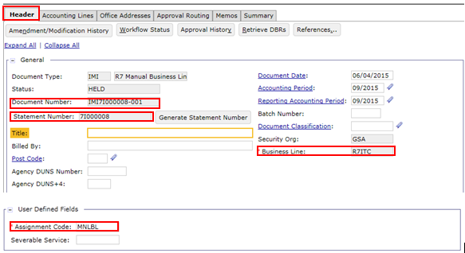
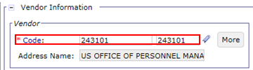
Billing Document – Header
Field | Description
Document Number | Number of document that was generated upon BD creation based on statement number
Statement Number | Number generated by which billing documents are grouped
Business Line | Manual Business Line value for Recycling (R7RECYCLE) or ITC (R7ITC)
Assignment Code | Identifies the GSA group responsible for follow-ups, if necessary
Vendor Code | Federal or Non-Federal Vendor
CGI Federal Proprietary and Confidential

Slide 24
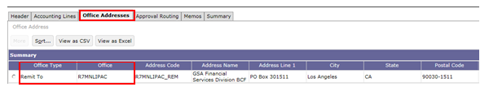
Billing Document – Office Addresses
Tab/Field | Description
Office Address | Provides detailed Payment Office information about GSA for IPAC and Non-IPAC transactions (R7MNLIPAC for IPAC, R7MNLNI for Non-IPAC)
Remit To Office Address | Used on the generated Billing Document and the Remit To Office information on the PDF generated statement
CGI Federal Proprietary and Confidential

Slide 25
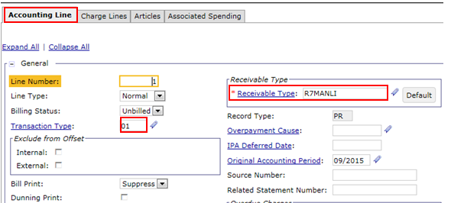
Billing Document – Accounting Line
Field | Description
Receivable Type | Used by downstream batch processes (R7MANLI for IPAC, R7MANLNI for Non-IPAC)
Transaction Type | Used to determine how transaction will post to General Ledger
CGI Federal Proprietary and Confidential

Slide 26
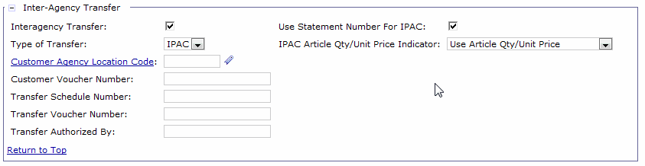
IPAC Billing Document
IPAC Billing Documents:
Are generated for customers configured in Pegasys to use IPAC
Inter-Agency Transfer Section:
IPAC Bills - designated as IPAC by:
Inter-Agency Flag (checked) on BD header, AND
Type of Transfer (set to IPAC)
Interagency flag, Type of Transfer, Use Statement Number for IPAC, IPAC Article Qty/Unit Price Indicator are defaulted when an IPAC document type is selected

Slide 27
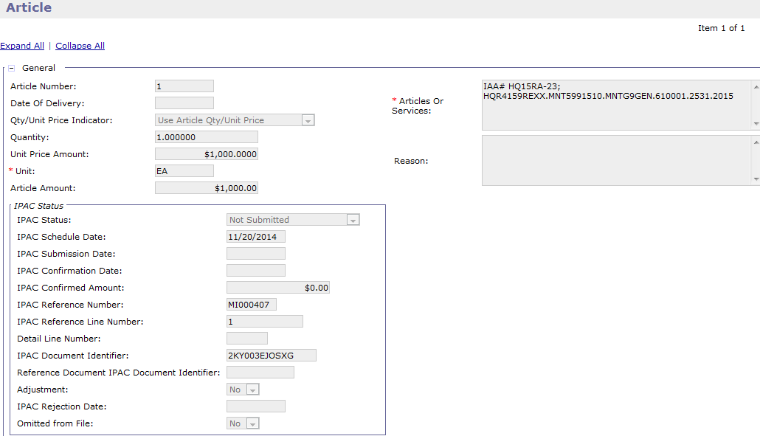
IPAC Billing Document – Articles
IPAC Billing Documents contain ‘Articles’:
Capture commodity/unit information, quantity, and unit price
Transmit this information to IPAC to be viewable on the customer’s IPAC record
Document the transaction's IPAC Status
Used to determine the state of the IPAC transaction within the IPAC lifecycle

Slide 28
Attachments Process
GSA users can add attachments:
Added directly to the form or document
For internal GSA use
To add an attachment:
If not within form/document - navigate to document:
Pegasys>Transactions>Form/Document Selection
Enter query criterion (be as detailed as possible)
Select item and select ‘View’
Within form/document:
Select Attachments Button
Select ‘Import Local File’
Enter required and relevant fields
Select ‘Browse’ and choose file
Select ‘Upload’

Slide 29
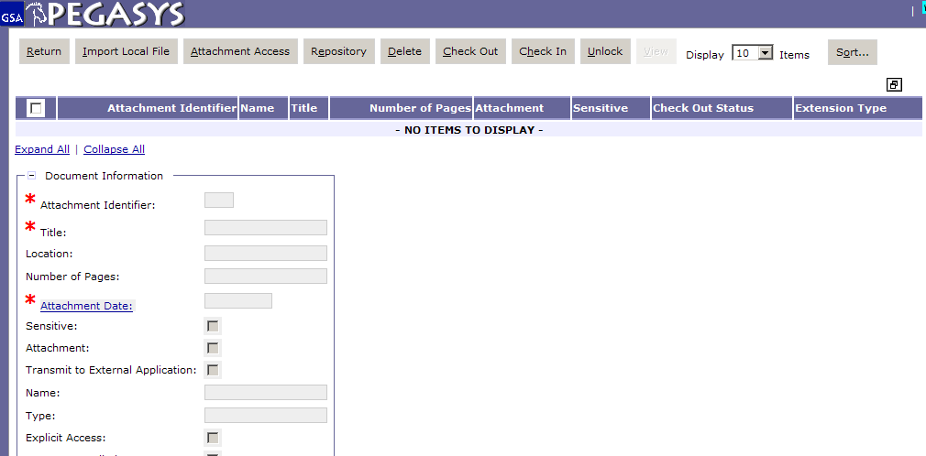
Billing Document - Add Attachments
Notes:
Click attachments button. This is what screen looks like

Slide 30
Dunning
Bill Statement Query

Slide 31
Billing Statement – Entity and Query
Statement Entity:
Generated by Pegasys when the BD transaction is processed
Pegasys “Statement Number” identifies the customer statement
Provides Pegasys view of PDF statement, and includes PDF statement as attachment (for Recycling only)
The Billing Statement Query provides the ability to view:
Statement-Level Balances (Statement Balances tab)
Related BD (Billing Document) Balances (Document Balances tab)
Vendor Balances (Vendor Balances tab)
Statement Level Correspondence (Correspondence tab)
Attachments/PDF statements
PDF statements are available once ARBILLGEN has been run

Slide 32
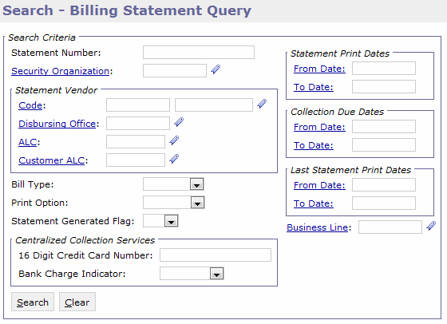
Billing Statement Query – Search Criteria
Pegasys > Queries > Accounts Receivable > Billing Statement Query
General Criteria | Billing Criteria
Statement Number | Print Option – Yes, No, Blank (both)
Vendor Code | Statement Generated Flag – Yes, No, Blank (both)
Bill Type – Standard/Non-IPAC, IPAC | Statement Print Dates
Blank (both) | Collection Due Dates
Business Line | Last Statement Print Date
CGI Federal Proprietary and Confidential

Slide 33
Statement Level Correspondence
Correspondence supports:
Communication between GSA and Customers using Pegasys and VCSS
The ability to add attachments to the correspondence record
Correspondence provides GSA with the ability to:
Initiate communication with the customer
Record and track customer communication
Respond to customer communication
Two Sources of Correspondence
VCSS: Customer initiated
Pegasys: User-entered correspondence
Notes:
Phase 1

Slide 34
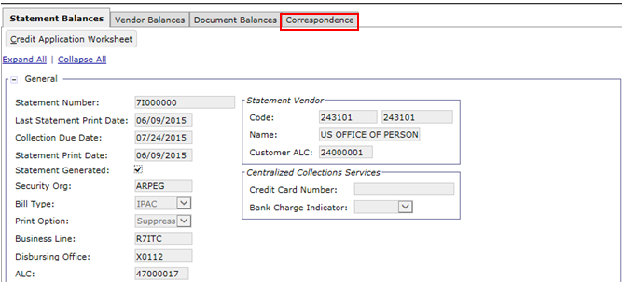
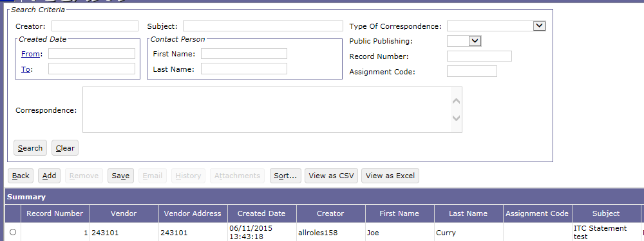
Billing Statement Query – Correspondence
Pegasys > Queries > Accounts Receivable > Billing Statement Query

Slide 35
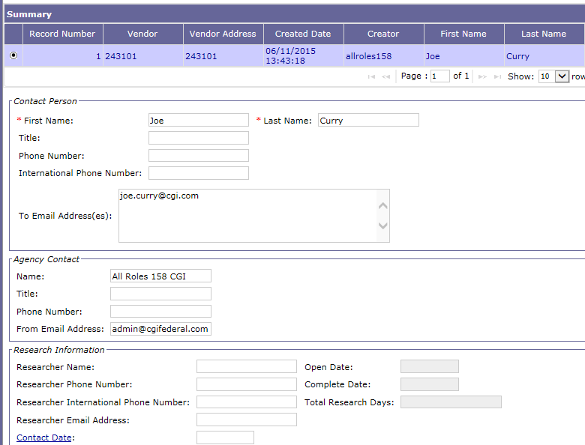
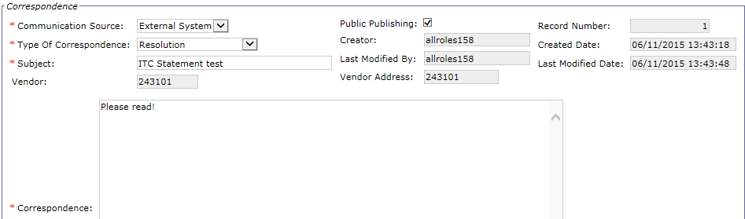
Billing Statement Query – Correspondence Page

Slide 36
Non-IPAC Disputes via VCSS
Outstanding Bills Query

Slide 37
Outstanding Bills Query
The Outstanding Bills Query:
Allows users to identify Billing Documents/Statements fully or partially not collected
Displays all unliquidated Billing Document Accounting Lines
Documents remain in the table until the outstanding amount becomes zero
The table is updated as Billing Documents are processed
Outstanding Bill Query - Actions:
Allows users to query for outstanding bills by a number of search fields
E.g. uncollected, non written-off, etc.
Launch Billing Documents from the query to edit or view as needed
Launch the Credit Application Worksheet to apply, refund, or transfer to Treasury Non-IPAC Credits
Generate IPAC refunds

Slide 38
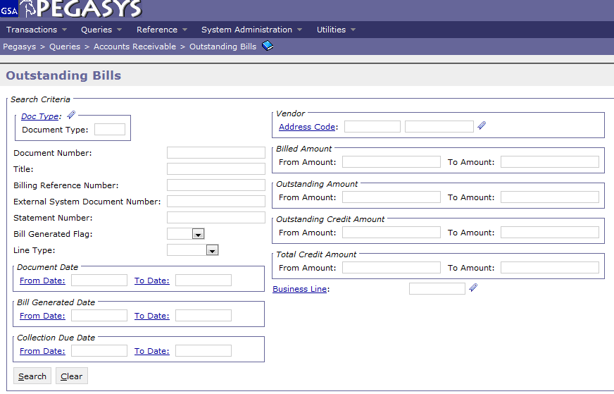
Outstanding Bills Query – Search Criteria
Pegasys > Queries > Accounts Receivable > Outstanding Bills
Additional
search criteria available in the Additional Criteria, Accounting Elements, and User Defined Header Fields search criteria sections
General Criteria | Document Date Criteria | Amount Criteria
Document Number | Document Date | Billed Amount
Bill Generated Flag | Bill Generated Date | Outstanding Amount
Vendor Code | Collection Due Date | Outstanding Credit Amount
 |  | Total Credit Amount

Slide 39
Exercise
Exercise 1: Create Manual ITC and Recycling Billing Documents and Review Statement via the Billing Statement Query and the Outstanding Bills Query

Slide 40
Segment 3:
Recycling - Billing and Downstream Processes

Slide 41
Table of Contents
Segment 1: Manual Billing Overview & Key Concepts
Segment 2: Creating Unbilled Receivables
Segment 3: Recycling - Billing and Downstream Processes
Recycling Billing Process
Track Receivables and Record Overdue Charges
Recycling Collections
Refunds
Non-IPAC Disputes
Write-Offs
Segment 4: ITC - Billing and Downstream Processes
Segment 5: Manual Billing Cycle Overview
Segment 6: Manual Billing Queries
Segment 7: Manual Billing Reports

Slide 42
Dunning
Recycling Billing Process

Slide 43
Non-PCAS/Non-DBR Billing Lifecycle
Generate Receivable and Earned Revenue
Send Bill to Customer
Manually create Billing Document
Credit Application
IPACOUT
ARBILLGEN
ARDUNNING
AROVERDUE
Record Collection
Track Receivable & Record Overdue Charges
Disputes/
Chargebacks
Process Write-off/Adjustment
IPACIN
Pay.gov via CIR
IPACIN
LOCKBOX
Pay.Gov via CIR
Manual
Not all steps will apply to every Receivable. These are potential events in the Accounts Receivable (AR) Life Cycle.

Slide 44
Recycling Billing
Recycling – Uses Standard/Non-IPAC Billing Method
Standard Non-IPAC Unbilled Receivables go through the following batch processes to become a billed Receivable:
Automated Credit Application (ARCRDAPP)
Application of non-IPAC credit against outstanding receivables
AR Bill Generation (ARBILLGEN)
Update Billing Status from Unbilled to Billed
Performs Unbilled to Billed General Ledger update
Populates Billing and Collection dates
Generation of PDF statement

Slide 45
Standard Non-IPAC Billing – Automated Credit Application
Automated Credit Application batch job:
Identifies customer credits that have not yet been resolved and performs the appropriate action per GSA policy
For Recycling (Non-IPAC receivables), Credit Application will:
Identify within statement an outstanding Billing Document to apply the credit
Generates a CW7 Credit Application Cash Receipt with two lines
Credit Reduction line referencing the BD credit line
Credit Application line applying the credit to a normal (debit) outstanding Billing Document within the same Statement
If there is no outstanding Billing Document or excess credit amount exists, the credit will remain outstanding (unapplied)

Slide 46
Standard Non-IPAC Billing – Bill Generation
The Bill Generation Process (ARBILLGEN) will:
Update billing transactions, indicating the transaction has been “billed” or sent to the customer
Select and prepare Billing Documents for PDF statement generation
Auto-executes the Bill Generation report, which produces the individual PDF statements and a consolidated file containing all the bills in the Batch run (grouped by Statement)

Slide 47
Standard Non-IPAC Billing – Bill Generation Updates
ARBILLGEN – Billing Document Updates:
Billing Status - Accounting Line level indicator indicates which GL postings should occur
Set to 'Billed' by ARBILLGEN
Triggers update from Unbilled (131000.07) to Billed (131000.08)
Bill Generated Flag - when true indicates the PDF statement has been generated and that the BD information has been transmitted to VCSS
Set to T by ARBILLGEN
Bill Print Date, Last Bill Date - Accounting Line fields
Set equal to “Print Date” parameter by ARBILLGEN
Last Bill Amount - Accounting Line field
Set equal to outstanding line amount

Slide 48
Dunning
Track Receivables and Record Overdue Charges

Slide 49
Non-PCAS/Non-DBR Billing Lifecycle
Generate Receivable and Earned Revenue
Send Bill to Customer
Manually create Billing Document
Credit Application
IPACOUT
ARBILLGEN
AROVERDUE
ARDUNNING
Record Collection
Track Receivable & Record Overdue Charges
Disputes/
Chargebacks
Process Write-off/Adjustment
IPACIN
Pay.gov via CIR
IPACIN
LOCKBOX
Pay.Gov via CIR
Manual
Not all steps will apply to every Receivable. These are potential events in the Accounts Receivable (AR) Life Cycle.

Slide 50
Overdue Charges – Overview
Pegasys assesses overdue charges for Non-IPAC customers with overdue account balances
Late fees applied to outstanding Billing Documents past Collection Due Date
Non-Federal:
Collection Due Date = 30 days from Bill Print Date
Assessed via automated Pegasys batch processing for Non-Federal customers
Federal:
Collection Due Date = 45 days from Bill Print Date
GSA may manually assess overdue charges for certain Federal customers with recurring delinquency issues
Overdue charges are assessed on outstanding BD at Accounting Line level after the BD’s Collection Due Date:
Interest Charges
Penalty Charges
Administrative Charges
Note: More information on Overdue Charges is provided in the Delinquency and Receivables Management course.

Slide 51
Dunning Process – Overview
Pegasys generates Dunning Notices for Non-IPAC customers with overdue account balances
Non-Federal Collection Due Date = 30 days from Bill Print Date
Federal Collection Due Date = 45 days from Bill Print Date
Shows delinquent bill amounts, including principal and IP&A charges, as well as any collections received by GSA
Customers with multiple Receivables outstanding have one Dunning Notice generated per Statement
Subsequent dunning notices are generated on 30 day interval after first dunning notice (maximum of 3 for non-Federal customers and 4 for Federal customers)
Note: More information on Dunning is provided in the Delinquency and Receivables Management course.

Slide 52
Dunning
Recycling Collections

Slide 53
Non-PCAS/Non-DBR Billing Lifecycle
Generate Receivable and Earned Revenue
Send Bill to Customer
Manually create Billing Document
Credit Application
IPACOUT
ARBILLGEN
ARDUNNING
AROVERDUE
Record Collection
Track Receivable & Record Overdue Charges
Disputes/
Chargebacks
Process Write-off/Adjustment
IPACIN
Pay.gov via CIR
IPACIN
LOCKBOX
Pay.Gov via CIR
Manual
Not all steps will apply to every Receivable. These are potential events in the Accounts Receivable (AR) Life Cycle.

Slide 54
Recycling Collections Overview
Vendors remit payment to GSA, including:
Fee Amount
Recycling Amount
Collections recorded as Cash Receipts within Pegasys and created via the following methods for Recycling:
Interfaced* via Pegasys batch processing:
Lockbox (L7M)
Pay.gov via CIR (PC7)
Manually entered by copying forward from a Billing Document (BD)
EFT (EF7)
Cash Receipts generated for Recycling via Lockbox and Pay.gov will be created as rejected forms in Pegasys
GSA will correct rejected CR via the Collections Query to change the Transaction Type on Line 2 (Recycling Amount) from the inferred value of 01 to 02
* Recycling Lockbox collections will reject when submitted to Pegasys via batch processes and will need to be manually corrected.
Note: More information on the Collections Query is provided in Segment 5.

Slide 55
Collection Processing: Lockbox
GSA’s Lockbox Banks serve as filing and processing agents
Allows customers to remit checks to designated Lockbox locations around the country
The Lockbox Bank then transmits the check to the Federal Reserve Bank (ECP - Electronic Check Processing) for settlement
A Lockbox interface transfers the data file from GSA’s Lockbox Bank provider to Pegasys, generating a Pegasys Cash Receipt
Pegasys creates the Lockbox CRs from the imported file:
Lockbox collections are matched using the Statement Number
Lockbox collections that cannot be successfully matched with a Billing Document are created and saved in Rejected status as Unapplied Collections
Unapplied Cash Receipts are researched and corrected via the Collections Query
Note: More information on Lockbox collections is provided in the Collections course.

Slide 56
Collection Processing: Pay.gov via CIR
Customer payments submitted to Pay.gov will be transmitted to Pegasys via CIR
Collections Information Repository (CIR):
CIR is a collections reporting tool provided by Treasury
Receives collection/deposit information from FMS collections systems/settlement mechanisms (e.g. Pay.gov)
Sends detailed and summarized collection records to GSA
Does not include IPAC transactions
Pay.gov:
Pay.gov is an online collection portal that allows Federal and Non-Federal customers to make credit card payments electronically to GSA
Pay.gov transactions are settled by Vantiv and sent to CIR
Vantiv transaction/settlement information is transmitted from CIR to GSA (loaded in Pegasys to create Cash Receipt)
Note: More information on Pay.gov collections is provided in the Collections course.

Slide 57

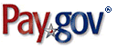

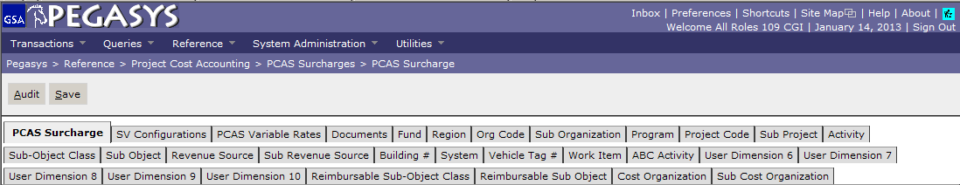
Collection Processing: Pay.gov via CIR
Customer submits credit card payment to Pay.gov
1
Pay.gov sends customer credit card
payments to Vantiv for settlement
2
Vantiv sends collection funds to CIR
CIR
3
CIR notifies GSA of collection and settlement information
Pegasys creates CRs
Batch Processes:
- CIR Import
- CIR Form Generation
CGI Federal Proprietary and Confidential

Slide 58
Cash Receipt Overview
Cash Receipt (CR) documents:
Record the collection of funds in Pegasys
Money that is received by GSA as payment for services rendered or goods provided
Typically used to reduce outstanding receivables and record the collection of cash
Liquidate the receivable balance recorded on the Billing Document (BD), when a CR references a BD
Cash Receipts contain the following tabs:
Header
Accounting Lines
Recycling Line 1 – Fee Amount; Trans Type 01
Recycling Line 2 – Recycling Amount; Trans Type 02
Charge Lines
Attachments can also be added to Cash Receipts

Slide 59
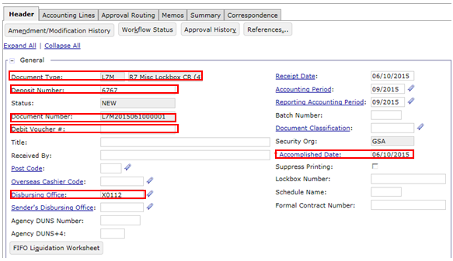
Cash Receipt Document – Header
Transactions > Accounts Receivable > New > Cash Receipt
Field | Description | Field | Description
Document Type | Corresponds to the document type configured for the type of CR entered, e.g. Pay.gov, Check, etc. | Debit Voucher Number | Populated on chargebacks and returned checks
Deposit Number | Deposit Ticket Number associated with the collection transaction | Disbursing Office | Disbursing Office stored in Pegasys, e.g. GS187, X0109, etc.
Document Number | System-generated number unique to the document | Accomplished Date | The date Treasury acknowledges the deposit actually occurred
Notes:
Speaker Notes:
Review/demo
Document Type: Direct users on how to search for Document types and where to find Doc types on the Configuration Spec
Document Number: (as covered in earlier slide)
Status: Explain Different Status’s the document can be in (New, Held, Scheduled, Rejected, Pending Approval, Cancelled, Processed)
Deposit number
Accomplished Date
Disbursing Office
Additional fields

Slide 60
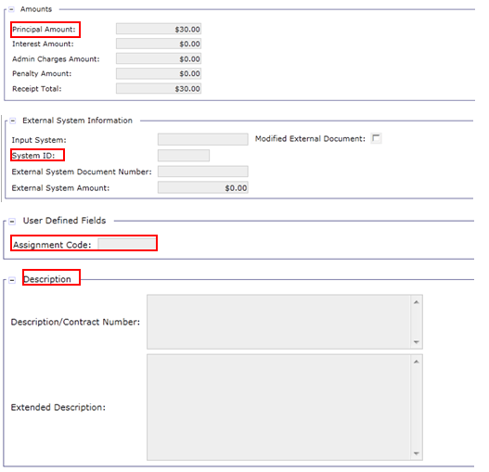
Cash Receipt Document – Header (cont.)
Field | Description | Field | Description
Principal Amount | Records the total amount of all accounting lines associated to the CR | Assignment Code | User defined text field used to tie the Finance assignee
System ID | Identifies the external system through which the transaction was processed, e.g., R7PAYGOV, etc. | Description | Used to enter any additional identifiable information on the transaction
Notes:
Speaker Notes:
Principal Amount
External System ID: External ID is retrieved from the CIR Detail process. Explain in which instances users will see different external system ID’s
Assignment Code: User defined text field ties to the finance person that is assigned to deal with it (typically a 9 digit code).
Description

Slide 61
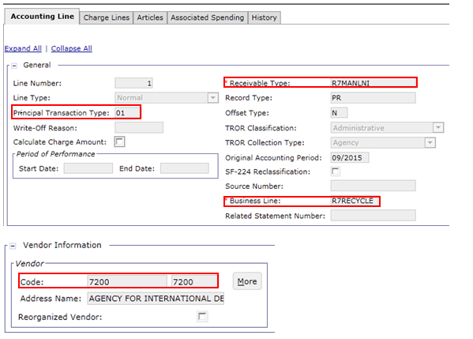
Cash Receipt Document – Accounting Line
Field | Description | Field | Description
Principal Transaction Type | Used in combination with document type to infer General Ledger postings | Business Line | Used to categorize CR documents, e.g. R7ITC, R7RECYCLE, etc.
Receivable Type | Used for flexible transaction definitions, e.g. R7MANLNI, R7MANLI, etc. | Vendor Code | Must be valid in Pegasys
Notes:
Line Type
Transaction Type (give examples of trans types and when they are used)
Receivable Type (i.e. EXTSERVNI or RITNI)
TROR Classification/Collection Type
Business Line
Vendor Code – vendors depend on the business line
Cash Receipt Posting Order: defines the order which a Cash Receipt should liquidate the different line types of BDs (this is dictated by Treasury)

Slide 62
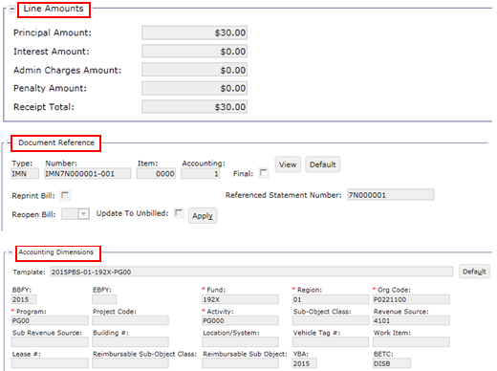
Cash Receipt – Accounting Line (cont.)
Field | Description | Field | Description
Line Amounts | Records principal amount & interest, admin, and penalty charges | Accounting Dimensions | Records document’s line of accounting
Document Reference | BD referenced by the document (if applicable)
Notes:
Line Amounts
Document Reference – Billing Document, or another Cash Receipt (ex. Advance Offset or Refund)
Accounting Template - see the config guide for valid accounting templates
Revenue Source Code - will need to be entered by user (reference backed field)
Agreement section: most RWA/HOTD and Manual Business Line CRs will reference agreements

Slide 63
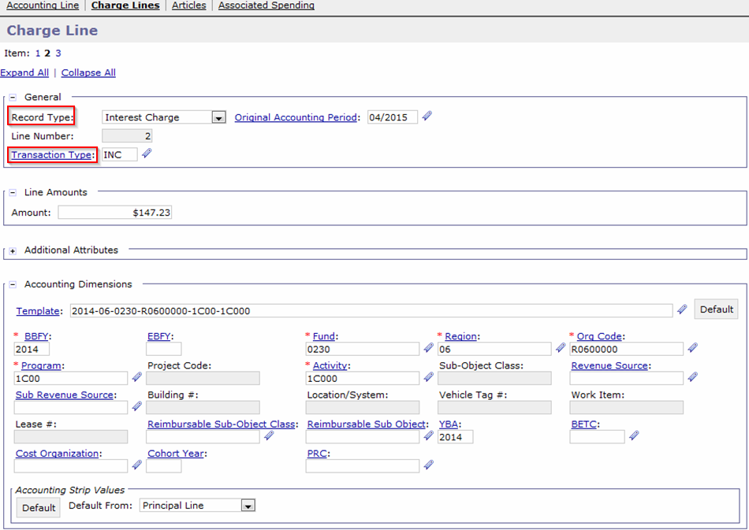
Cash Receipt – Charge Line
Field | Description | Field | Description
Record Type | Options: Interest Charge, Administrative Charge, Penalty Charge | Transaction Type | Used in combination with document type to infer postings to the General Ledger
Notes:
Speaker Notes:
Line Number is constant across all CRs:
Line 1 = Admin
Line 2 = Interest
Line 3 = Penalty
Charge Amount recorded in the Line Amounts section.
Transaction Type recorded (ADC, INC, PNC)
Accounting Dimensions

Slide 64
Dunning
Refunds

Slide 65
Recycling Refund Process Overview
One time per year, GSA issues refunds via IPAC to return Collected Amount less the Fee Amount to the Federal Agency
Example:
GSA contracts with Ace Recycling to collect recycling for the Department of Energy (DoE) with a fee amount of $200
At the end of the year, GSA has collected $5000 from Ace Recycling for DoE
GSA will create a payment to DoE for $4800 to refund the collected amount less the fee amount.

Slide 66
Recycling Refunds in Pegasys
Recycling Refunds in Pegasys:
Manually created Itemized Payment document
Document Type – RY7
Trans Type – 01
Do not reference the non-IPAC Cash Receipt (from the Recycling vendor)
Payment documents use the following tabs:
Header
Accounting Line
Disbursing Information

Slide 67
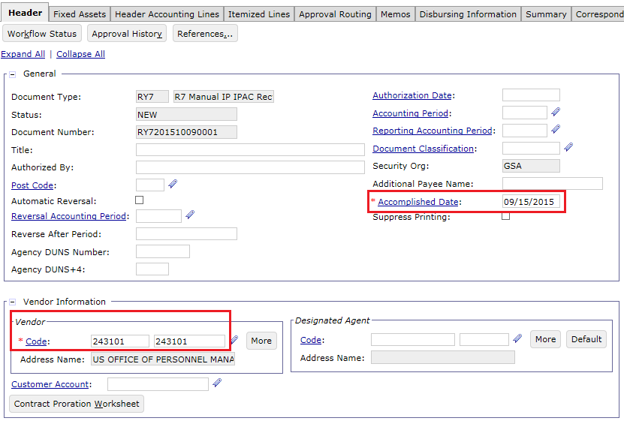
Itemized Payment – Header
Field | Description
Vendor | Federal Agency being refunded
Accomplished Date | The date Treasury acknowledges the deposit actually occurred. Entered by the user when manually creating the payment. After Treasury confirms the IP, the Accomplished Date will automatically be updated with the date the confirmation occurred.

Slide 68
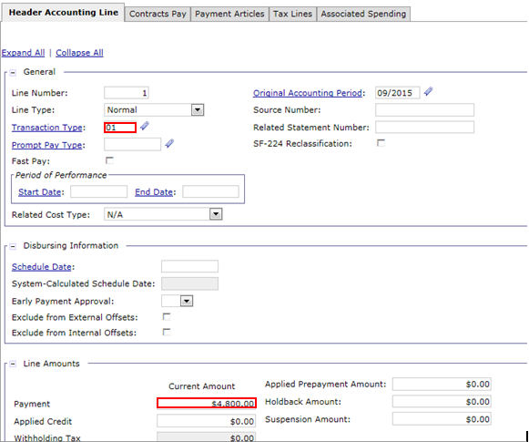
Itemized Payment – Accounting Line
Field | Description | Field | Description
Transaction Type | Used to determine how transaction will post to General Ledger. Set to 01 for Recycling Refund. | Payment Amount | Amount to be refunded to the Federal Agency

Slide 69
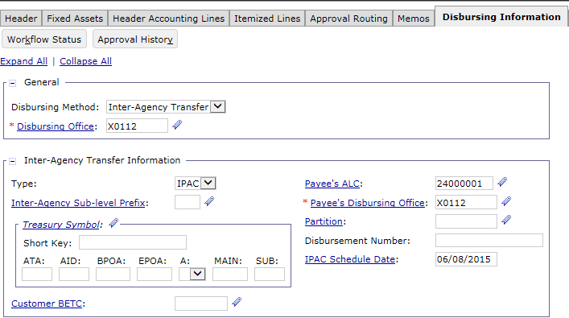
Itemized Payment – Disbursing Information
Field | Description
Disbursing Office | Disbursing Office stored in Pegasys, e.g. GS187, X0112, etc.

Slide 70
Exercise
Exercise 2: Review a Recycling Refund

Slide 71
Non-IPAC Disputes via VCSS
Non-IPAC Disputes

Slide 72
Non-PCAS/Non-DBR Billing Lifecycle
Generate Receivable and Earned Revenue
Send Bill to Customer
Manually create Billing Document
Credit Application
IPACOUT
ARBILLGEN
AROVERDUE
ARDUNNING
Record Collection
Track Receivable & Record Overdue Charges
Disputes/
Chargebacks
Process Write-off/Adjustment
IPACIN
Pay.gov via CIR
IPACIN
LOCKBOX
Pay.Gov via CIR
Manual
Not all steps will apply to every Receivable. These are potential events in the Accounts Receivable (AR) Life Cycle.

Slide 73
Disputes Overview
Customer may have a concern with the general status of their account with GSA or disagree with the statements they have received
In these cases, customer will contact GSA to file a dispute, which is recorded and tracked via the Disputed Billings Query
Note: Disputes will be covered in the Delinquency and Receivables Management course.

Slide 74
Non-IPAC Disputes via VCSS
Write-Offs

Slide 75
Non-PCAS/Non-DBR Billing Lifecycle
Generate Receivable and Earned Revenue
Send Bill to Customer
Manually create Billing Document
Credit Application
IPACOUT
ARBILLGEN
AROVERDUE
ARDUNNING
Record Collection
Track Receivable & Record Overdue Charges
Disputes/
Chargebacks
Process Write-off/Adjustment
IPACIN
Pay.gov via CIR
IPACIN
LOCKBOX
Pay.Gov via CIR
Manual
Not all steps will apply to every Receivable. These are potential events in the Accounts Receivable (AR) Life Cycle.

Slide 76
Recycling Write-off Process
Non-IPAC Receivables outstanding amounts may be written-off if the bill is deemed uncollectible by GSA
Recycling Write-off Process:
Manual creation of write-off CR for Fee Amount
Document Type – NW7
Accounting Line 1:
Trans Type – 01
Line Type – Write-off
Document Reference – Line 1 of the original non-IPAC BD to write-off the fee amount
Manual correction of original non-IPAC BD to reduce line 2 (Recycling Amount) to $0
Note: The process above is for Recycling only. More information on write-offs for other business lines can be found in the corresponding billing training course materials.

Slide 77
Segment 4:
ITC – Billing and Downstream Processes

Slide 78
Table of Contents
Segment 1: Manual Billing Overview & Key Concepts
Segment 2: Creating Unbilled Receivables
Segment 3: Recycling - Billing and Downstream Processes
Segment 4: ITC - Billing and Downstream Processes
ITC Process Overview
Pull Payments
IPAC Collections and Chargebacks
Standard/Non-IPAC Collections
Segment 5: Manual Billing Cycle Overview
Segment 6: Manual Billing Queries
Segment 7: Manual Billing Reports

Slide 79
Non-IPAC Disputes via VCSS
ITC Process Overview

Slide 80
ITC Process Overview
International Trade Center (ITC) – Uses Collections Processes and IPAC Billing
ITC will:
Generate a subset of their transactions as collections only transactions
Initiate pull payments for a subset of their transactions
IPAC Billing Documents will be used to initiate pull payments from Treasury’s IPAC system for Federal vendors

Slide 81
Non-IPAC Disputes via VCSS
Pull Payments

Slide 82
Non-PCAS/Non-DBR Billing Lifecycle
Generate Receivable and Earned Revenue
Send Bill to Customer
Manually create Billing Document
Credit Application
IPACOUT
ARBILLGEN
ARDUNNING
AROVERDUE
Record Collection
Track Receivable & Record Overdue Charges
Disputes/
Chargebacks
Process Write-off/Adjustment
IPACIN
Pay.gov via CIR
IPACIN
LOCKBOX
Pay.Gov via CIR
Manual
Not all steps will apply to every Receivable. These are potential events in the Accounts Receivable (AR) Life Cycle.

Slide 83
ITC IPAC Billing
ITC IPAC Unbilled Receivables (unbilled Billing Documents) go through the following batch processes to become a billed Receivable:
IPAC Outbound (GSIPACOUT)
Update Billing Status from Unbilled to Billed
Updates IPAC status and creates upload file for Treasury
AR Bill Generation (ARBILLGEN)
Populates Billing and Collection dates
Generation of PDF statement

Slide 84
IPAC Billing – IPAC Outbound
IPAC Outbound (GSIPACOUT) batch process will:
Update billing transactions, indicating the transaction has been “billed” or sent to the customer
Select billing and payment transactions in the system and create an upload file for Treasury
IPAC Bulk layout
IPAC Outbound preliminary mode:
Validates Statements are complete with no Rejected documents
Business lines that send Statement Numbers to Pegasys may not want to send incomplete Statements to Treasury
“Override Readiness Check” Parameter is set to True in Final Mode to prevent (or in some special cases, submit) partial Statements
Enables error checking pre-billing
Performed before GSIPACOUT’s final mode
CGI Federal Proprietary and Confidential

Slide 85
IPAC Billing – IPAC Outbound Updates
IPAC Outbound final mode updates:
Billing Status - Accounting Line level indicator indicates which GL postings should occur
Set to 'Billed' by GSIPACOUT
Triggers update from Unbilled (131000.07) to Billed (131000.08)
IPAC Status - Article level indicator
Many different values that correspond to the IPAC lifecycle in Pegasys
Set to ‘In Transit’ by GSIPACOUT
Bill Generated Flag - Billing Document Header flag that when checked sends the BD information to VCSS
Set to T by GSIPACOUT
Note: More information on IPAC can be found in the IPAC Lifecycle course.

Slide 86
IPAC Billing – Bill Generation Updates
ARBILLGEN - Billing Document Updates:
Last Bill Amount - Accounting Line field
Set equal to outstanding line amount
CGI Federal Proprietary and Confidential

Slide 87
Non-IPAC Disputes via VCSS
IPAC Collections and Chargebacks

Slide 88
Non-PCAS/Non-DBR Billing Lifecycle
Generate Receivable and Earned Revenue
Send Bill to Customer
Manually create Billing Document
Credit Application
IPACOUT
ARBILLGEN
ARDUNNING
AROVERDUE
Record Collection
Track Receivable & Record Overdue Charges
Disputes/
Chargebacks
Process Write-off/Adjustment
IPACIN
Pay.gov via CIR
IPACIN
LOCKBOX
Pay.Gov via CIR
Manual
Not all steps will apply to every Receivable. These are potential events in the Accounts Receivable (AR) Life Cycle.

Slide 89
IPAC Inbound – Overview
IPAC Inbound (GSIPACIN) - used to upload IPAC data from Treasury into Pegasys in order to create collections
IPAC Inbound creates the following types of transactions:
Confirmations of IPAC Outbound Billings:
Bill Confirmations/Collections (Cash Receipt documents)
IPAC Inbound confirm bills submitted to Treasury via IPAC Outbound
New transactions not initiated by GSA via IPAC Outbound or GOALs
Adjustments/Chargebacks (Cash Receipt and Itemized Payment documents)
Chargebacks of bills/refunds

Slide 90
IPAC Inbound – Updates
IPAC Inbound Collection Updates:
Creates Confirmation Transactions
Cash Receipts (CRs) represent collection of cash
Document Type – IR7
Updates Referenced Documents
CRs liquidate/close IPAC BDs
The CR is the Treasury confirmation of the billing transaction
IPAC Status- Article level indicator
Many different values that correspond to the IPAC lifecycle in Pegasys
Set to “Confirmed” by GSIPACIN on BDs, CRs
(Confirming the BD)
Note: More information on IPAC can be found in the IPAC Lifecycle course.

Slide 91
IPAC Chargebacks – Overview
Chargebacks as defined by Treasury (“Adjustments”):
If a customer agency disagrees with an IPAC transaction sent from GSA, they “charge back” the transaction
Treasury calls chargebacks “Adjustments”:
An Adjustment is a transaction the customer agency initiates to adjust an erroneous or incorrect payment or collection
Agencies can only use adjustments to reduce (adjust down) the original transaction amount
Agencies can only process an adjustment against a payment or collection that is 90 days old or less from the age of the transaction’s accomplished date
90 Day Window - Treasury limits adjustment transactions to 90 days of the original transaction’s accomplish date

Slide 92
IPAC Transaction Query Overview
IPAC Transaction Query
Cash Receipts created by IPAC Inbound can be viewed on the IPAC Transaction Query
IPAC Transaction Query is also used to research and review transactions sent to IPAC via IPAC Outbound process
Can be used to find Rejected Documents
Can be used to search by IPAC Status
Can create Correspondence from IPAC Transaction Query

Slide 93
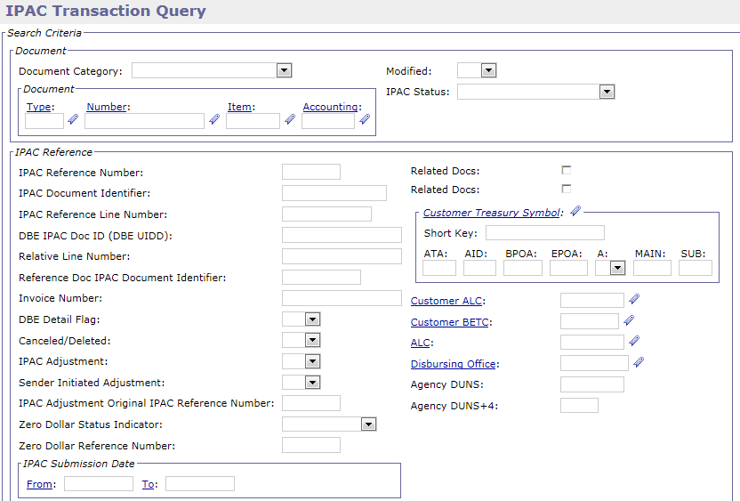
IPAC Transaction Query Search Criteria
Pegasys > Queries > General System > IPAC Transaction Query
Additional search criteria available in the IPAC Reference, Additional Criteria, Vendor, Chargeback Information, and Accounting Dimensions search criteria sections
General Criteria
Document Category
Document Type
Document Number

Slide 94
IPAC Transaction Query – IPAC Statuses: Billing Documents
IPAC Status | Description
Not Submitted | An IPAC Status equal to Not Submitted is given to any IPAC Bill that has been processed but not yet been sent to IPAC via IPAC Outbound.
In Transit | An IPAC Status equal to In Transit is given to any IPAC Bill that has been sent to IPAC via IPAC Outbound and awaiting confirmation via IPAC Inbound.
Rejected | An IPAC Status = Rejected is given to any IPAC Bill that has been sent to IPAC but has been rejected by IPAC. IPAC will notify the sending agency of a problem with the payment or collection via e-mail correspondence and the IPAC status will be manually set to Rejected.
Confirmed | An IPAC Status equal to Confirmed is given to any IPAC Billing Document that has been sent to IPAC via IPAC Outbound and IPAC has accepted and confirmed the transaction. Confirmation from IPAC is processed via IPAC Inbound.
Hold-Pending Chargeback | An IPAC Status of Hold-Pending Chargeback is given to an IPAC Billing Document that has an inbound collection adjustment referencing a CR which references a confirmed BD.
Do Not Send | An IPAC Status equal to Do Not Send is given to any Billing Document Article where the Rebill flag is true but the user has determined that the bill should not be resent to IPAC. The status of Do Not Send can only be set on an Article where the rebill flag is true, meaning the Article was automatically created when a Debit Voucher set to re-open the bill is processed.
Write-Off | An IPAC Status = Write-Off is given to the IPAC BD (Bill) when the write-off amount equals the total Article amount.
Note: More information on the IPAC Transaction Query can be found in the IPAC Lifecycle course.

Slide 95
Non-IPAC Disputes via VCSS
Standard / Non-IPAC
Collections

Slide 96
Non-PCAS/Non-DBR Billing Lifecycle
Generate Receivable and Earned Revenue
Send Bill to Customer
Manually create Billing Document
Credit Application
IPACOUT
ARBILLGEN
ARDUNNING
AROVERDUE
Record Collection
Track Receivable & Record Overdue Charges
Disputes/
Chargebacks
Process Write-off/Adjustment
IPACIN
Pay.gov via CIR
IPACIN
LOCKBOX
Pay.Gov via CIR
Manual
Not all steps will apply to every Receivable. These are potential events in the Accounts Receivable (AR) Life Cycle.

Slide 97
ITC Collections Overview
ITC is primarily a collections only business line
Cash Receipts with no BD reference will be created in Pegasys for these collections
ITC Collections within Pegasys contain the following tabs:
Header
Accounting Lines:
One Line using Trans Type 01
Note: More information on Cash Receipts is provided in Segment 3.

Slide 98
ITC Collections Overview (cont.)
Collections recorded as Cash Receipts within Pegasys are created via the following methods for Recycling:
Interfaced* via Pegasys batch processing:
Lockbox (L7M)
Pay.gov via CIR (PC7 – Collection, PV7 – Pay.gov Refund)
Manually entered by copying forward from a Billing Document (BD)
EFT (EF7)
Cash Receipts generated for ITC via Lockbox and Pay.gov will be created as rejected in Pegasys
Users will correct rejected CR via the Collections Query to enter the required data and submit for processing
* Recycling Lockbox collections will reject when submitted to Pegasys via batch processes and will need to be manually corrected.
Note: More information on the Collections Query is provided in Segment 5.

Slide 99
Segment 5:
Manual Billing Cycle Overview

Slide 100
Table of Contents
Segment 1: Manual Billing Overview & Key Concepts
Segment 2: Creating Unbilled Receivables
Segment 3: Recycling - Billing and Downstream Processes
Segment 4: ITC - Billing and Downstream Processes
Segment 5: Manual Billing Cycle Overview
Cycles Overview for Recycling and ITC
Segment 6: Manual Billing Queries
Segment 7: Manual Billing Reports

Slide 101
Dunning
Cycles Overview for
Recycling and ITC

Slide 102
Region 7 Manual Business Lines: Cycles Overview
Billing:
Date TBD
Automated Credit Application (ARCRDAPP)
IPAC Outbound (GSIPACOUT)
Bill Generation (ARBILLGEN)
Overdue Charges and Dunning:
Date TBD
Overdue Charges Generation (AROVERDUE)
Dunning Generation (ARDUNNING)
Collections:
Daily
Lockbox (ARLOCKREC)
Pay.gov (ARCIRIN/TRSDETAIL)
IPAC Inbound (GSIPACIN)

Slide 103
Region 7 Manual Business Lines: Batch Jobs
Functional Area | Batch Job | Process Code
Billing | Automated Credit Application | ARCRDAPP
 | A/R Bill Generation | ARBILLGEN
 | IPAC Outbound | GSIPACOUT
Collections | Lockbox | R7MARLOCKR
 | CIR Inbound | ARCIRIN
 | CIR Detail | TRSDETAIL
 | IPAC Inbound | GSIPACIN
Delinquency Management | Dunning Notice Generation | ARDUNNING
 | Overdue Charges Generation | AROVERDUE
 | Allowance for Loss | ARALLOWLOS
 | TROR Selection | ERTROR

Slide 104
Segment 6:
Manual Billing Queries

Slide 105
Table of Contents
Segment 1: Manual Billing Overview & Key Concepts
Segment 2: Creating Unbilled Receivables
Segment 3: Recycling - Billing and Downstream Processes
Segment 4: ITC - Billing and Downstream Processes
Segment 5: Manual Billing Cycle Overview
Segment 6: Manual Billing Queries
Collections Query
Segment 7: Manual Billing Reports

Slide 106
Dunning
Collections Query

Slide 107
Collections Query
The Collections query provides GSA a single place to obtain information regarding all collections
Used to search for rejected Lockbox and Pay.gov collections for ITC and Recycling
Users with the appropriate Collections role have the capability to amend/correct the document from the query
Amend is used on Processed CRs
Correct is used on Held/Rejected CRs Forms

Slide 108
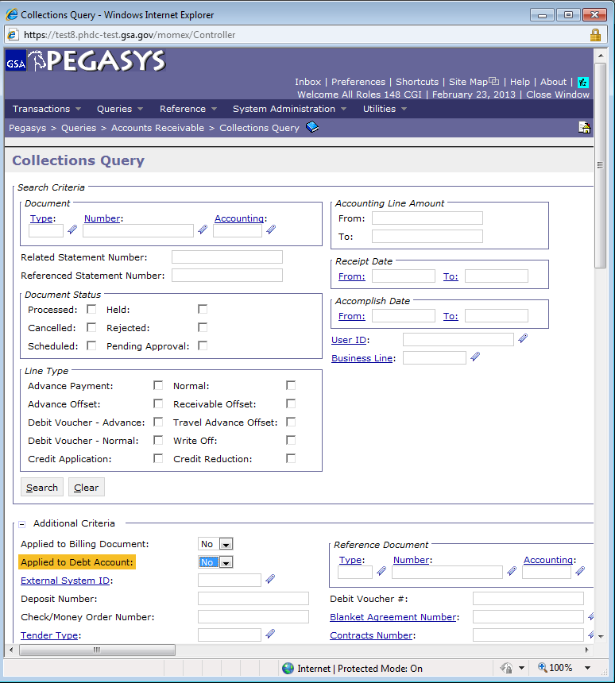
Collections Query – Search Criteria
Pegasys > Queries > Accounts Receivable > Collections Query
General Criteria | Collection Specific Criteria
Document Number | Deposit Number
Document Status | Applied or Unapplied
Vendor Code | Input System (Lockbox, Pay.gov, etc)
Document Date | Business Line
Statement Number | Receivable Type
CGI Federal Proprietary and Confidential

Slide 109
Exercise
Exercise 3: Correct and Process Rejected ITC and Recycling Lockbox Collections via the Collections Query

Slide 110
Segment 7:
Manual Billing Reports

Slide 111
Table of Contents
Segment 1: Manual Billing Overview & Key Concepts
Segment 2: Creating Unbilled Receivables
Segment 3: Recycling- Billing and Downstream Processes
Segment 4: ITC- Billing and Downstream Processes
Segment 5: Manual Billing Cycle Overview
Segment 6: Manual Billing Queries
Segment 7: Manual Billing Reports
Reports Overview
Report Execution / Retrieval
Custom Reports

Slide 112
Dunning
Reports Overview

Slide 113
Report Execution Process
BAAR reports are generated from BAAR reporting tables, which are populated by a series of Extract, Transform and Load (ETL) processes
Two methods of running reports:
On-Demand Reports (Manual Reports)
On-Demand reports can be run on an as-needed basis
Utilities > Reports > View Reports
Scheduled Reports (Automated Reports)
Scheduled reports are generated by Pegasys on a predetermined basis
Tivoli jobs are configured to run each ETL job and BIRT report
The jobs will pick up the prior day’s activity and record the transactions onto the BAAR reporting tables
Once this occurs, reports run on that day will be current with data processed through the prior day
Notes:
GSA is still working out the schedule for how often to run reports during UAT but scheduled reports will automatically be generated through Tivoli once or twice a week as determined necessary. The tentative plan is to run the reports every Tues and Thursday based on which grouping the report was assigned. They will be posted to the Pegasys Reports Portal under the Current Monthly reports directory where testers can retrieve them. On-demand reports can be run at any time by the tester but will only be accurate with data as of the prior business day.

Slide 114
Dunning
Report
Execution / Retrieval

Slide 115
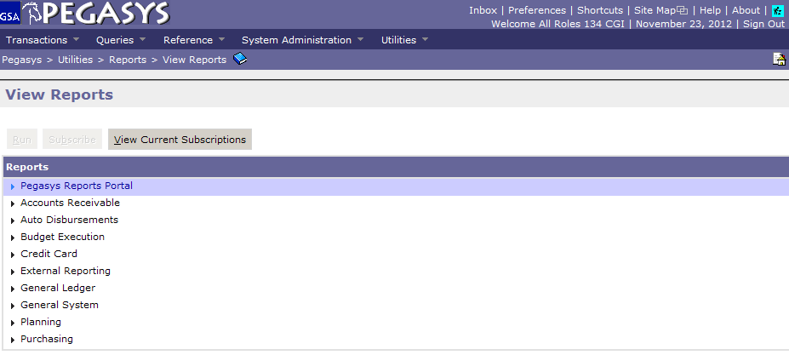
Retrieving a Scheduled Report
Scheduled reports generated through Tivoli are posted to the Pegasys Reports Portal
Retrieved in Pegasys
Navigate to Utilities > Reports > View Reports
Scheduled reports are executed under: Pegasys Reports Portal

Slide 116
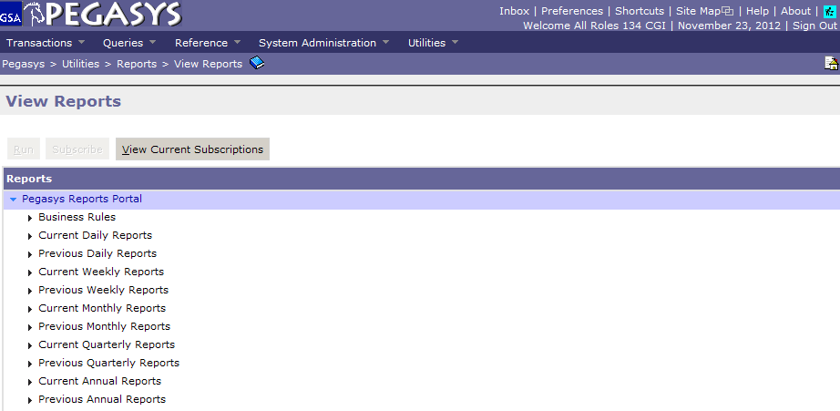
Retrieving a Scheduled Report (cont.)
Folders have been established to store current daily, weekly, monthly, quarterly and annual reports
As new reports are generated and posted to the “Current” folder, scripts are run to move older reports from the “Current” to the “Previous” folders

Slide 117
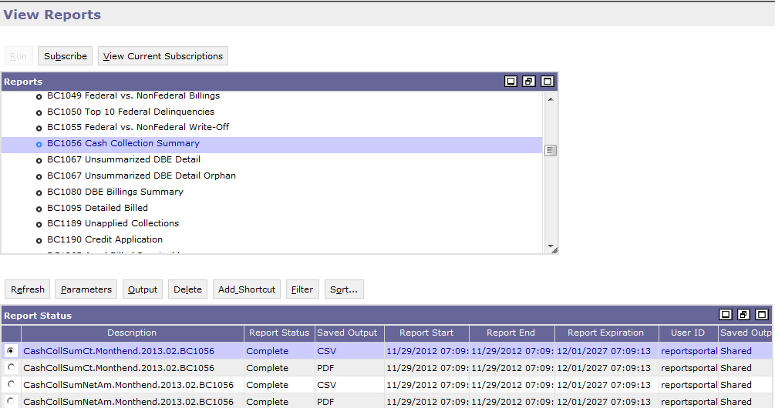
Retrieving a Scheduled Report (cont.)
Select desired report under the “Current Monthly Reports” folder
Select the desired output from the results and click the Output button
Some reports have many outputs because they have different “views” (CSV, PDF, HTML)
Use the Description to identify the report outputs
The Description can be used to identify the report view and parameters
Description format = ReportFileName.Frequency.YYYY.MM.parameter tags
Select a record and click the Output button to view the PDF or CSV output

Slide 118
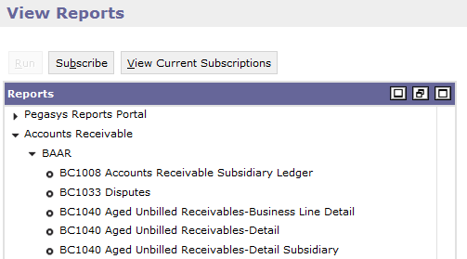
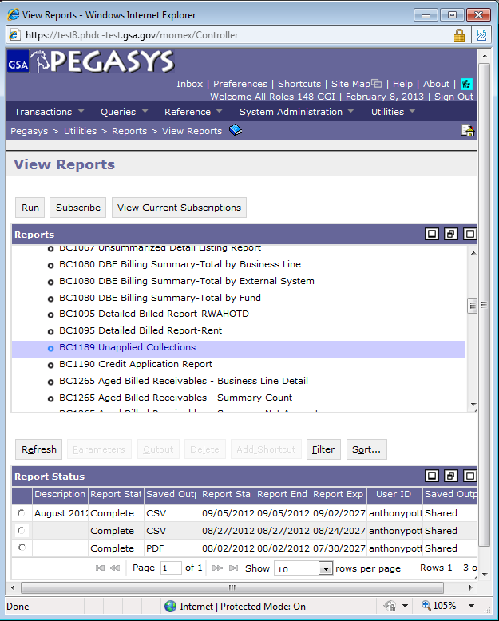
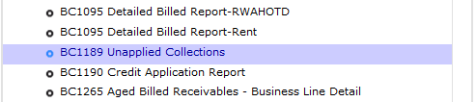
Running an On-Demand Report
Navigate to Utilities > Reports > View Reports
On-demand reports are executed under: Accounts Receivable > BAAR
There will be an entry for each report view available to run
Select the desired report and click Run

Slide 119
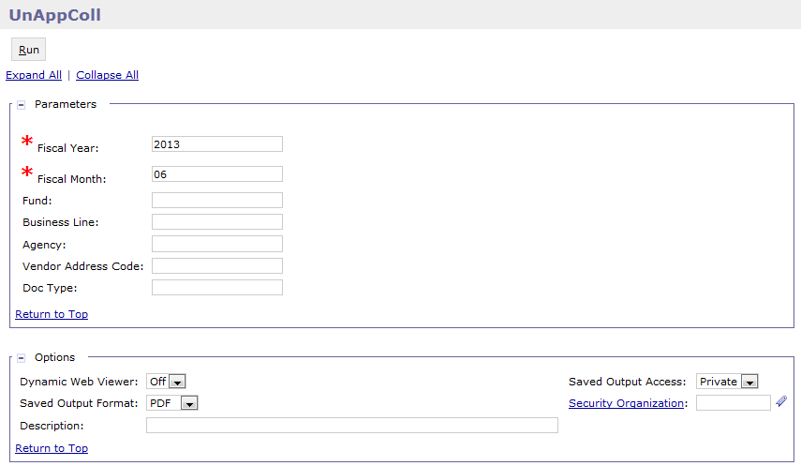
Running an On-Demand Report (cont.)
Enter any required parameters
Select the Saved Output Format of PDF or CSV
Enter a Description if desired
Select a Saved Output Access value:
Private: allows only the user running report to view output
Shared: allows the output to be viewed by other users in the system
Select the Run button
Close the window to return to the View Reports page

Slide 120
Dunning
Custom Reports

Slide 121
Manual Billing Reports
Aged Billed Receivables Report (BC1265)
The Aged Billed Receivables report is generated weekly and monthly. This report provides management with the tools to track outstanding non-IPAC billed receivables by business line and region by displaying outstanding non-IPAC billed receivables by business line, region, and age (days old and delinquent). There are four views for this report: Business Line Detail, Summary by Net Amount, Summary by Count and Detail. Dollar volume and counts are displayed by age categories on the summary views. This report includes both federal and non-federal outstanding receivables.
Frequency: Weekly/Monthly
Unapplied Collections Report (BC1189)
The Unapplied Collections report lists cash receipt transactions that have not been applied to receivables. It includes transactions that do not have a reference to a billing document along with those that are in a held or rejected status in Pegasys.
CGI Federal Proprietary and Confidential

Slide 122

Questions

