Slide 1
BAAR System Operations Training Phase 3
October 2015

Slide 2
Welcome!

Slide 3
Table of Contents
Segment 1: BAAR Introduction
Segment 2: BAAR Technical Architecture
Segment 3: BAAR Batch Jobs
Segment 4: BAAR Billing Cycle
Segment 5: Tivoli Job Streams
Segment 6: Data Exchanges with Pegasys

Slide 4
Segment 1:
BAAR Introduction

Slide 5
Segment Outline
Segment 1: BAAR Introduction
BAAR Phase 1 Overview
BAAR Phase 2 Overview
BAAR Phase 3 Introduction
Segment 2: BAAR Technical Architecture
Segment 3: BAAR Batch Jobs
Segment 4: BAAR Billing Cycle
Segment 5: Tivoli Job Streams
Segment 6: Data Exchanges with Pegasys

Slide 6
BAAR Project Phases
The Billing and Accounts Receivable Project (BAAR) Implementation is made up of 3 phases:
Phase 1
The Accounts Receivable (AR) module of Pegasys turned on
Phase 2
New features and business lines implemented
Phase 3
Additional features and business lines will be implemented
National Electronic Accounting and Reporting (NEAR) will be fully retired

Slide 7
BAAR Phase 1 Overview
Functionality implemented for Phase 1:
Pegasys Accounts Receivable
Receiving vendor updates from NABAS
Receiving detail billings records from GSA feeder systems
Generating receivable transactions and recording GL impact
Billing customers via IPAC and VCSS
Tracking billed and unbilled receivables; generating dunning
Receiving collections from customers via IPAC, Lockbox, check, etc.
Recording/resolving customer disputes/chargebacks
Processing credits, write-offs, and adjustments
Billing and Accounts Receivable reporting
VCSS (Vendor/Customer Self-Service)
Business Lines: Fleet and Rent
Phase 1 went live August 2011

Slide 8
BAAR Phase 2 Overview
Functionality implemented for Phase 2:
Leveraged existing BAAR functionality implemented with Phase 1
Implemented new Accounts Receivable functionality, including:
Project Cost Accounting System (PCAS)
Pegasys module that provides the ability to manage the relationship between GSA and the customer through the use of customer agreements
Revenue Credit Card Billing
Pay.gov via CIR (Collections Information Repository)
DoD Interfund Billing/Collections
CIR Reconciliation
2A went live in July 2013; 2B went live in January 2014

Slide 9
BAAR Phase 2 Overview (cont.)
Functionality implemented in Phase 2:
Receiving vendor updates from CAF
Receiving agreements from RETA
Receiving DBRs via flat files
Generating receivable transactions and recording GL impact
Billing customers via IPAC, Credit Card, and VCSS
Tracking billed and unbilled receivables; generating dunning
Receiving collections from customers via IPAC, Lockbox, Credit Card, etc.
Recording/Resolving customer disputes/chargebacks
Processing credits and adjustments
Providing reporting functions

Slide 10
BAAR Phase 2 Business Lines
Automated Business Lines (Full Name) | Business Line (Short Name) | Phase | Finance Division
Reimbursable Work Authorization | RWA | 2A | 7
Heating Operation and Transmission District | HOTD | 2A | 7
Global Supply | SUPPLY | 2B | 6
Automotive Purchases | AUTOPURCH | 2B | 6
Multiple Award Schedule | MAS | 2B | 6
Government Wide Acquisition Contract | GWAC | 2B | 6
Travel and Transportation | TRAVTRAN | 2B | 6
Manual Business Lines | Phase | Finance Division
GM&A Central Office PCAS | 2A | 6
Acquisition Policy | 2A | 6
Office of Inspector General (OIG) Investigative Programs | 2A | 6
Real Property Utilization and Disposal Division (RPUDD) | 2A | 6
US Marshal Service Personal Property Sales | 2A | 6
Personal Property Center | 2B | 6
eTravel | 2B | 6

Slide 11
BAAR Phase 3 Introduction
Phase 3 Enhanced Functionality
Leverages existing BAAR functionality currently in use today
Implements new Accounts Receivable functionality, including:
Debt Accounts (Claims)
Treasury Referrals Process
Automated Allowance for Loss
Treasury Report on Receivables (TROR)

Slide 12
BAAR Phase 3 Introduction
BAAR Phase 3 implements remaining business lines from NEAR
Implemented in 6.5
Wave 3.1 (Aug 2014) – Simple/low complexity Manual Business lines. Use Agreement/Non-Agreement based billing methods. No new batch jobs or cycles.
Wave 3.2 (Feb 2015) – Medium complexity Manual Business lines. Create new document types. Non-agreement based billing method or flat-rate based agreement billing method. No new batch jobs or cycles.
Implemented in 7.1.2
Wave 3.3 (Nov 2015) – Outlease, Claims, and Complex Manual Business lines. New batch jobs and cycles.
Wave 3.4 (Feb 2016) – AAS, ITS, Telecom, WAN. New batch jobs and cycles.
Workload Characteristics
Lower data volumes
New and additions to existing batch cycles
New ETL and report outputs

Slide 13
BAAR Phase 3 Manual Business Lines: Waves 3.1 and 3.2
Business Process | Wave | Finance Division
AAMS-EADS | 3.1 | 6
Board of Contract Appeals | 3.1 | 6
Comprehensive HR Integration System (CHRIS) Program | 3.1 | 6
Congressional Support Prg | 3.1 | 6
ECIPC | 3.1 | 6
Government Wide Policy | 3.1 | 6
NCSC - PBS Billing | 3.1 | 6
Teleproduction | 3.1 | 6
Training Programs- Federal Acquisition Institute (FAI) – SARAH | 3.1 | 6
Broker Rebates | 3.1 | 7
NGAP | 3.1 | 7
Concessions | 3.1 | 7
Pay to Park | 3.1 | 7
Fund 210X Manual Payroll Processing | 3.2 | 6
Employee Details (PIF Program and 18F) | 3.2 | 6
Working Capital Fund – External Clients - Updated | 3.2 | 6
CGI Federal Proprietary and Confidential

Slide 14
BAAR Phase 3 Automated Business Lines: Waves 3.3 and 3.4
Business Line (Full Name) | Business Line (Short Name) | Wave | Finance Division
Claims | R6CLAIMS, R7CLAIMS | 3.3 | 6 and 7
Outlease | OUTLEASE | 3.3 | 7
National Assisted Acquisition Services-FEDSIM | AASFEDSIM | 3.4 | 6
Regional Assisted Acquisition Services | AASREGIT | 3.4 | 6
Integrated Workplace Acquisition Center (IWAC) | IWAC | 3.4 | 6
Regional Network Services-Expanded Services | ITSEXPSER | 3.4 | 6
Wide Area Network | ITSWAN | 3.4 | 6
Regional Network Services-Telecom | ITSREGTEL | 3.4 | 6
National IT Commodity Program | ITSNATITCM | 3.4 | 6
HSPD-12 | ITSHSPD12 | 3.4 | 6

Slide 15
BAAR Phase 3 Manual Business Lines: Waves 3.3 and 3.4
Business Process | Wave | Finance Division
Employee Details – other | 3.3 | 6
IT Schedule-IT Comm Ctr-SmartBuy | 3.3 | 6
Transportation Audit | 3.3 | 6
TMVCS/Travel Training | 3.3 | 6
External Services Clients | 3.3 | 6
Scrap Metal | 3.3 | 6
Recycling | 3.3 | 7
International Trade Center | 3.3 | 7
Public Key Infrastructure (PKI) | 3.4 | 6
Network Rebate Treasury (WAN Process) | 3.4 | 6
Great Seal of US | 3.4 | 6
Interagency Council | 3.4 | 6
University for People | 3.4 | 6
Federal Citizen Services (FCS) | 3.4 | 6
IAE- Integrated Acquisition Environment | 3.4 | 6

Slide 16
Segment 2:
BAAR Technical Architecture

Slide 17
Segment Outline
Segment 1: BAAR Introduction
Segment 2: BAAR Technical Architecture
Technical Architecture Overview
Pegasys BAAR Subsystem Overview
FMESB Overview
VCSS Overview
BAAR Reporting Overview
Segment 3: BAAR Batch Jobs
Segment 4: BAAR Billing Cycle
Segment 5: Tivoli Job Streams
Segment 6: Data Exchanges with Pegasys

Slide 18
BAAR Technical Architecture
GSA
FM ESB
GSA Feeder systems
PDC
Business
Intelligence
External FTP Server
Business Objects
Web Pres database
Workflow
WM
Pegasys
Database
REPORTS
database
Webserver
Apache
Weblogic
Tuxedo
Shareplex
Integration
WM
VCSS
VCSS
ACQ App
VCSS
Webserver
Apache
VCSS
Weblogic
CGI Federal Proprietary and Confidential

Slide 19
BAAR Technical Architecture (cont.)
BAAR Technical Architecture consists of 4 major components:
FM-ESB
Pegasys BAAR subsystem
VCSS
BAAR Reporting

Slide 20
BAAR Technical Architecture (cont.)
FM-ESB:
Facilitates end-to-end transmission of billing-related files from GSA Feeder Systems to Pegasys and return of processing results to the originating feeder system
Provides batch control checks, sFTP, logging, file translation, email notifications, web services
Phase 2 feeder systems:
RWA/HOTD Billing (Phase 2a): Submits web service calls to create PCAS agreements
Supply Billing (Phase 2b): Submits billing-related files to Pegasys
Pegasys creates Detail Billing Records (DBRs) from billing-related data
Submits Treasury Reporting System (TRS) collection data files from GSA to Pegasys

Slide 21
BAAR Technical Architecture (cont.)
FM-ESB (cont.):
Phase 3 adds:
Region 7 Outleases and Region 6 AAS: Submits web service calls to create PCAS agreements
Region 6 AAS, Telecom, WAN: Submits Billing-related and Accrual files to Pegasys
Region 6 Telecom: Vendor Address file to Pegasys
Vehicle Claims: Debt Account file to Pegasys

Slide 22
BAAR Technical Architecture (cont.)
Pegasys BAAR Subsystem:
Provides functionality for accounts receivable processing cycle
Processing cycle involves batch jobs that are executed on a scheduled basis
Batch jobs perform billing and collection related activities
Manages dispute and chargeback resolution
Facilitates credit application (offsets, refunds, Treasury transfers) and receivable write-offs
Maintains customers via NABAS (Fleet, Rent, RWA) and CAF (Global Supply, Auto Purchases)
Phase 3 adds Allowance For Loss, Referral Selection, Treasury Referral External Offset Generation, External Collections, Treasury Referral External Offset Error, TROR, Write Off Selection, Write Off Generation

Slide 23
BAAR Technical Architecture (cont.)
Pegasys BAAR Subsystem (cont.):
Phase 3 adds:
Allowance For Loss
Referral Selection
Treasury Referral External Offset Generation
External Collections
Treasury Referral External Offset Error
TROR
Write Off Selection
Write Off Generation

Slide 24
BAAR Technical Architecture (cont.)
VCSS:
Provides customers and financial analysts capability to:
View billing information
Export billing data to comma separated values (CSV) files
Review account history and outstanding balances
Submit correspondences and disputes
Search for statements by Agreement Number
Search for status of disputes

Slide 25
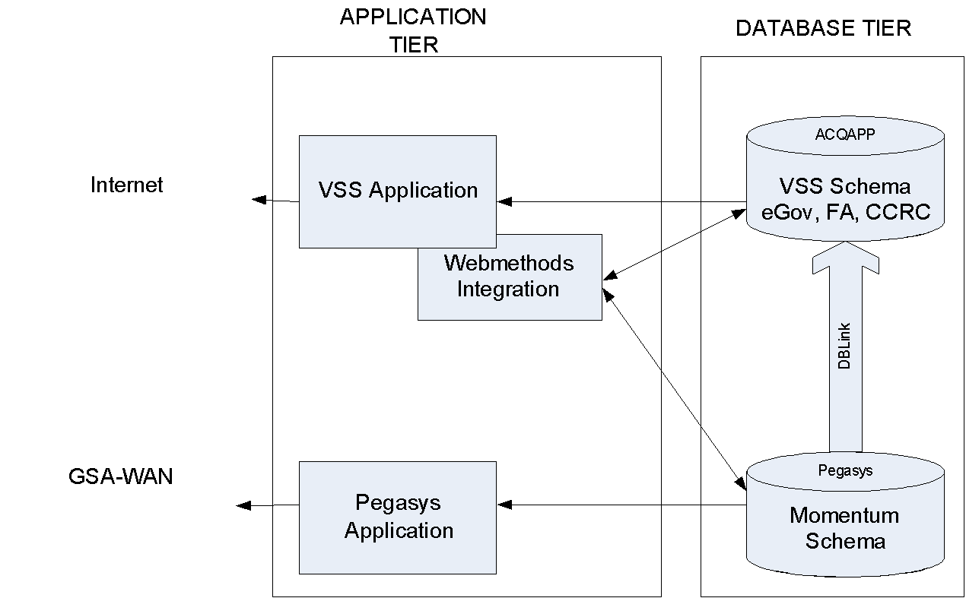
BAAR Technical Architecture (Cont.)
VCSS Architecture

Slide 26
BAAR Technical Architecture (cont.)
BAAR Reporting
Runs Daily and Monthly ETL processes
Periodic reports on weekly, semi-monthly, monthly, and quarterly basis
Posts reports to Momentum Reports Portal
On-demand reports in Pegasys application
CSV and PDF format

Slide 27
BAAR Technical Architecture (cont.)
Number | Phase 1 | Phase 2 | Phase 3
ETL - Daily | 20 | 5 | 0
ETL – Monthly | 11 | 4 | 1
ME Report Outputs | 118 | 616 | 600 to 4000 (TBD)
On-demand reports | 16 | 3 | 6

Slide 28
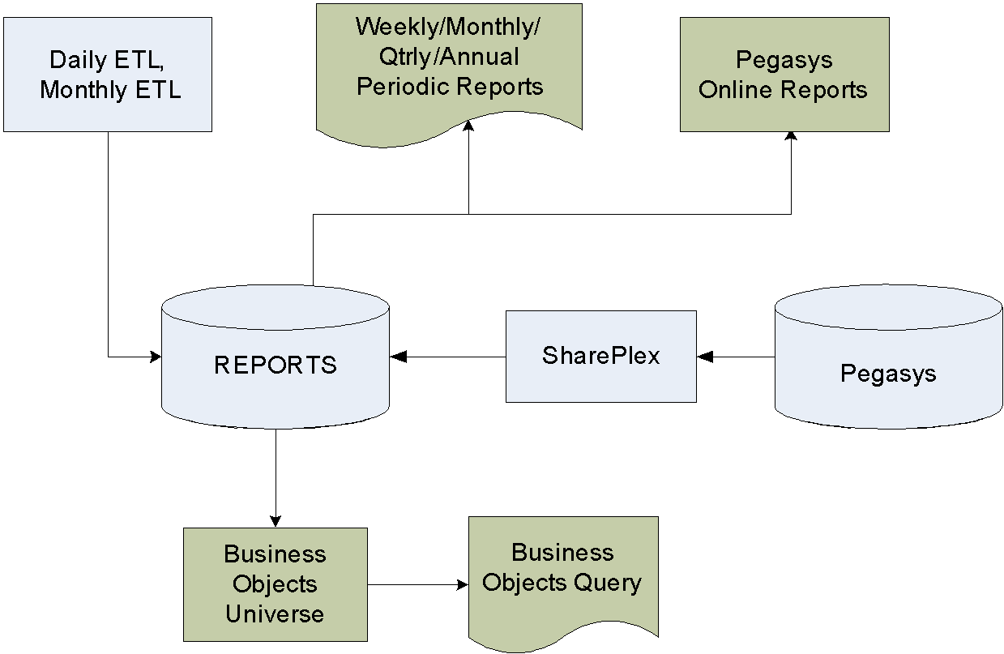
BAAR Technical Architecture (cont.)
Reports Architecture

Slide 29
Segment 3:
BAAR Batch Jobs

Slide 30
Segment Outline
Segment 1: BAAR Introduction
Segment 2: BAAR Technical Architecture
Segment 3: BAAR Batch Jobs
Business Line Batch Jobs Overview
Batch Job Return Codes
Allowance for Loss Batch Job
Referral Selection Batch Job
Treasury Referral and External Offset Generation Batch Job
External Collections Batch Job
Treasury Referral and External Offset Error Batch Job
TROR Select Batch Job
Segment 4: BAAR Billing Cycle
Segment 5: Tivoli Job Streams
Segment 6: Data Exchanges with Pegasys

Slide 31
Business Line Batch
Jobs Overview

Slide 32
Outlease Business Line: Overview
Agreement Processing:
Automated creation via new Outlease Agreement interface
Source system: Occupancy Agreement Tool (OA Tool)
Agreement type: External Direct (Document Category ED) > Non-IPAC only
Billing frequency: monthly, quarterly, annually
Bill amount determined via: flat rate documented on Agreement
Security Deposits and Advance Payments:
Received via Lockbox, manual Checks, EFT, and Credit Card (Pay.gov)
Revenue Recognition:
Recognize revenue monthly/quarterly/annually via PCPROJBILL, based on flat rate
Processed via Advance Offsets and/or Billing Documents
Billing-Based Collections:
Received via Lockbox, manual Checks, EFT, and Credit Card (Pay.gov)

Slide 33
Outlease Business Line: Batch Jobs
Functional Area | Batch Job | Process Code
Billing | PCAS Project Bill Generation | PCPROJBILL
 | Automated Credit Application | ARCRDAPP
 | A/R Bill Generation | ARBILLGEN
Collections | Lockbox | R7MARLOCKR
 | CIR Inbound | ARCIRIN
 | CIR Detail | TRSDETAIL
Agreement Management | PCAS Agreement Novation | PCASAGRNOV
 | Annual Close Expiring Unfilled Customer Order Reversal | ACCSTORRVS

Slide 34
Outlease Business Line: Batch Jobs
Functional Area | Batch Job | Process Code
Delinquency Management | Dunning Notice Generation | ARDUNNING
 | Overdue Charges Generation | AROVERDUE
 | Referral Selection | ARREFERSEL
 | Treasury Referral Extract | ARTREOEX
 | External Collections Processor | AREOCOLL
 | Treasury Referral Error Processor | ARTREOERR
 | Allowance for Loss | ARALLOWLOS
 | IPAC Inbound Processor | GSIPACIN
 | TROR Selection | ERTROR

Slide 35
Outlease Business Line: Cycles Overview
Pre-Billing:
Day 4
PCAS Bill Generation (PCPROJBILL)
Billing:
Day 4
Overdue Charges Generation (AROVERDUE)
Automated Credit Application (ARCRDAPP)
Bill Generation (ARBILLGEN)
Dunning:
10th of month
Dunning Generation (ARDUNNING)

Slide 36
Region 6 Claims Business Line: Overview
Claim Initiation:
Vehicle claims: Interface processing of Pegasys Debt Account document via GSA Comprehensive Accident Reporting Systems (CARS)
All other R6 claims: Manual processing of Pegasys Debt Account document
First Demand Letter Generation:
Program Office claims: generated by the Program Office, not via Pegasys
All other R6 claims: generated via Pegasys Dunning Generation batch job
Promissory Note (potential step based on debtor action):
Amortization Schedule created in Pegasys based on principal amount
Run Promissory Note report and send to debtor for signature/notary
Collections:
Received via Lockbox, manual Checks, EFT, and Credit Card (Pay.gov)
Note: Lockbox collections for R6 Claims will be entered manually by Region 6 Finance Division instead of via the Lockbox batch job.

Slide 37
Region 7 Claims Business Line: Overview
Claim Initiation:
Manual processing of Pegasys Debt Account document
First Demand Letter Generation:
Generated via Pegasys Dunning Generation batch job
Promissory Note (potential step based on debtor action):
Amortization Schedule created in Pegasys based on principal amount
Run Promissory Note report and send to debtor for signature/notary
Collections:
Received via Lockbox, manual Checks, EFT, and Credit Card (Pay.gov)

Slide 38
R6/R7 Claims Business Lines: Batch Jobs
Functional Area | Batch Job | Process Code
First Demand Letter | Dunning Notice Generation | ARDUNNING
Collections | Lockbox | R7MARLOCKR
 | CIR Inbound | ARCIRIN
 | CIR Detail | TRSDETAIL
Delinquency Management | Dunning Notice Generation | ARDUNNING
 | Overdue Charges Generation | AROVERDUE
 | Referral Selection | ARREFERSEL
 | Treasury Referral Extract | ARTREOEX
 | External Collections Processor | AREOCOLL
 | Treasury Referral Error Processor | ARTREOERR
 | Write-Off Selection | ARWOSEL
 | Write-Off Generation | ARWOGEN
 | Allowance for Loss | ARALLOWLOS
 | IPAC Inbound Processor | GSIPACIN
 | TROR Selection | ERTROR

Slide 39
R6 Claims Business Line: Cycles Overview
Overdue Charges, Write-Offs, and Dunning:
Daily
Pay.gov (ARCIRIN/TRSDETAIL)
Overdue Charges Generation (AROVERDUE)
Write-Off Selection/Generation (ARWOSEL/ARWOGEN)
Dunning Generation (ARDUNNING)
Referral Selection (ARREFSEL)
Allowance for Loss and Referrals:
ME before reporting
Allowance for Loss (ARALLOWLOS)

Slide 40
R7 Claims Business Line: Cycles Overview
Overdue Charges, Write-Offs, and Dunning:
Daily
Lockbox (ARLOCKREC)
Pay.gov (ARCIRIN/TRSDETAIL)
Overdue Charges Generation (AROVERDUE)
Write-Off Selection/Generation (ARWOSEL/ARWOGEN)
Dunning Generation (ARDUNNING)
Allowance for Loss and Referrals:
ME before reporting
Allowance for Loss (ARALLOWLOS)
Mid-month
Referral Selection (ARREFSEL)

Slide 41
Region 6 Manual Business Lines: Overview
Manual Business Line | Customer Types |  |  | Billing Cycle |  |  |  | Billing Model |  |  | Billing Method |  |  | PCAS Agreements |  |  | Collection Method(s) |  |  |  |  |  | Miscellaneous
 | Federal | Non-Federal | Internal | Monthly | Quarterly | Annually | As Needed | PCAS Agreements | Manual BD/NV/SVs | Collections Only | IPAC | Non-IPAC | Internal Transfer | Actual Spending | Agreement Charges | Flate Rate/Percent | IPAC | Lockbox | Pay.gov | ECP (checks) | CIR | Manual Misc/other | Income Accruals | Surcharges | Cost Transfers | Advances | Payments Only
Region 6
Wave 3.3
Employee Details - Other |  |  | X | X |  |  |  |  | X |  |  |  | X
External Services | X | X |  | X |  |  |  | X | X | X | X | X |  | X | X |  | X |  | X |  | X | X | X |  |  | X
SmartBuy |  | X |  |  |  |  |  |  |  | X |  |  |  |  |  |  |  |  |  |  | X
TMVCS/Travel Training | X | X | X | X |  |  |  |  | X |  | X | X | X |  |  |  | X | X | X |  | X | X
Transportation Audit - TARPS |  | X |  |  |  |  |  |  |  |  |  |  |  |  |  |  |  |  |  |  |  | X
Scrap |  | X |  | X |  |  |  |  | X |  |  | X |  |  |  |  |  | X | X |  | X | X |  |  |  |  | X
Wave 3.4
Public Key Infurstructure (PKI) | X |  |  |  |  |  | X |  | X |  | X |  |  |  |  |  | X
WAN Processes - Treasury Rebate | X |  |  |  |  |  | X |  |  |  | X |  |  |  |  |  |  |  |  |  |  |  |  |  |  |  | X
IAE (Integrated Acquisition Environment) | X |  | X | X |  |  |  | X | X |  | X |  | X |  |  | X | X |  |  |  |  |  | X |  |  | X
Interagency Council | X |  | X | X |  |  |  | X | X |  | X |  | X |  | X |  | X |  |  |  |  |  | X |  |  | X
FCS | X |  | X |  | X |  |  | X |  | X | X |  | X | X | X |  | X | X | X | X | X |  | X
Great Seal of US | X | X | X | X |  |  |  | X |  |  | X | X | X |  | X |  | X | X | X |  | X |  | X |  |  | X
University for People | X |  | X | X |  |  |  | X | X |  | X | X |  | X |  |  | X |  | X |  | X |  | X | X

Slide 42
Region 6 Manual Business Lines: Batch Jobs
Functional Area | Batch Job | Process Code
Billing | PCAS Surcharge Generation | PCSURGEN
 | PCAS Project Bill Generation | PCPROJBILL
 | Automated Credit Application | ARCRDAPP
 | A/R Bill Generation | ARBILLGEN
 | IPAC Outbound | GSIPACOUT
Collections | CIR Inbound | ARCIRIN
 | CIR Detail | TRSDETAIL
 | IPAC Inbound | GSIPACIN

Slide 43
Region 6 Manual Business Lines: Batch Jobs
Functional Area | Batch Job | Process Code
Agreement Management | PCAS Automated Accrual Generation | PCACCRUE
 | PCAS Agreement Novation | PCASAGRNOV
 | Annual Close Expiring Unfilled Customer Order Reversal | ACCSTORRVS
Delinquency Management | Dunning Notice Generation | ARDUNNING
 | Overdue Charges Generation | AROVERDUE
 | Allowance for Loss | ARALLOWLOS
 | TROR Selection | ERTROR

Slide 44
Region 6 Manual Business Lines: Cycles Overview
Pre-Billing:
20th of month
PCAS Surcharge Generation (PCSURGEN)
PCAS Bill Generation (PCPROJBILL)
Billing:
21st of month
Overdue Charges Generation (AROVERDUE)
Automated Credit Application (ARCRDAPP)
IPAC Outbound (GSIPACOUT)
Bill Generation (ARBILLGEN)
Dunning:
10th of month
Dunning Generation (ARDUNNING)
Collections:
Daily
Lockbox (ARLOCKREC)
Pay.gov (ARCIRIN/TRSDETAIL)
IPAC Inbound (GSIPACIN)

Slide 45
Region 7 Manual Business Lines: Overview
Manual Business Line | Customer Types |  |  | Billing Cycle |  |  |  | Billing Model |  |  | Billing Method |  |  | PCAS Agreements |  |  | Collection Method(s) |  |  |  |  |  | Miscellaneous
 | Federal | Non-Federal | Internal | Monthly | Quarterly | Annually | As Needed | PCAS Agreements | Manual BD/NV/SVs | Collections Only | IPAC | Non-IPAC | Internal Transfer | Actual Spending | Agreement Charges | Flate Rate/Percent | IPAC | Lockbox | Pay.gov | ECP (checks) | CIR | Manual Misc/other | Income Accruals | Surcharges | Cost Transfers | Advances | Payments Only
Region 7
Wave 3.3
ITC | X |  |  |  |  |  | X |  | X | X | X |  |  |  |  |  | X | X | X |  | X | X
Recycling |  | X |  | X |  |  |  |  | X |  |  | X |  |  |  |  |  | X | X |  | X | X |  |  |  |  | X
CGI Federal Proprietary and Confidential

Slide 46
Region 7 Manual Business Lines: Batch Jobs
Functional Area | Batch Job | Process Code
Billing | Automated Credit Application | ARCRDAPP
 | A/R Bill Generation | ARBILLGEN
 | IPAC Outbound | GSIPACOUT
Collections | Lockbox | R7MARLOCKR
 | CIR Inbound | ARCIRIN
 | CIR Detail | TRSDETAIL
 | IPAC Inbound | GSIPACIN
Delinquency Management | Dunning Notice Generation | ARDUNNING
 | Overdue Charges Generation | AROVERDUE
 | Allowance for Loss | ARALLOWLOS
 | TROR Selection | ERTROR

Slide 47
Region 7 Manual Business Lines: Cycles Overview
Billing:
Date TBD
Automated Credit Application (ARCRDAPP)
IPAC Outbound (GSIPACOUT)
Bill Generation (ARBILLGEN)
Overdue Charges and Dunning:
Date TBD
Overdue Charges Generation (AROVERDUE)
Dunning Generation (ARDUNNING)
Collections:
Daily
Lockbox (ARLOCKREC)
Pay.gov (ARCIRIN/TRSDETAIL)
IPAC Inbound (GSIPACIN)

Slide 48
AAS/ITS Business Lines: Overview
Business Line Description | Pegasys | Source System | Billing Model | Billing Method
AAS National Assisted Acquisition-FEDSIM | AASFedSim | NBA | Agreement/DBR Hybrid | IPAC, Non-IPAC, Interfund
AAS Regional IT Solution | AASREGIT | RBA | Agreement/DBR Hybrid | IPAC, Non-IPAC, Interfund
General Supply and Services (GSS) Integrated Workplace Acquisition Center | IWAC | RBA | Agreement/DBR Hybrid | IPAC, Non-IPAC, Interfund
ITS/ Network Services/Expanded Services-Acquisition | ITSEXPSER | RBA | Agreement/DBR Hybrid | IPAC, Non-IPAC, Interfund
ITS/National IT Commodity | ITSNATITCM | RBA | Agreement/DBR Hybrid | IPAC, Non-IPAC, Interfund
ITS/Strategic Program/HSPD-12 | ITSHSPD12 | NBA | Agreement/DBR Hybrid | IPAC, Non-IPAC, Interfund

Slide 49
AAS/ITS Business Lines: Overview
Agreement Processing:
Automated creation via new AAS Agreement interface
Source systems: Regional Business Application (RBA) and National Business Application (NBA)
Agreement type(s): External Direct (Doc Cat ED) and Internal Direct (Doc Cat ID)
Billing frequency: semi-monthly (twice per month) via DBRs received from AAS Billing Interface (not determined via agreement/PCPROJBILL)
Revenue Recognition:
Initiated via receipt of DBRs from new AAS Billing Interface
Source systems: RBA and NBA
DBR Import/Crosswalk/Summarization generates Pegasys BDs/NVs
Billing-Based Collections:
Received via IPAC, Lockbox, manual Checks, EFT, and Credit Card (Pay.gov)
Revenue Accruals:
AAS RBA Interim Revenue Accrual Interface
AAS NBA Interim Revenue Accrual Interface using Mass Import

Slide 50
AAS/ITS Business Lines: Batch Jobs
Functional Area | Batch Job | Process Code
Billing | Detail Billing Record Import | AASARDBIMP
 | Detail Billing Record Crosswalk | DTBLXWLK
 | Detail Billing Record Summarization | ARDBSUMR
 | Automated Credit Application | ARCRDAPP
 | IPAC Outbound | GSIPACOUT
 | A/R Bill Generation | ARBILLGEN
Collections | IPAC Inbound | GSIPACIN
 | Lockbox | ITARLOCKRE
 | CIR Inbound | ARCIRIN
 | CIR Detail | TRSDETAIL

Slide 51
AAS/ITS Business Lines: Batch Jobs
Functional Area | Batch Job | Process Code
Agreement Management | PCAS Agreement Novation | PCASAGRNOV
 | Annual Close Expiring Unfilled Customer Order Reversal | ACCSTORRVS
Delinquency Management | Dunning Notice Generation | ARDUNNING
 | Overdue Charges Generation | AROVERDUE
 | Allowance for Loss | ARALLOWLOS
 | TROR Selection | ERTROR

Slide 52
AAS/ITS Business Lines: Cycles Overview
Pre-Billing – Semi-Monthly (2 cycles per month):
Daily
DBR Import (AASARDBIMP)
DBR Crosswalk (DTBLXWLK)
DBR Summarization (ARDBSUMR)
Accrual Form Import (GSIMPORT)
Billing – Semi-Monthly (2 cycles per month):
Day 5 and Day 20
Automated Credit Application (ARCRDAPP)
IPAC Outbound (GSIPACOUT)
Bill Generation (ARBILLGEN)
Receivables Management:
Monthly – Day 2
Allowance for Loss (ARALLOWLOS)
Monthly – Day 4 (after BAAR_FLEET_4)
Overdue Charges Generation (AROVERDUE)
Dunning Generation (ARDUNNING)

Slide 53
Telecom/WAN Business Lines: Overview
Business Line Description | Pegasys | Source System | Billing Model | Billing Method
ITS/Network Services/WAN | ITSWAN | TOPS, WITS, E-MORRIS | DBR Only | IPAC, Non-IPAC, Interfund
ITS/ Network Services/Regional Telecom | ITSREGTEL | TOPS, WITS, E-MORRIS | DBR Only | IPAC, Non-IPAC, Interfund

Slide 54
Telecom/WAN Business Lines: Overview
Record Telecom Vendors (Telecom/WAN):
Initiated via new Telecom Address Interface
Source systems:
Telecommunications Ordering and Pricing System (TOPS)
Washington Interagency Telecommunications System (WITS)
Revenue Recognition:
Initiated via receipt of DBRs from new Telecom/WAN Billing Interface
Source systems:
Telecom Ordering and Pricing System (TOPS)
Washington Interagency Telecommunications System (WITS)
E-Enhanced Monthly On-Line Records and Reports of Information Technology Service (E-MORRIS)
DBR Import/Crosswalk/Summarization generates Pegasys BDs/NVs
Billing-Based Collections:
Received via IPAC, Lockbox, manual Checks, EFT, and Credit Card (Pay.gov)
Revenue Accruals:
Telecom Revenue Accrual Interface

Slide 55
Telecom/WAN Business Lines: Batch Jobs
Functional Area | Batch Job | Process Code
Billing | Detail Billing Record Import | AASARDBIMP
 | Detail Billing Record Crosswalk | DTBLXWLK
 | Detail Billing Record Summarization | ARDBSUMR
 | Automated Credit Application | ARCRDAPP
 | IPAC Outbound | GSIPACOUT
 | A/R Bill Generation | ARBILLGEN
Collections | IPAC Inbound | GSIPACIN
 | Lockbox | ITARLOCKRE
 | CIR Inbound | ARCIRIN
 | CIR Detail | TRSDETAIL
Delinquency Management | Dunning Notice Generation | ARDUNNING
 | Overdue Charges Generation | AROVERDUE
 | Allowance for Loss | ARALLOWLOS
 | TROR Selection | ERTROR

Slide 56
Telecom Business Line: Cycles Overview
Pre-Billing:
Day 23 and Daily – 24th to last day of month
DBR Import (AASARDBIMP)
DBR Crosswalk (DTBLXWLK)
DBR Summarization (ARDBSUMR)
Billing – monthly:
Day 5
Automated Credit Application (ARCRDAPP)
IPAC Outbound (GSIPACOUT)
Bill Generation (ARBILLGEN)
Receivables Management:
Monthly – Day 2
Allowance for Loss (ARALLOWLOS)
Monthly – Day 4 (after BAAR_FLEET_4)
Overdue Charges Generation (AROVERDUE)
Dunning Generation (ARDUNNING)

Slide 57
WAN Business Line: Cycles Overview
Pre-Billing:
Day 10
DBR Import (AASARDBIMP)
DBR Crosswalk (DTBLXWLK)
DBR Summarization (ARDBSUMR)
Automated Credit Application (ARCRDAPP)
Daily – 24th to last day of month
DBR Import (AASARDBIMP)
DBR Crosswalk (DTBLXWLK)
DBR Summarization (ARDBSUMR)
Billing – monthly:
Day 11
IPAC Outbound (GSIPACOUT)
Bill Generation (ARBILLGEN)
Receivables Management:
Monthly – Day 2
Allowance for Loss (ARALLOWLOS)
Monthly – Day 4 (after BAAR_FLEET_4):
Overdue Charges Generation (AROVERDUE)
Dunning Generation (ARDUNNING)

Slide 58
External Services Business Line: Overview
Agreement Processing:
Manual creation of agreements (USIP and Other Clients)
Agreement type: External Direct (Document Category ED) > IPAC and Non-IPAC
Billing frequency: monthly, quarterly, annually
Bill amount determined via:
Actual Spending – USIP
Agreement Charges – All other non-USIP
Non-agreement based processing:
Manual creation of non-PCAS/non-DBR Billing Documents
Advance Collection via:
IPACOUT/IPACIN to record advance collection
Debit Voucher chargeback of Advance Payments
Revenue Recorded by:
Bill monthly via PCPROJBILL
Accruals:
Monthly self-reversing accruals via PCACCRUE for agreement based billing

Slide 59
External Services Business Line: Batch Jobs
Functional Area | Batch Job | Process Code
Billing | PCAS Project Bill Generation | PCPROJBILL
 | Automated Credit Application | ARCRDAPP
 | IPAC Outbound | IPACOUT
 | A/R Bill Generation | ARBILLGEN
Collections | IPACIN | IPACIN
 | CIR Inbound | ARCIRIN
 | CIR Detail | TRSDETAIL
Agreement Management | PCAS Agreement Novation | PCASAGRNOV
 | Annual Close Expiring Unfilled Customer Order Reversal | ACCSTORRVS

Slide 60
External Services Business Line: Batch Jobs
Functional Area | Batch Job | Process Code
Delinquency Management | Dunning Notice Generation | ARDUNNING
 | Overdue Charges Generation | AROVERDUE
 | Allowance for Loss | ARALLOWLOS
 | TROR Selection | ERTROR

Slide 61
External Services Business Line: Cycles Overview
Billing:
Day 20
PCProjBill (PCPROJBILL)
Credit Application (ARCRDAPP)
IPAC Outbound (IPACOUT)
Bill Generation (ARBILLGEN)
Daily
CIR Inbound for Pay.gov
IPAC Inbound for ALC18 (IPACIN)
Non-IPAC Bill Generation (ARBILLGEN)
Except for 20th
Dunning:
10th of month
Dunning Generation (ARDUNNING)

Slide 62
Shared Business Line Batch Job Overview
The following new batch jobs will be used by multiple Phase 3 and prior phase business lines:
Write-Off Selection (ARWOSEL)
Write-Off Generation (ARWOGEN)
Allowance for Loss (ARALLOWLOS)
Referral Selection (ARREFERSEL)
Treasury Referral Extract (ARTREOEX)
External Collections (AREOCOLL)
Treasury Referral Error Processor (ARTREOERR)
TROR Selection (ERTROR)

Slide 63
Batch Job Return Codes

Slide 64
Batch Job Return Codes
Return Code | Explanation
-1 | Scheduled Job error
0 | Successful Execution
1 | Executable could not be found
3 | Problem in RunBatch only
4 | Program completed with warnings
8 | Program completed with data errors
12 | Program completed with server errors
33 | Problem with tuxedo on client machine
34 | Job manager server is down
65 | Op lock error
67 | Database error
68 | Generic object core exception
69 | Transport Error
70 | Unknown exception
255 | Severe unknown exception

Slide 65
Allowance for Loss

Slide 66
Allowance for Loss (ARALLOWLOS) Batch Process Overview
An allowance for estimated losses is recorded for receivables that GSA believes will not be fully collected
Receivables are presented on the Balance Sheet at Net Realizable Value
Net Realizable Value = Total Accounts Receivable - Allowance for Loss
Established based on the history of collections and responses or non-responses from debtor customers
Business Lines establish selection criteria to calculate the Allowance for Loss on the Allowance For Loss Selection Criteria Maintenance table
The Allowance for Loss (ARALLOWLOS) batch job calculates and records the Allowance for Loss in Pegasys
CGI Federal Proprietary and Confidential

Slide 67
Allowance for Loss (ARALLOWLOS) Batch Process Overview
The Allowance for Loss (ARALLOWLOS) batch process
Posts the Allowance for Loss at the detail accounting dimension level
Generates a self-reversing Standard Voucher (SV) document that processes:
Non-Federal Receivables:
Bad Debt Expense (debit)
Allowance for Loss (credit)
Federal Receivables:
Contra Revenue (debit)
Allowance for Loss (credit)
Does not calculate Allowance for Losses for:
Foreign debts
Produces an Allowance for Loss Reconciliation Output file

Slide 68
Allowance for Loss (ARALLOWLOS) Batch Process Overview
The Allowance for Loss batch process will generate SVs based on the parameters specified
Parameters are set such that SVs will be generated as follows for Federal versus Non-Federal debt:
SV Field | Federal | Non-Federal
Transaction Event | Revenue | GL Transfer
Increase/Decrease Indicator | Decrease | Increase
Revenue Source Code | Revenue Source Code from the related BD | Blank
Sub-Object Class | Blank | T01

Slide 69
Allowance for Loss (ARALLOWLOS) Batch Process Output File
Allowance for Loss Reconciliation Output File
Details the relationship between the documents selected and the SV generated by the batch job
Contains the following information:
Document Category, Document Type, and Document Number
Statement Number
Line Number, including Charge Lines for BDs
Allowance for Loss Code and Allowance for Loss Priority Row
Outstanding Line Amount
Percentage of Loss Applied
Calculated Allowance Amount
Associated SV Document Type, SV Document Number, and SV Line Number

Slide 70
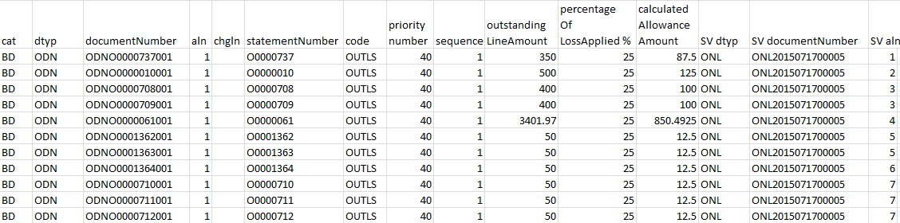
Allowance for Loss (ARALLOWLOS) Batch Process Output File
Allowance for Loss Reconciliation Output File

Slide 71
Allowance for Loss (ARALLOWLOS) Batch Job Instances
Process Code | Job ID | Job Name
ARALLOWLOS | RHFARALLOWLOS | RWA/HOTD Federal Allowance for Loss Batch Process
 | RHNFARALLOWLOS | RWA/HOTD Non Federal Allowance for Loss Batch Process
 | OLARALLOWLOS | Outlease Allowance for Loss Batch Process
 | RNTFARALLOWLOS | Rent Federal Allowance for Loss Batch Process
 | R7MLFARALLOWLOS | Region 7 Manual Federal Allowance for Loss Batch Process
 | R7MLNFARALOWLOS | Region 7 Manual Non-Federal Allowance for Loss Batch Process
 | R7CARALLOWLOS | Region 7 Claims Allowance for Loss Batch Process
 | SUFARALLOWLOS | Supply Federal Allowance for Loss Batch Process
 | SUNFARALLOWLOS | Supply Non Federal Allowance for Loss Batch Process
CGI Federal Proprietary and Confidential

Slide 72
Allowance for Loss (ARALLOWLOS) Batch Job Instances
Process Code | Job ID | Job Name
ARALLOWLOS | FLFARALLOWLOS | Fleet Federal Allowance for Loss Batch Process
 | FLNFARALLOWLOS | Fleet Non Federal Allowance for Loss Batch Process
 | AMFARALLOWLOS | Automotive Federal Allowance for Loss Batch Process
 | AMNFARALLOWLOS | Automotive Non Federal Allowance for Loss Batch Process
 | R6CARALLOWLOS | Region 6 Claims Allowance for Loss Batch Process
 | FEDSMFARALOWLOS | AAS - National - FEDSIM Federal Allowance for Loss Batch Process
 | FEDSMNFARALOWLO | AAS - National - FEDSIM Non Federal Allowance for Loss Batch Process
 | REGITFARALOWLOS | AAS - Regional - IT Federal Allowance for Loss Batch Process
 | REGITNFARALOWLO | AAS - Regional - IT Non Federal Allowance for Loss Batch Pro
CGI Federal Proprietary and Confidential

Slide 73
Allowance for Loss (ARALLOWLOS) Batch Job Instances
Process Code | Job ID | Job Name
ARALLOWLOS | IWACFARALLOWLOS | Integrated Workplace Acquisition Center Federal Allowance
 | IWACNFARALOWLOS | Integrated Workplace Acquisition Center Non Federal Allowance
 | EXPSRFARALOWLOS | Regional Network Service-Expanded Service Federal Allowance
 | EXPSRNFARALOWLO | Regional Network Service-Expanded Service Non Federal Allowance
 | HSPDFARALLOWLOS | HSPD-12 Federal Allowance for Loss Batch Process
 | HSPDNFARALOWLOS | HSPD-12 Non Federal Allowance for Loss Batch Process
 | NATITFARALOWLOS | National IT Commodity Program Federal Allowance for Loss
 | NATITNFARALOWLO | National IT Commodity Program Non Federal Allowance for Loss
 | REGTLFARALOWLOS | Regional Network Services-Telecom Federal Allowance for Loss
CGI Federal Proprietary and Confidential

Slide 74
Allowance for Loss (ARALLOWLOS) Batch Job Instances
Process Code | Job ID | Job Name
ARALLOWLOS | REGTLNFARALOWLO | Regional Network Services-Telecom Non Federal Allowance for Loss
 | WANFARALLOWLOS | Wide Area Network Federal Allowance for Loss Batch Process
 | WANARNFALLOWLOS | Wide Area Network Non Federal Allowance for Loss Batch Process
CGI Federal Proprietary and Confidential

Slide 75
Allowance for Loss (ARALLOWLOS) Batch Job Parameters
Parameter | Description | Sample Value
Process Mode | Allows users to run ARALLOWLOS in Preliminary (P) or Final (F) Mode. Only Final mode will generate SVs. Set to Final for all instances. | F
Document Type | Defines the SV Document Type that will be created by the Allowance for Loss Batch job to post the calculated Allowance amounts. Must be a valid document type on the Document Type Maintenance table. | AFL
Document Status | The document status (HELD, SCHEDULED, and PROCESSED) to be used for the SV. Set to PROCESSED for all instances. | PROCESSED
Hold Rejected Forms | Indicates whether rejected forms should be created and held, or not created at all, but listed on the batch job report. Valid Values are T or F. Set to blank for all instances.
Max SV Lines | Sets the maximum number of accounting lines generated SV will contain. Can be blank or a positive integer. | 250
Code | The Allowance for Loss Selection Criteria Codes established on the Allowance for Loss Selection Criteria Maintenance table, which determines which receivables will be selected for the Batch job and which Age Percentage to be applied to each group of selected receivables. | RWAHOTDFED
Remove Revenue Source | Determines whether or not to include the Revenue Source Code on the generated SV document. Valid values T or F. | T
CGI Federal Proprietary and Confidential

Slide 76
Allowance for Loss (ARALLOWLOS) Batch Job Parameters
Parameter | Description | Sample Value
Trans Event | Default transaction event (e.g., Expenditure, Revenue) to be specified on the generated SV lines. | Revenue
Effective Date | The date to be used in the comparison to selected receivables to determine the receivable’s age. Must be a valid date in mm/dd/yy or mm/dd/yyyy format. Set to blank for all instances.
Increase Decrease | Default increase/decrease indicator to be specified on the generated SV lines. Valid values D or I. | D
CGI Federal Proprietary and Confidential

Slide 77
Allowance for Loss (ARALLOWLOS) Common Errors and Resolutions
Return Code | Error Description | Resolution
8 | Invalid batch parameters Example: GS4302E: The User Id value, [entered invalid value], is not valid in the database. | Update the parameter value to the valid parameter value. Refer to the configuration specifications for the valid parameter settings
65, 67, 68, 69, -1, 1, no return code | Batch job does not complete In most cases, these error codes do not produce a batch execution report; therefore no error messages are displayed | Contact CGI production support
CGI Federal Proprietary and Confidential

Slide 78
Allowance for Loss (ARALLOWLOS) Inputs, Dependencies, Database Updates, & Outputs
Data Inputs | Dependencies
Does not require any input files Billing Documents and Debt Accounts that are eligible for Allowance for Loss exist in the system | No dependencies
Database Updates | Data Outputs
Updates the Pegasys database by creating new Standard Voucher forms, and optionally submitting the forms for processing Main tables updated: MF_SV MF_SV_LN | Output file should contain information detailing the relationship between the selected transactions and the calculated SV lines
CGI Federal Proprietary and Confidential

Slide 79
Referral Selection
Batch Job

Slide 80
Referral Selection (ARREFERSEL) Batch Process Overview - Referral Lifecycle
Delinquent Debt
Transmit to FedDebt/TOP
Treasury successfully collects
Treasury IPACs money back to GSA & records on the weekly Collections file
Agency records collections in their system against the debt

Slide 81
Referral Selection (ARREFERSEL) Batch Process Overview - Referral Submission
Referral Selection (1)
Review and Approve (2)
Referral Generation (3)
Referral File (4)

Slide 82
Referral Selection (ARREFERSEL) Batch Process Overview
Debt Accounts and Billing Documents can be selected for referral by:
Using the automated Referral Selection (ARREFSEL) process, or
Manually adding the DA and BD documents to the Referral Entry Query in Pegasys

Slide 83
Referral Selection (ARREFERSEL) Batch Process Overview
Automated Selection
The Referral Selection (ARREFSEL) batch job selects all Debt Account entities and Billing Documents that meet pre-defined eligibility criteria
Creates new eligible record(s) on the Referral Entry Query
Debt Account Entity and Billing Document Accounting Line Eligibility Criteria:
Referral Minimum Amount = $25
Referral Lag Days = 90
Referral Minimum Dunning Count:
R6 Program Office Claims = 2 (First Demand Letter + 2 Pegasys Dunning Letters)
R6 non-Program Office and R7 Claims = 3 (Pegasys generates First Demand Letter)
Referral Dunning Lag Days = 0

Slide 84
Referral Selection (ARREFERSEL) Batch Job Instances
Process Code | Job ID | Job Name
ARREFERSEL | R6CLMARREFERSEL | Region 6 Claims Referral Selection
 | R7CLMARREFERSEL | Region 7 Claims Referral Selection
 | R7BILARREFERSEL | Region 7 BD Referral Selection
CGI Federal Proprietary and Confidential

Slide 85
Referral Selection (ARREFERSEL) Batch Job Parameters
Parameter | Description | Sample Value
Age Category | The Age Category of receivables to be selected. Valid values include: A, B, C, D, E, F, and G. Multiple values are allowed. Set to blank for all instances.
Effective Date | The date to be used as the current date. This date is used to determine if the receivable has been outstanding for the minimum number of days. Must be a valid date in mm/dd/yy or mm/dd/yyyy format. Defaults to the current date. Set to blank for all instances.
Exclude Billing Document Doc Type | If entered, the batch job will exclude those entered document type values. Must be valid on Document Type Maintenance table. Multiple values are allowed. Set to blank for all instances.
Exclude Debt Account Doc Type | If entered, the batch job will exclude those entered document type values. Must be valid on Document Type Maintenance table. Multiple values are allowed. Set to blank for all instances.
Include Billing Document Doc Type | If entered, the batch job will filter/select only those entered document type values. Must be valid on Document Type Maintenance table. Multiple values are allowed. | ODN, OMN
Include Debt Account Doc Type | If entered, the batch job will filter/select only those entered document type values. Must be valid on Document Type Maintenance table. Multiple values are allowed. | DAV, D6M, DES
CGI Federal Proprietary and Confidential

Slide 86
Referral Selection (ARREFERSEL) Batch Job Parameters
Parameter | Description | Sample Value
Receivable Type | If entered, only BDs/DAs with the entered Receivable Type are selected. Must be valid on the Receivable Type maintenance table. Set to blank for all instances.
Security Org | If entered, the batch job will filter/select only those entered security org values. Must be valid on Security Organization Maintenance table. Multiple values are allowed. Set to blank for all instances.
User Id | The identification code associated with all database updates. Where necessary, the security permissions of the ID are checked and validated against the requirements for completing the updates. In addition, all log entries made are associated with the given value. Must be a valid entry on the Principal Maintenance table. | runbatcharrefersel
Vendor Type | Vendor Type to be selected. Must be valid on the Vendor Type maintenance table. Set to blank for all instances.
CGI Federal Proprietary and Confidential

Slide 87
Referral Selection (ARREFERSEL) Common Errors and Resolutions
Return Code | Error Description | Resolution
8 | Invalid batch parameters Example: GS4302E: The User Id value, [entered invalid value], is not valid in the database. | Update the parameter value to the valid parameter value. Refer to the configuration specifications for the valid parameter settings
65, 67, 68, 69, -1, 1, no return code | Batch job does not complete In most cases, these error codes do not produce a batch execution report; therefore no error messages are displayed | Contact CGI production support
CGI Federal Proprietary and Confidential

Slide 88
Referral Selection (ARREFERSEL) Inputs, Dependencies, Database Updates, & Outputs
Data Inputs | Dependencies
Does not require any input files Billing Documents and Debt Accounts that are eligible for referral exist in the system | No dependencies
Database Updates | Data Outputs
The Referral Selection job updates the Pegasys Referral Query Main tables updated: MF_AR_RFRL | The Referral Selection job has no output files
CGI Federal Proprietary and Confidential

Slide 89
Treasury Referral and External Offset Generation Batch Job

Slide 90
Treasury Referral External Offset Generation (ARTREOEX) Batch Process Overview
Delinquent Debt
Transmit to FedDebt/TOP
Treasury successfully collects
Treasury IPACs money back to Agency & records on the weekly Collections file
Agency records collections in their system against the debt

Slide 91
Treasury Referral External Offset Generation (ARTREOEX) Batch Process Overview
Treasury Referral and External Offset Extract (ARTREOEX) batch job
Selects all records on Referral Entry Query with:
Referral Status = Authorized
Referral Type = Treasury Cross-Servicing
Generates Agency Debt ID = Concatenation of: Doc Type, Doc Number, Line Number, DA Number, DA Line Number
Creates the submission file for FedDebt containing Billing Document and Debt Account entity lines to be referred
Updates the related records:
Referral Entry Query – Referral Status, Status Date, Referred Date/Amount
Related Billing Document/Debt Account Entity – Treasury Cross-Servicing Date

Slide 92
Treasury Referral External Offset Generation (ARTREOEX) Batch Job Instances
Process Code | Job ID | Job Name
ARTREOEX | R6ARTREOEX | Region 6 Treasury Referral External Offset Generation
 | R7ARTREOEX | Region 7 Treasury Referral External Offset Generation
CGI Federal Proprietary and Confidential

Slide 93
Treasury Referral External Offset Generation (ARTREOEX) Batch Job Parameters
Parameter | Description | Sample Value
ALC | The agency location code associated with the process. Must be valid on the Agency Location Code Maintenance Table. | 47000016
Batch Cnt Nbr | The batch count number is used to identify groupings of files sent to Treasury and is used in the event a file needs to be recreated. It is required when Recreate File is set to True. Valid values include Batch Count Numbers from previous executions of the batch job. Set to blank unless Recreate File is set to True.
Effective Dave | The date to be used as the current date. Defaults to current date. Must be a valid date in mm/dd/yy or mm/dd/yyyy format. Set to blank for all instances.
Recreate File | Indicates whether the file should be recreated from scratch or appended to an existing file. Valid values include True, T, False, or F. Defaults to False. | FALSE
User Id | The identification code associated with all database updates. Where necessary, the security permissions of the ID are checked and validated against the requirements for completing the updates. In addition, all log entries made are associated with the given value. Must be a valid entry on the Principal Maintenance table. | runbatchartreoex
CGI Federal Proprietary and Confidential

Slide 94
Treasury Referral External Offset Generation (ARTREOEX) Common Errors and Resolutions
Return Code | Error Description | Resolution
8 | Invalid batch parameters Example: GS4302E: The User Id value, [entered invalid value], is not valid in the database. | Update the parameter value to the valid parameter value. Refer to the configuration specifications for the valid parameter settings
65, 67, 68, 69, -1, 1, no return code | Batch job does not complete In most cases, these error codes do not produce a batch execution report; therefore no error messages are displayed | Contact CGI production support
CGI Federal Proprietary and Confidential

Slide 95
Treasury Referral External Offset Generation (ARTREOEX) Inputs, Dependencies, Updates, Outputs
Data Inputs | Dependencies
The Treasury Referral External Offset Generation Process requires referral records with a referral status of authorized | No dependencies
Database Updates | Data Outputs
The Treasury Referral External Offset Generation Process updates the Referral Query and selected Billing Documents and Debt Accounts Main tables updated: MF_AR_RFRL MF_DEBT_ACCT_LN MF_BD_LN | The Treasury Referral External Offset Generation Process creates an output file that will be sent to Treasury’s FedDebt system
CGI Federal Proprietary and Confidential

Slide 96
External Collections
Batch Job

Slide 97
External Collections (AREOCOLL) Batch Process Overview
Delinquent Debt
Transmit to FedDebt/TOP
Treasury successfully collects
Treasury IPACs money back to Agency & records on the weekly Collections file
Agency records collections in their system against the debt

Slide 98
External Collections (AREOCOLL) Batch Process Overview
External Collections (AREOCOLL) batch job
Reads Treasury’s weekly collection file
Contains collection information for Billing Documents and Debt Accounts that GSA had previously referred to Treasury
Information identified by Agency Debt ID
Writes the collection records to the Pegasys External Collections Reconciliation Query

Slide 99
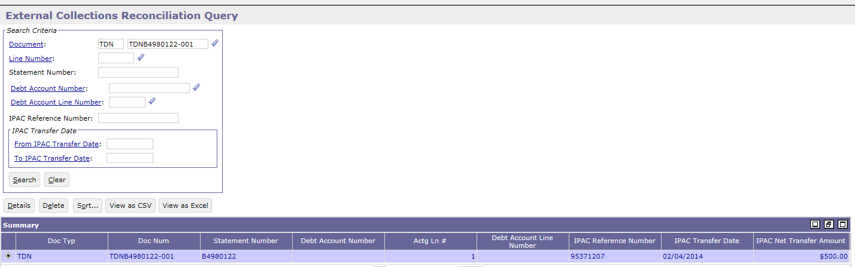
External Collections (AREOCOLL) Batch Process Overview - Reconciliation Query
External Collection Reconciliation Query
Lists Cash Receipts that Treasury collected on behalf of GSA against referred debts
Lists IPAC stand alone Cash Receipts that match the referred debt
Allows users to correct the Cash Receipt to add a reference to the debt

Slide 100
External Collections (AREOCOLL) Batch Job Instances
Process Code | Job ID | Job Name
AREOCOLL | R6AREOCOLL | Region 6 External Collections Processor
 | R7AREOCOLL | Region 7 External Collections Processor
CGI Federal Proprietary and Confidential

Slide 101
External Collections (AREOCOLL) Batch Job Parameters
Parameter | Description | Sample Value
ALC | The Agency Location Code that is associated with the records to be selected from the input file. Must be valid on the Agency Location Code maintenance table. | 47000017
User Id | The identification code associated with all database updates. Where necessary, the security permissions of the ID are checked and validated against the requirements for completing the updates. In addition, all log entries made are associated with the given value. Must be a valid entry on the Principal Maintenance table. | runbatchareocoll
CGI Federal Proprietary and Confidential

Slide 102
External Collections (AREOCOLL) Common Errors and Resolutions
Return Code | Error Description | Resolution
8 | Invalid batch parameters Example: GS4302E: The User Id value, [entered invalid value], is not valid in the database. | Update the parameter value to the valid parameter value. Refer to the configuration specifications for the valid parameter settings
65, 67, 68, 69, -1, 1, no return code | Batch job does not complete In most cases, these error codes do not produce a batch execution report; therefore no error messages are displayed | Contact CGI production support
8 | Unable to open file - BJ0009E : Unable to open file: [File name] | Check to verify the file name is correct and that the read/write permission are correct on the file
CGI Federal Proprietary and Confidential

Slide 103
External Collections (AREOCOLL) Inputs, Dependencies, Database Updates, & Outputs
Data Inputs | Dependencies
The External Collections batch process requires a weekly Treasury collection input file containing collections associated to the debts referred to Treasury via the Treasury Referral process | The External Collections batch process is dependent on the transmission of the output file generated by the Treasury Referral and Cross-Servicing Extract batch process to Treasury The External Collections batch process is dependent on running the daily IPAC Inbound file
CGI Federal Proprietary and Confidential

Slide 104
External Collections (AREOCOLL) Inputs, Dependencies, Database Updates, & Outputs
Database Updates | Data Outputs
The External Collections Processor updates the External Collections Reconciliation table by populating the values received in the input file to the table, including: IPAC Reference Number Debt Account Number OR Billing Document Number Principal Amount Interest, Penalty, and Admin Charge Amounts Main tables updated: MF_XTRN_CLTS_RCON | The External Collections batch process does not create an output file
CGI Federal Proprietary and Confidential

Slide 105
Treasury Referral and External Offset Error Batch Job

Slide 106
Treasury Referral External Offset Error (ARTREOERR) Batch Process Overview
Delinquent Debt
Transmit to FedDebt/TOP
Treasury successfully collects
Treasury IPACs money back to Agency & records on the weekly Collections file
Agency records collections in their system against the debt

Slide 107
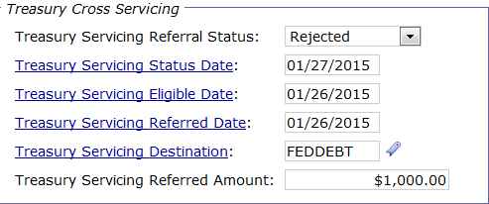
Treasury Referral External Offset Error (ARTREOERR) Batch Process Overview
Treasury Referral and External Offset Error (ARTREOERR) batch job
Reads Treasury Referral Error file containing unsuccessful transfers
Using Agency Debt ID, identifies/updates rejected referral records on Referral Entry Query
Referral Status = Rejected
Referral Type = Treasury Cross-Servicing
Treasury error code

Slide 108
Treasury Referral External Offset Error (ARTREOERR) Batch Job Instances
Process Code | Job ID | Job Name
ARTREOERR | R6ARTREOERR | Region 6 Treasury Referral External Offset Error Processor
 | R7ARTREOERR | Region 7 Treasury Referral External Offset Error Processor
CGI Federal Proprietary and Confidential

Slide 109
Treasury Referral External Offset Error (ARTREOERR) Batch Job Parameters
Parameter | Description | Sample Value
ALC | The Agency Location Code that is associated with the records to be selected from the input file. Must be valid on the Agency Location Code maintenance table. | 47000016
User Id | The identification code associated with all database updates. Where necessary, the security permissions of the ID are checked and validated against the requirements for completing the updates. In addition, all log entries made are associated with the given value. Must be a valid entry on the Principal Maintenance table. | runbatchartreoerr
CGI Federal Proprietary and Confidential

Slide 110
Treasury Referral External Offset Error (ARTREOERR) Common Errors and Resolutions
Return Code | Error Description | Resolution
8 | Invalid batch parameters Example: GS4302E: The User Id value, [entered invalid value], is not valid in the database. | Update the parameter value to the valid parameter value. Refer to the configuration specifications for the valid parameter settings
65, 67, 68, 69, -1, 1, no return code | Batch job does not complete In most cases, these error codes do not produce a batch execution report; therefore no error messages are displayed | Contact CGI production support
8 | Unable to open file - BJ0009E : Unable to open file: [File name] | Check to verify the file name is correct and that the read/write permission are correct on the file
CGI Federal Proprietary and Confidential

Slide 111
Treasury Referral External Offset Error (ARTREOERR) Inputs, Dependencies, Database Updates, & Outputs
Data Inputs | Dependencies
The Treasury Referral and External Offset Error batch process requires a Treasury Referral Error Record input file containing transactions that were not successfully referred to Treasury via the Treasury Referral process | The Treasury Referral and External Offset Error batch process is dependent on the transmission of the output file generated by the Treasury Referral and Cross-Servicing Extract batch process to Treasury
Database Updates | Data Outputs
Treasury Referral and External Offset Error updates the Referral Entry table by populating the associated Pegasys Referral error code and error information Main tables updated: MF_AR_RFRL MF_TRES_ERR_CD_JN | The Treasury Referral and External Offset Error batch process does not create an output file

Slide 112
TROR Selection
Batch Job

Slide 113
TROR Selection (ERTROR) Batch Process Overview
Capture Transactions
Establish Cell Criteria (*backend only)
Execute Batch Job (ERTROR)
Review Results on Query
Perform Adjustments
Generate Report

Slide 114
TROR Selection (ERTROR) Batch Process Overview
TROR Data Extract (ERTROR) Batch Job
Extracts the applicable records based on the simple input parameters and hard-coded selection criteria
Hard-coded selection criteria include
Specified Agency
Specified Bureau
Vendor Attribute not equal to Government
Accounting Event not equal to BExx
Builds the TROR entity based on the extracted data and cell criteria rules
Not all cells/fields are pre-filled/calculated by the ERTROR process
CGI Federal Proprietary and Confidential

Slide 115
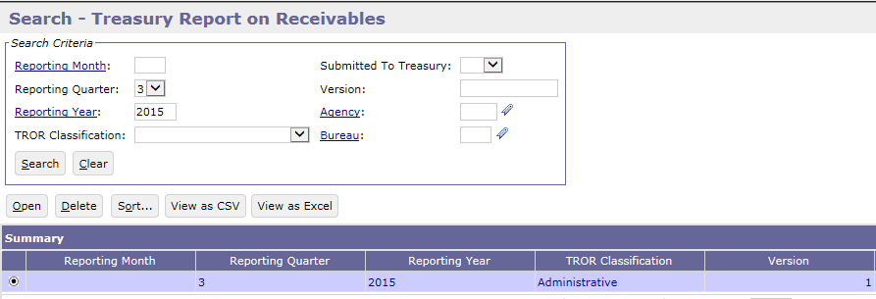
TROR Selection (ERTROR) Batch Process Overview - Receivables Query
TROR Query provides the ability to:
View the results of the TROR Extract (ERTROR) process
Drill-down on a given TROR field to view the detailed transaction information
Perform adjustment and add footnotes
TROR Query displays one ‘header’ record for each
Reporting Period (FM/FY or FQ/FY)
Agency/Bureau
TROR Classification
Version Number

Slide 116
TROR Selection (ERTROR) Batch Job Instances
Process Code | Job ID | Job Name
ERTROR | TRORSEL | Treasury Report on Receivables Selection Job
CGI Federal Proprietary and Confidential

Slide 117
TROR Selection (ERTROR) Batch Job Parameters
Parameter | Description | Sample Value
Agency | The agency to be included in the batch process. Must be a valid record on the Agency maintenance table. | 047
Beginning FY Balance Amount | Reflects the dollar amount of outstanding receivables as of the beginning of the fiscal year. This figure should agree with the ending balance reported in DMIS for the previous fiscal year. Accepts positive dollar amounts. | ***Will need to be updated by GSA/USDA at the beginning of each Fiscal Year***
Beginning FY Balance Number | Reflects the number of outstanding receivables as of the beginning of the fiscal year. This figure should agree with the ending balance reported in DMIS for the previous fiscal year. Accepts positive integer amounts. | ***Will need to be updated by GSA/USDA at the beginning of each Fiscal Year***
Bureau | The bureau to be included in the batch process. Must be a valid record on the Bureau maintenance table. Multiple values are allowed. Set to blank for all instances.
CGI Federal Proprietary and Confidential

Slide 118
TROR Selection (ERTROR) Batch Job Parameters
Parameter | Description | Sample Value
Fiscal Month | The fiscal month to be included in the batch process. Required if the report type is set to monthly. Must be a valid month in the format MM. Set to blank for all instances.
Fiscal Quarter | The fiscal quarter to be included in the batch process. Required if the report type is set to quarterly. Value must be a valid fiscal quarter (1, 2, 3, or 4). | <To be passed in via the mscript>
Fiscal Year | The fiscal year to be included in the batch process. Value must be a valid fiscal year in the format YYYY. | <To be passed in via the mscript>
Report Type | The report type to be included in the batch process. Valid values include: M (Monthly) and Q (Quarterly). | Q
TROR Classification | The TROR classification to be included in the batch process. Valid values include: A (Administrative), D (Direct Loan), and F (Defaulted Guaranteed Loan). Multiple values are permitted. | A
CGI Federal Proprietary and Confidential

Slide 119
TROR Selection (ERTROR) Common Errors and Resolutions
Return Code | Error Description | Resolution
8 | Invalid batch parameters Example: GS4302E: The System Id value, [entered invalid value], is not valid in the database. | Update the parameter value to the valid parameter value. Refer to the configuration specifications for the valid parameter settings
65, 67, 68, 69, -1, 1, no return code | Batch job does not complete In most cases, these error codes do not produce a batch execution report; therefore no error messages are displayed | Contact CGI production support
CGI Federal Proprietary and Confidential

Slide 120
TROR Selection (ERTROR) Common Errors and Resolutions
Functional errors that may get directed to the System Operations personnel:
Return Code | Error Description | Resolution
0 | A query record exists with no data associated to it. | There are no records that meet the parameters for this Bureau. Double check the Bureau parameter in the report. The Bureau code is inferred from the fund associated to the documents. Verify that your funds are configured to the correct Bureau code.
0 | The FY Beginning Balance Amount is not correct in the query. | The batch parameter needs to be updated. This can also be adjusted within the TROR Query.
CGI Federal Proprietary and Confidential

Slide 121
TROR Selection (ERTROR) Inputs, Dependencies, Database Updates, & Outputs
Data Inputs | Dependencies
There are no input files for the TROR Selection batch job. Data is selected for this job is based on the status of receivables in the reporting period and the collections received during the reporting period | TROR Selection has no dependencies
CGI Federal Proprietary and Confidential

Slide 122
TROR Selection (ERTROR) Inputs, Dependencies, Database Updates, & Outputs
Database Updates | Data Outputs
The TROR Selection batch captures applicable transactions in the reporting period and writes them to the tables used in the TROR Query so users can review the transactions associated with TROR reporting criteria and make adjustments accordingly Main tables updated: MF_TROR MF_TROR_CELL MF_TROR_CELL_AC MF_TROR_CELL_FTNT MF_TROR_CELL_SPNG_ATTR | The TROR Selection process does not create output files
CGI Federal Proprietary and Confidential

Slide 123
Segment 4:
BAAR Batch Cycles

Slide 124
Segment Outline
Segment 1: BAAR Introduction
Segment 2: BAAR Technical Architecture
Segment 3: BAAR Batch Jobs
Segment 4: BAAR Billing Cycle
BAAR Batch Cycle Overview
Segment 5: Tivoli Job Streams
Segment 6: Data Exchanges with Pegasys

Slide 125
Batch Cycle Overview Description
A BAAR Billing cycle is a group of BAAR batch processes that are executed together on a periodic basis
Timing, scheduling, and dependencies considered when defining and executing the Billing cycle
Dependency can be a file or a batch job

Slide 126
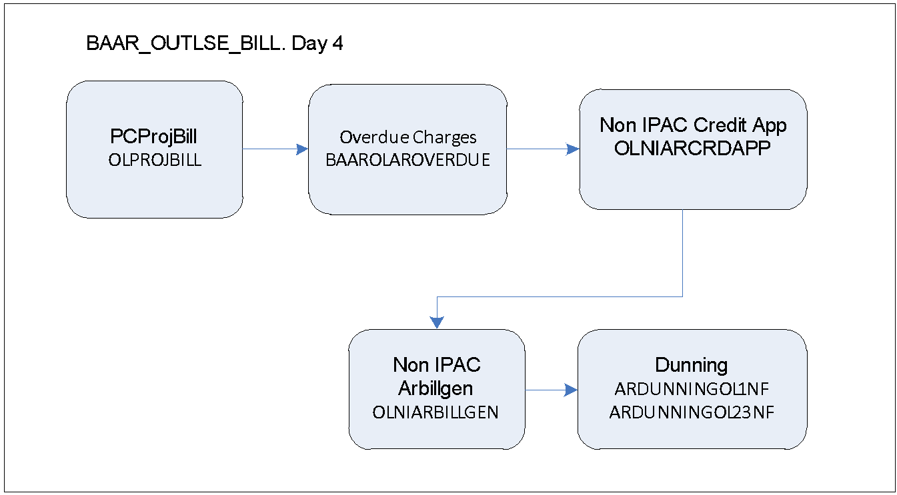
Outlease Business Line: Cycles Overview
Outlease does not have specific daily cycle
Outlease Monthly cycle starts on Day 4

Slide 127
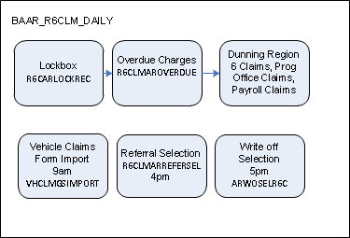
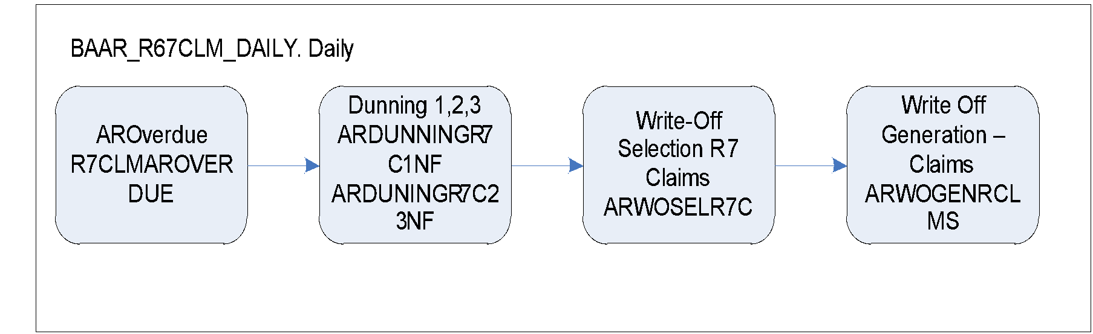
R6/R7 Claims Business Line: Cycles Overview
R6/R7 Claims have no monthly cycle
R6/R7 Daily cycle is shown below

Slide 128
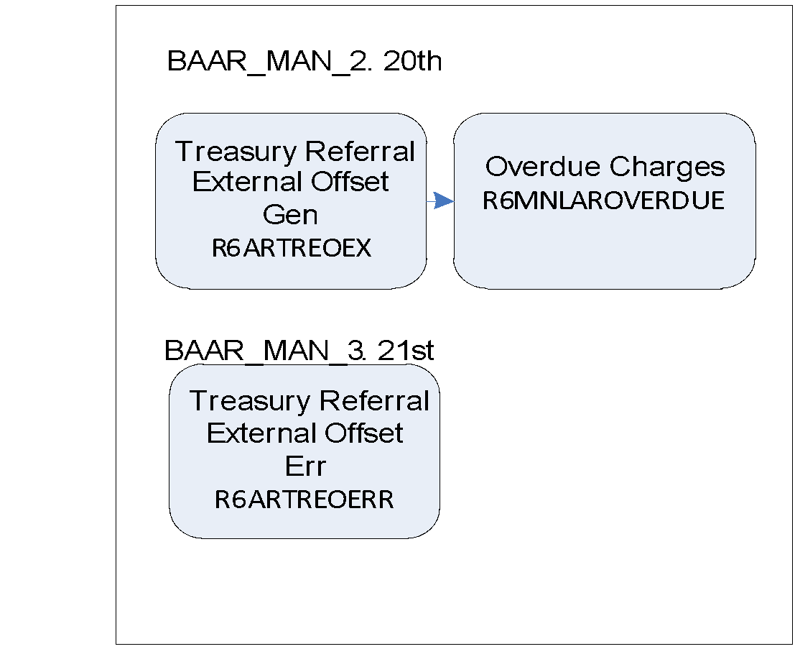
Region 6 Manual Business Lines: Cycles Overview
Region 6 Manual requires only the External Collections to run daily
Region 6 Manual has a monthly cycle that starts on 20th similar to cycle set up in Phase 2

Slide 129
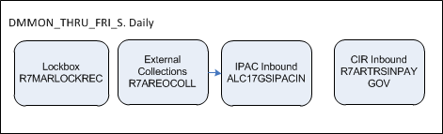
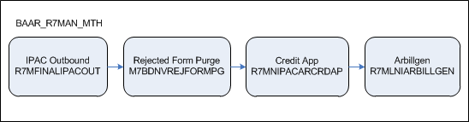
Region 7 Manual Business Lines: Cycles Overview
Region 7 Manual daily cycle is shown below
Region 7 Manual monthly cycle (date TBD) is shown below

Slide 130
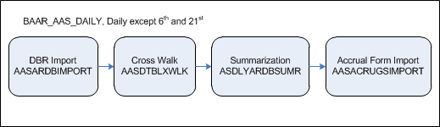
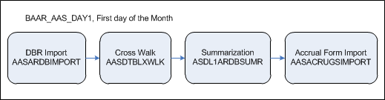
AAS/ITS Business Lines: Cycles Overview
AAS daily cycle is shown below
AAS day 1 cycle is shown below

Slide 131
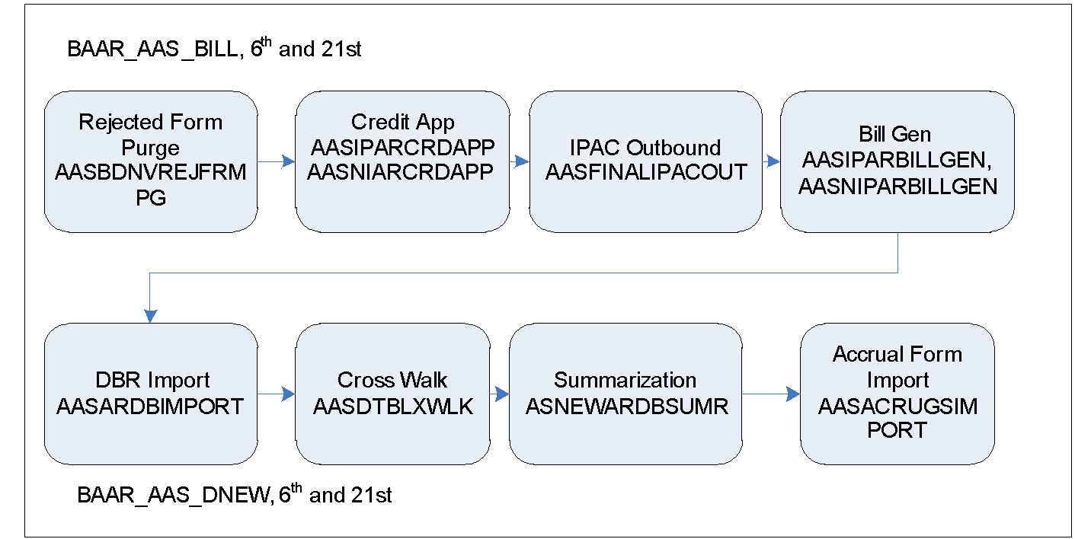
AAS/ITS Business Lines: Cycles Overview
AAS billing cycle is run on 6th and 21st

Slide 132
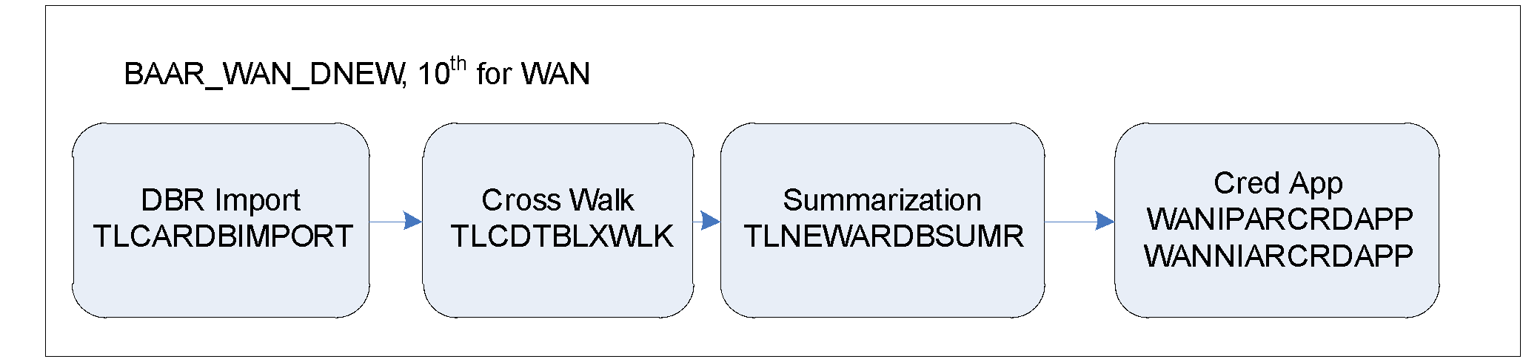
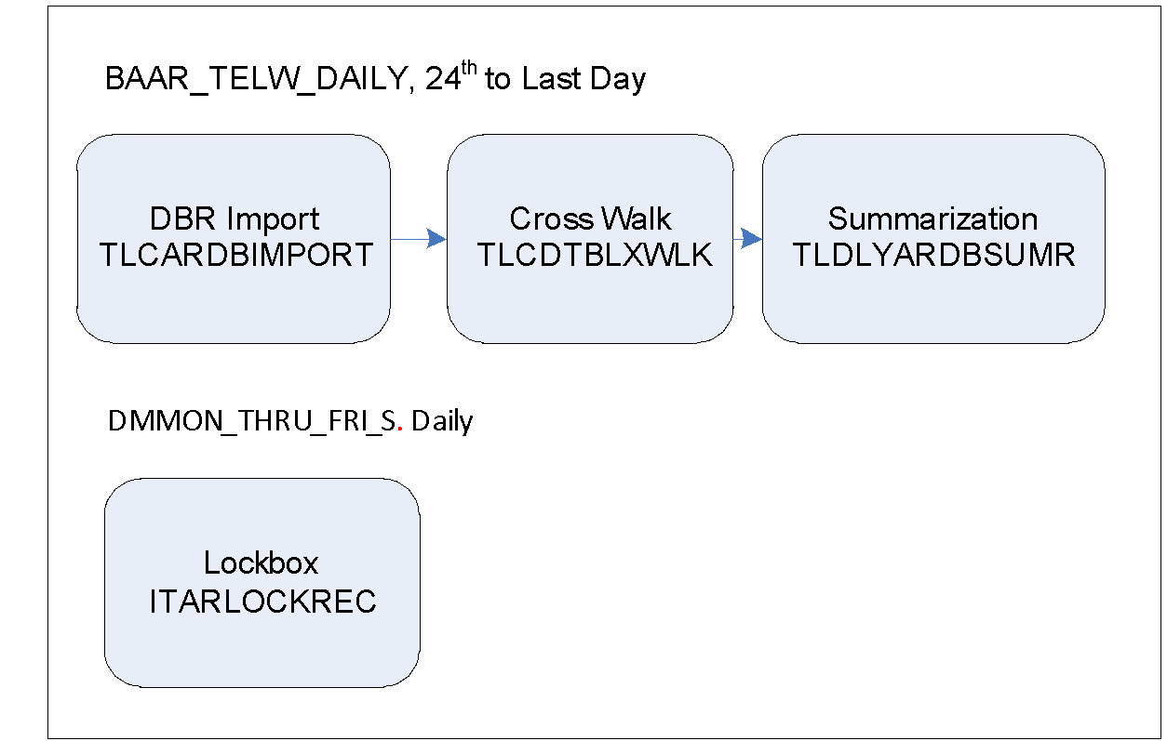
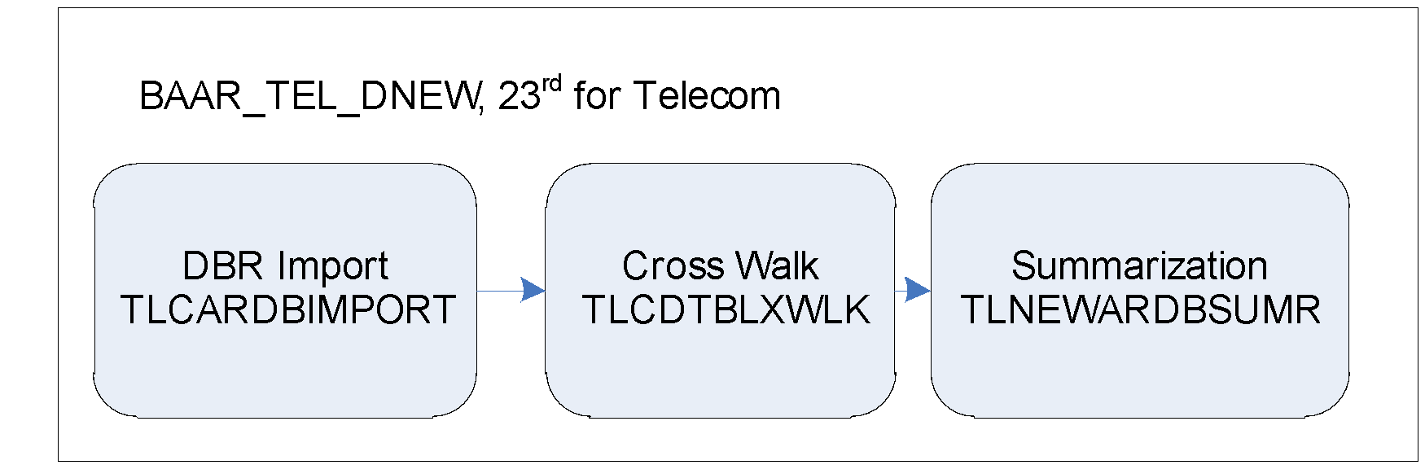
Telecom/WAN Business Lines: Cycles Overview
WAN sends a billing file on the 10th and runs through the daily jobs.
Telecom sends a billing file on the 23rd and run the daily jobs.
From 24th to the last day of the month, combined WAN and Telecom daily files are run through the daily jobs.

Slide 133
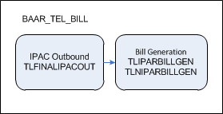
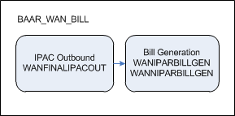
Telecom/WAN Business Lines: Cycles Overview
Telecom and WAN Billing Cycles are shown below

Slide 134
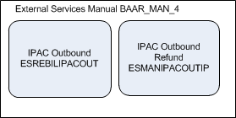
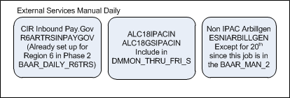
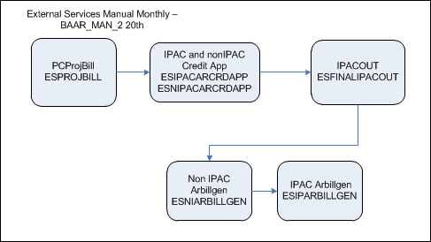
External Services Business Line: Cycles Overview
External Services Billing Cycles are shown below

Slide 135
Segment 5:
Tivoli Job Streams

Slide 136
Segment Outline
Segment 1: BAAR Introduction
Segment 2: BAAR Technical Architecture
Segment 3: BAAR Batch Jobs
Segment 4: BAAR Billing Cycle
Segment 5: Tivoli Job Streams
Tivoli Job Streams Overview
Outlease Job Streams
R6/R7 Claims Job Streams
Manual Business Lines Job Stetams
AAS/ITS Job Streams
Telecom/WAN Job Streams
Segment 6: Data Exchanges with Pegasys

Slide 137
Tivoli Job Streams Overview
BAAR Billing Cycles, and their timing, scheduling and dependencies are established using IBM® Tivoli® Workload Scheduler
More automation based on file, time, prior job completion
Identify jobs that can run off-hours
Run non-BAAR and BAAR jobs in parallel
Kick off mscripts that “wrap” batch jobs

Slide 138
Tivoli Job Streams Overview (cont.)
Outlease
BAAR_OUTLSE_BILL
R6/R7 Claims
BAAR_R67CLM_DAILY, BAAR_RWAHOTD_5
R6 Manual Business Lines
BAAR_MAN_3, BAAR_MAN_2
R7 Manual Business Lines
BAAR_R7MAN_MTH, BAAR_RWAHOTD_5, BAAR_RWAHOTD_WF, BAAR_RWAHOTD_1
AAS
BAAR_AAS_DAY1, BAAR_AAS_DAILY, BAAR_AAS_BILL, BAAR_AAS_DNEW
Telecom/WAN
BAAR_TELW_DAILY, BAAR_TEL_DNEW, BAAR_TEL_BILL, BAAR_WAN_DNEW, BAAR_WAN_BILL
External Services
BAAR_MAN_2, BAAR_MAN_4
Multiple business lines
LAST-1, ME+2, R6/R7 Dun, DMMON_THRU_FRI_S, BAAR_R6_A4LOSS, BAAR_R7_A4LOSS
Note: Some batch jobs for Phase 3 business lines were added to Phase 1 or Phase 2 job streams based on timing needed. These are included in the list above and on the following slides.

Slide 139
Outlease Job Streams
BAAR_OUTLSE_BILL (Day 4)
Batch Job | Batch Instance
Project Bill Generation | OLPROJBILL
Overdue Charges Generation | BAAROLAROVERDUE
Credit App | OLNIARCRDAPP
Bill Generation | OLNIARBILLGEN
Dunning | ARDUNNINGOL1NF ARDUNNINGOL23NF

Slide 140
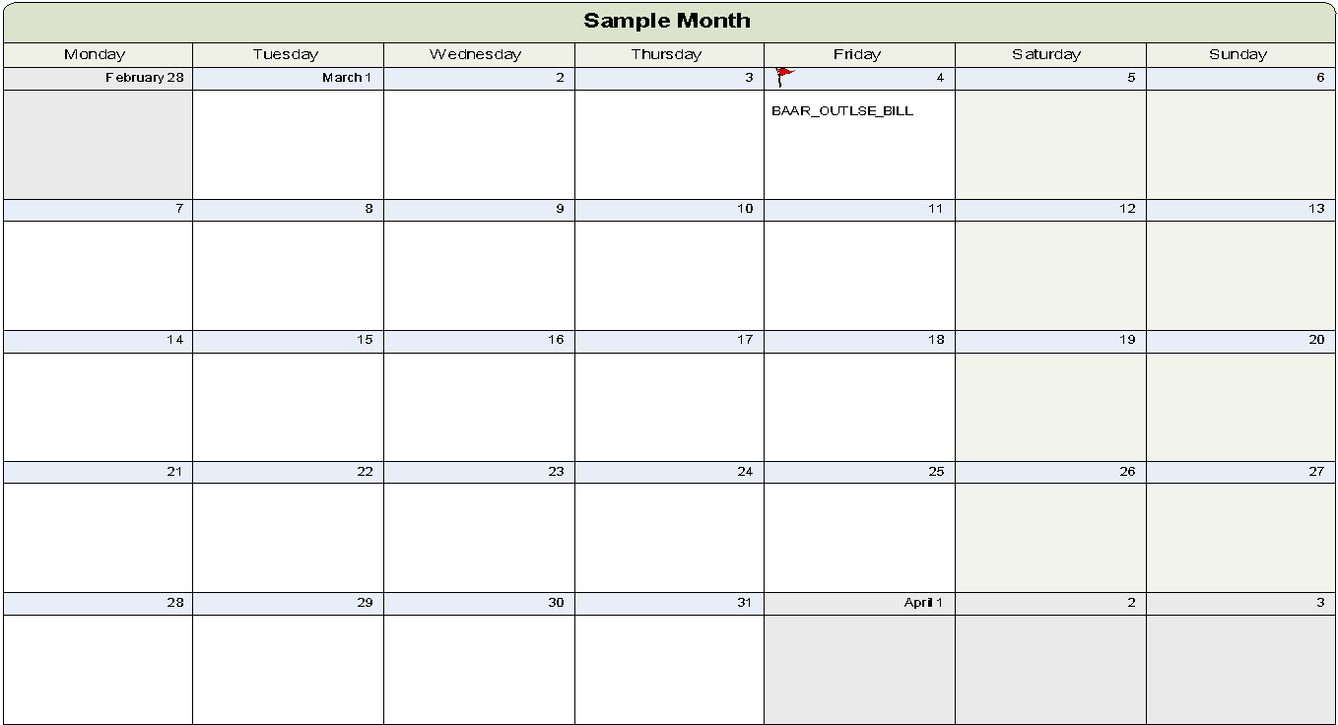
Outlease Job Stream
Outlease Calendar

Slide 141
R6/R7 Claims Job Streams
No Monthly cycle
BAAR_R67CLM_DAILY
R6 Batch Job | Batch Instance
Vehicle Claims Form Import | VHCLMGSIMPORT
Overdue Charges | R6CLMAROVERDUE
Dunning | ARDUNNR6POC1NF ARDUNNR6POC2NF ARDUNNINGR6C1NF ARDUNINGR6C23NF ARDUNINGR6PR1NF ARDUNNR6PR23NF
Referral Selection | R6CLMARREFERSEL
Write Off Selection | ARWOSELR6C
R7 Batch Job | Batch Instance
R7 Overdue Charges | R7CLMAROVERDUE
Dunning | ARDUNNINGR7C1NF ARDUNINGR7C23NF
Write-Off Selection | ARWOSELR7C
Write Off Generation | ARWOGENRCLMS
BAAR_RWAHOTD_5 (15th)
R7 Batch Job | Batch Instance
Region 7 Claims Referral Selection | R7CLMARREFERSEL

Slide 142
Region 6 Manual Business Lines Job Streams
Region 6 BAAR_MAN_2 (20th)
Batch Job | Batch Instance
Region 6 Treasury Referral External Offset | R6ARTREOEX
BAAR Region 6 Manual Overdue Charges Generation Batch Job | R6MNLAROVERDUE
Region 6 BAAR_MAN_3 (21st)
Batch Job | Batch Instance
Treasury Referral External Offset Error | R6ARTREOERR
Region 6 DMMON-THRU-FRI-S (Daily)
Batch Job | Batch Instance
Region 6 External Collections | R6AREOCOLL

Slide 143
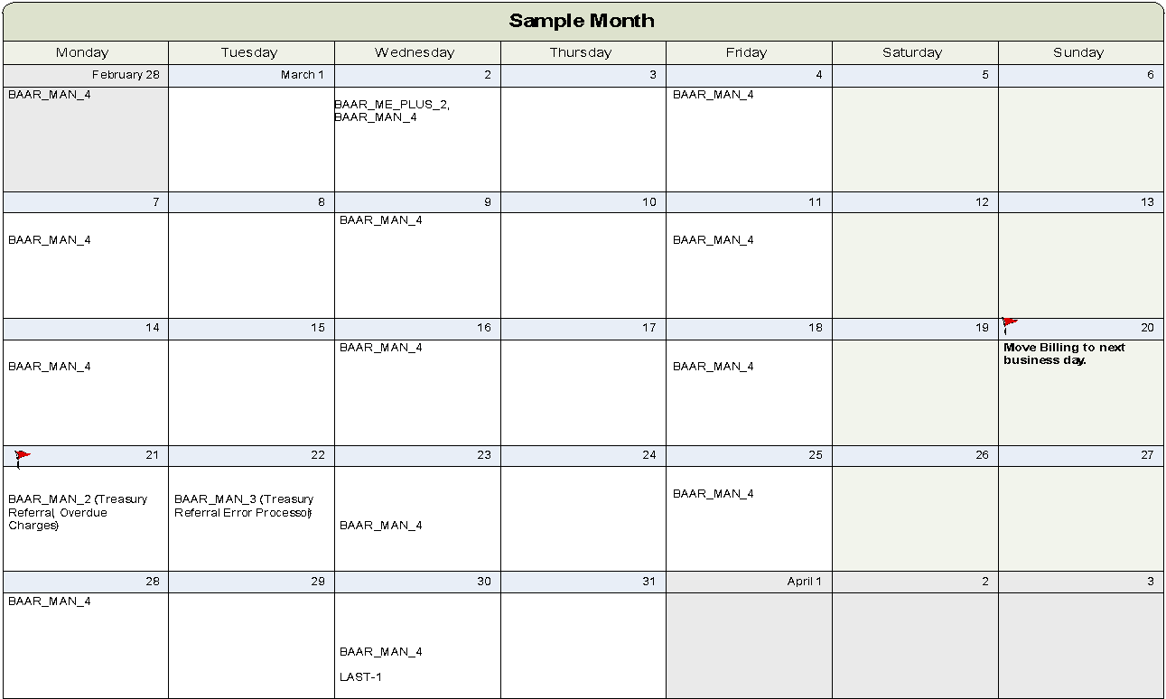
Region 6 Manual Business Lines Job Stream
R6 Manual Calendar
‹#›
CGI Federal Proprietary and Confidential

Slide 144
Region 7 Manual Business Lines Job Streams
Region 7 BAAR_R7MAN_MTH (TBD)
Region 7 DMMON_THRU_FRI_S (Daily)
Batch Job | Batch Instance
R7 Manual IPACOUT | R7MFINALIPACOUT
Rejected Form Purge | M7BDNVREJFORMPG
Automated Credit Application | R7MNIPACARCRDAP
Bill Generation | R7MLNIARBILLGEN
Batch Job | Batch Instance
Lockbox | R7MARLOCKREC
External Collections | R7AREOCOLL
Region 7 BAAR_RWAHOTD_WF
Batch Job | Batch Instance
R7 Manual IPACOUT | R7MFINALIPACOUT
R7 Manual IPACOUT Rebill | R7MREBILIPACOUT
Region 7 BAAR_RWAHOTD_5 (15th)
Batch Job | Batch Instance
Region 7 BD Referral Selection | R7BILARREFERSEL
Referral External Offset Generation | R7ARTREOEX
Region 7 BAAR_RWAHOTD_1 (19th)
Batch Job | Batch Instance
Treasury Referral External Offset Error | R7ARTREOERR

Slide 145
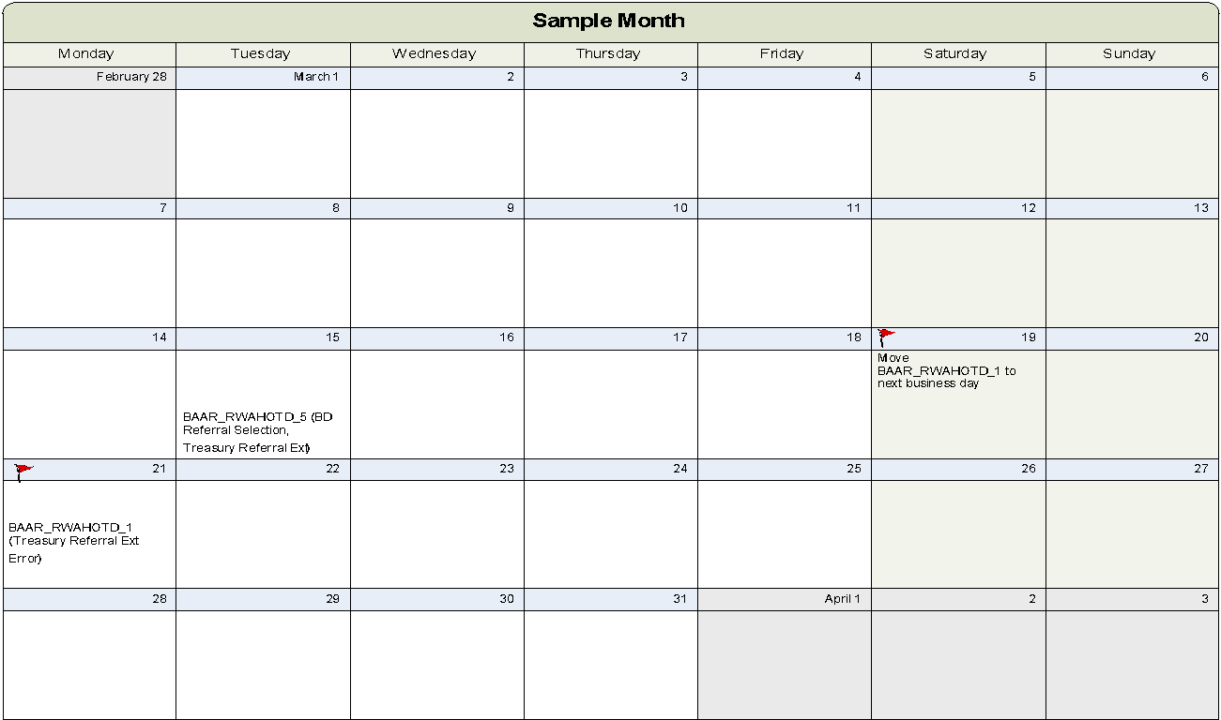
Region 7 Manual Business Lines Job Streams
R7 Manual Calendar

Slide 146
AAS/ITS Job Streams
BAAR_AAS_DAILY (2nd to 5th, 7th to 20th, 22nd to Last-Day)
BAAR_AAS_DNEW (6th or 21st after BAAR_AAS_BILL)
Batch Job | Batch Instance
DBR Import | AASARDBIMPORT
Crosswalk | AASDTBLXWLK
Summarization | ASDLYARDBSUMR
Accrual Form Import | AASACRUGSIMPORT
Batch Job | Batch Instance
DBR Import | AASARDBIMPORT
Crosswalk | AASDTBLXWLK
Summarization | ASNEWARDBSUMR
Accrual Form Import | AASACRUGSIMPORT
BAAR_AAS_BILL (6th and 21st)
BAAR_AAS_DAY1 (1st)
Batch Job | Batch Instance
AAS/ITS/Telecom Rejected Form Purge | AASBDNVREJFRMPG
Credit Application | AASIPARCRDAPP AASNIARCRDAPP
IPAC Outbound | AASFINALIPACOUT
Bill Generation | AASIPARBILLGEN AASNIPARBILLGEN
Batch Job | Batch Instance
DBR Import | AASARDBIMPORT
Crosswalk | AASDTBLXWLK
Summarization | ASDL1ARDBSUMR
Accrual Form Import | AASACRUGSIMPORT

Slide 147
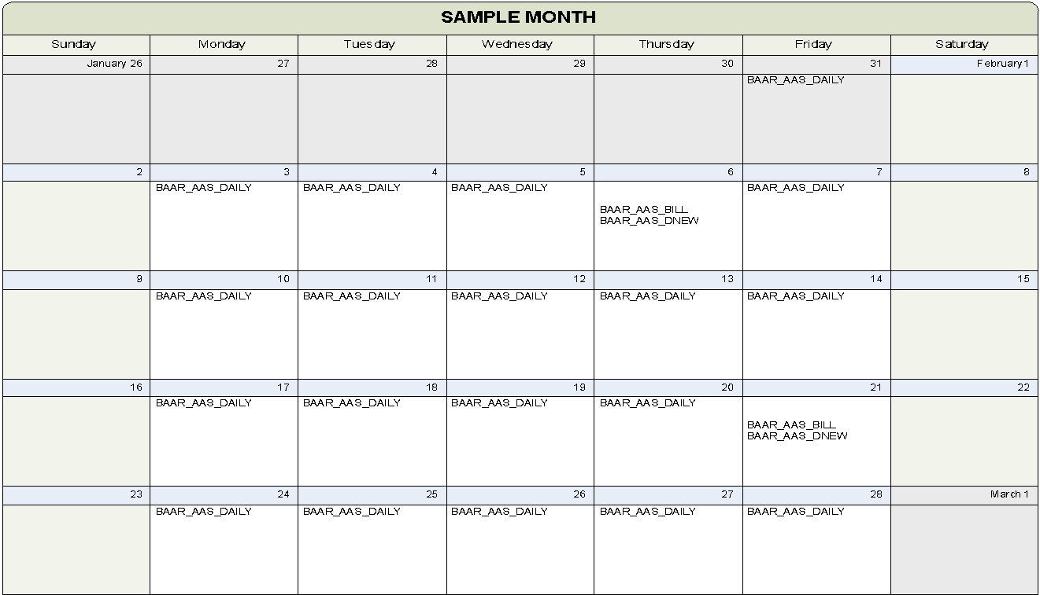
AAS/ITS Job Streams
AAS/ITS Calendar

Slide 148
Telecom/WAN Job Streams
DMMON_THRU_FRI_S. Daily
BAAR_TEL_BILL (Day 5)
Batch Job | Batch Instance
Lockbox | ITARLOCKREC
Batch Job | Batch Instance
IPACOUT | TLFINALIPACOUT
Bill Generation | TLIPARBILLGEN TLNIPARBILLGEN
BAAR_WAN_DNEW (10th for WAN )
Batch Job | Batch Instance
DBR Import | TLCARDBIMPORT
Crosswalk | TLCDTBLXWLK
Summarization | TLNEWARDBSUMR
Credit Application | WANIPARCRDAPP WANNIARCRDAPP
BAAR_WAN_BILL (Day 5)
Batch Job | Batch Instance
IPACOUT | WANFINALIPACOUT
Bill Generation | WANIPARBILLGEN WANNIPARBILLGEN
BAAR_TEL_DNEW (23rd for Telecom)
BAAR_TELW_DAILY (24th to last day of month)
Batch Job | Batch Instance
DBR Import | TLCARDBIMPORT
Crosswalk | TLCDTBLXWLK
Summarization | TLNEWARDBSUMR
Batch Job | Batch Instance
DBR Import | TLCARDBIMPORT
Crosswalk | TLCDTBLXWLK
Summarization | TLDLYARDBSUMR
CGI Federal Proprietary and Confidential

Slide 149
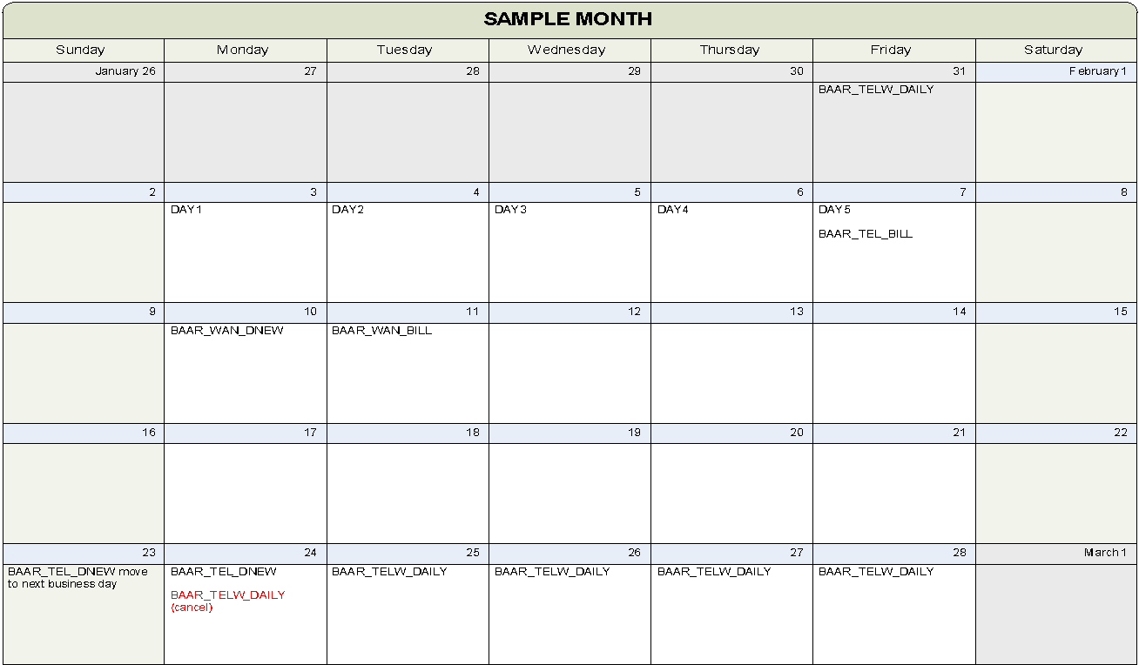
Telecom/WAN Job Streams
Telecom/WAN Calendar

Slide 150
External Services Job Streams
External Services BAAR_MAN_2 (20th)
Batch Job | Batch Instance
PCProjBill | ESPROJBILL
IPAC Credit Application | ESIPACARCRDAPP
Non-IPAC Credit Application | ESNIPACARCRDAPP
IPAC Outbound | ESFINALIPACOUT
Non-IPAC Bill Generation | ESNIARBILLGEN
IPAC Bill Generation | ESIPARBILLGEN
External Services BAAR_MAN_4 (Monday, Wednesday, Friday)
Batch Job | Batch Instance
IPAC Outbound | ESREBILIPACOUT
IPAC Outbound Refund | ESMANIPACOUTIP

Slide 151
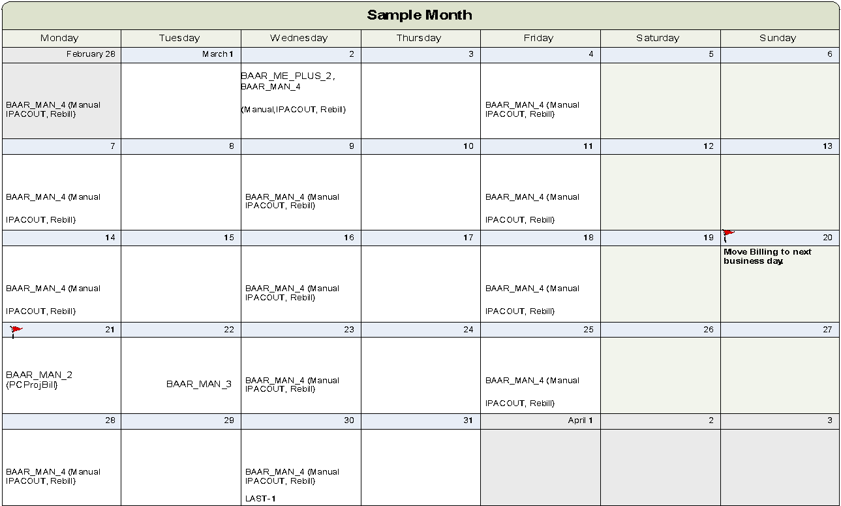
External Services Job Streams
External Services Calendar

Slide 152
Segment 6:
Data Exchanges with Pegasys

Slide 153
Segment Outline
Segment 1: BAAR Introduction
Segment 2: BAAR Technical Architecture
Segment 3: BAAR Batch Jobs
Segment 4: BAAR Billing Cycle
Segment 5: Tivoli Job Streams
Segment 6: Data Exchanges with Pegasys
Data Exchanges with Pegasys

Slide 154
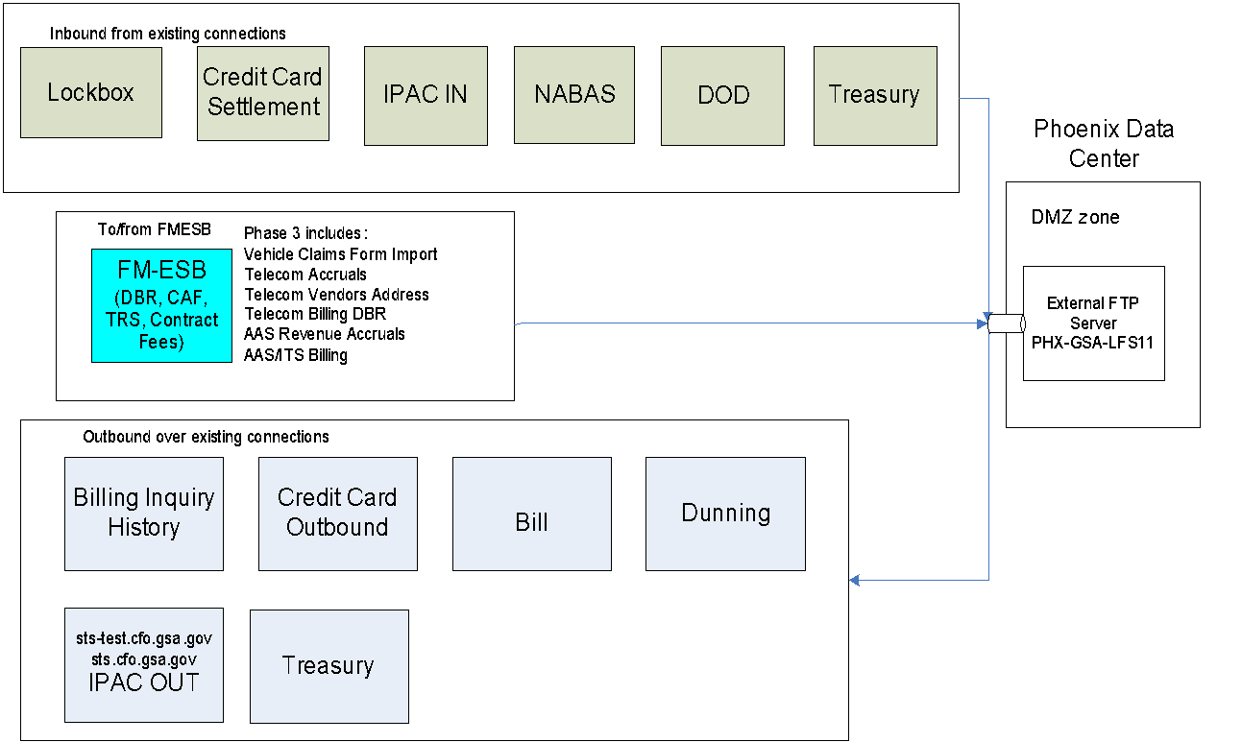
Data Exchanges between GSA and Pegasys

Slide 155

Questions

